Slide 1
CloudACL Data Analysis -Zhengyang Zhou

Slide 2
1. General Analysis 2. China Scenario Analysis
Agenda

Slide 3
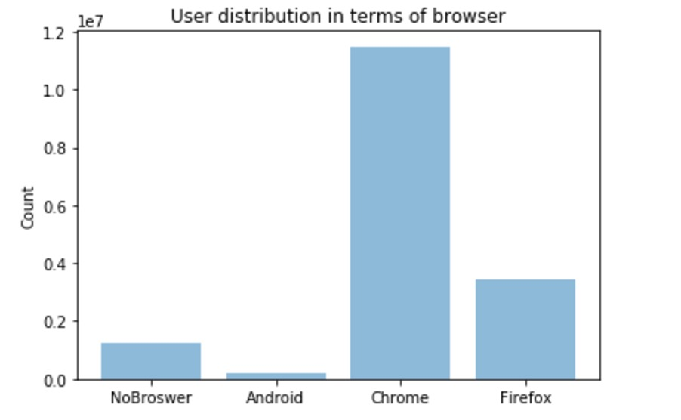
General Information - Browser
Chrome is the most popular browser
Firefox is the next, but it is about 1/3 of what Chrome takes

Slide 4
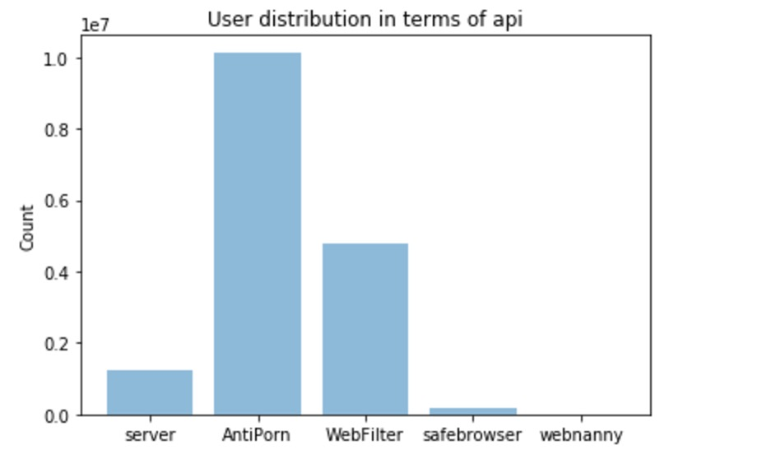
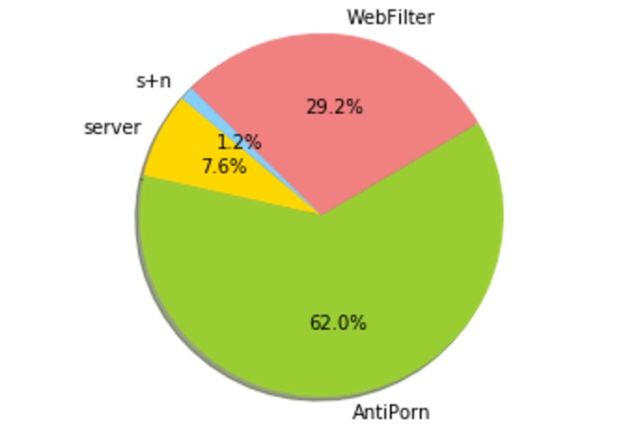
General Information - API

Slide 5
General Information – top countries
Peru, USA, Philippines, Romania, Italy, Bolivia, Mexico, France, Columbia, Argentina, Spain, Indonesia, India, Venezuela, Russia, Ecuador
Latin American countries take about half of the top 16 list

Slide 6
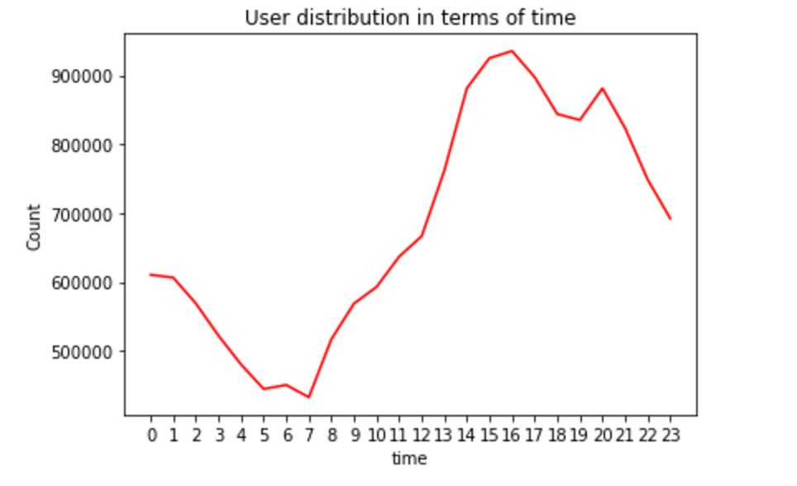
General Information - time
Peak time is from 13 to 23 PST
From 0 to 13, the load the server
needs to take is comparatively low.

Slide 7
Business Suggestion ------ in general case
Concentrate more on service development on Chrome, as Chrome has the most users
Allocate more resources on the time period 13 - 0 PST, because the request frequencies are higher from 13 to 0 PST than from 0 to 13.
Do more promotion on Latin American countries.

Slide 8
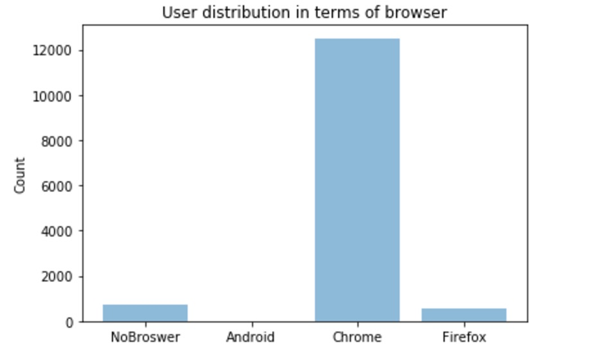
China Scenario Analysis - Browser
It is similar with what we have seen in the world, in which Chrome is also the most favorite browser.
We don’t see Chinese users use any CloudACL service on Android.

Slide 9
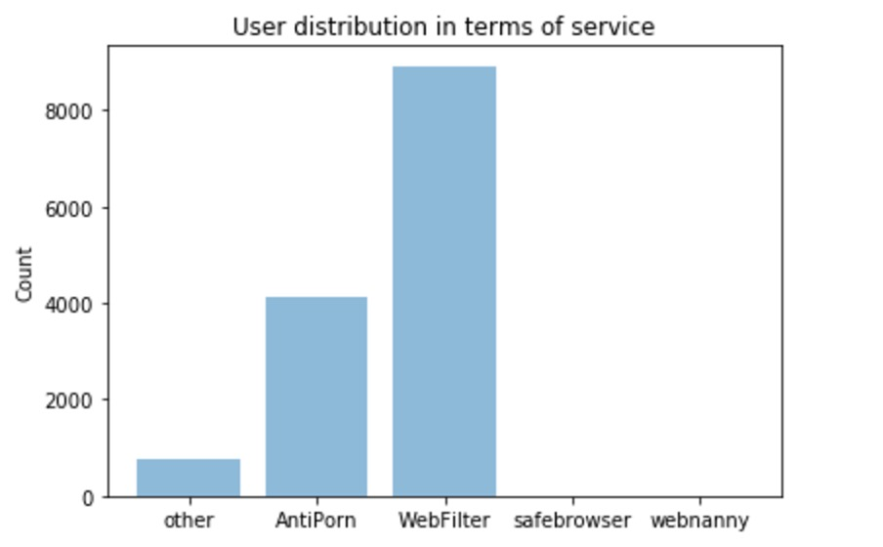
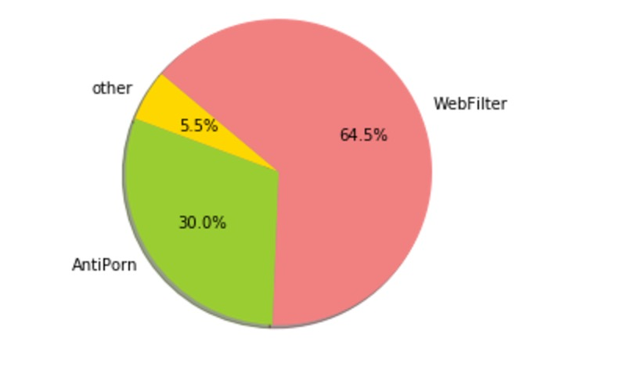
China Scenario Analysis - API
Chinese users chooses more on Webfilter
than Antiporn. Also the counts of safebrowser
and webnanny are 0 because they are
services on android.

Slide 10
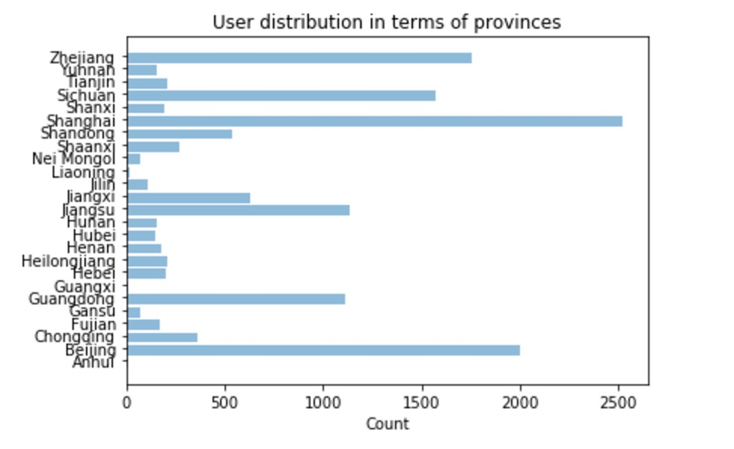
China Scenario Analysis - Province
Majority of Chinese users are from
Shanghai, Beijing, Zhejiang,
Sichuan, Jiangsu and Guangdong
Only 25 provinces has records, but China
has 32 provinces (Not including HongKong
and Macau)

Slide 11
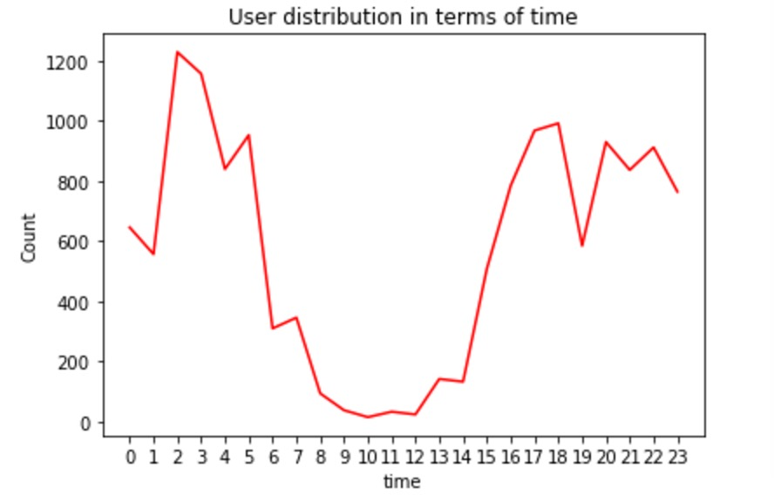
General Information - time
Peak time is from 15 to 6, Beijing time
From 6 to 15, it is a relatively low, in which people are in work or school.

Slide 12
China Scenario Analysis – Top Categories
The world
media-streaming
social-networking
search-engine
business-and-economy
internet-portal
computer-information
game
news-and-media
China
search-engine
internet-portal
business-and-economy
auctions
personal-site-and-blog
entertainment-and-art
computer-information
educational-institution

Slide 13
Before further analyzing, we can say Chinese users
like to use Chrome and WebFilter;
are mostly from rich provinces or cities that has more access to the outside world;
are different from the rest of the world as they like to find the joy through auctions, personal blogs and entertainment as well as seeking more education resources;
are mostly active from 15 to 6, Beijing Time;

Slide 14
China Scenario Analysis – kmeans
According to kmeans, I divided the Chinese users into 4 groups
Group1 with top features of cat_search-engine, morning, afternoon
------ researcher
Group2 with top features of cat_media-streaming, morning, evening, night ------ day and night media-streaming user
Group3 with top features of cat_educational-institution, evening, afternoon ------ students or whoever likes study
Group4 with top features of lunch-break time, cat_media-streaming,
cat_educational-institution, cat_real-estate ------ employees taking lunch-break

Slide 15
Business Suggestion ------ Customization
Put the cloudACL android service on some Chinese platforms, such as Tencent MyApp
For webfilter, make more options of categories for users to choose to block, such as adding online-shopping
When a user visits some blocked websites, we can classify this user into a group, based on kmeans results. Then instead of just telling the user that he is blocked from accessing the webstie, we recommend some websites or ads, based on popularity of categories in that group with excluding the banned category.

Slide 16
Thank you!

