Slide 1
A Brief Survey on Deep Learning in Traffic Forecasting & Traffic State Estimation
Ito’s Lab
M1 Student
Zhengyou Han
07/12/2024
Notes:
This is the first time talking to most of you guys, so please let me do a quick self-introduction.

Slide 2
Introducing myself
My name is Zhengyou HAN(韩政佑), and please call me Alex
I am a M1 student from Ito’s Lab.
Ito’s Lab is affiliated to Social ICT Research Center
We focus on Intelligent Transportation System studies(ITS)
My current research theme is traffic prediction and estimation
Graduated from the University of Illinois at Urbana-Champaign
Hobbies: trying new games(video games, card games, board games… ); Computer Graphics; reading books(novels, conference papers, blogs, my students’ love letters…) in a bean bag with 1L size coke.
Notes:
Hello everyone, my name is Zhengyou Han and I prefer the name Alex.
M1 student from Ito's lab. And our lab is affiliated to Social ICT research center. We focus on the studies of ITS. Meanwhile, my research direction can be generalized as the deep learning in traffic forecasting and traffic state estimation.
I graduated from UIUC. I'm not sure if you guys are familiar with it. UIUC is an Ace in Computer Science, literally always been among the TOP 5. So, I got my bachelor degree in Mathematics. And of course I took many cs courses. So don't question yourself why we are in the room. And I became a math & physics teacher for high school and middle school students, for quite a while.
I like trying new games because I'm so into Computer graphics. Don't judge me, that's what I told my mom. I also enjoy reading books while drinking diabetes-guaranteed amout of coke.

Slide 3
Traffic State Estimation(TSE)& DL
What is TSE?
History
Model-based methods
LWR, ARZ models
Data-driven methods
STGCN, DCRNN
Hybrid methods
PIDL-FDL, STDEN
Notes:
Well, here we go, let’s get into the real deal today. TSE is one the two of my interests in transportation.
- So, what is TSE?
Traffic state estimation are kind of similar with traffic forecasting. But there is a subtle difference in their goals. In forecasting, we predict the parameters’ future state based on data we have. But for TSE, we only focus on the reconstruction of the current diagram(or say, the real-time network) by estimating absent elements or hidden patterns in it. So, TSE is like doing puzzles based on our knowledge in transportation science.
-Let me briefly walk you through the history of TSE.
At the very beginning, scientists estimated upon traffic models such as LWR and ARZ. These classic models are based on hydrodynamics models. But while applying them to the real cases, we need extremely complicated models attempting to generalize the underlying pattern. If we managed to do that, we would go through tedious parameter calibration which is even more complicated.
Afterwards, maybe scientists finally could afford computers, we have the data-driven methods. But in most of the real scenarios, we don’t have sufficient suitable data. So, purely data-driven methods sometimes give unnatural results such as showing all the drivers in a part of the highway are driving backwards.
Right now, desperate scientists decide to combine former two methods and introduce idea of physical-informed neural networks into TSE field. Therefore, we have emerging works such as PIDL-FDL and STDEN which focus on solving differential equations in traffic models.

Slide 4
Traffic Forecasting & DL
What is Traffic Forecasting?
To predict, based on data we have
What is forecasting like before?
1960s: linear models (Stone age)
1970s-1990s: statistical models, e.g. ARIMA (Dark ages)
2000s: machine learning(Industrial Revolution)
2010s-Present: Deep learning(iphone4)
Notes:
So, I am going to introduce a key area of my research, traffic forecasting. As the name suggests, traffic forecasting involves using past data to predict future traffic states.
As a long-standing topic in transportation science, the history of this field is a long one. It can be divided into four phases:
In 1960s, we relied on linear models like savages, lacking the basic respect towards complexity of traffic
Then, we harnessed the power of stats in this field and got a decent tool for short-term predictions, since tools like ARIMA cannot handle potential of changes in long-term forecasting.
in 2000s, unprecedented abundance of data shed a light into the dark age. And we heard the god's whisper, "Machine learning". This changed the game.
And to nowadays, deep learning is prevailing in my field. And now, we have some famous methods triumph in all kind of time interval with good accuracy. It's safe to say ML and DL revolutionized the field. These advanced methods allowed us to uncover the underlying behavior of traffic networks, therefore enabling accurate predictions in large timesteps.

Slide 5
GNNs in traffic forecasting
Graph Neural Networks(GNNs)
Why GNNs is chosen?
Traffic network are naturally graphs
Features in Non-Euclidean Space
One of the first attempt:
Shahsavari et al., Short-term traffic forecasting, 2015
A famous baseline method:
Yu et al. spatial-temporal graph convolutional network (STGCN), 2017
Notes:
As researchers delved deeper into the implementations of deep learning in forecasting, they found traditional architectures to be insufficient. For instance, recent studies utilized convolution operators to account for spatial dependencies among data points, or say the sensors. Yet, in transportation science, spatial correlations don't necessarily align with Euclidean space. For example, consider two sensors: one on a bridge and one beneath it. Though close in distance, they serve different nodes in the traffic network and thus have weak interrelations between.
So, this is the start for GNN to rule the realm of traffic forecasting.
By incorporating graph structures into deep learning frameworks, GNNs allow the model to focus on nodes and their neighbors which is defined by domain knowledge. In 2015, Shahsavari and his colleagues introduced a graph-based short-term traffic forecasting model. Here, nodes represent traffic flow, density and speed, while edges capture the spatial interrelations dictated by the topological features of road networks. This framwork of GNN set a standard for future GNN applications in traffic forecasting.

Slide 6
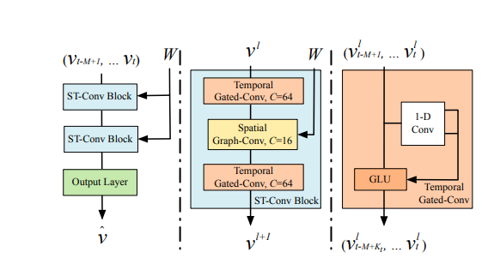
Spatial-Temporal Graph Convolution Networks(STGCN)
Notes:
Based on which, Yu et al. introduced a spatial-temporal graph convolutional network(STGCN) in 2017. Not gonna lie, this is my favorite. In which, they used two sequential Spatial-temporal convolution blocks and connected it to a fully-connected layer. In each ST-Convolution block, there are two temporal block surrounding a spatial block. By this framework, STGCN used less parameters than model based on LSTM and achived even higher accuracy. And it is used as a popular baseline method in many recent works.

Slide 7
Future Direction
Interpretability
Notes:
So, there is a huge topic in both DL community and transportation. Interpretability is a long-standing topic. Although some of the domain in CS or industry believe interpretability is not important as accuracy of the results. But in transportation, a field that is usually required to make influential decisions, we need more explanation on results from the machine and to conduct “what-if” analysis or to testify the solidness of the answer. And another example in a microscope view, when you are driving in an autonomous car, I believe you worried about the auto-pilot’s decision at least once. Sometimes may be “Why it is turning at this intersection?” or “God, it brakes for what?”
In field of TF and TSE, our worries usually fall into the first category. Right now, the interpretability of DL in transportation is still overlooked.

Slide 8
Future research direction
Kolmogorov-Arnold Networks(KANs)

Slide 9
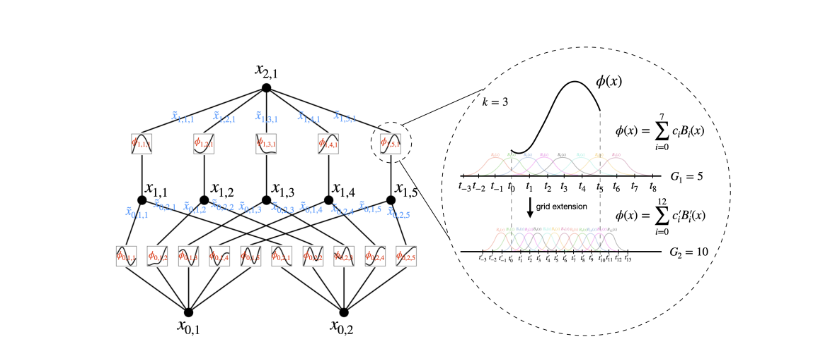
Kolmogorov-Arnold Networks(KANs)
Based on Kolmogorov-Arnold Representation Theorem(KART)
Why now?
Controversial? Why?
What about now?
GraphKAN & Temporal-KAN(or TKAN)
Notes:
KAN is based on Kolmogorov-Arnold Representation Theorem(KART) which claims that all the function can be approximated with sum of finite number of univariate functions.
a neural network framework by substituting linear weights with spline-based univariate function, and these functions are specifically structured as learnable activation functions.
Liu et al. claimed the network can produce a parametric explanation of results based on the topological structure of the network, meanwhile users are able to interact with the network by manually adjusting every learnable functions to tune or test the neural network. And therefore obtain a decent interpretability.
Cons:
Kan is not genuine product from KART, since it can be expand to a very deep level.. Kan is a MLP with learnable activation functions
KAN is suffering from curse of dimensionality
So far, there is no concrete proof about KANs’ capacity to replace MLPs, but I think KANs is still promising in certain topics due to its unique structure. Inspired by KANs, on June 19th, the KAN community proposed a novel scheme for graph neural network based on KANs by incorporating the message passing framework into KAN. In the result, GraphKAN, comparing to graph convolution network, had higher accuracy in accuracy while the computation time was 25 percent more. But, GraphKAN successfully showcased a new option for GNN framework for transportation field. Furthermore, the DL community subsequently introduced Temporal-KAN(or TKAN) [20] and Time-series KAN [21] which focus on the forecasting with time-series data.

