Slide 1
ECLT 5830
Assignment #4 Specification
Due: 16 Apr 2018

Slide 2
Specification
Objective: To practice using JavaScript to manipulate DOM and to practice using Ajax
Task #1: Create an interactive UI and using local storage
Task #2: Use Ajax to send/retrieve data to/from a server
You can find the requirements for each task in the following slides.

Slide 3
Task #1
Requirements:
Modify task1/task1.html accordingly so that
Whenever a user changes the value in the "title" text field or the "description" text area, the value of the elements <div id=title> and <div id=description> are updated immediately.
Whenever a user selects a different "animal", the "src" attribute of the element <img id=animal_img> is changed to the url of the image of the selected animal immediately.
Whenever the "save" button is clicked, the values of the input elements are saved in the local storage so that when the page is reloaded, the "states of the page" can be restored (including values of the input elements, the image of the selected animal, the values in <div id=title> and <div id=description>.

Slide 4
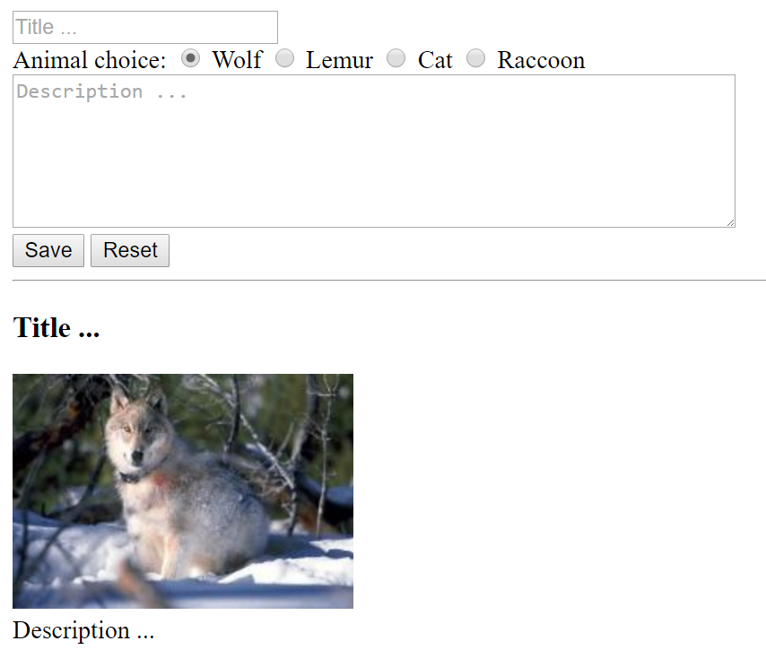
Task #1
Whenever a user changes the values of any of these input elements, update the corresponding values at the bottom half of the page immediately.
Whenever a user clicks the "Save" button, the values of the input elements should be saved in the local storage.

Slide 5
Task #1 (About Local Storage)
Local storage is represented by the JavaScript object window.localStorage
The object stores data as name-value pairs and the value needs to be a string.
e.g.,
window.localStorage['title'] = "Some title"; // Store a string
savedTitle = window.localStorage['title']; // Retrieve a string
window.localStorage['myobj'] = JSON.stringify(myobj); // Store a non-string
myobj = JSON.parse(window.localStorage['myobj']); // Retrieve a non-string

Slide 6
Task #2
Requirements:
Modify task2/task2.html and task2/getNames.php accordingly so that whenever the value in the input text field is changed, the following tasks are performed:
Send the value (if it is not empty) in the input field asynchronously via Ajax to getNames.php (a server-side script).
Upon receiving this value (let it be S), getNames.php would retrieve all names that begins with S from $names[], and send them back in the request.
Upon successfully receiving the response, the JavaScript code in task2.html should show all the names returned by the server as <li> elements in <ul id=output>.
You need to modify task2/getNames.php accordingly so that the values to be returned is encoded properly in the body of the response.

Slide 7
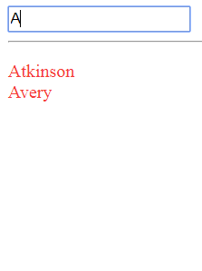
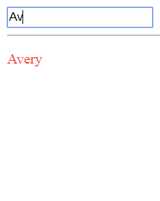
Task #2 (Sample Output)
As soon as the user entered 'A' in the input field, the JavaScript code sent "A" via Ajax to the server-side script getNames.php. getNames.php retrieved all names that begin with "A" from $names[], and return them in the response. When the client-side JavaScript received the names in the response, it showed them as <li> items in <ul id=output>.
As soon as the user entered a 'v', the JavaScript code sent "Av" via Ajax to the server-side script getNames.php and then updated the list items accordingly when it received the new set of names in the response.

Slide 8
Task #2 (Additional note)
You must not perform the filtering of names on the client side.

Slide 9
Submission
To submit your solution, please archive the folder containing all the files that make up assignment #4 into a ZIP file, and upload the ZIP file to eLearn.

