Slide 1
ECLT 5830
Assignment #5 Specification
Due: 28 Apr 2018

Slide 2
Specification
Objective: To experience customizing a content management system (CMS) into a web application.

Slide 3
Requirements
Requirements:
Apply a account at a web hosting service provider that supports hosting of WordPress. The hosting service should allow you to install different WordPress plugins for your website.
e.g., https://www.000webhost.com/ (free)
Please note that the "free" version will go into sleep mode (for an hour or so) after being active for a while.
Build a WordPress Website
Install a Gallery Plugin (e.g., Robo Gallery)
Create a Gallery with some images (using the default images in WordPress is enough).
Add a menu item to the "top menu" to point to the newly created gallery.
In the About page, enter the last 4 digits of your student ID.

Slide 4
Todo #1: Installing Plugin
In the WordPress DashBoard, click "Plugins" (on the left menu).
If you cannot find "Robo Gallery" in the plugin list, select the "Add New" (under "Plugins" menu item).
When presented with a list of available plugins, use the "Search plugins" feature to find a gallery plugin (e.g., Robo Gallery).
Click "Install Now" and then click "Activate" to make the plugin active in your WordPress website.

Slide 5

Todo #2: Create a Gallery with some images
In you have activated "Robo Gallery" (or other gallery plugin), in the DashBoard you should see a new menu item named after the plugin.
Click that gallery plugin's menu item to customize the gallery.
e.g., add a new gallery and then add images to the gallery.
After you have added images and customized a gallery, you need to click the "Publish" button on the right hand side of the DashBoard to apply your change.

Slide 6
Todo #3: Add a menu item to the "top menu"
In the WordPress DashBoard, click "Appearance" (on the left menu).
Here you can choose to change the background images, colors, menu, theme, etc. of your website.
Select "Menus", then select "Top Menu (Top Menu)" from the dropdown list at the top. (the one next to the label "Select a menu to edit")
On the left hand side of the page, you can select pages you want to add to the selected menu. For this assignment, you can choose Robo Gallery (or the gallery plugin you have chosen) and select the gallery you created earlier, then click "Add to Menu".
Click "Save Menu" to save the menu.

Slide 7
Todo #4: Customizing the "About" page
In the WordPress DashBoard, click "Pages" (on the left menu).
This is where you will find all the pages on your website. Please feel free to change them accordingly.
Select "About" page on the list of pages.
Edit the content of the page accordingly (to include the last 4 digits of your student ID)
Click the "Publish" button on the right hand side of the DashBoard to apply your change.

Slide 8
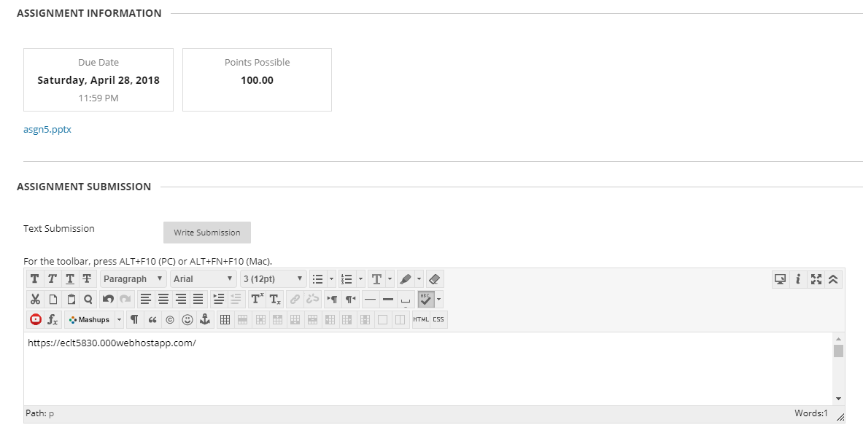
Submission
When you are done customizing your website according to the spec, please submit the URL of your website using the "Text Submission" feature on Blackboard.
There isn't any file to upload.
Enter the URL of your website here

