Slide 1
Densely Connected Convolutional Networks
Ziqiang Zheng

Slide 2
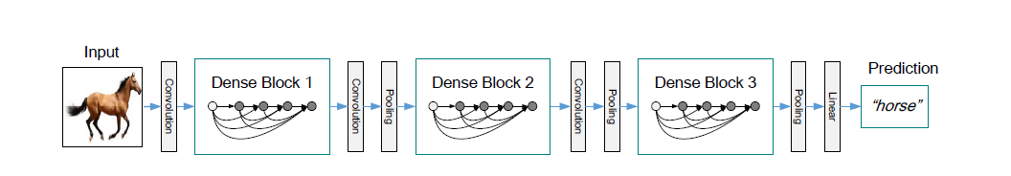
which connects each layer to every other layers in a feed-forward fashion

Slide 3


$$L∗\frac{L+1}{2} connections$$

Slide 4
Why dense connection?
Direct access to the gradients from the loss function
Improved flow of information and gradients throughout the network
Utilizing multi-level features in CNNs
Skip connection

Slide 5
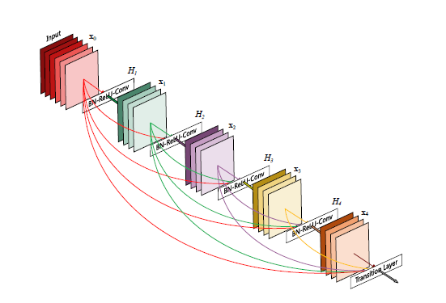
Feature reuse

Slide 6


Compared to ResNet
ResNet
Densnet

Slide 7
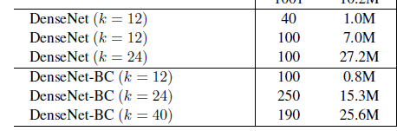
Growth rate(k)
Control the number of feature maps

Slide 8
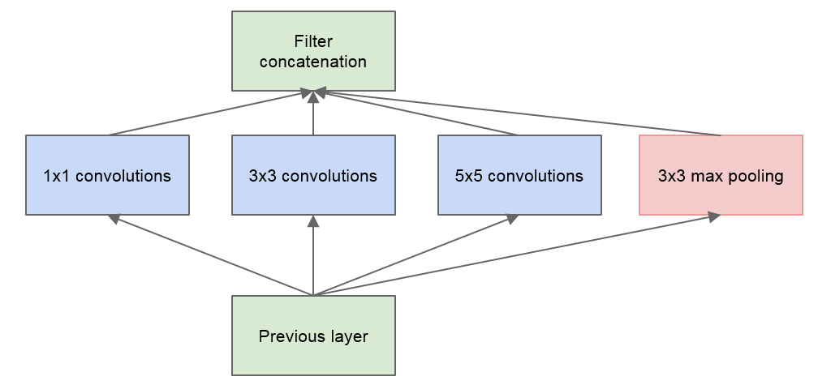
Bottleneck layers.

Slide 9

Compression
Improve model compactness
Descent the parameters
Transition layers $0<θ<1$

Slide 10
Code
https://github.com/gpleiss/efficient_densenet_pytorch (pytorch)
https://github.com/YixuanLi/densenet-tensorflow (tf)

