Slide 1
Do field-scale radars blink through the rain?
Ground truth from 120 US Climate Reference Network stations tests whether Sentinel-1 and NISAR see soil-moisture wetting events, and makes the case for launching ARMO, a targeted L-band revisit mission
ES4304 Eyes on Earth | NASA ROSES-style proposal | 5 November 2026
Tang Zhen Ian [+ group members]
Notes:
We are selling a problem: field-scale radar may be blind to the short wetting events that matter for floods and irrigation. We test it with independent ground truth before asking for a satellite.

Slide 2
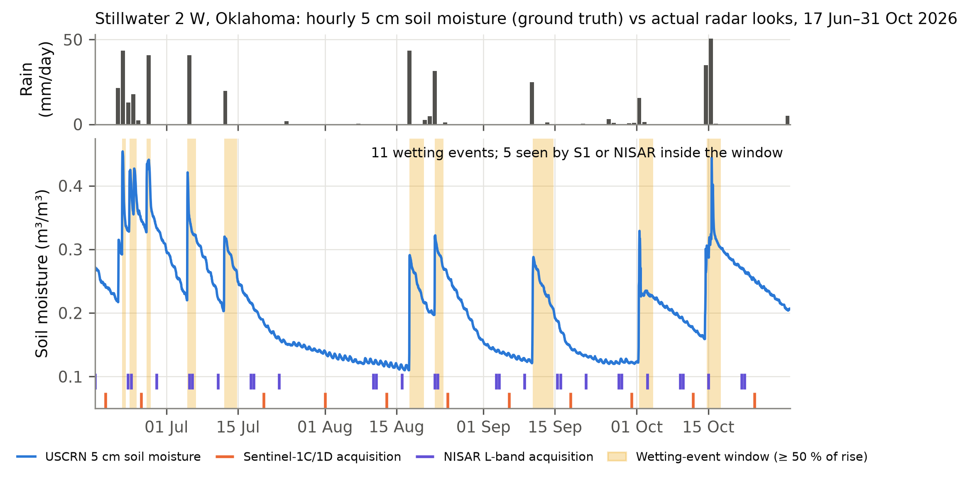
Every storm writes a two-day signal into the soil
And most satellites look at the wrong moment
▪ Moisture jumps within hours of rain, then decays over 1–3 days
▪ That state sets runoff from the next storm, crop water and land–air fluxes
▪ At Stillwater, OK: 11 events, only 5 seen by any radar look
ES4304 | ARMO proposal
2
Notes:
Hourly 5 cm soil moisture from the USCRN probe (blue). Shaded windows are when at least half the wetting is still present. Orange and violet ticks are actual Sentinel-1 and NISAR acquisitions.

Slide 3
Resolution or revisit: today you must choose one
Field scale needs SAR, and SAR revisits slowly
40 km
6–12 d
12 d
≥ 2030
SMAP radiometer
Sentinel-1C/1D
NISAR (2025)
ROSE-L (planned)
~40 km footprint
2–3 day revisit
10 m C-band SAR
6–12 day revisit; crops attenuate C-band
200 m L-band soil moisture
12-day repeat; SM ~2× per 12 d
L-band, 6 d over global land (3 d Europe)
Launch ≥ 2030 (WMO OSCAR)
Physics: L-band (24 cm) penetrates crops and senses ~5 cm; C-band (5.6 cm) senses ~1–2 cm and is attenuated by vegetation.
ES4304 | ARMO proposal
3
Notes:
Radiometers have revisit but not resolution; SAR has resolution but not revisit. The swath is a small fraction of the orbit-to-orbit spacing.

Slide 4
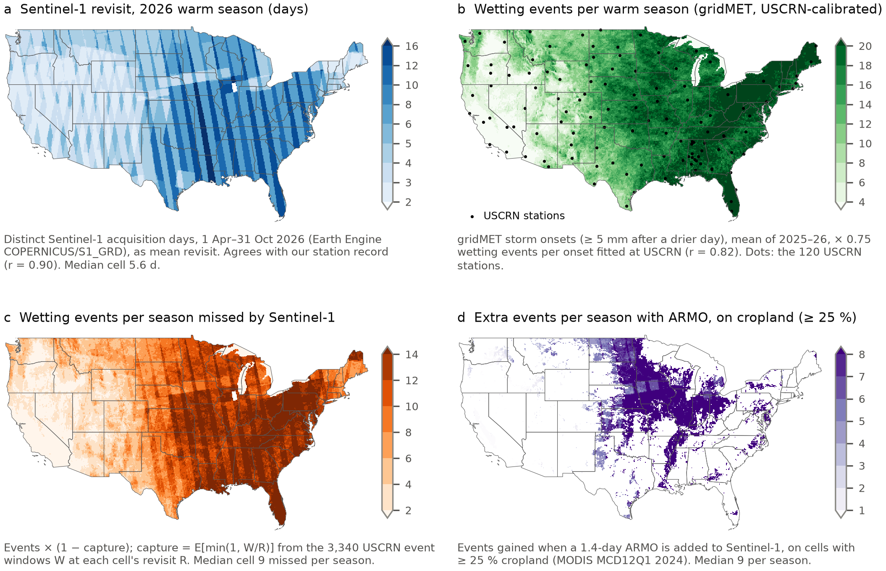
Where the gap bites: the Midwest and East
Sentinel-1 revisits slowest where rain, and farms, are most frequent
▪ Sentinel-1 revisit: 5.6 d median, 8–16 d over the Midwest and East
▪ Wetting events: ≈ 15 per season (gridMET, calibrated to USCRN, r = 0.82)
▪ Missed by Sentinel-1: ≈ 9 per season; ≈ 12 on cropland
▪ ARMO adds: ≈ 9 events per season on cropland, mostly the Corn Belt and Delta
ES4304 | ARMO proposal
4
Notes:
All from Google Earth Engine at 0.1 deg. (a) Sentinel-1 GRD distinct acquisition days, Apr-Oct 2026; they agree with our Planetary Computer record at the stations (r = 0.90). (b) gridMET storm onsets (>= 5 mm after a drier day), scaled by 0.75 wetting events per onset, fitted at 227 USCRN station-seasons. (c) events x (1 - E[min(1, W/R)]) with the USCRN windows. (d) gain with a 1.4-day ARMO, where MODIS cropland >= 25 %.

Slide 5
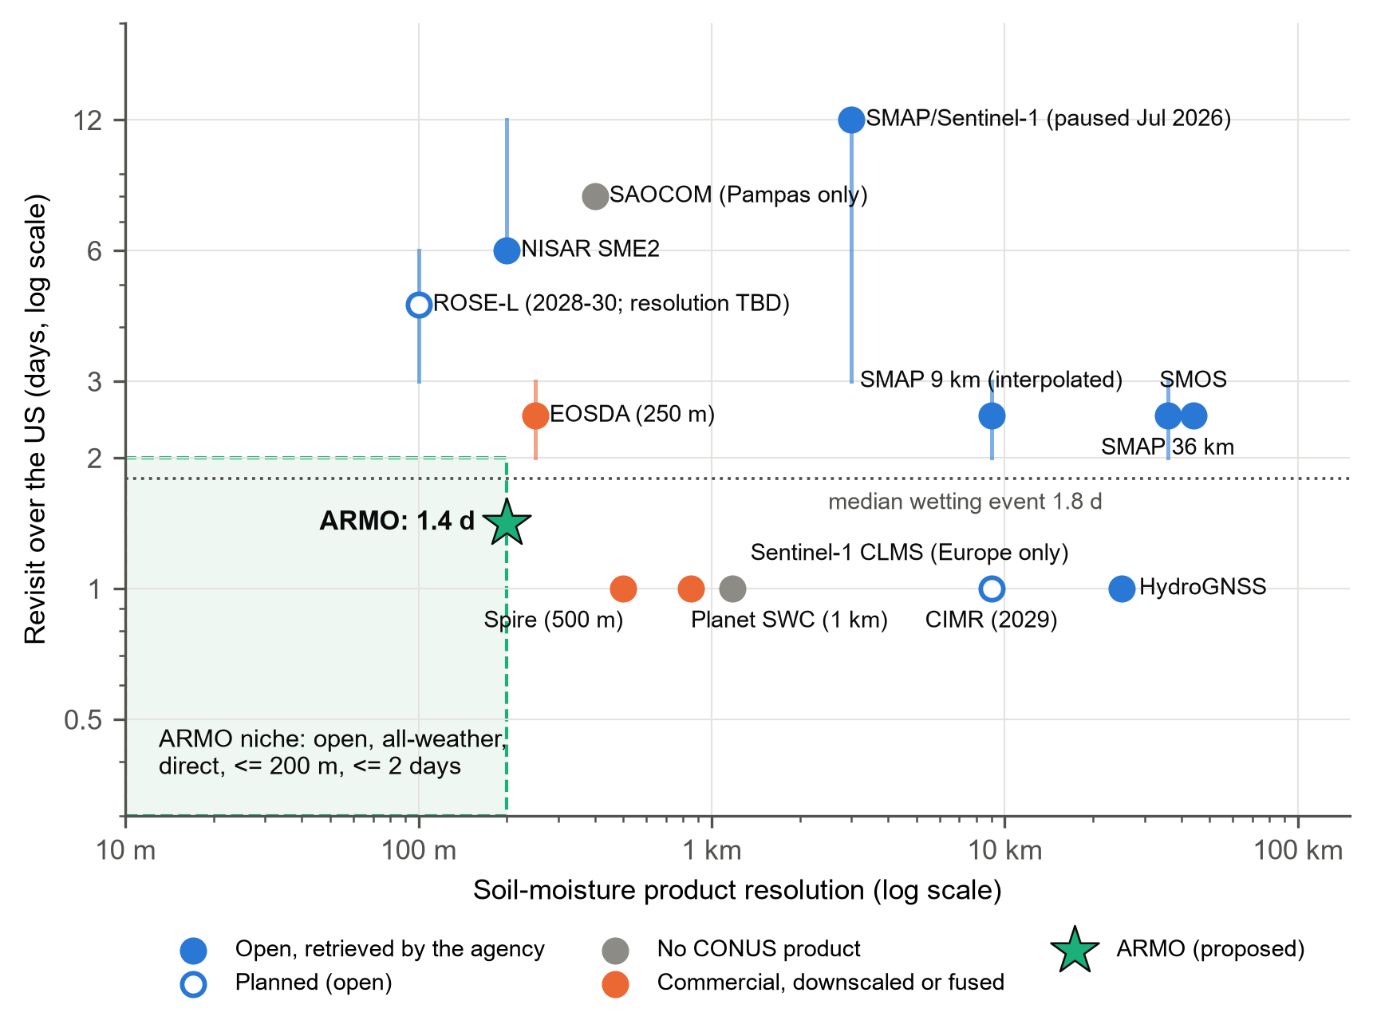
ARMO's niche: field scale plus fast revisit
Open, all-weather, ≤ 200 m and ≤ 2 days over the US: nobody fills this box today
▪ NISAR SME2: same 200 m L-band, but ~6-day revisit and 72 h latency
▪ ROSE-L: 6 d global land (ESA); 3 d per eoPortal; launch ≥ 2030
▪ Spire, Planet: daily but modelled from coarse sensors, closed; Planet dropped 100 m
▪ Optical: a clear look in only 56 % of events, even daily
▪ Novelty = revisit, not resolution
ES4304 | ARMO proposal
5
Notes:
Market review checked 2 Nov 2026 (market.pdf). Say it carefully: field-scale L-band already exists in NISAR. What does not exist is field-scale, all-weather, open soil moisture faster than every ~6 days over the US.

Slide 6
Research question
Does today's field-scale radar fleet observe rain-driven soil-moisture wetting events and, if not, what revisit would a dedicated L-band mission need to capture ≥ 80 % of them?
O1 Measure
O2 Quantify
O3 Test
O4 Decide
Event duration and amplitude from hourly ground truth
Capture by regular revisits and by actual S1 / NISAR passes
Is a sampled event detectable? S1, NISAR, SMAP, ERA5-Land
Revisit and noise requirements; marginal value of ARMO
▪ H1: events are shorter than the fleet's revisit, so most are missed
▪ H2: a sampled event's signal is smaller than today's change noise
▪ H3: a dedicated L-band revisit mission lifts capture to ≥ 80 %
Decadal Survey 2017: question H-4 (floods, droughts)
Soil moisture TO-17: unallocated, no coverage after SMAP
Two stages: retrieval study, then an Earth Venture-class mission
ES4304 | ARMO proposal
6
Notes:
Three testable hypotheses. The 2017 Decadal Survey lists soil moisture as Targeted Observable TO-17 but left it unallocated because nothing is planned after SMAP and SMOS; it points such observables to Venture-class proposals. We are asking for the research that decides whether that mission should be built.

Slide 7
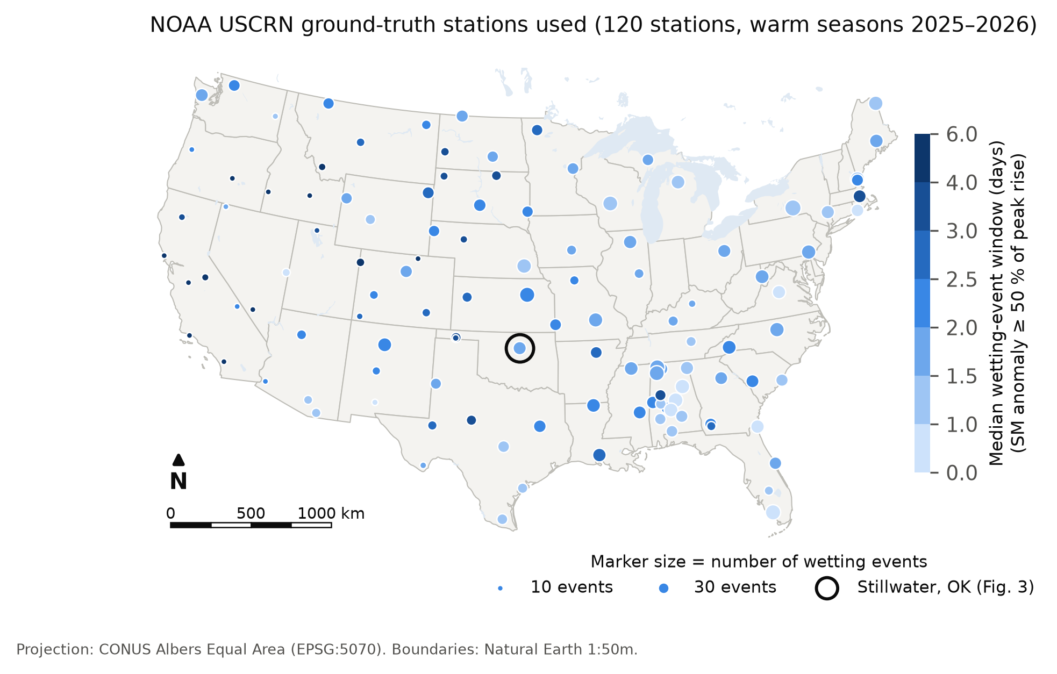
Ground truth first: 120 reference stations, hourly
NOAA US Climate Reference Network, warm seasons 2025–2026
▪ 3,340 wetting events at 120 stations
▪ Triplicate 5 cm probes, rain gauge, soil temperature
▪ Independent: used to validate, never to calibrate, satellite products
▪ QC: NUL-byte repair, frozen mask, ≥ 70 % valid hours
▪ Land cover (Earth Engine): 60 grassland, 36 tree, only 9 cropland
ES4304 | ARMO proposal
7
Notes:
Ground truth is the backbone. USCRN is NOAA's climate-grade network; it spans desert to humid forest. It deliberately avoids farms, which is a limitation for an agricultural mission.

Slide 8
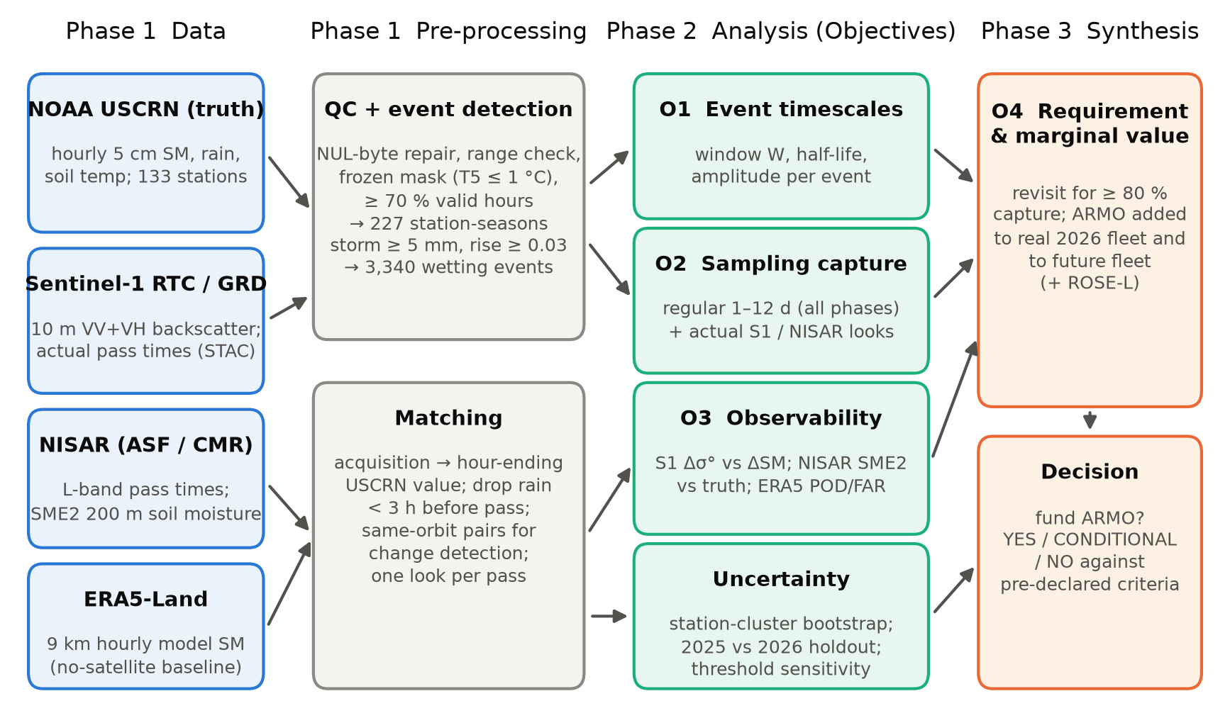
Method: from probe to mission decision
▪ Event: ≥ 5 mm rain and a rise ≥ 0.03 m³/m³
▪ Window: time the anomaly stays ≥ 50 % of peak
▪ Captured: a satellite look falls inside the window
▪ Real schedules: 14k S1 and 6k NISAR passes from STAC/CMR
▪ Stats: station bootstrap; 2026 holdout; 9 alternative thresholds
ES4304 | ARMO proposal
8
Notes:
Beyond tutorials: cloud-native range reads of COG and HDF5 at 120 sites; sampling theory E[min(1,W/R)].

Slide 9
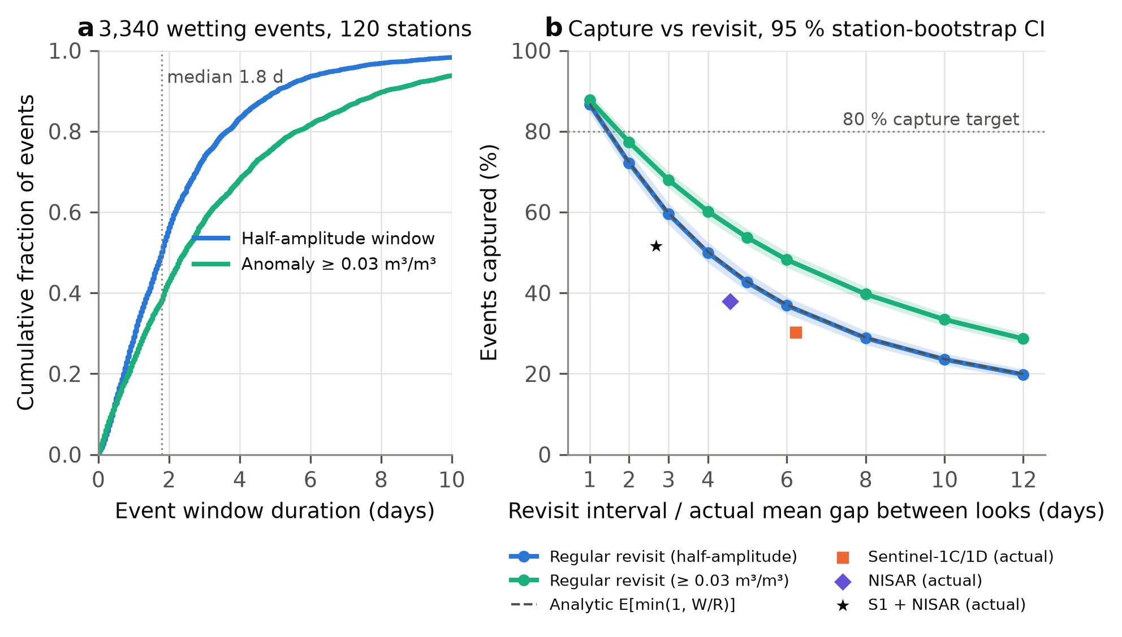
Half of all events fade within 1.8 days
Capture falls quickly with revisit interval
37 %
captured at 6-day revisit
60 % at 3 days; 87 % at 1 day
≈ 1.5 d
for 80 % capture
Regular revisit from one system
ES4304 | ARMO proposal
9
Notes:
The analytical model matches simulation within 0.2 points; 2025 and 2026 agree.

Slide 10
The real 2026 fleet sees about half of the events
Even assuming every look were a perfect measurement
30 %
38 %
52 %
Sentinel-1C/1D
NISAR L-band
S1 + NISAR
median gap 6.2 d
median gap 4.6 d; max 18 d
regular sampling at the same rate: 64 %
979 wetting events at 107 stations, 17 Jun–31 Oct 2026. Looks cluster on consecutive days, so uncoordinated timing costs ≈ 12 percentage points.
ES4304 | ARMO proposal
10
Notes:
Capture is an upper bound on detection. Next slide: what happens when a look does land in an event.

Slide 11
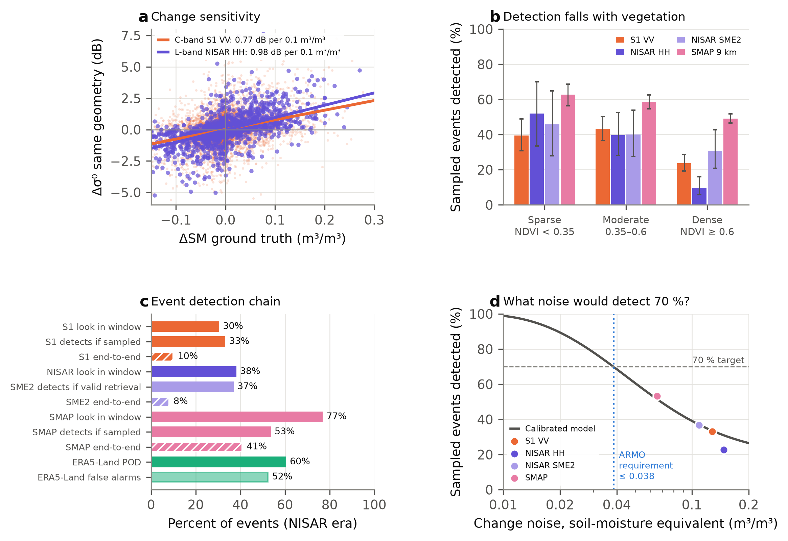
When sampled, can the sensor see it?
Field-scale radars mostly not; the 9 km SMAP radiometer does better
▪ Sentinel-1 (C): detects 33 % of sampled events; noise ≈ 0.13 m³/m³
▪ NISAR (L): 23 % (σ⁰HH), 37 % (SME2); noise no lower than C-band
▪ SMAP 9 km: 53 % when sampled, 41 % end to end, but cannot resolve fields
▪ ERA5-Land: POD 60 %, false alarms 52 %
ES4304 | ARMO proposal
11
Notes:
Panel c is the detection chain: look in window x detect when sampled. NISAR SME2 is counted only where a valid retrieval pair exists (22 % if missing retrievals count as misses). SMAP looks twice a day with low noise, so frequency plus low noise make event detection possible, at 9 km.

Slide 12
What would it take to see the events?
A detection model calibrated on all four sensors sets ARMO's noise requirement
≤ 0.038
0.38 dB
≈ 15×
m³/m³ change noise
L-band σ⁰ noise needed
more independent looks
detects 70 % of sampled events (model fits sensors within 3 pts)
today 1.45 dB: a 3.8× reduction
if the noise is speckle: a resolution vs noise trade
This turns the critical risk into a number ARMO's design must meet, and Phase A research must show is reachable (multi-looking, burst averaging, SMAP–SAR fusion).
ES4304 | ARMO proposal
12
Notes:
Model: P(detect | event size A) = Phi(k A / n - 1), n = change noise in soil-moisture units, one factor k fitted across S1, NISAR HH, NISAR SME2 and SMAP. Solved for 70 % over the observed event sizes.

Slide 13
Head to head: ARMO captures 2× as many events as NISAR
Each system alone, scored on the same 979 ground-truth events (Jun–Oct 2026)
53 %
registered by ARMO, if it meets its requirement
NISAR today: 9–14 %
83 %
with S1 + NISAR + ROSE-L
ARMO lifts capture from 64 % (6-day ROSE-L)
ES4304 | ARMO proposal
13
Notes:
Same events, same rules. NISAR uses its real 2026 passes; ROSE-L is a regular 6- or 3-day sampler; ARMO is design D flown in our orbit model. Amber bars multiply capture by detection when sampled: NISAR's measured 23–37 % (midpoint shown), assumed the same for ROSE-L, and ARMO's 70 % requirement, which is not yet demonstrated. The gain is revisit: both are L-band at 200 m.

Slide 14
The ARMO mission concept
Two L-band smallsats, one launch, field-scale wetness to forecasters within 24 hours
Fly
Image
Downlink
Process
Deliver
2 smallsats, 620 km dawn–dusk orbit, 180° apart
Only the US: 22 min/day, 362 km access, HH + HV
45 GB/day to polar ground stations, every orbit
Cloud change-detection retrieval, 100–200 m
NOAA National Water Model, USDA, open data, < 24 h
251 kg
5.9 m
155 W
$150 M
per satellite, wet (30 % margin)
mesh reflector, 27 m²
orbit average; 498 W peak RF
incl. launch, 3-yr ops, 30 % reserve
ES4304 | ARMO proposal
14
Notes:
Antenna: at 45 deg off-nadir L-band needs >= 27 m2 to avoid ambiguities (Freeman et al. 2000), hence a 5.9 m mesh reflector, half NISAR's 12 m. Radar equation: NESZ -25 dB (2 dB better than NISAR's ~-23 dB) needs ~50 W average RF. Mass: bottom-up budget, reflector scaled from < 8 kg at 3.35 m (Sushko et al. 2021); both satellites (503 kg) fit one Firefly Alpha-class launch (630 kg to 500 km SSO). Cost by analogy with NovaSAR-1 and CYGNSS, +-40 %; Earth Venture cap US$ 190 M.

Slide 15
Verdict: retrieval first, then launch ARMO
The revisit gap is real and measured. Find out how good the sensor can be, then launch either way.
Stage 1 (2027–28): retrieval
Stage 2 (2029–36): launch ARMO
It pays off either way
US$ 218 k, 2 years. Event retrieval on validated NISAR vs USCRN; result sets ARMO's sensor (looks, bandwidth, power)
Two 251 kg L-band smallsats, one launch ≈ 2033; ≈ US$ 150 M, under the US$ 190 M Earth Venture cap
Retrieval works: 53 % of events registered, 4–6× NISAR. It doesn't: revisit alone still doubles NISAR (17–28 % vs 9–14 %)
Notes:
We tried to kill our own mission with ground truth. It survives: the revisit gain is measured, the spacecraft fits a Venture-class budget. We fund retrieval first because its result decides how good ARMO's sensor must be, not whether ARMO flies: the revisit gain pays off either way. ROSE-L is assumed at ESA's 6-day global-land revisit; at 3 days ARMO still adds 12 points.

Slide 16
Limitations and the two-stage plan
▪ Retrieval: if 70 % is reached, 53 % of events registered, 4–6× NISAR; if not, still 2×
▪ Reflector: 5.9 m on a 251 kg satellite not yet flown; deployment test before build
▪ Cost: ± 40 %; descope to one satellite (≈ US$ 111 M)
▪ Few farms: only 9 of 121 stations are cropland
▪ Scope: CONUS warm seasons; NISAR still provisional
Stage 1 (2027–28), US$ 0.22 M
Retrieval on validated NISAR vs USCRN; field campaign
Result sets the sensor: looks, bandwidth, power
Stage 2 build (2029–33)
Design, reflector test, build two spacecraft; launch ≈ 2033
Stage 2 operations (2034–36)
Open products to NOAA and USDA in < 24 h
ES4304 | ARMO proposal
16
Notes:
Each limitation has a fix. Point-vs-pixel mismatch is handled by the Phase B field campaign; P-band SAR is barred over the US and UHF signals of opportunity reach only ~1 km at swath centre, so L-band stays the baseline.

Slide 17
Who would use it, and what it costs
42 %
≈ $30 B
$218 k
$150 M
of US freshwater is for irrigation
2012 flash-drought damage
Stage 1: retrieval study now
Stage 2: ARMO mission
USGS Circular 1441 (2015 data)
NOAA 2013
2 years; personnel-driven; data free
Incl. launch; Earth Venture cap $190 M
▪ NOAA National Water Model: antecedent wetness for flood forecasts
▪ USDA Crop-CASMA / FAS: separate rain-fed from irrigated response
▪ Water managers and insurers: when and how much water reached a field
▪ Commercial X-band alternative: ≈ US$ 19–20 M for the same looks, and physically unsuited
ES4304 | ARMO proposal
17
Notes:
Weekly drought products do not need 2-day revisit; event-scale users do.

Slide 18
Take-home
▪ Wetting events last ~1.8 days; today's fleet captures 52 % at best
▪ When sampled, field-scale radar detects 23–37 % of events; 9 km SMAP 53 %
▪ Alone, ARMO captures 76 % vs NISAR 38 % and ROSE-L 38–61 %; with the fleet 81 %
▪ Stage 1: fund retrieval first (US$ 218 k) to learn how good ARMO's sensor can be
▪ Stage 2: launch two 251 kg smallsats (≈ US$ 150 M); revisit alone doubles NISAR, retrieval adds the rest
▪ Questions?

Slide 19
Backup slides
For questions: marginal value, orbit designs, traceability, frequency options

Slide 20
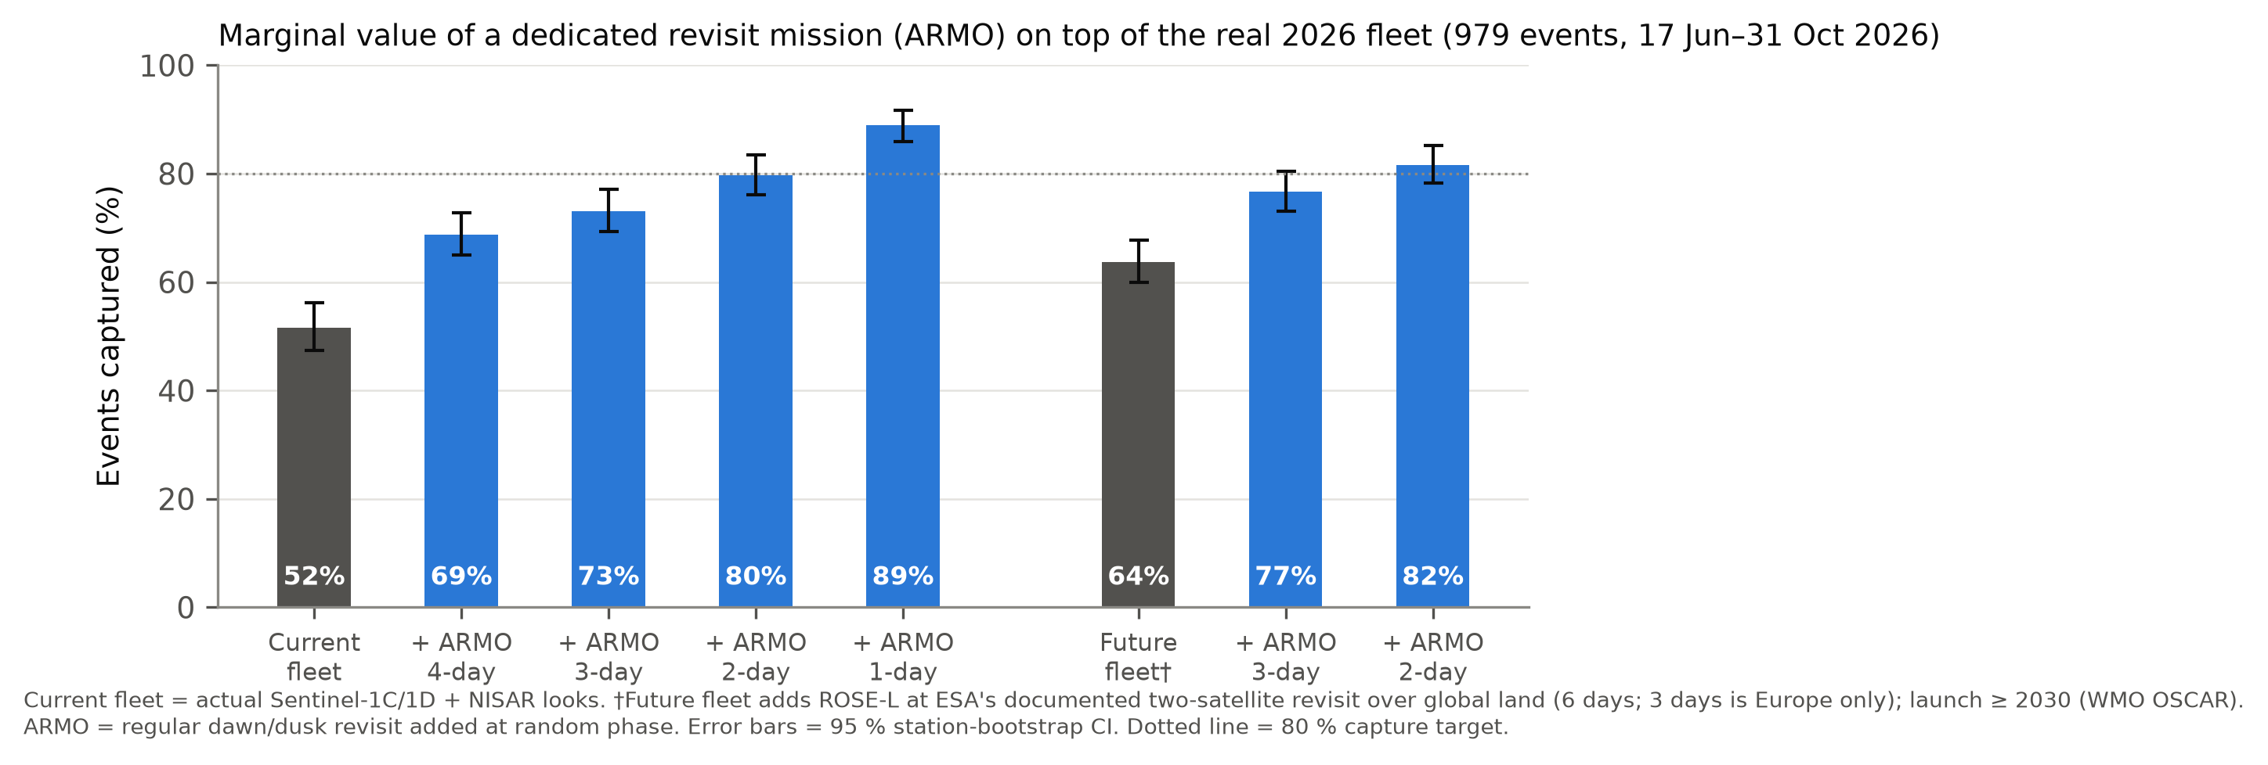
What would ARMO add?
Large gain today; still +18 points once ROSE-L flies
80 %
with ARMO 2-day, today
from 52 %
+18 pts
added on top of ROSE-L
2-day ARMO, points gained
ES4304 | ARMO proposal
20
Notes:
The value of a new satellite depends on what else flies. ROSE-L is simulated at ESA's documented two-satellite revisit over global land (6 days; 3 days applies to Europe only).

Slide 21
Can a real orbit deliver it?
Simulated 620 km dawn-dusk orbits, scored against ground truth
Design | ARMO revisit | Fleet + ARMO capture | CONUS imaging duty
1 sat, right-looking, 25-45 deg, dawn-dusk | 2.8 d | 71 % | 1.5 %
1 sat, roll left/right on alternate orbits, dawn-dusk | 2.8 d | 70 % | 1.6 %
1 sat, roll alternate, wider 20-50 deg access | 1.8 d | 77 % | 1.7 %
2 sats (180 deg apart), right-looking, dawn-dusk | 1.4 d | 81 % | 1.5 %
2 sats, roll alternate, dawn-dusk | 1.4 d | 77 % | 1.6 %
Only two satellites clear 80 %. Rolling left/right does not shorten a single satellite's revisit. Regional imaging needs < 2 % of each orbit, far less than global mapping.
ES4304 | ARMO proposal
21
Notes:
J2 sun-synchronous propagation, 10 s steps, 25-45 deg off-nadir ScanSAR, one side per pass; passes added to the real S1+NISAR schedule; 8 orbital phases.

Slide 22
ARMO traceability: objective to requirement
Baseline = design D (2 satellites); threshold = design C (1 satellite)
Objective | Requirement | Evidence
Capture ≥ 80 % of events | Revisit ≤ 2 d, with or without ROSE-L | 80 % today / 82 % with ROSE-L
Detect ≥ 70 % when sampled | Noise ≤ 0.038 m³/m³ (0.38 dB) | Calibrated model; unverified
See under vegetation | L-band ~1.26 GHz, HH + HV | Literature; L-band σ⁰ ahead only in sparse cover
Field scale | 100–200 m, ScanSAR multi-look | Trades against noise
Orbit | 620 km dawn–dusk SSO, 180° apart | Orbit simulation (D 81 %, C 77 %)
Spacecraft | 2 × 251 kg, 5.9 m reflector, one launch | Sizing: ≈ US$ 150 M incl. launch
ES4304 | ARMO proposal
22
Notes:
Mission cost is not requested here; analogs: NovaSAR-1 S-band smallsat (GBP 21 M UKSA investment), NISAR NASA life-cycle cost US$1,174 M (GAO 2026; US$867 M 2016 baseline).

Slide 23
Why L-band, not P-band or UHF?
Deeper sensing does not buy longer events, and P-band radar may not operate over the US
P-band SAR (BIOMASS, 435 MHz)
UHF / P-band signals of opportunity
L-band SAR (ARMO baseline)
Secondary allocation behind US space-object tracking radars: may not operate over North America
12 m reflector, not a smallsat; 6 MHz bandwidth; ionospheric correction
Receive-only: reuses Navy MUOS signals, no licence needed
≈ 200 m only at swath edge, ~1 km at centre; 7 satellites; one CubeSat demo (SNOOPI)
Senses ~5 cm, works under crops
Same band as NISAR and ROSE-L: retrievals and calibration transfer
Ground truth at 10 cm (P/UHF depth): 2,531 events instead of 3,340; windows 1.9 d vs 1.8 d; a 2-day revisit captures 73 % (5 cm: 72 %). Way forward: study a UHF receiver as a hosted secondary payload for root-zone moisture.
ES4304 | ARMO proposal
23
Notes:
Sources: Quegan et al. 2019 RSE (BIOMASS, SOTR restriction, 12 m reflector, 6 MHz); Shen et al. 2021 IEEE TGRS (P-band ~7 cm vs L-band ~5 cm; >10 cm below 0.5 GHz); Yueh et al. 2020 IEEE GRSL (260 MHz tower, 0.02 m3/m3 against top 10 cm; single frequency dominated by surface moisture); Yueh et al. 2021 IEEE JSTARS (SoOp SAR concept); Garrison et al. 2024 Adv. Space Res. (SNOOPI). The 10 cm result is our own: same event rules on USCRN 10 cm probes.

