Slide 1

ReRoute
The trip room that plans with you, travels with you, and never leaves you stranded.
CodeNection 2026 · Lifestyle Track: Planning an Escape
The Avengers

Slide 2



The Problem
Group travel planning is scattered, uncoordinated, and can't adapt when things change.
Fragmented apps
Who feels it most
Bookings, budgeting, and itineraries live in separate apps.
Trip organizer — carries the coordination load
No shared space
Groups can't sync preferences, budget, or schedule together.
Budget-conscious member — hit hardest by cost disputes
No adaptability
Spontaneous member — frustrated by rigid plans
When plans break mid-trip, there's no fallback.

Slide 3

Our Solution
Every trip gets a dedicated Trip Room — one shared space that plans the trip with AI, mediates group decisions, adapts in real time when plans break, splits the bill, and remembers the trip once it's over.
Plan
Mediate
Adapt
Split costs
Remember
One mechanism, two triggers: the same decision-card system resolves both group disagreements and mid-trip disruptions.

Slide 4








Feature Highlights
AI Route + Landmarks
Safety Alerts
Trip Room Mediation
Splitwise-style Budget
Live ETAs, instant reroute, tap-to-explore landmarks
AI flags conflict, disaster, or unrest risk
Anonymous voting resolves group disagreements
Split by %, shares, or exact + AI receipt scan
AI-Suggested Itineraries
Emergency SOS
Language + Translator
Album & Badges
Recommendations from aggregate traveler data
Alerts your group + dials local emergency number
Mini-lessons and a live translator per destination
Auto-organized photos and travel history badges

Slide 5

What Makes It Different
One decision-card mechanism, two triggers. Most travel apps treat group conflict and mid-trip disruption as separate problems. ReRoute resolves both the same way — whichever fires, the group sees options and votes together.
Photo-first landmarks
Real photos lead; the AI 3D model is a secondary extra — based on direct mentor feedback.
Trip-scoped, not social
We deliberately cut general social features (public feed, DMs) that didn't serve real trip planning.

Slide 6
How We Compare
 | ReRoute | TripIt | Splitwise
Itinerary planning | ✓ AI-generated | ✓ Manual | —
Group expense split | ✓ + receipt AI | — | ✓
Disruption handling | ✓ | — | —
Group decision mediation | ✓ Anonymous voting | — | —
TripIt organizes itineraries but stops there. Splitwise only handles money. ReRoute is the only one built around the whole trip, together.

Slide 7
Ideation & Process
v1 · 1 Sept
v2 · 3 Sept
v3 · 4 Sept
v4 · 12 Sept
3 ideas explored individually
Unified into one Trip Room
Refined after mentor feedback
Session cancelled — proceeded as-is
Mentor Session #1 (4 Sept) feedback applied:
Cut Community & Friends chat — the trip room's group chat already covers this
Added a live translator feature
3D landmark model repositioned as secondary; real photo is now primary
Individual brainstorm: You proposed the Trip Room; Gan added safety checks + Splitwise-style budgeting; Jiabao proposed the AI 3D landmark models.

Slide 8
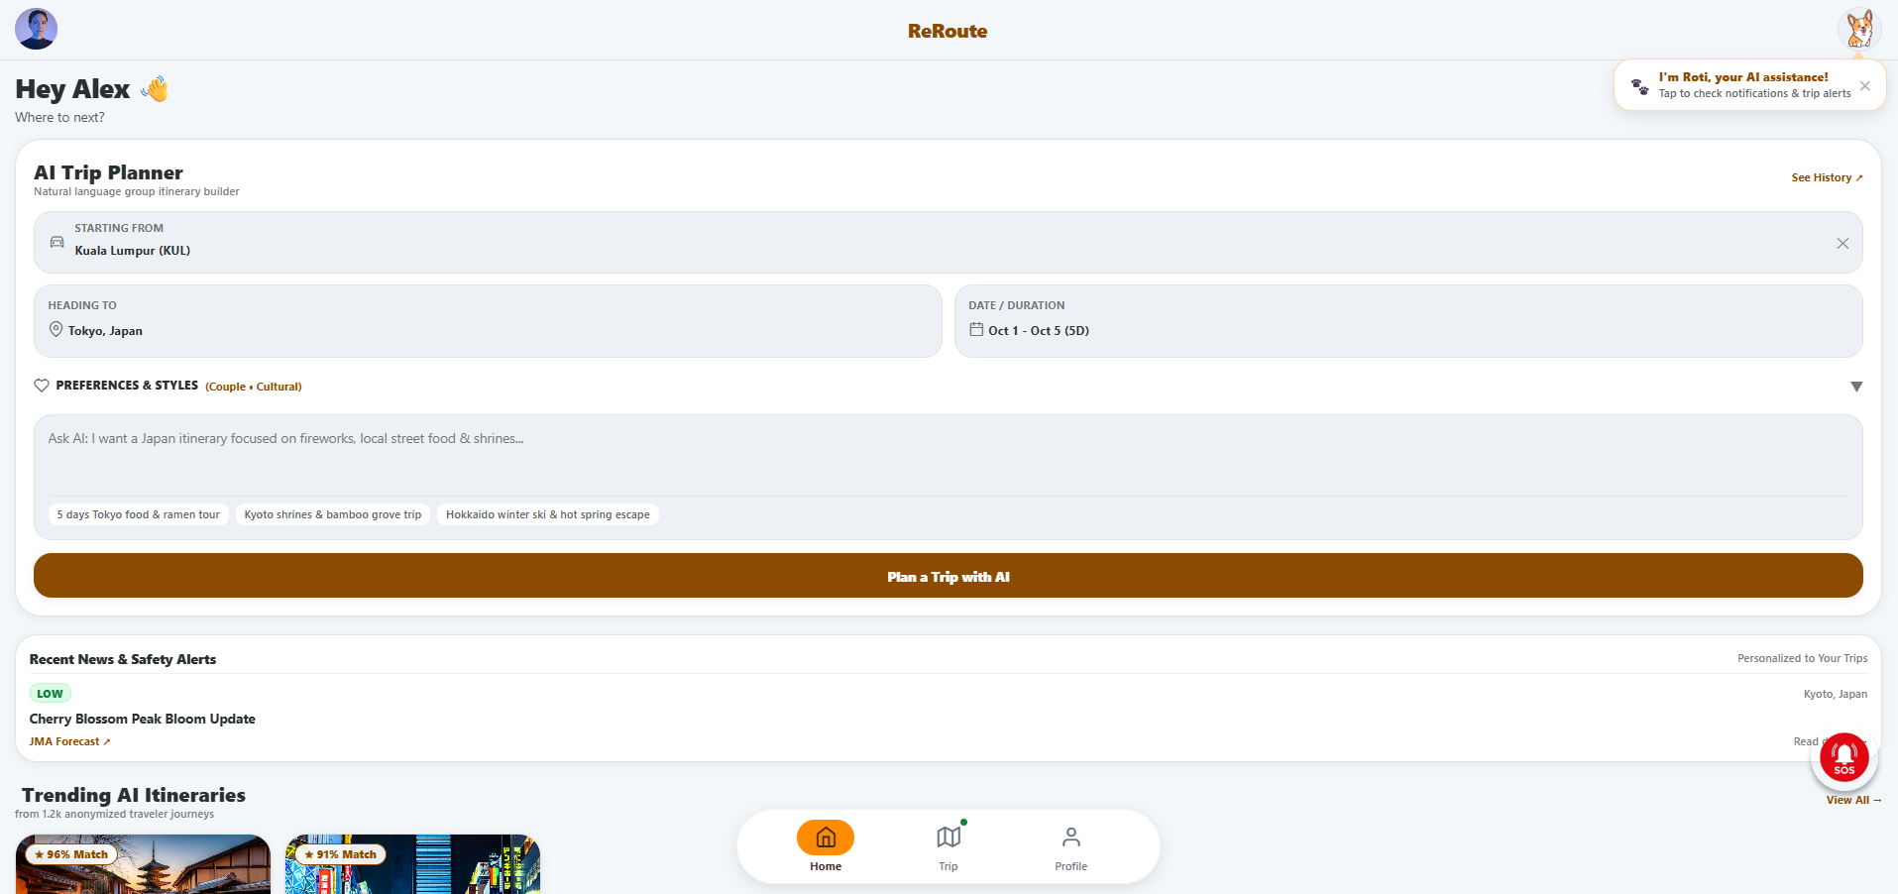
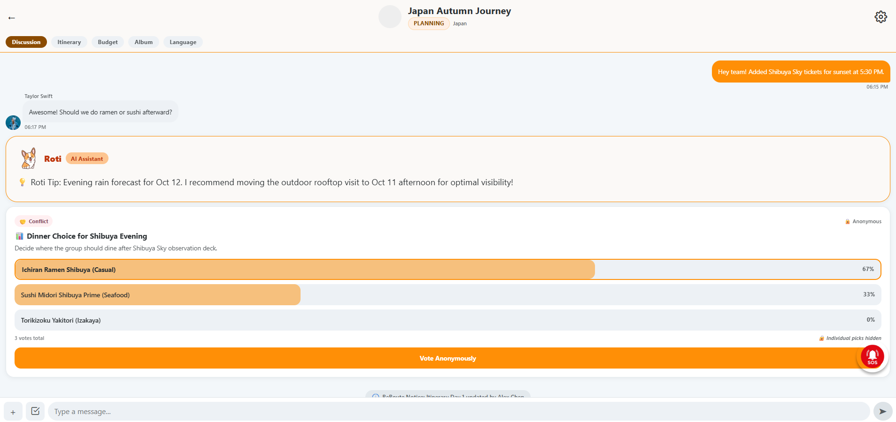
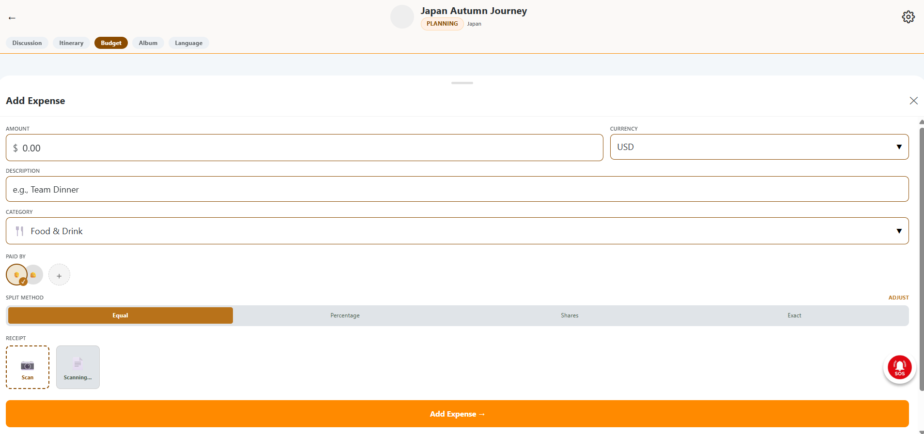
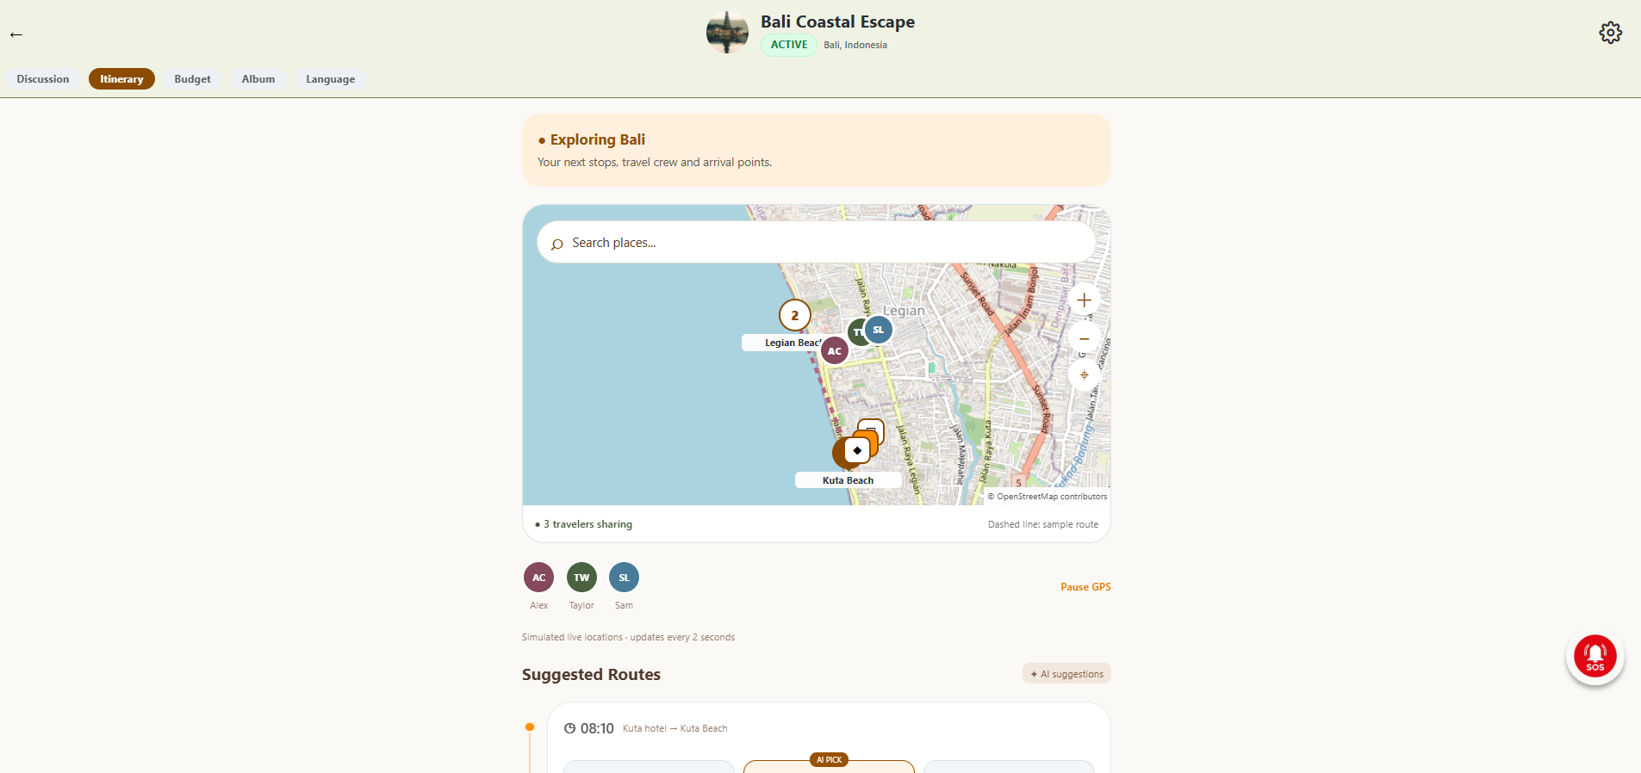
Prototype
Designed in Stitch + Figma, then translated into working React Native (Expo) code to give the Building Phase a head start.
Home — AI trip chatbox
Trip Room — Discussion & voting
Trip Room — Budget & receipt scan
Trip Room — Map & SOS

Slide 9



Tech Stack & Feasibility
React Native (Expo)
Supabase
Google Maps API
Claude / OpenAI
Native performance, one codebase
Postgres + PostGIS, Auth, Realtime, Storage
Directions and places data
Itinerary AI, safety summaries, receipt OCR
Build Plan & Scope
We're implementing one end-to-end flow fully rather than all features shallowly: sign up → create a Trip Room → AI-generated itinerary → disruption occurs → group votes via decision card → expense logged via receipt scan → settle up → shared album. Remaining features are scoped in our feature-requirements doc, with clear notes on what's real vs. mocked for the demo.

Slide 10



Thank You
ReRoute — The Avengers
GitHub Repo
Demo Video
Prototype
Tap Here
Tap Here
Tap Here

