Slide 1
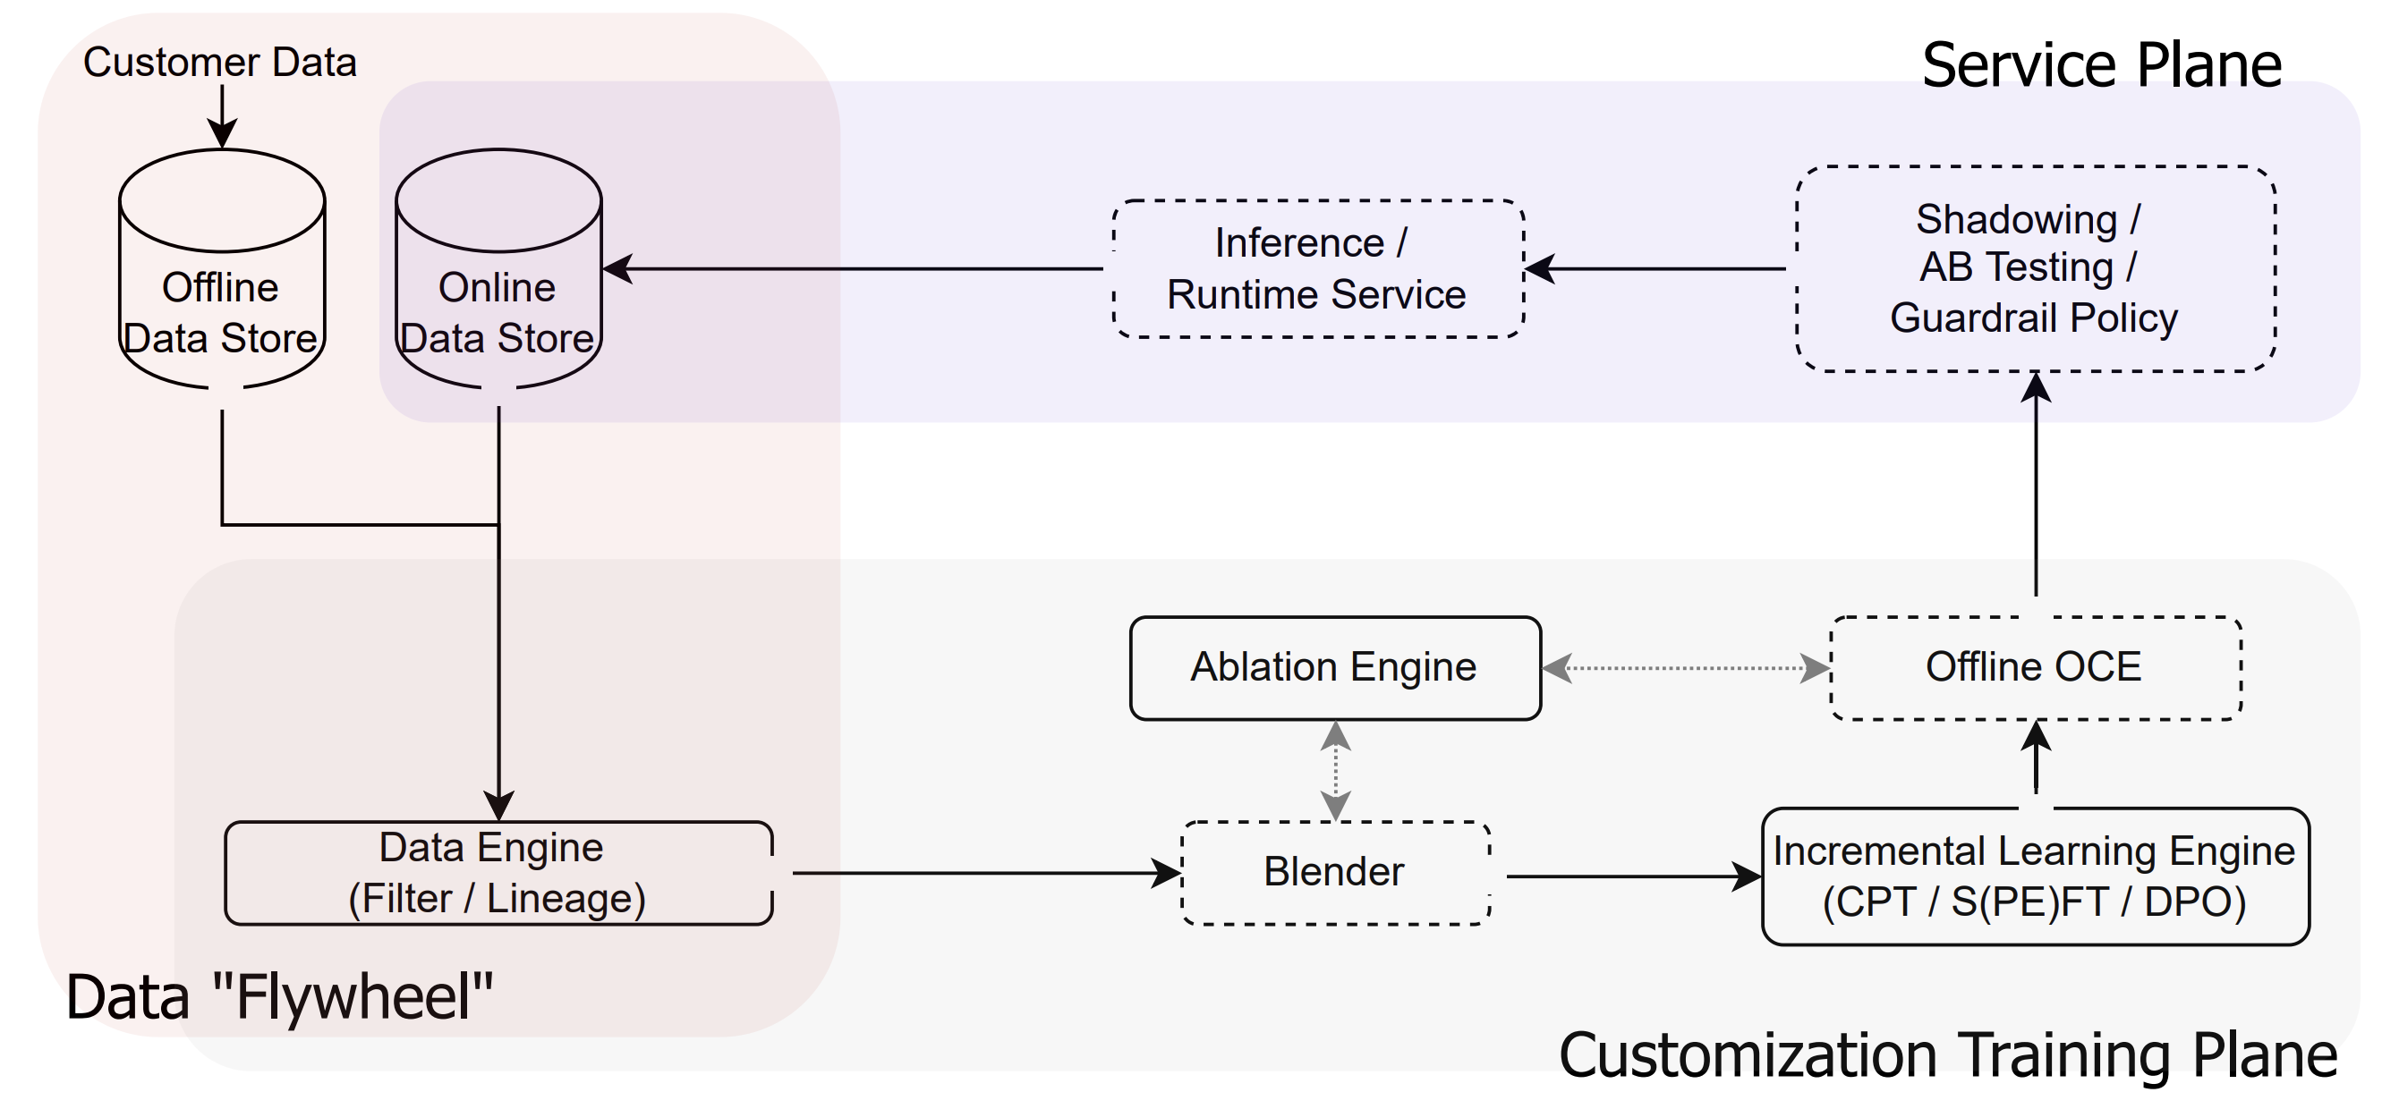
Notes:
https://app.diagrams.net/#G13Ad98_Q08-JE7gj6X_G9bd-xdXLHszHt#%7B%22pageId%22%3A%22qvh4TntDw6zh0ArF_9IW%22%7D

Slide 2
Customer Data
Service Plane
Shadowing/
AB Testing/
Guardrail Policy
Offline
Data Store
Online
Data Store
Inference/
Runtime Service
Core Training Stack (UM/
OmegaT/Nemo/Megatron-LM/...)
Ablation Engine
Offline OCE
Data Engine
(Filter/Lineage)
Blender
Incremental Learning Engine
(CPT/SFT/DPO)
Data Flywheel
Cust. Training Execution Plane

Slide 3
Customer Data
Service Plane
Shadowing/
AB Testing/
Guardrail Policy
Offline
Data Store
Online
Data Store
Inference/
Runtime Service
Core Training Stack (UM/
OmegaT/Nemo/Megatron-LM/...)
Ablation Engine
Offline OCE
Data Engine
(Filter/Lineage)
Blender
Incremental Learning Engine
(CPT/SFT/DPO)
Data Flywheel
Cust. Training Execution Plane

Slide 4
