Slide 1
Sparse Augmented Tensor Networks (Saten) for Language Models
Ryan Solgi
Department of Electrical and Computer Engineering

Slide 2
Background and Motivation
Previous works reduced parameters required for fine-tuning of LLMs.
Post fine-tuning compression using low-rank tensorization has not been successfully reported.
Challenges:
1- Pre-trained parameters may not exhibit a low-rank structure.
2- Lack of access to pre-trained data to fully retrain low-rank parameters.
We study how to tensorize fine-tuned models without significant accuracy loss.
Notes:
here are ongoing efforts to improve the efficiency of fine-tuning large language models (e.g., LoRa, LoRETTA).
Despite reducing the number of parameters for fine-tuning, the inference computational cost remains high.
Previous works have utilized matrix factorization to reduce the memory requirements of language models’ inference.
Although there are studies applying low-rank tensorized training (e.g., CoMERA), applications of low-rank tensor decomposition for fine-tuning have been less studied.
When an LLM is pre-trained via a standard method, the model itself may not have a low-rank structure, and directly compressing the pre-trained model for fine-tuning can result in a significant loss of accuracy.

Slide 3
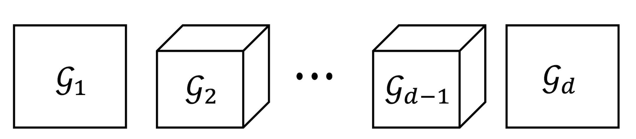
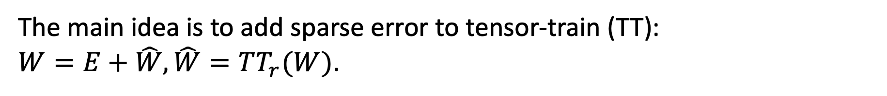
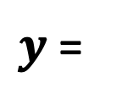
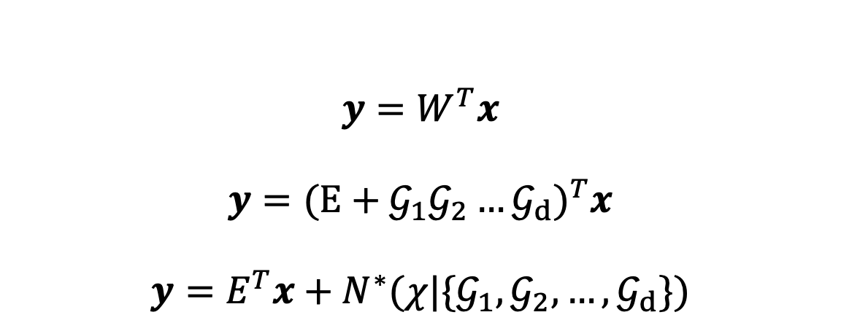




Method
The main idea is to add sparse error to tensor-train (TT):
$W=E+\hat{W},\hat{W}=TT_{r}(W)$.
$$y=W^{T}x$$
$$y={(E+𝒢_{1}𝒢_{2}…𝒢_{d})}^{T}x$$
$$y=E^{T}x+N^{∗}(χ|\{𝒢_{1},𝒢_{2},…,𝒢_{d}\})$$
$y$ =
$$E$$
$$+$$
$$χ$$
$$x^{T}$$

Slide 4
Experiment
DistilBERT for SST-2 Data set.
Attention, FFN and Pre-Classifier were tensorized via Saten
The word embedding was compressed using the TT only.
The positional embedding layer, Queries and Keys, and the last classifier were not tensorized.

Slide 5
Results
Comparing the base, Saten, Low Rank Tensorized (LRT) (this study), and recent papers for Distilled-Bert for SST-2
Model | Accuracy (%) | #Parameters (M) | #MACs (M) | #Parameters* (M)
Base | 91.2 | 67 | 43 | 67
Saten | 90.7 | 34.5 | 25.1 | 34.5+2(4.4)=43.3
LRT | 85.8 | 44.3 | 35.5 | 44.3
Hsu et al. (2022) | 89.0 | 46.7 | - | -
Gao et al. (2024) | 90.0 | 44.9 | - | -
#Parameters* accounts for extra memory required for sparsity in implementation.
Memory distribution among different components of Saten
Total #Parameters | Low Rank | Sparse | Embedding | Uncompressed
34.5M | 11M (Not including Embedding) | 4.4M | 12.2 (11+0.8+0.4) | 7M

Slide 6
Results
Comparing Saten for different sparsity budgets.
Model | Accuracy (%) | #Parameters (M) | #MACs (M) | #Parameters* (M)
Saten | 90.7 | 34.5 | 25.1 | 34.5+2(4.4)=43.3
Saten-II | 89.1 | 32.5 | 23.2 | 32.5+2(2.5)=37.5
Saten and Saten-II both share the same low-rank structure, but Saten-II has fewer sparse parameters.
Sparsity pattern across different layers for Saten (values outside parentheses) and Saten-II (values inside parentheses).
Layer (#) | Dimension Size | Average (%) | Min (%) | Max (%)
FFN (12) | 3072*768 | 88 (93) | 85 (91) | 92 (96)
Atten-Out (6) | 768*768 | 90 (94) | 85 (92) | 94 (97)
Atten-V (6) | 768*768 | 88 (93) | 82 (90) | 94 (97)
Atten-K (6) | 768*768 | - | - | -
Atten-Q (6) | 768*768 | - | - | -

Slide 7
Inference Performance (In Progress)
Intel Core i7 9th Gen
Model | CPU Inference (it/s) using Torch
Base | ~6
Saten (only low rank) | ~8.3
The available packages (e.g., torch.sparse and pytorch-sparse) for sparsity are not compatible with Hugging Face accelerator.
We need to do optimization for sparsity as well as CPU and GPU implementation.
Model | CPU Inference (it/s) using Torch
Base | ~6 it/sec
Saten with sparsity | ~20 sec/it
Notes:
I defined sparse layers using torch.sparse and another package, pytorch-sparse, which optimizes autograd for sparsity. However, neither of these packages seems to be optimized for use with the Hugging Face accelerator, causing the network to slow down drastically on both CPU and GPU, regardless of the sparsity level. When I integrate them into my Hugging Face code, the system almost halts (12-20 seconds per iteration compared to the base model's 5-6 iterations per second), with additional dependency issues between Hugging Face and pytorch-sparse. As a result, the available packages for sparsity do not appear to be helpful, and I need to find an alternative solution.

Slide 8
Future works
Studying alternative way to handle sparsity for Inference.
Application for other networks.
Notes:
Long-term:
Adopting manifold optimization for low-rank factors while utilizing architecture search for sparsity and rank optimization.
Adopting low-precision and zeroth-order optimization.
Application for pre-training.

Slide 9
References
Hsu et al. ”Language model compression with weighted low-rank factorization.” arXiv:2207.00112v1, 2022.
Gao et al. “Adaptive rank selections for low-rank approximation of language models.” Association for Computational Linguistics, 2024

