Slide 1
4-bit Weight-Only Quantization & Beyond
AHS Workshop 02/14/2024

Slide 2
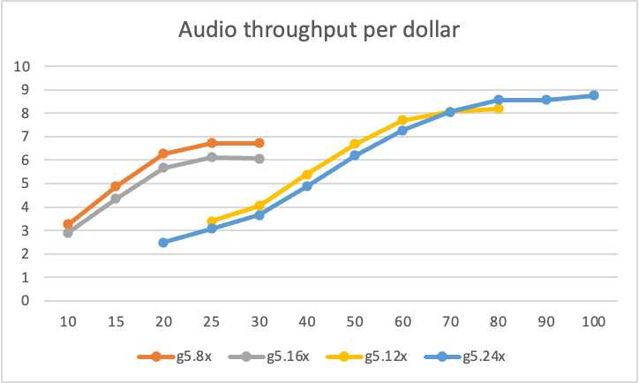
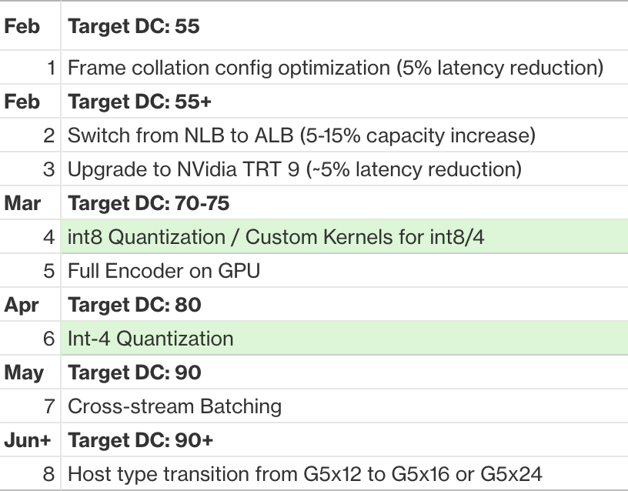
Towards cost-parity
100M -> 1B -> 2B -> …

Slide 3
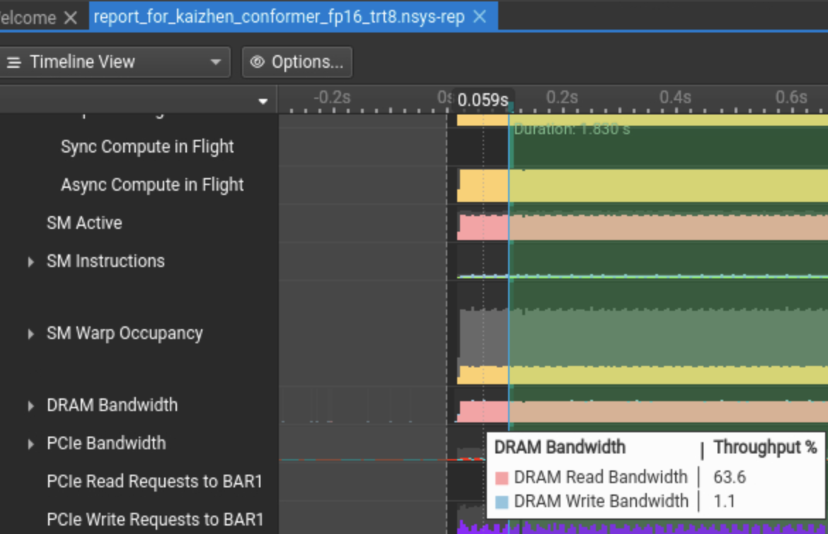
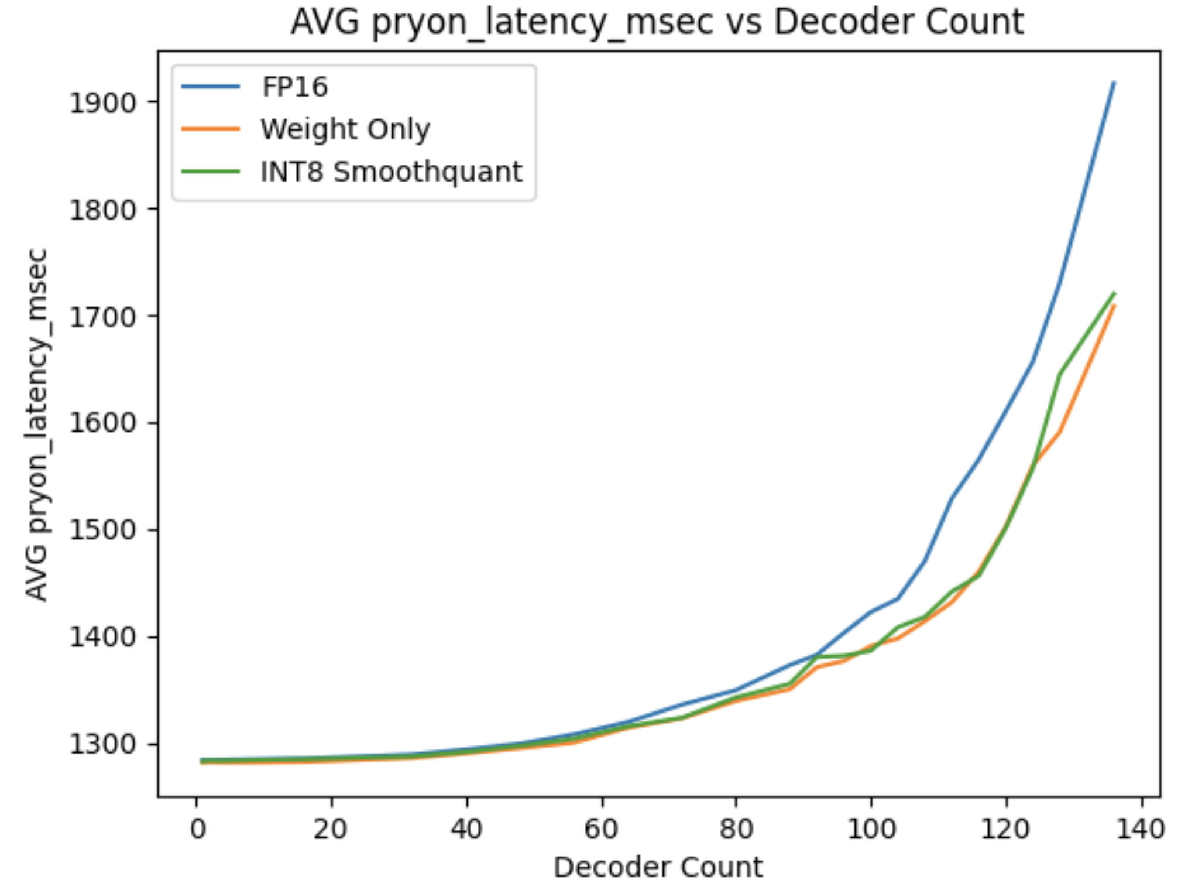
Memory bound v.s. compute bound

Slide 4
Some takeaways
Large ASR is currently CPU-bound. Compressing models won’t push the needle much at this time.
Move FFR-Enc and Decoder to GPU
Shift towards new GPU instances
Large Conformer is memory-bound. Activation quantization won’t help much.
Going from 4-bit to 2-bit, it may be compute-bound.

