Slide 1
4-bit Weight-Only Quantization & Beyond
AHS Workshop 02/14/2024

Slide 2
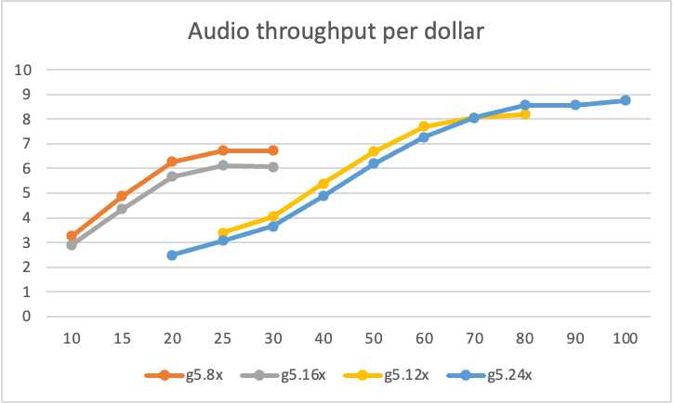
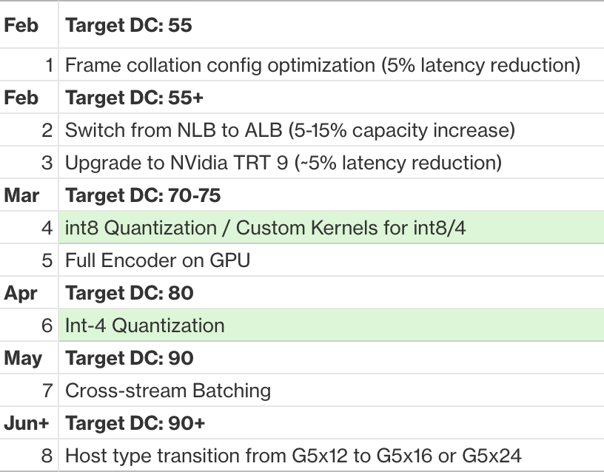
Towards cost-parity for large ASR
100M -> 1B -> 2B -> …

Slide 3
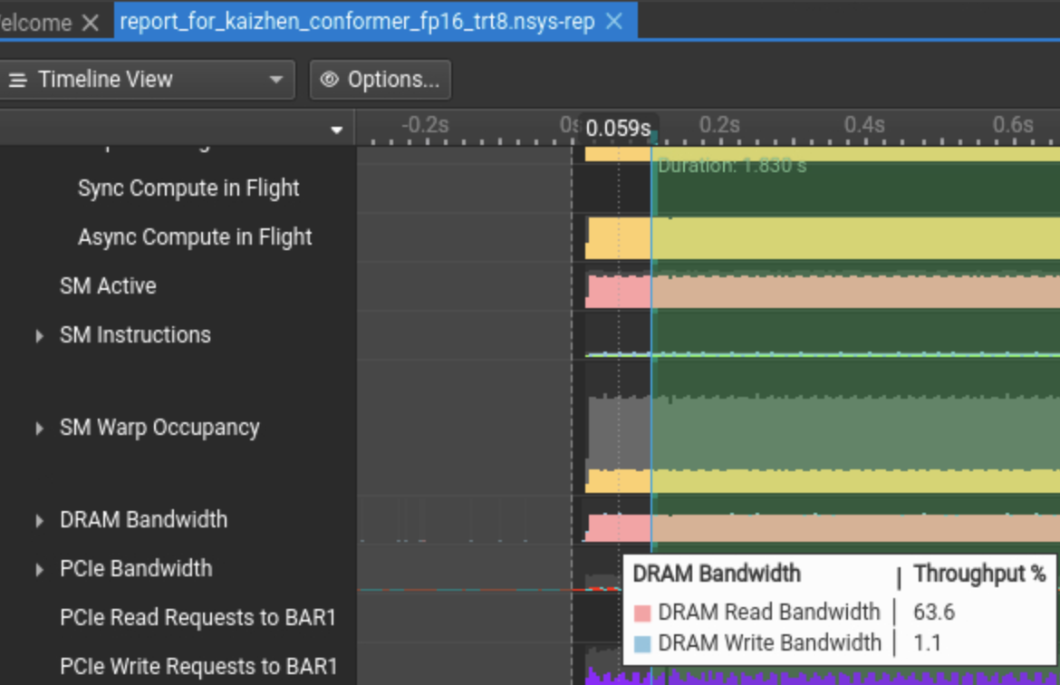
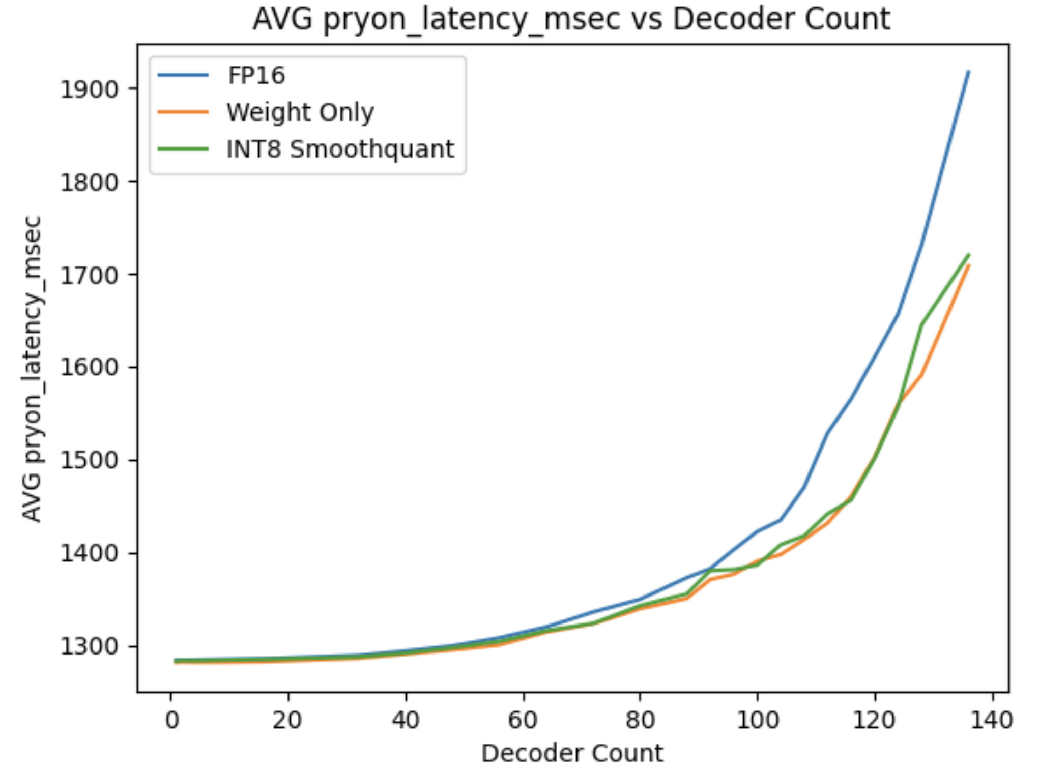
Memory bound v.s. compute bound

Slide 4
Some pre-mature takeaways
Large ASR is currently CPU-bound. Compressing models won’t push the needle much at this time.
Move FFR-Enc and Decoder to GPU
Shift towards new GPU instances
Large Conformer is memory-bound. Activation quantization won’t help much.
Going from 4-bit to 2-bit, it may be compute-bound.

Slide 5
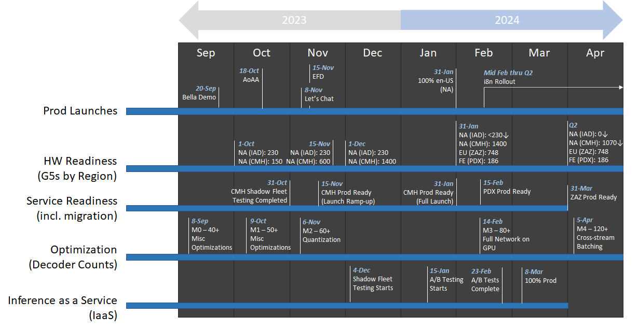
Towards cost-parity
100M -> 1B -> 2B -> 7B -> …

Slide 6
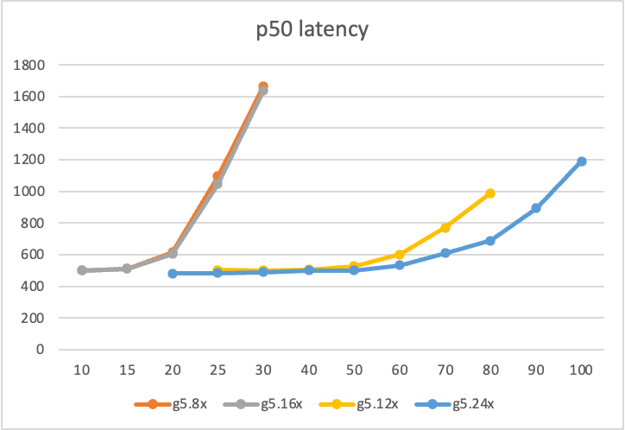
Towards cost-parity
100M -> 1B -> 2B -> 7B -> …

Slide 7
Towards cost-parity
100M -> 1B -> 2B -> 7B -> …

Slide 8
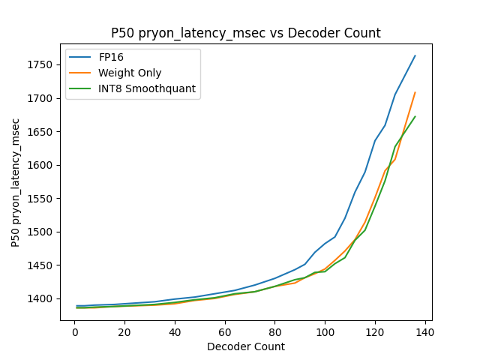
CPU bound

Slide 9
Why’s 4-bit WoQ important?
Solve the encoder bound issue -> more decoder count -> higher throughput
Without sacrificing latency as much

Slide 10
Neural efficiency tools
Structures
Scheduler
Compression utilities
Hyperparameter configs
Readiness
Phasa
PyRama

Slide 11
Neural efficiency tools
Structures
Scheduler
Compression utilities
Hyperparameter configs
Readiness
Phasa
PyRama

Slide 12
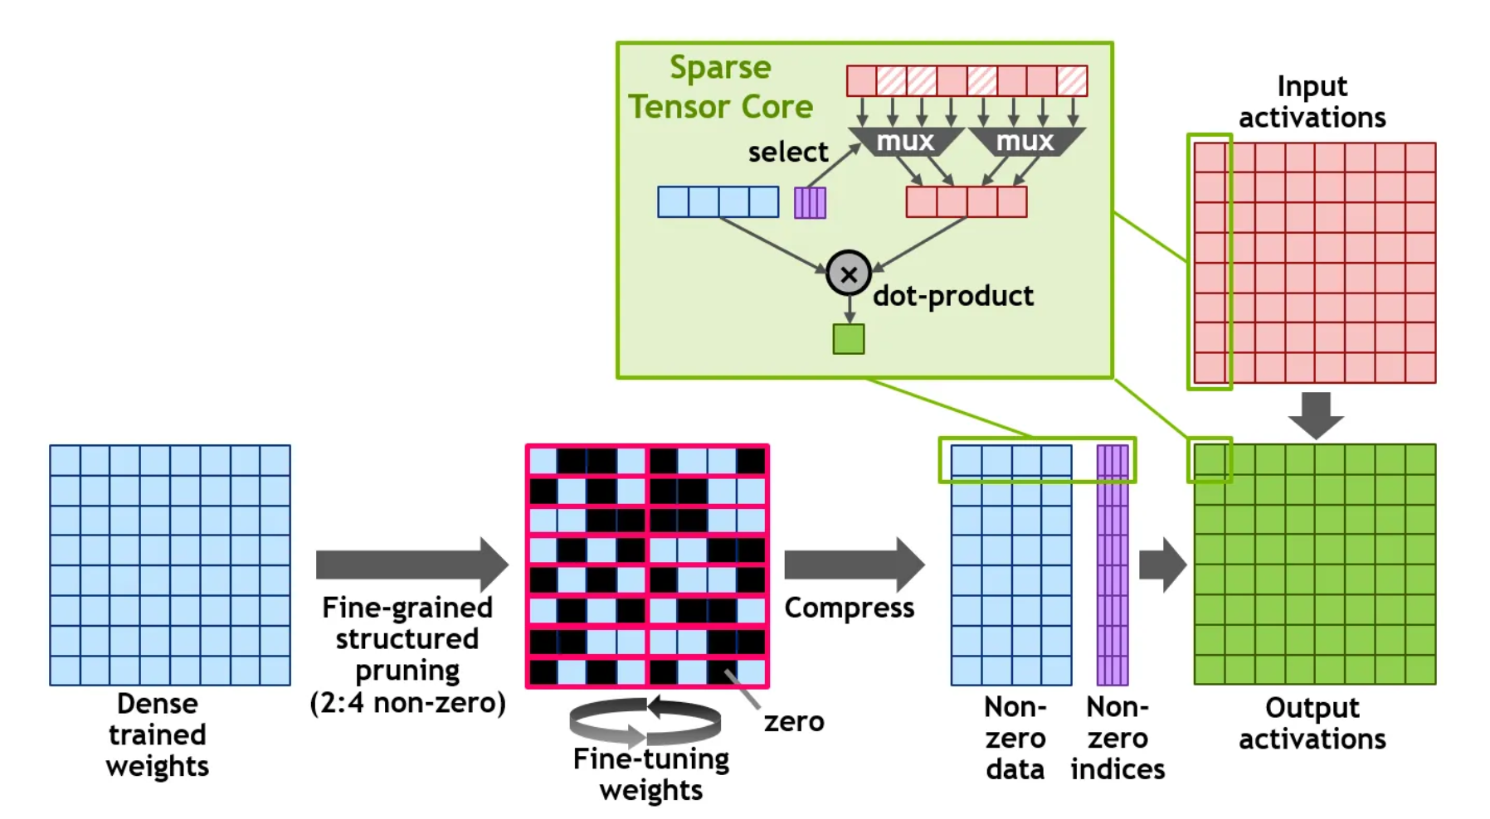

Slide 13
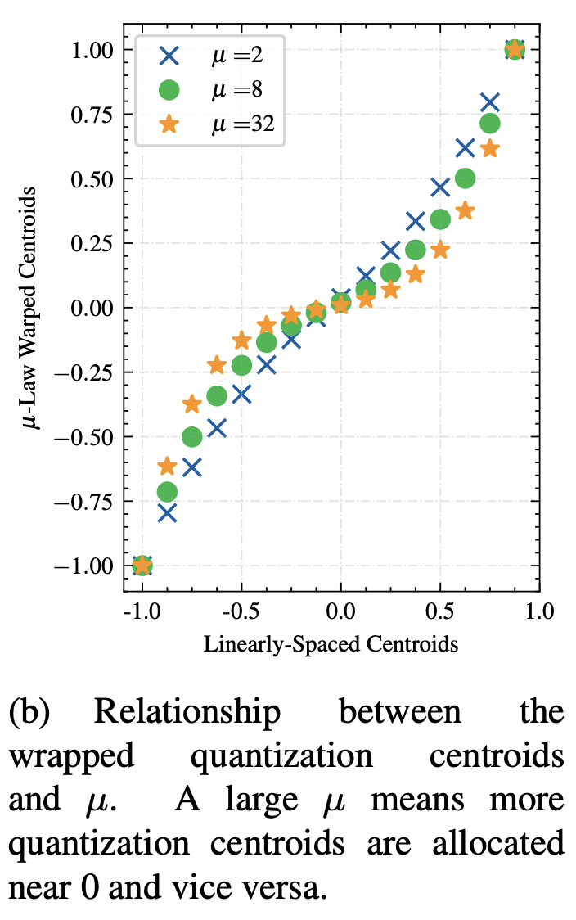

Slide 14
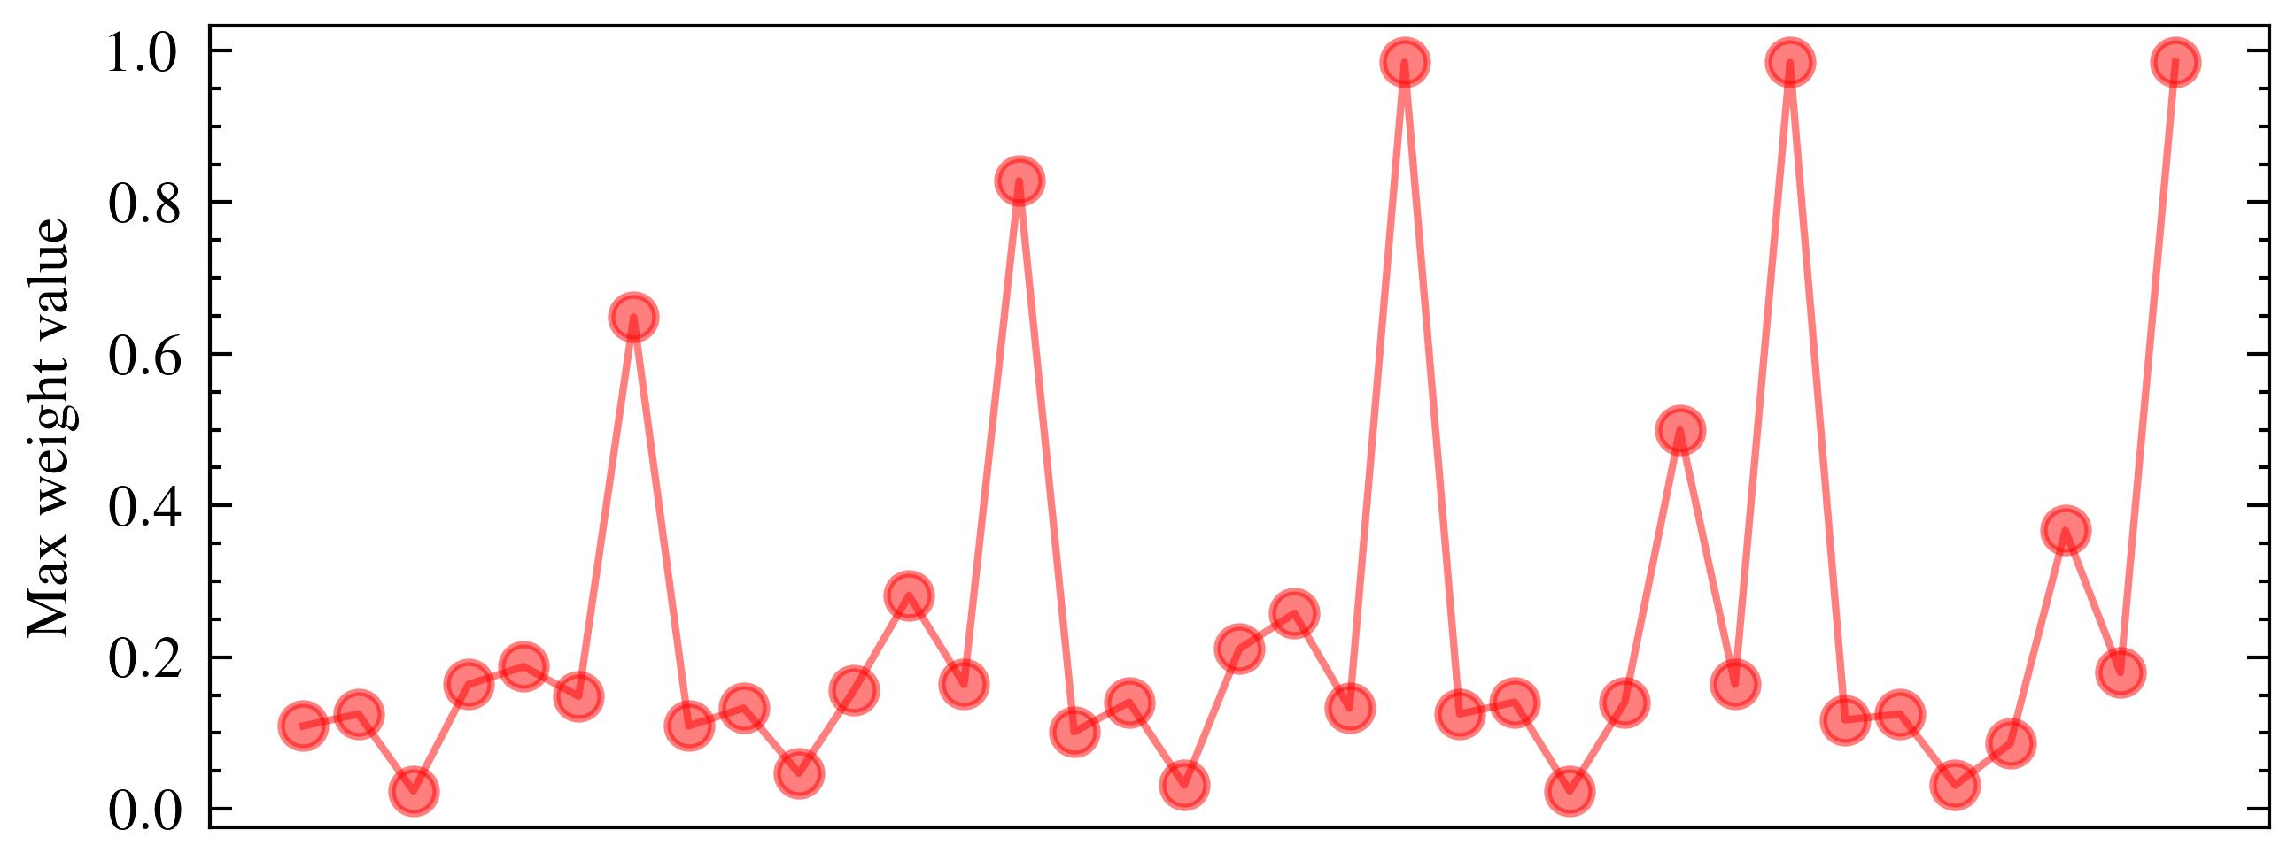
Block-1
Block-2
Block-3
Block-4
Block-5
MHA Kernels
FF Kernels
MHA Kernels
FF Kernels
MHA Kernels
FF Kernels
MHA Kernels
FF Kernels
MHA Kernels
FF Kernels

Slide 16
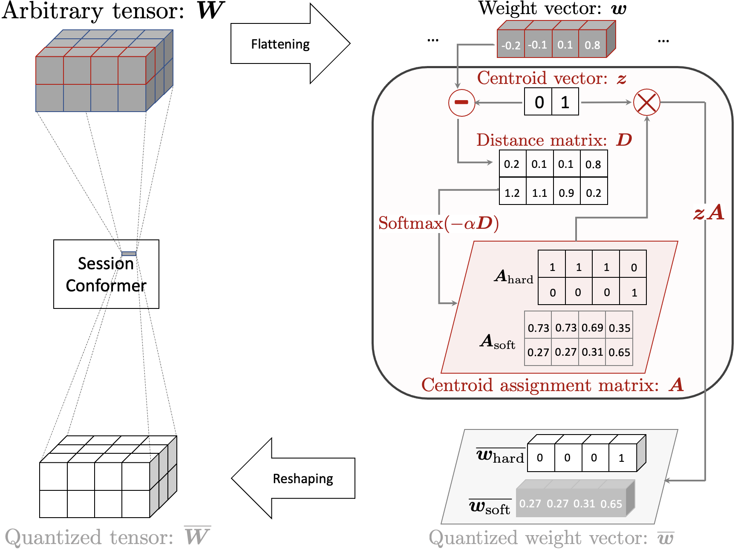
Stage-I Conformer
Session Conformer
WoQ
Neural Biasing Conformer

Slide 17
Stage-I Conformer
Session Conformer
WoQ
Neural Biasing Conformer
Stage-I Conformer
Session Conformer
Neural Biasing Conformer
WoQ

Slide 18
Weight histogram in FP16 format
Non-uniform 4-bit quantized weight histogram

Slide 19
Flattening
…
…
-0.2
-0.1
0.1
0.8
-
0
1
0.2
0.1
0.1
0.8
1.2
1.1
0.9
0.2
Session Conformer
1
1
1
0
0
0
0
1
0.73
0.73
0.69
0.35
0.27
0.27
0.31
0.65
Reshaping
0
0
0
1
0.27
0.27
0.31
0.65

Slide 20
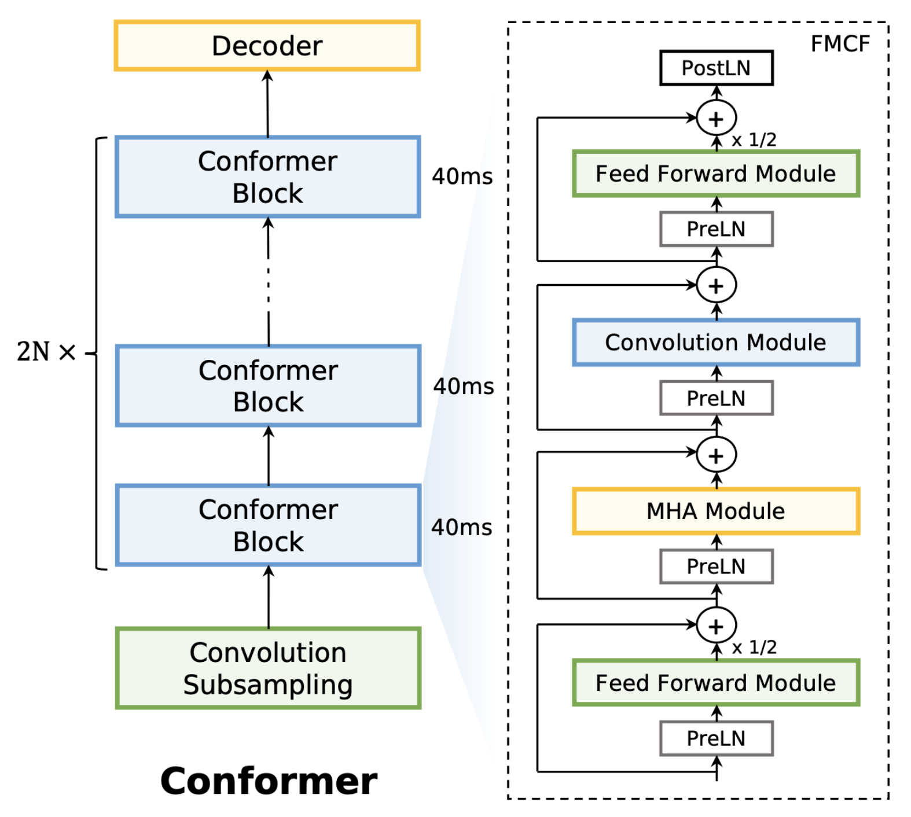
…
…
…

Slide 21
…
…
…

