Slide 1
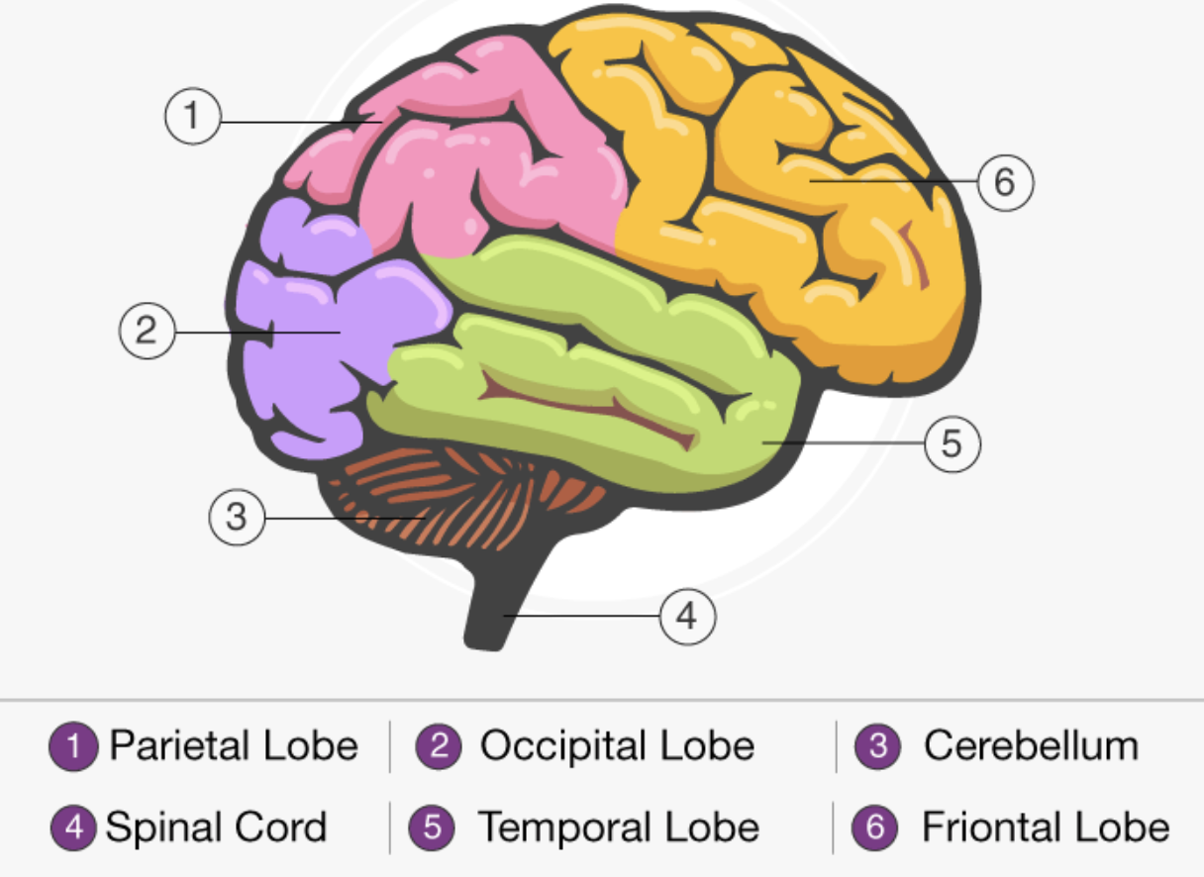

Human-like LLM
p
Gating
Module
X

Slide 2

Codebook
4_bit v1
Specialist_4_1
…
…
Codebook
m_bit vn
Specialist_m_m

