Slide 1
Strengths recognized:
- Ownership, Deliver Results, Invent and Simplify — consistently called out by manager and peers
- Learn and Be Curious, Dive Deep — strong peer recognition
- Concrete impact: LLM merging (3-7% WERR), ACL publication, Amazon Science feature, T2 prod coordination
Growth areas (what matters for next cycle):
- Manager is direct: "technical gaps in pretraining... diving deep into inner working of the system... drive complex and ambiguous problems independently"
- Manager wants you to "establish reputation as L6 expert on one or several pretraining dimensions"
- Peers flag: Think Big, Hire and Develop the Best (mentoring), expanding influence beyond team
The real message from your manager:
You transferred into scaling/pretraining and have been delivering well on coordination and execution. But to be seen as a strong L6 here, you need to go from "reliable executor who coordinates" to "technical expert who drives direction."

Slide 2
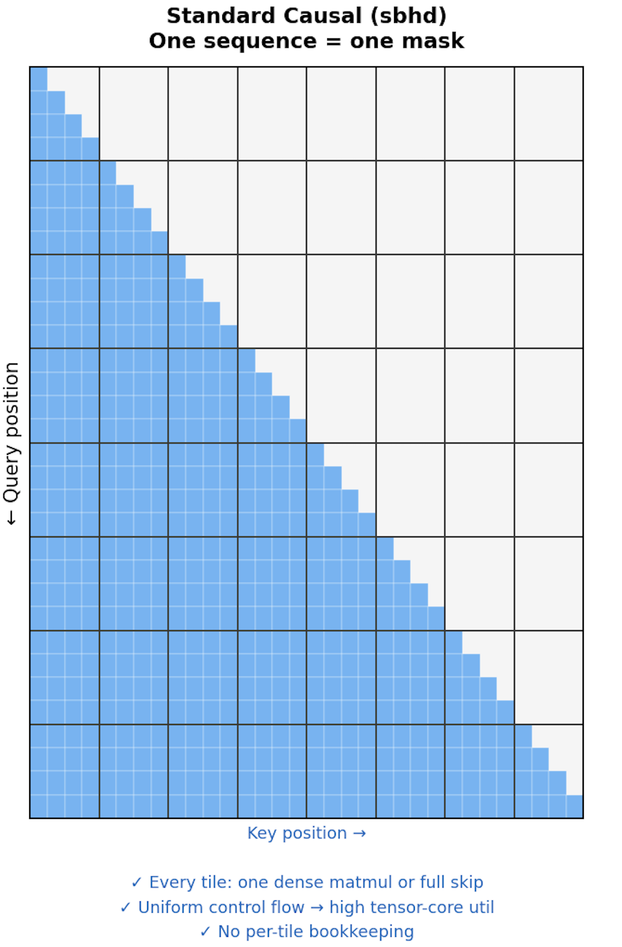
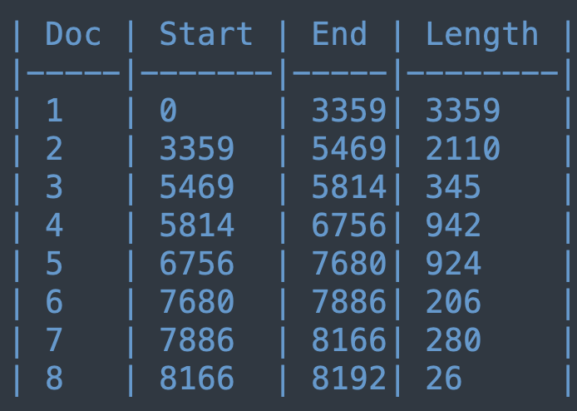
[BLOCK_MASK_DEBUG] batch=3 cu_seqlens shape=torch.Size([2, 10]), num_docs_in_seq0=8,
cu_seqlens[0]=[0, 3359, 5469, 5814, 6756, 7680, 7886, 8166, 8192, -1]

Slide 3
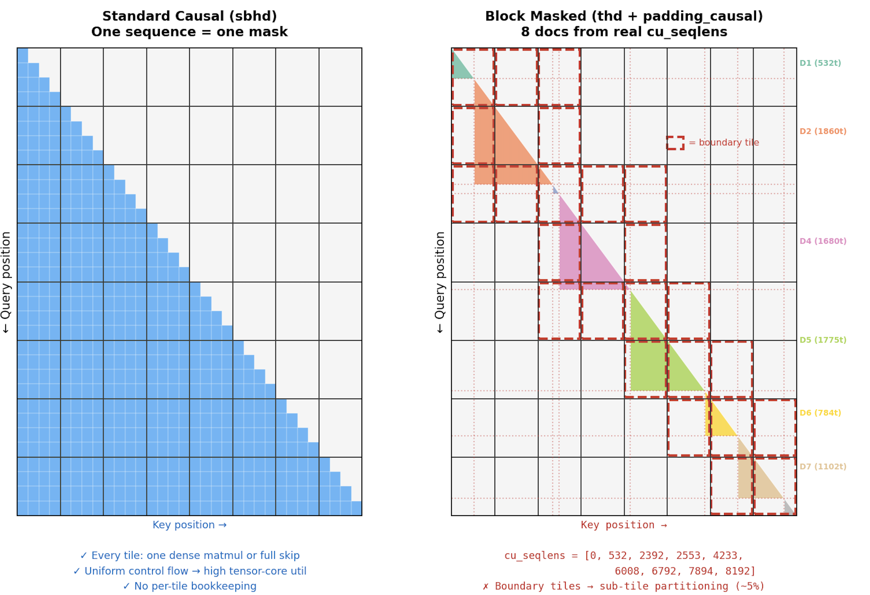

Slide 4
[BLOCK_MASK_DEBUG] batch=3 cu_seqlens shape=torch.Size([2, 10]), num_docs_in_seq0=8,
cu_seqlens[0]=[0, 3359, 5469, 5814, 6756, 7680, 7886, 8166, 8192, -1]
return PackedSeqParams( cu_seqlens_q=cu_seqlens, cu_seqlens_kv=cu_seqlens, max_seqlen_q=max_seqlen, max_seqlen_kv=max_seqlen, qkv_format="thd", # not ”sbhd" when cu_seqlens present )

Slide 5
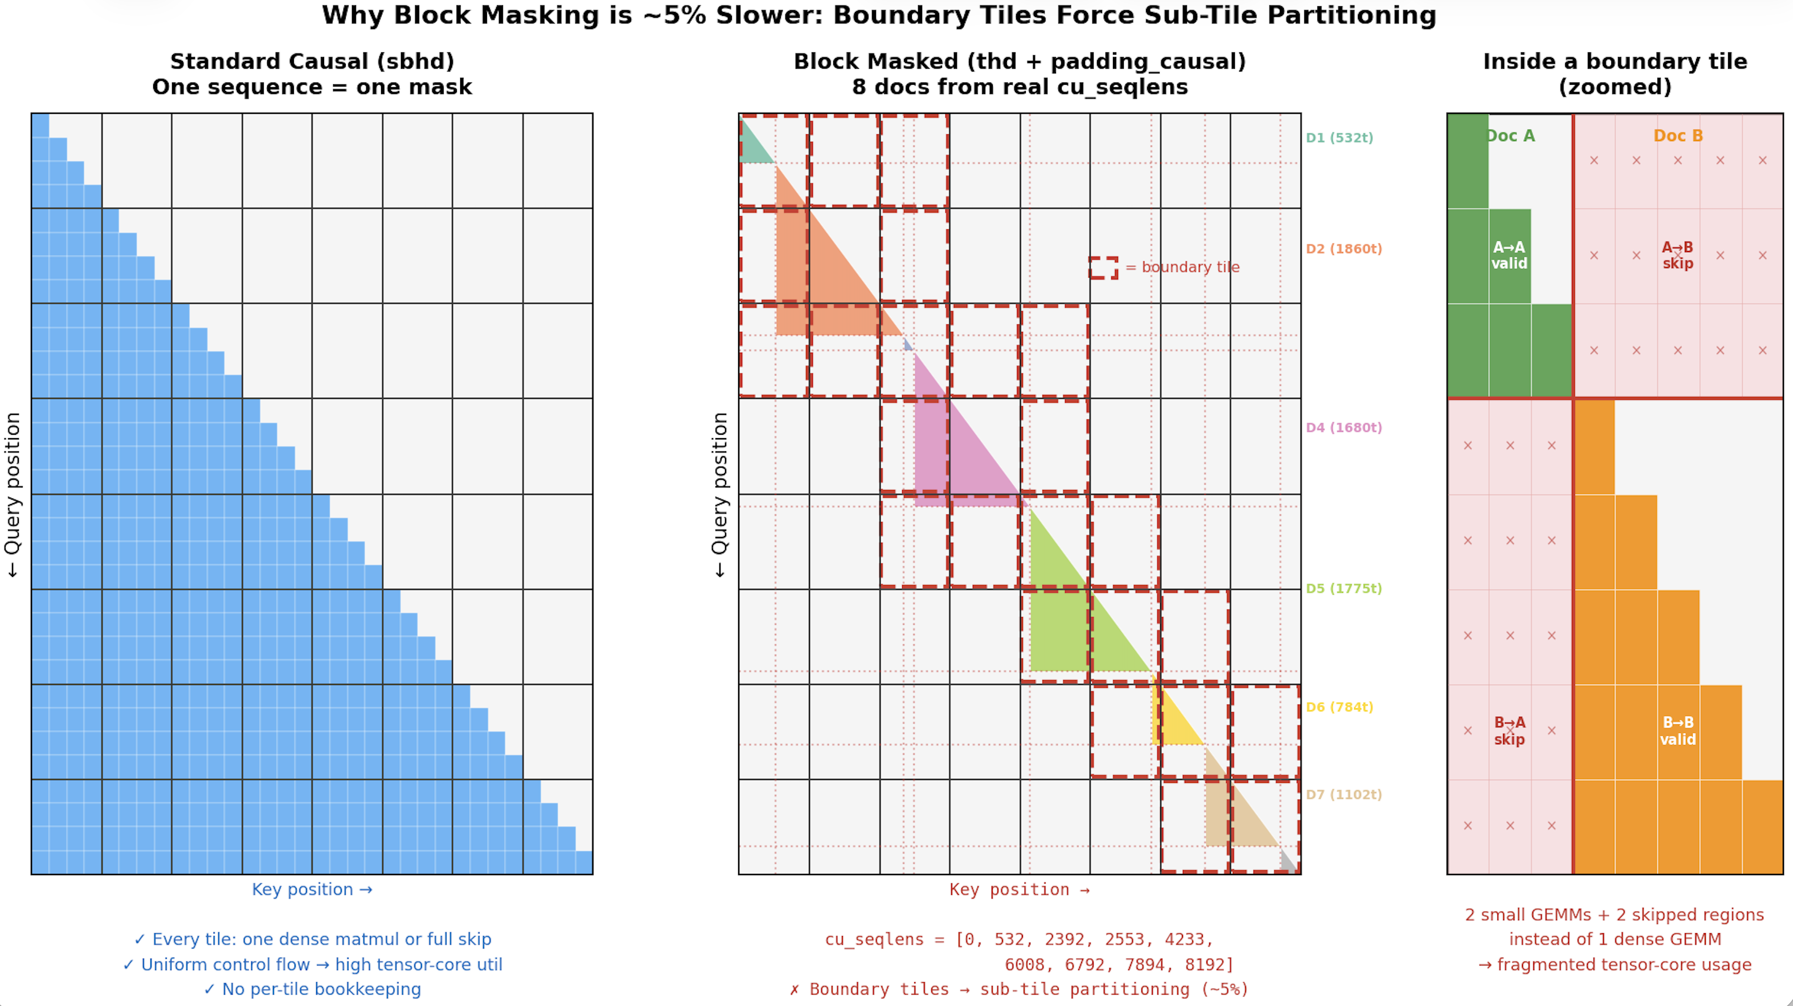

Slide 6
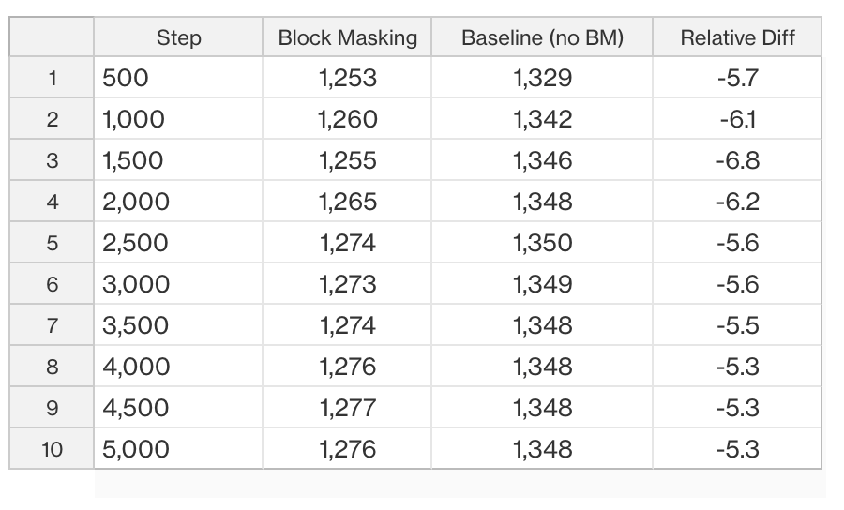
~5.4% throughput cost due to the variable-length flash attention kernel (thd + padding_causal)

Slide 7
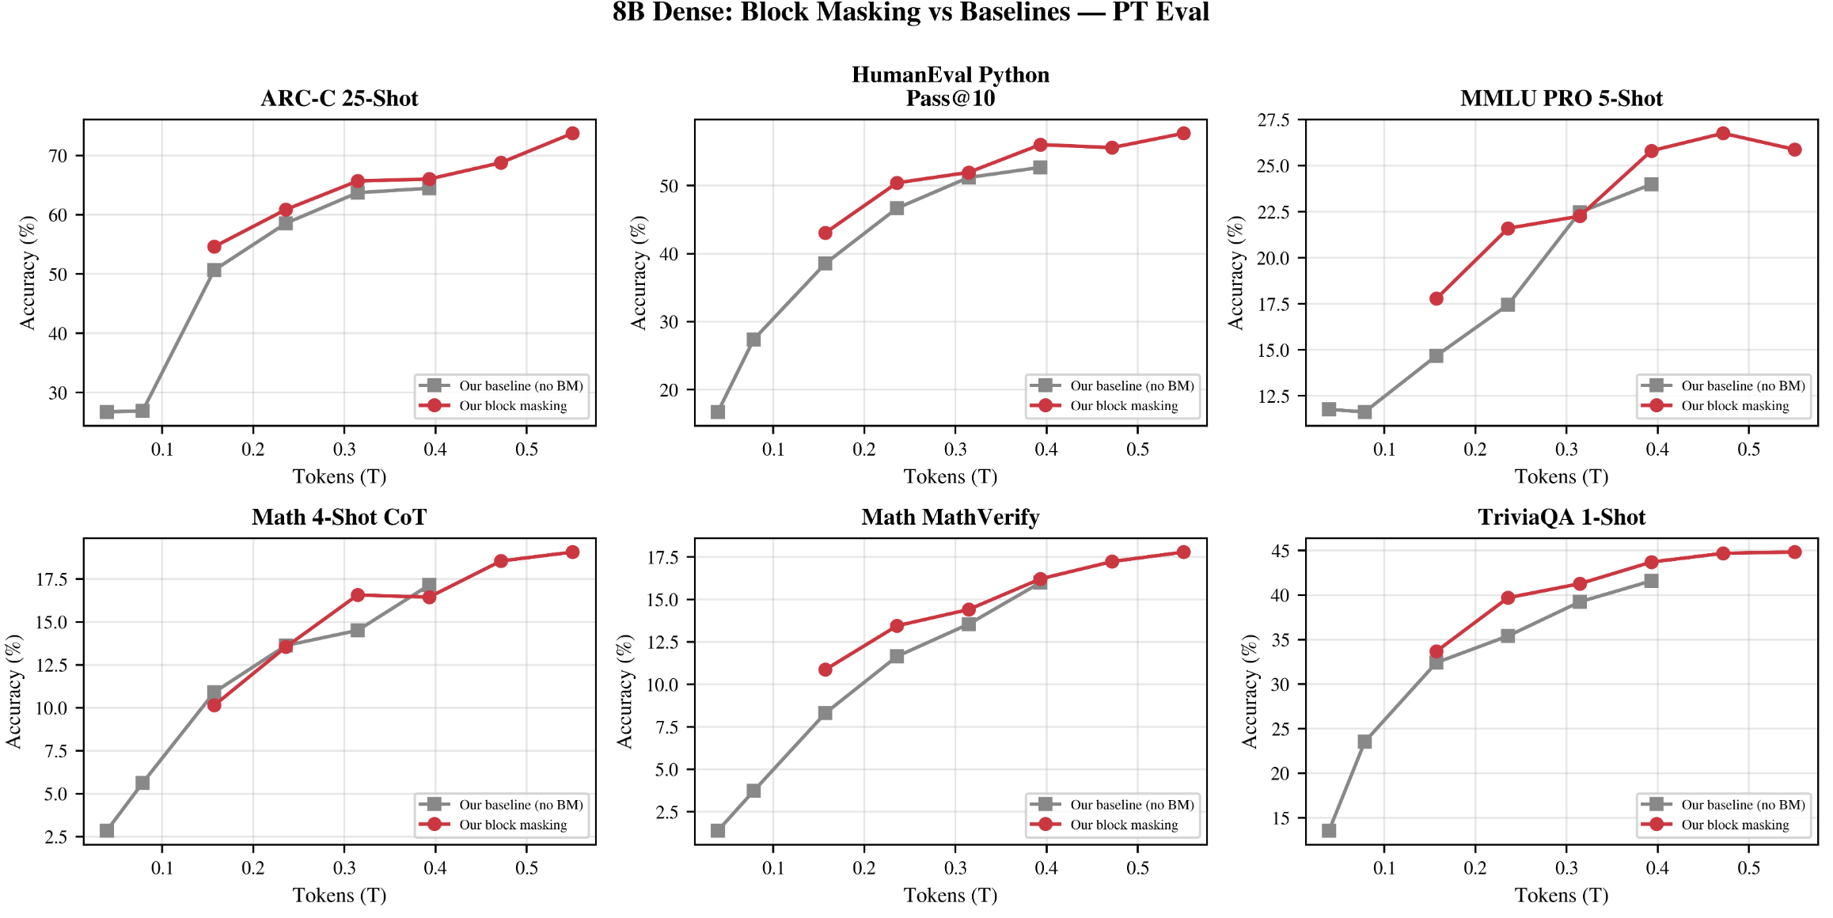
Eval still early on: no degradation so far.

