Slide 1
Neural Architecture Search for LLM
Mentor: Kai Zhen, Markus Mueller, Chayut Thanapirom
Manager: Nathan Susanj
Principal shepherd: Denis Filimonov

Slide 2
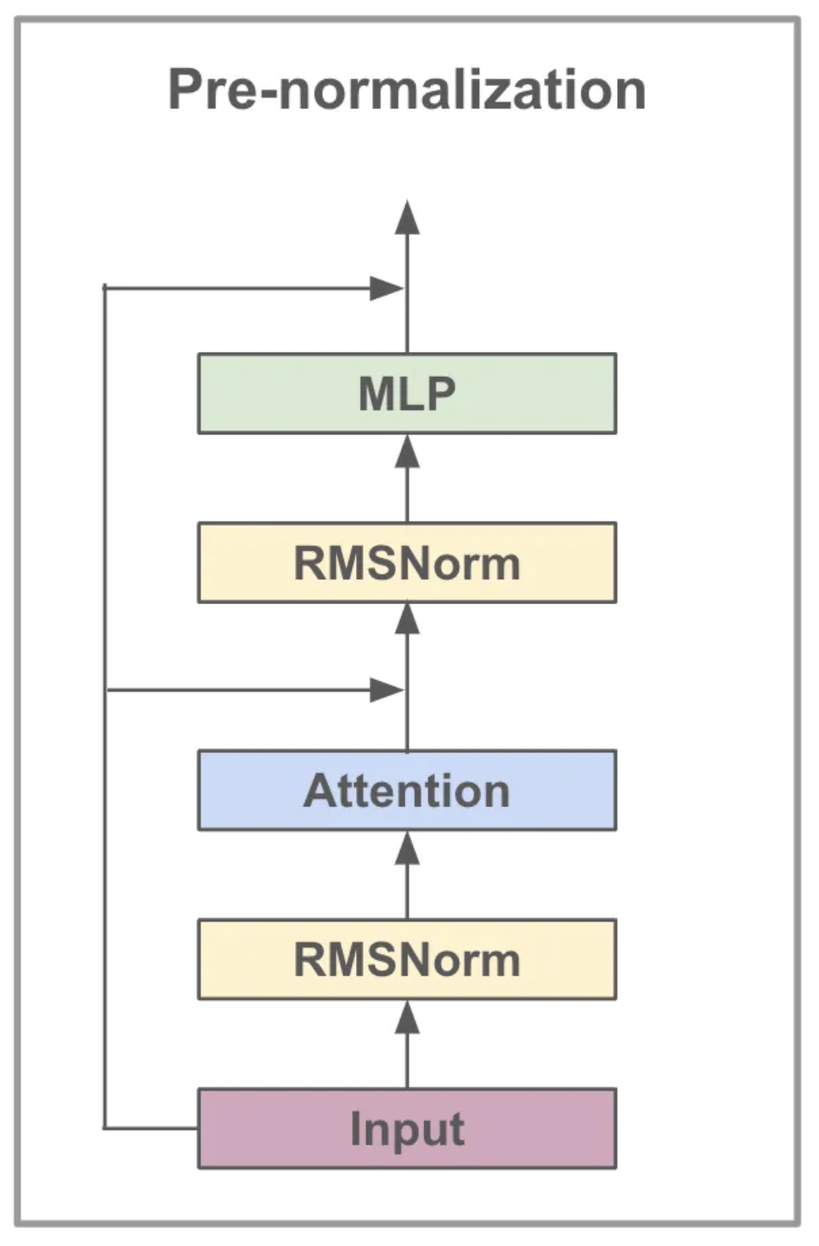
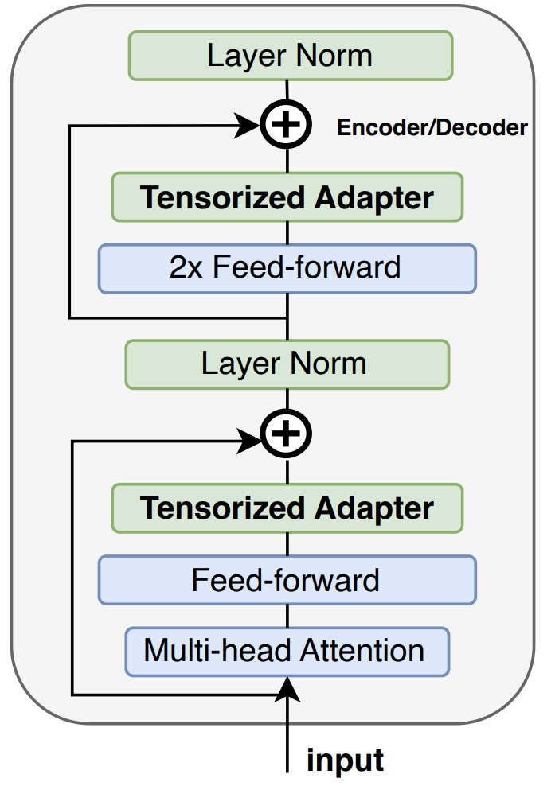

“Boring” diagram and “fun” fact
Params in feedforward modules account for 64.6% of total params in Llama 7B model.
Hidden_size = 4096
Intermediate_size = 11008
Num_blocks = 32

Slide 3
Transformer Block
for Llama
Feedforward or
MLP modules
Hidden size
Down proj
Intermediate size
Hadamard prod
Up proj
Gate proj
Intermediate size

Slide 4
MLP modules
Hidden size
Down proj
Intermediate size
Hadamard prod
Up proj
Gate proj
Intermediate size

Slide 5
Shrinking mode
Transformer Block
for Llama
Feedforward or
MLP modules
Hidden size
Down proj
Intermediate size
Hadamard prod
Up proj
Gate proj
Intermediate size

Slide 6
Shrinking mode
Transformer Block
for Llama
Feedforward or
MLP modules
Hidden size
Down proj
Intermediate size
Hadamard prod
Up proj
Gate proj
Intermediate size

Slide 7
Hidden size
Down proj
Down proj
Hidden size
Intermediate size
Intermediate size
Hadamard prod
Hadamard prod
Re-parameterization
Up proj
Gate proj
Up proj
Gate proj
Intermediate size
Intermediate size
Figure 1. A “shrinked” MLP module in Llama 2: Intermediate size is cut by half as an example, therefore accelerating the training speed.

Slide 8
Re-parameterization
Hidden size
Down proj
Down proj
Hidden size
Intermediate size
Intermediate size
Hadamard prod
Hadamard prod
Up proj
Gate proj
Up proj
Gate proj
Intermediate size
Intermediate size
Figure 1. A “shrunken” MLP module in Llama 2: Intermediate size is cut by half as an example, therefore accelerating the training speed.

Slide 9
Figure 1. A “shrinked” MLP module in Llama 2: Intermediate size is cut by half as an example, therefore accelerating the training speed.

Slide 10
MLP-S
MLP-M
MLP-L
Figure 2. Grow MLP modules as needed

Slide 11
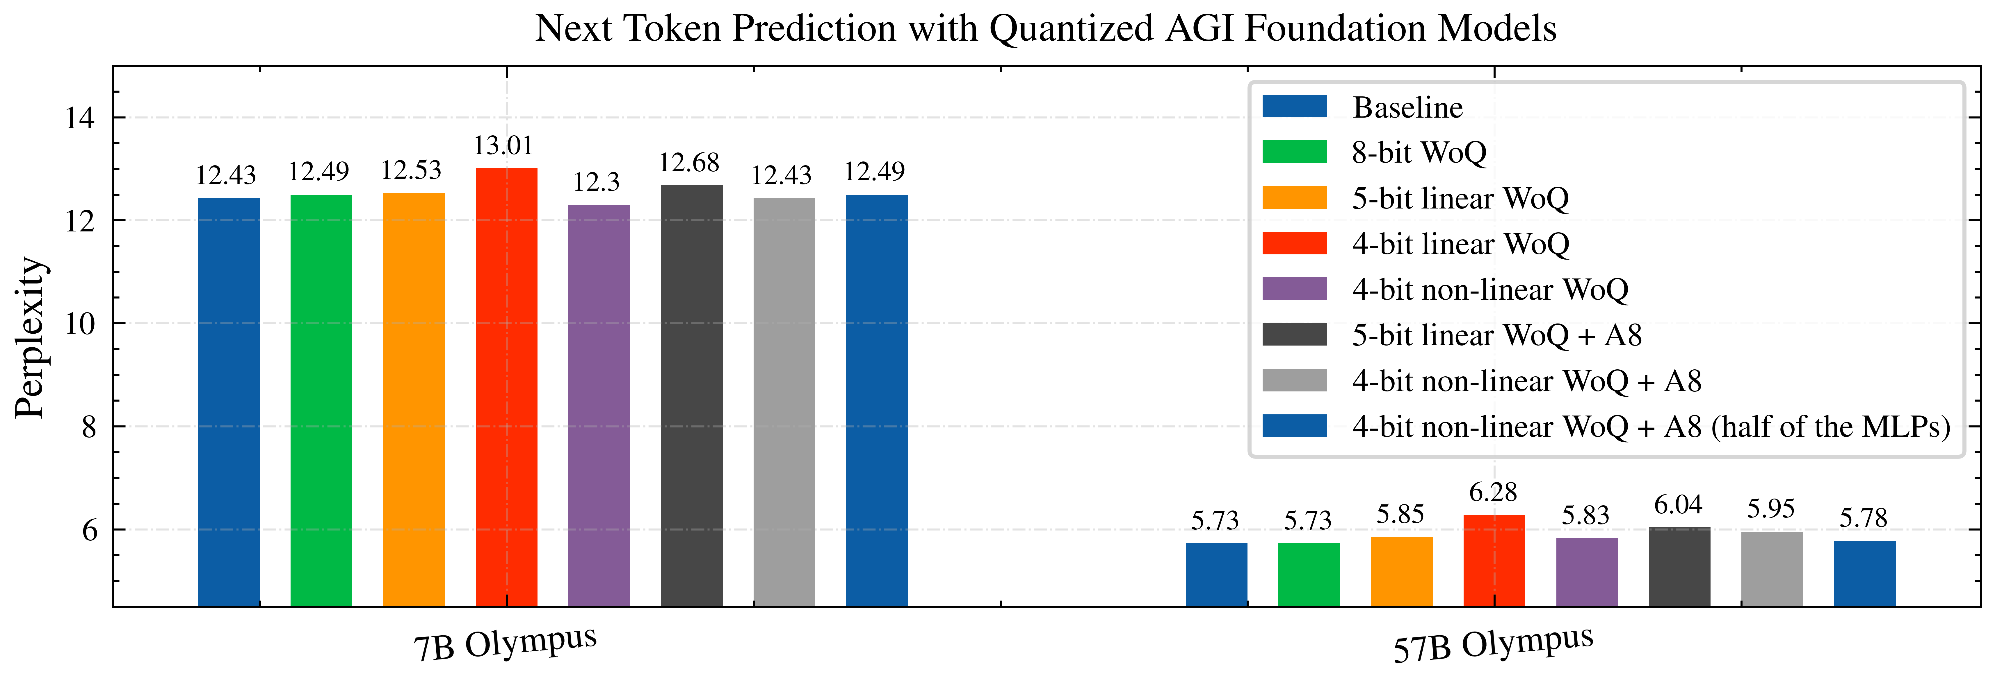

Slide 12
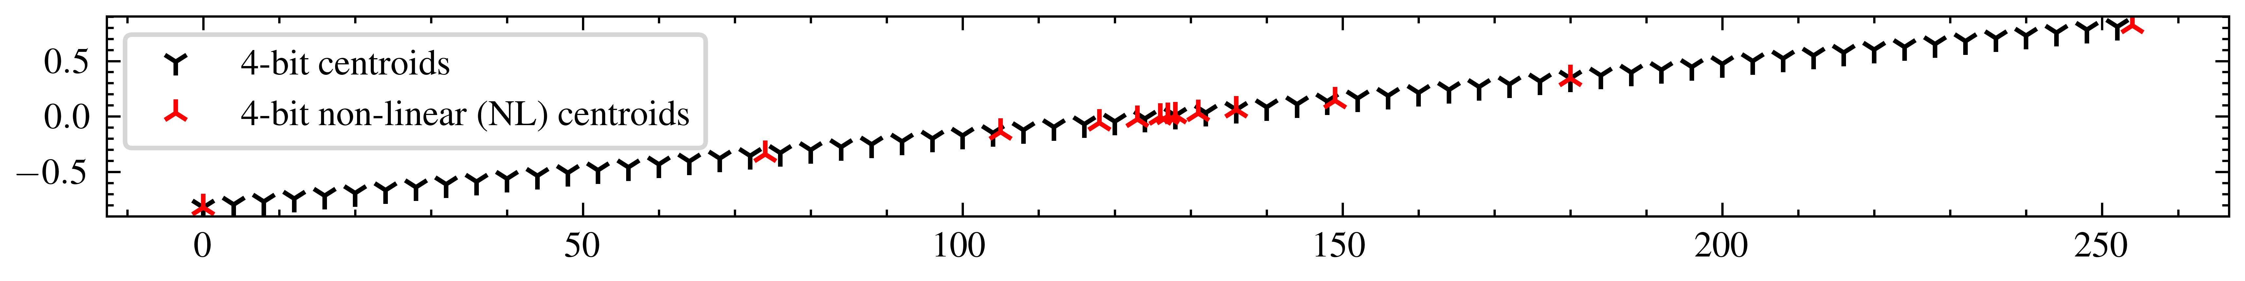
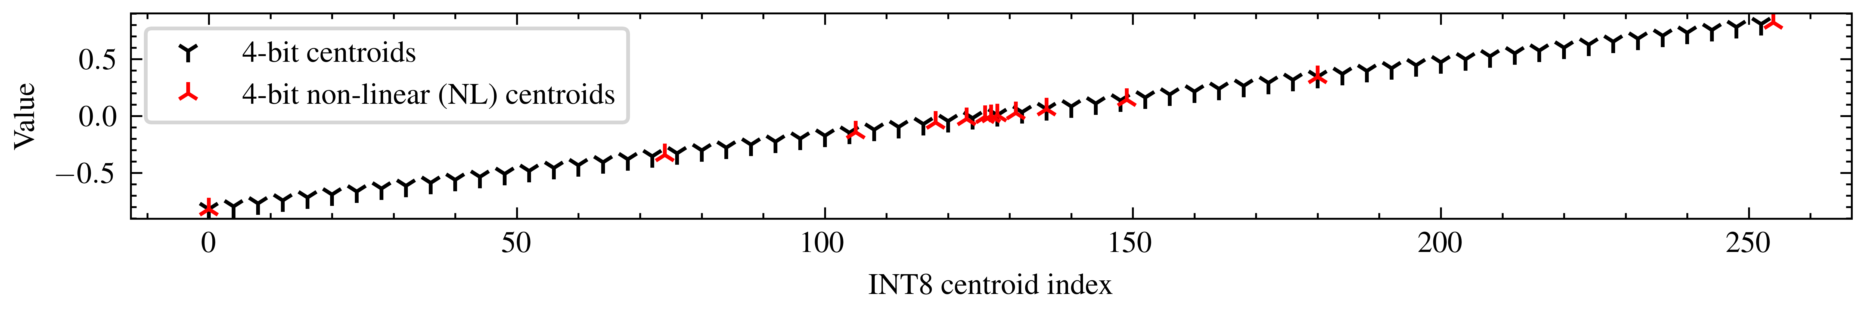
Compatible with INT8
Not Compatible with INT8

Slide 13
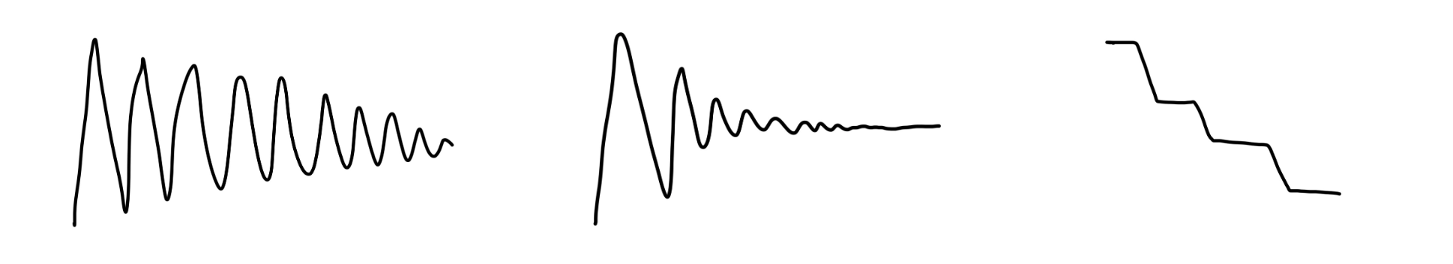
Shrink-and-grow scheduler
The scheduler determines how the model shrinks and grows.
Different schedules can be implemented
Interval for growing
Interval for shrinking
(Exponential) decay of the growing/shrinking operations
More details in the proposal

Slide 14
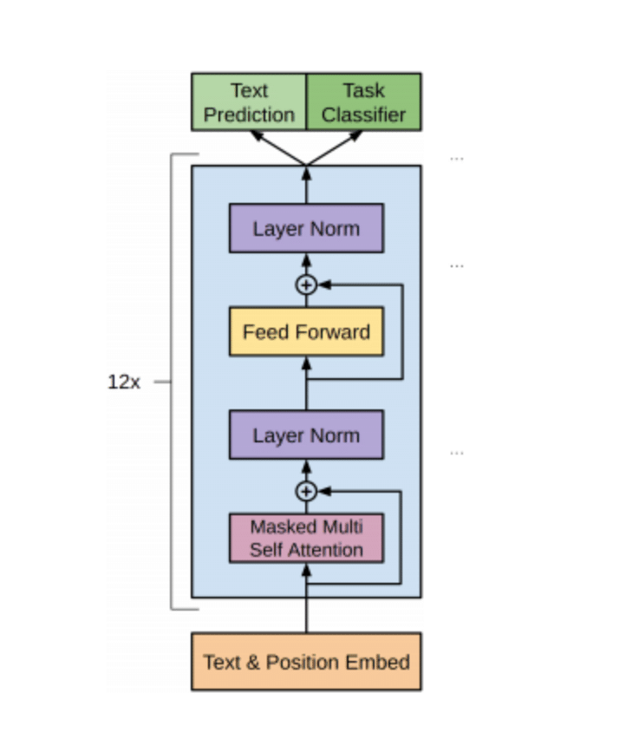
Outcome: architecture of each block is unique

Slide 15
Best case impact
Our Shrink-and-Grow (SnG) LLM fine-tuning mechanism can lead to significant savings in training costs.
With NAS applied to feedforward modules, which account for approximately 70% of the total model parameters, we are able to reduce the number of parameters in feedforward modules by 15-20% without degrading the model's performance.

Slide 16
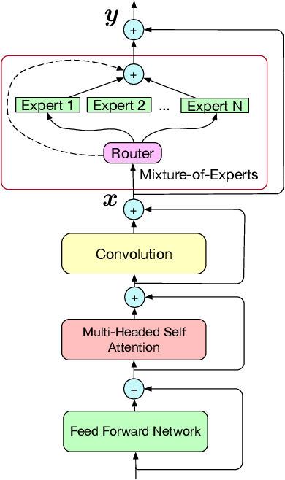
Extending NAS to mixed of experts
Runtime
Training time
Router

