Slide 1
Hardware Acceleration via Sparsity
“Hardware specific”
Accelerating column-wise / tile-wise sparse Conformer on CPU (need NeMoRT support)
Accelerating 2:4 sparse RescoreBERT/Conformer on GPU
Sparsity Pattern
Hardware Type
Acoustic Model
Language Model
Column/tile sparsity
NNA
Conformer
CPU
RescoreBERT
2:4 sparsity
GPU
: Short-term plan
: Long-term plan

Slide 2
Hardware Acceleration via Sparsity
“Hardware specific”
Accelerating column-wise / tile-wise sparse Conformer on CPU (need NeMoRT support)
Accelerating 2:4 sparse RescoreBERT/Conformer on GPU
Sparsity Pattern
Hardware Type
Acoustic Model
Language Model
Column/tile sparsity
NNA
Conformer
CPU
RescoreBERT
2:4 sparsity
GPU
: Short-term plan
: Long-term plan

Slide 3
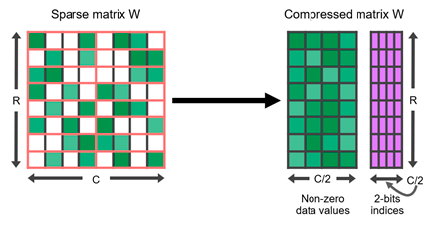


2:4 Sparsity
Put val
at pos <01>
Put val
at pos <11>

Slide 4
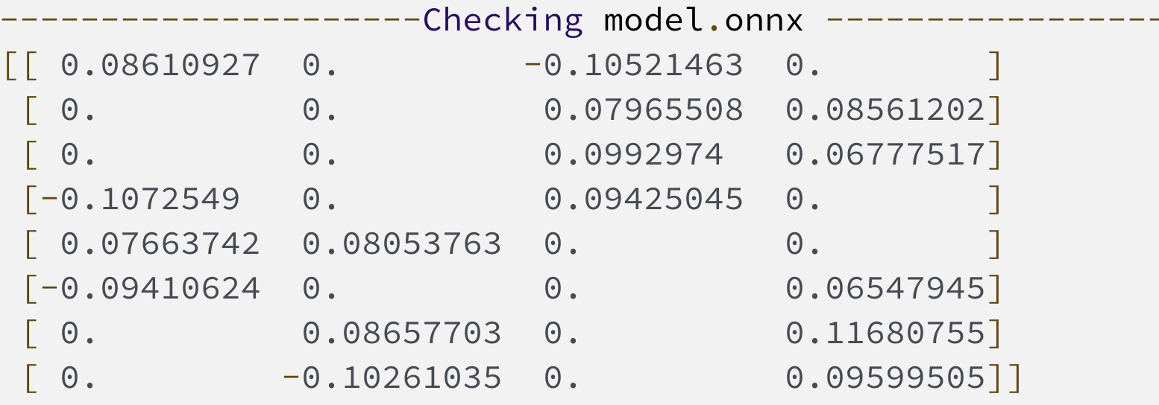
2:4 Sparse for RescoreBERT
Hosted on g5
Sparse Tensor Cores accelerate a 2:4 sparsity pattern on NVIDIA A100 GPU
Low metadata overhead
Up to 2x runtime speedup
Input Operands | Accumulator | Dense TOPS | Sparse TOPS
FP32 | FP32 | 19.5 | –
TF32 | FP32 | 156 | 312
FP16 | FP32 | 312 | 624
BF16 | FP32 | 312 | 624
FP16 | FP16 | 312 | 624
INT8 | INT32 | 624 | 1248
https://hanlab.mit.edu/files/course/slides/MIT-TinyML-Lec04-Pruning-II.pdf
https://developer.nvidia.com/blog/accelerating-inference-with-sparsity-using-ampere-and-tensorrt/

Slide 5
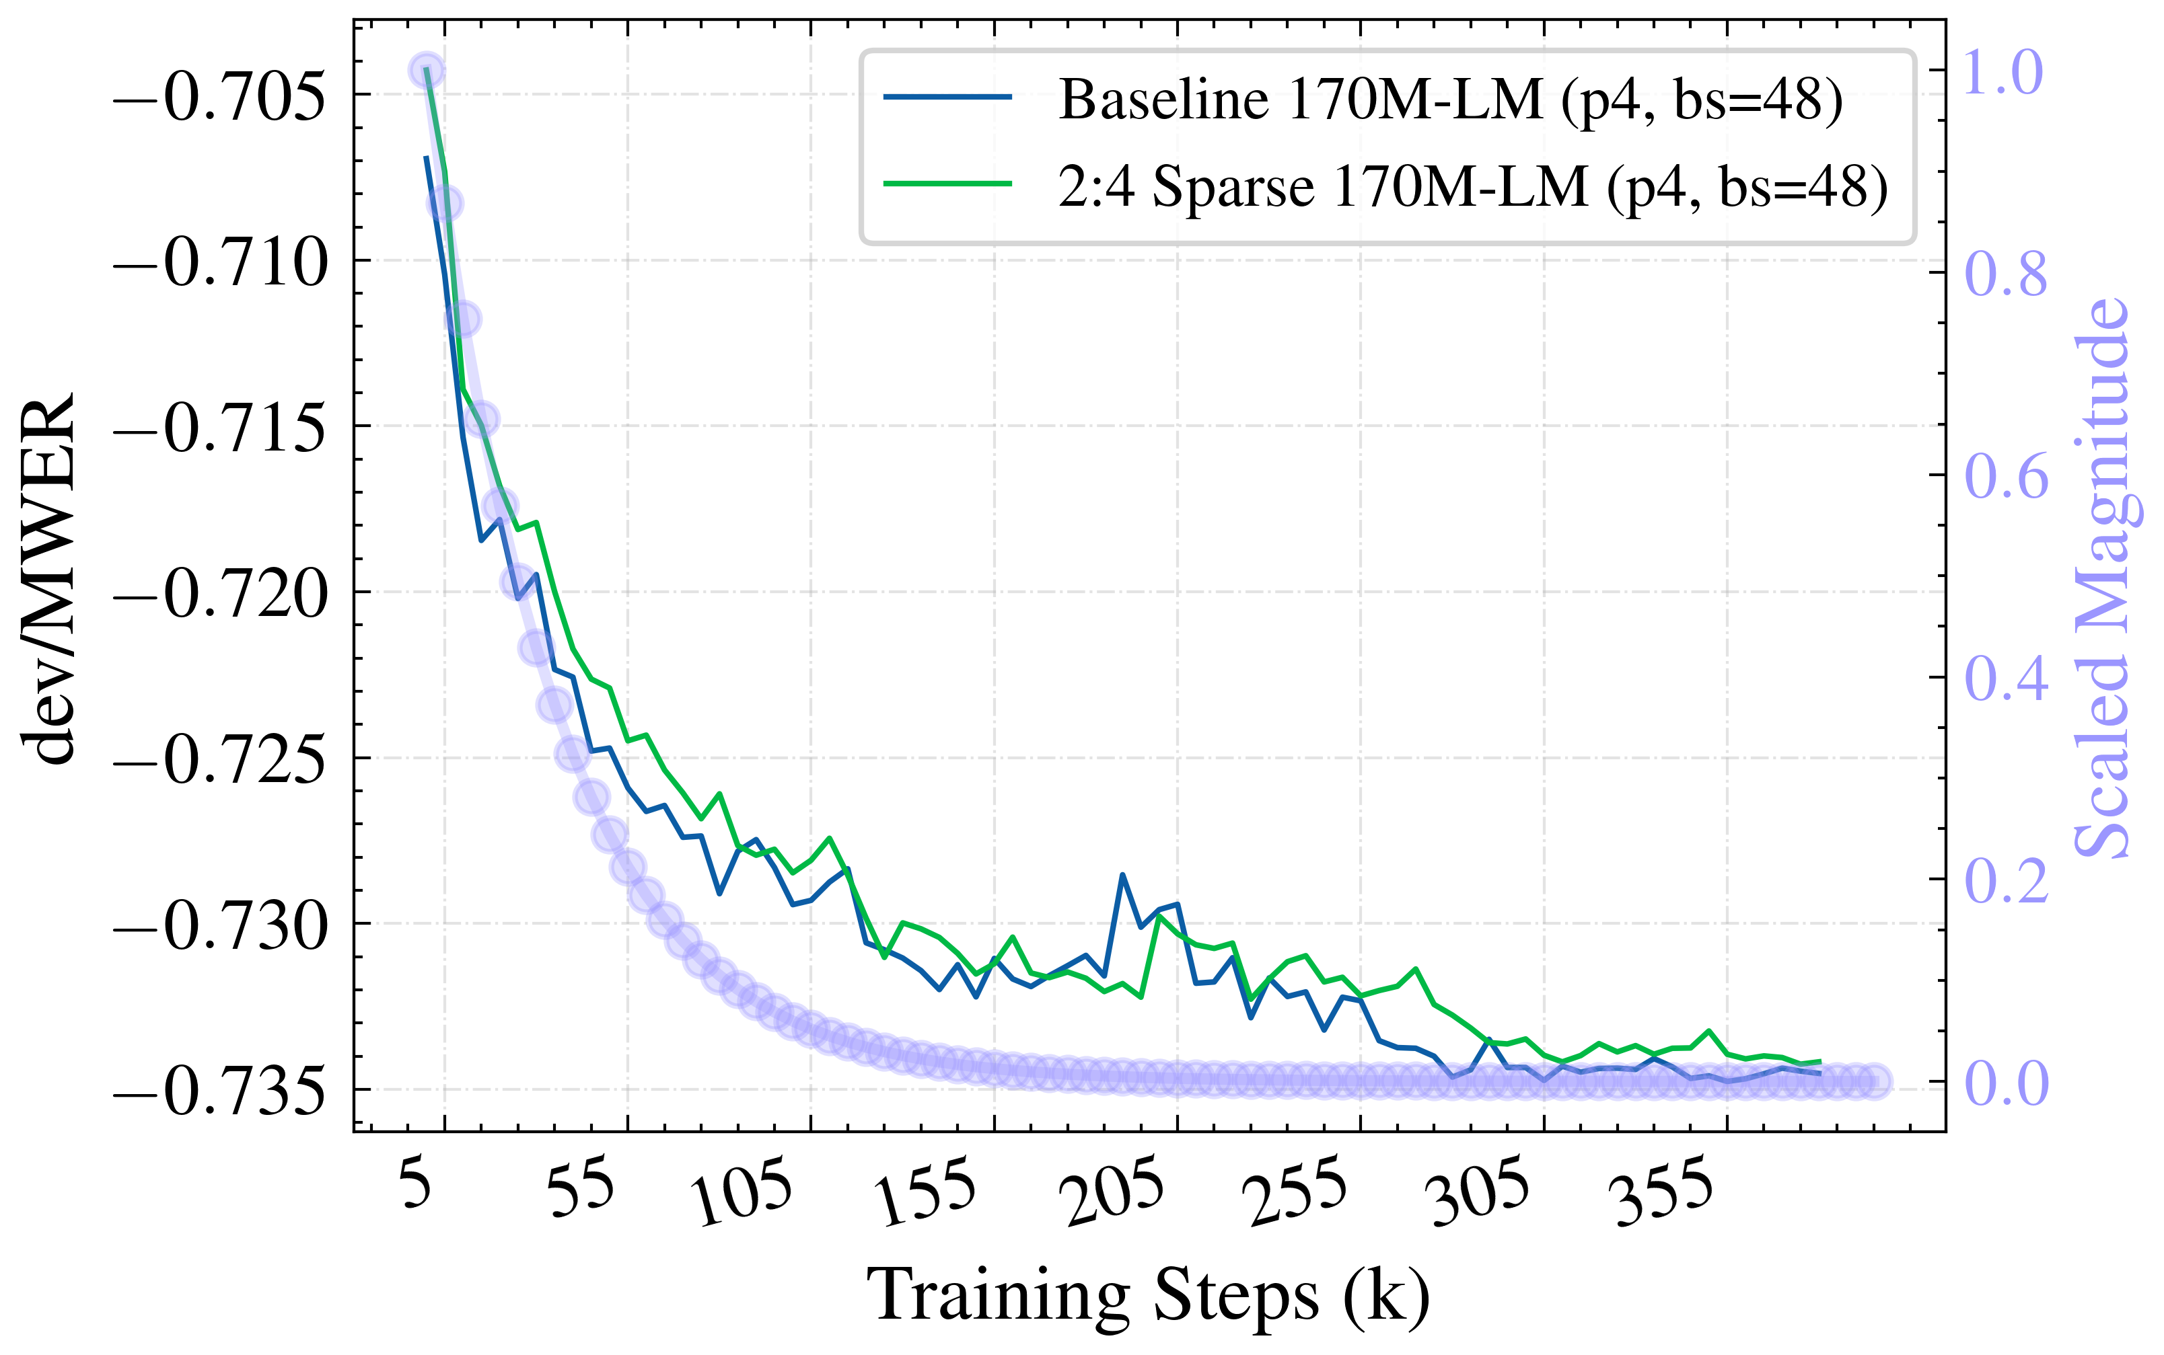
2:4 Sparse for RescoreBERT
Accuracy
No degradation observed during training
In Bluebottle, w. sparse RescoreBERT
No degradation on glidepath
1% relative degradation on tail
Test set | Dense LM | Sparse LM | Rel. Deg.
glidepath | 8.39 | 8.41 | 0
Info_tail | 6.51 | 6.56 | 1
170M RescoreBERT | dev/WER | dev/MWER | dev/untuned_wer
Baseline | 0.13 | -0.73 | 11.61
50% sparsity | 0.13 | -0.73 | 11.62
glidepath: https://blueflame-na.aka.amazon.com/execution/3d9393a2-b687-4602-a427-487af4c88801
tail: https://blueflame-na.aka.amazon.com/execution/73f16167-cc7e-4cd4-aae6-3874bfb3a01f

Slide 6
2:4 Sparse for RescoreBERT
What’s next?
Runtime support for sparse RescoreBERT acceleration
https://sim.amazon.com/issues/ASRCT-3927
Patch sparse 170M RescoreBERT into Bluebottle R19 or R18.2
Experiment with 1B RescoreBERT (post-training sparsification, etc)

Slide 7
Conformer Quantization
Is QAT needed for cloud ASR?
Cloud ASR runtime also represents weights in 8-bit.
QAT won’t lead to latency reduction: the model runs in INT8 mode.
QAT for cloud Conformer is more of an accuracy-driver.
FP32
FP32
FP32
FP32
INT8
Conformer training in Phasa
Serialization in Phasa
IL in Phasa
EB in Phasa
Packaging
In DBS
FP8
~FP8
~FP8
~FP8
Conformer training in Phasa
Serialization in Phasa
IL in Phasa
EB in Phasa

Slide 8
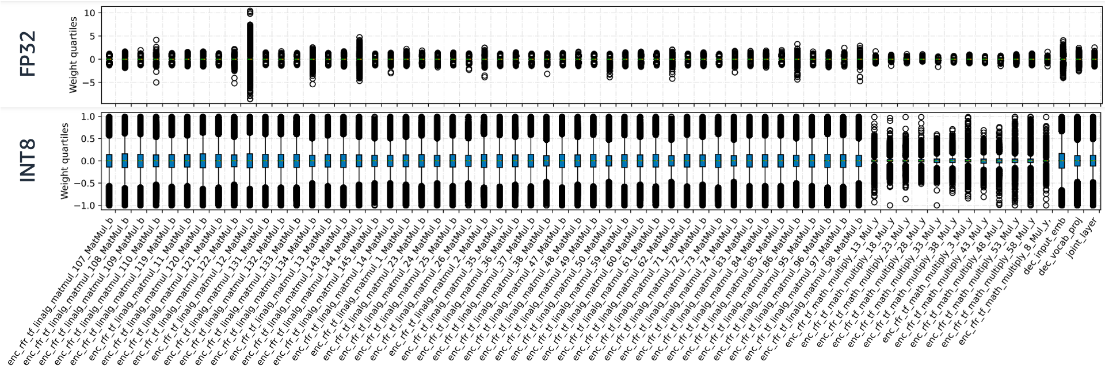
Conformer Quantization
8-bit post-training quantization is lossy
32-bit trained weight distributions vary among layers

Slide 9
Conformer Quantization
8-bit post-training quantization is lossy
How much accuracy loss exactly is from 8-bit PTQ?
FP32
FP32
FP32
FP32
INT8
Conformer training in Phasa
Serialization in Phasa
IL in Phasa
EB in Phasa
Packaging
In DBS
FP32
Packaging
In DBS
Test set | INT8 | FP32 | WERR (FP32 v.s. INT8)
tail_golden_live | 4.93 | 4.7 | 5
wbr | 7.69 | 7.63 | 1
system_multiturn_2022 | 10.22 | 10.15 | 1
https://blueflame-eu.aka.amazon.com/execution/00ae93c7-5b14-45bd-8fd4-b1ab5f690d56

Slide 10
Conformer Quantization
QAT+PTQ v.s. PTQ
With QAT, the de-DE Conformer candidate shows 2-4% WERR after NB on wbr/tail/multiturn.
Disabling both LM passes, we still observe 1-4% WERR.
Test set | FP32->INT8 | ~FP8->INT8 | WERR
tail_selection | 7.41 | 7.18 | 3
wbr | 7.72 | 7.51 | 3
system_multiturn | 10.41 | 10.01 | 4
Test set | FP32->INT8 | ~FP8->INT8 | WERR
tail_selection | 7.56 | 7.5 | 1
wbr | 7.83 | 7.75 | 1
system_multiturn | 10.73 | 10.55 | 2
INT8
INT8
INT8
Packaging
In DBS
Packaging
In DBS
Packaging
In DBS
✓
✓
✓
FP8
~FP8
~FP8
~FP8
INT8
Conformer training in Phasa
Serialization in Phasa
IL in Phasa
EB in Phasa
Packaging
In DBS
✓
https://blueflame-eu.aka.amazon.com/execution/96c616a0-2a55-4cae-bdc8-d4b829b4d068
(LM disabled) https://blueflame-eu.aka.amazon.com/execution/3cbde29c-9c37-4607-8e61-a6bc93f5a312

