Slide 1
Neural Architecture Search for LLM
Mentor: Kai Zhen, Markus Mueller, Chayut Thanapirom
Manager: Nathan Susanj
Principal shepherd: Denis Filimonov

Slide 2
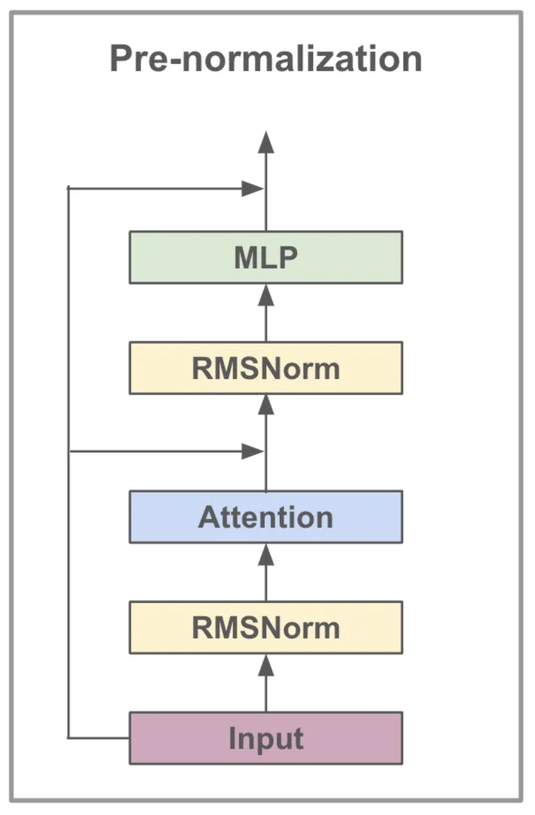
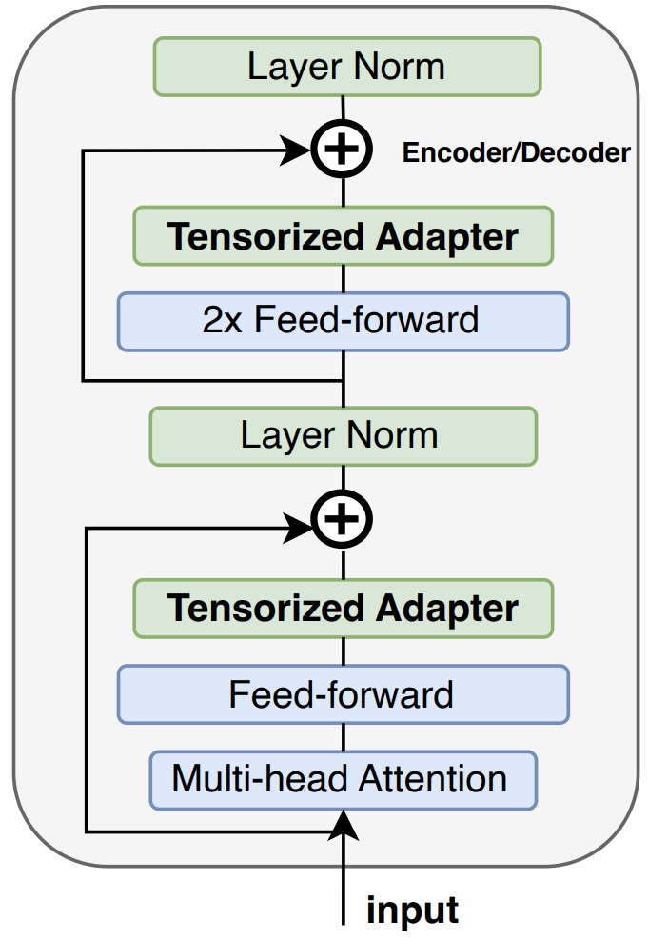

“Boring” diagram and “fun” fact
Params in feedforward modules account for 64.6% of total params in Llama 7B model.
Hidden_size = 4096
Intermediate_size = 11008
Num_blocks = 32

Slide 3
Transformer Block
for Llama
Feedforward or
MLP modules
Hidden size
Down proj
Intermediate size
Hadamard prod
Up proj
Gate proj
Intermediate size

Slide 4
Shrinking mode
Transformer Block
for Llama
Feedforward or
MLP modules
Hidden size
Down proj
Intermediate size
Hadamard prod
Up proj
Gate proj
Intermediate size

Slide 5
Shrinking mode
Transformer Block
for Llama
Feedforward or
MLP modules
Hidden size
Down proj
Intermediate size
Hadamard prod
Up proj
Gate proj
Intermediate size

Slide 6
Shrinking mode
Transformer Block
for Llama
Feedforward or
MLP modules
Hidden size
Down proj
Intermediate size
Hadamard prod
Up proj
Gate proj
Intermediate size

Slide 7
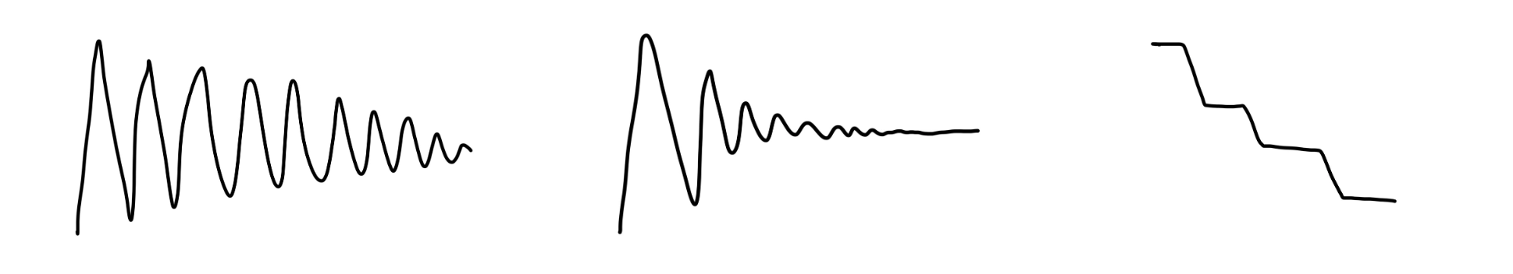
Shrink-and-grow scheduler
The scheduler determines how the model shrinks and grows.
Different schedules can be implemented
Interval for growing
Interval for shrinking
(Exponential) decay of the growing/shrinking operations
More details in the proposal

Slide 8
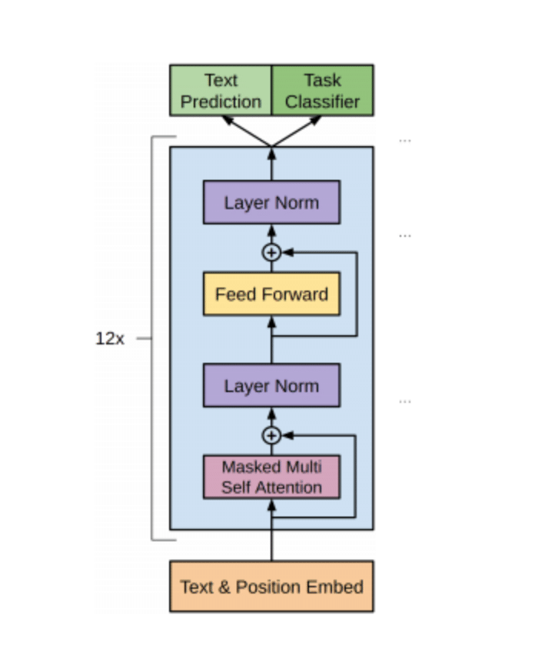
Outcome: architecture of each block is unique

Slide 9
Best case impact
Our Shrink-and-Grow (SnG) LLM fine-tuning mechanism can lead to significant savings in training costs.
With NAS applied to feedforward modules, which account for approximately 70% of the total model parameters, we are able to reduce the number of parameters in feedforward modules by 15-20% without degrading the model's performance.

Slide 10
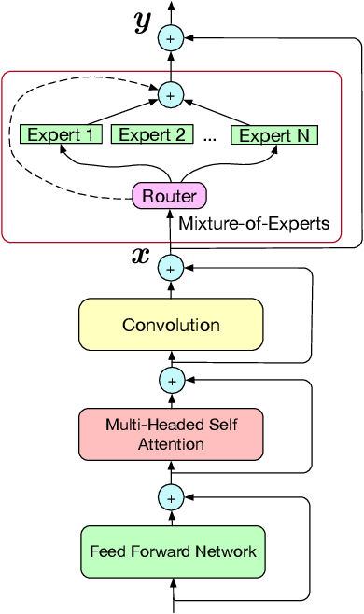
Extending NAS to mixed of experts
Runtime
Training time
Router

