Slide 1
Eliminating Bank Churn
Analysis + Recommendations

Slide 2
CONTEXT + PROBLEM
Eliminating BANK CHURN
Client - A National Bank
Suffering from customer attrition
Need to retain current customers instead of acquire new customers
Looking for models to predict customer churn and recommendations to target these customers before they close their accounts
Problem
Data
Models
Recommendations

Slide 3
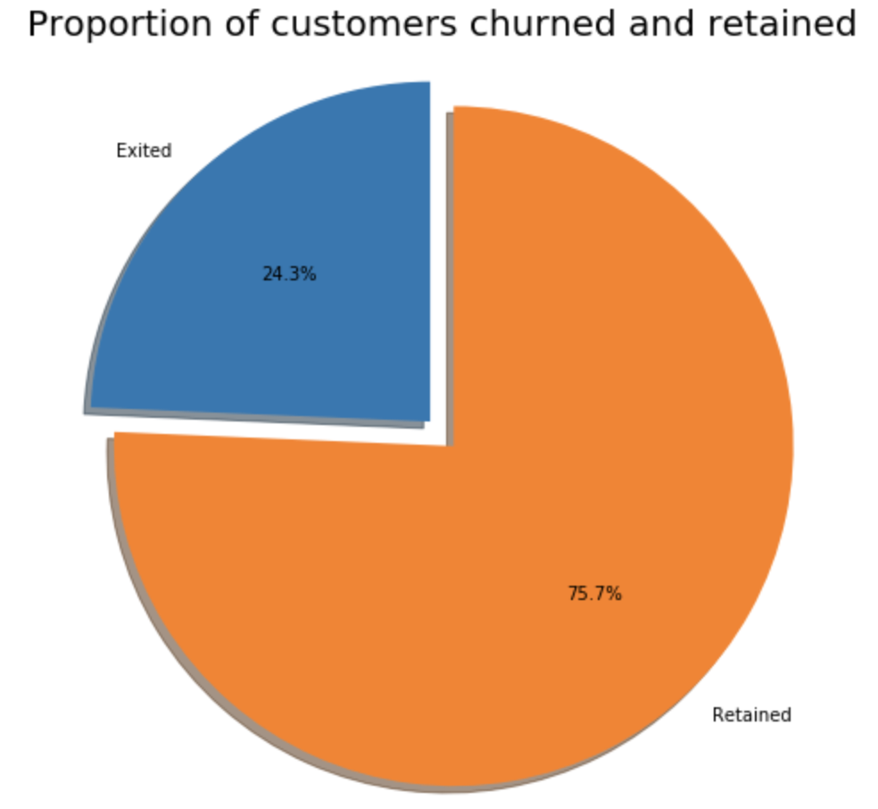
DATa Overview
Eliminating BANK CHURN
Extensive data set contain information on 24,000 bank customers
Include data on account terminations
Attributes included: ClientId, Surname, First Name, FICO Score, Subsidiary, Gender, Age, Balance, Product, BankCC, Active Status, Regular Deposit Amount, Life Insurance, Platinum Status, Terminated Account
Problem
Data
Models
Recommendations

Slide 4

Prediction Models
Eliminating Bank churn
KMN Model + Principle Component Analysis
Logistic Regression
RFE Analysis
Random Forest
Problem
Data
Models
Recommendations

Slide 5

Recommendation #1: Implement desirable interest rates
Eliminating BANK CHURN
Lower interest rates on loans for customers with excellent FICO scores
Raise Interest Rates on savings accounts for customers with excellent FICO scores
The new rate would apply exclusively to customers with a FICO score of 800 - 1000
Problem
Data
Models
Recommendations

Slide 6
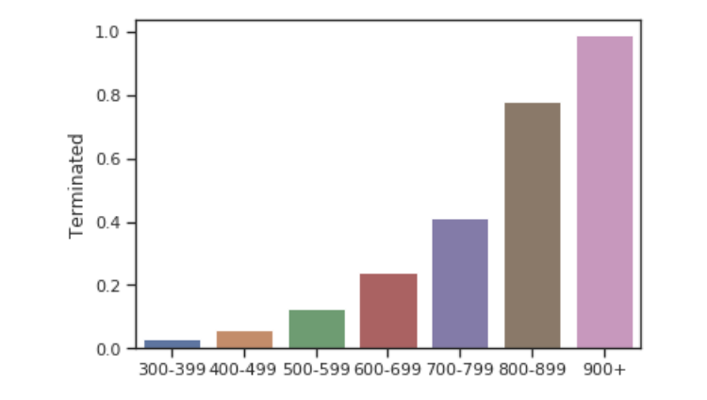
DATA ANALYSIS
Eliminating BANK CHURN
Data Analysis: Customers with a higher FICO score are more likely to terminate their account
Problem
Data
Models
Recommendations

Slide 7
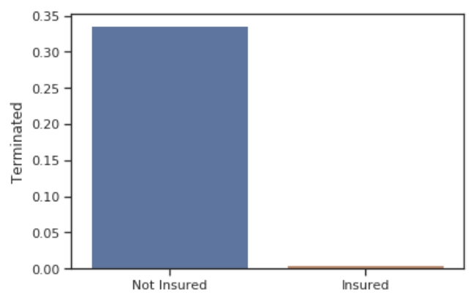
Recommendation #2: Build customer loyalty through Marketing life insurance plans
Eliminating BANK CHURN
Advertise and sell life Insurance plans to customers who are 30+ years old
Incentivize life insurance plans
Problem
Data
Models
Recommendations

Slide 8


Recommendation #3: Improve Customer Service
Eliminating BANK CHURN
Customer service is the largest cause of customer churn
24/7 customer service
Increase number of customer service employees
Problem
Data
Models
Recommendations

Slide 9
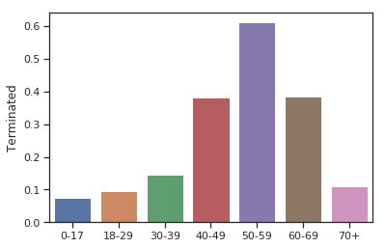
Data analysis
Eliminating BANK CHURN
Assign best sales representatives and customer support employees to 40+ demographic
Problem
Data
Models
Recommendations

Slide 10



Summary
1. Implement Desirable Interest Rates
2. Increase Customer Loyalty
3. Improve Customer Service

