Slide 1
UX Scenario Document File Version 4.4
IvPlayer
Submission Date | 2026 / 09 / 30
App Ver. | 1.0.1
App Developer | Name: Mehmet Burak Fırat E-mail address: destek@ivplayer.tr

Slide 2
Table of Contents
1. Basic Information
2. Document History
3. Page Description (Guideline)
4. Detailed Login Information
5. Main Page Description
6. Sub Page Description
7. Paid Content
8. In-App Ad

Slide 3
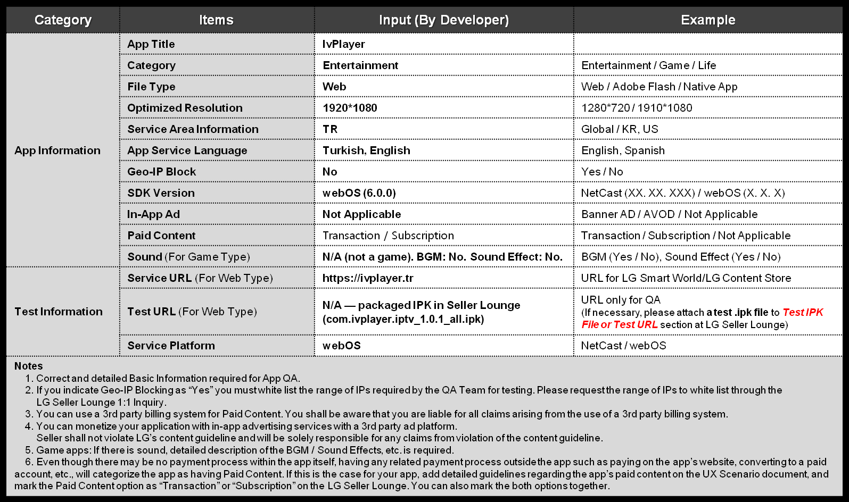
1. Basic Information

Slide 4
2. Document History
No. | Sent | Version | File Name | Contents
1 | 14.08.2026 | 1.0.0 | IvPlayer-UX-Scenario-4.4.ppt | Initial document for IvPlayer 1.0.0
2 | 30.09.2026 | 1.0.1 | IvPlayer-UX-Scenario-4.4.ppt | QA2026091422903: real 1920x1080 screenshots of every screen, flow chart, exit popup, activation / error / 18+ PIN / settings pages; new icons (QA...901/902)

Slide 5
3. Page Description (Guideline)
1. Numbering guideline (keep as reference)
Description
1 | Description for Number 1 button
2 | Description for Number 2 button
3 | Description for Number 3 button
4 | Description for Number 4 button
5 | Description for Number 5 button
- Place your app’s display image.
- Use unique number to indicate each menu or UI button correctly.
- Write the description on each menu or UI button of number at the right-side table.
- Next pages show examples with sample images and texts.
Detailed Information
All screens on the following pages are real 1920x1080 captures of IvPlayer 1.0.1 (webOS UI).
Red numbers on each screenshot match the numbered rows of the table on the right.
UI language is Turkish by default; English is available in Ayarlar (Settings) > Dil (Language) > English.

Slide 6
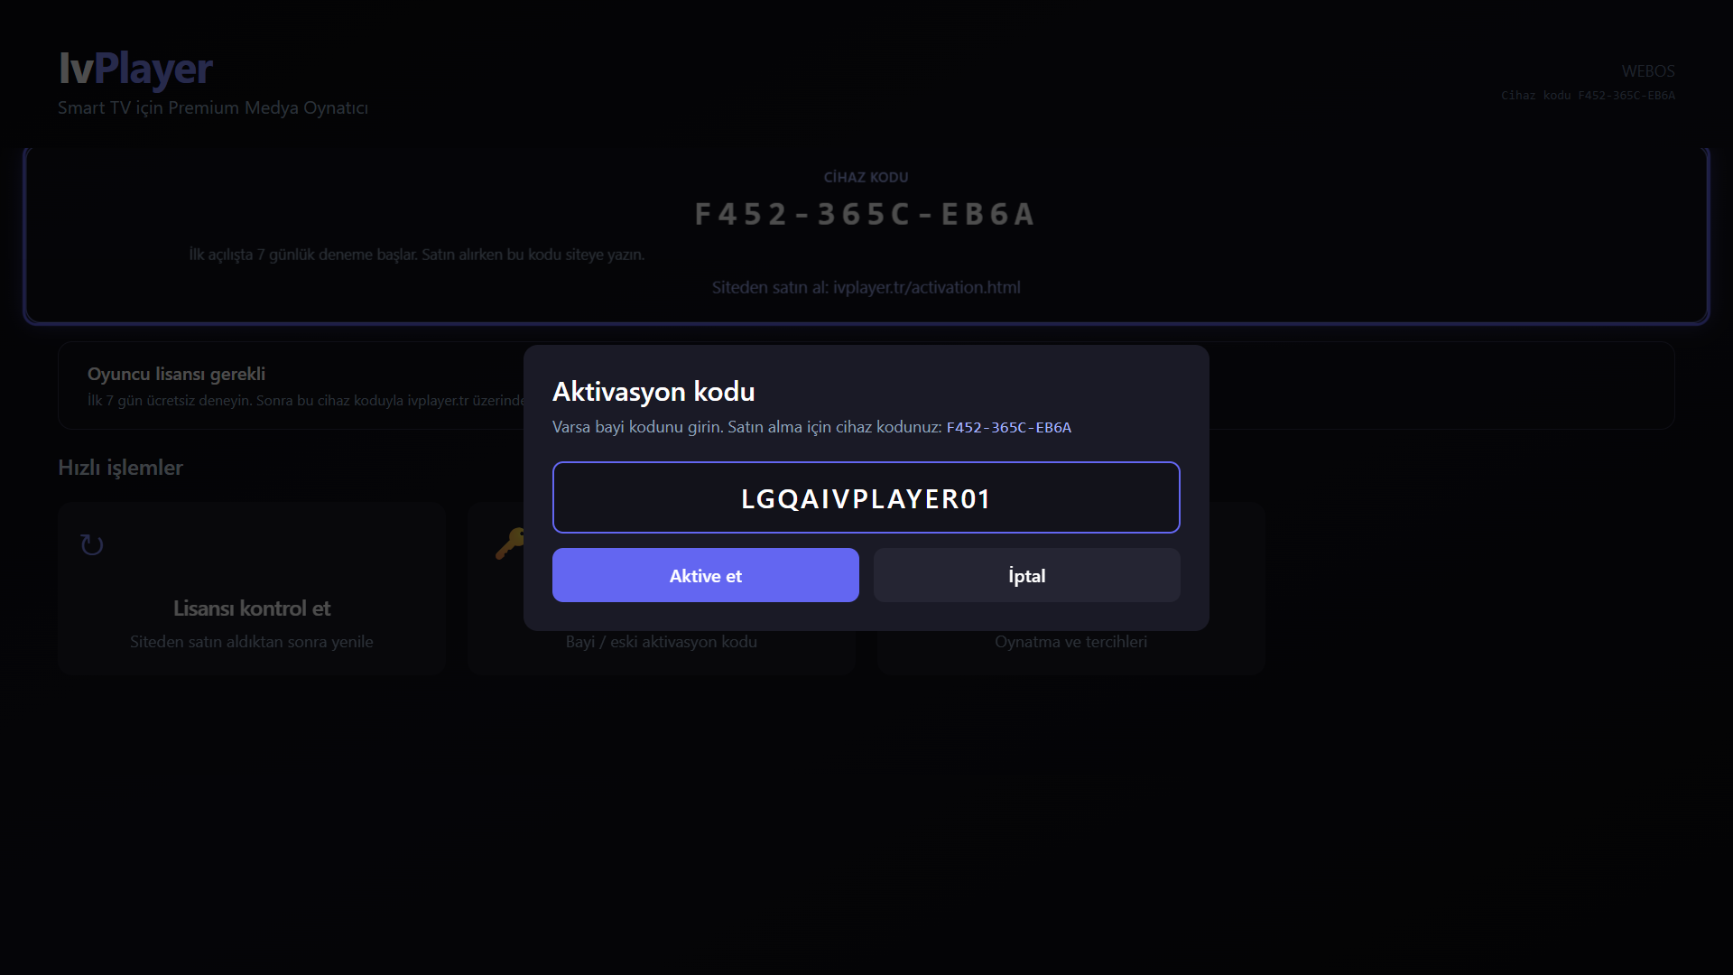
4. Detailed Login Information
Description
1 | Cihaz kodu (Device code), 12 chars. No user ID field - IvPlayer has no member login.
2 | Activation code field. 3 Aktive et (Activate) / 4 İptal (Cancel). No password field.
Test Accounts (ID / PW)
1 | N/A - there are no ID / password accounts
2 | N/A
3 | N/A
Activation Codes
1 | LGQAIVPLAYER01 (valid for up to 20 QA TVs): Home > Kodum var > Aktive et
2 | If the limit is reached: e-mail the on-screen device code to destek@ivplayer.tr
3 | After we bind it: Home > Lisansı kontrol et (Check license)
1
2
3
4
Detailed Information
IvPlayer has no user ID / password. Access is a device-bound software player license; the app sells no channels or IPTV subscriptions.
The first launch starts a free 7-day trial automatically. If the trial has ended, Home shows only Lisansı kontrol et, Kodum var and Ayarlar (page 8).
QA: Home > Kodum var > type LGQAIVPLAYER01 with the webOS on-screen keyboard > Aktive et. A wrong code shows "Geçersiz aktivasyon kodu" (page 10).
Do NOT make a real payment during QA.

Slide 7

5. Main Page Description
1. Start Page (Splash)
Description
1 | Splash image with the IvPlayer logo (webOS splashBackground)
2 | No Start button: Home opens automatically after loading (~1-2 s)
1
2
Detailed Information
Cold start: webOS shows splash.png on the #0b1226 background, then IvPlayer Home. There is no separate start page.
handlesRelaunch = true: launching IvPlayer again from the Launcher or Recent apps brings back a working Home (never a black screen).
Back on Home opens the exit popup (page 21).

Slide 8
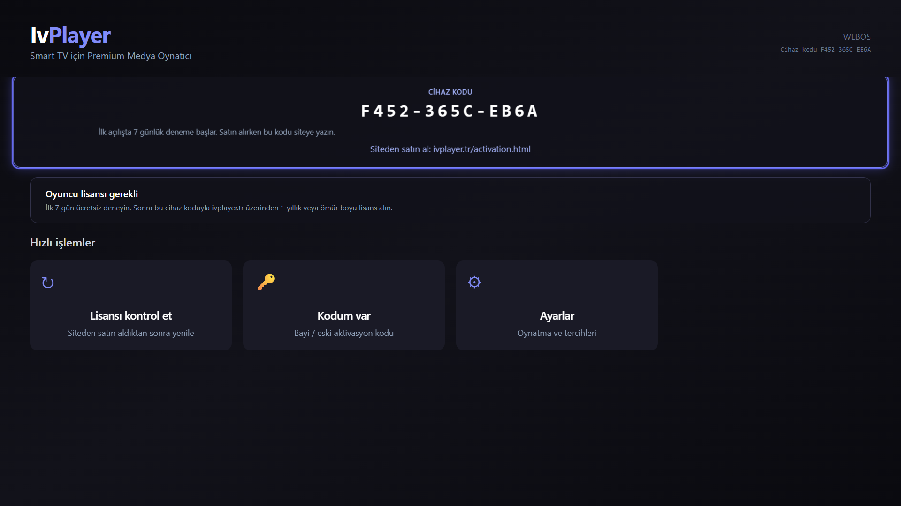
5. Main Page Description
2. Main Page (Home) - no license
Description
1 | Cihaz kodu (Device code) - used when buying on the website
2 | Siteden satın al: ivplayer.tr/activation.html (information text)
3 | Oyuncu lisansı gerekli (Player license required) notice
4 | Lisansı kontrol et (Check license) - refresh after buying
5 | Kodum var (I have a code) - activation dialog (page 6)
6 | Ayarlar (Settings, page 20)
Back | Exit popup (page 21)
1
2
3
4
5
6
Detailed Information
Shown when the 7-day trial has ended and no license is bound to this TV.
Playlist, channel and player screens stay hidden until a license is active (no free content access).
Remote: arrow keys move the blue focus frame, OK selects.

Slide 9
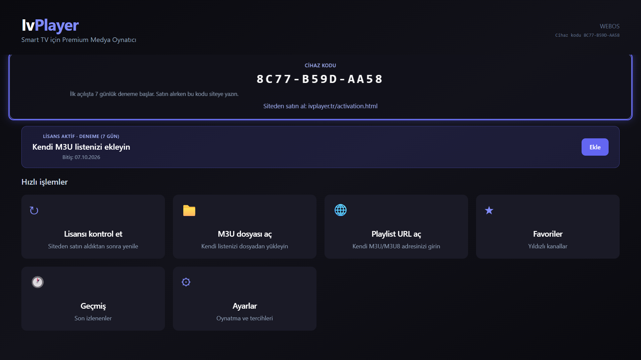
5. Main Page Description
3. Main Page (Home) - licensed / trial
Description
1 | Cihaz kodu (Device code) and buy URL
2 | License status: LİSANS AKTİF · DENEME (7 GÜN) (trial) and Bitiş (expiry)
3 | Ekle (Add) - add your own playlist; Aç (Open) once one is saved
4 | Lisansı kontrol et (Check license)
5 | M3U dosyası aç (Open M3U file)
6 | Playlist URL aç (Open playlist URL, page 15)
7 | Favoriler (Favorites, page 19)
8 | Geçmiş (History, page 19)
9 | Ayarlar (Settings, page 20)
Back | Exit popup (page 21)
1
2
3
4
5
6
7
8
9
Detailed Information
Shown with an active license or the free 7-day trial. IvPlayer has no built-in channels: the user adds their own M3U/M3U8.
After a playlist is loaded, Son playlistler (Recent playlists) appears below the tiles.
Remote: arrow keys move focus, OK opens the focused tile.

Slide 10
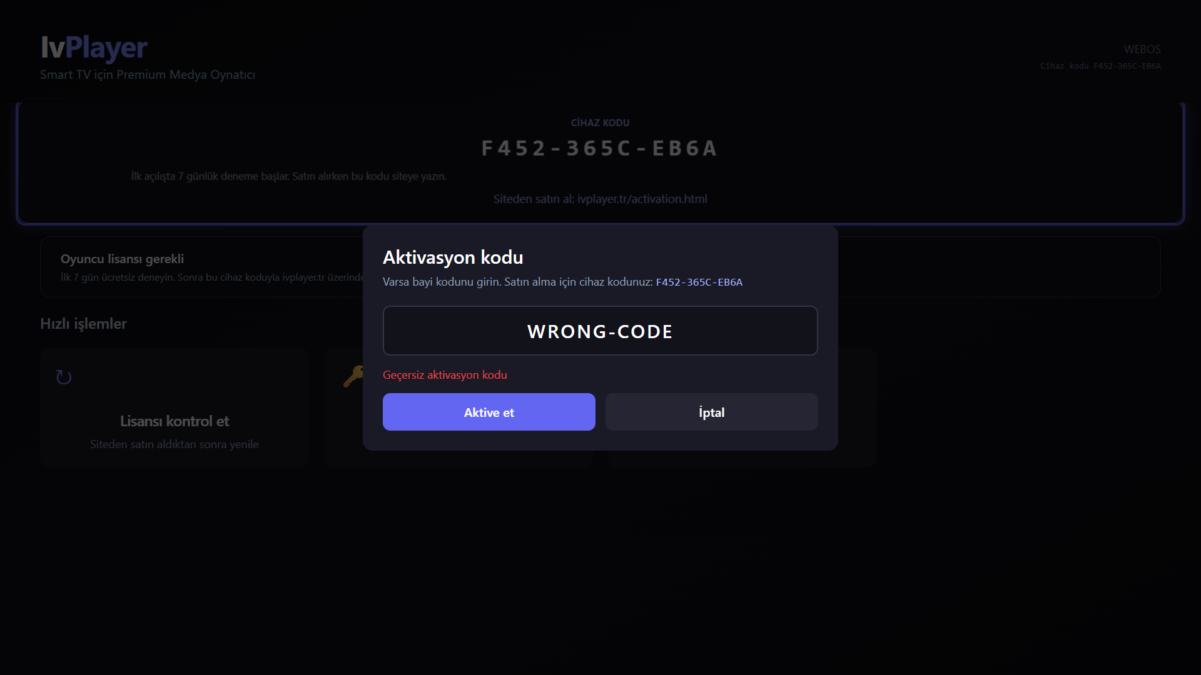
5. Main Page Description
4. Activation dialog - errors
Description
1 | Aktivasyon kodu (Activation code) dialog, shows the device code
2 | Code field (webOS on-screen keyboard; OK in the field submits)
3 | Error text, e.g. Geçersiz aktivasyon kodu (Invalid activation code)
4 | Aktive et (Activate)
5 | İptal (Cancel) - Back also closes the dialog
1
2
3
4
5
Detailed Information
Invalid or expired code: red error under the field, the dialog stays open, no crash.
License server unreachable: "Lisans sunucusuna bağlanılamadı" (Could not reach the license server).
Lisansı kontrol et without a license: red banner "Bu cihaz için lisans yok" (No license for this device).
Valid code: the dialog closes and Home switches to the licensed view (page 9).

Slide 11
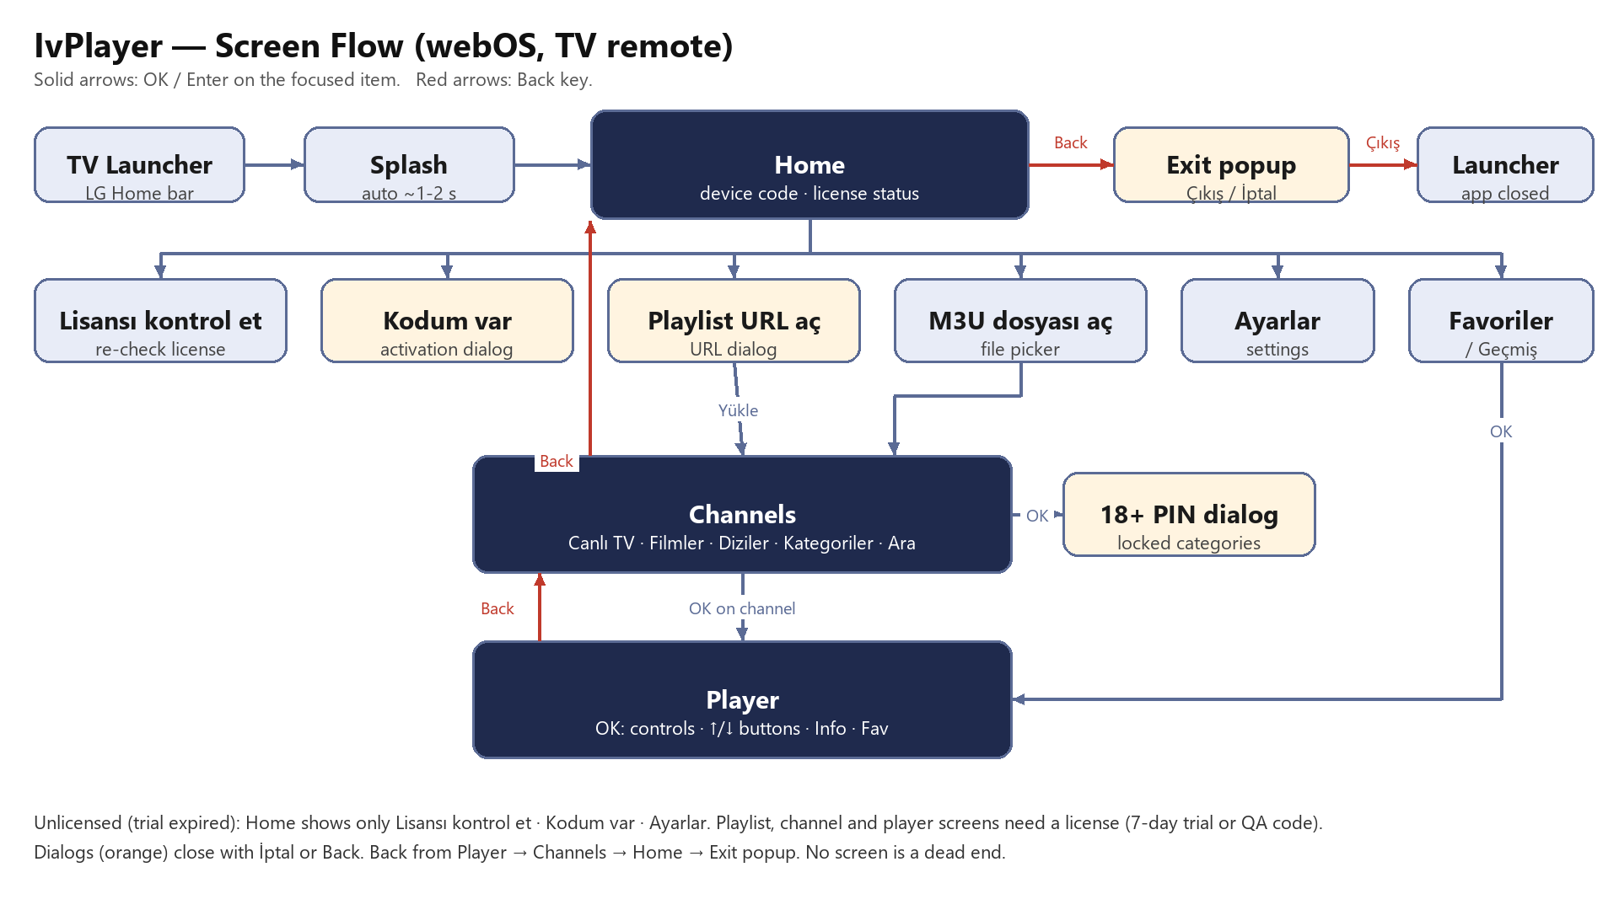
6. Sub Page Description
1. Flow Chart
Detailed Information
Launcher > Splash > Home. Licensed Home: Playlist URL aç / M3U dosyası aç > Channels > Player. Favoriler / Geçmiş > Player. Ayarlar > Back > Home.
Back: Player > Channels > Home > Exit popup (Çıkış = close the app, İptal = stay). Every dialog closes with İptal or Back.
Remote: arrows move focus, OK selects, Back goes one screen back. The Magic Remote pointer also works (click = OK).

Slide 12
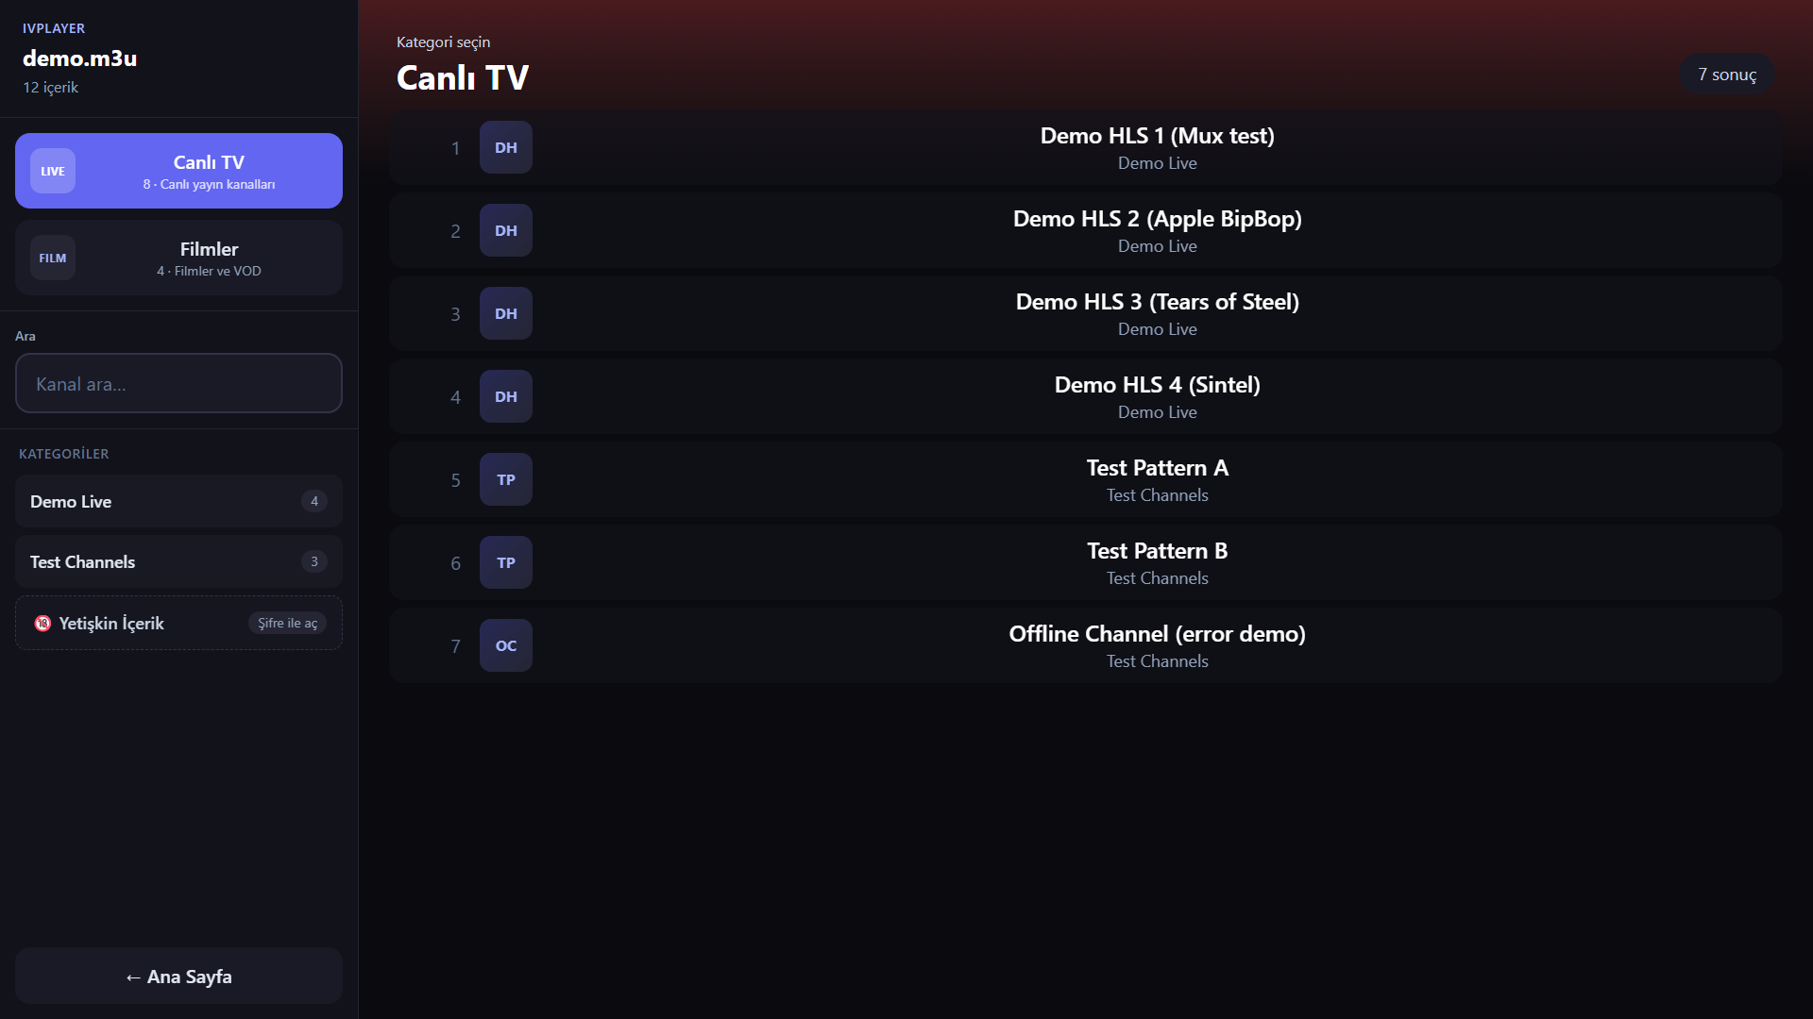
6. Sub Page Description
1. Channels (Live TV)
Description
1 | Canlı TV (Live TV) section with channel count
2 | Filmler (Movies) / Diziler (Series) - shown if the playlist has them
3 | Ara (Search) - page 13
4 | Kategoriler (Categories) from the playlist group-title
5 | Yetişkin İçerik (Adult) - PIN-locked categories, page 14
6 | Ana Sayfa (Home)
7 | Channel list - OK opens the Player
8 | Result count
8
1
7
2
3
4
5
6
Detailed Information
Content comes only from the user's own M3U/M3U8. The screenshot uses a public test playlist (Apple / Mux / Blender open test streams).
Up/Down scroll the list, Left/Right move between the sidebar and the list. Back returns to Home.
Very large playlists show "Hazırlanıyor..." (Preparing) while categories are indexed.

Slide 13
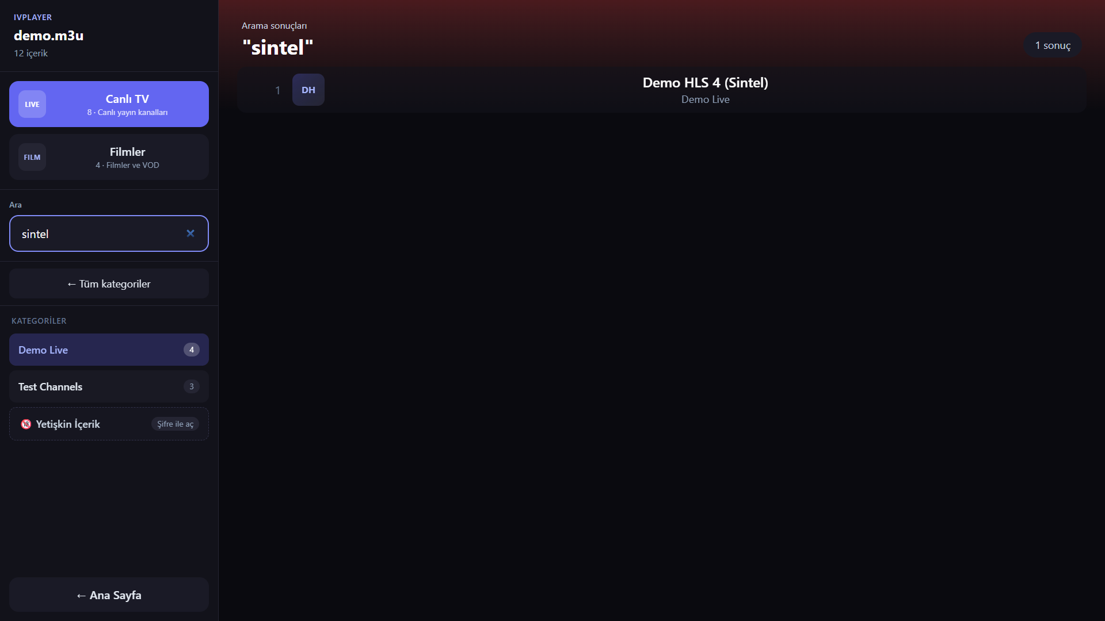
6. Sub Page Description
2. Category filter and search
Description
1 | Ara (Search) - results update while typing
2 | Tüm kategoriler (All categories) - clear the filter
3 | Selected category
4 | Arama sonuçları (Search results) with the query
5 | Matching channel - OK plays it
4
5
1
2
3
Detailed Information
No match: "Sonuç bulunamadı" (No results).
While the search field has focus, Back is used by the on-screen keyboard; press Down to leave the field, then Back returns Home.

Slide 14
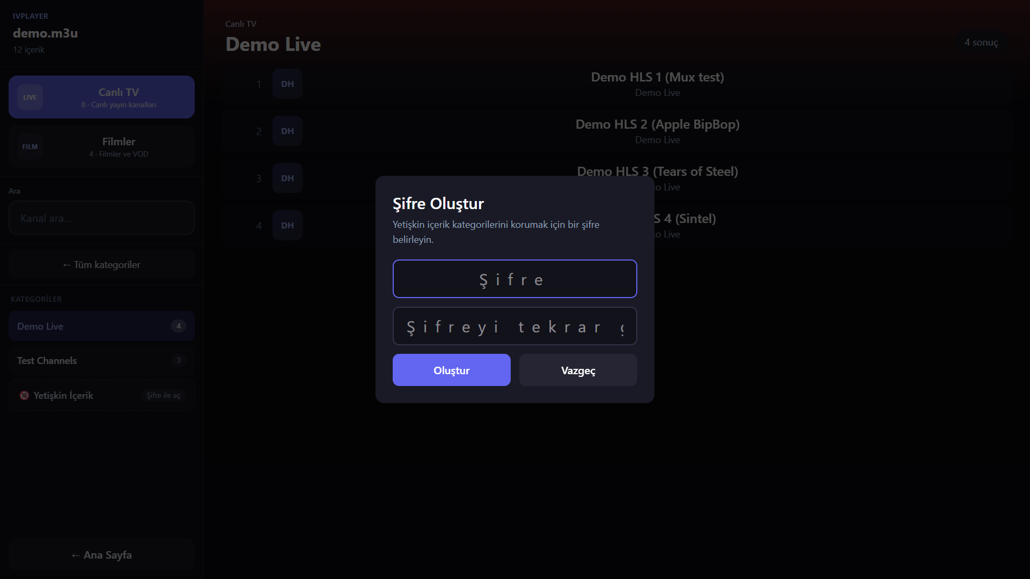
6. Sub Page Description
3. Adult content lock (18+ PIN)
Description
1 | Yetişkin İçerik - locked adult categories (names hidden)
2 | Şifre Oluştur (Create PIN) on first use; afterwards Enter PIN
3 | PIN
4 | PIN again (Şifreyi tekrar girin)
5 | Oluştur (Create) / unlock
6 | Vazgeç (Cancel) - Back also closes
2
3
4
5
6
1
Detailed Information
Categories detected as adult (18+, XXX, Adult ...) are hidden behind this PIN. The lock is ON by default (Ayarlar > Yetişkin İçerik Kilidi).
The PIN is stored only on the TV. Wrong PIN: error, categories stay hidden.
IvPlayer supplies no adult content; the lock only filters the user's own playlist.

Slide 15
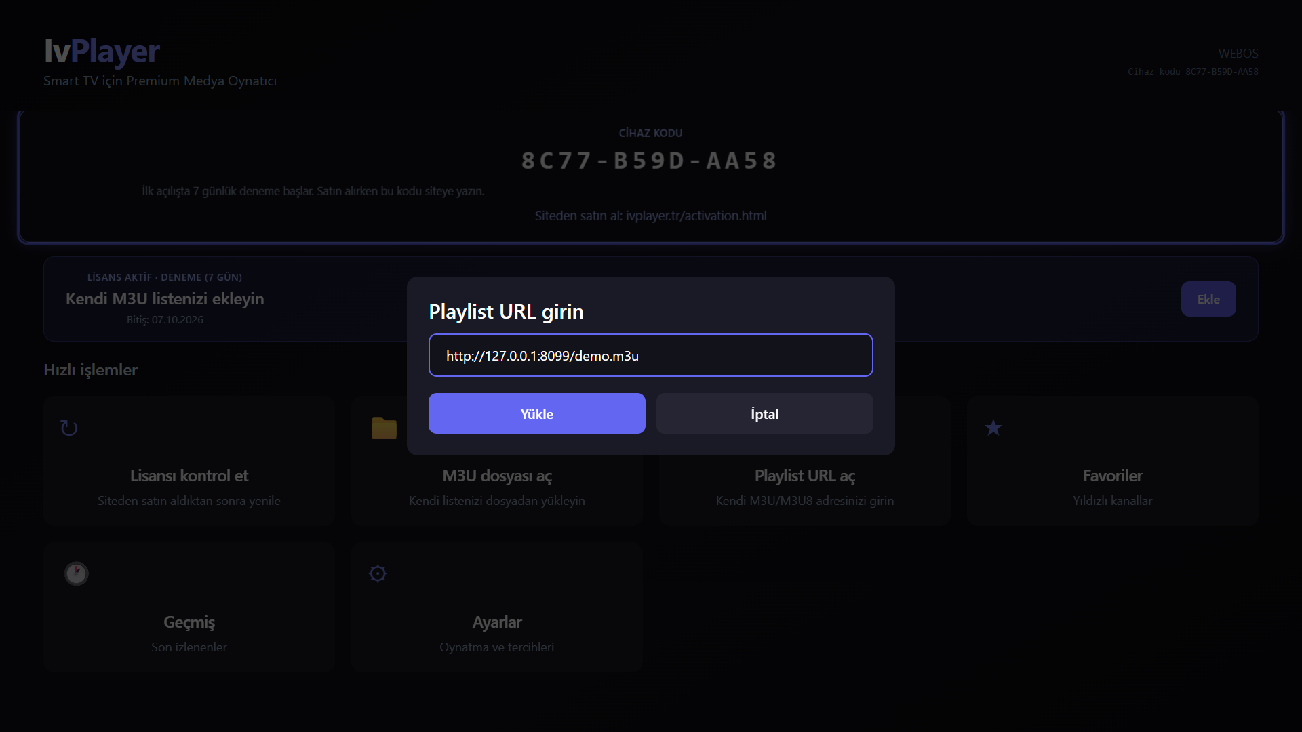
6. Sub Page Description
4. Playlist URL dialog
Description
1 | Playlist URL girin (Enter playlist URL)
2 | URL field (http/https M3U or M3U8, webOS keyboard)
3 | Yükle (Load) - loads the playlist and opens Channels
4 | İptal (Cancel) - Back also closes
1
2
3
4
Detailed Information
Unreachable URL or invalid file: error message on Home, no crash; the dialog can be opened again.
The loaded playlist is remembered and listed under Son playlistler (Recent playlists) on Home.
QA may use any legal public test playlist (e.g. Apple / Mux HLS test streams).

Slide 16
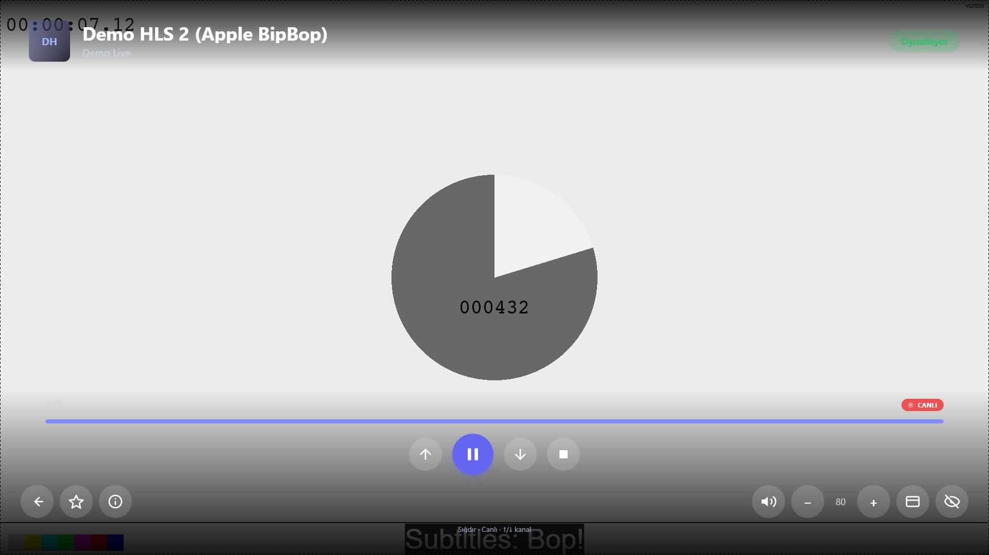
6. Sub Page Description
5. Player - live channel
Description
1 | Channel name and category
2 | Status: Oynatılıyor / Yükleniyor / Yeniden bağlanıyor / Hata
3 | Önceki / Sonraki kanal (previous / next channel)
4 | Oynat / Duraklat (Play / Pause)
5 | Durdur (Stop)
6 | Geri (Back to channel list)
7 | Favorilere ekle (Add to favorites)
8 | Bilgi (Info panel, page 17)
9 | Ses / - / + (Mute, volume down / up)
10 | Görüntü (Fit / Fill / Stretch) and Hide controls
1
2
3
4
3
5
6
7
8
9
10
Detailed Information
Controls hide after 3 s of playback. With controls hidden: Up/Down = previous/next channel, OK = show controls (focus on Play/Pause).
With controls shown: arrows move between buttons, OK presses the focused button. Remote Play / Pause / Stop keys also work.
Back returns to the channel list. Live streams have no seek (CANLI badge). Colour bars: Apple BipBop public test stream.

Slide 17
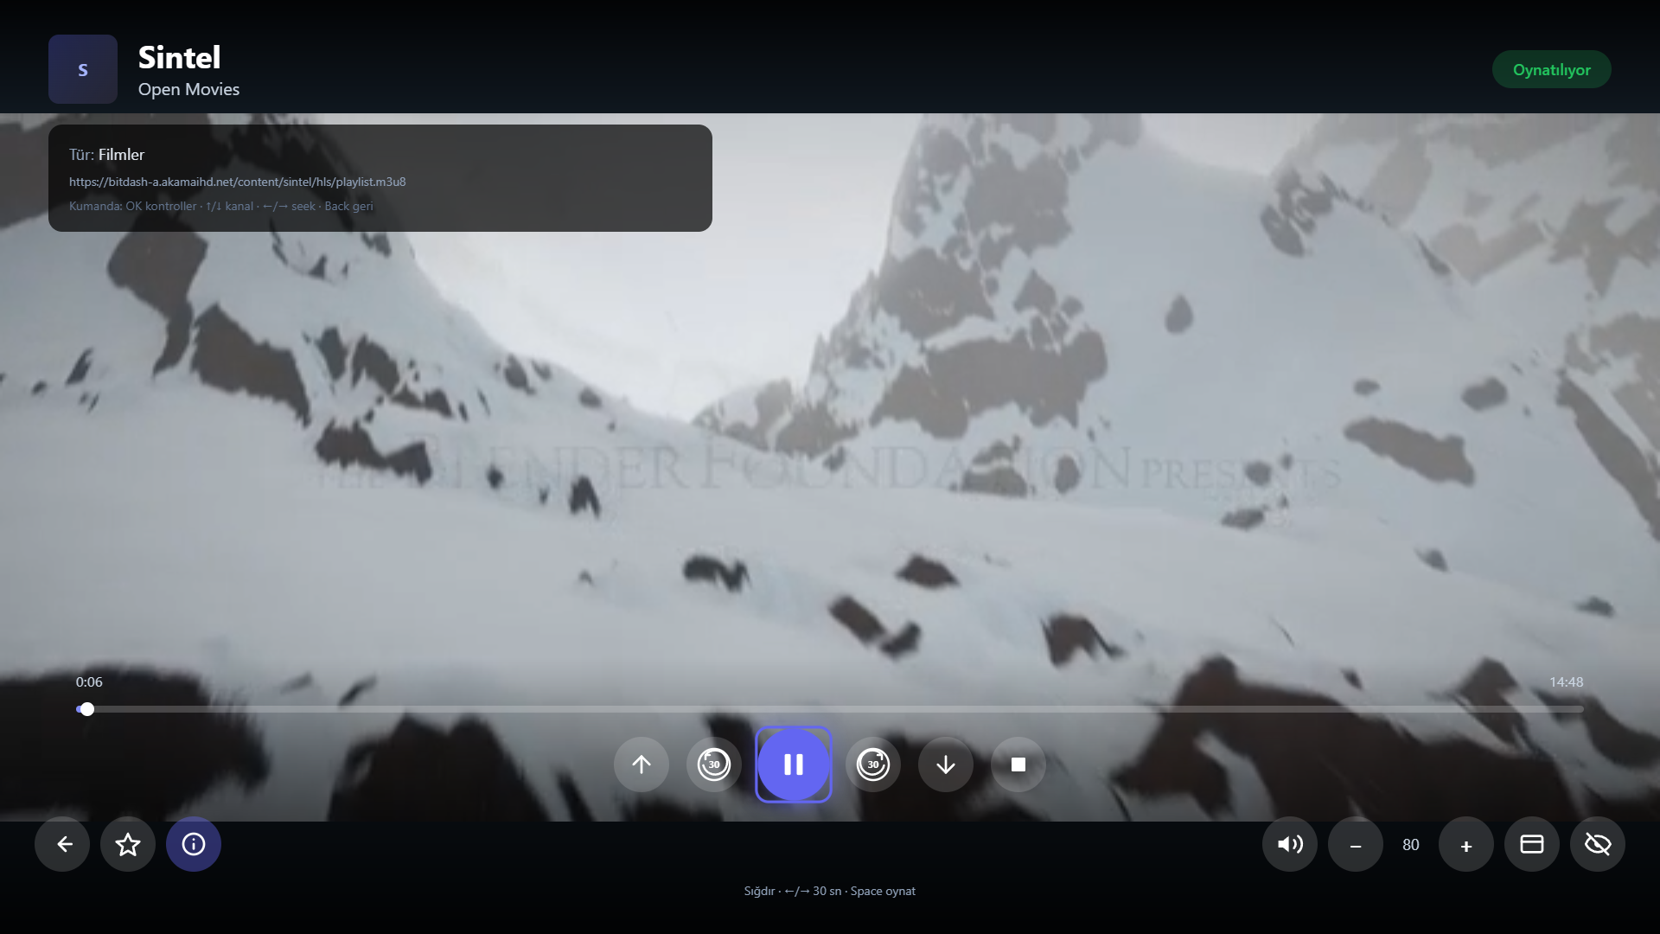
6. Sub Page Description
6. Player - movie (VOD) and info panel
Description
1 | Bilgi (Info): type, stream URL, remote help
2 | Zaman çubuğu (Timeline) with elapsed / total time
3 | 30 saniye geri (Back 30 s)
4 | 30 saniye ileri (Forward 30 s)
5 | Oynat / Duraklat (Play / Pause)
6 | Bilgi button - show / hide the info panel
1
2
5
3
4
6
Detailed Information
Movies and series (VOD) add a timeline and 30 s seek buttons. With controls hidden, Left/Right also seek 30 s.
All other buttons work as on the live player (page 16). Back returns to the list.
Video in the screenshot: Sintel (Blender Foundation, open movie).

Slide 18
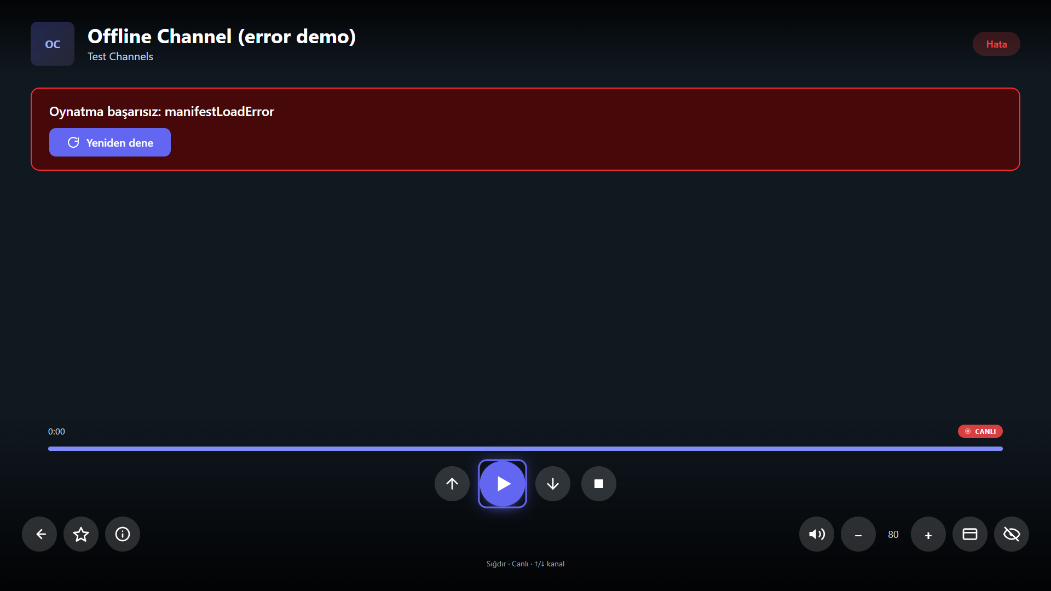
6. Sub Page Description
7. Player - stream error
Description
1 | Status Hata (Error)
2 | Error message, e.g. Oynatma başarısız (Playback failed)
3 | Yeniden dene (Retry) - loads the stream again
4 | Up / Down: another channel
5 | Geri / Back: return to the channel list
1
2
3
4
4
5
Detailed Information
A dead or unsupported third-party stream never crashes the app. Short network drops are retried automatically first (Ayarlar > Otomatik yeniden bağlan).
The stream belongs to the user's playlist, not to IvPlayer; the UI stays fully usable.

Slide 19
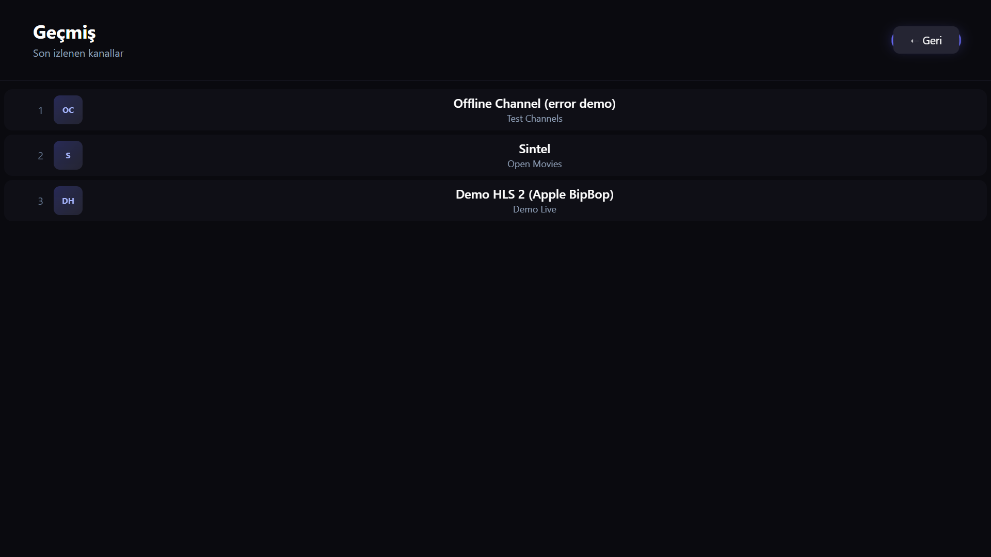
6. Sub Page Description
8. Geçmiş (History) / Favoriler (Favorites)
Description
1 | Geçmiş (History) - recently watched, newest first
2 | Geri (Back to Home) - the Back key does the same
3 | Channel row - OK plays it
- | Favoriler (Favorites) uses the same layout. Empty: "Henüz favori yok. İzlerken yıldızlayın."
1
2
3
Detailed Information
History and favorites are stored only on the TV. Add a favorite with the star button in the Player (page 16).
Ayarlar > Geçmişi temizle clears the history.

Slide 20
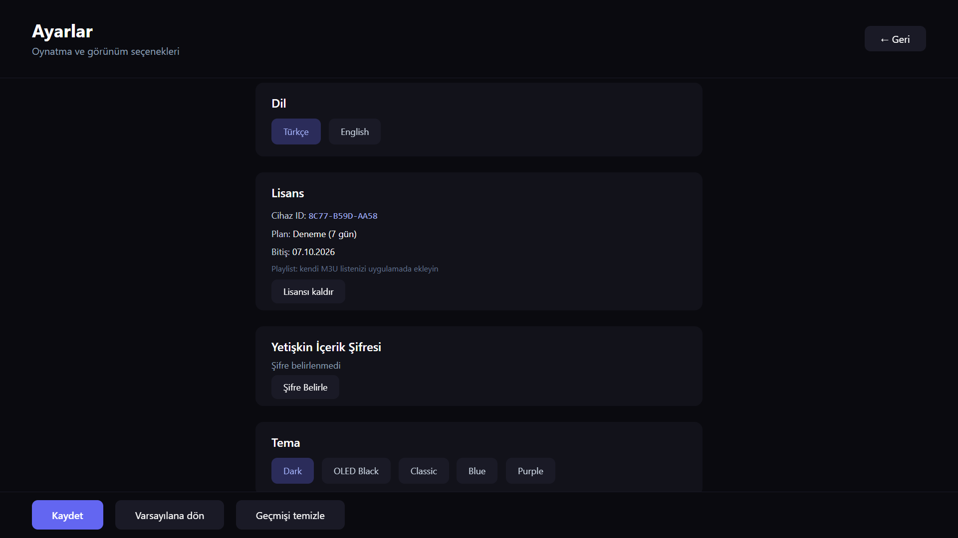
6. Sub Page Description
9. Ayarlar (Settings)
Description
1 | Dil (Language): Türkçe / English
2 | Lisans (License): device ID, plan, expiry
3 | Lisansı kaldır (Remove license from this TV)
4 | Yetişkin İçerik Şifresi (Adult PIN): set / change / remove
5 | Tema (Theme)
6 | Kaydet (Save)
7 | Varsayılana dön (Reset to defaults)
8 | Geçmişi temizle (Clear history)
9 | Geri (Back to Home)
9
1
2
3
4
5
6
7
8
Detailed Information
Scroll down (Down key) for playback options: auto reconnect, reconnect attempts / delay, buffer, default volume, channel numbers, hardware acceleration and the 18+ lock switch.
Back returns to Home.

Slide 21
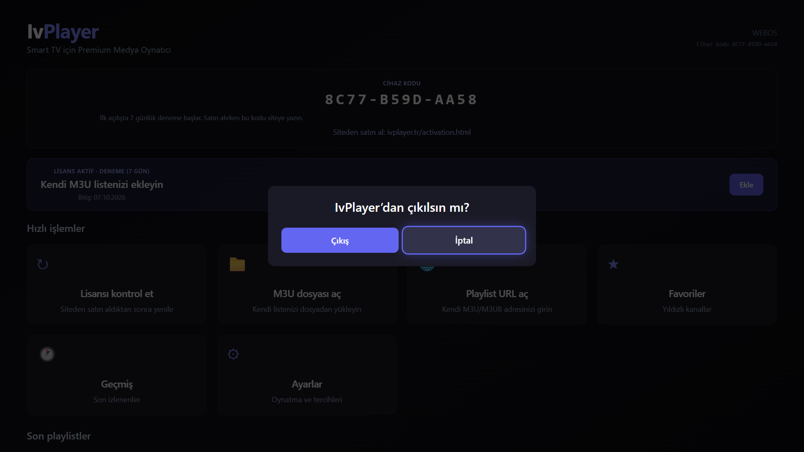
6. Sub Page Description
10. Exit popup
Description
1 | IvPlayer’dan çıkılsın mı? (Exit IvPlayer?) - opens with Back on Home
2 | Çıkış (Exit) - closes the app and returns to the TV
3 | İptal (Cancel) - default focus; Back also closes the popup
1
2
3
Detailed Information
Back on Home never exits silently and is never ignored: it always opens this popup.
Focus starts on İptal, so an accidental OK does not close the app.

Slide 22
7. Paid Content
Description
1 | No in-app payment UI. This screen does not exist in the app.
2 | Payment is on the website only: https://ivplayer.tr/activation.html (PayTR).
3 | Sold item: IvPlayer software license (1 year or lifetime). NOT IPTV / channels.
4 | QA must NOT pay: use the 7-day trial or code LGQAIVPLAYER01 (Home > Kodum var).
Test Credit Cards (Mandatory)
1 | N/A — no in-app credit card form
2 | N/A
Test Voucher Codes (Mandatory)
1 | N/A — no in-app voucher field
2 | Use LGQAIVPLAYER01 instead
3 | Or bind the on-screen Device Code via destek@ivplayer.tr
1
2
Detailed Information
Paid content is OUTSIDE the app: website checkout via PayTR at ivplayer.tr/activation.html using the device code (1).
Plans: 1-year and lifetime software player license. IvPlayer provides no TV channels, IPTV subscriptions or channel packages.
Every new TV gets a free 7-day trial. LG QA: do not use real cards.

Slide 23
8. In-App Ad
1. Banner Type — Not Applicable
Description
Banner Type Information
1 | Page: none — IvPlayer has no in-app ads
 | Location: none
Detailed Information
In-App Ad = Not Applicable. No banner, no third-party ad SDK. Screenshot: Player without any ad area.

Slide 24
8. In-App Ad
2. Video Type — Not Applicable
Description
Video Type Information
Detailed Information
No AVOD / preroll / midroll ads. The Player only plays the user's own playlist stream.

Slide 25
[Appendix]
If you have anything to let the LG QA Management know, please comment here.
1. Product: IvPlayer is an LG webOS media player. It provides no TV channels, IPTV subscription or channel package. Users play their own authorized M3U/M3U8 playlist.
2. License: free 7-day trial on first launch; afterwards a device-bound software license. QA code: Home > Kodum var > LGQAIVPLAYER01 (up to 20 TVs), or e-mail the device code to destek@ivplayer.tr.
3. Changes in 1.0.1 (QA2026091422901/02/03): square app icon with a solid #0b1226 background equal to iconColor (no rounded corners); this document now shows every screen with real screenshots.
4. Remote: arrows + OK + Back on every screen. Back on Home opens an exit popup. Player: OK shows controls, Up/Down channel, Left/Right seek (VOD), Play/Pause/Stop keys supported.
5. Adult categories of the user's playlist are PIN-locked by default (page 14).
6. Support: destek@ivplayer.tr - https://ivplayer.tr/support.html - Privacy: https://ivplayer.tr/privacy.html

