Slide 1
Asteroid Threat Assessment
The chances of hitting to the earth during 2026-2035
Zhen Tian

Slide 2
Presentation Outline
Project Overview
Data Sources
Process Pipeline
Research Hypotheses
Findings
Evaluations
Conclusion& Limitations

Slide 3
Project Overview
This is an analysis that builds a Composite Threate Score for every near-earth asteroid close approach event between 2026 and 2035 using publicly available NASA data.

Slide 4
Research Questions
Which asteroids pose the greatest threat during 2026-2035?
Which orbital family(Apollo/ Aten/Amor) contributes most high-threat events?
Besides PHA designation, which factor best explains variance in threat scores?

Slide 5
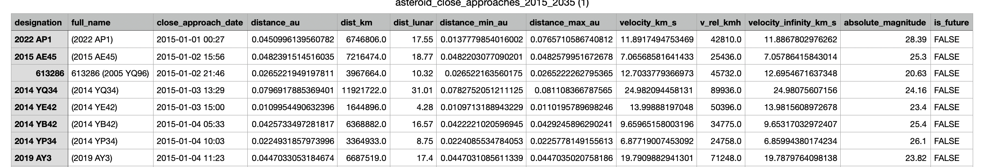
Data Sources
near_earth_asteroids_2025.csv (35,000+ asteroids, 32 columns)
Every known NEA with identity, hazard classification, size estimates, orbital elements, Earth proximity metrics, and observation history.
Notes:
close_approach_date: The exact date and time when the asteroid passes closest to Earth;
distance_au: Closest approach distance in Astronomical Units — 1 AU is the distance from Earth to the Sun
dist_lunar: Same distance expressed in Lunar Distances
Distance_min_au: Minimum possible approach distance accounting for orbital uncertainty
velocity_km_s: Speed of the asteroid relative to Earth at closest approach, in km/s
velocity_infinity_km_s: The asteroid's speed after removing Earth's gravitational pull — reflects its true orbital speed
absolute_magnitude: The H magnitude — a measure of the asteroid's brightness, which indirectly tells us its size. Lower H = larger and brighter object

Slide 6
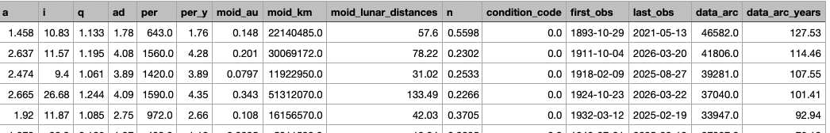
Data Sources
asteroid_close_approaches_2015_2035.csv (50,000+ events)
Every close approach within 0.1 AU of Earth — date, distance, velocity, and whether it already happened or is upcoming.
Notes:
Pha: Potentially Hazardous Asteroid flag — True if the asteroid's orbit brings it close enough and it's large enough to cause significant damage
H: Absolute magnitude — same as above, the key proxy for estimating size
Class: Which orbital family it belongs to — Apollo, Aten, or Amor — based on the shape and size of its orbit
data_arc_years：Same arc length expressed in years — longer means we have more data and a more reliable orbit
e： Orbital eccentricity — how elongated the orbit is. 0 = perfect circle, closer to 1 = more stretched out
moid_au: Minimum Orbit Intersection Distance — the closest the asteroid's orbit can ever get to Earth's orbit, in AU. PHAs have MOID ≤ 0.05 AU
Albedo: How reflective the surface is, on a scale of 0 to 1. Used together with H to estimate diameter
size_category: A human-readable size label: Tiny / Small / Medium / Large

Slide 7
Process Pipeline
Data Cleaning
Feature engineering
EDA
Statistic Testing
Evaluation

Slide 8
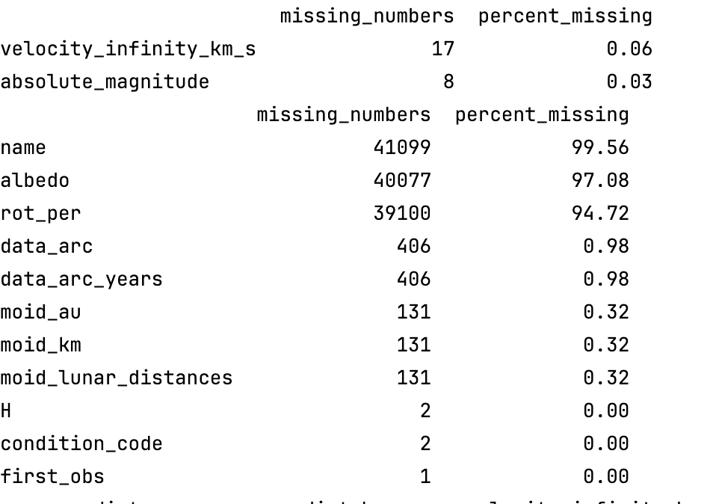
Data cleaning
Filter dataset to future close approach events (2026–2035), 3,888 rows retained
Missing values: velocity_infinity_km_s (17) and absolute_magnitude (8) →ignore
Missing diameter_m (97%) → estimated using NASA formula: 1329 / √albedo × 10^(−H/5),
default albedo = 0.14
pha unmatched (3 rows) → filled with False
Convert close_approach_date from string → datetime
Merge two tables on full_name (left join) → 3,885/3,888 matched (99.9%)
Final dataset: 3,888 rows × 43 columns

Slide 9
Feature engineering
Normalize each dimension to [0, 1] using min-max scaling and Preserves the original relative ordering
Construct five component scores:
Proximity (closer = higher risk)
Size (larger = higher risk)
Velocity (faster = higher risk)
PHA flag (binary)
Uncertainty (orbit variability)
Composite Threat Score =
(0.35 × proximity) + (0.30 × size) + (0.15 × velocity) + (0.10 × pha) + (0.10 × uncertainty) × 100
Weights based on domain knowledge;
proximity and size weighted highest as primary damage determinants

Slide 10
Hypothese test

Slide 11
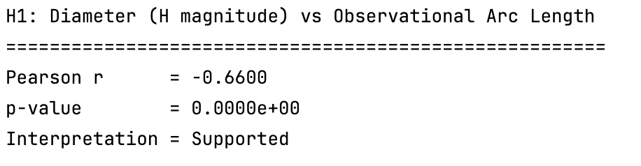
H1 (Pearson correlation)
H1: Near-Earth asteroids with larger estimated diameters have significantly longer observational arcs than smaller asteroids.
Key Question :Is there a linear relationship between two continuous variables (H magnitude and arc length)?
Notes:
Pearson correlation is the natural choice here because both variables are continuous and the hypothesis is purely about whether and how strongly they move together. The output r directly answers both questions at once — direction and strength，
So, as we can see, There is a moderate negative correlation between the size of an asteroid and the duration of its observation (r = -0.66, p ≈ 0); larger asteroids possess more complete observational records. This result is statistically significant.

Slide 12
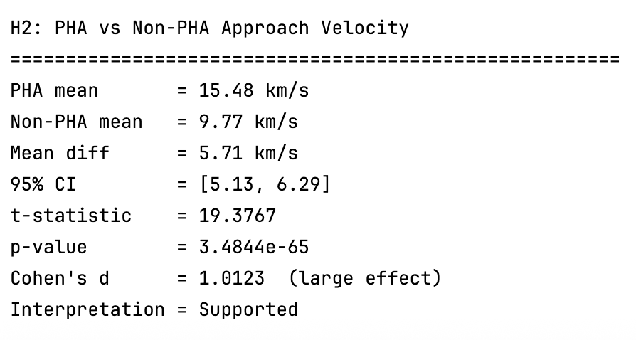
H2 (t test and Cohen’s d)
H2: Potentially Hazardous Asteroids (PHAs) have a higher mean relative velocity at close approach than non-PHAs.
Key question: Do two independent groups (PHA vs non-PHA) have different mean velocities?
Notes:
H2 asks whether the gap between two group means, it is too large to be explained by random chance. Welch's variant is used because it doesn't assume the two groups have equal variance, which is the safer default.
Cohen's d is added on top because with large datasets, even a trivially small difference will produce a significant p-value.
PHAs approach Earth at significantly higher velocities than non-PHAs (15.48 vs 9.77 km/s), with the difference being both statistically unambiguous (p ≈ 3.5e-65) and practically large (d = 1.01), strongly supporting H2.

Slide 13
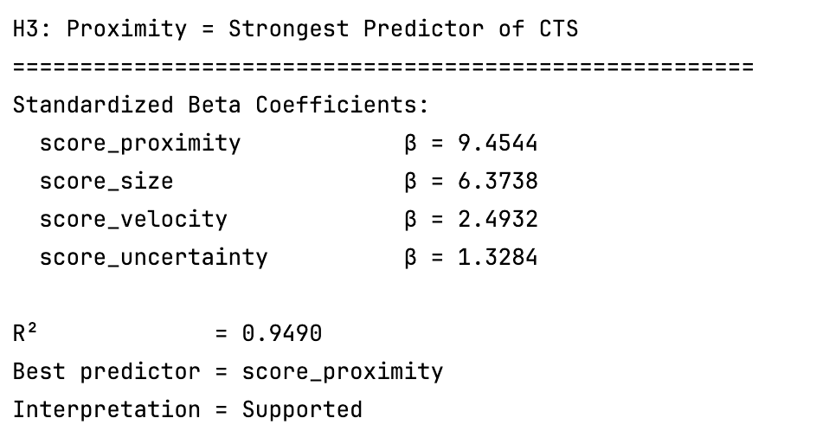
H3 (Standardized Linear Regression)
H3:Approach distance is the strongest predictor of composite threat scores compared to size, velocity, and orbital uncertainty.
Key Question: Among four predictor variables, which one explains the most variance in the threat score?
Notes:
By Z-score scaling all predictors before fitting, the β coefficients are expressed in the same unit (standard deviations), so comparing their absolute values directly tells which predictor pulls the most weight. R² then tells how much of the outcome the whole model explains together.
The coefficient of Score proximity is higher than others and R squared =0.9490, very close to 1, strongly supported H3.

Slide 14
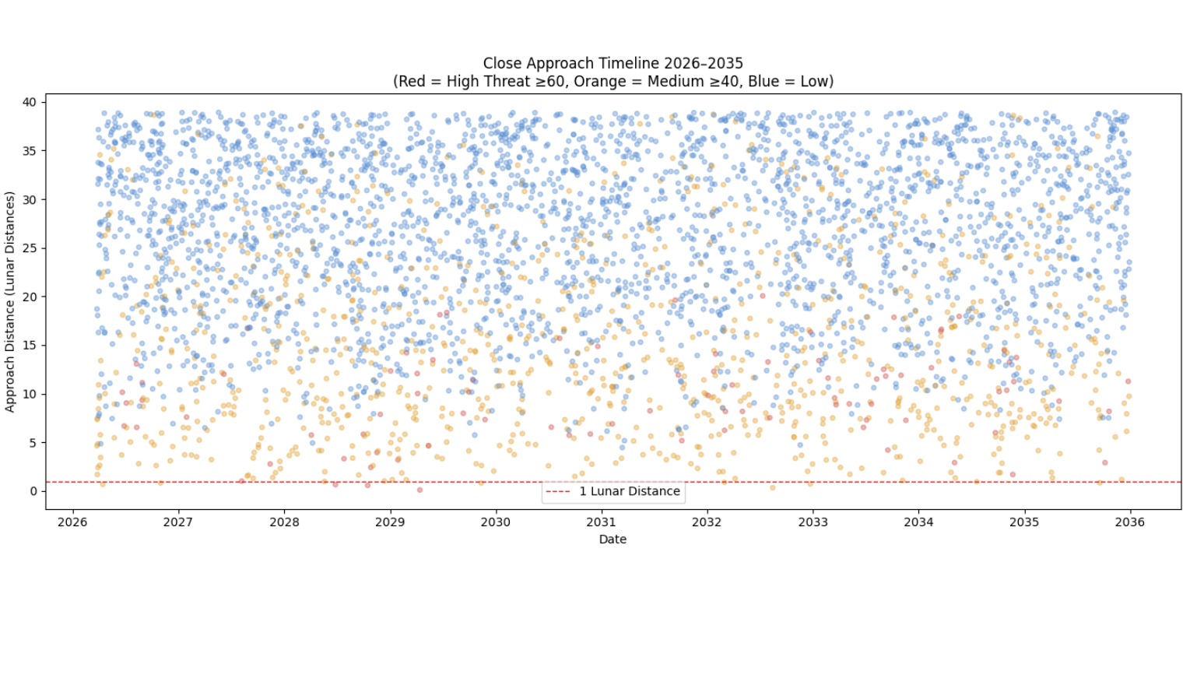
EDA
Notes:
the scatterplot is quite sparse and every high-threat event occurs below approximately 15 lunar distances, proving proximity as the dominant threat driver and supporting H3.
The vast majority of approaches are low-threat and distant, with only a handful of events crossing below 1 lunar distance — most notably the Apophis flyby in April 2029 at just 0.10 lunar distances.

Slide 15
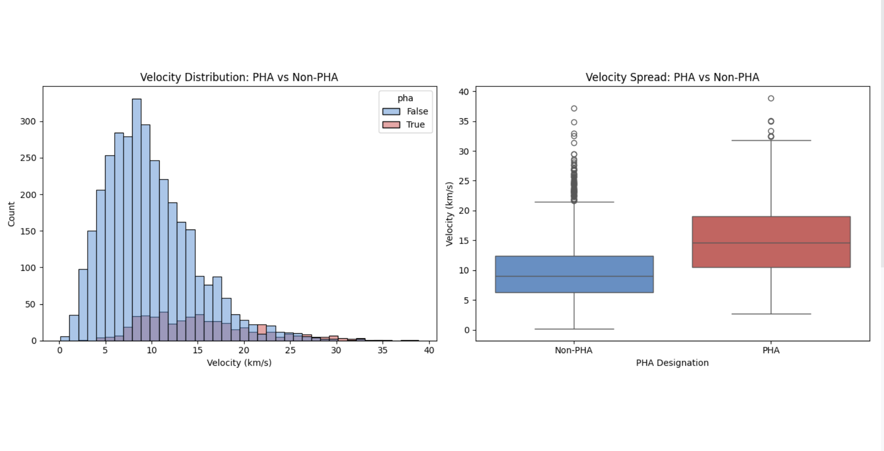
Notes:
first chart reveals that non-hazardous objects are significantly more numerous and peak at a lower velocity, while PHAs are distributed more sparsely across a similar speed range.
PHAs approach Earth at substantially higher velocities than non-PHAs, with median speeds of approximately 15 km/s versus 9 km/s respectively, and the middle 50% of each group barely overlapping — providing strong visual confirmation of the H2 findings.

Slide 16
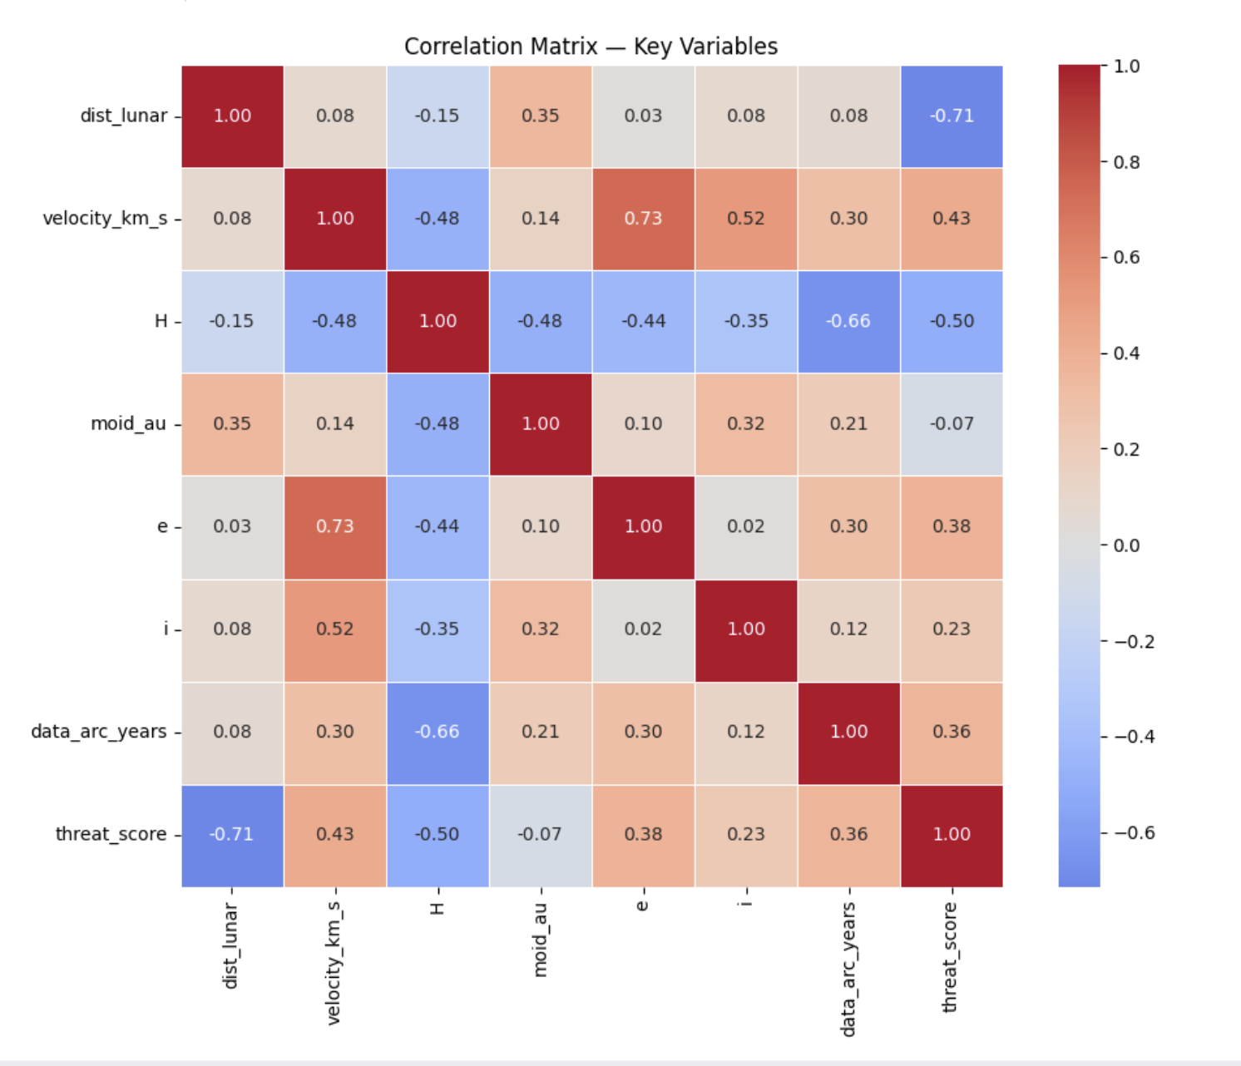
Notes:
The heatmap confirms proximity as the dominant threat driver, with dist_lunar showing the strongest correlation to threat score at -0.71, followed by H magnitude at -0.50 and velocity at 0.43 — directly supporting H3.
Next, There is a -0.66 correlation between H magnitude (size) and arc-length, confirming that larger asteroids tend to have much longer and more detailed observational histories than smaller ones.
also, We see a high correlation of 0.73 between velocity and eccentricity. This tells us that asteroids with more elongated orbits travel significantly faster as they pass Earth, which explains the high approach speeds we’ve observed among pha.

Slide 17
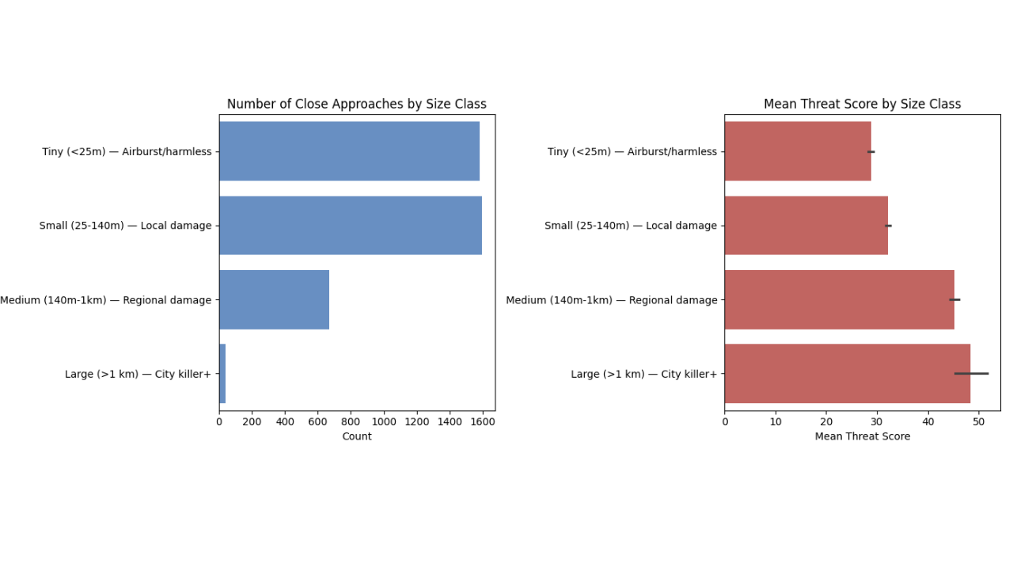
Notes:
The most frequently observed asteroids are the least dangerous, while the rarest ones pose the greatest threat, revealing an inverse relationship between close approach frequency and actual risk.

Slide 18
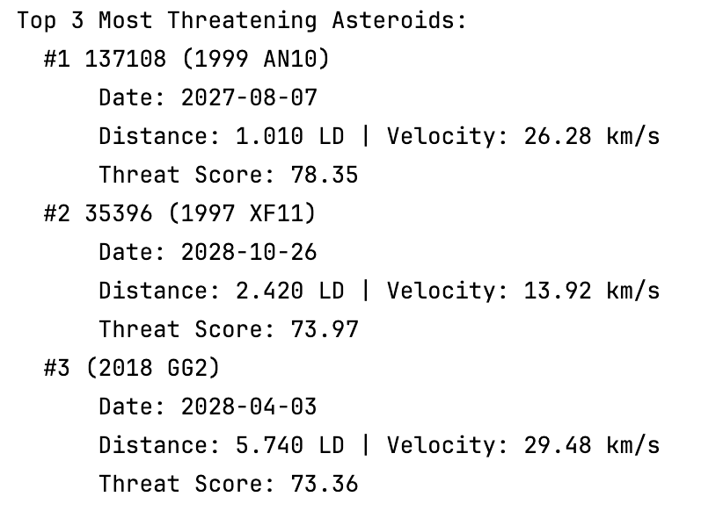
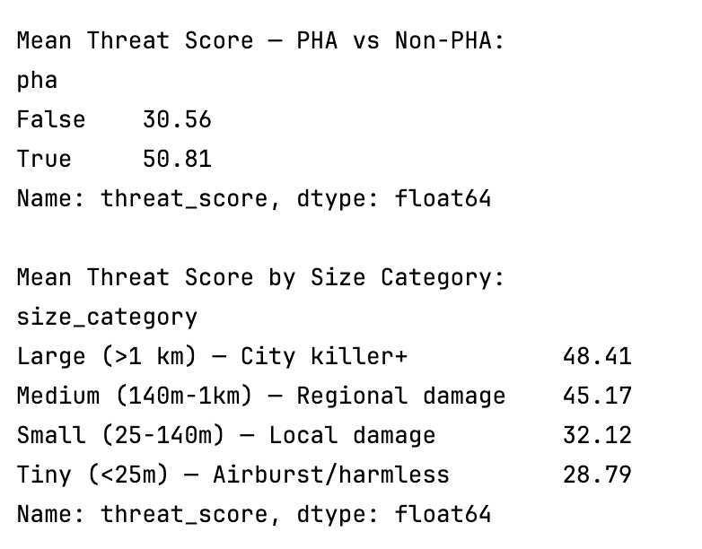
Research question1: Which asteroids pose the greatest threat during 2026-2035?

Slide 19
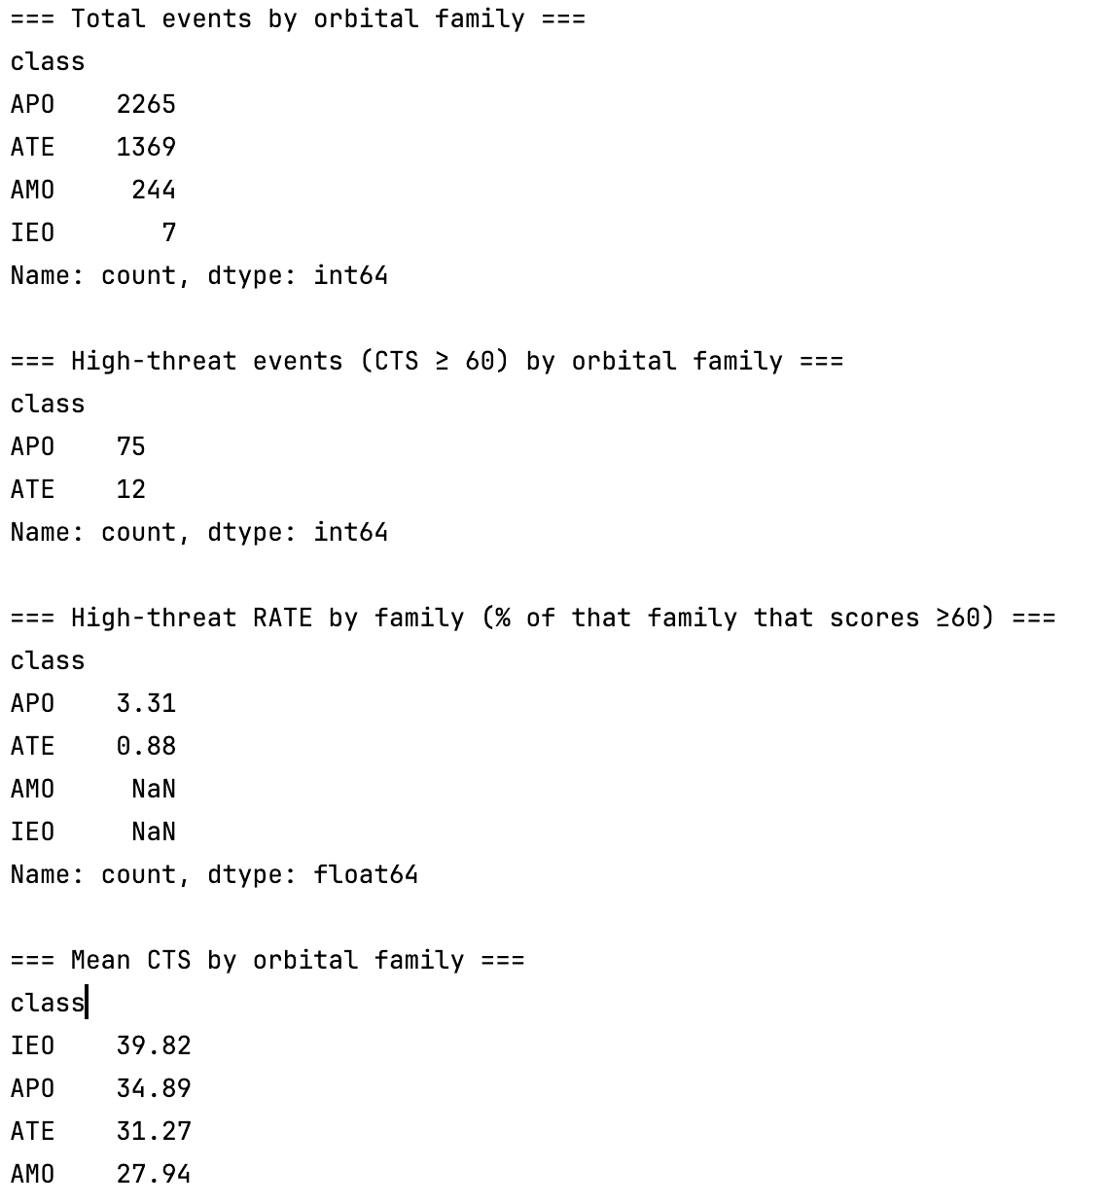
Research question2:
Which orbital family(Apollo/ Aten/Amor) contributes most high-threat events?
Notes:
Apollo asteroids dominate the threat landscape — contributing 86% of all high-threat close approach events and showing a high-threat rate nearly 4 times higher than Aten asteroids, largely because their orbits cross Earth's path from the outside, creating more frequent and faster close encounters.

Slide 20
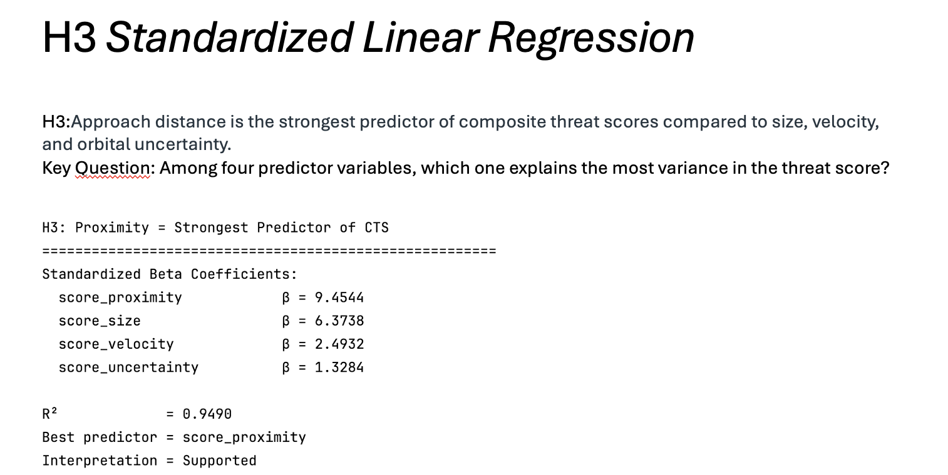
Research question3:
Besides PHA designation, which factor best explains variance in threat scores?
According to h3, proximity explains best.

Slide 21
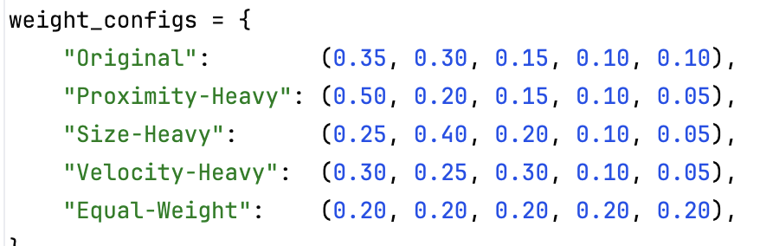
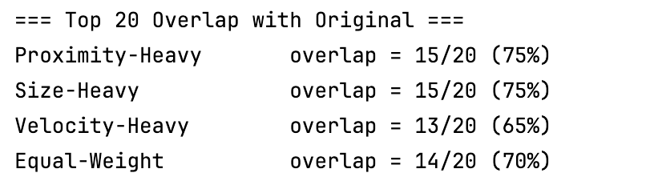
Evaluation (Spearman correlation)
Notes:
Spearman correlation measures the monotonic relationship between two variables by comparing their ranks, making it more robust than Pearson when evaluating ranking stability or non-linear relationships.
To evaluate whether our Composite Threat Score is robust, i tested five different weight configurations — ranging from proximity-heavy to equal-weight — and compared how much the Top 20 ranking changed across each. The overlap ranged from 65% to 75%, meaning at least 13 out of 20 high-threat asteroids remain consistent regardless of how we adjust the weights, confirming that our core findings are not an artifact of our specific weight choices.

Slide 22
Limitations
CTS is a relative ranking, NOT impact probability
- 97% of diameters are estimated (albedo assumed = 0.14)
- Weights are expert-based, not statistically derived
- Small asteroid catalog is incomplete (arc < 0.1 yr)

