Slide 1
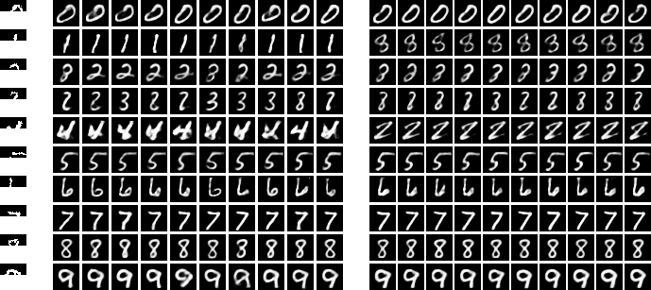
input
NFW
meanfield

