Slide 1

Market Value & Machine Learning
Team Smile –
Bing Zhang
Zhen Yang
Amy Vargas-Tonsi
Michelle Bigham
Steve Allison

Slide 2
Gather Data
U.S. Census Bureau American Housing Survey (AHS): A statistical survey funded by the United States Department of Housing and Urban Development (HUD)
National longitudinal samples
Metropolitan area longitudinal oversamples
Integrated national samples and metropolitan oversamples
Largest regular national housing sample survey in the United States
Contains information on the number and characteristics of U.S. housing units & occupants

Slide 3
Data Cleansing & Munging
Data Cleansing
Multiple tables with 1,800+ columns
66,752 records
New csv (narrowed down housing features)
Data Munging
Removed null values: 27,095
Removed outliers: 24,385

Slide 4
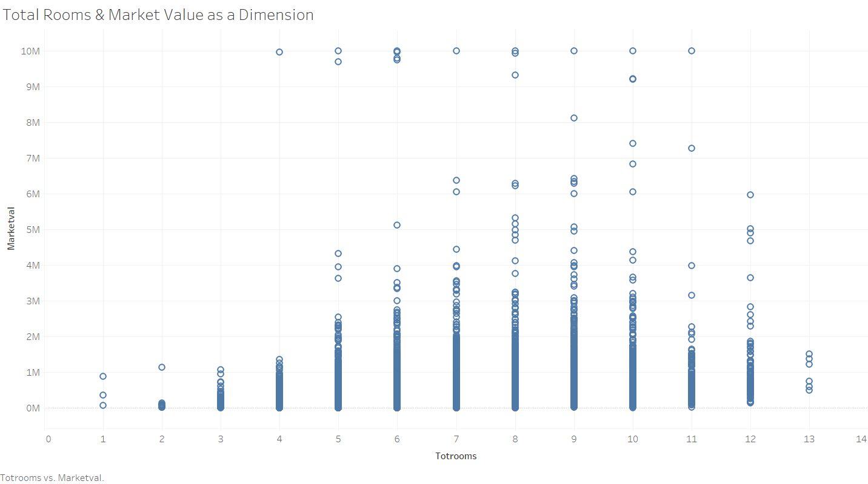
Tableau: Initial Data Review
Market Value as a Dimension is Noisy

Slide 5
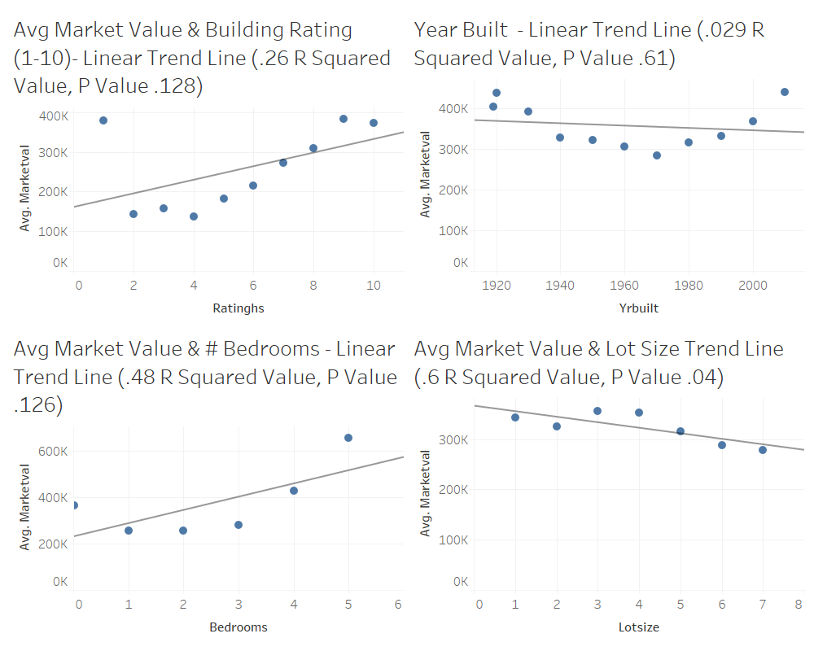
Tableau: Housing Features
Weak Correlation to Average Market Value

Slide 6
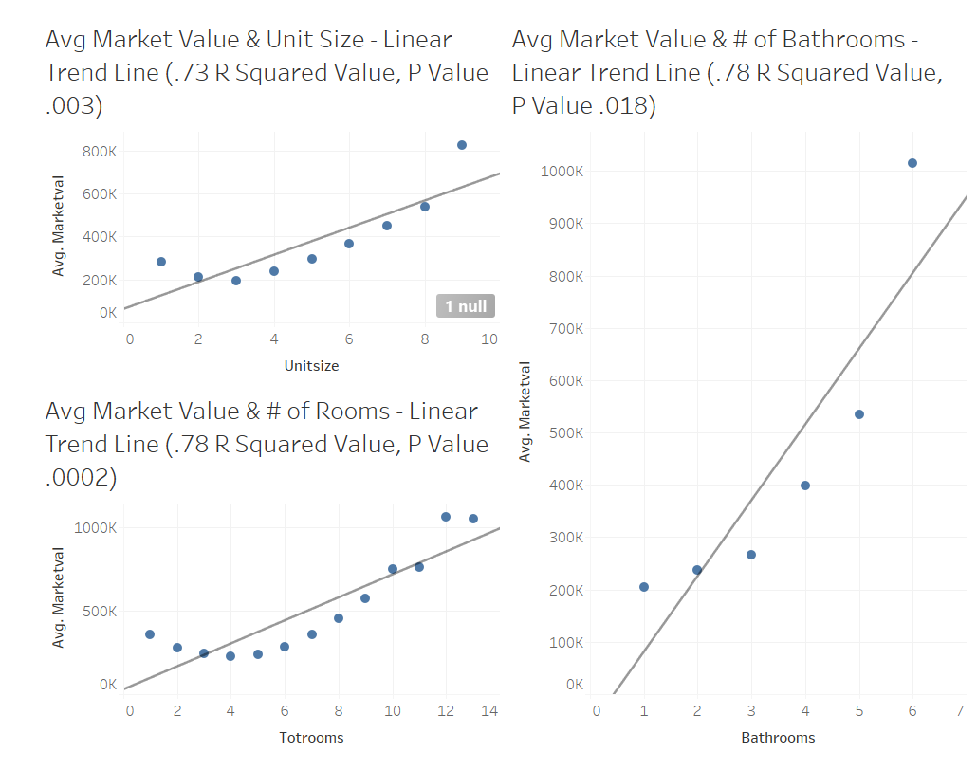
Tableau: Housing Features
Stronger Correlation to Average Market Value

Slide 7
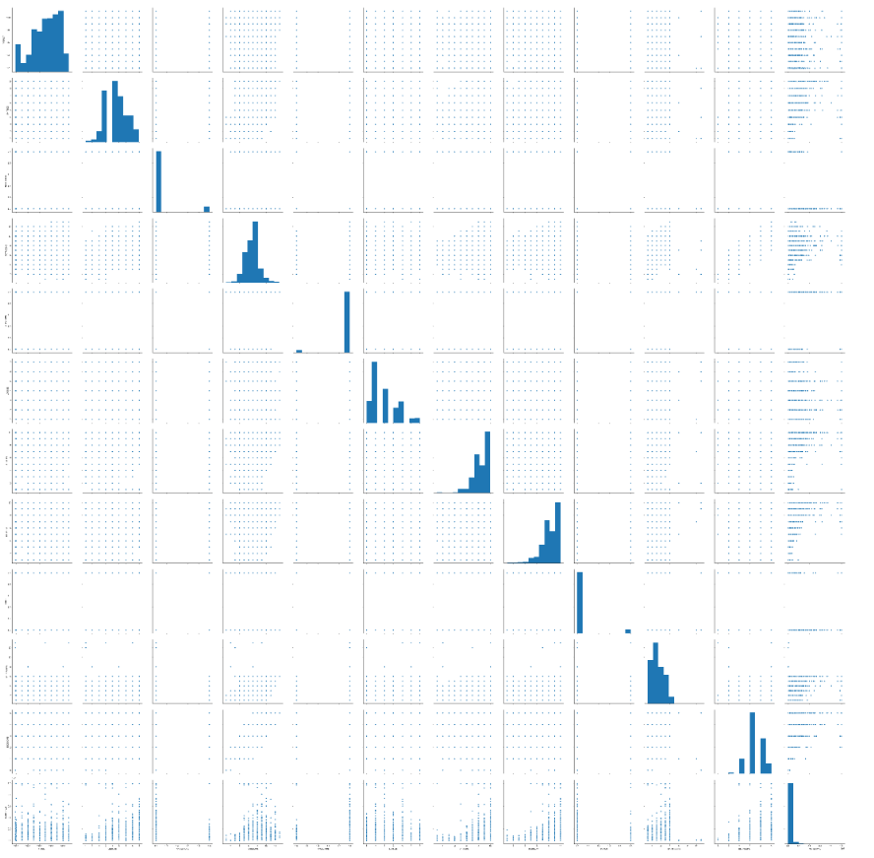
Data Analysis Visualization
Seaborn Pair Plot Function

Slide 8
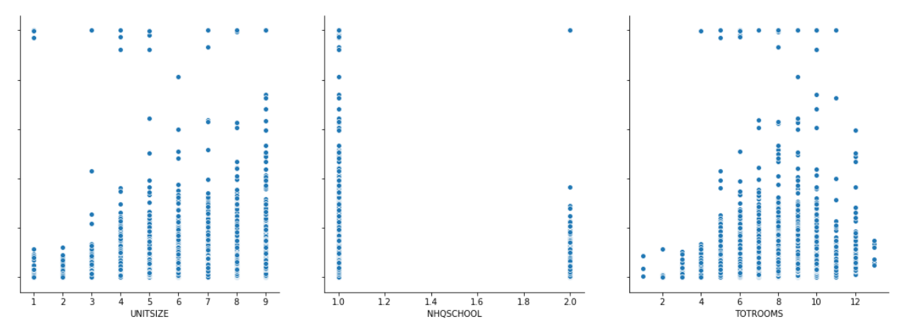
Data Analysis & Visualization

Slide 9
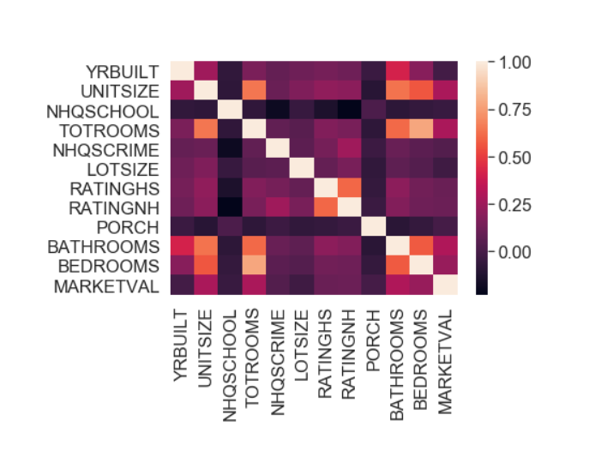
Data Analysis Visualization
Pandas DataFrame & Seaborn Heatmap Function

Slide 10
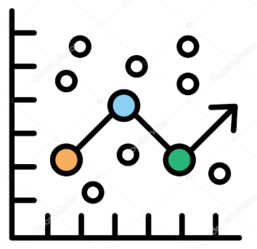

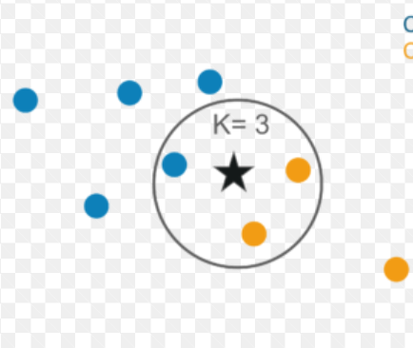
Choosing Our Algorithms
We tried several different models to see which was most accurate for our data including:
Ⅰ. Multiple Linear Regression Model
Ⅱ. Decision Tree Model
Ⅲ. KNN Classification Model

Slide 11
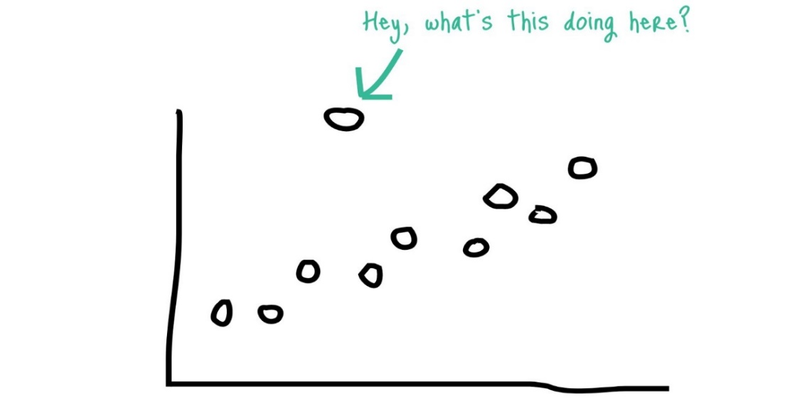
Remove Outliers
Initial review of our data allowed us to see a large variance in the dataset and existence of outliers.
Used “Elliptic Envelope” module to remove the outliers.
This took us from 27,095 records to 24,385 records
The results doubled our score!

Slide 12
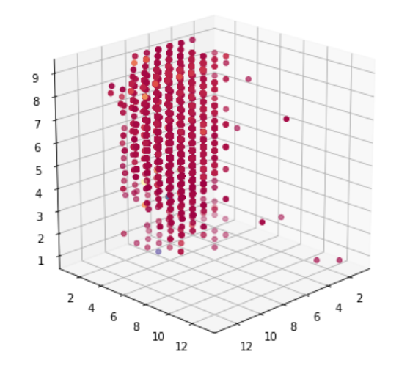
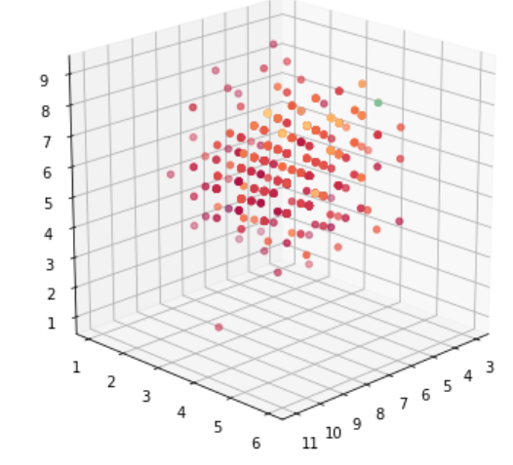
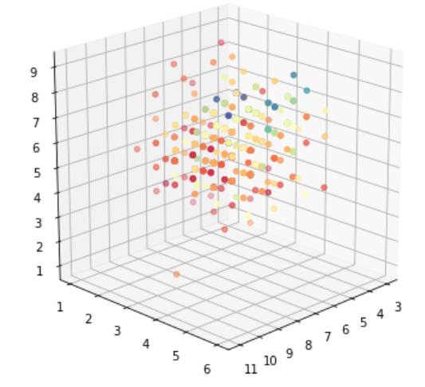
Multiple Regression Model
◆ Independent variables(Xs): Total Rooms, Bathrooms, Unit Size
⇒ dependent variables(Y) : Marketing Price
・National
・City
・City (cleaned)

Slide 13
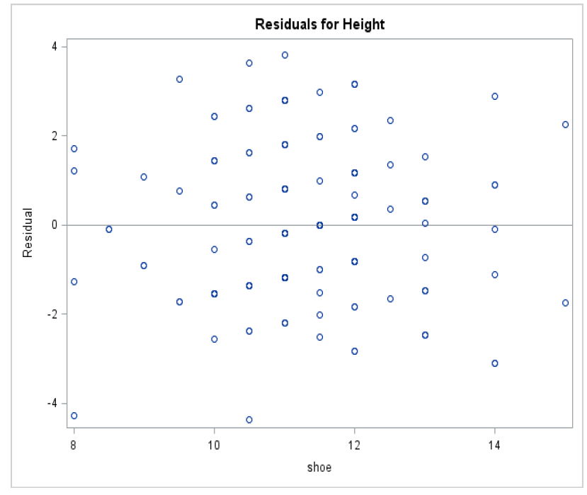
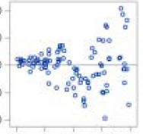
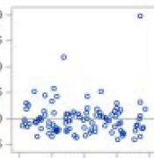
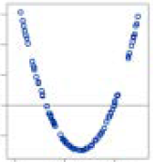
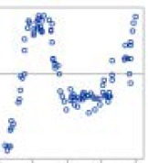
Assumptions of Linear Regression
✔Data met assumptions
Ⅰ. No or little collinearity
Ⅱ. Same Variance
Ⅲ. No significant outliers
(normally distributed)
Ⅳ. Linear relationship
Ⅴ. No auto-correlation
✖ Data did NOT meet assumptions
Ⅱ
Ⅲ
Ⅳ
Ⅴ

Slide 14
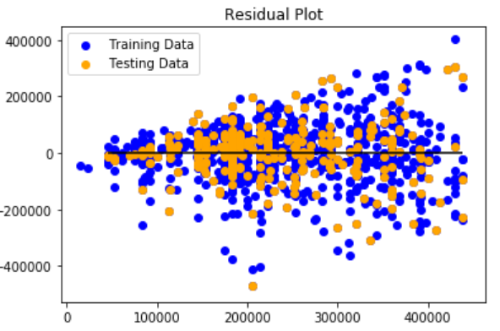
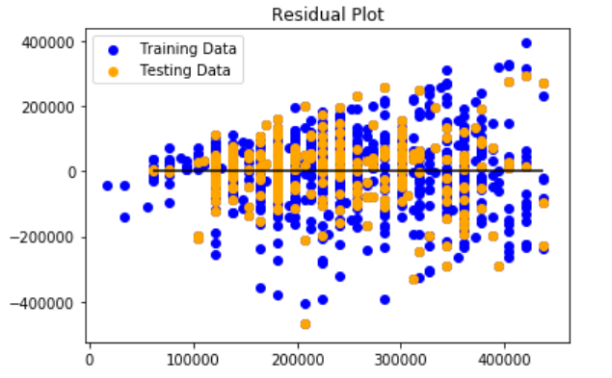
Validate the Housing Data
Assumption Ⅰ & Ⅱ: No or little collinearity
Same variance
R2: 47%
R2: 47%
・Total Rooms
・Bathrooms
・Unit Size
・Total Rooms
・Bathrooms
・Unit Size

Slide 15
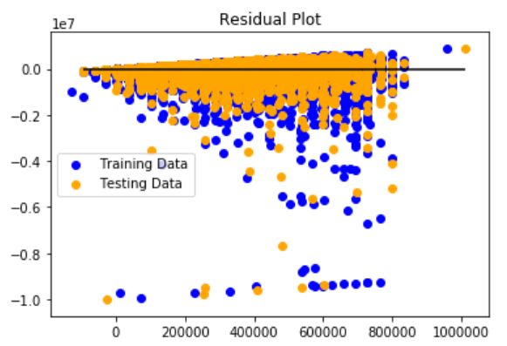
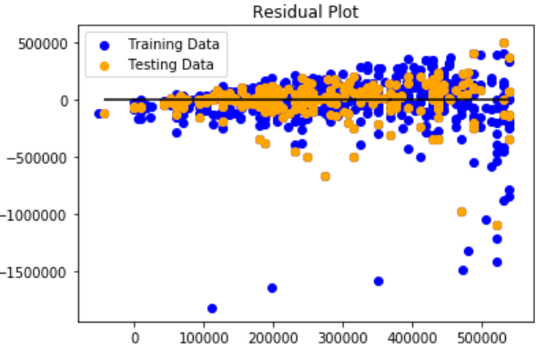
Validate the Housing Data
AssumptionⅢ:no significant outlier(normality)
・National
└R2: 9%
・City └R2: 33%
・City (cleaned) └R2: 47%

Slide 16
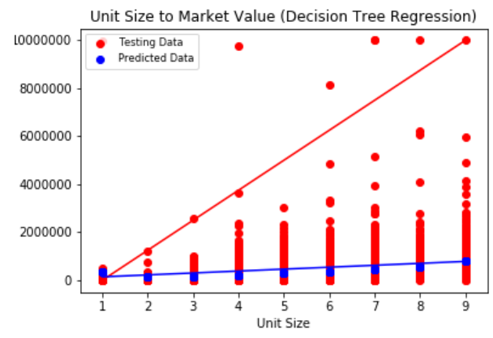
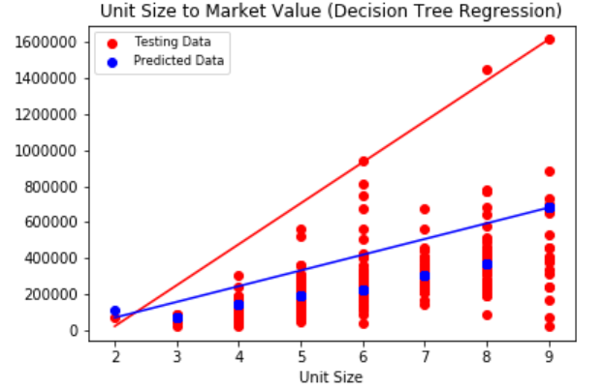
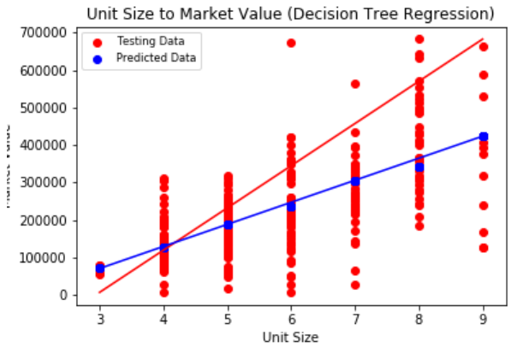
Decision Tree Ⅰ
◆Independent variables(X):Unit Size
⇒dependent variables(Y) :Marketing Price
・National
└R2: 9%
・City └R2: 38%
・City (cleaned) └R2: 43%
Predicted and Testing lines are getting closer!

Slide 17

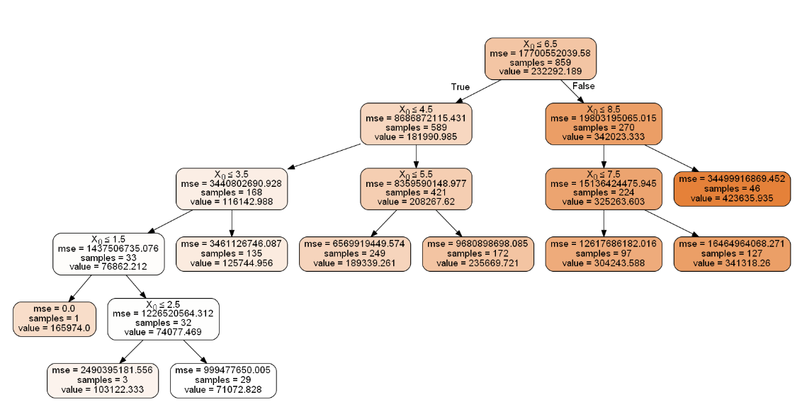
Decision Tree Ⅱ

Slide 18

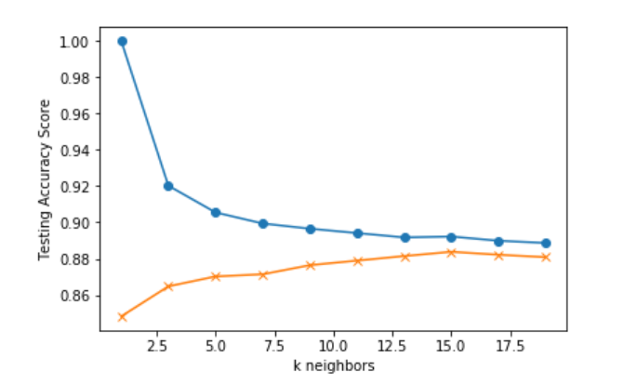

KNN Classification
K=15
Accuracy: 88%

Slide 19
Next Steps
Phase II
Identify other models that incorporate additional features
Scale to fit market to improve accuracy
Phase III
Build web app with user interface

