Slide 1
2026-01-27

Slide 2
Iceberg Hidden Partition
隐藏分区根据已有字段做函数转换，生成分区，不需要额外在表中添加分区列
分区函数通常包含以下
Identity
Bucket[N]
Truncate[W]
Year
Month
Day
Hour

Slide 3
Iceberg Hidden Partition
隐藏分区类型
 | 分区列 | 存储路径 | 分区类型 | 示例 | 场景
Identity分区 | 表中的原始列event_date | attr_vals/data/event_date=2025-10-01 | Identity | event_date 按照event_date原始值分区 | 低基数列 Region Department Status Product
非identity分区 | 对原始列的加工year(event_date) | attr_vals/data/event_date_year=2025 | Bucket | Bucket(serial_num,,16) 根据serial_num做hash分成16个桶 | 高基数列 User_id Order_id Serial_num
 |  |  | Truncate | Truncate(serial_num,3) 根据serial_num前三位分区 | 长字符串 Url File_path
 |  |  | Year Month Day Hour | Year(event_date) (必须为时间类型) | 时间列

Slide 4
Iceberg Hidden Partition – Test case
Truncate分区示例
在三级分区下创建基于serial_num前三位的分区
CREATE TABLE icebergrestbk5.summit.attr_vals (
serial_num varchar,
trans_seq varchar,
seq varchar,
……
drive_event_date varchar,
fail_code varchar,
event_date varchar,
family varchar,
operation varchar
)
WITH (
compression_codec = 'ZSTD',
format = 'PARQUET',
format_version = 2,
location = s3a://kor-gfit-dev-uss01/ice_warehouse_bk2/summit/attr_vals ',
partitioning = ARRAY['event_date','family','operation','truncate(serial_num, 3)']
)

Slide 5
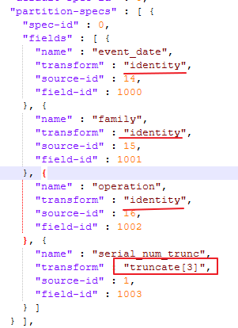
Iceberg Hidden Partition – Test case
元数据json中的分区信息，原分区三列类型为identity，serial_num分区类型为truncate

Slide 6
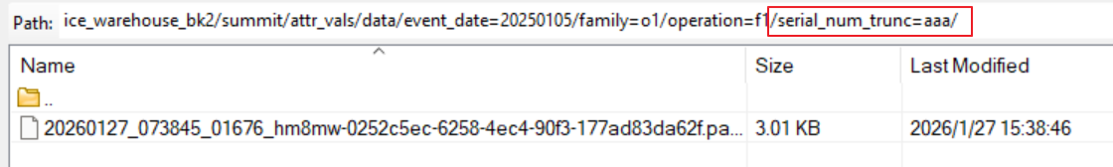
Iceberg Hidden Partition – Test case
插入一条数据后
S3 data目录结构，增加了serial_num_trunc=aaa的分区

Slide 7
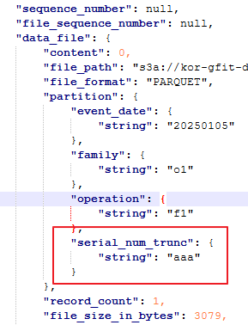
Iceberg Hidden Partition – Test case
Iceberg的元数据manifest中写入了serial_num分区信息

Slide 8
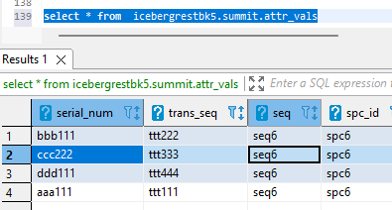
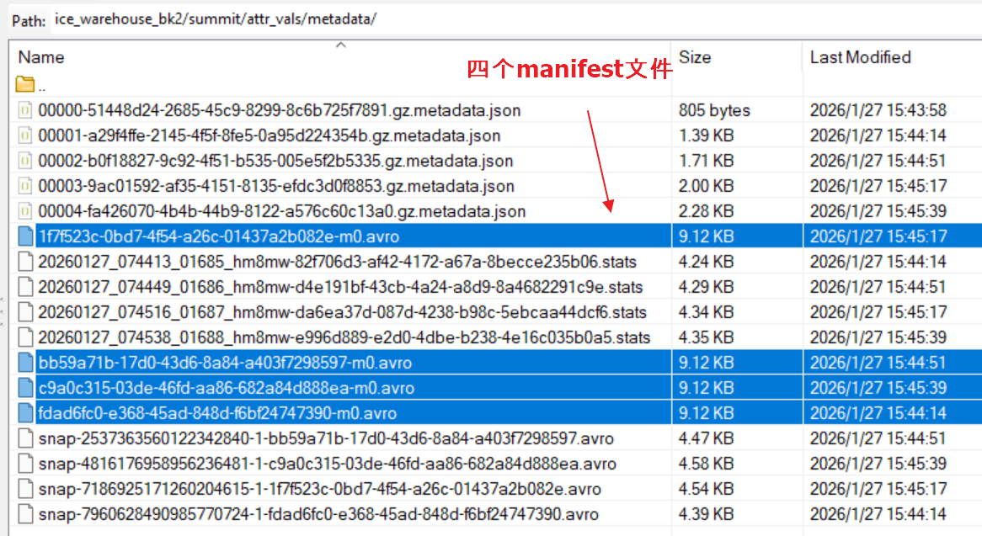
Iceberg Hidden Partition – Test case
再插入3条数据后
四次提交，四份metadata

Slide 9
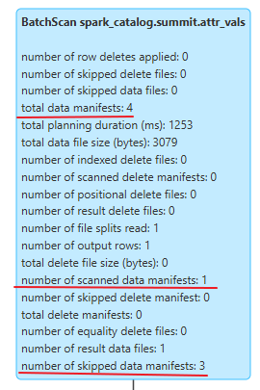
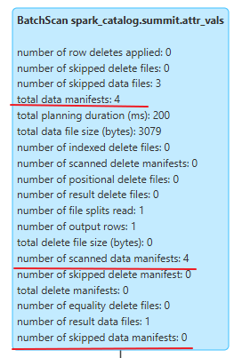
Spark Sql Analyze
执行 SELECT count(*) FROM summit.attr_vals
WHERE serial_num =‘aaa111'
执行 SELECT count(*) FROM summit.attr_vals
WHERE trans_seq =‘ttt111'
用serial_num过滤时，iceberg只扫描了4个mainifest文件中的1个，trans_seq字段过滤时，全量扫描4个 mainifest

Slide 10
Hidden Partition Write/Read Flow
以truncate(serial_num, 3)分区为例
Client
Client
写
读
Iceberg
Iceberg
Data
metadata
Snapshot
读取最新的snapshot，找到对应的manifest
parquet
Manifest
Manifest
读取manifest找到包含serial_num_trunc=‘aaa’的data文件
增加data目录serial_num_trunc=‘aaa’
写入分区信息serial_num_trunc=‘aaa’
parquet
读取manifest对应的data文件

