Slide 1
2026-02-05

Slide 2
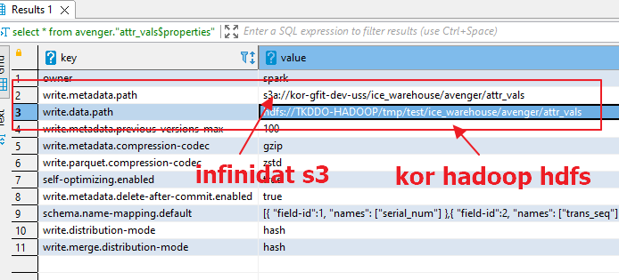
Catalog Support S3 and Hdfs
目标：将iceberg表的metadata和data分别写入s3和hdfs
修改avenger.attr_vals表属性write.metadata.path, write.data.path

Slide 3
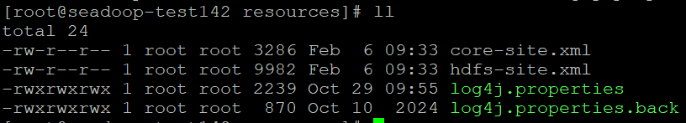
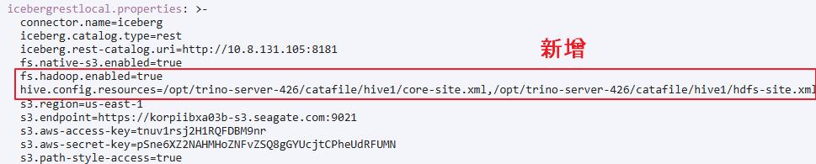
Catalog Support S3 and Hdfs
将hadoop配置文件core-site.xml,hdfs-site.xml放到catalog的资源目录下，打包发布catalog
在trino的iceberg connector下配置hadoop参数

Slide 4
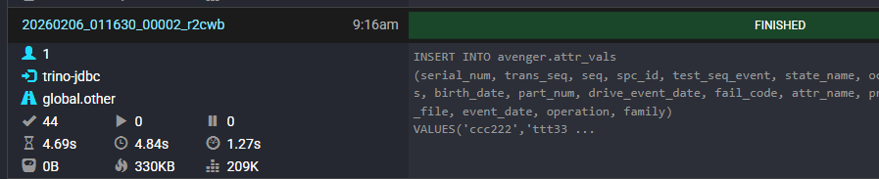
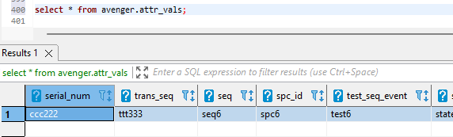
Catalog Support S3 and Hdfs
在trino中用insert into语句插入avenger.attr_vals表数据，执行成功
查询数据

Slide 5
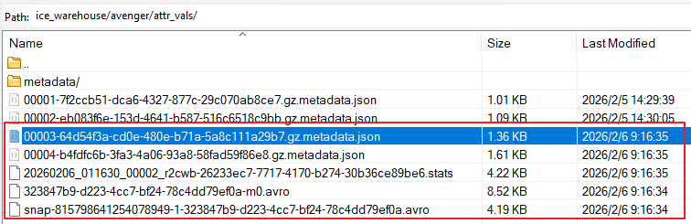
Catalog Support S3 and Hdfs
S3 metadata地址
Hdfs data地址

Slide 6
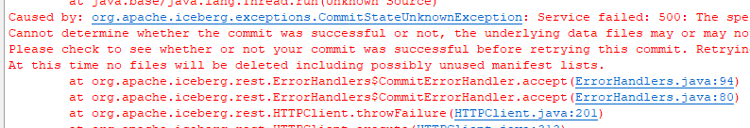
Catalog Support S3 and Hdfs
尝试将metadata从s3迁移到hdfs，报错
ALTER TABLE cimarron.attr_vals SET TBLPROPERTIES (‘write.metadata.path’ = ‘hdfs://TKDDO-HADOOP/tmp/test/ice_warehouse/cimarron/attr_vals/testmetadata’)
Caused by: org.apache.iceberg.exceptions.CommitStateUnknownException: Service failed: 500: The specified bucket does not exist (Service: S3, Status Code: 404, Request ID: UNQKEQ2PHOQS2P67, Extended Request ID: fc63d3b93c4b68f1f32e5c2636f9e56748297736)
Cannot determine whether the commit was successful or not, the underlying data files may or may not be needed. Manual intervention via the Remove Orphan Files Action can remove these files when a connection to the Catalog can be re-established if the commit was actually unsuccessful.
Please check to see whether or not your commit was successful before retrying this commit. Retrying an already successful operation will result in duplicate records or unintentional modifications.
At this time no files will be deleted including possibly unused manifest lists.

Slide 7
Iceberg Hidden Partition
隐藏分区类型
 | 分区列 | 存储路径 | 分区类型 | 示例 | 场景
Identity分区 | 表中的原始列event_date | attr_vals/data/event_date=2025-10-01 | Identity | event_date 按照event_date原始值分区 | 低基数列 Region Department Status Product
非identity分区 | 对原始列的加工year(event_date) | attr_vals/data/event_date_year=2025 | Bucket | Bucket(serial_num,,16) 根据serial_num做hash分成16个桶 | 高基数列 User_id Order_id Serial_num
 |  |  | Truncate | Truncate(serial_num,3) 根据serial_num前三位分区 | 长字符串 Url File_path
 |  |  | Year Month Day Hour | Year(event_date) (必须为时间类型) | 时间列

Slide 8
Iceberg Hidden Partition – Test case
Truncate分区示例
在三级分区下创建基于serial_num前三位的分区
CREATE TABLE icebergrestbk5.summit.attr_vals (
serial_num varchar,
trans_seq varchar,
seq varchar,
……
drive_event_date varchar,
fail_code varchar,
event_date varchar,
family varchar,
operation varchar
)
WITH (
compression_codec = 'ZSTD',
format = 'PARQUET',
format_version = 2,
location = s3a://kor-gfit-dev-uss01/ice_warehouse_bk2/summit/attr_vals ',
partitioning = ARRAY['event_date','family','operation','truncate(serial_num, 3)']
)

Slide 9
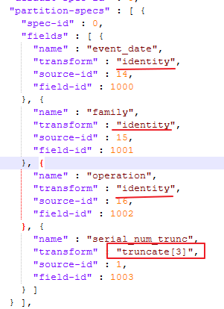
Iceberg Hidden Partition – Test case
元数据json中的分区信息，原分区三列类型为identity，serial_num分区类型为truncate

Slide 10
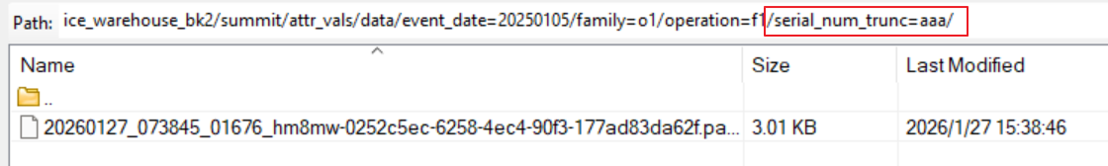
Iceberg Hidden Partition – Test case
插入一条数据后
S3 data目录结构，增加了serial_num_trunc=aaa的分区

Slide 11
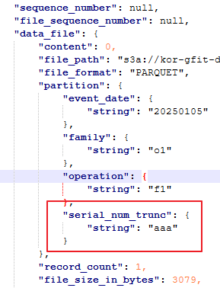
Iceberg Hidden Partition – Test case
Iceberg的元数据manifest中写入了serial_num分区信息

Slide 12
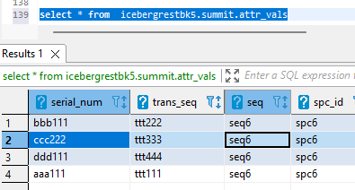
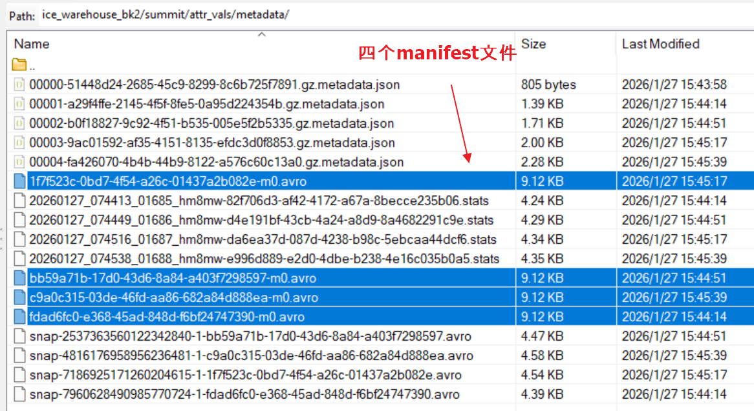
Iceberg Hidden Partition – Test case
再插入3条数据后
四次提交，四份metadata

Slide 13
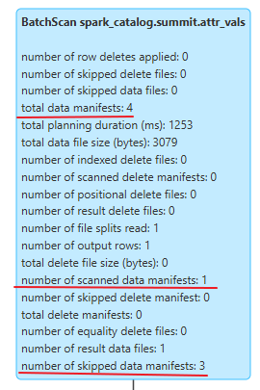
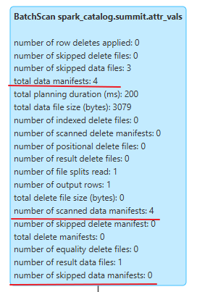
Spark Sql Analyze
执行 SELECT count(*) FROM summit.attr_vals
WHERE serial_num =‘aaa111'
执行 SELECT count(*) FROM summit.attr_vals
WHERE trans_seq =‘ttt111'
用serial_num过滤时，iceberg只扫描了4个mainifest文件中的1个，trans_seq字段过滤时，全量扫描4个 mainifest

Slide 14
Hidden Partition Write/Read Flow
以truncate(serial_num, 3)分区为例
Client
Client
写
读
Iceberg
Iceberg
Data
metadata
Snapshot
读取最新的snapshot，找到对应的manifest
parquet
Manifest
Manifest
读取manifest找到包含serial_num_trunc=‘aaa’的data文件
增加data目录serial_num_trunc=‘aaa’
写入分区信息serial_num_trunc=‘aaa’
parquet
读取manifest对应的data文件

