Slide 1
Stress field prediction with ML

Slide 2
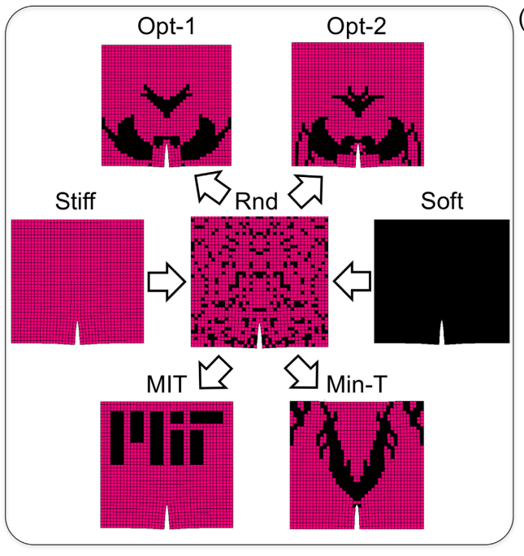
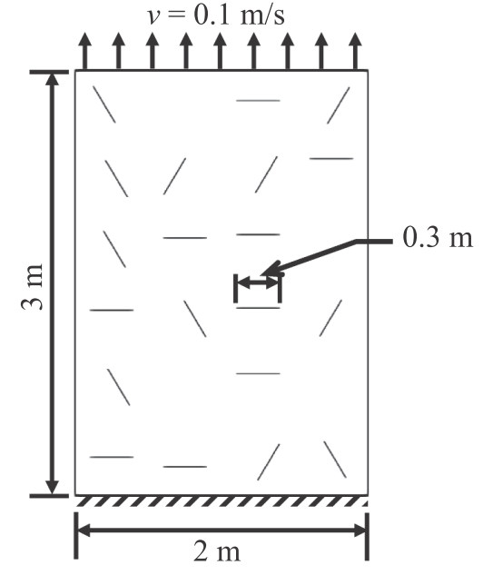
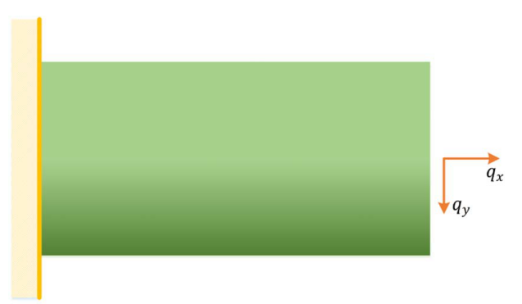
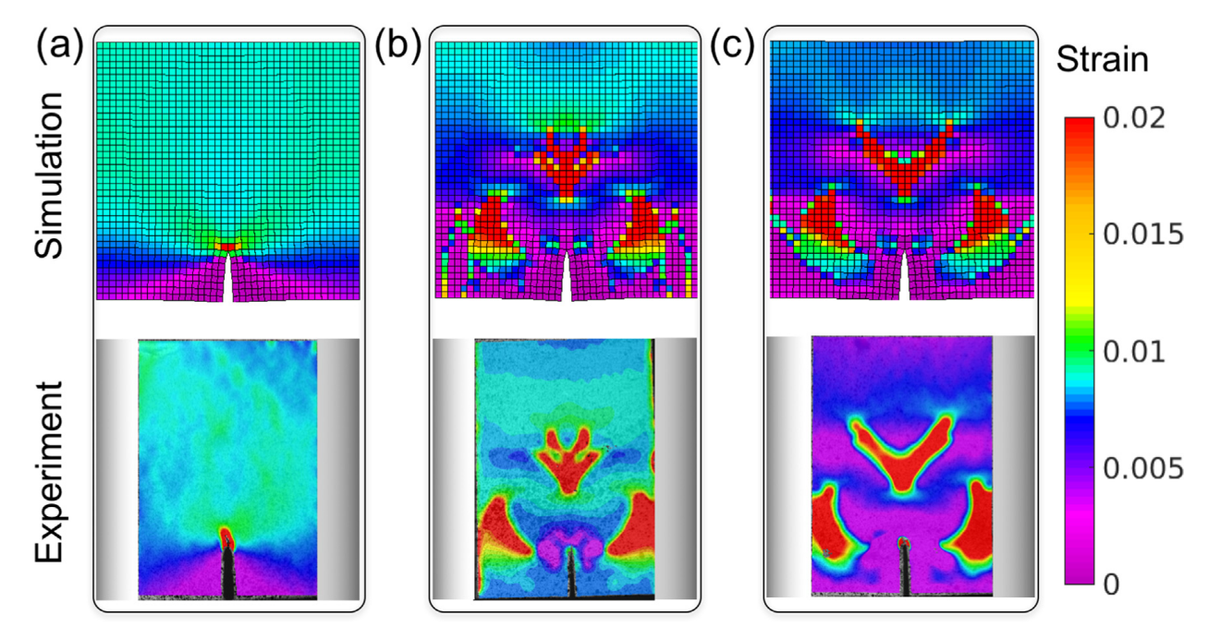
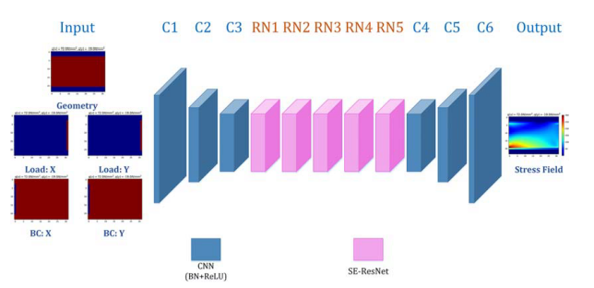
Background: From simple to complex
Simple structure
With crack
Compostie materials design
Nie, Zhenguo et al Journal of Computing and Information Science in Engineering (2020).
Hunter, Abigail, et al. Computational Materials Science (2019)
Gu, Grace X et al Additive Manufacturing (2017)

Slide 3
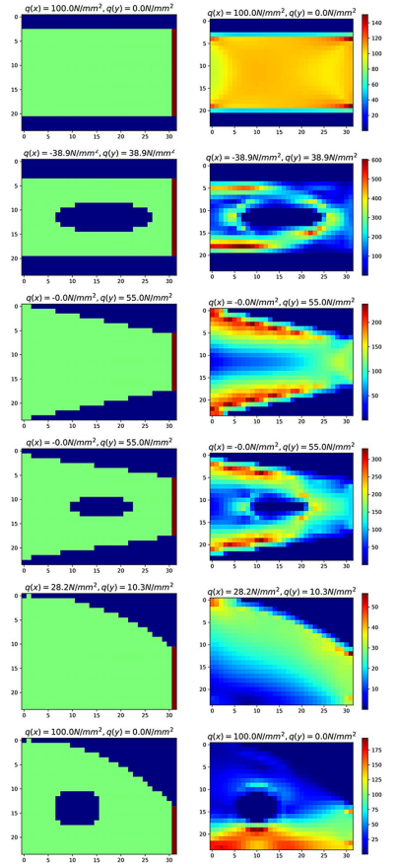
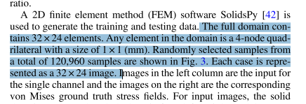
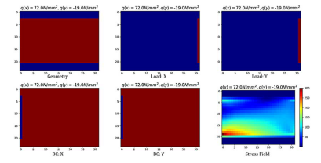
One example
Nie, Zhenguo et al Journal of Computing and Information Science in Engineering (2020).

Slide 4
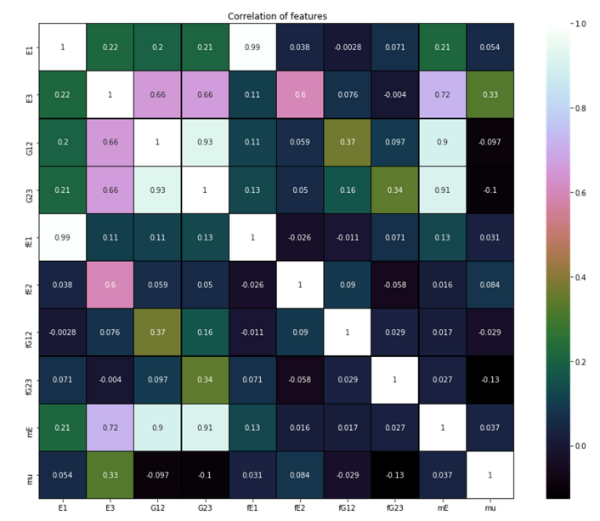
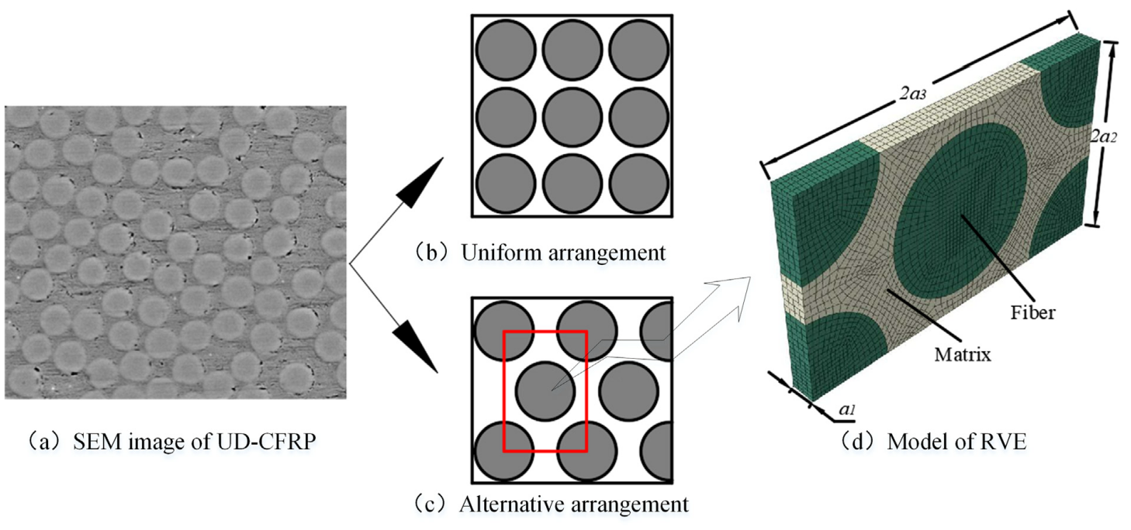
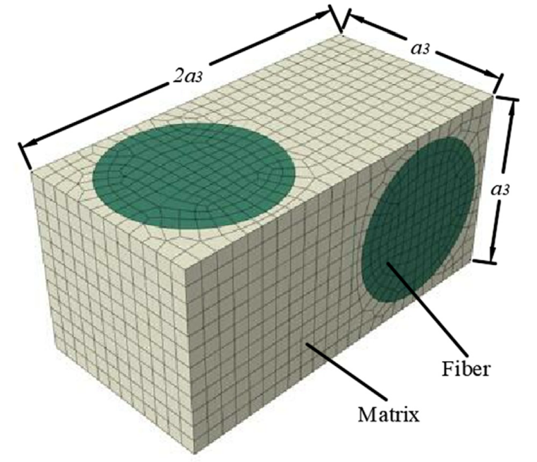
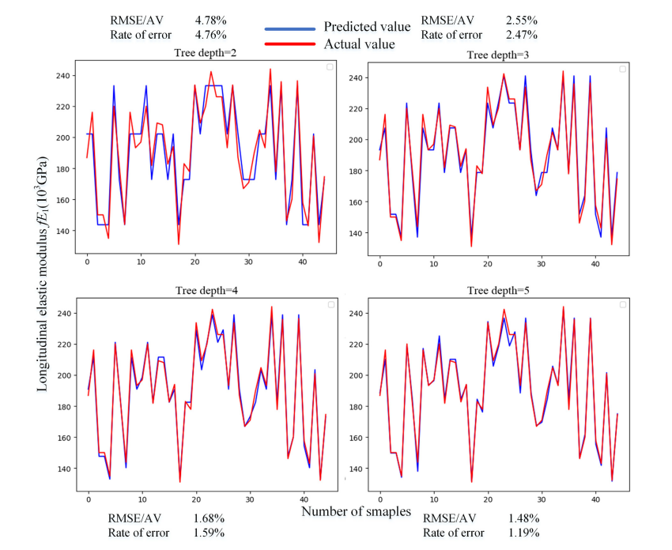
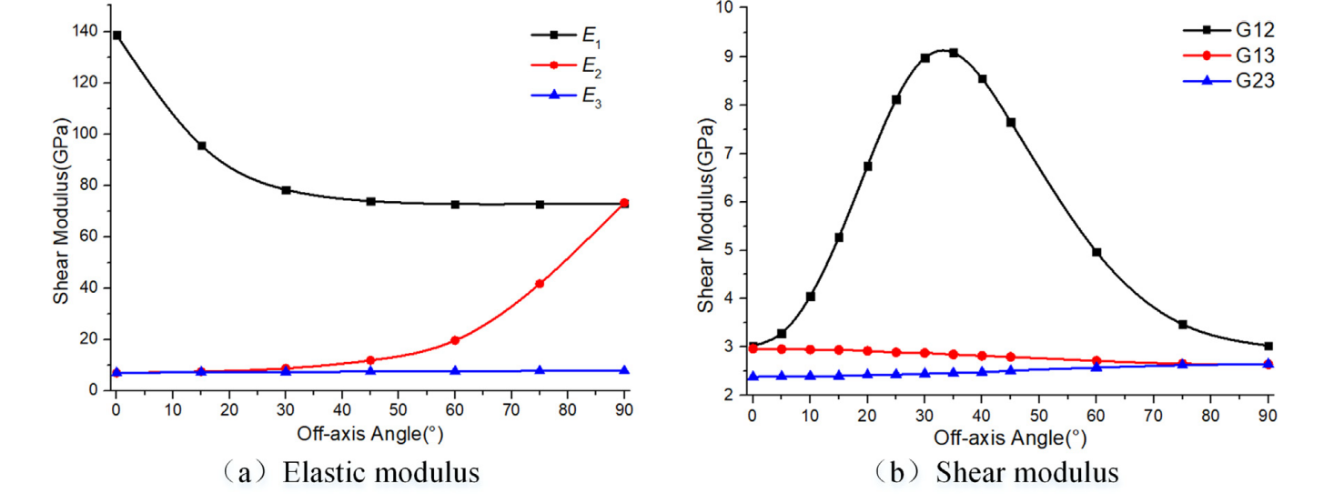
Another exmaple
Qi Zhenchao, et al. Composite Structures (2019) 1
Qi Zhenchao, et al. Composite Structures (2019) 2

Slide 5
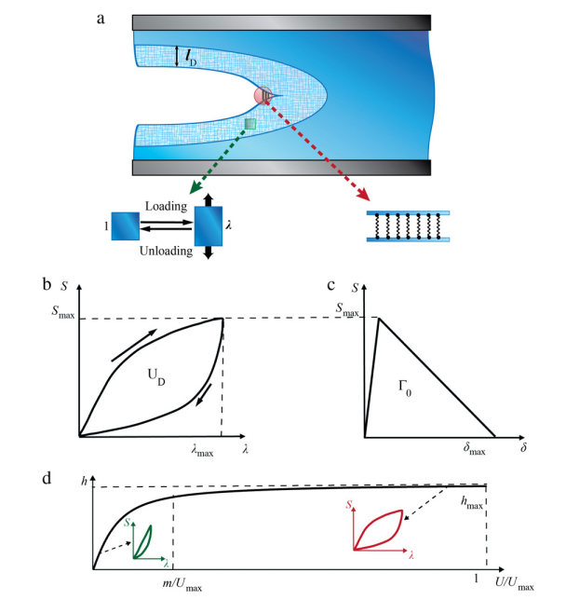
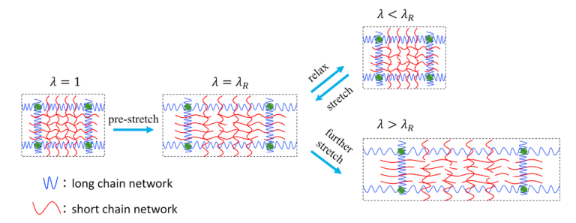
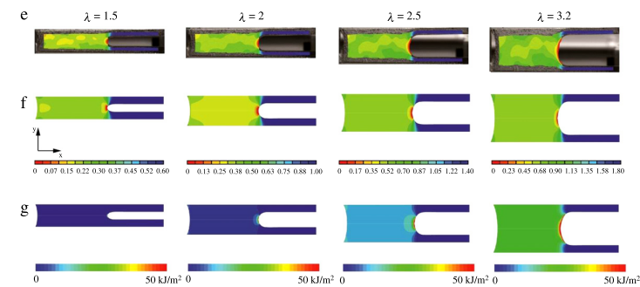
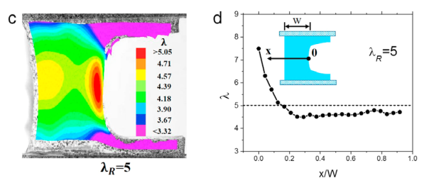
Future work
Lin Shaoting et al. Extreme Mechanics Letters(2015)
Zhang Teng et al. Extreme Mechanics Letters(2015)

