Slide 1
Health Care Tracking
Human activity recognition using smartphone sensors
Asian machine learning camp jeju 2018
Mentor: Dr. NGUYEN TRUNG LAP

Slide 2
About me
Luu Tan Nguyen
4-year Bachelor of Software Engineering
Hoa Sen University, Vietnam

Slide 3
Project overview
Health Care Tracking is a an Android application that I built last year
The purpose is checking and tracking user’s health status
To detect whether or not user’s activities, food-consuming may harm their healthy?

Slide 4
Project in camp
Human Activity Recognition (HAR) using smartphone sensors to detect 6 activities: WALKING, WALKING UPSTAIRS, WALKING DOWNSTAIRS, SITTING, STANDING, LAYING.
Based on Accelerometer and Gyroscope

Slide 5
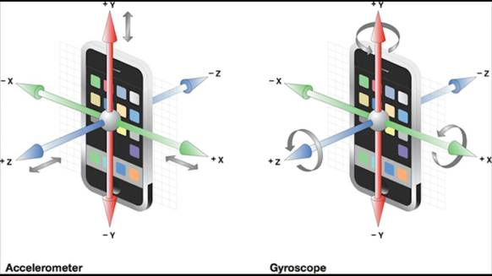

Slide 6
Process
Download datasets
Choose algorithms
Training
Analysis results
Convert Embedded Android

Slide 7
Techniques
The dataset collected by recording 30 participants
2 datasets (1 resource - 8k training, 2k testing)
- Modified dataset:
https://www.kaggle.com/uciml/human-activity-recognition-with-smartphones
- Raw dataset https://archive.ics.uci.edu/ml/datasets/human+activity+recognition+using+smartphones

Slide 8
Modified dataset approach
Test: 30%
Training: 70%
Validation: 10% split from training
Using simple neural network with Keras
Epochs: ~700
Accuracy: 93.69%

Slide 9
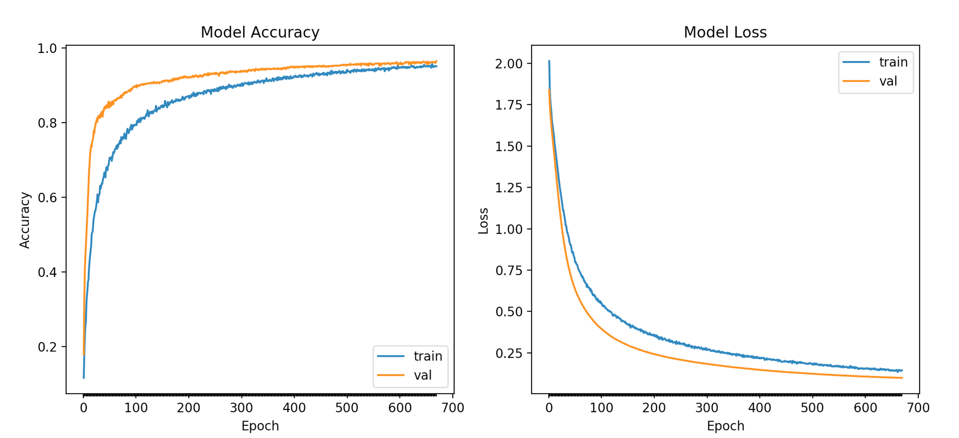
Modified dataset approach

Slide 10
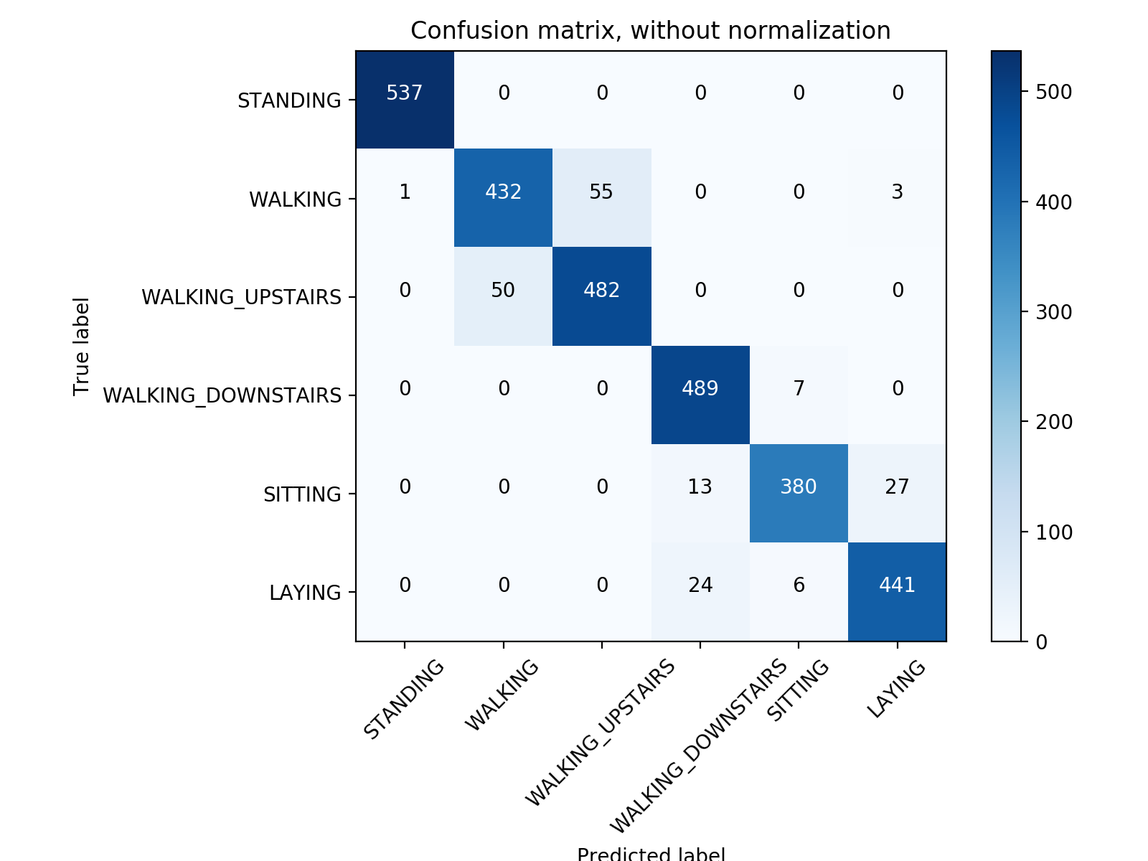

Slide 11


Slide 12
Modified dataset approach
Because large of features, I have no time to map 561 features between output model with Android raw signal => I stopped this. ☹

Slide 13
Raw dataset approach
Test and Validation: 30%
Training: 70%
Using recurrent neural network with Keras
Epochs: 50
Accuracy: 88.36%

Slide 14
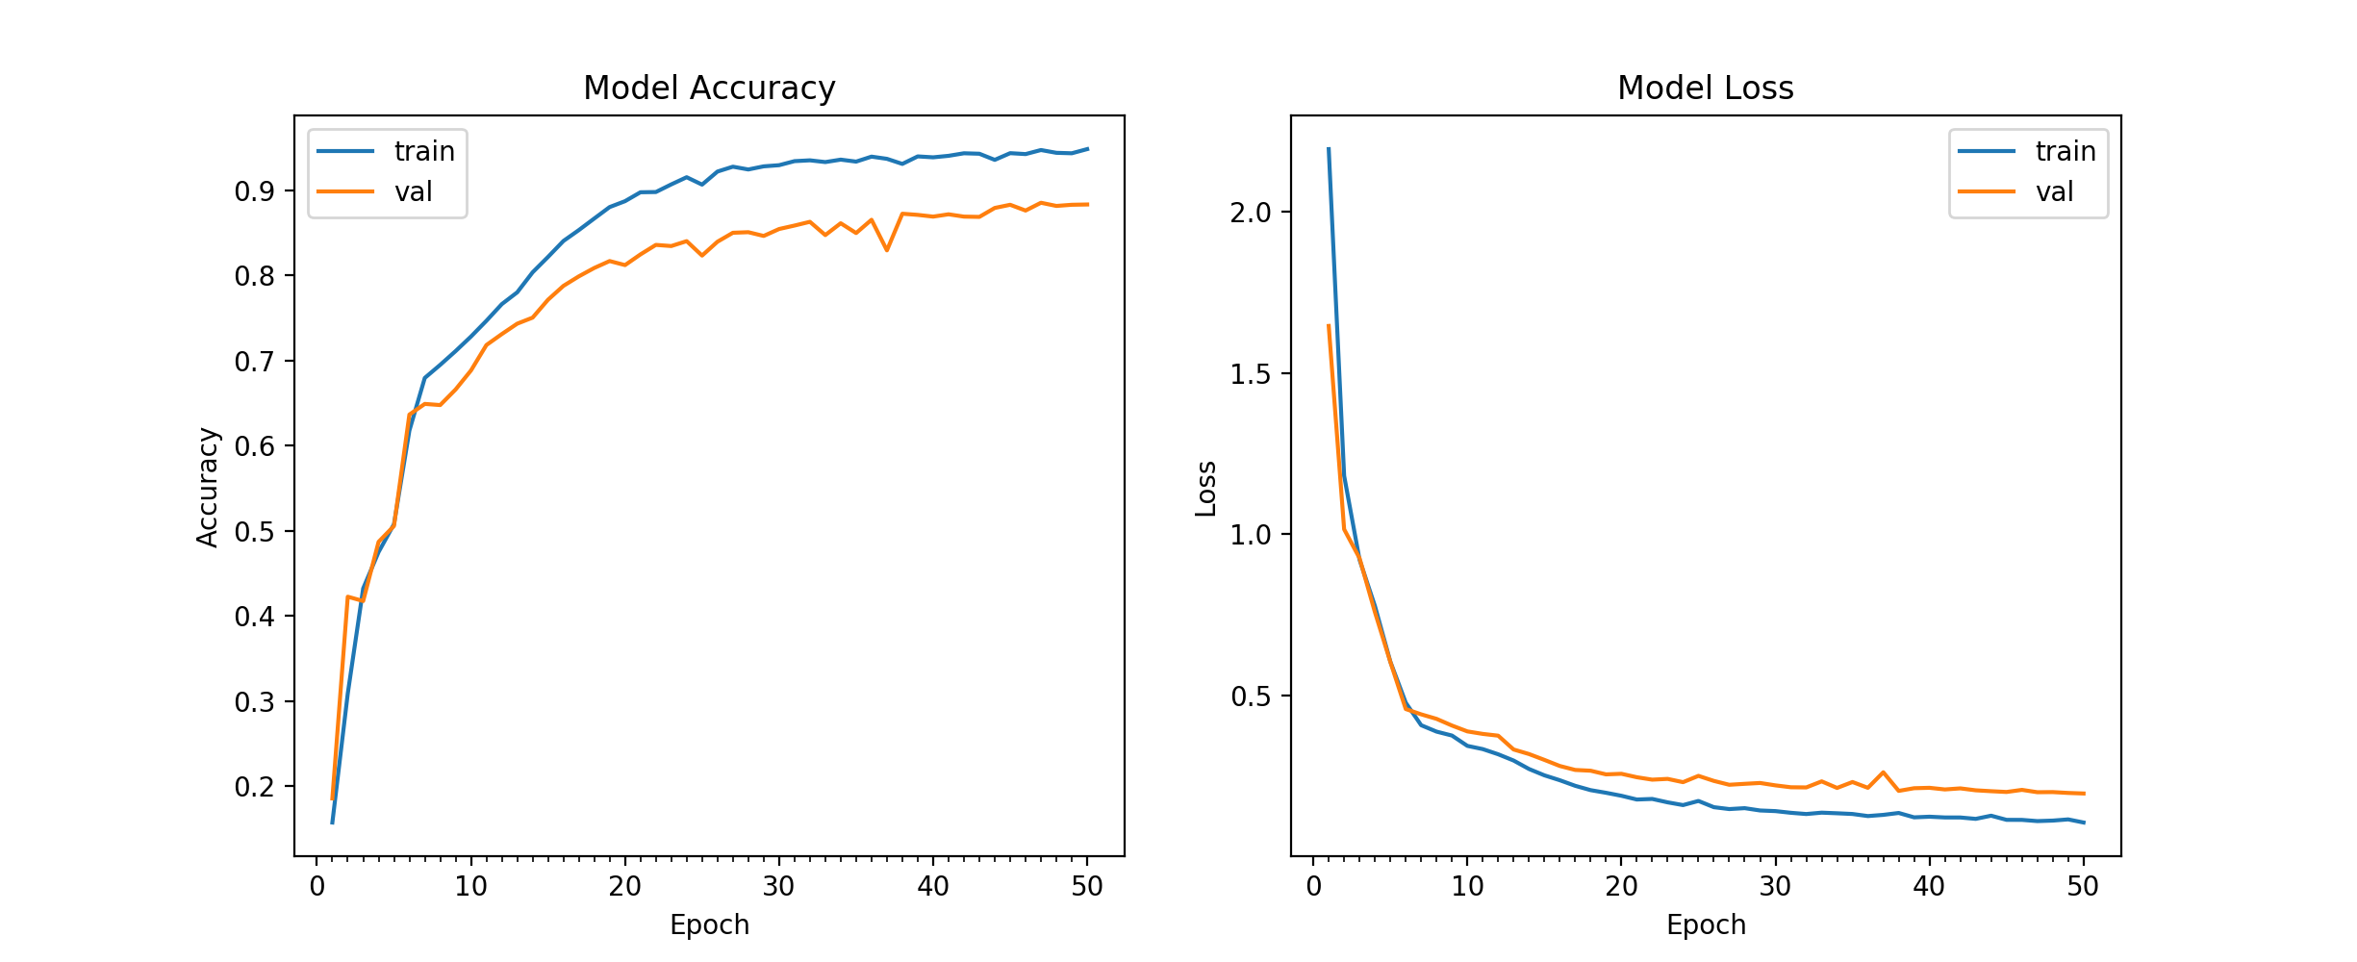

Slide 15
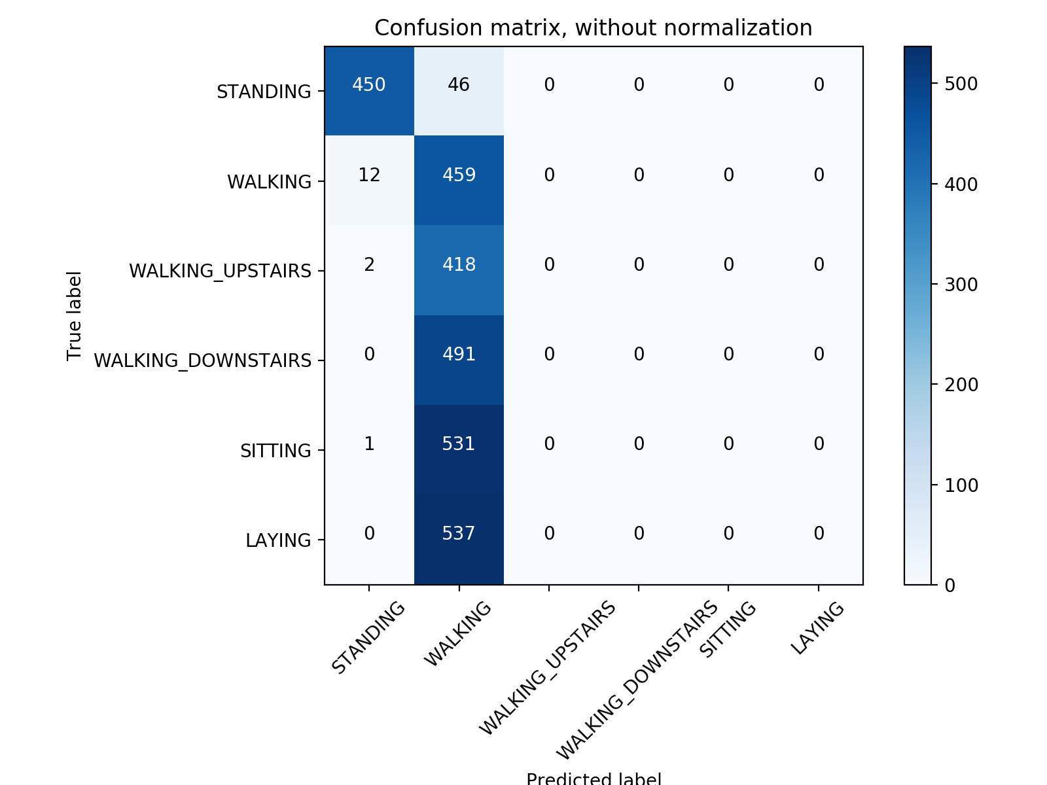

Slide 16
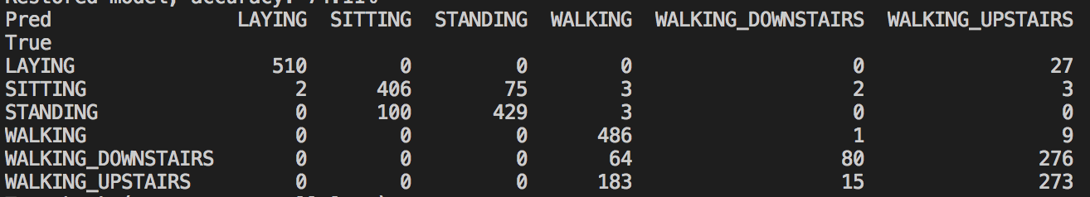
Raw dataset approach
Using LSTM model with Keras
Epochs: 50
Accuracy: 74.11%

Slide 17
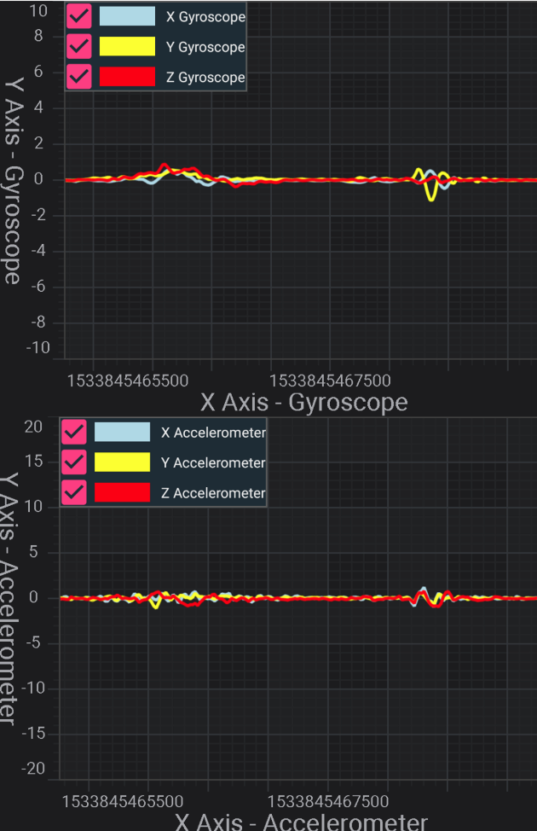
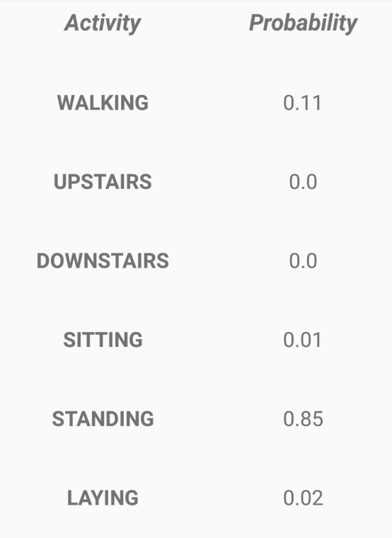
Demostration

Slide 18
Future work
Enhance algorithm, features mapping on modified dataset
Write down daily activities, give recommendation
Refactor and optimize code
Estimate Calories burning
Synchronize model with my own server

Slide 19
References
Davide Anguita, Alessandro Ghio, Luca Oneto, Xavier Parra and Jorge L. Reyes-Ortiz. A Public Domain Dataset for Human Activity Recognition Using Smartphones. 21th European Symposium on Artificial Neural Networks, Computational Intelligence and Machine Learning, ESANN 2013. Bruges, Belgium 24-26 April 2013.
Nilesh Patil, Human Activity Ercognition Using Smartphone Data, 2016
https://github.com/llSourcell/A_Guide_to_Running_Tensorflow_Models_on_Android
https://github.com/aqibsaeed/Human-Activity-Recognition-using-CNN
https://github.com/guillaume-chevalier/LSTM-Human-Activity-Recognition
https://github.com/nilesh-patil/human-activity-recognition-smartphone-sensors

Slide 20
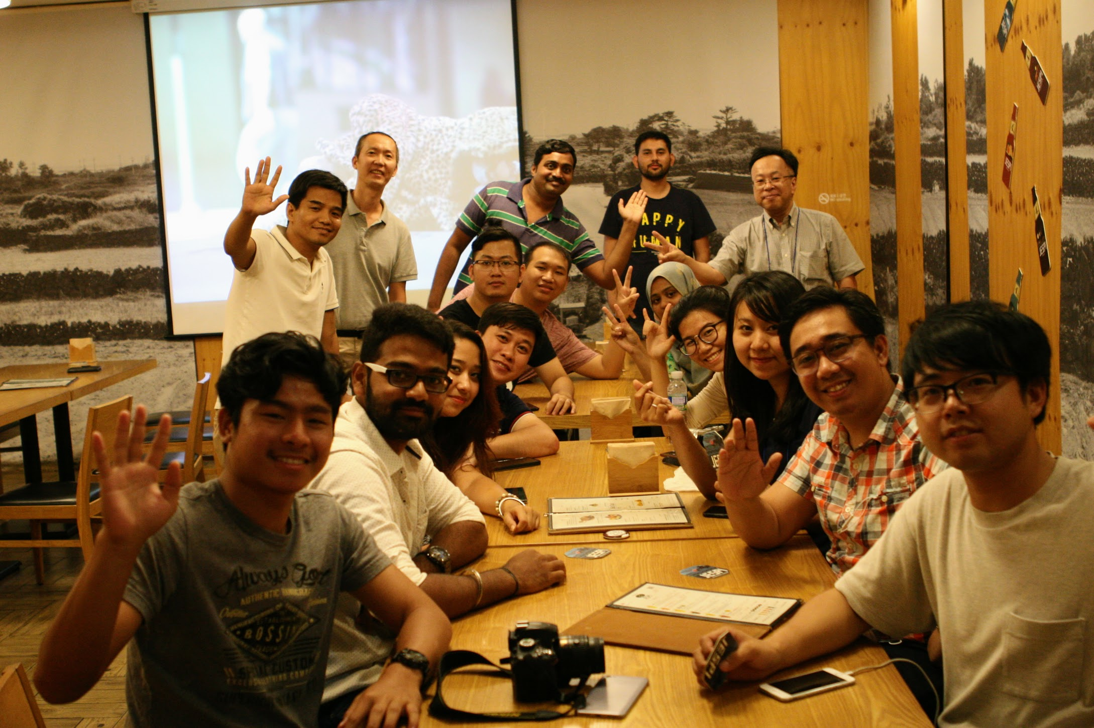
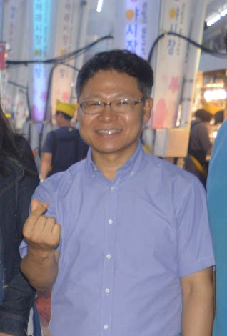
Thank

Slide 21


Fully or partially,
this work was supported by

