Slide 1
Data Bootcamp Final Project
Insights into Covid-19
Phillip Ding, Sophia Park, Zhen Yu Yang

Slide 2
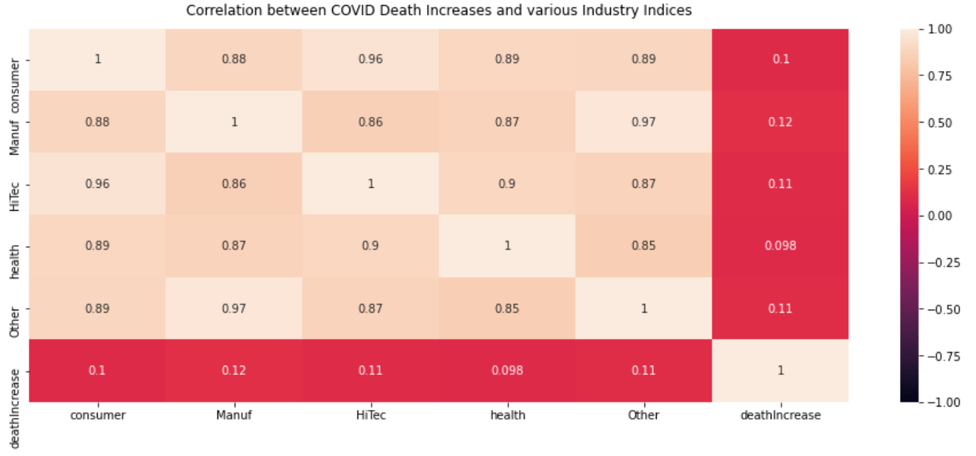
Initial analysis into Covid-19 death rates in relation to the stock market

Slide 3
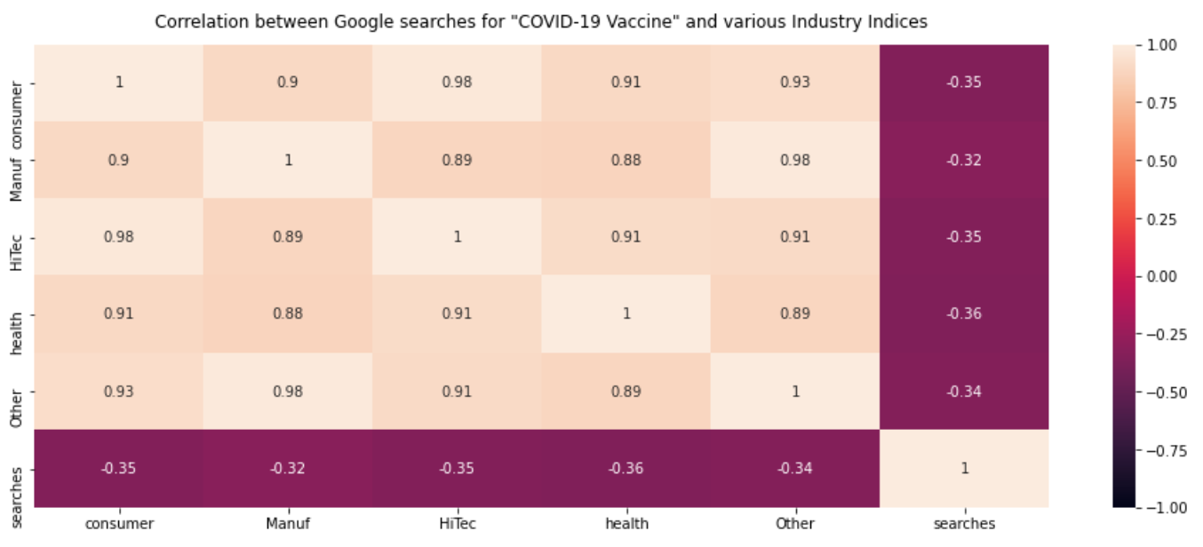
Google searches for Covid Vaccines in relation to industry indices

Slide 4
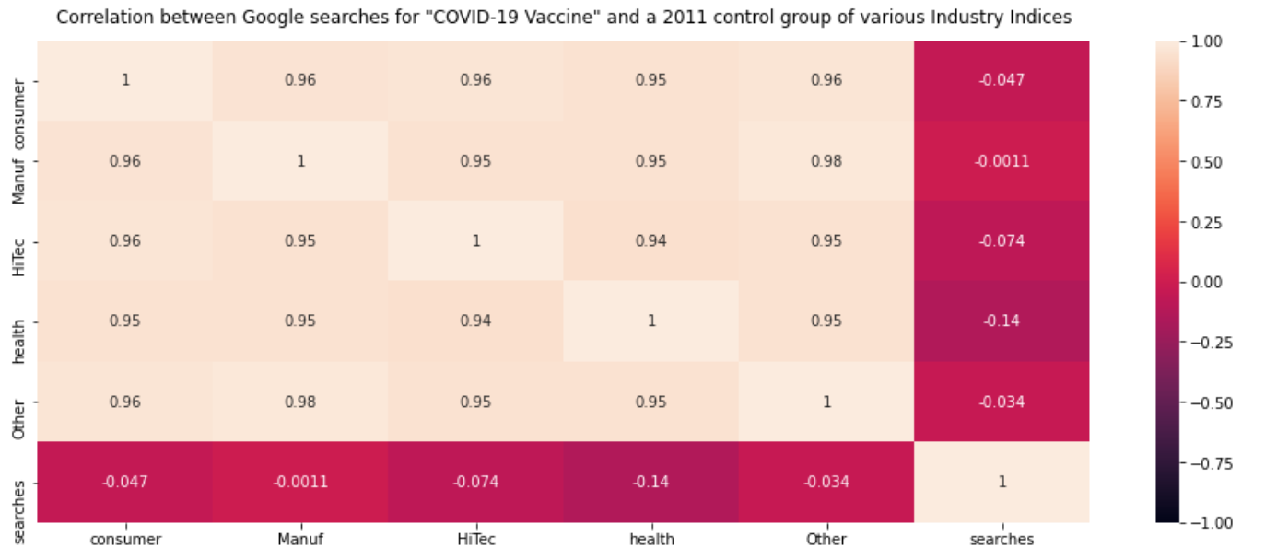
Correction for possible confounding variables for previous correlation

Slide 5
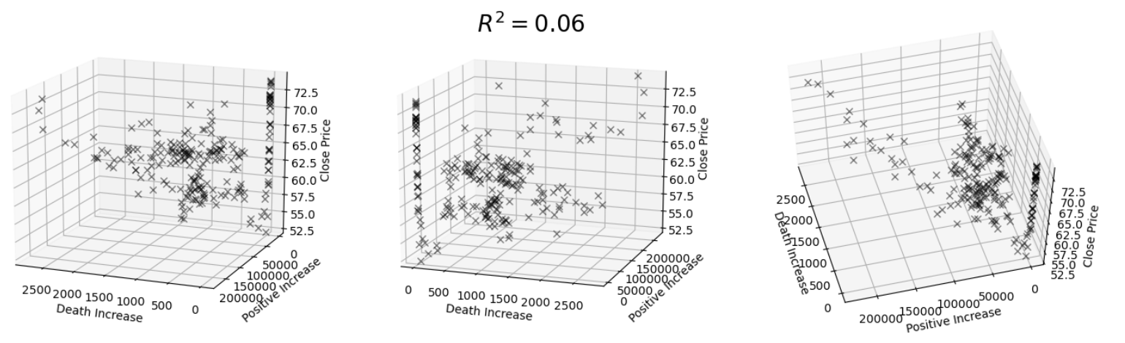
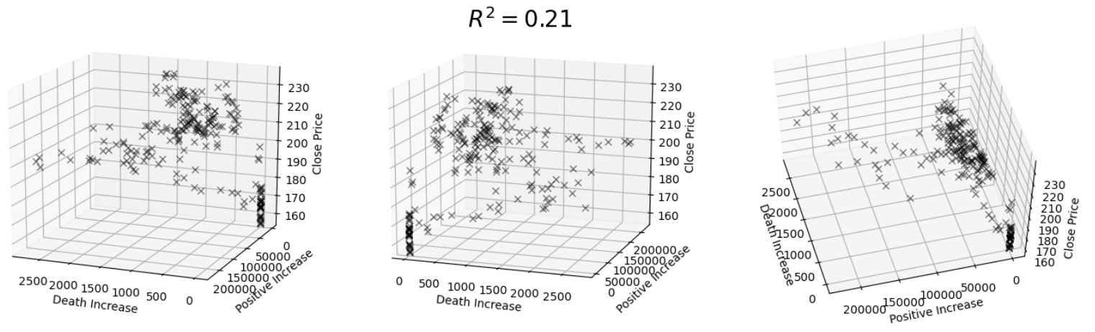
Multivariate Regression Analysis
CVS close price vs. Death Increase vs. Positive Test Increase
Clorox close price vs. Death Increase vs. Positive Test Increase

Slide 6
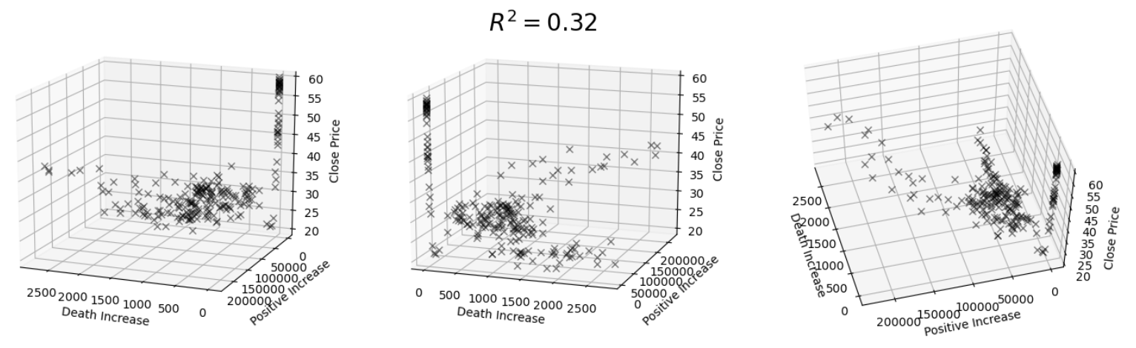
Multivariate Regression Analysis cont.
Delta Airlines close price vs. Death Increase vs. Positive Test Increase

