Slide 1
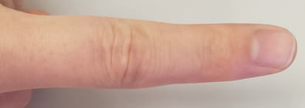
x-axis
Θ ∈ [0, 180)
center point
short-side
long-side
x-axis
Θ ∈ [0, 180)
center point
short-side
long-side

Slide 4
177
178
179
0
1
2
3
175
176
4
174
5
Gaussian Window Function
95
94
84
93
85
92
91
90
87
86
89
88

