Slide 1
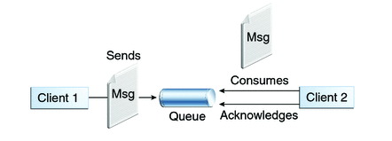

How to send/receive message to /from Queue of ActiveMQ
Queues [point-to-point]:
Queue’s are based on point-to-point messaging model where messages are sent to a queue.
Each message has exactly one sender and one receiver.
Message is guaranteed to be delivered to only one receiver.
MessageSender.java
MessageReceiver.java

Slide 2
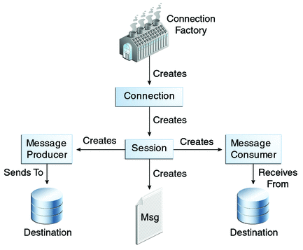
How to send/receive message to /from Queue of ActiveMQ

