Slide 1

ActiveMQ Setup
Download links
http://activemq.apache.org/download.html
http://activemq.apache.org/components/classic/download/

Slide 2
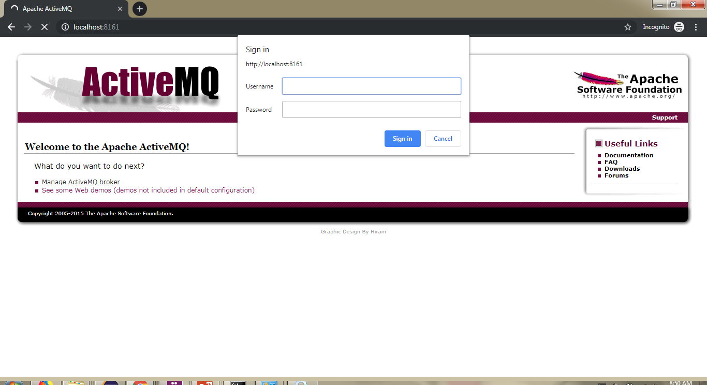
http://localhost:8161/
User name = admin
Password = admin
ActiveMQ Setup

