Slide 1
New theater location selection in NYC
ZHE REN
06/03/20

Slide 2
INTRODUCTION
This project would like to investigate the potential location of an invested theater location in NYC
In order to obtain the potential places, the clustering technique will be applied to rank venues, especially to discover where the theaters have been located.
Finally choosing the ranking no. 1 venues as the aiming location.

Slide 3
Data
The Foursquare location data will be applied to complete the "New theater location selection in NYC" project.

Slide 4
Data
The Manhattan county will be the target town and be explored from the Foursquare developer website. The data were chosen because:
1) the convenience to obtain the data;
2) updated and precise venue information could be received. For example, the regular search with Foursquare can be used to explore Manhattan, NY.# New theater location selection in NYC

Slide 5
Table 1. Theater list in NYC
0 20 Thomas St. (The Flea Theater)
1 Schaeberle Studio Theater
2 Theater Bar
3 iHeartRadio Theater
4 Royal Theater Cinema
5 Theater for the New City
6 Theater District
7 Peter Jay Sharp Theater
8 LES* Drive-In Movie Theater
9 The Public Theater
10 Hulu Theater
11 Nevada Theater
12 St Venice Theater
13 Delacorte Theater
14 Connelly Theater
15 iPic Theaters at Fulton Market
16 Pioneer Theater
17 Russian American Musical Theater
18 Public Theater Conference Room
19 Theater 219 (VPR)
20 Robert Moss Theater
21 Galli Theater
22 Time Inc. Theater
23 IRT (Interborough Repertory Theater)
24 Kumble Theater
25 Kraine Theater
26 Helen Mills Event Space and Theater
27 See Forever Theater
28 accss theater
29 Collective: Unconscious Theater

Slide 6
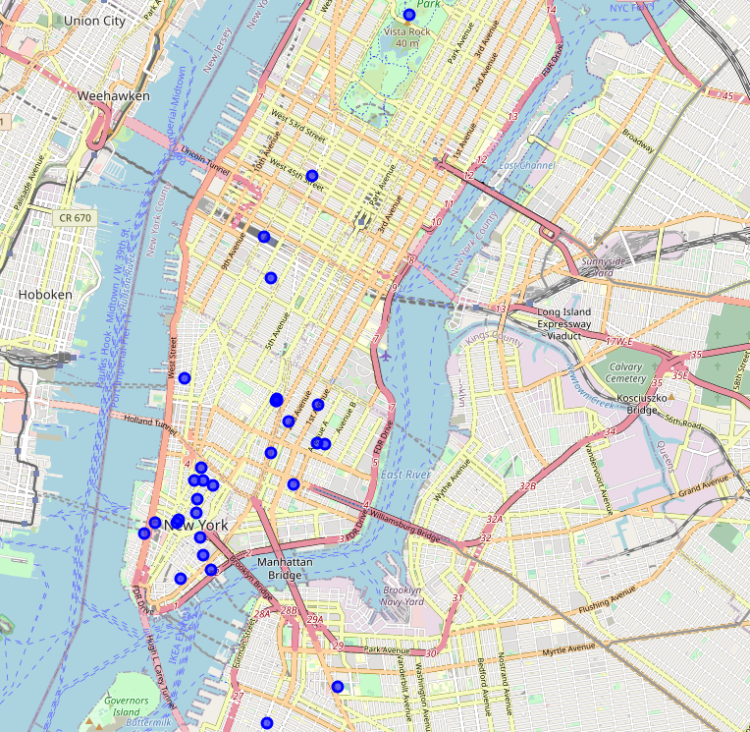
Figure 1. All the theaters on the map

Slide 7
Result
Based on the map, the planned theater should be placed near NYC City Hall
this area has the most theaters located and a highly possible place people would like to visit to enjoy the performing arts compared to other locations.

