Slide 1
Light Condition
check
Edge Detection
Card Type
Check
Card Flip Check
Card Quality Check
Auto Scan
e-KTP

Slide 2
Image Preprocessing
Line/Edge Detection
Missing Edge Reconstruction
Contour & Contrast Ranking
Quadrilateral Filtering & Reordering
Documents / Cards
Auto Scan

Slide 3
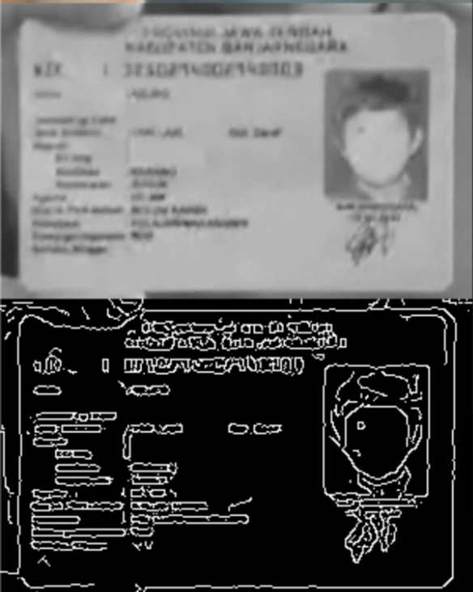
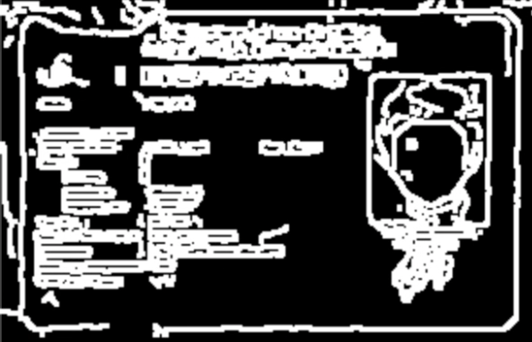
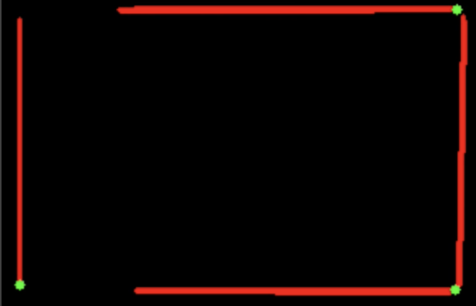
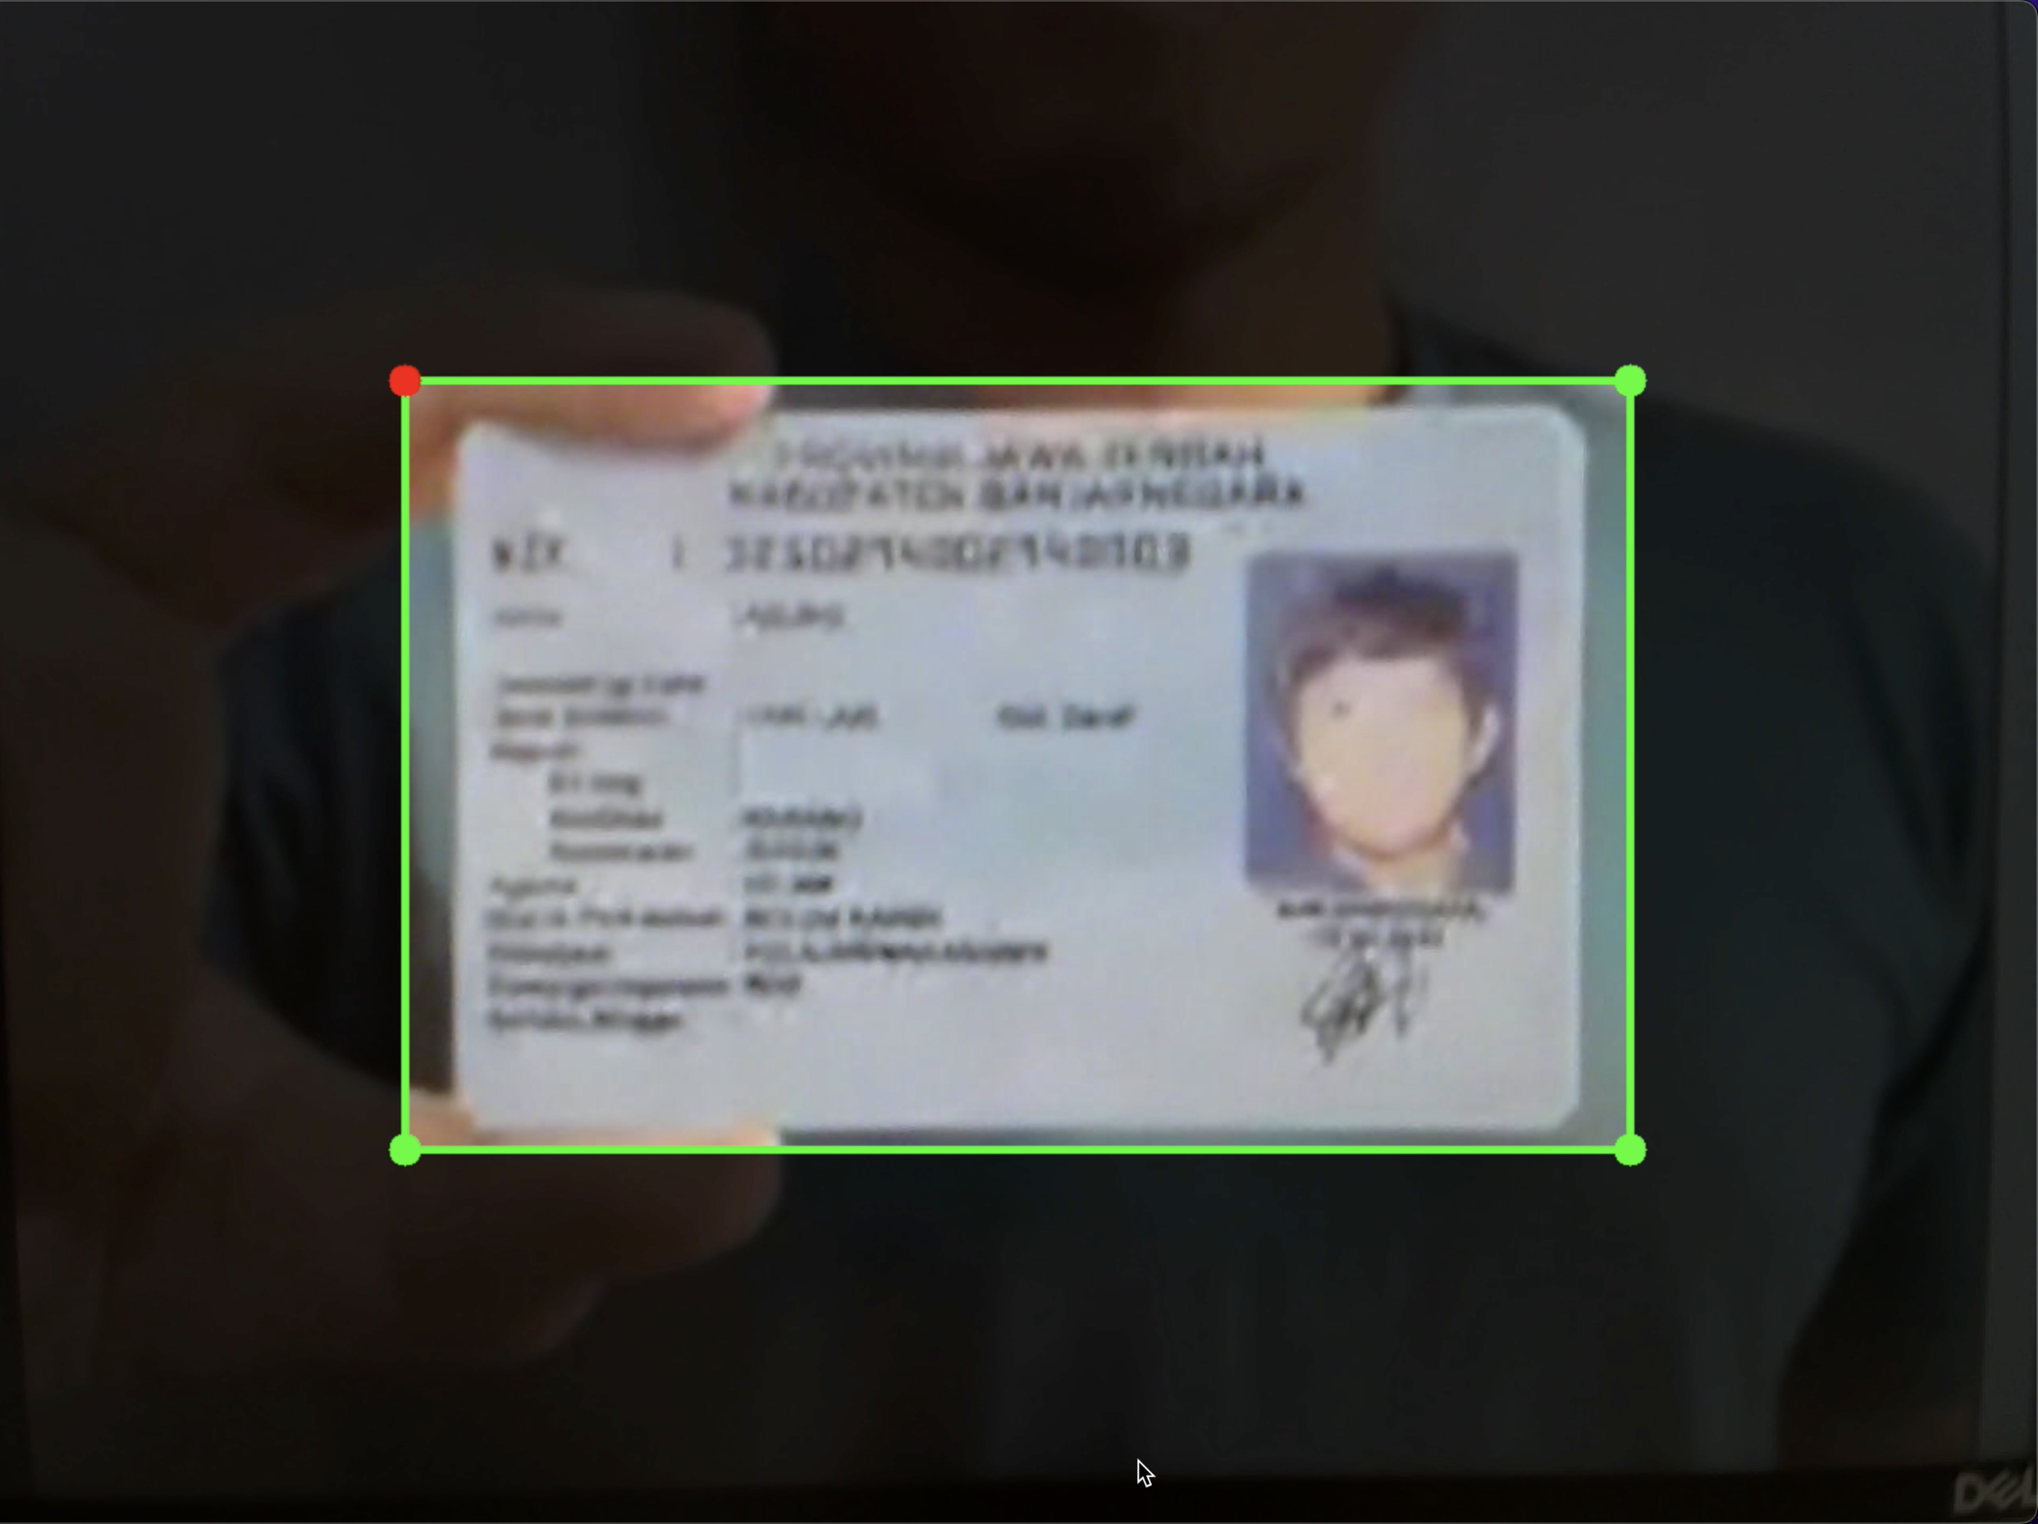
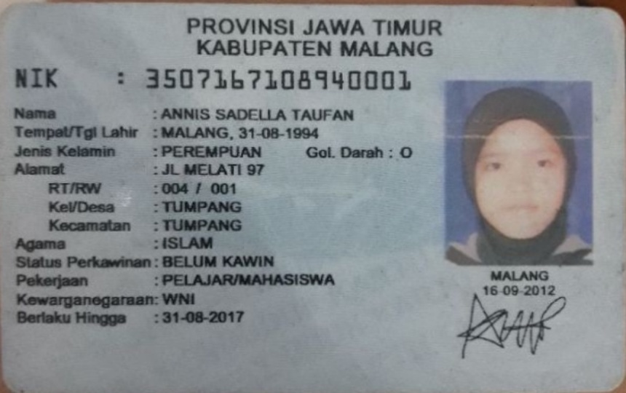
3. Dilation
1. Grayscale
& Blur
5. Shi-Tomasi
Corner Detection
2. Canny
Detector
Webcam/Video Frame
Apply mask to guide user
Image Processing
Find lines in 4 side regions
Find corners in 4 corner regions
Found 3 corners for Y milliseconds
Auto Capture
4. Probabilistic
Houghline Transform

Slide 4
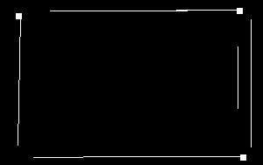
3. Dilation (I believe custom algo does not implement dilation)
1. Grayscale (done by preprocessing) and Blur
5. Shi-Tomasi
Corner Detection
Simple corner detection by checking if line found in the 4 corner regions
2. Canny Detector
Android Camera Input in byteArray
Java Bitmap Preprocessing
Custom Canny Edge Detection
Custom Hough Line Transform
Find corners in 4 corner regions
Found 3 or 4 corners ✅
Card Type Detection
C++ byteArray
-> Java Bitmap
Crop/Resize
Grayscale
-> C++ byteArray
Sent into edge detection model as `unsigned char *`
4. Find lines in the 4 side regions

Slide 5
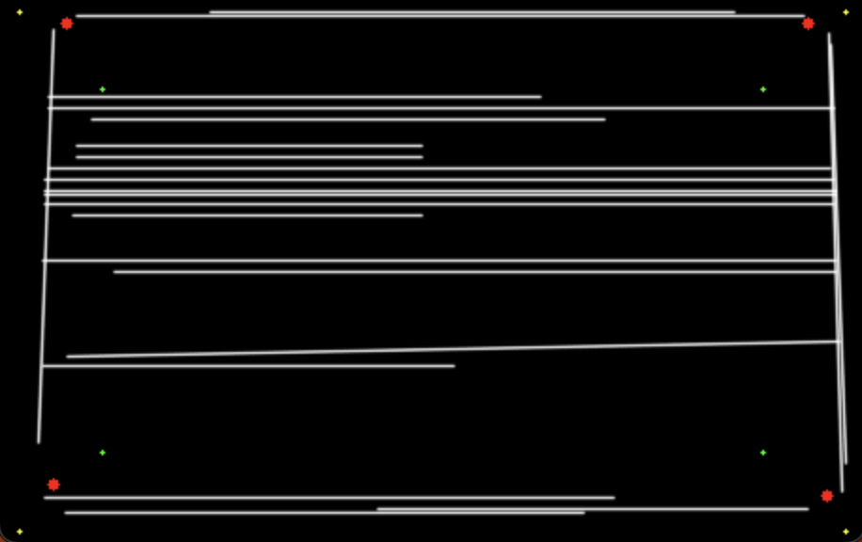
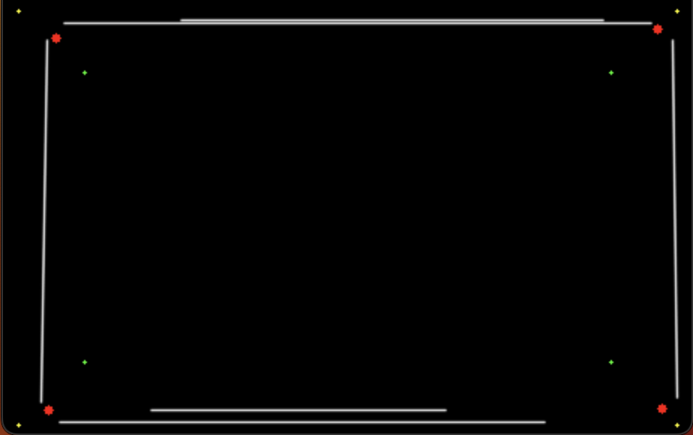
3. Probabilistic Hough Line Transform
1. Gaussian Blur
5. Filter line start/end points in the 4 corner regions
2. Canny Detector
Android Camera Input in byteArray
Mobile FE Preprocessing
Pure C++ Library
Grayscale → Canny → Houghline
Find lines and corners in 4 regions
Corner Moving Average
Card Type Detection
Crop/Flip Camera Frame
Grayscale by summing RGB values
Sent into edge detection model as `unsigned char *`
4. Filter only lines in the 4 side regions

Slide 6

detection
guideview
frame
$$cornerScore=1−\frac{dist\left(foundCorner −guideCorner\right)}{dist(frameCorner −guideCorner)}$$
Hence, if foundCorner close to guideCorner, cornerScore is higher

Slide 9
Possible Improvements for Card Detection
Method | Description | Pros | Cons
Current method: use edge/line detection then find “corners” in the 4 corner regions using Shi-Tomasi or naïve algo | Canny and HoughLine algos to find edges and lines followed by Harris or Shi-Tomasi or naïve algo to find “corners”. Trying to use line intersections to find corners is also not reliable. | - Able to remove OpenCV dependency (only need open-source edge/line detection algo) - Simple and straightforward allows the model size to be very small | - Not stable. It is very difficult to find “corners”, especially when they are rounded (not 90 degrees) - Allowing 3 corner cards to pass also adds a lot of problems because we cannot easily use contouring or segmentation to get a closed rectangular shape
Relying only on Harris or Shi-Tomasi corner detection and filtering them based on some conditions | Maybe skipping edge/line detection could help? Preprocessing such as bilateral filter instead of Gaussian filter then corner detection followed by checking if in corner regions [link] | - Need to prototype in OpenCV first | - Need to prototype in OpenCV first
Document scanning method: using edge/line detection then extract the contours in the image to find the largest closed rectangular shape | Again, Canny and HoughLine to get a binary image followed by contouring algorithm to find the biggest closed shapes | - Accurately finds the 4 corners - Cards that are slanted, tilted, warped, too small will still work | - Must have all 4 corners of the card to form a closed shape - Would need to find a few more algorithms to be custom made in cpp instead of OpenCV
ML method: NN regression model or Haar classifiers | KIV | KIV | KIV

Slide 10
