Slide 1
Maximum Subsequence Sum (MSS) Problem
在一個具有正負數陣列當中，
找出一段連續的元素總和最大
Ex. For input -2, 11, -4, 13, -5, 2
the answer is 20 (A2 through A4 )

Slide 2
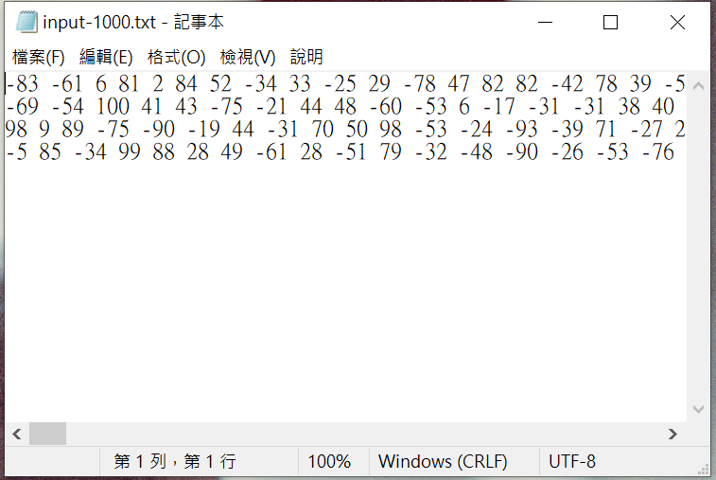
#include <iostream>
#include <cstdlib>
#include <fstream> //載入定義檔案操作的標頭檔
using namespace std;
int Num = 1000;
int main(void){
fstream infile; //宣告可以輸出/輸入檔案的物件
infile.open("input-6.txt",ios::in);;
int i, ARR[Num];
for(i=0; i<Num; i++)
{
infile >> ARR[i];
}
infile.close();
int j, k, maxSum=0, start, end;
.
.
.
start++;
end++;
cout << "最大子序列和為 "<< maxSum << " 由第 " << start << " 個值到第 " << end << " 個值加總可得!" << endl;
return 0 ;
}

