Slide 1
Toward Informal Language Processing: Knowledge of Slang in Large Language Models
Zhewei Sun*, Qian Hu†, Rahul Gupta†, Richard Zemel‡, and Yang Xu*
*University of Toronto
†Amazon Alexa AI
‡Columbia University

Slide 2
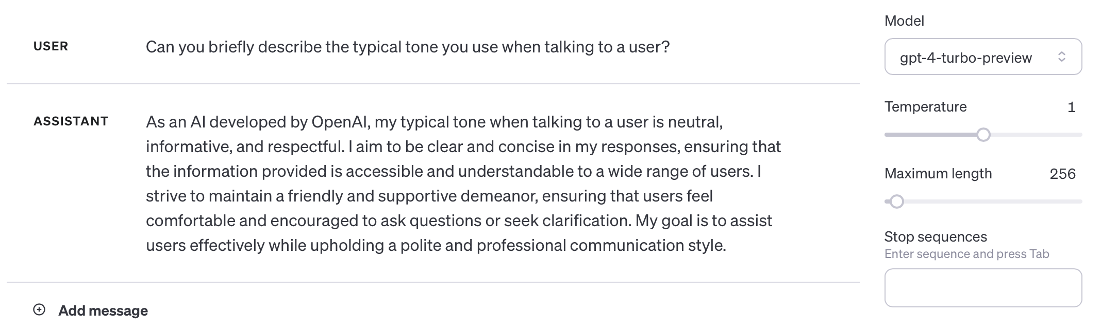
Formality in chatbots
AI chatbot systems such as ChatGPT tend to use formal language.
Can these systems also handle informal language?

Slide 3
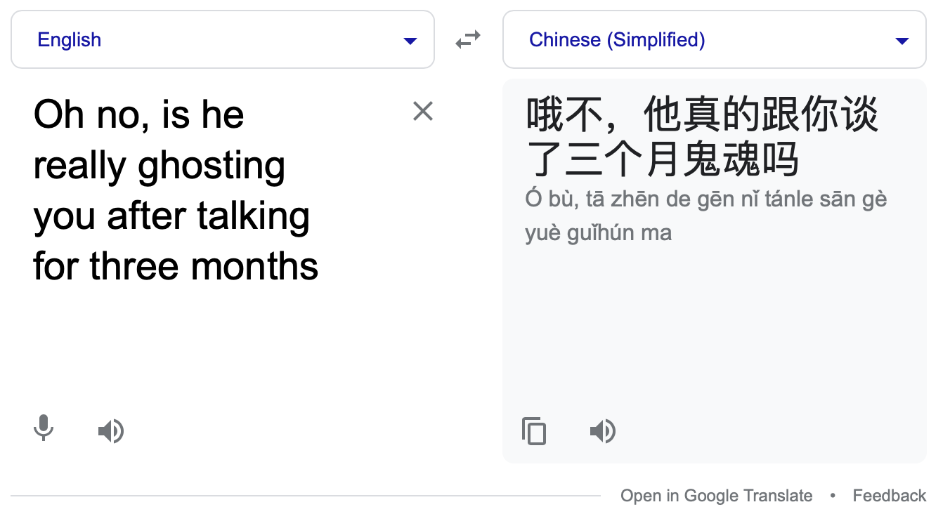
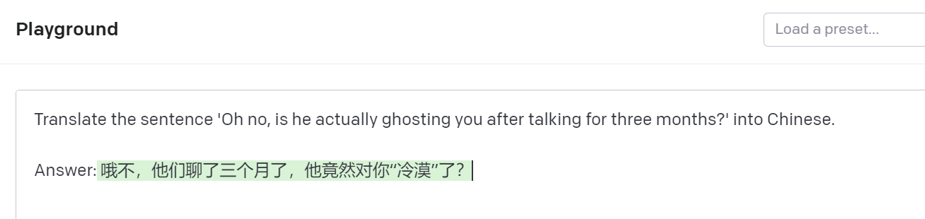
Slang and large language models
Oh no, did he really talk to you about ghosts for three months
Oh no, they talked for three months already, is he really unconcerned about you?

Slide 4
Motivation
How much knowledge about slang do large language models contain?
  Prior work suggests pre-trained BERT-based models lack knowledge about slang (Sun et al., 2021, 2022).
  Recent LLMs (e.g., GPT-4) seem to do much better at a first glance.
Such knowledge has important implications in downstream applications.
  Performance bias towards different groups of language users.
  Exposure of personal information based on language use.

Slide 5
Resources
To evaluate LLMs on slang-related knowledge, we need a comprehensive benchmark dataset.
Prior resources are insufficient in crafting a robust benchmark:
  Datasets based on Urban Dictionary (e.g., Ni and Wang, 2017) are large but 1) often contain erroneous entries and 2) lack the necessary meta-data.
  Datasets based on authoritative slang dictionaries (e.g., Sun et al., 2021) cannot be publicly distributed.

Slide 6
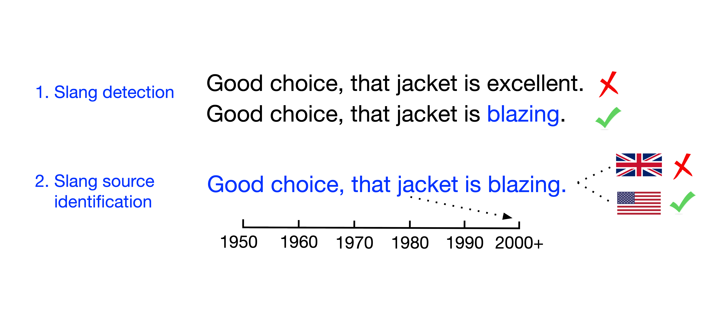
Contributions
We contribute a novel benchmark dataset – OpenSub-Slang – by annotating movie subtitles from the OpenSubtitles corpus.
We perform a comprehensive set of experiments on recent LLMs to evaluate the knowledge of slang contained in the models.
  Slang detection
  Slang source identification
  Interpretive analysis

Slide 7
Dataset - Desiderata
An ideal benchmark dataset contains the following elements:
  Lexical entry for the slang usage (i.e., term and definition sentence).
  Slang-containing and non-slang sentences from the same data source.
  Literal paraphrase of the word in context.
  Time and region of usage.
  Publicly accessible.
shrink
A psychiatrist or a psychotherapist.
“I told my shrink, and she said I should act on it.”
psychiatrist
US, 2007
OpenSubtitles – 3151540:313

Slide 8
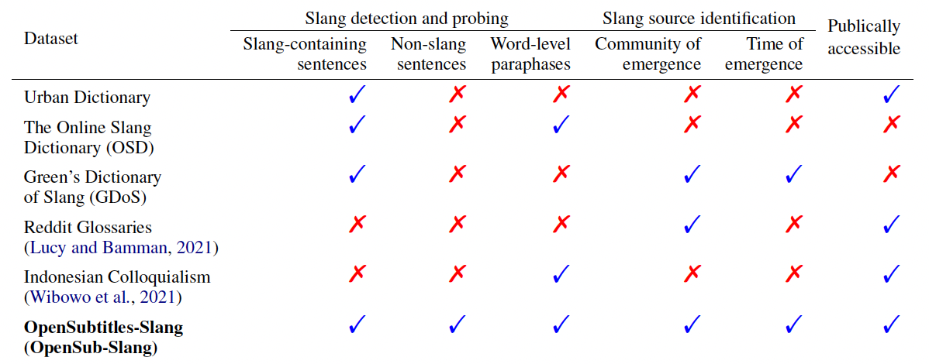
Dataset - Features
Our OpenSub-Slang dataset contains features that are desirable for evaluation.

Slide 9
Dataset - Annotation
We randomly sample sentences from 100 movies for annotation:
  50 movies from the US and 50 from the UK.
  All sampled movies were produced after year 2000.
  Three-step annotation procedure:
    Three annotators identify whether a slang is in the sentence.
    An additional annotator defines each annotated slang.
    The annotator from step 2) writes a literal paraphrase.
  More annotation details in the paper.

Slide 10
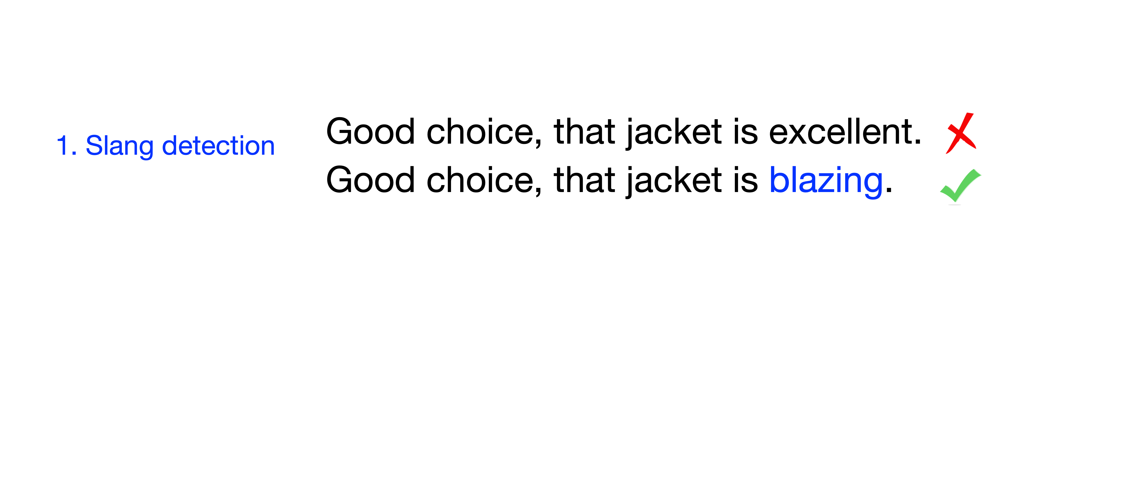
Evaluation
We evaluate the LLMs on slang using two probing tasks:
We also look at intrinsic tasks (e.g., LM probability on slang vs. literal terms) for model interpretation.

Slide 11
Evaluation - Setup
We perform the evaluations on two sets of models:
  BERT-like models:
    BERT, RoBERTa, and XL-Net,
    All models are fine-tuned.
  GPT-family models:
    GPT-3, GPT-3.5, and GPT-4
    We evaluate pre-trained GPT models with finetuning on GPT-3.5.

Slide 12
Evaluation - Datasets
We perform all evaluations on our OpenSub-Slang datasets and include prior slang dictionary datasets whenever applicable:
  OpenSub-Slang.
    7,488 slang-containing sentences and 17,512 annotated negatives.
    We use the 2,256 slang-containing sentences with high annotator confidence, of which 836 have annotated definitions and paraphrases.
  Green’s Dictionary of Slang (Green, 2010) from Sun et al. (2022).
  Online Slang Dictionary from Sun et al. (2021).
  Urban Dictionary dataset from Sun et al. (2021).

Slide 13
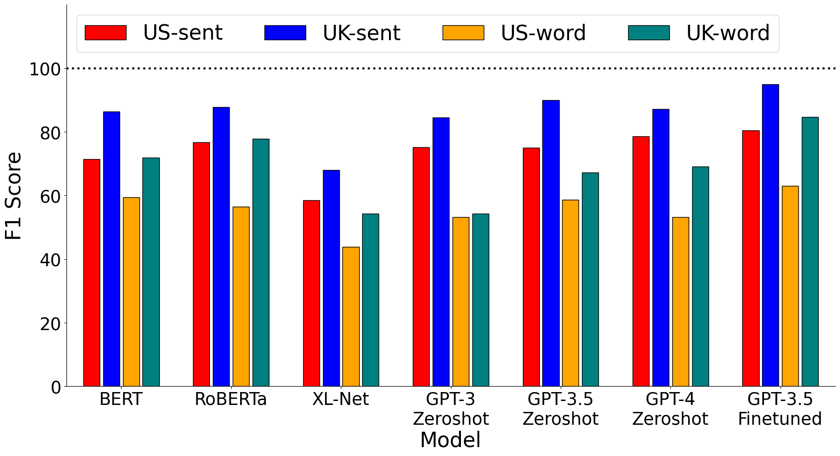
Slang detection

Slide 14
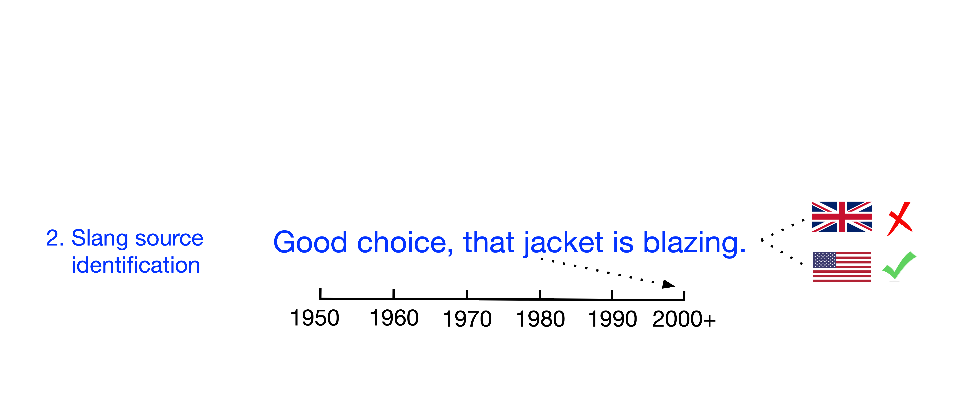
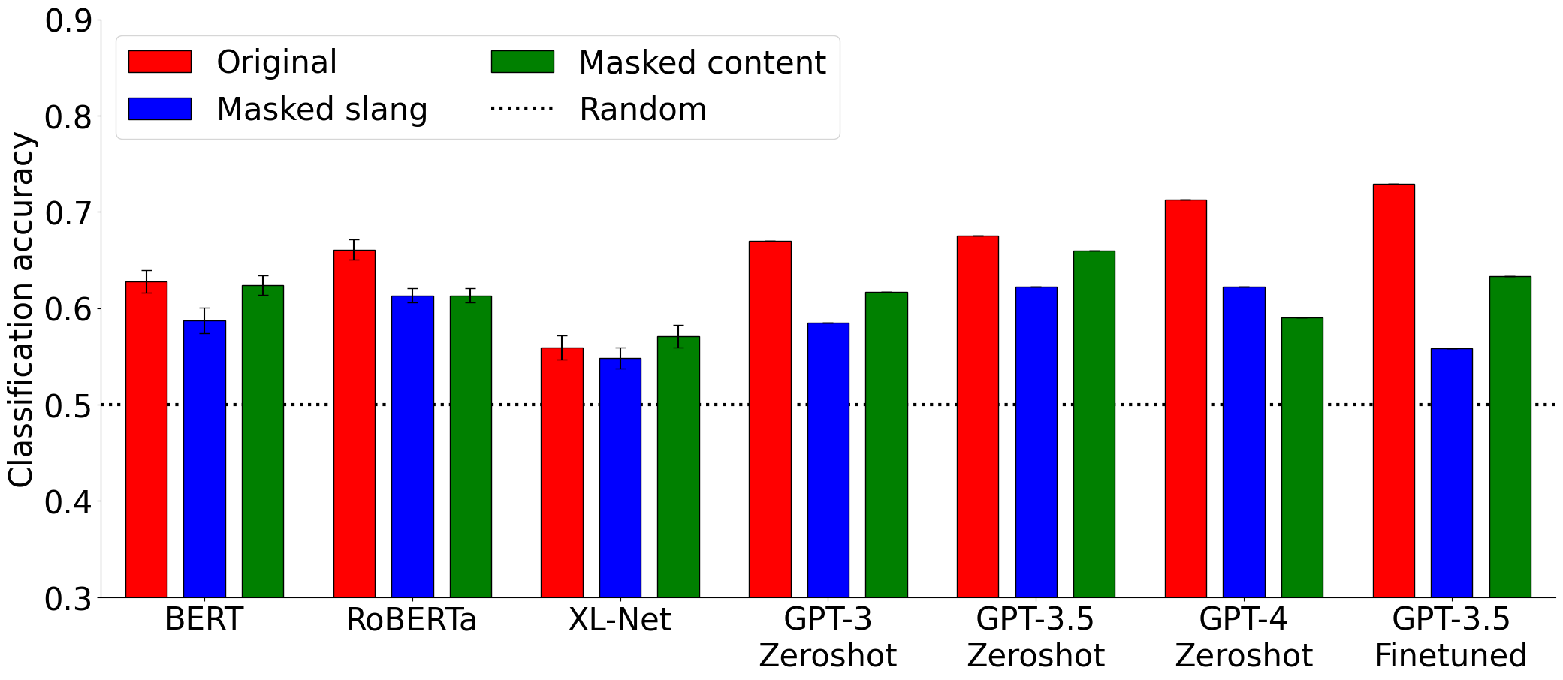
Slang source identification
Original:
  Good choice, that jacket is blazing.
Masked slang:
Good choice, that jacket is [MASK].
Masked content:
Good choice, that [MASK] is blazing.

Slide 15
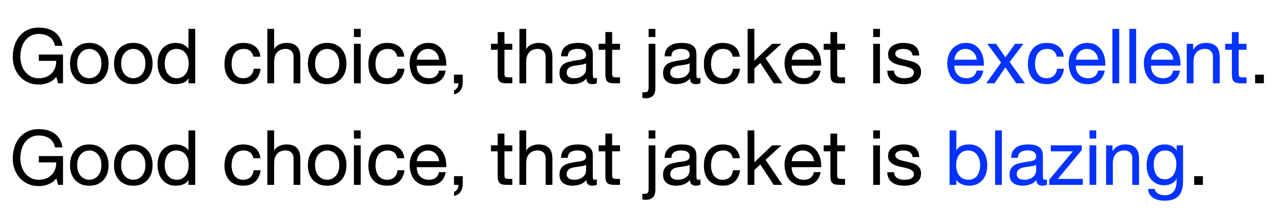
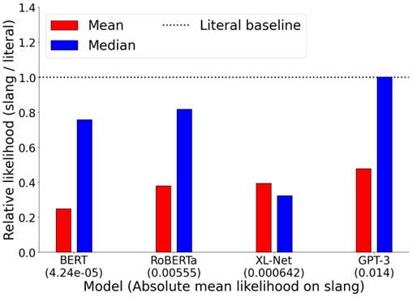
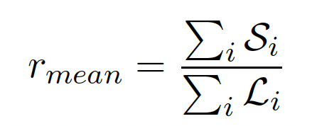
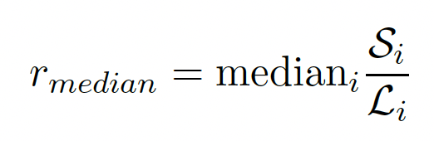
Model interpretation
1. LM probability comparison:
S_{i} = P ( “blazing” | context )
L_{i} = P ( “excellent” | context )

Slide 16
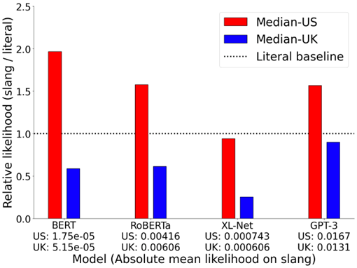
Model interpretation
1. LM probability comparison:
S_{i} = P ( “blazing” | context )
L_{i} = P ( “excellent” | context )

Slide 17
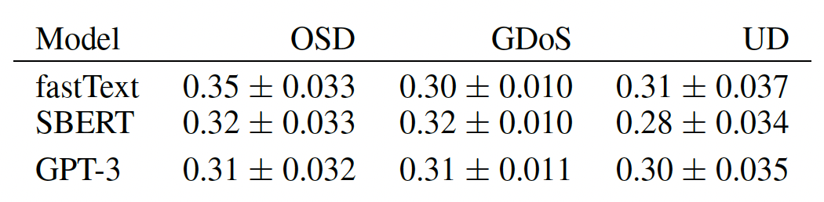
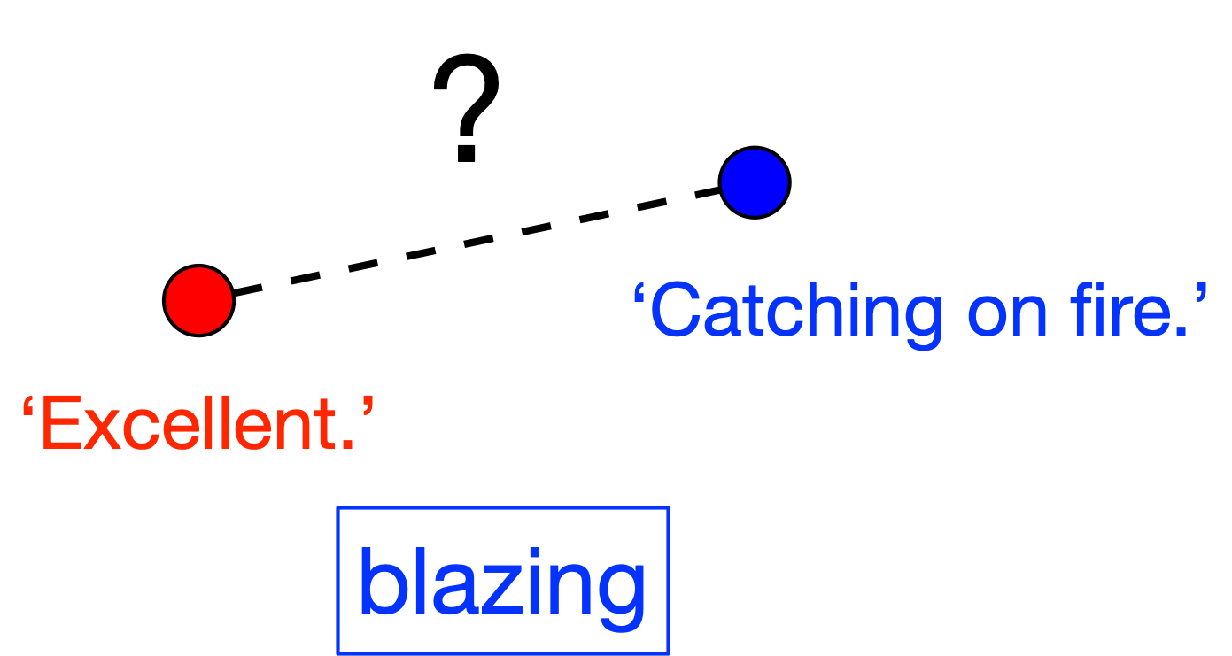
Model interpretation
2. Comparing the semantic representations:

Slide 18
Conclusion
We contributed a comprehensive benchmark dataset for slang and thoroughly investigated slang knowledge in large language models.
GPT-based models are indeed more knowledgeable about informal language off-the-shelf, though smaller models can narrow the performance gap by finetuning.
Future work could build on the current findings and investigate the source of such knowledge.
Notes:
Example data entry

Slide 19

Thank you!
Code and data: https://github.com/amazon-science/slang-llm-benchmark
Link to paper: https://arxiv.org/abs/2404.02323
Contact:
Zhewei Sun
zheweisun [at] cs.toronto.edu
https://zhewei-sun.github.io
Department of Computer Science
University of Toronto
Toyota Technological Institute at Chicago (TTIC)
(Starting Fall 2024)
Notes:
Example data entry

