Slide 1

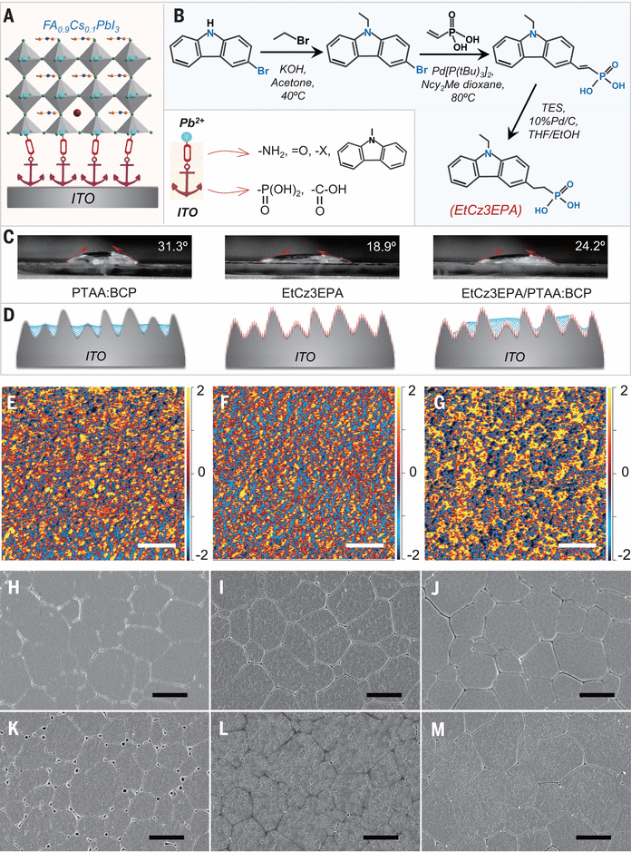
Strong-bonding hole-transport layers reduce ultraviolet degradation of perovskite solar cells, Volume: 384, Issue: 6700, Pages: 1126-1134, DOI: (10.1126/science.adi4531)

