Slide 1
HSPT: Practical Implementation and Efficient Management of Embedded Shadow Page Tables for Cross-ISA System Virtual Machines
Zhe Wang¹, Jianjun Li¹, Chenggang Wu¹ , Dongyan Yang²,
Zhenjiang Wang¹, Wei-Chung Hsu³, Bin Li⁴, Yong Guan⁵
¹State Key Laboratory of Computer Architecture, Institute of Computing Technology,
²China Systems and Technology Lab, IBM,
³Dept. Computer Science & Information Engineering, National Taiwan University,
⁴Netease, ⁵College of information Engineering, Capital Normal University

Slide 2
Outline
Background
Motivation
Contributions
The Framework of HSPT
Evaluation
Conclusion

Slide 3
Outline
Background
Motivation
Contributions
The Framework of HSPT
Evaluation
Conclusion

Slide 4
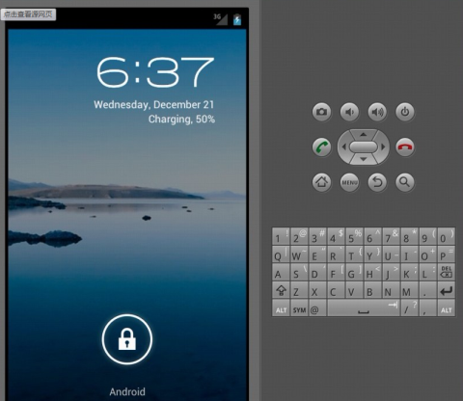
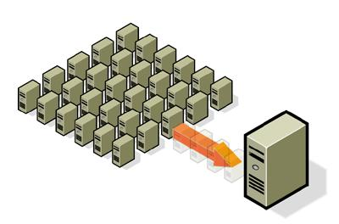
System Virtualization
System virtualization has regained its popularity in recentyears and has been widely used for cloud computing.
Allow applications running on such systems to be agnostic about the underlying operating systems and hardware platforms.
Enable developing and testing OS and application on different platforms. e.g. Android Emulator on a PC (ARM to x64)
App
App
OS
OS
Hypervisor

Slide 5
The Category of System Virtualization
System virtualization can be divided into same-ISA and cross-ISA categories depending on whether the guest and the host are of different instruction-set architecture.
Same-ISA system virtualization is commonly used for server consolidation.
Example: VMware Workstation, VirtualBox.
Cross-ISA system virtualization is also important and commonplace.
Android Emulator emulates the Android/ARM environment on the x86-64 platforms is yet another example, it offers great conveni-ence in development and debugging to Android application deve-lopers.
We only focus on Cross-ISA system virtualization.

Slide 6
The Overhead of Cross-ISA System Virt.
Virtualization brings an additional layer of abstraction and causes some unavoidable overhead.
Memory virtualization overhead is one major overhead.
Memory subsystem emulation in QEMU system mode takes about 23%~43% time during the execution. [ESPT, VEE’14]
All hardware functions are emulated by software.
So optimizations to minimize such memory virtualization overhead are the key to enhance the performance of the Cross-ISA system-level emulator.

Slide 7
Traditional Memory Virtualization in Cross-ISA
0
Guest OS
4G
guest virtual address
(GVA)
P1
Memory Mapping Table
Address translation
SGPS: Simulated Guest Physical Space
Address Page
Guest Page Table
1
2
Page Entry
(GPA->HVA)
0
Page Entry
(GVA->GPA)
1G
guest physical address
(GPA)
P2
P
N
0
2⁶⁴-1
host virtual address
(HVA)
SGPS
P3
Host Page Table
0
4G
Emulator Page Entry
(HVA->HPA)
3
host physical address
(HPA)
P4
Host OS
Disadvantage
Each guest memory access instruction will go through these three address translations.
Despite of software-TLB, the overhead is still huge.
Host OS

Slide 8
Embedded Shadow Page Table
Embedded Shadow Page Tables (ESPTs) has been propo-sed to reduce address translations and improve the perf-ormance.[ESPT, VEE’14]
ESPT utilizes the larger address space on modern 64-bit processors and creates a loadable kernel module (LKM) to embed the shadow page entries into the host page ta-ble.
Those shadow page table (SPT) entries are used to store the mapping between guest virtual address and host ph-ysical address.
This table can be used by the hardware walker.

Slide 9
Embedded Shadow Page Table (cont.)
0
Guest OS
4G
guest virtual address
(GVA)
Address Mapping
Address translation
SGPS: Simulated Guest Physical Space
GDVAS: Guest Dedicated Virtual Address Space
P1
0
1G
guest physical address
(GPA)
P2
1
0
4G
2⁶⁴-1
host virtual address
(HVA)
GDVAS
SGPS
G1
P3
Host Page Table
2
Embedded Shadow Page Entry
Shadow Page Table
0
4G
host physical address
(HPA)
P4
Emulator Page Entry
Host OS
Hardware can walk the shadow page table directly to accelerate guest memory access.
ESPT uses LKMs to create shadow page mapping (mapped G1 to P4).
It also proposed a signal notification mechanism to reduce overhead of creating shadow page mapping.
It intercepted the “TLB flush” instruction to reduce synchronization overhead.

Slide 10
Embedded Shadow Page Table (cont.)
Support for Multi-Process
ESPT maintains a shadow page table for each guest process, when the guest process switches, ESPT will use LKMs to set the host directory page table base pointer for the lower 4G space to the targeted shadow page table.
Shadow Page Table A
Guest Process Switching
Switch Process A to Process B
Switch Process B to Process N
Host Page Table
Shadow Page Table B
Embedded Shadow Page Entry
Emulator Page Entry
...
Shadow Page Table N

Slide 11
Outline
Background
Motivation
Contributions
The Framework of HSPT
Evaluation
Conclusion

Slide 12
Motivation
ESPT can significantly reduce the address translation overhead. However, ESPT has a few drawbacks due to LKM.
Using LKMs is less desirable for system virtual machines due to portability, security and maintainability concerns.
Most of LKMs use the internal kernel interface and different kernel versions may have different interfaces.
To enforce security, modern OS only allows the user who has root privilege to load LKMs.
Using LKMs, the kernel would be less secure.
For example, for the Linux kernel, many kernel exploits have been reported, and often these exploits attack LKMs instead of the core kernel [APSys ’11].
So we proposed a different implementation to manage ESPTs without using LKMs.

Slide 13
Outline
Background
Motivation
Contributions
The Framework of HSPT
Evaluation
Conclusion

Slide 14
Contributions
Proposed a practical implementation of ESPT without using loadable kernel modules.
Proposed an efficient synchronization mechanism based on shared memory mapping methods.
Proposed and evaluated three SPT organizations.
Our approach has achieved up to 92% speedup for CINT2006 benchmarks and 44% improvement for the Android system boot and practical applications start-up on the Android emulator.

Slide 15
Outline
Background
Motivation
Contributions
The Framework of HSPT
Evaluation
Conclusion

Slide 16
Challenges of ESPT without using LKMs
ESPT only uses a LKM to help to complete two operations.
Creating shadow page mapping.
Because shadow page table should be walked by hardware MMU directly, so it must be placed in host kernel space and at kernel privilege.
Handling guest multi-process.
By modifying the host page table, ESPT complete switching shadow page table.
Our challenges are how to complete these two operations without using LKMs.
To distinguish our new implementation from the original ESPT, we call our approach “Hosted Shadow Page Table” (HSPT).

Slide 17
Challenge1: Creating Shadow Page Mapping
->P3
->P4
?
Tradtional address translation: . HSPT:
What we need to do is to make G1 to share P4 mapped from P3.
So we use shared memory mechanism which maps two or more virtual pages to the same physical page to accomplish this shared operation (“mmap” system call).
operation.
P1
->P2
P1->G1
P4
0
4G
SGPS: Simulated Guest Physical Space
GDVAS: Guest Dedicated Virtual Address Space
guest virtual address
(GVA)
P1
0
1G
guest physical address
(GPA)
P2
MAP_SHARED
0
4G
2⁶⁴-1
host virtual address
(HVA)
GDVAS
SGPS
G1
P3
Host Page Table
offset
Hosted Shadow Page Entry
F1
File
0
4G
host physical address
(HPA)
P4
offset
Emulator Page Entry
Host OS

Slide 18
Creating Shadow Page Mapping
The time of creating shadow page mapping (similar to ESPT).
We do not create mappings for all SPT entries. Instead, we only set the page protection value of all the entries. Thus when a shadow page entry is accessed at the first time, the SIGSEGV will be raised and we have the chance to create the mapping.
We also intercept the guest “TLB flush” instruction to monitor the modifications of guest page table and update the SPT (similar to ESPT).

Slide 19
Challenge2: Handling Guest Multi-process
By using LKM, ESPT can easily switch the corresponding shadow page table (SPT) when guest switch the process by modifying the host page table. So the different SPT can use the same host virtual address.
Without using LKM, different shadow page table must use different host virtual space (each SPT is bound to a separate GDVAS).
So we investigate three variations of SPT organizations.
Shared SPT
All guest processes shared the same shadow page table.
Private SPT
Each guest process has its own shadow page table.
Group Shared SPT
It is a combination of the Shared SPT and the Private SPT.

Slide 20
Shared SPT
All guest processes shared the same shadow page table.
Time
Process A execute routine
Process B execute routine
1. First time access page P1
2. Receive SIGSEGV,create G1 mapping
5. Access page P1
6. Receive SIGSEGV, create
G1 mapping
3. First time access page P2
4. Receive SIGSEGV,create
G1 mapping
1
2
switch
A to B
4
switch
B to A
5
7
0
4G
0
4G
P1
P2
GVA
Process A
Process B
Host User Space
Host Kernel Space
G1
HVA
GDVAS
0
base
base+4G
2⁶⁴-1
3
6
Empty shadow page table by “mmap” GDVAS with none prot

Slide 21
Private SPT
In the Shared SPT strategy, when a process is switched back again, the information of the filled SPT entries in the last timeslot is lost and the SPT of the switched-in process has to be warmed up again.
So each guest process has its own shadow page table is a good solution.
But there is a problem that how to monitor the switched-out guest page tables (GPTs).
Setting write-protection to the switched-out GPTs is a common but expensive method.

Slide 22
Private SPT (cont.)
Consider x86 and ARM, as an example, they use PCID (Process Context Identifier) and ASID (Address Space Identifier) respectively to identify TLB entries for each pr-ocess.
We call this kind of identifier as “Context Identifier” (CID).
When guest modifies the switched-out process’s page table, TLB must be informed with CID and the address.
Base on this principle, we choose to bind each SPT with a CID rather than the process ID.

Slide 23
Private SPT (cont.)
0
4G
0
4G
0
4G
0
4G
Process 0
Process 1
Process 2
Process …
GVA
…
Guest OS manage CID
Point to current CID
CID
Table
0
1
…
A
…
B
…
N-1
Context Identifier
Host User Space
Host Kernel Space
0
Base_A
Base_B
2⁶⁴-1
Host Page Table
HVA
…
GDVAS_A
…
GDVAS_B
…
…
The number of GDVAS is N
SPT_B
SPT_A
…
Guest os switch CID A to CID B (process switching)
gs segment register is used to store current base of GDVAS.
Segment Register gs: Base_A → Base_B

Slide 24
Group Shared SPT
Private SPT consumes too much host virtual space.
Taking ARM as the guest, a virtual space size of 256*4G=1TB (upto 256 different processes allowed) would be needed.
0
4G
0
4G
0
4G
Process 0
Process 1
Process ..
GVA
…
CID
Table
0
1
…
A
…
B
…
N-1
GDVAS Pool Manager
(use LRU Algorithm)
M<=N
GDVAS
Table
0
… …
M-1
Host User Space
Host Kernel Space
HVA
GDVAS_0
…
GDVAS_M-1
0
Base_0
Base_M-1
2⁶⁴-1
The number of GDVAS is M

Slide 25
Group Shared SPT (cont.)
With a given number of SPTs, if the number of processesis relatively small, each process can obtain its own SPT, thus enjoy the full benefit of Private SPT.
When the number of processes increases beyond the nu-mber of SPTs, some processes must share a SPT.
So Group Shared SPT works adaptively to balance betw-een high performance and limited virtual address space.

Slide 26
Outline
Background
Motivation
Contributions
The Framework of HSPT
Evaluation
Conclusion

Slide 27
Experiment Setting
Experiment platform
Host Machine: Intel E74807 machine with 1064MHZ, 15G RAM
Host OS: Ubuntu 12.04.3 LTS(x86-64).
Guest OS: Android 4.4 (Linux Kernel: 3.4.0-gd853d22nnk, ARM)
Bechmark
SPEC CINT2006
Comparison
Tradtional Memory Virtualization
Hosted Shadow Page Table
Shared SPT
Private SPT
Group Shared SPT

Slide 28
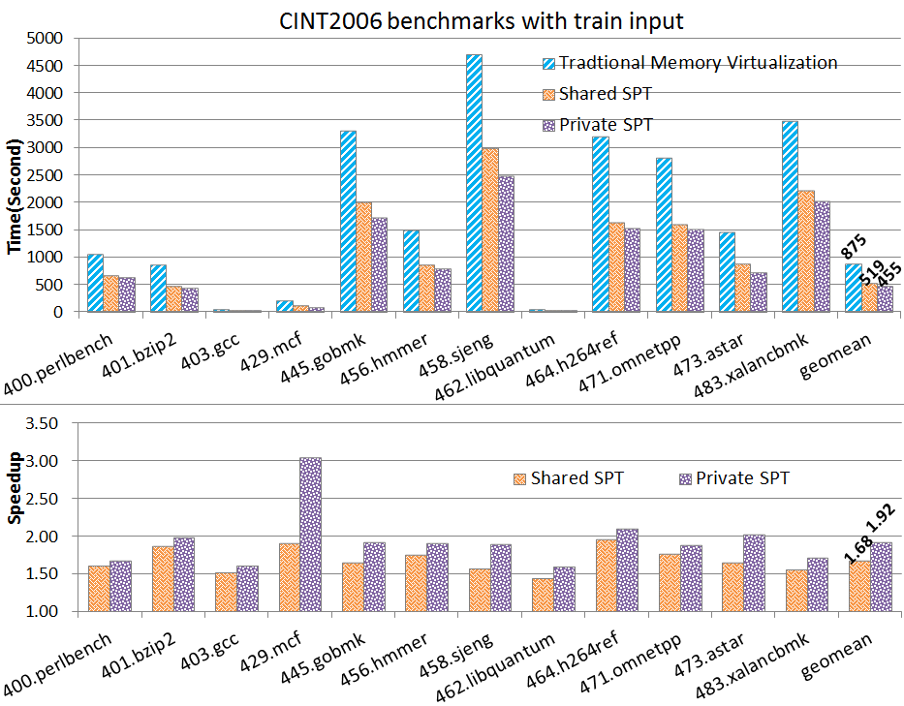
Shared SPT/Private SPT
Shared SPT has one SPT. Private SPT has 256 SPTs.

Slide 29
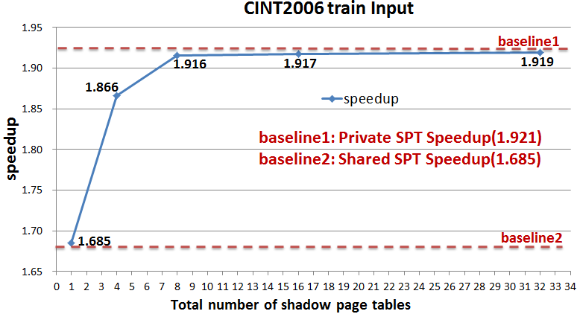
Group Shared SPT
We test the performance when the number of SPTs is 1, 4, 8, 16 and 32.
We can see obviously the performance keeps improving with the increasing number of SPTs and when the number of SPTs exceeds 8, the performance of Group Shared SPT is very close to Private SPT.

Slide 30
Disscussion
We did not compare the performance of HSPT side-by-side with ESPT.
Our work does not claim HSPT will yield greater performance than ESPT.
It is motivated for better platform portability, higher system security, and improved usability for application developers since non-root users can also benefit from HSPT technology.

Slide 31
Outline
Background
Motivation
Contributions
The Framework of HSPT
Evaluation
Conclusion

Slide 32
Conclusion
We proposed an practical implementation of SPT for cross-ISA virtual machines without using LKMs.
Our approach uses part of the host page table as SPT and rely on the shared memory mapping schemes to update SPT, thus avoid the use of LKMs.
We Proposed and evaluated three SPT organizations to handle multi-processing in guest OS.
With sufficient host virtual space, our approach has achieved up to 92% speedup for CINT2006 benchmarks.

Slide 33
Thank You

