Slide 1
RERANZ: A Light-Weight Virtual Machine to Mitigate Memory Disclosure Attacks
Zhe Wang^{1,2}, Chenggang Wu¹ , Jianjun Li¹, Yuanming Lai¹,
Xiangyu Zhang³, Wei-Chung Hsu⁴, Yueqiang Cheng⁵
¹State Key Laboratory of Computer Architecture, Institute of Computing Technology,
²University of Chinese Academy of Sciences, ³Dept. Computer Science, Purdue University,
⁴Dept. Computer Science & Information Engineering, National Taiwan University,
⁵Acetti Software
Notes:
Hello, everyone. I am glad to be here to share our work about how to use a process-level machine to mitigate memory disclosure attacks.
I am a Phd candidate of Chinese Academy of Sciences, and I am the first author of this paper.

Slide 2
Outline
Background
The Idea of RERANZ
Challenges
Two Key Design Choices
Architecture Overview
Evaluation
Conclusion
Notes:
Today, I will give my presentation into 7 parts.

Slide 3
Outline
Background
The Idea of RERANZ
Challenges
Two Key Design Choices
Architecture Overview
Evaluation
Conclusion
Notes:
For the first part, I will introduce the background of the memory disclosure attacks.

Slide 4


Return-Oriented Programming (ROP)
Analyze the content
Notes:
Memory disclosure attacks are much more advance attacks. Return-oriented programming attack, short for ROP attack is the basis of the memory disclosure attack.
To introduce the ROP attack vividly, we show an example that how does an attacker generate a malicious sentence from a benign newspaper.
(click) First, the attacker analyze the newspaper in detail.

Slide 5
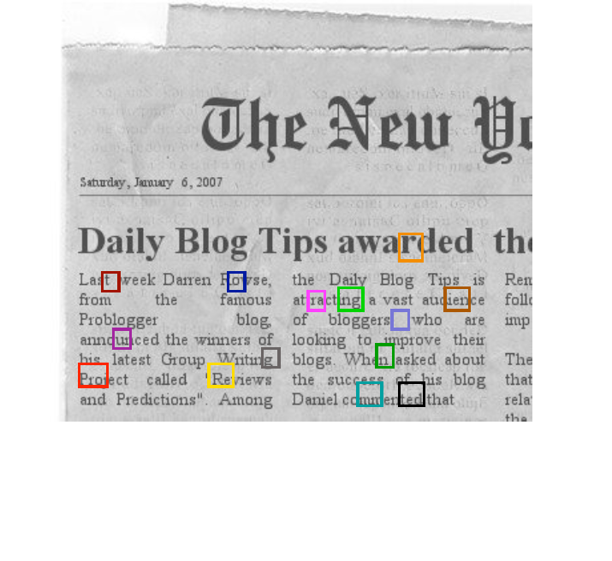
Return-Oriented Programming (ROP)
Find useful fragments
Notes:
And then finding useful fragments

Slide 6
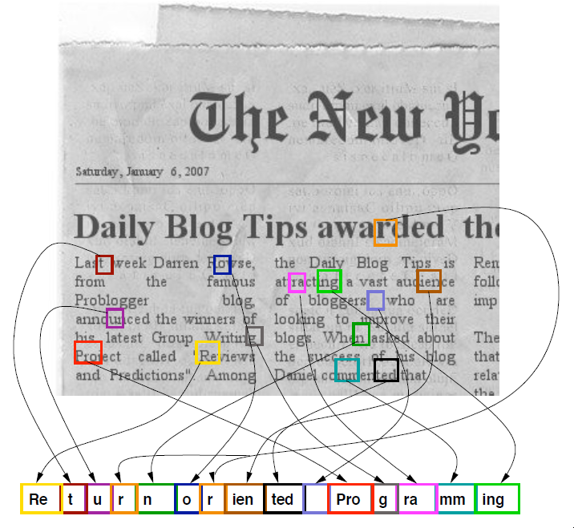
Return-Oriented Programming (ROP)
Chain these fragments
Notes:
At last, the attacker chain all these fragments to construct a malicious sentence: return oriented programming

Slide 7


Example of an ROP Attack
Step 1: Scan binaries to find code fragments (gadgets)
1
Attacker
Executable and Libraries
Gadgets in Binary
0x4005b2: mov %eax, $0x3b; syscall
0x400394: pop %rdx; retq
0x4005a3: xor %rsi, %rsi ; retq
0x4004b5: pop %rdi; retq
Notes:
We have given a big picture of ROP just now.
Now we give you a real example. There is an attacker here, he analyzes the executables and libraries to find code fragments, called gadgets.
And we can see that each gadget consists of several instructions that ends with a ret instruction.

Slide 8
Example of an ROP Attack
Step 1: Scan binaries to find code fragments (gadgets)
1
Stack
Attacker
stack growth
Executable and Libraries
…
Gadgets in Binary
return address
0x4005b2: mov %eax, $0x3b; syscall
0x400394: pop %rdx; retq
char *buf[20]
0x4005a3: xor %rsi, %rsi ; retq
0x4004b5: pop %rdi; retq
…
Notes:
In the victim process, there is a buffer in the stack. And a return address is stored above the buffer.

Slide 9
Example of an ROP Attack
Step 2: Upload the payload (gadgets’ addresses)
1
Stack
Attacker
2
“/bin/sh”
Executable and Libraries
0x4005b2
0
Stack
0x400394
0x4005a3
&binsh
Gadgets in Binary
0x4004b5
0x4005b2: mov %eax, $0x3b; syscall
0x400394: pop %rdx; retq
20*’A’
0x4005a3: xor %rsi, %rsi ; retq
…
0x4004b5: pop %rdi; retq
Notes:
In the second step, the attacker will upload the payload into the buffer. The size of the payload is larger than the buffer’s.
So it will over write the buffer.

Slide 10
Example of an ROP Attack
Step 2: Upload the payload (gadgets’ addresses)
1
Stack
Attacker
2
“/bin/sh”
Executable and Libraries
0x4005b2
0
Stack
0x400394
0x4005a3
&binsh
Gadgets in Binary
0x4004b5
0x4005b2: mov %eax, $0x3b; syscall
0x400394: pop %rdx; retq
20*’A’
0x4005a3: xor %rsi, %rsi ; retq
…
0x4004b5: pop %rdi; retq
Notes:
The payload consists of many pointers, where each pointer refers to a gadget.

Slide 11
Example of an ROP Attack
Step 3: Hijack the control flow to execute the payload
1
Stack
Attacker
2
“/bin/sh”
Executable and Libraries
0x4005b2
0
Stack
0x400394
0x4005a3
&binsh
Gadgets in Binary
0x4004b5
3
0x4005b2: mov %eax, $0x3b; syscall
SP
0x400394: pop %rdx; retq
20*’A’
Buffer
Overflow
0x4005a3: xor %rsi, %rsi ; retq
…
0x4004b5: pop %rdi; retq
Notes:
Because the attacker had over write the return address, when the ret instruction uses the modified return address, the control flow will be hijacked.

Slide 12
Example of an ROP Attack
Step 3: Hijack the control flow to execute the payload
1
Stack
Attacker
2
“/bin/sh”
Executable and Libraries
0x4005b2
0
Stack
0x400394
0x4005a3
SP
&binsh
Gadgets in Binary
0x4004b5
3
0x4005b2: mov %eax, $0x3b; syscall
0x400394: pop %rdx; retq
20*’A’
Buffer
Overflow
0x4005a3: xor %rsi, %rsi ; retq
…
0x4004b5: pop %rdi; retq
Notes:
Once a gadget has executed and the top of the stack points to the address of the next gadget, the exploit continues.

Slide 13
Example of an ROP Attack
Step 3: Hijack the control flow to execute the payload
1
Stack
Attacker
2
“/bin/sh”
Executable and Libraries
0x4005b2
0
Stack
0x400394
SP
0x4005a3
&binsh
Gadgets in Binary
0x4004b5
3
0x4005b2: mov %eax, $0x3b; syscall
0x400394: pop %rdx; retq
20*’A’
Buffer
Overflow
0x4005a3: xor %rsi, %rsi ; retq
…
0x4004b5: pop %rdi; retq

Slide 14
Example of an ROP Attack
Step 3: Hijack the control flow to execute the payload
1
Stack
Attacker
2
“/bin/sh”
Executable and Libraries
0x4005b2
0
Stack
0x400394
SP
0x4005a3
&binsh
Gadgets in Binary
0x4004b5
3
0x4005b2: mov %eax, $0x3b; syscall
0x400394: pop %rdx; retq
20*’A’
Buffer
Overflow
0x4005a3: xor %rsi, %rsi ; retq
…
0x4004b5: pop %rdi; retq
Notes:
The program will execute all the gadgets orderly.

Slide 15
Example of an ROP Attack
Step 3: Hijack the control flow to execute the payload
1
Stack
Attacker
2
“/bin/sh”
Executable and Libraries
0x4005b2
0
Dynamic Execution Flow
Stack
0x400394
1: pop %rdi;
2: xor %rsi, %rsi;
3: pop %rdx;
4: mov %eax, $0x3b;
5: syscall;
SP
0x4005a3
&binsh
Gadgets in Binary
0x4004b5
3
0x4005b2: mov %eax, $0x3b; syscall
0x400394: pop %rdx; retq
20*’A’
Buffer
Overflow
0x4005a3: xor %rsi, %rsi ; retq
…
0x4004b5: pop %rdi; retq
Notes:
After deleting the control transfer operations, we get the dynamic execution flow that the attacker wants to execute these five instructions.

Slide 16
Example of an ROP Attack
Step 3: Hijack the control flow to execute the payload
1
Stack
Attacker
2
“/bin/sh”
Executable and Libraries
0x4005b2
0
?
Dynamic Execution Flow
Attacker’s Intent
Stack
0x400394
1: pop %rdi;
2: xor %rsi, %rsi;
3: pop %rdx;
4: mov %eax, $0x3b;
5: syscall;
SP
0x4005a3
execve(“/bin/sh”, NULL, NULL)
?
&binsh
Gadgets in Binary
0x4004b5
3
0x4005b2: mov %eax, $0x3b; syscall
Attacker wants to start a shell!
0x400394: pop %rdx; retq
20*’A’
Buffer
Overflow
0x4005a3: xor %rsi, %rsi ; retq
…
0x4004b5: pop %rdi; retq
Notes:
But what’s the attacker’s Intent.
(click) (click) Yes, he wants to start a shell!!!

Slide 17
Address Space Layout Randomization
Load-time ASLR techniques could mitigate the ROP.
They could ensure that the code layout will be different every time a process is running.
Notes:
Load-time ASLR had been proposed to mitigate ROP attacks by making the addresses of gadgets unpredictable at load-time.
(click) they could ensure that the code layout will be different every time a process is running.

Slide 18
Address Space Layout Randomization
Load-time ASLR techniques could mitigate the ROP.
They could ensure that the code layout will be different every time a process is running.
Traditional ASLR
2³²
Sys.
Virtual Address Space
User Address Space
2⁰
Module-level
Notes:
Module-level ASLR is widely deployed now.

Slide 19
Address Space Layout Randomization
Load-time ASLR techniques could mitigate the ROP.
They could ensure that the code layout will be different every time a process is running.
Traditional ASLR
Fine-grained ASLR
2³²
2³¹
Sys.
lib1
Virtual Address Space
User Address Space
User Address Space
lib2
lib3
main
2⁰
2⁰
Module-level
Function/Basic Block/Instruction level
Notes:
To raise the bar of cracking the memory layout, fine-grained ASLR had been proposed by permuting functions, basic block or instructions.

Slide 20
Address Space Layout Randomization
Load-time ASLR techniques could mitigate the ROP.
They could ensure that the code layout will be different every time a process is running.
Traditional ASLR
Fine-grained ASLR
2³²
2³¹
?
?
?
Sys.
lib1
Virtual Address Space
User Address Space
User Address Space
lib2
lib3
Attacker
Where are the gadgets?
main
2⁰
2⁰
Module-level
Function/Basic Block/Instruction level
Notes:
It is difficult for adversaries to guess the gadgets’ location under these techniques.

Slide 21
Memory Disclosure Attacks
Just-in-time Return-Oriented Programming (JIT-ROP)
The code layout remain unchanged throughout the execution.
Iteratively leak code at runtime.
Notes:
To counter these defenses, memory disclosure attacks were proposed. JIT-ROP is a famous attack of this type.
(click) Although load-time randomization techniques ensure that the code layout will be different every time a process is
running, the code layout will remain unchanged throughout the execution.
(click) So JIT-ROP attack could leak the code pages at runtime and then launch the ROP attack.

Slide 22


Memory Disclosure Attacks
Just-in-time Return-Oriented Programming [JIT-ROP, S&P’14]
The code layout remain unchanged throughout the execution.
Iteratively leak code at runtime.
Stack
4
55 8B EC 8B
56 8D 48 20
FF 78 37 92
Return Address
5
51 FF B0 74
00 85 C0 75 08 FF 15 B8
Buffer
Upload ROP payload
FF D6 3D E5 03 00 00 74
5D C2 0C 00
Execute
Gadgets
Leak code pages
Library code
3
0x75abfec0:
2
Request the contents
Victim
Heap
Attacker
0x75abfec0
1
Leak a code pointer
Has Memory Disclosure
Vulnerabilities
Program code
Repeat many times to harvest enough code pages
Address Space
Notes:
There is an example to explain how the JIT-ROP attack works.
In the left side, there is a victim computer that has memory disclosure vulnerabilities.
In the right side, there is an attacker.
And the attacker wants to hijack the current process of the victim.
In the address space of the victim process, we can see there is a code pointer that points to the library code.
(click) The attacker through the memory disclosure vulnerability to disclose this pointer,
(click) Then he requires to leak a code page pointed by this pointer,
(click) A code page is leaked to the attacker.
(click) Actually, the attacker need repeat this process many times to leak enough code pages.
(click) And then he analyzes the code pages to find gadgets and build the payload.
(click) At last, he uploads the ROP payload to launch the ROP attack.

Slide 23
Outline
Background
The Idea of RERANZ
Challenges
Two Key Design Choices
The Framework of RERANZ
Evaluation
Conclusion
Notes:
Next, I will introduce the basic idea of ReRanz.

Slide 24
The Idea of RERANZ
What if we re-randomize code at runtime?
Stack
55 8B EC 8B
56 8D 48 20
FF 78 37 92
Return Address
51 FF B0 74
00 85 C0 75 08 FF 15 B8
Buffer
Upload ROP payload
FF D6 3D E5 03 00 00 74
5D C2 0C 00
Execute
Crash
Library Code
Leak code pages
Victim
Attacker
Program
Code
Has Memory Disclosure
Vulnerabilities
Address Space
Notes:
What if we re-randomize code at runtime?
(click) –> (click) -> (click) We randomize the code between leaking code and uploading payload.
So the gadgets’ addresses in the payload points to the old code layout.
(click) In this cartoon, the attacker wants to execute the yellow code block, but it’s location has been changed!

Slide 25
What is RERANZ ?
Defense based on continuous re-randomization.
Re-randomize all code in the basic block level.
Mitigate known memory disclosure attacks.
Efficient
Introduce 6% and 9.7% overhead for SPEC CPU2006 and Parsec-2.1.
Incur 10% overhead for Apache/Nginx running in the batch mode.
Deployable
Binary analysis w/o needing source code.
Support common application features
Multi-threading/Multi-processes
Linux Signals/Dynamic Library Loading.
Self-referencing Code
Notes:
Our ReRanz uses the basic block level code re-randomization techniques to mitigate the memory disclosure attacks.
(click) And ReRanz introduce low overhead in the real word applications
(click) ReRanz re-randomize the code w/o needing source code and support
(click) common application features. Making it deployable

Slide 26
Outline
Background
The Idea of RERANZ
Challenges
Two Key Design Choices
Architecture Overview
Evaluation
Conclusion
Notes:
In this part, I will introduce two challenges.

Slide 27
Challenges
Challenge1: How to re-randomize code at runtime?
Easy to copy code & relocate the direct references.
But what about code pointers?
Ptr:
&Func_2
Func_1
…
mov $func_2, Ptr
…
call *Ptr
…
Func_2
PC
Notes:
The first challenge is how to re-randomize code at runtime.
We could move the code to a randomized location and relocate the direct reference between them.
But what about the indirect references through the code pointers?
There is an example that a call instruction changes the control flow by de-referencing the ptr.

Slide 28
Challenges
Challenge1: How to re-randomize code at runtime?
Easy to copy code & relocate the direct references.
But what about code pointers?
Ptr:
&Func_2
Func_1
…
mov $func_2, Ptr
…
call *Ptr
…
(deleted)
Func_2
PC
Notes:
After randomizing the location of Fun_2, the ptr points to a invalid code

Slide 29
Challenges
Challenge1: How to re-randomize code at runtime?
Easy to copy code & relocate the direct references.
But what about code pointers?
We should update Ptr at runtime.
Ptr:
&Func_2
Func_1
…
mov $func_2, Ptr
…
call *Ptr
…
(deleted)
Func_2
PC
Crash
Notes:
(click) When it jumps to the old location of Func_2, it will crash.
To avoid it, we need to update the ptr after randomizing the code.
But it is hard to updating all code pointers.

Slide 30
Challenges
Challenge1: How to re-randomize code at runtime?
Easy to copy code & relocate the direct references.
But what about code pointers?
How to update all propagated code pointers?
Precisely identifying and tracking such pointers in binary during execution is a prominent problem.
&Func_2
&Func_2
&Func_2
&Func_2
&Func_2
Ptr:
&Func_2
(deleted)
Func_2
Notes:
Especially the code pointers can be propagated at runtime.

Slide 31
Challenges
Challenge2: When to re-randomize code?
Overly frequent re-randomization can incur an unacceptably high overhead.
Insufficiently frequent re-randomization can weaken or eliminate security guarantees.
An attacker may have the opportunity to leak information and execute the main attack before the process is re-randomized.
Notes:
The second challenge is when to re-randomize the code.
(click) 读
(click) 读
(click) 读

Slide 32
Outline
Background
The Idea of RERANZ
Challenges
Two Key Design Choices
Architecture Overview
Evaluation
Conclusion
Notes:
In this part, we will show how we address these two challenges.

Slide 33
Re-randomization without Tracking Pointers
Avoid identifying and updating code pointers.
It dynamically redirects a code pointer to its corresponding address in the code variant when it is de-referenced.
Notes:
To address the first challenge, we avoid identifying and updating code pointers at runtime.
(click) Instead of updating code pointers, we dynamically redirects a code pointer to its randomized location when it is de-referenced.

Slide 34
Re-randomization without Tracking Pointers
Avoid identifying and updating code pointers.
It dynamically redirects a code pointer to its corresponding address in the code variant when it is de-referenced.
Stack
Return Address
This property is required for self-referencing code.
Self-referencing Code: It usually treats the code pointers as data pointers and use these data pointers to read the content.
Code Cache
Code Variant
Original Code
Change to
Read-only
Permission
Code
Address Space
Notes:
There is a victim process’s address space after loading.
(click) We do not randomize the code in the original code region. We first change the origin code region to read-only permission
(click) And randomize the code into a Code Cache (click)
(click) Since all code pointers point to un-randomized code region, so this design supports the self-referencing code.
(click) Self-referencing code usually treats the code pointers as data pointers and read the code.

Slide 35
Re-randomization without Tracking Pointers
Dynamic Address Translation.
During re-randomization, we need to update the Mapping Table.
Code Cache
Original | New
&Func2(RO) | &Func2(RX)
Func_2(RX)
Func_1
…
mov $func_2, Ptr
…
call *Ptr
…
Randomized Location
PC
1. Lookup Mapping Table
2. Jump to New Target
Call translation(*ptr)
Func_2(RO)
Note.
RO : Read-Only
RX : Readable and eXecutable
Ptr:
&Func_2(RO)
Heap
Original Code
Notes:
To demonstrate the dynamic address translation, we give an example here.
There is a ptr in the heap and it points to the original Func_2. In the code cache, there is a randomized Func_2.
The call instruction is now de-referencing the ptr.
(click) We instrument the call instruction to
(click) first look up a mapping table
(click) that contains the code’s map from the original location to the randomized location
(click) And then jumps to the randomized code.
(click) Notice that during re-randomization, we need to update the mapping table.

Slide 36
Re-randomization without Tracking Pointers
STACK (RW):
…
Note.
BB : Basic Block
RW : Readable and Writable
RO : Read-Only
RX : Readable and eXecutable
Addr5:
Addr3
target
+off_c
Addr6:
BB4
Addr7:
BB1
Addr8:
target
+off_c
BB2
Addr9:
BB3
Code Cache
(RX)
STACK (RW):
Trampolines:
…
Addr1+off_c:
Addr5:
Addr3
Jump to Addr7
Addr2+off_c:
Jump to Addr8
Addr3+off_c:
Jump to Addr9
Addr4+off_c:
Jump to Addr6
CODE (RX):
CODE (RO):
Addr1:
BB1
Addr1:
BB1
call rax
call rax
Addr2:
BB2
Addr2:
BB2
Addr3:
BB3
Addr3:
BB3
BB4
ret
ret
Addr4:
Addr4:
BB4
Notes:
In this slide, we give a more specific example than the last slide.
In the left side, there is a victim’s address space without ReRanz
In the right side, there is the victim’s address space with ReRanz and you can see there is a code cache in it.
(click) All basic blocks are permuted in the code cache
(click) To accelerate the dynamic address translation, we maintain a set of trampolines.
Each basic block has a corresponding trampoline located at a place with a fixed offset from the original basic block and the jump target of a trampoline is
the randomized location.
(click) And all indirect branch instruction only need to jump to the trampoline by adding a offset with the jump target,
(click) it will jump to the randomized target basic block. (click)

Slide 37
Re-randomization without Tracking Pointers
Security Flaw of the Basic Design
To launch an attacker, the attackers could only chain basic blocks.
The payload only contains the original location of basic blocks.
We renamed the basic block as the useful gadget.
With the help of the trampolines, the gadget addresses in the payload can be translated to the randomized locations.
Notes:
But there is a security flaw of the basic design
(click) the attacker could only chain the basic blocks
(click) and the payload only contains the original location of basic blocks.
(click) Here, we renamed the basic block as the useful gadget
(click) with the help of the trampolines, the gadget addresses in the payload can be translated to the randomized locations.

Slide 38
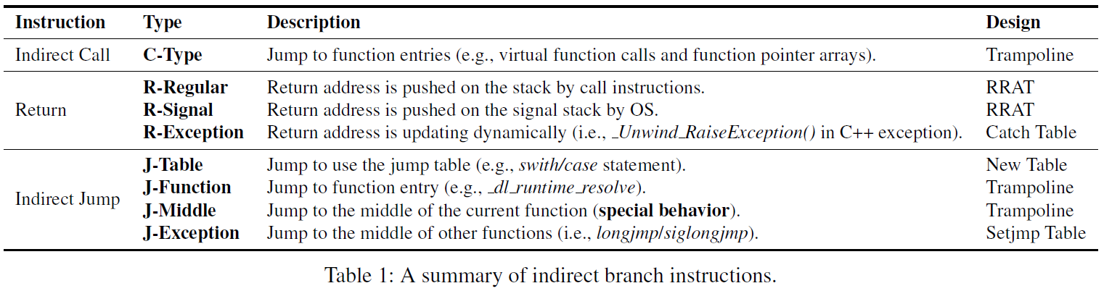
Re-randomization without Tracking Pointers
Enhanced Design
Reduce the pointer de-reference operations of accessing trampolines
Reduce the number of trampolines.
To understand the behavior of indirect branch instructions, we analyzed vast Linux binaries.
Goal: Reduce the amount of the useful gadgets.
Only these three types of instruction need trampoline!
The reduced trampolines are jump targets of these instructions.
Notes:
The root cause of the above vulnerability is that the adversary might exploit the process of the dynamic address translation.
(click) we attempt to minimize such risks through two ways, the first way is to reduce the pointer de-referenced operations of accessing trampolines.
Attackers cannot use the basic block without using trampolines.
(click) the second way is to reduce the number of trampolines. Attacker cannot chain the basic block without corresponding trampolines.
(click) Both approaches leave very few blocks as gadget candidates for adversaries to exploit.
(click) To accomplish these, we need to analyze the indirect instructions’ behavior and adopt the different methods.
(click) We analyze many binaries and summary the types of indirect branch instructions.
For example, return instruction and some of indirect jump instructions did not need trampolines any more, they use three different tables.
(click) And only three types of instructions need trampolines. The reduced trampolines are jump targets of these instructions.

Slide 39
Re-randomization without Tracking Pointers
Introduction to RRAT (Real Return Address Table)
Func_2_New
…
ret
Code
Cache
Stack
SP
0x40044d
Func_1_New
…
call Func_2_New
…
PC
0x7ff1046a:
RRAT
0x7ff1046a
Func_1_Orig
…
call Func_2_Orig
…
More details are in the paper!
RRAT is hidden in the victim’s address space.
It can only be accessed by the %gs segmentation.
0x40044d:
Func_2_Orig
…
ret
Original
Code
Notes:
In this slide, we will introduce the RRAT, which is short for real return address table.
This table is used to make the ret instruction get rid of using trampolines.
(click……)
RRAT is similar to shadow stack, it stores the randomized return addresses in Code Cache during the execution
of call instructions and ret is transformed to load the jump target from RRAT.
(click) RRAT is protected by %gs segmentation register.
More details about RRAT and other tables are in the paper.

Slide 40
Time to Perform Re-randomization
Identify possible disclosure time
Identify possible corruption time
Randomize code layout in between
Notes:
To choose a propriate randomization time, we need identify possible disclosure time.
(click) and identify possible corruption time
(click) and then randomize code layout in between them

Slide 41
Time to Perform Re-randomization
==> Leak code pages (system output)
Identify possible disclosure time
Identify possible corruption time
Randomize code layout in between
==> Upload payload (system input)
Stack
Return Address
Upload payload
Library code
Leak a code page
Read a page size’s content
Victim
Heap
Leak a code page
Attacker
Read a page size’s content
Has Memory Disclosure
Vulnerabilities
Program code
Address Space
Notes:
(click 4次) attackers usually communicate with the victim machine many times to harvest the code pages and then upload the payload
(click) Learned from this process, the possible disclosure time is the output of the victim machine
(click) the possible corruption time is the input of the victim machine

Slide 42
Time to Perform Re-randomization
Re-randomize after system output and before system input [TASR, CCS’15]
System Output: output system calls, such as write(), pwritev().
System Input : input system calls, such as read(), preadv().
But we find that this strategy may cause prohibitively high overhead for I/O intensive applications (e.g., Nginx).
To reduce the frequency of re-randomization, we proposed a new method based on the amount of data transmitted by the output system calls.
Notes:
Re-randomization can be performed after system output and before system input.
This is the TASR’s work in 2015.
(click) the system output is choosed at output system calls, such as write
(click) the system input is choosed at input system calls, such as read
(click) But we find that this strategy may cause high overhead for I/O intensive applications due to high frequency re-randomization.
(click) So we proposed a new method based on this strategy.

Slide 43
Time to Perform Re-randomization
Inspiration
Sequence of output syscalls before an input syscall may not transmit a large amount of data, e.g., password checking.
It is impossible to launch a meaningful ROP attack if the size of executable code is smaller than 20KB.[ROPecker, NDSS’14]
Our Strategy
Monitor the amount of transmitted data of output system calls.
Re-randomize when the accumulated amount exceeds a certain threshold.
Notes:
(click) Our strategy is based two inspirations
(click) the first one is…
(click) the second one is…
(click) so the final strategy is to monitor…
(click) and re-randomize…

Slide 44
Time to Perform Re-randomization
Example
Assume the average data size of write() is 4KB and the threshold is set to 20KB.
Execution flow of syscalls:
write() -> write() -> read() -> write() -> read() -> write() -> read() -> write() -> read()
TASR needs re-randomize before each read().
Our strategy needs only re-randomize before the last read().
Notes:
Given an example here.
Assume…
(click) There is an execution flow of syscalls here
(click) TASR needs…
(click) We need…

Slide 45
Outline
Background
The Idea of RERANZ
Challenges
Two Key Design Choices
Architecture Overview
Evaluation
Conclusion
Notes:
In this part, I will introduce the architecture overview

Slide 46
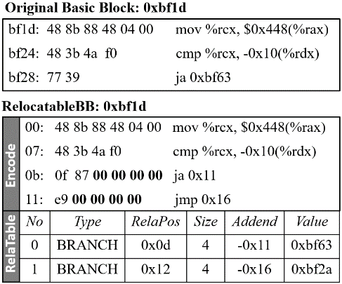

Architecture Overview
Offline Static Analysis Phase
Analyze executable and related libraries and generate files for each module.
Disassemble/Partition into Basic Blocks/Instruction Transformation
Static Program Binary
Static
Analyzer
1
Randomiza-
tion Files
Notes:
(click) RERANZ begins by analyzing the executable and its libraries, and then generate a randomization file for each module in an Offline Static Analysis Phase.
(click) It disassembles the executable, partitions it into basic blocks and then transforms the instructions in each basic block.
(click) For each basic block, RERANZ generates a RelocatableBB
(click) It contains a modified basic block followed by
(click) a relocation table that records the addresses that need to be replaced during randomization.

Slide 47
Architecture Overview
Load-time Initialization Phase
When the protected proc starts, kernel module starts a shuffling proc.
Static Program Binary
Protected Process
Shuffling Process
2
Code Generator
Static
Analyzer
Library
1
Communication
Main Program
Randomiza-
tion Files
Kernel Module
5
OS
Notes:
The task of the Load-time Initialization Phase is to allocate the Code Cache, and generate the first code variant into it.
(click) When the protected process starts, kernel module starts a shuffling process

Slide 48
Architecture Overview
Load-time Initialization Phase
When the protected proc starts, kernel module starts a shuffling proc.
Along with the initialization of the protected process, kernel module allocates Code Cache for each module.
Static Program Binary
Protected Process
Shuffling Process
2
Lib Code Cache
Code Generator
3
Static
Analyzer
Library
Main Code Cache
3
1
Communication
Main Program
Randomiza-
tion Files
Kernel Module
5
OS
Notes:
Along with…

Slide 49
Architecture Overview
Load-time Initialization Phase
When the protected proc starts, kernel module starts a shuffling proc.
Along with the initialization of the protected process, kernel module allocates Code Cache for each module.
Meanwhile, the shuffling process will read the randomization files and generate the first code variant into the Code Cache through shared memory mechanism.
Static Program Binary
Protected Process
Shuffling Process
2
Lib Code Cache
Code Generator
Code Variant1
3
4
Code Variant1
Shared Memory
Static
Analyzer
Library
Main Code Cache
Code Variant1
Code Variant1
3
1
Communication
Main Program
Randomiza-
tion Files
Kernel Module
OS
Notes:
Meanwhile, the shuffling process will
(click) read the randomization files and
(click) generate the first code variant into the Code Cache through shared memory mechanism.

Slide 50
Architecture Overview
Runtime Re-randomization Phase
The kernel module detects the syscall pattern in the execution of protected process.
When a randomization point occurs, the kernel module modifies the protected process’s page table to map the new code variant to the protected process’s Code Cache and update all the tables, such as RRAT.
Static Program Binary
Protected Process
Shuffling Process
2
Lib Code Cache
Code Generator
Code Variant1
Code Variant2
3
4
Code Variant1
Shared Memory
Static
Analyzer
Code Variant2
Library
6
Code Variant2
Main Code Cache
Code Variant2
Code Variant1
Code Variant1
3
1
Communication
Main Program
Randomiza-
tion Files
Kernel Module
5
OS
Notes:
(click) (click) In the Runtime Re-randomization Phase, the kernel module monitors the normal execution of the protected process and the shuffling process generates new code variants in parallel.
(click) When a randomization …

Slide 51
Challenges & Optimization
Implementation Challenges
Multi-threading
Multiple processes
Linux Signals
Dynamic Library Loading
Optimization
Destroying Caller-saved Registers
Merging Fall-through Basic Block
Reordering Extended Basic Blocks in Group
More details are in the paper!
Notes:
In our implementation, we also address these four challenges
(click) To improve the performance of generated code variants, we optimize the transformation of instructions.
(click) More details…

Slide 52
Outline
Background
The Idea of RERANZ
Challenges
Two Key Design Choices
Architecture Overview
Evaluation
Conclusion
Notes:
In this part, I will show our evaluation

Slide 53
Evaluation
Experiment Platform
Machine: Intel E74807 with 48 cores, 1.6GHZ and 16G RAM
OS: Ubuntu 12.04.3 LTS (x86-64).
Security Evaluation
Blind ROP attack [Blind-ROP, S&P’14]
Useful Gadgets Analysis
Performance Evaluation
SPEC CPU2006 with ref input.
Multi-threaded Parsec-2.1 with native input.
Nginx web server with 4 worker processes.
Apache web server with 16 threads.
Notes:
This is our experiment platform
(click) We evaluate our system from two ways, this first is defense Blind ROP attack and the second is evaluating the useful gadgets
(click) We use spec, parsec benchmarks and two servers to evaluate the performance.

Slide 54

Real Exploit Testing
Blind-ROP attack
Stack Probing: Overwrite the stack byte-by-byte.
Finding Enough Gadgets: Scan text segments.
Build the Exploit.
RERANZ defends against Blind-ROP successfully.
Request
Crash/No-Crash
Notes:
Blind-ROP attack contains three steps.
(click) The first step is stack probing to overwrite canary and return address.
(click) （click）If the worker process does not crash, the guessed value is correct.
(click) The second step is to find enough gadgets.
(click) The last step is build the exploit.
(click) The result shows that the attack always fails

Slide 55
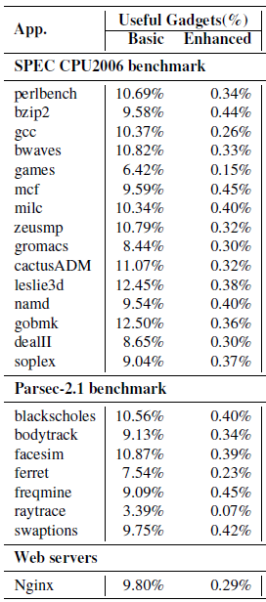
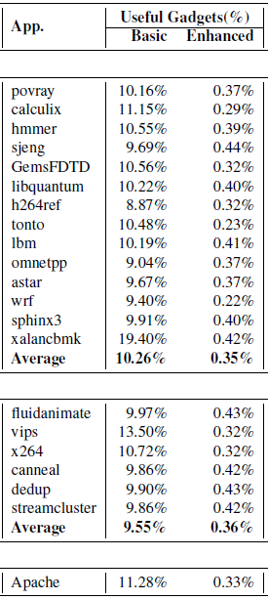
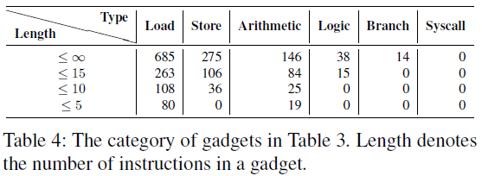
Useful Gadgets Analysis
Use ROPgadget tool to find useful gadgets in code variants.
Notes:
To evaluate the categories and quantity of useful gadgets, we use ROPgadget tool to find them in the code variant of two benchmarks and two servers.
(click) The result show that the enhanced design can lower the quantity of gadgets vastly.
(click) To further evaluate the categories of the useful gadgets, we extract and analyze all unique useful gadgets.
We find that when the gadget length is less than 5, four out of six gadget types are missing, making it very difficult for the adversaries to
launch a real ROP attack.

Slide 56
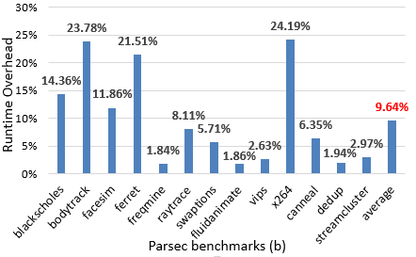
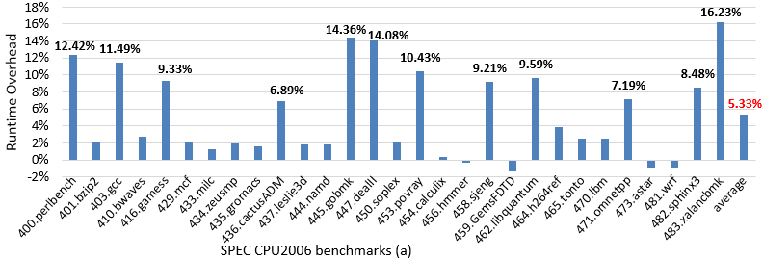
SPEC CPU2006 & Parsec-2.1
Threshold=0
TASR’s Re-rand Strategy
Notes:
We use the spec and parsec to evaluate the ReRanz. And ReRanz uses the TASR’s re-randomization strategy.
The result shows that the average overhead of SPEC is less than 6% and 10% for Parsec.

Slide 57
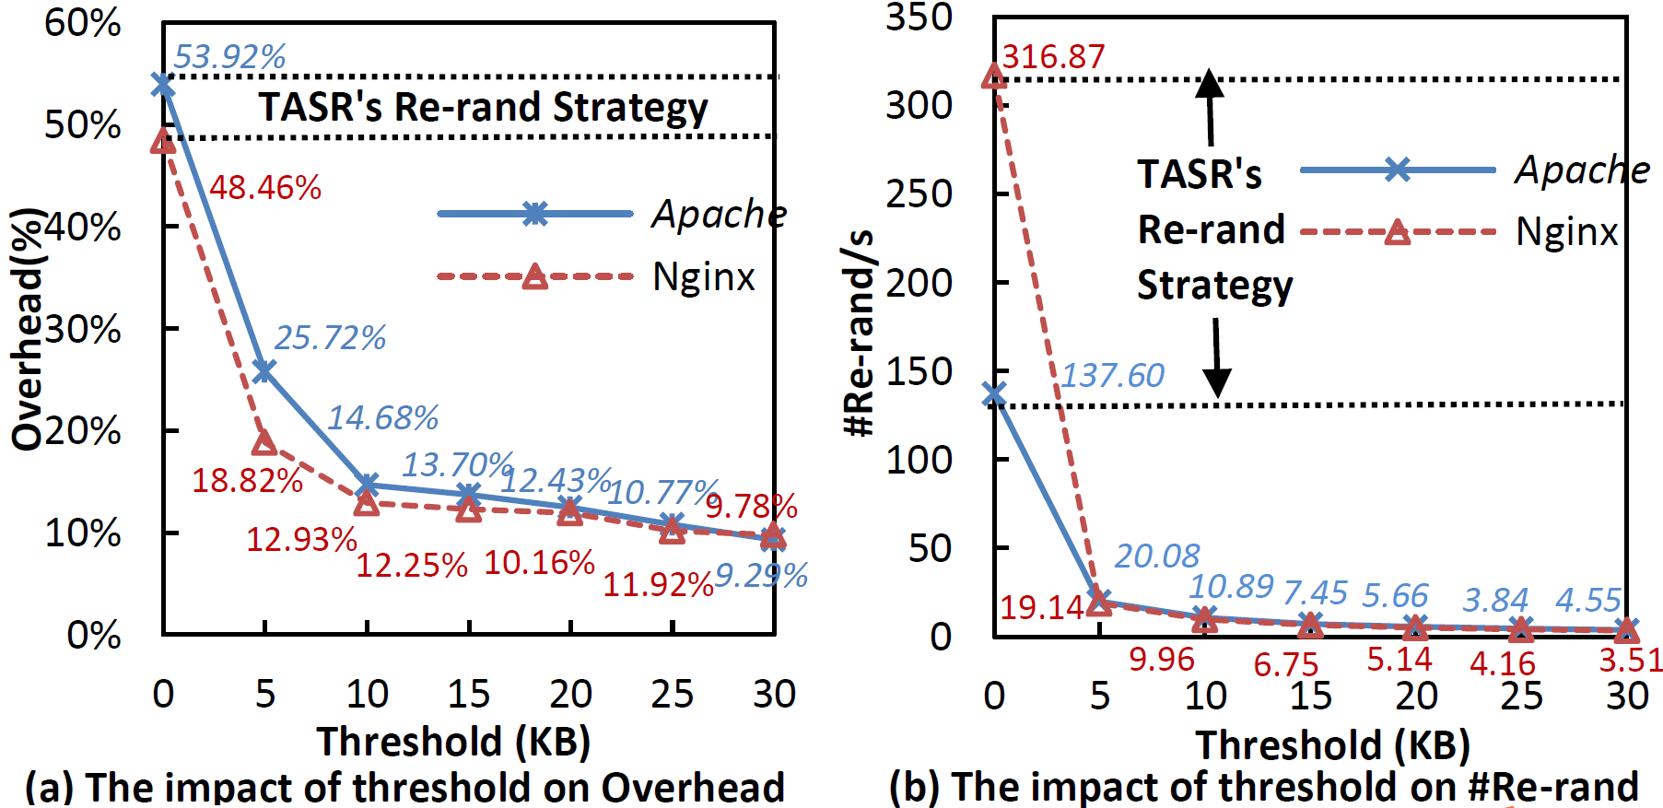
Web servers
Notes:
We also evaluate the impact of threshold of ReRand.
Figure a shows the impact on the overhead
Figure b shows the impact on the times of re-randomization
TASR’s strategy could incur very high performance overhead.
We observe that the average overhead decreases with the growing threshold.

Slide 58
Future Work
Could not defend against function-reuse attacks, such as COOP attack [COOP, S&P’15].
Watching over the content transmitted might help to make more accurate decisions on whether re-randomization is warranted
Notes:
Although enhanced design had raised the difficulty to perform a real ROP attack, we should note that almost all of the remainder trampolines in are the function entries.
The attackers could conduct the function reuse attacks, such as COOP. In the future, we will try to address this problem.
Watching over…

Slide 59
Conclusion
RERANZ could re-randomize all code in the protected process.
Avoid identifying and updating code pointers.
Data accumulation based re-randomization strategy.
Asynchronous Re-randomization (by using a shuffling process)
Efficient
Introduce 6% and 9.7% overhead for SPEC CPU2006 and Parsec-2.1.
Incur 10% overhead for Apache/Nginx running in the batch mode.
Deployable
Without needing any source code.
Support common application features
Multi-threading/Multi-processes
Linux Signals/Dynamic Library Loading.
Self-referencing Code

Slide 60
Thank You

Slide 61
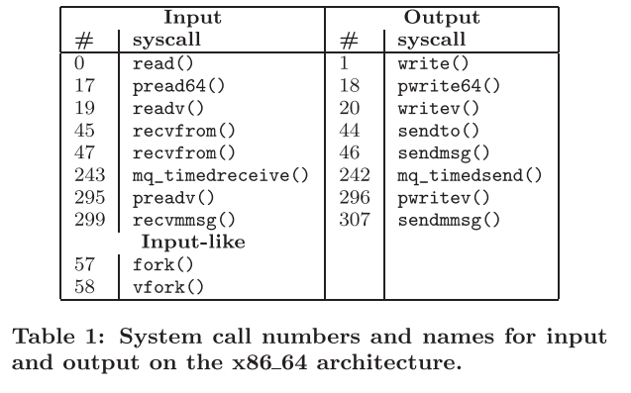
Input and Output Syscalls

Slide 62
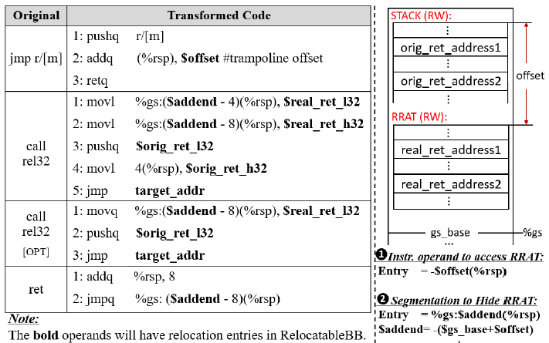
Instruction Transformation

Slide 63
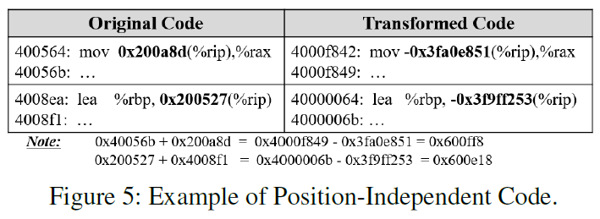
Instruction Transformation

