Slide 1
SafeHidden: An Efficient and Secure Information Hiding Technique Using Re-randomization
Zhe Wang, Chenggang Wu
ISec Lab,
State Key Laboratory of Computer Architecture,
Institute of Computing Technology (ICT)

Slide 2

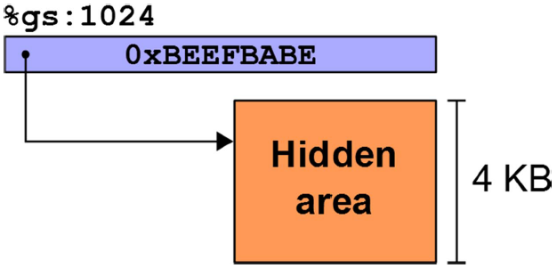


Information Hiding Technique
Information Hiding Technique
Hiding an important area at a random location
Has no pointers in memory referring to it
Is as small as possible
Normal accesses are done through
an offset from a dedicated register
It is widely used in
Code Pointer Integrity
Control Flow Integrity
Code (Re-)Randomization
[stack]
[heap]
executables
libraries
Hidden
Address Space

Slide 3
Information Hiding is Not Secure Any More
Recent attacks have made it vulnerable again.
Via breaking the assumptions of this technique !!!
Rethink the assumptions of IH :
Failed guesses could crash the program
→ Avoid crash
Safe area is designed very small (high entropy)
→ Reduce entropy
Normal accesses will not leak the location
→ Leak page table structure

Slide 4

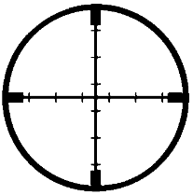
Attacks against Information Hiding
%gs:0x0
0x1fafe7fbf000
0
128T
Virtual Address
main
library
Safe
Area
stack
Crash
Crash
Bingo
Avoid Crash
CROP attack ^{[NDSS’16]}
Using the exception handling mechanism to avoid crash.
Clone-probing attack ^{[S&P’14]}
Probing the child processes to avoid crash the parent process.

Slide 5
Attacks against Information Hiding
%gs:0x0
0x1fafe7fbf000
0
128T
Virtual Address
main
Safe
Area
library
Safe
Area
Safe
Area
Safe
Area
stack
Safe
Area
Safe
Area
Bingo
Reduce Entropy
Attack via spraying safe areas ^{[SECURITY’16]}
Spraying thread-local safe areas via spraying threads.

Slide 6
Attacks against Information Hiding
%gs:0x0
0x1fafe7fbf000
0
128T
Virtual Address
main
library
Safe
Area
stack
Bingo
Reduce Entropy
Attack via spraying safe areas ^{[SECURITY’16]}
Spraying thread-local safe areas via spraying threads.
Attack via filling memory holes ^{[SECURITY’16]}
Allocating memory to occupy the unmapped areas.

Slide 7
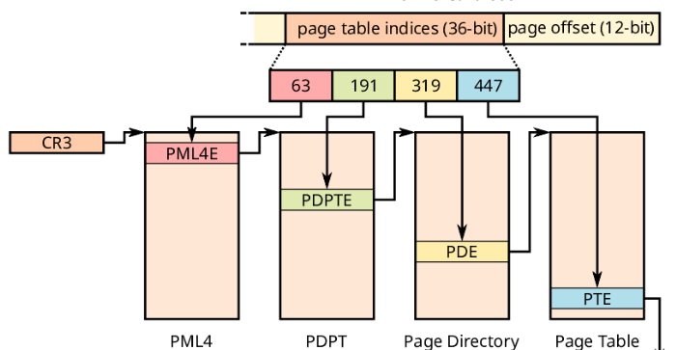

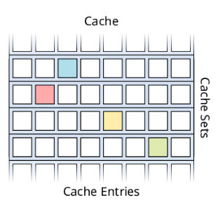
Attacks against Information Hiding
Attack against Page Table Structure^{[NDSS’17]}
0
128T
Virtual Address
main
library
Safe
Area
stack
0x1fafe7fbf000 =
%gs:0x0
= 0x???????????
PRIME+PROBE
Leak
Page
Table
0
4G
Physical Address
^{Image from} https://www.vusec.net/projects/xlate/

Slide 8
Outline
Threat Model
Attack vectors
Our design
System Implementation
Evaluation

Slide 9
Threat Model
We consider an IH-based defense that protects a vulnerable application against code reuse attacks.
Web servers or browsers.
The design of this IH-based defense is not flawed:
Before launching code reuse attacks, attackers must circumvent the defense by revealing the safe area.
Attackers’ abilities
Read and write arbitrary memory locations;
Allocate and free arbitrary memory areas;
Create any number of threads;

Slide 10
Outline
Threat Model
Attack vectors
Our design
System Implementation
Evaluation

Slide 11
Attack Vectors —— Summary of Attacks
Vector-1 Gathering memory layout information to help to locate safe areas
Vector-2 Creating opportunities to probe safe areas without crashing the system
Vector-3 Reducing the entropy of the randomized safe area locations
Vector-4 Monitoring page-table access patterns using cache side channels

Slide 12
Outline
Threat Model
Attack vectors
Our design
System Implementation
Evaluation

Slide 13
Our Design —— SafeHidden
SafeHidden is proposed to block these attack vectors
Mediating all types of probes that may leak the locations
Randomizing safe areas upon detecting suspicious probes
Isolating the thread-local safe areas
Raising security alarms when illegal probes are detected

Slide 14





Block Attack Vector-1
Vector-1 Gathering memory layout information to help to locate safe areas
[stack]
[heap]
executables
libraries
Hidden
But persistent attacks
could always succeed.
Address Space

Slide 15

Block Attack Vector-2
Vector-2 Creating opportunities to probe safe areas without crashing the system
[stack]
[stack]
Leave Traps
[heap]
[heap]
executables
executables
libraries
libraries
Hidden
Hidden
But persistent attacks
could always succeed.
Address Space
Address Space

Slide 16
But when to perform randomization?
Events | Interception Points
memory management system calls | mmap, munmap, mremap, mprotect, brk
syscalls that could return EFAULT | read, write, access, send, ...
cloning memory space | clone, fork, vfork
memory access instructions | page fault exception
[stack]
Hidden
[heap]
Other Area (OA)
Trap Area (TA)
Safe Area (SA)
Unmapped Area (UA)
executables
libraries
Events | Responses in SafeHidden
 | SA | UA | TA | OA
memory management system calls | Alarm | Rand | Alarm | —
syscalls that could return EFAULT | Alarm | Rand | Alarm | —
cloning memory space | Rand | Rand | Rand | Rand
memory access instructions | — | Rand | Alarm | —
Hidden
Address Space

Slide 17
Block Attack Vector-3
Vector-3 Reducing the entropy of the randomized safe area locations
SafeHidden prevents unlimited shrink of unmapped areas and unrestricted growth of safe areas.
The maximum size of the mapped area is set to 64 TB.
It is half of the entire virtual address space in the user space.
Using thread-private memory mechanism to isolate thread-local safe areas.
The entropy will not be reduced by thread spraying.

Slide 18

Thread-private Memory
Instead of using the thread-private page table method, we use a thread-private EPT method to avoid the compatible problem.
Thread0
Virtual Memory
Thread1
Virtual Memory
Guest Page Table
…
Core 0
Core 1
CR3
CR3
Guest
EPTP
Guest Physical Memory
EPTP
Host
EPT0
EPT1
…
…
Host Physical Memory

Slide 19
Thread-private Memory
Instead of using the thread-private page table method, we use a thread-private EPT method to avoid the compatible problem.
Thread0
Virtual Memory
P0
P1
P2
P3
Thread1
Virtual Memory
Thread0’s safe area：
Thread1’s safe area：
Guest Page Table
P0
P2
P1
P3
…
Core 0
Core 1
CR3
P5
CR3
Guest
EPTP
Guest Physical Memory
EPTP
Host
EPT0
EPT1
…
…
P6
Host Physical Memory

Slide 20
Block Attack Vector-4
Vector-4 Monitoring page-table access patterns using cache side channels
Observation
It needs hundreds of Prime+Probe or Evict+Time tests.
It is also imperative that the test address remains the same and the PTEs remain the same, too.
Solution: Re-randomization!

Slide 21
Block Attack Vector-4
SafeHidden also monitors legal accesses to the safe area that may be triggered by the attacker on purpose.
Once such a legal access is detected, SafeHidden will randomize the location of the safe area.
The virtual address of the safe area is changed.
The corresponding PTEs and their cache entries no longer reflect the real virtual address of the safe area.
But, how to detect this legal access from the attacker?

Slide 22
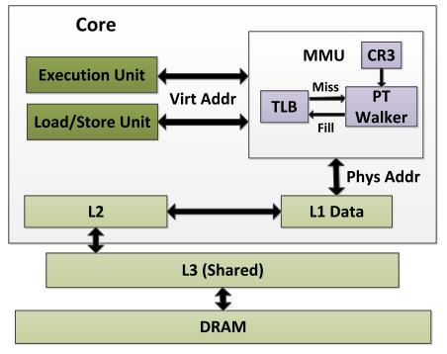
Block Attack Vector-4
The key step of cache side-channel attack against page table is to force a page table walk.
We could intercept TLB misses !!!
But, how to only intercept the TLB miss occurred in safe areas?

Slide 23
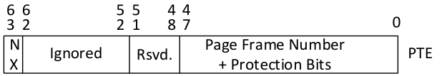
Convert TLB Miss to Page Fault Exception
When the reserved bit is set, a page fault exception will be triggered during the page table walk.
SafeHidden sets the reserved bit in all of the PTEs for the safe areas to detect the TLB misses.
When a TLB miss occurs, it is trapped into the pf handler.

Slide 24
Flowchart of Page Fault Handler
Return from Trap
Virtual Address
Retry will hit in TLB
Relocate to the New Address
6
TLB Lookup
Set Reserved Bit in All of PTEs
5
Two Problems
Y
TLB Hit?
Original Page Fault Handler
How to insert
TLB entry
under KPTI
Insert TLB Entry
N
4
Y
Hardware Page Table Walk
Possible
RSVD==0?
Trap
Randomization
Cause false alarm
TLB misses
at new location
3
N
Trap Handler:
Instrumented #PF
2
Clean All Page Table Entries
Physical Address
1

Slide 25
Outline
Threat Model
Attack vectors
Our design
System Implementation
Evaluation

Slide 26
Architecture Overview
SafeHidden is designed as a loadable kernel module.
No need to modify the existing defenses.
No need to re-compile the OS kernel.
We integrated a thin hypervisor into the kernel module for a non-virtualized OS.
The thin hypervisor virtualizes the running OS as the guest without rebooting the system.
The other components, called GuestKM, runs in guest kernel.

Slide 27


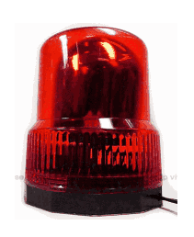
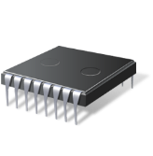

Architecture Overview
Protected APP’s thread0
Protected APP’s thread1
Other Applications
SafeHidden
Page Tables
OS Kernel
Kernel Module
Syscall Interceptor
#511
Process
Sched
Function
Module
. . .
. . .
#0
Randomizer
Checker
Linux
Notifier
#PF Interceptor
Sync EPT
Switch EPT
vmcall
Inject
Interrupt
Hypercall Handlers
EPT
Violation
Handler
#511
Intercept
Events
. . .
. . .
Hardware
#0
Hypervisor
Extended page tables

Slide 28
How to Integrate SafeHidden with KPTI?
KPTI splits the page table for each process into a user-mode page table and a kernel-mode page table.
PCID is used to avoid the TLB flush during context-switch.
Kernel Mode
User Mode
TLB
PCID | VPN->PFN
kPCID | 0xsafehidden->0x…
kPCID | 0xsafehidden->0x…
kPCID | 0xsafehidden->0x…
Kernel Space
PC
SafeHidden
CR3[11] = 1
Kernel Space
User Space
kPCID
User Space
Safe Area
Safe Area
uPCID
CR3[12] = 0
… …
PGD
Kernel
PGD
User
… …
physical
memory

Slide 29
How to Integrate SafeHidden with KPTI?
The TLB entry loaded in kernel-mode page table with kPCID cannot be used by user-mode code!
Kernel Mode
User Mode
TLB
PCID | VPN->PFN
kPCID | 0xsafehidden->0x…
kPCID | 0xsafehidden->0x…
kPCID | 0xsafehidden->0x…
kPCID | 0xsafearea ->0x…
Kernel Space
SafeHidden
CR3[11] = 1
Kernel Space
User Space
kPCID
User Space
Safe Area
Safe Area
PC
TLB miss
uPCID
CR3[12] = 0
… …
PGD
Kernel
PGD
User
… …
physical
memory

Slide 30
How to Integrate SafeHidden with KPTI?
SafeHidden proposed to bind kernel-mode page table with uPCID temporarily.
Kernel Mode
User Mode
TLB
PCID | VPN->PFN
kPCID | 0xsafehidden->0x…
kPCID | 0xsafehidden->0x…
kPCID | 0xsafehidden->0x…
Kernel Space
PC
SafeHidden
CR3[11] = 1
Kernel Space
User Space
kPCID
User Space
Safe Area
Safe Area
uPCID
CR3[12] = 0
… …
PGD
Kernel
PGD
User
… …
physical
memory

Slide 31
How to Integrate SafeHidden with KPTI?
SafeHidden proposed to bind kernel-mode page table with uPCID temporarily.
But some pages related to this operation are also loaded.
Kernel Mode
User Mode
TLB
PCID | VPN->PFN
kPCID | 0xsafehidden->0x…
kPCID | 0xsafehidden->0x…
kPCID | 0xsafehidden->0x…
uPCID | 0xsafearea ->0x…
Kernel Space
PC
SafeHidden
CR3[11] = 1
Kernel Space
User Space
kPCID
User Space
Safe Area
Safe Area
PC
TLB hit
uPCID
CR3[12] = 0
… …
PGD
Kernel
PGD
User
… …
physical
memory

Slide 32
How to Integrate SafeHidden with KPTI?
SafeHidden proposed to bind kernel-mode page table with uPCID temporarily.
But some pages related to this operation are also loaded.
Kernel Mode
User Mode
TLB
PCID | VPN->PFN
kPCID | 0xsafehidden->0x…
kPCID | 0xsafehidden->0x…
kPCID | 0xsafehidden->0x…
uPCID | 0xsafearea ->0x…
uPCID | 0xsafehidden->0x…
Kernel Space
PC
SafeHidden
CR3[11] = 1
Kernel Space
User Space
kPCID
User Space
Safe Area
Safe Area
uPCID
CR3[12] = 0
… …
PGD
Kernel
PGD
User
… …
physical
memory
To avoid these TLB entries to be exploited by the Meltdown attack,
we flush them by using invcpid instructions

Slide 33
Reloading TLB Entries after Randomization
SafeHidden uses the Intel TSX to test which PTEs of safe areas are loaded in the TLB.
And then loading them into TLB after randomization to avoid many false alarms of TLB misses.
if _xbegin() == _XBEGIN_STARTED:
access a page in safe area
_xend()
else
fallback routine
When MMU walk a poisoned PTE, it will trigger #PF, and then captured by Intel TSX.
Abort if it is
not in TLB

Slide 34
Outline
Threat Model
Attack vectors
Our design
System Implementation
Evaluation

Slide 35
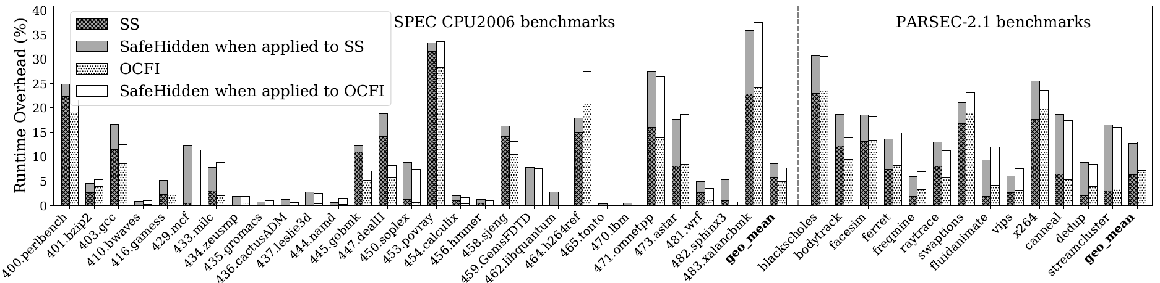
Performance Evaluation
CPU-intensive benchmarks
SPEC CPU2006 benchmark with ref input
Incurred 2.75% and 2.76% when protecting O-CFI and Shadow Stack.
Multi-threaded Parsec-2.1 benchmark with native input
Incurred 5.78% and 6.44% when protecting O-CFI and Shadow Stack.

Slide 36
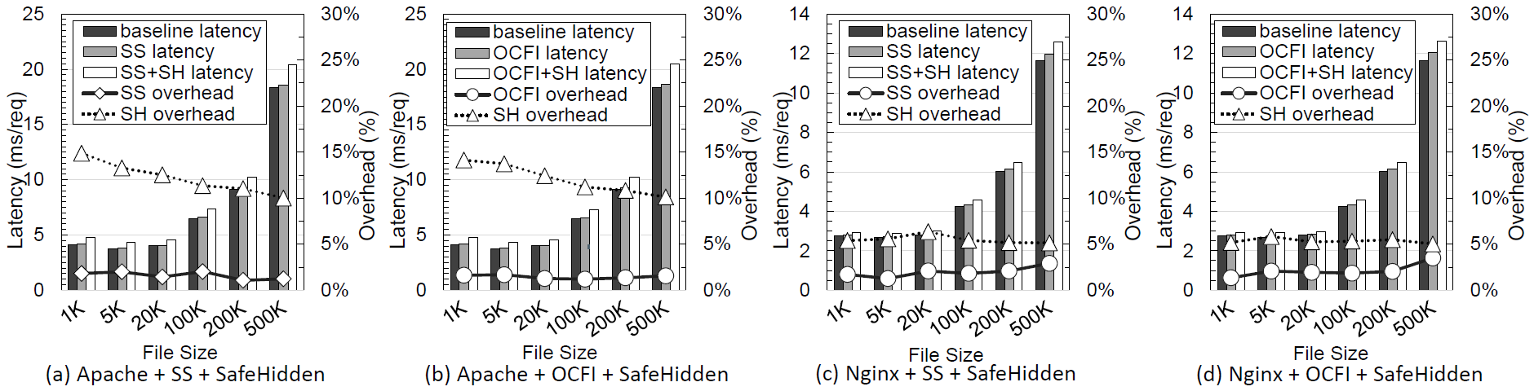
Performance Evaluation
Network I/O benchmarks
Apache is configured to work mpm-worker mode (8 threads).
Incurred 12.07% and 12.18% when protecting O-CFI and Shadow Stack.
Nginx is configured to work with 4 worker processes.
Incurred 5.35% and 5.51% when protecting O-CFI and Shadow Stack.

Slide 37
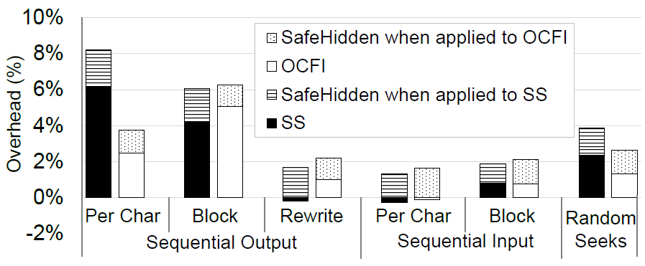
Performance Evaluation
Disk I/O benchmarks
Bonnie++ benchmark tool (read and write tests)
Incurred 1.76% and 2.18% when protecting O-CFI and Shadow Stack.

Slide 38
Conclusion
SafeHidden proposes the re-randomization based IH technique against all known attacks.
SafeHidden introduces the use of thread-private memory to isolate thread-local safe areas.
Using hardware-assisted extended page tables.
It devises a new technique to detect TLB misses.
It is the key trait of cache side-channel attacks against the location of the safe areas.

