Slide 1


Institute of Computing Technology
Chinese Academy of Sciences
CETIS: Retrofitting Intel CET for Generic and Efficient Intra-process Memory Isolation
Mengyao Xie¹, Chenggang Wu¹², Yinqian Zhang³, Jiali Xu¹, Yuanming Lai¹, Yan Kang¹, Wei Wang¹, and Zhe Wang¹²
¹ Institute of Computing Technology, Chinese Academy of Sciences,
² Zhongguancun Laboratory,
³ Southern University of Science and Technology
Notes:
Hello, I’am Mengyao Xie from Institute of Computing Technology, Chinese Academy of Sciences. This work is in collaboration with Zhongguancun Laboratory and Southern University of Science and Technology. Today I will talk about our research on intra-process memory isolation by using intel hardware feature CET.
0.5m

Slide 2
Intra-process Memory Isolation
Intra-process memory isolation can be used in:
Protecting the metadata of the memory corruption defenses
Notes:
First, I introduce the intra-process memory isolation.
Read…
The existing memory isolation can be divided into address-based isolation and domain-based isolation.
For example, there are two regions in the memory space, one is the regular memory, and the other is sensitive memory. And there is a pointer can access the two regions. To protect the sensitive memory, address-based isolation such as Intel MPX checks whether the target address falls within the sensitive memory region.
1m

Slide 3
Intra-process Memory Isolation
Intra-process memory isolation can be used in:
Protecting the metadata of the memory corruption defenses
The safe region in CPI, the shadow stack in CFI, the metadata table in CFIXX…
Notes:
First, I introduce the intra-process memory isolation.
Read…
The existing memory isolation can be divided into address-based isolation and domain-based isolation.
For example, there are two regions in the memory space, one is the regular memory, and the other is sensitive memory. And there is a pointer can access the two regions. To protect the sensitive memory, address-based isolation such as Intel MPX checks whether the target address falls within the sensitive memory region.
1m

Slide 4
Intra-process Memory Isolation
Intra-process memory isolation can be used in:
Protecting the metadata of the memory corruption defenses
The safe region in CPI, the shadow stack in CFI, the metadata table in CFIXX…
Protecting the code cache of Just-In-Time compiler
Notes:
First, I introduce the intra-process memory isolation.
Read…
The existing memory isolation can be divided into address-based isolation and domain-based isolation.
For example, there are two regions in the memory space, one is the regular memory, and the other is sensitive memory. And there is a pointer can access the two regions. To protect the sensitive memory, address-based isolation such as Intel MPX checks whether the target address falls within the sensitive memory region.
1m

Slide 5
Intra-process Memory Isolation
Intra-process memory isolation can be used in:
Protecting the metadata of the memory corruption defenses
The safe region in CPI, the shadow stack in CFI, the metadata table in CFIXX…
Protecting the code cache of Just-In-Time compiler
Existing memory isolation mechanisms can be roughly categorized into：
Address-based isolation
Notes:
First, I introduce the intra-process memory isolation.
Read…
The existing memory isolation can be divided into address-based isolation and domain-based isolation.
For example, there are two regions in the memory space, one is the regular memory, and the other is sensitive memory. And there is a pointer can access the two regions. To protect the sensitive memory, address-based isolation such as Intel MPX checks whether the target address falls within the sensitive memory region.
1m

Slide 6
Intra-process Memory Isolation
Intra-process memory isolation can be used in:
Protecting the metadata of the memory corruption defenses
The safe region in CPI, the shadow stack in CFI, the metadata table in CFIXX…
Protecting the code cache of Just-In-Time compiler
Existing memory isolation mechanisms can be roughly categorized into：
Address-based isolation
Intel MPX uses bound checks for memory access.
Regular memory
*ptr
Sensitive memory
Notes:
First, I introduce the intra-process memory isolation.
Read…
The existing memory isolation can be divided into address-based isolation and domain-based isolation.
For example, there are two regions in the memory space, one is the regular memory, and the other is sensitive memory. And there is a pointer can access the two regions. To protect the sensitive memory, address-based isolation such as Intel MPX checks whether the target address falls within the sensitive memory region.
1m

Slide 7


Intra-process Memory Isolation
Intra-process memory isolation can be used in:
Protecting the metadata of the memory corruption defenses
The safe region in CPI, the shadow stack in CFI, the metadata table in CFIXX…
Protecting the code cache of Just-In-Time compiler
Existing memory isolation mechanisms can be roughly categorized into：
Address-based isolation
Intel MPX uses bound checks for memory access.
Domain-based isolation
Intel MPK switches the permissions of pages.
Intel SMAP can be used for isolating user-mode pages in ring0.
Regular memory
Enable Access Permission
*ptr1
Disable Access Permission
Sensitive memory
*ptr2
Notes:
The domain-based isolation enables the access permission before the memory dereference, and disables the permission after the memory dereference. So in this example, ptr1 can access the sensitive memory, while ptr2 can not.
The intel MPK and SMAP hardware features can be used for domain-based isolation.
0.5m

Slide 8

Intra-process Memory Isolation
Intra-process memory isolation can be used in:
Protecting the metadata of the memory corruption defenses
The safe region in CPI, the shadow stack in CFI, the metadata table in CFIXX…
Protecting the code cache of Just-In-Time compiler
Existing memory isolation mechanisms can be roughly categorized into：
Address-based isolation
Intel MPX uses bound checks for memory access.
Domain-based isolation
Intel MPK switches the permissions of pages.
Intel SMAP can be used for isolating user-mode pages in ring0.
They are not efficient enough.
Notes:
But they are not efficient enough, so we still need a more efficient solution.

Slide 9
Threat Model
Attackers’ capabilities:
Arbitrary read and write by exploiting memory corruption vulnerabilities.
Use cases.
Web servers, browsers and other user applications that are protected by memory corruption defenses.
Just-in-time compiler.
The design of the memory corruption defenses are secure:
breaking memory isolation is a prerequisite for compromising the defense (e.g., attackers cannot hijack the control flow before it).
Notes:
In our threat model, attackers have the arbitrary read and write capabilities by using memory corruption vulnerabilities.
We have two use cases.
Read…
40s

Slide 10
Introduction to Intel CET
Control-flow Enforcement Technology (CET) is an Intel hardware feature that blocks return/jump-oriented programming (ROP) attacks.
Notes:
I will introduce the hardware feature CET first.
Read…
This figure gives an example for shstk. The CALL and RET instructions update the shstk implicitly, and if the return addresses at the main
stack and the shadow stack are not matched during the function return, a hardware exception will be raised.
Read…
1m

Slide 11
Introduction to Intel CET
Control-flow Enforcement Technology (CET) is an Intel hardware feature that blocks return/jump-oriented programming (ROP) attacks.
SHSTK in CET is a shadow stack mechanism that protecting return addresses.
CALL
RET
#CP exception
return address
return address
bad address
return address
SP
SSP
SP
(Corrupted)
SSP
Main Stack
Shadow Stack
Main Stack
Shadow Stack
Notes:
I will introduce the hardware feature CET first.
Read…
This figure gives an example for shstk. The CALL and RET instructions update the shstk implicitly, and if the return addresses at the main
stack and the shadow stack are not matched during the function return, a hardware exception will be raised.
Read…
1m

Slide 12
Introduction to Intel CET
Control-flow Enforcement Technology (CET) is an Intel hardware feature that blocks return/jump-oriented programming (ROP) attacks.
SHSTK in CET is a shadow stack mechanism that protecting return addresses.
The shstk page is a read-only dirty page and regular memory access instructions do not have write permission.
CALL
RET
#CP exception
return address
return address
bad address
return address
SP
SSP
SP
(Corrupted)
SSP
Main Stack
Shadow Stack
Main Stack
Shadow Stack
Notes:
I will introduce the hardware feature CET first.
Read…
This figure gives an example for shstk. The CALL and RET instructions update the shstk implicitly, and if the return addresses at the main
stack and the shadow stack are not matched during the function return, a hardware exception will be raised.
Read…
1m

Slide 13
Introduction to Intel CET
Control-flow Enforcement Technology (CET) is an Intel hardware feature that blocks return/jump-oriented programming (ROP) attacks.
SHSTK in CET is a shadow stack mechanism that protecting return addresses.
The shstk page is a read-only dirty page and regular memory access instructions do not have write permission.
WRSSQ/WRSSD instruction can write 8/4 bytes to the shstk page.
CALL
RET
#CP exception
return address
return address
bad address
return address
SP
SSP
SP
(Corrupted)
SSP
Main Stack
Shadow Stack
Main Stack
Shadow Stack
Notes:
I will introduce the hardware feature CET first.
Read…
This figure gives an example for shstk. The CALL and RET instructions update the shstk implicitly, and if the return addresses at the main
stack and the shadow stack are not matched during the function return, a hardware exception will be raised.
Read…
1m

Slide 14

Outline
01
High-level Idea
02
Understanding SHSTK and WRSS
03
CETIS Framework
04
Case studies
05
Evaluation

Slide 15
High-level Idea
The general belief is that SHSTK is only useful in protecting the integrity of return addresses.
Notes:
Read…
This figure gives the high-level idea of CETIS.
Read…
Generic
0.5m

Slide 16
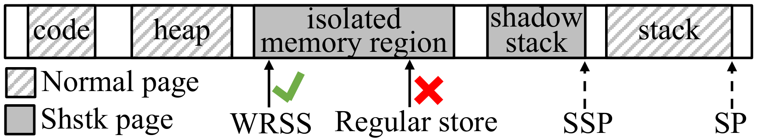
High-level Idea
The general belief is that SHSTK is only useful in protecting the integrity of return addresses.
CETIS achieves more generic isolation by placing the isolated memory region on the shstk pages and ensures the WRSS instruction can only be used by the trusted code.
Notes:
Read…
This figure gives the high-level idea of CETIS.
Read…
Generic
0.5m

Slide 17
High-level Idea
The general belief is that SHSTK is only useful in protecting the integrity of return addresses.
CETIS achieves more generic isolation by placing the isolated memory region on the shstk pages and ensures the WRSS instruction can only be used by the trusted code.
CETIS can protect the integrity of data and code.
Notes:
Read…
This figure gives the high-level idea of CETIS.
Read…
Generic
0.5m

Slide 18
Outline
01
High-level Idea
02
Understanding SHSTK and WRSS
03
CETIS Framework
04
Case studies
05
Evaluation
Notes:
Before we use CETIS for isolation, we do some experiments to estimate the performance impact of the SHSTK and WRSS instruction.

Slide 19
Understanding SHSTK and WRSS
a) Performance impact due to SHSTK
Notes:
First is the performance impact due to the shstk, we compared the hardware shstk with software shstk, and found that hardware shstk is highly efficient and could be widely deployed.
15s

Slide 20
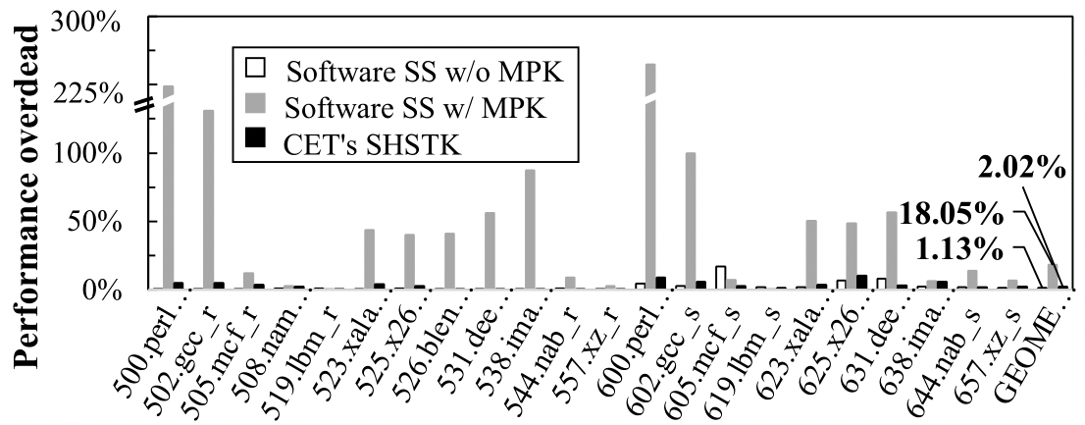
Understanding SHSTK and WRSS
a) Performance impact due to SHSTK
Observation 1: SHSTK introduces only about 2% overhead on SEPC CPU2017 C/C++ benchmarks, which is highly efficient and could be widely deployed.
Notes:
First is the performance impact due to the shstk, we compared the hardware shstk with software shstk, and found that hardware shstk is highly efficient and could be widely deployed.
15s

Slide 21
Understanding SHSTK and WRSS
a) Performance impact due to SHSTK
Observation 1: SHSTK introduces only about 2% overhead on SEPC CPU2017 C/C++ benchmarks, which is highly efficient and could be widely deployed.
b) Latency of WRSS
Notes:
Second, we found the latency of WRSS instruction is nine point three cpu cycles, which is slower than MOV.
10s

Slide 22
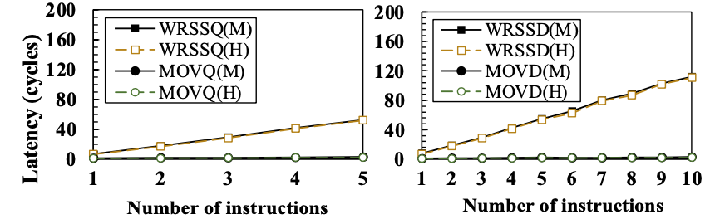
Understanding SHSTK and WRSS
a) Performance impact due to SHSTK
Observation 1: SHSTK introduces only about 2% overhead on SEPC CPU2017 C/C++ benchmarks, which is highly efficient and could be widely deployed.
b) Latency of WRSS
Observation 2: The latency of WRSS takes about 9.3 CPU cycles which is slower than the MOV instruction.
Notes:
Second, we found the latency of WRSS instruction is nine point three cpu cycles, which is slower than MOV.
10s

Slide 23
Understanding SHSTK and WRSS
a) Performance impact due to SHSTK
Observation 1: SHSTK introduces only about 2% overhead on SEPC CPU2017 C/C++ benchmarks, which is highly efficient and could be widely deployed.
b) Latency of WRSS
Observation 2: The latency of WRSS takes about 9.3 CPU cycles which is slower than the MOV instruction.
c) Comparison with MPK
Notes:
Third, we compared the WRSS with the domain-based isolation hardware feature intel MPK, and WRSSQ performs better than MPK when data writing is within 24 bytes.
We can also see that the latency of writing 1 byte to 7 bytes of data by using WRSSQ was slightly higher than that of writing 8 bytes. This is due to the data combination, and I will give an example latter.
40s
Total: 5m

Slide 24
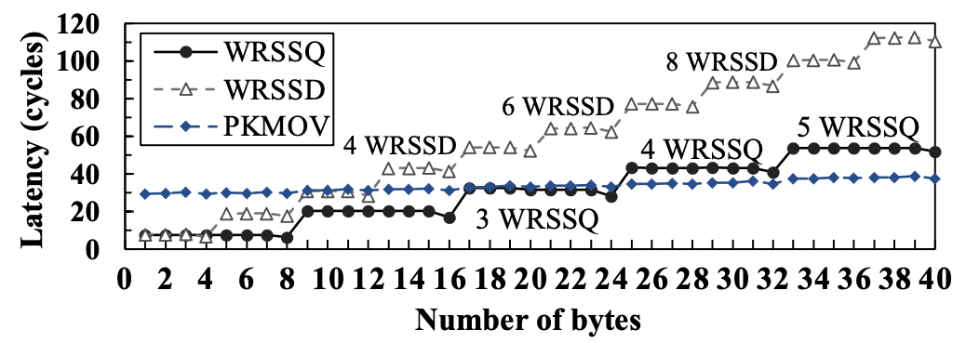
Understanding SHSTK and WRSS
a) Performance impact due to SHSTK
Observation 1: SHSTK introduces only about 2% overhead on SEPC CPU2017 C/C++ benchmarks, which is highly efficient and could be widely deployed.
b) Latency of WRSS
Observation 2: The latency of WRSS takes about 9.3 CPU cycles which is slower than the MOV instruction.
c) Comparison with MPK
Observation 3: A data combination operation is needed when using WRSS to write data with arbitrary length at an arbitrary address. WRSSQ performs better than MPK when data writing is within 24 bytes.
Notes:
Third, we compared the WRSS with the domain-based isolation hardware feature intel MPK, and WRSSQ performs better than MPK when data writing is within 24 bytes.
We can also see that the latency of writing 1 byte to 7 bytes of data by using WRSSQ was slightly higher than that of writing 8 bytes. This is due to the data combination, and I will give an example latter.
40s
Total: 5m

Slide 25
Understanding SHSTK and WRSS
a) Performance impact due to SHSTK
Observation 1: SHSTK introduces only about 2% overhead on SEPC CPU2017 C/C++ benchmarks, which is highly efficient and could be widely deployed.
b) Latency of WRSS
Observation 2: The latency of WRSS takes about 9.3 CPU cycles which is slower than the MOV instruction.
c) Comparison with MPK
Observation 3: A data combination operation is needed when using WRSS to write data with arbitrary length at an arbitrary address. WRSSQ performs better than MPK when data writing is within 24 bytes.
d) Other properties of SHSTK
Observation 4: The shstk pages can be executable to protect the code.
Notes:
The last observation is that, since the NX bit in page table entry is orthogonal to the r/w bit and dirty bit, shstk page can protect code.
20s

Slide 26
Challenges in CETIS
Challenge-1: A data combination operation is needed when using WRSS instructions.
Notes:
Based on the observations, there are 2 challenges in CETIS.
(Read)
We can see from the code that write a 1-byte data by using WRSS needs to read the old value, combine and write the new value to the memory.
So we need to choose the optimal write strategy.
30s
选择优化的写策略
缓存小数据

Slide 27
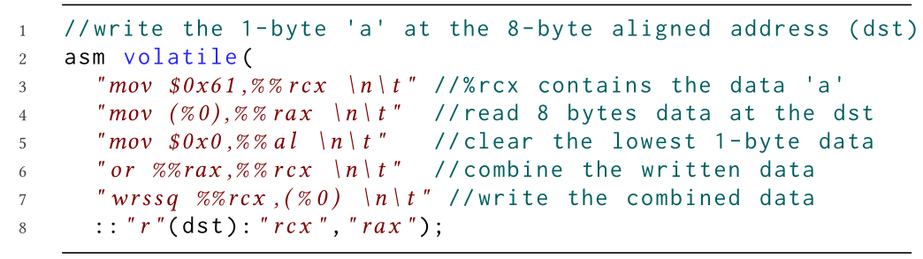
Challenges in CETIS
Challenge-1: A data combination operation is needed when using WRSS instructions.
Notes:
Based on the observations, there are 2 challenges in CETIS.
(Read)
We can see from the code that write a 1-byte data by using WRSS needs to read the old value, combine and write the new value to the memory.
So we need to choose the optimal write strategy.
30s
选择优化的写策略
缓存小数据

Slide 28
Challenges in CETIS
Challenge-1: A data combination operation is needed when using WRSS instructions.
Choose the optimal write strategy with WRSS instruction based on the address and data length is important.
Notes:
Based on the observations, there are 2 challenges in CETIS.
(Read)
We can see from the code that write a 1-byte data by using WRSS needs to read the old value, combine and write the new value to the memory.
So we need to choose the optimal write strategy.
30s
选择优化的写策略
缓存小数据

Slide 29
Challenges in CETIS
Challenge-1: A data combination operation is needed when using WRSS instructions.
Choose the optimal write strategy with WRSS instruction based on the address and data length is important.
Challenge-2: WRSS instruction is not as efficient as the MOV instruction.
4 Bytes
4 Bytes
Memory
Notes:
（Read）
Here is an example. When we want to write the blue data and orange data into memory, it takes 2 WRSS, about eighteen cycles.
20s

Slide 30
Challenges in CETIS
Challenge-1: A data combination operation is needed when using WRSS instructions.
Choose the optimal write strategy with WRSS instruction based on the address and data length is important.
Challenge-2: WRSS instruction is not as efficient as the MOV instruction.
4 Bytes
4 Bytes
Memory
2 WRSS ≈ 18.6 cycles
Notes:
（Read）
Here is an example. When we want to write the blue data and orange data into memory, it takes 2 WRSS, about eighteen cycles.
20s

Slide 31
Challenges in CETIS
Challenge-1: A data combination operation is needed when using WRSS instructions.
Choose the optimal write strategy with WRSS instruction based on the address and data length is important.
Challenge-2: WRSS instruction is not as efficient as the MOV instruction.
4 Bytes
4 Bytes
4 Bytes
4 Bytes
Buffer
(Register)
Memory
Memory
2 WRSS ≈ 18.6 cycles
Notes:
If we buffer the data in a register, it takes only 1 wrss to write the data into memory, about 9 cycles.

Slide 32
Challenges in CETIS
Challenge-1: A data combination operation is needed when using WRSS instructions.
Choose the optimal write strategy with WRSS instruction based on the address and data length is important.
Challenge-2: WRSS instruction is not as efficient as the MOV instruction.
4 Bytes
4 Bytes
4 Bytes
4 Bytes
Buffer
(Register)
Memory
Memory
2 WRSS ≈ 18.6 cycles
Notes:
If we buffer the data in a register, it takes only 1 wrss to write the data into memory, about 9 cycles.

Slide 33

Challenges in CETIS
Challenge-1: A data combination operation is needed when using WRSS instructions.
Choose the optimal write strategy with WRSS instruction based on the address and data length is important.
Challenge-2: WRSS instruction is not as efficient as the MOV instruction.
Buffer small data writes is important.
4 Bytes
4 Bytes
4 Bytes
4 Bytes
Buffer
(Register)
Memory
Memory
2 WRSS ≈ 18.6 cycles
1 WRSS ≈ 9.3 cycles
Notes:
If we buffer the data in a register, it takes only 1 wrss to write the data into memory, about 9 cycles.
So buffer small data writes is important.

Slide 34
Challenges in CETIS
Challenge-1: A data combination operation is needed when using WRSS instructions.
Choose the optimal write strategy with WRSS instruction based on the address and data length is important.
Challenge-2: WRSS instruction is not as efficient as the MOV instruction.
Buffer small data writes is important.
Solution: CETIS provides a software framework for developers to adopt CETIS easily.
Notes:
Read
20s
Total: 6.5m

Slide 35
Outline
01
High-level Idea
02
Understanding SHSTK and WRSS
03
CETIS Framework
04
Case studies
05
Evaluation

Slide 36

CETIS Framework
CETIS is implemented on Linux/X86_64 platform.
Two components in CETIS Framework——CETIS Memory File Abstraction and CETIS Library.
Run-Time defenses
App.
CPI
CFIXX
sensitive code
safe region
metadata
sensitive data
CETIS Memory File Abstraction
LLVM
CETIS Library
OS
CETIS support
Hardware
Intel CET
Notes:
There are 2 components in CETIS framework, the …
With the framework, CETIS can protect the sensitive objects of the runtime defenses and applications.
20s
Total: 7m

Slide 37
CETIS Framework
An isolated memory region is abstracted as a CETIS memory file (cmfile).
Run-Time defenses
App.
CPI
CFIXX
sensitive code
safe region
metadata
sensitive data
CETIS Memory File Abstraction
LLVM
CETIS Library
OS
Memory
Isolation Memory Region
CETIS support
Hardware
Intel CET
Notes:
In memory file abstraction, (read)

Slide 38
CETIS Framework
An isolated memory region is abstracted as a CETIS memory file (cmfile).
Run-Time defenses
App.
CPI
CFIXX
sensitive code
safe region
metadata
Cmfile
sensitive data
CETIS Memory File Abstraction
LLVM
CETIS Library
OS
Memory
Isolation Memory Region
CETIS support
Hardware
Intel CET
Notes:
In memory file abstraction, (read)

Slide 39
CETIS Framework
An isolated memory region is abstracted as a CETIS memory file (cmfile).
The buffer design in CETIS is similar to the file buffer in the GNU C Library.
Run-Time defenses
App.
CPI
CFIXX
sensitive code
safe region
metadata
Cmfile
sensitive data
CETIS Memory File Abstraction
Buffer
(Register)
LLVM
CETIS Library
OS
Memory
Isolation Memory Region
CETIS support
Hardware
Intel CET
Notes:
In memory file abstraction, (read)

Slide 40
CETIS Framework
Cmfile supports the read/write mode and the append mode.
Complicated WRSS usages are hidden from users.
read/write mode
Read/write data with arbitrary length at an arbitrary position of a cmfile directly.
No buffering is necessary.
Operations
Write 4B at 0x2
Write 8B at 0x18
Cmfile
0
0x2
0x18
scratch reg
②
combine
init state
Time
stateA
stateB
④wrssq
③wrssq
①load
Memory
Isolated Memory Region
0x2000
8 bytes
……
8 bytes
Notes:
(Read)
Since data combination operations are highly dependent on address alignment, CETIS supports the automatic alignment inference and the user-provided hints.

Slide 41
CETIS Framework
Cmfile supports the read/write mode and the append mode.
Complicated WRSS usages are hidden from users.
read/write mode
Read/write data with arbitrary length at an arbitrary position of a cmfile directly.
No buffering is necessary.
Address alignment
Alignment inference
User-provided hints
Operations
Write 4B at 0x2
Write 8B at 0x18
Cmfile
0
0x2
0x18
scratch reg
②
combine
init state
Time
stateA
stateB
④wrssq
③wrssq
①load
Memory
Isolated Memory Region
0x2000
8 bytes
……
8 bytes
Notes:
(Read)
Since data combination operations are highly dependent on address alignment, CETIS supports the automatic alignment inference and the user-provided hints.

Slide 42
CETIS Framework
Cmfile supports the read/write mode and the append mode.
Complicated WRSS usages are hidden from users.
append mode
Support the writing of small-sized data at consecutive positions of a cmfile.
Write-combine buffer (reserved 64-bit register)
Maintain the buffer
Avoid buffer corruption
Synchronize buffer implicitly by CETIS or explicitly by users
Operations
Twice append 2B
append_pos=0x34
Cmfile
0
①
combine
0x34
buffer: reserved %R14
init state
Time
②
combine
stateC
stateD
append_ptr
③wrssq
Memory
Isolated Memory Region
0x2000
8 bytes

Slide 43
CETIS Framework
CETIS provides APIs to implement read/write mode and append mode operations on cmfiles.
Run-Time defenses
App.
CPI
CFIXX
sensitive code
safe region
metadata
sensitive data
CETIS Memory File Abstraction
LLVM
CETIS Library
OS
CETIS support
Hardware
Intel CET

Slide 44
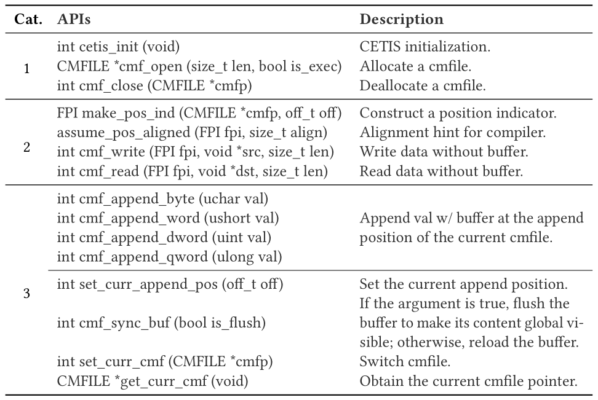
CETIS Framework
CETIS provides APIs to implement read/write mode and append mode operations on cmfiles.
Run-Time defenses
App.
CPI
CFIXX
sensitive code
safe region
metadata
sensitive data
Init.
CETIS Memory File Abstraction
read/write mode
LLVM
CETIS Library
OS
CETIS support
append mode
Hardware
Intel CET

Slide 45
CETIS Framework
CETIS provides APIs to implement read/write mode and append mode operations on cmfiles.
The data structures in CETIS are stored on the shstk pages.
Run-Time defenses
App.
CPI
CFIXX
sensitive code
safe region
metadata
sensitive data
Init.
CETIS Memory File Abstraction
read/write mode
LLVM
CETIS Library
OS
CETIS support
append mode
Hardware
Intel CET

Slide 46
Outline
01
High-level Idea
02
Understanding SHSTK and WRSS
03
CETIS Framework
04
Case studies
05
Evaluation

Slide 47
Case studies
CETIS protects Code-pointer integrity(CPI) and CFIXX with read/write mode and JIT compiler with append mode.
CPI
CPI protects the code pointers.
Notes:
(Read)
CPI protects the code pointers, and for each code pointer, it records twenty-four bytes metadata, value, lower bound and upper bound.
CETIS stores metadata in the shstk pages, to improve the performance, CETIS losslessly compress metadata to sixteen bytes. That is, using forty eight bits store pointer value, two seven bits store the offset of value and bound.

Slide 48
Case studies
CETIS protects Code-pointer integrity(CPI) and CFIXX with read/write mode and JIT compiler with append mode.
CPI
CPI protects the code pointers.
Value | Lower | Upper
Metadata(24 bytes)
Notes:
(Read)
CPI protects the code pointers, and for each code pointer, it records twenty-four bytes metadata, value, lower bound and upper bound.
CETIS stores metadata in the shstk pages, to improve the performance, CETIS losslessly compress metadata to sixteen bytes. That is, using forty eight bits store pointer value, two seven bits store the offset of value and bound.

Slide 49
Case studies
CETIS protects Code-pointer integrity(CPI) and CFIXX with read/write mode and JIT compiler with append mode.
CPI
CPI protects the code pointers.
Store metadata in the shstk pages.
Value | Lower | Upper
Metadata(24 bytes)
Notes:
(Read)
CPI protects the code pointers, and for each code pointer, it records twenty-four bytes metadata, value, lower bound and upper bound.
CETIS stores metadata in the shstk pages, to improve the performance, CETIS losslessly compress metadata to sixteen bytes. That is, using forty eight bits store pointer value, two seven bits store the offset of value and bound.

Slide 50
Case studies
CETIS protects Code-pointer integrity(CPI) and CFIXX with read/write mode and JIT compiler with append mode.
CPI
CPI protects the code pointers.
Store metadata in the shstk pages.
Losslessly compress 24 bytes of metadata to 16 bytes.
Value | Lower | Upper
Metadata(24 bytes)
Compress the metadata:
127
64
offset2
offset1
63
61
54
47
0
extend
offset2
offset1
Pointer value
value - lower
upper - value
code/data ptr
Notes:
(Read)
CPI protects the code pointers, and for each code pointer, it records twenty-four bytes metadata, value, lower bound and upper bound.
CETIS stores metadata in the shstk pages, to improve the performance, CETIS losslessly compress metadata to sixteen bytes. That is, using forty eight bits store pointer value, two seven bits store the offset of value and bound.

Slide 51
Case studies
CETIS protects Code-pointer integrity(CPI) and CFIXX with read/write mode and JIT compiler with append mode.
CPI
CPI protects the code pointers.
Store metadata in the shstk pages.
Losslessly compress 24 bytes of metadata to 16 bytes.
Each metadata update only requires 1 or 2 WRSS instructions.
Value | Lower | Upper
Metadata(24 bytes)
Compress the metadata:
127
64
offset2
offset1
63
61
54
47
0
extend
offset2
offset1
Pointer value
value - lower
upper - value
code/data ptr
Notes:
(Read)
CPI protects the code pointers, and for each code pointer, it records twenty-four bytes metadata, value, lower bound and upper bound.
CETIS stores metadata in the shstk pages, to improve the performance, CETIS losslessly compress metadata to sixteen bytes. That is, using forty eight bits store pointer value, two seven bits store the offset of value and bound.

Slide 52
Case studies
CETIS protects Code-pointer integrity(CPI) and CFIXX with read/write mode and JIT compiler with append mode.
CPI
CFIXX
JIT compiler
CPI protects the code pointers.
Store metadata in the shstk pages.
Losslessly compress 24 bytes of metadata to 16 bytes.
Each metadata update only requires 1 or 2 WRSS instructions.
CFIXX protects the virtual table pointers.
Read/write mode.
Store the metadata table in the shstk page.
Code cache for improving efficiency.
Append mode.
Store code cache in the executable shstk page.
Notes:
CETIS can also protect CFIXX and JIT compiler.

Slide 53
Outline
01
High-level Idea
02
Understanding SHSTK and WRSS
03
CETIS Framework
04
Case studies
05
Evaluation

Slide 54
Performance Evaluation
Protecting memory-corruption defenses: CPI and CFIXX
Isolation: IH-based(randomization), SFI-based, MPK-based, and CETIS-based schemes
Macrobenchmarks: SPEC CPU2006 and SPEC CPU2017 C/C++ benchmarks with ref input
Real-world application: Nginx
Protecting code cache of ChakraCore
Isolation: mprotect-based, MPK-based, and CETIS-based schemes
Benchmark: Octane benchmark
Notes:
Here is the experiments configuration.
To protect defenses, we used IH-based, SFI-based, MPK-….. Isolation methods.
Read…
To protect code cache, we used…

Slide 55
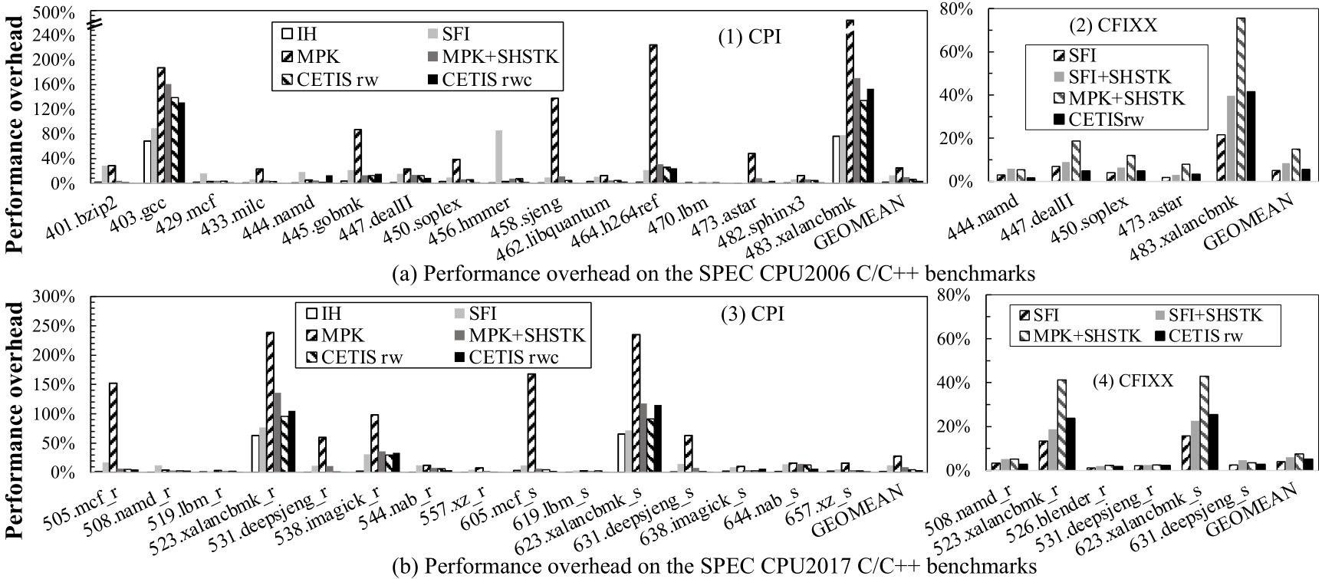
Performance Evaluation
CETIS is more performant than SFI-based and MPK-based isolation on protecting SPEC CPU2006/2017, and the average overhead is less than 6%.
* Some benchmarks are missing because of raising #CP exception.

Slide 56
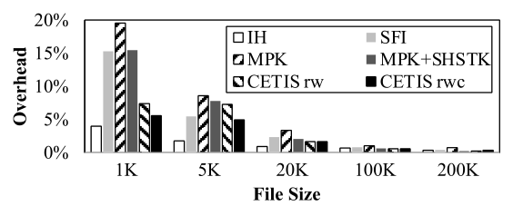
Performance Evaluation
CETIS is more performant than SFI-based and MPK-based isolation on protecting SPEC CPU2006/2017, and the average overhead is less than 6%.
CETIS is also performant on protecting Nginx.
(c) Performance overhead on Nginx
* Some benchmarks are missing because of raising #CP exception.

Slide 57
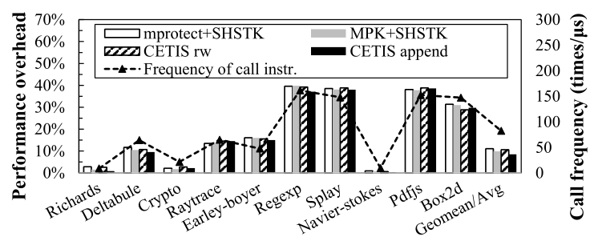
Performance Evaluation
CETIS is more performant than SFI-based and MPK-based isolation on protecting SPEC CPU2006/2017, and the average overhead is less than 6%.
CETIS is also performant on protecting Nginx.
CETIS is more performant than mprotect-based and MPK-based schemes on protecting Octane benchmark.
(c) Performance overhead on Nginx
(d) Performance overhead on Octane
* Some benchmarks are missing because of raising #CP exception.

Slide 58
Conclusion
We propose an efficient intra-process memory isolation technique CETIS, which leverages the new hardware feature — CET.
To allow users to use CETIS efficiently and conveniently, we propose the software framework with CETIS APIs.
We believe that CETIS can be used not only for intra-process memory isolation, but also for…
Protecting sensitive memory objects (e.g., the page table) in the kernel.
Isolating the code and data inside an enclave in SGX.
…

Slide 59

Any Questions?
xiemengyao@ict.ac.cn

Slide 60
Backup

Slide 61
Possible attacks against CETIS
Function-calls spraying: Attackers may execute a large number of CALLs to adjust %SSP
Guard page in the start and end of the isolated memory region.
Arguments corrupting: Attackers may tamper with the arguments when they are passed between APIs through non-control data attacks. MPK faces the same threat. However, a successful attack has not been demonstrated as of yet.
A possible solution is to pass arguments through registers.
Unintended gadgets: Attackers could use other WRSS and INCSSP/RSTORSSP (for adjusting %SSP) to corrupt the isolated regions.
Insert the bound-checks before these instructions.

Slide 62
Maintain the append mode buffer
Implicit synchronizations by CETIS
When the buffer pointer exceeds or reaches the buffer’s boundary;
When switching the cmfile(isolated memory region).
Explicit synchronizations by users
When switching the mode.
Multi-thread.

