Slide 1
Geometry for Game

Slide 2
Game Models
Geometry
  Position / vertex normals / vertex colors / texture coordinates
Topology
  Primitive
    Lines / triangles / surfaces / …
Property
  Materials
  Textures
Motion
Hierarchy
Level-of-detail

Slide 3
Geometry Data
Vertex position
  (x, y, z, w)
  In model space or screen spane
Vertex normal
  (n_{x}, n_{y}, n_{z})
Vertex color
  (r, g, b) or (diffuse, specular)
Texture coordinates on vertex
  (u₁, v₁), (u₂, v₂), …
Skin weights
  (bone₁, w₁, bone₂, w₂, …)

Slide 4
Topology Data
Lines
  Line segments
  Polyline
    Open / closed
Indexed triangles
Triangle Strips / Fans
Surfaces
  Non-uniform Rational B Spline (NURBS)
Subdivision

Slide 5
Indexed Triangles
Geometric data
  Vertex data
  v₀, v₁, v₂, v₃, …
  (x, y, z, n_{x}, n_{y}, n_{z}, t_{u}, t_{v})
  or (x, y, z, c_{r}, c_{g}, c_{b}, t_{u}, t_{v, …})
Topology
  Face v₀ v₃ v₆ v₇
  Edge table
polygon normal
v₀
vertex normal
v₇
v₃
v₆
Right-hand rule for index

Slide 6
Triangle Strips
v₀
v₂
v₄
v₆
T₀
T₄
T₂
T₅
T₃
T₁
v₅
v₁
v₇
v₃
v₀ , v₁ , v₂ , v₃ , v₄ , v₅ , v₆ , v₇
“Get great performance to use triangle strips for rendering on current hardware

Slide 7
Property on Surface
Material
Textures
Shaders

Slide 8
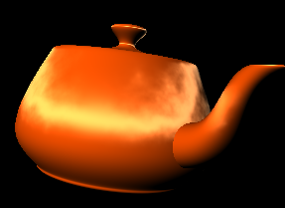
Materials
Material
  Ambient
    Environment
    Non-lighted area
  Diffuse
    Dynamic lighting
  Emissive
    Self-lighting
  Specular with shineness
    Hi-light
    View-dependent
    Not good for hardware rendering
Local illumination
For fixed function rendering pipeline

Slide 9
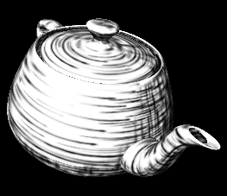

Textures
Textures
  Single texture
  Texture coordinate animation
  Texture animation
  Multiple textures
  Alphamap
Lightmap
Base color texture
Material or vertex colors

Slide 10
Shaders
Programmable Shading Language
  Vertex shader
  Pixel shader
Procedural way to implement some process of rendering
  Transformation
  Lighting
  Texturing
  BRDF
  Rasterization
  Pixel fill-in

Slide 11
Shader Pipeline
Vertex Data
Topology Data
Classic
Transform &
Lighting
Vertex Shader
Geometry
Stage
Clipping & Viewport Mapping
Texturing
Pixel Shader
Rasterizer
Stage
Fog
Alpha, Stencil, Depth Testing

Slide 12
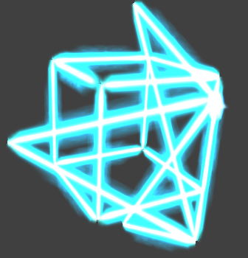
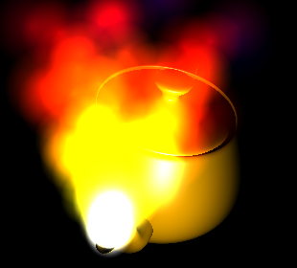
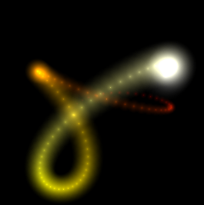
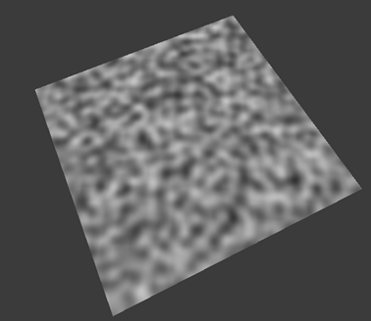
Powered by Shader
Per-pixel lighting
Motion blur
Volume / Height fog
Volume lines
Depth of field
Fur fighting
Reflection / Refraction
NPR (non-photorealistic rendering )
Shadow
Linear algebra operators
Perlin noise
Quaternion
Sparse matrix solvers
Skin bone deformation
Normal map
Displacement map
Particle shader
Procedural Morphing
Water Simulation

Slide 13
Motion Data
Time-dependent data
Transformation data
  Position
  Orientation
Formats
  Pivot
  Position vector
  Quaternion
  Eurler angles
  Angular displacement

Slide 14
Level-of-detail
Discrete LOD
  Switch multiple resolution models run-timely
Continuous LOD
  Use progressive mesh to dynamically reduce the rendered polygons
View-dependent LOD
  Basically for terrain

Slide 15
Progressive Mesh
Render a model in different level-of-detail at runtime
User control or automatic change the percentage of rendered vertices
Use mapping function between two successive meshes to control the simplification process
Index | 0 | 1 | 2 | 3 | 4 | 5 | 6 | 7 | 8
Map | 0 | 1 | 1 | 2 | 3 | 0 | 4 | 5 | 6
Map for
edge collapse
Vertex list
Triangle list
0 | 1 | 2 | 3 | 4 | 5 | 6 | 7 | 8
0 | 2 | 5 | 0 | 1 | 2 | 3 | 5 | 8
0
0
6
4

Slide 16
View-dependent LOD for Terrain - ROAM
Real-time optimal adapting meshes (ROAM)
Use height map
Run-timely to re-construct the active (for rendering) geometric topology (re-mesh) to get an optimal mesh (polygon count) to improve the rendering performance
Someone calls this technique as the view-dependent level-of-detail
Very good for fly-simulation-like application

Slide 17
Level-of-detail Suggestion
Apply progressive mesh for multi-resolution model generation
Use in-game discrete LOD for performance tuning
Why ?
  For modern game API / platform, dynamic vertex update is expensive (not good for performance)
    Lock video memory -> aversely affect CPU/GPU performance

Slide 18
Bounding Volume
Bounding sphere
Bounding cylinder
Axis-aligned bounding box (AABB)
Oriented bounding box (OBB)
Discrete oriented polytope (k-DOP); k/2 pairs
Bounding Sphere
AABB
k-DOP
Bounding Cylinder
OBB

Slide 19
Bounding Volume - Application
Collision Detection
Visibility Culling
Hit Test

Slide 20
Application Example - Bounding Sphere
B₂
B₁
D
c₂
c₁
Bounding sphere B₁(c₁, r₁), B₂(c₂, r₂)
If the distance between two bounding spheres is
larger than the sum of radius of the spheres, then
these two objects have no chance to collide.
d > r₁+ r₂

Slide 21
Application Example - AABB
Axis-aligned bounding box (AABB)
  Simplified computation based on the axis-aligned feature
  Have to compute the AABBs at runtime
AABB

Slide 22
Application Example - OBB
Oriented bounding box (OBB)
  Intersection computation based on the transformed OBB geometric data
    3D containment test
    Line intersection with plane
For games, ☺
OBB

