Slide 1
Game System Analysis

Slide 2
Contents
Idea about system analysis (SA)
Mind mapping
Case study – term project

Slide 3
Why system analysis (1/2)
For program structure analysis
  Program modulus
  Tools
To identify work load
  Programs/tools under development
For resource management
  Man month
  How many programmers ?
  Development tools ?
  Specific tools ?
For job dependency analysis

Slide 4
Why system analysis (2/2)
To make technical feasibility analysis 程式結構
  R&D ?
Pre-process for
  Technical design document
  Project management
Bridge from game design to programming

Slide 5
Something about system analysis
No standard procedures
Something must be done!
Methods
  UML
  Mind mapping (心智圖法)

Slide 6
System analysis steps
Brainstorming
Integration
Dependency analysis
Create the project
Write the technical design document (TDD)

Slide 7
Brainstorming
Based on the game design to put everything as many as we could
Use mind mapping
Including
  Game system
    Combat / Village / Puzzle / …
  Program modulus
    Camera / PC control / NPC AI / UI / FX /…
  Tools
    Level editor / Scene editor / …
  Entities in games
    Characters / vehicles / terrain / audio / …

Slide 8
Integration
Confirm the resource limitation
Technical implement possibility
Put all related items together
Man month analysis
  How many ?
  Who ?
Jobs/System identification

Slide 9
Dependency analysis
Sort the Jobs
  By dependency
  By programmers
Prototype for scheduling

Slide 10


















Dependency analysis
Schedule One:
Schedule Two:

Slide 11
System analysis – create the project
Scheduling
Job assignment
Resource allocation
Check points
Milestones
Risk management policy

Slide 12
Write the technical design document
Specification
Resources
Design in details
Implementation methods (工法)
Algorithms
The project
Show each milestone
SOP (standard operation procedure 標準作業程序)

Slide 13
Mind map
Mind mapping 心智圖法
A radiant thinking tool
Applications
  What one has learned from study
  Proposal
  Notes
  Traveling journal 遊記
  System analysis
Reference
  Program
    Visio
    MindManager,
    MindMapper: http://www.mindmapper.com/?gclid=CI7837Ot15ECFRs3egod7ixdag
  Tony Buzan, Barry Buzan, “The Mind Map Book: How to Use Radiant Thinking to Maximize Your Brain's Untapped Potential”

Slide 14
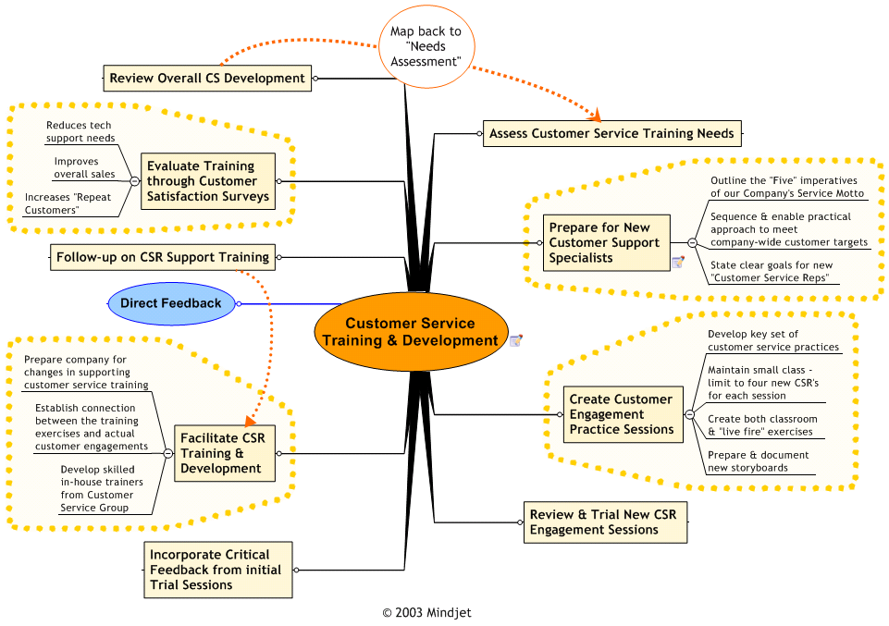

Slide 15
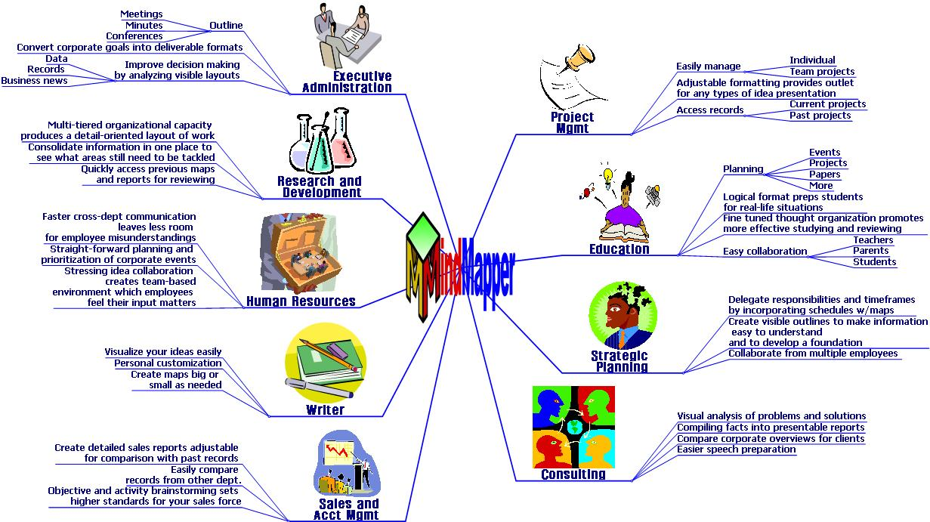
MindMapper 2008

Slide 16
Mind map demo using MindManager
Use MindManager Pro 7
Developed by MindJet
http://www.softpedia.com/get/Others/Finances-Business/Mindjet-MindManager-Pro.shtml

Slide 17
Term Project
System Analysis

Slide 18
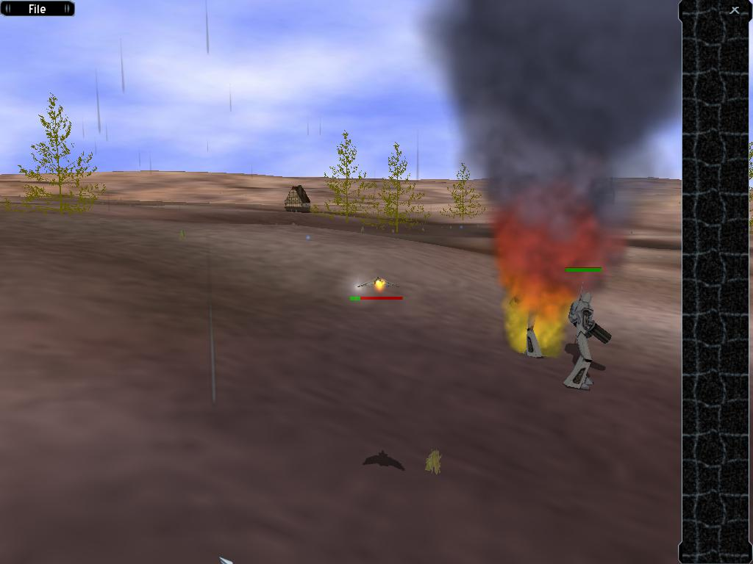
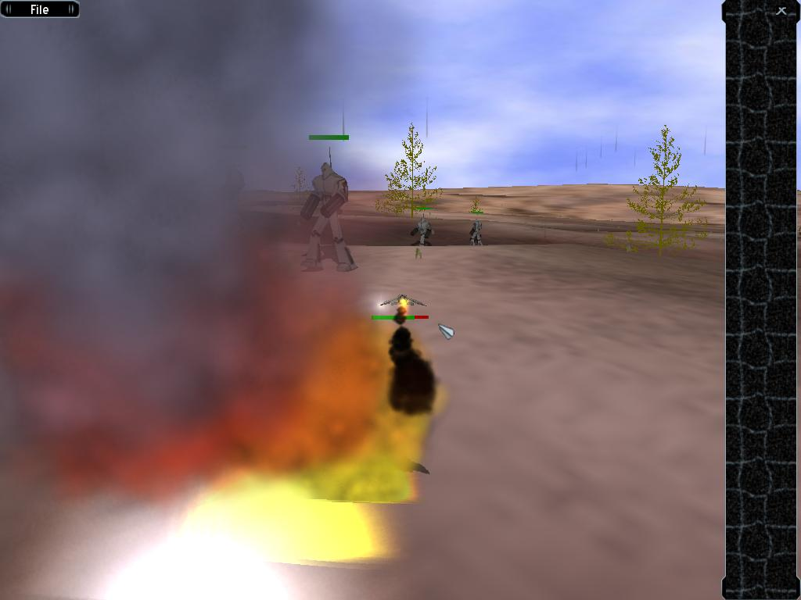
Game design (1/3)
Real-time shooting game
Mission-based levels
Keyboard- and mouse-driven controls
Player vs computer
State-based AI
Group movement

Slide 19
Game design (2/3)
Space ship – controlled by player
    Move
    Attack
NPC – controlled by computer
  “Robots” - Enemy
    Triggered by time table
  AI
    Move
    Standby
    Anti-attack
    Attack

Slide 20
Game design (3/3)
Game AI
  Finite state machine
  Path finding
    3D
    A*
  Steering behavior
    Flocks / Schools / Herds
    http://www.red3d.com/cwr/boids/
  AI Game Programming Wisdom, Charles River Media (1 & 2)

Slide 21
Doxygen – A documentation generator
Basic comments
/*!
  \brief A game listener
  A detailed description: A game listener handles game events, game state and game geometry.
*/
class GameListener {
private:
int n; //!< The number of elements.
//!<
…
…
};

Slide 22
Doxygen – A documentation generator
Basic comments
/*!
  \brief Add two numbers
  Compute the sum of two integers.
  \param a The first integer.
  \param b The second integer.
  \return The sum of two integers.
*/
int addTwoNumbers(int a, int b);

Slide 23
Introduction to OGRE 3D

Slide 24
Prerequisites:
On Windows,
Microsoft Visual C++ .NET 2003
Familiar with ISO Standard C++, STL
Latest drivers for graphics hardware

Slide 25
OGRE3D
- An open source software project
- Lesser GNU Public License
Mature
Stable
Reliable
Flexible, plug-in libraries
Cross-platform
Full-featured library
For real-time 3D graphics applications
in an object-oriented manner

Slide 26
Dependencies
On Windows:
- FreeType
- devIL
- zziplib
- zlib
- Cg Toolkit

Slide 27
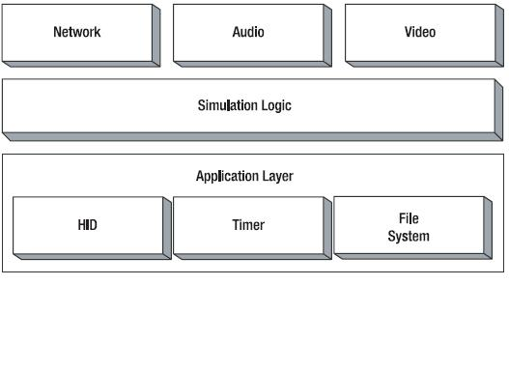
Where does OGRE 3D fit?
Rendering Video View
A typical high-level game / simulation architecture

Slide 28
Features:
Support both OpenGL and Direct3D
Cross-platforms, e.g. Windows, Linux, Mac OS
Extensible object framework
Support fixed-function texture, blending techniques,
programmable GPU techniques,
shading languages, e.g. Cg, HLSL
Queue-based rendering management
LoD

Slide 29
Features:
Advanced maskable scene-querying system
Advanced plug in-based particle system
Support for skyboxes, skyplanes and skydomes
Robust material system
Support animation: skeletal, morph, pose
Compositor postprocessing
Extensible resource management

Slide 30
Scene Graph
The data structure of the scene objects
Design ?
  Something to render
  meshes
  sub-meshes
  materials
  positions of the objects

Slide 31
Scene Graph
The data structure of the scene objects
Design ?
  Something to render
  meshes
  sub-meshes
  materials
  positions of the objects
Movable or not?
[ 1 .. n ]
[ 1 .. 1 ]
[ 1 .. n ]
[ 1 .. n ]
Scene
Graph
Scene
Node
Mesh
Sub-mesh
Renderable
[ 1 .. n ]
Material

Slide 32
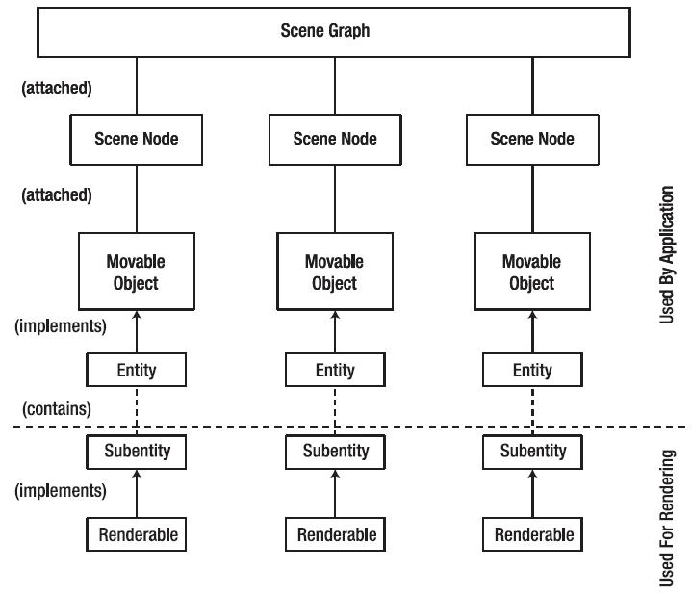
Attached ?
Implements ?

Slide 33
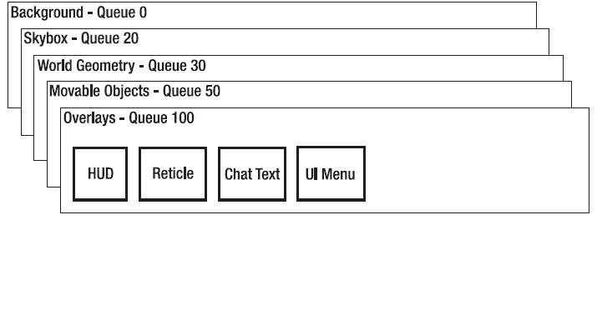
Render queue architecture
Each queue has an order
Render based on order
Each item in a queue has an order too!

Slide 34
OGRE3D: Subsystem overview
(1) Root
  fire up and shut down
  can access every subsystems
(2) Resource management
  Mesh, .mesh
  Skeleton, .skeleton
  Material, .material
  GPU program, .program, .asm
  Texture
  Compositor, .compositor
  Font, .fontdef

Slide 35
OGRE3D: Subsystem overview
(3) Scene management
  SceneManager
  SceneNode
(4) Render system and render target
  RenderSystem, generalization of the
  interface between OGRE and hardware API
  RenderTarget

Slide 36
OGRE3D: Managers
Manages access to
or control lifetimes of other related types of objects
Singleton objects.
(1) LogManager
(2) ControllerManager
(3) DynLibManager
(4) PlatformManager

Slide 37
OGRE3D: Managers
(5) CompositorManager
(6) ParticleSystemManager
(7) MaterialManager
(8) SkeletonManager

Slide 38
OGRE3D: Managers
(9) MeshManager
(10) OverlayManager
(11) ResourceGroupManager
(12) TextureManager

