Slide 1
Terrain

Slide 2
Introduction
Game Type Oriented
Terrain
  For visual (廣義的場景)
    Ground / Building / Static models / Dynamic models
  For terrain following
    Polygon mesh
    Grids
  For path finding
    Polygon mesh
    Grids
Terrain Following
  Make a 3D entity walking on terrain
Path Finding
  Find a path before walking

Slide 3
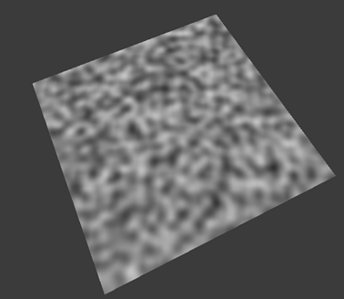
Terrain Formats
Grid
  2D
  Quadtree
Height map
  Procedural height map
ROAM
  Real-time Optimally Adapting Meshes
Triangular Mesh
  Procedurally generated
  Created by artists
Perlin Noise

Slide 4
Grid Map
2D Grid Map
  Rectangular or Hexagonal grids
  Attributes
    Height
    Walkable or not
    Texture pattern ID
Step Look Terrain
Application
  2D games
  3D games with god view
    2D tile-based game terrain

Slide 5
Height Map
Almost the same as a 2D grid map
  Height on grid vertex
  Only height is saved
  Regular grid
  Irregular grid but structured
Application
  As the base data structure for ROAM terrain
  Water simulation
Top view

Slide 6
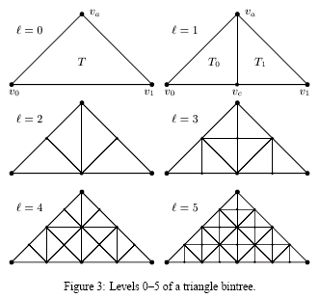
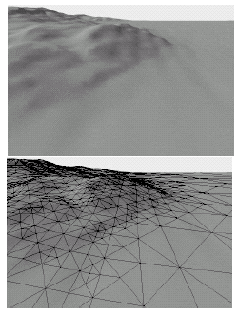
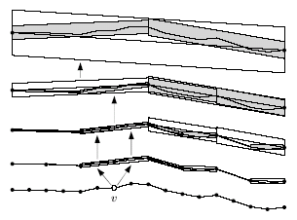
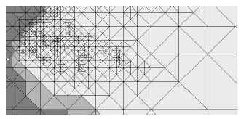
ROAM
Real-time Optimally Adapting Mesh
  http://www.llnl.gov/graphics/ROAM/
Application
  Fly-simulation

Slide 7
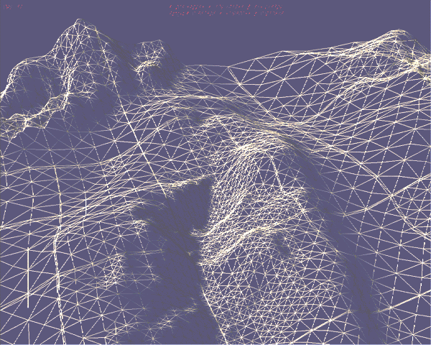
Chunked LOD Terrain
Use quad tree to construct the level-of-detail of terrain
  A quad tree for LOD

Slide 8
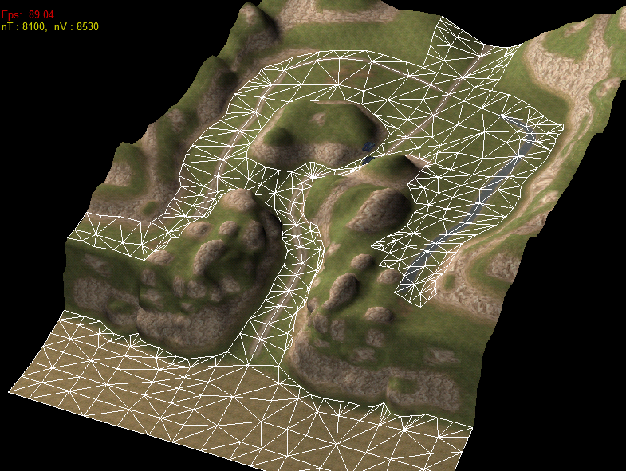
Triangular Mesh
Possibly the Most Popular Way for Games
  General
  Can be created by artists
Multiple-layered Terrain

Slide 9
Terrain Following Using Triangular Mesh
Solve the Terrain Height for the Object to Stand on
  Use the triangular coordinate system
Find the Next Neighboring Triangle
  Half-edge data structure

Slide 10
Half-edge (1/2)
Create cohesive relationship between triangles using “half edge”
Use half-edge table to search the neighboring triangles
Edge = two halves

Slide 11
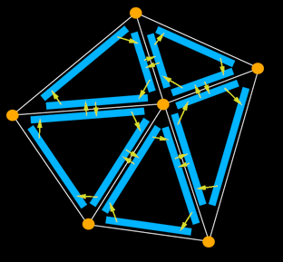
Half-edge (2/2)
struct HE_edge
{
HE_vert* vert; // vertex at the end of the half-edge
HE_edge* pair; // oppositely oriented adjacent half-edge
HE_face* face; // face the half-edge borders
HE_edge* next; // next half-edge around the face
};
struct HE_vert
{
float x;
float y;
float z;
HE_edge* edge; // one of the half-edges
// emantating from the vertex
};
struct HE_face
{
HE_edge* edge; // one of the half-edges bordering the face
};
http://www.flipcode.com/tutorials/tut_halfedge.shtml

