Slide 1
Contents
Audio
Sprite
Input devices
Game production milestones
Course summary

Slide 2
Audio (1/3)
Sounds FX
  WAV audio files
  Load into memory and play it
    Load
    Play
    Stop
    Pause
  2D or 3D
    3D should be integrated into scene management
  APIs
    DirectSound
    Direct3DSound
    DirectMusic

Slide 3
Audio (2/3)
Music
  CD audio
    Sound tracks on CD
    Play by sound card
    No system overhead
  MP3
    MPEG
    Decode with CPU cost
  MIDI
    Instrument tempo
    Very compact
  WAV
  Streaming data
    Load / play / load / play ….
  APIs
    DirectMusic

Slide 4
Audio (3/3)
The Most Non-important Part of the Domestic Games.
Most Company Is Outsourcing to the Music Studio.
Do the Audio Production When Game Is Testing (☹).
The Audio Budget is Poor.
On PC, Most Gamer Have Great Graphics Card But with Onboard Sound Card.
But It’s Total Different on Console Games.
  On Xbox, 5.1 Sound Tracks + Dolby Digital(杜比數碼)….
Audio Should Be Another Entertainment Element in Living Room. So, …

Slide 5
3D Audio
Integrated into Scene Management System
CPU Bound Consideration
  Be aware the re-calculated frame rate
Audio source
Listener
Top direction
outside cone
direction
Inside cone
Face direction

Slide 6
2D Sprite System – An Introduction
Bit-Mapped Images
Sprites
  A set of image sequences to describe a 2D object
  Playback the image (animation) to simulate the motion of the 2D object
Clips
  A look of a sprite at some time
Clip
Sprite

Slide 7
Hot Spot of A Sprite
Hot Spots Affect the Rendering Order
Hot-spot
Hot spot coordinate
A sprite
z
x
screen
Rendering order
weight: z > y > x
y

Slide 8
Hierarchy of Sprites
Describe the Geometry Relationship of Sprites
(0,0)
Parent Sprite
(+2,+2)
(+40,+15)
(+10,+2)

Slide 9
2D Sprite Applications in Modern 3D Games
User Interface
2D Sprite Characters in Real-time 3D World
Cursors
In the Near Future :
  2D sprites support from API will disappear
    After DX8 -> No DirectDraw any more
  Use transformed polygons with textures to simulate the bit-mapped images
  Chinese font set will suffer the resolution

Slide 10
Input Devices – Mouse + Keyboard
Mouse
  Only on PC
  2D device
    Mouse movement in (x, y) axes
  Behaviors
    Mouse moving
    Mouse button pressed
    Mouse button released
    Dragging
    Double-click
  “God view”
Keyboard
  Key combination, e.g. control key + other key

Slide 11
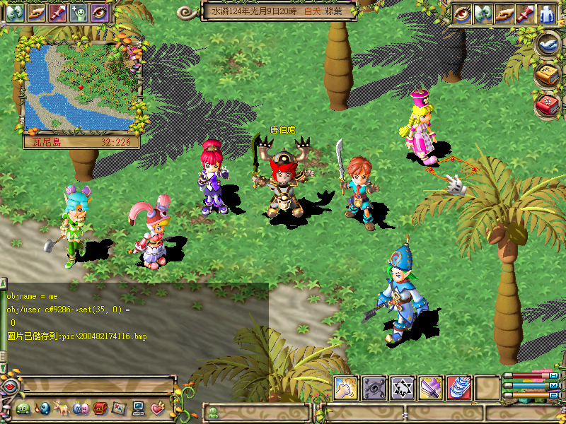

Slide 12
Input Devices - Gamepad
Gamepad
  Special buttons on one input device
  Analog controllers
    Joystick
    Value ranging from 0 – 255
  Digital controllers
    Buttons
    Value = 0 or 1
  Force feedback
  Console games mostly
  “First personal view”
  “Third personal view”

Slide 13
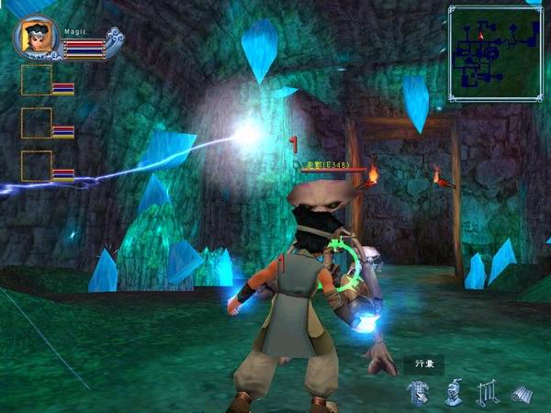

Slide 14
Input Devices - Keyboard
Keyboard
  ASCII characters input
Hotkeys
  Key pressed or released
  Can be mapped to gamepad
    A very large gamepad ?

Slide 15
Input Devices - APIs
DirectInput
  Mouse
  Keyboard
  Gamepad
Win32 SDK
  Window messages
    WM_XXXXXX
  Mouse
  Keyboard

Slide 16
DirectX
Current Released
  DirectX 9.0c (Update December 2004)
  http://www.microsoft.com/DirectX
Components
  Direct Graphics (9)
    Direct3D (9)
      2D functionality & helper move to Direct3D extension (D3DX)
    DirectDraw (7)
      No longer recommended
  DirectSound (9)
  DirectInput (8)
  DirectPlay (8)
    Will have new update through 12/31, 2004 (?)
  DirectMusic (8)
  DirectShow (8)

Slide 17
DirectX
Current Released
  DirectX 9.0c (Update December 2004)
  http://www.microsoft.com/DirectX
Components
  DirectX Graphics (9)
    Direct3D (9)
      2D functionality & helper move to Direct3D extension (D3DX)
    DirectDraw (7)
      No longer recommended
  DirectSound (9)
  DirectInput (8)
  DirectPlay (8)
    Will have new update through 12/31, 2004 (?)
  DirectMusic (8)
  DirectShow (8)

Slide 18
Something about DirectX
2D vs 3D
  DirectDraw is no longer existing
  Use textures for images
  Use D3DXSprite interface
  Local game companies’ hurt!
Shaders vs Fixed Rendering Pipeline
  GPU impact
DirectX vs OpenGL
  DirectX -> OpenGL
    No 2D any more
    Much easier to code
  OpenGL -> DirectX
    Shader extension
    More rendering features for textures

Slide 19
Game Production Milestones
Milestones
  1. “Walk through”
  2. “Combat system” without FX & AI
  3. Add NPC AI
  4. Add FX
  5. Cheat code system
  6. Levels
  7. Add village system
    Major map
    Village
    …
  8. Add cut scenes

Slide 20
Summary
This is a basic course for game programming.
Learn the process to develop a game.
Some necessary skills & knowledge for 3D game programming.
Remember Hero’s Journey! It will repeat itself in other places.
Programming assignments for working with Ogre3D and integrating sound effects into games.
  They are pieces of code of a game engine.
  Game programming can be very tough but you can enjoy it!
  Now, finish the project to see the whole view!
Next steps for you to take action :
  Game engine programming
  Network game programming

Slide 21
Conclusion
You might need an API for you to program a game.
  Not just based on DirectX or OpenGL or Ogre3D…
The game software is pretty complicated compared to the other software development
  Different fields of expert involved
    Game designers
      Creativity
    2D/3D artists
      Visual art
  Not-very-friendly platforms
    Most of the players are not the same level
    But they still want to have the same game playing quality
    PC, consoles, …
The game programming is very fun. You create your own world!

Slide 22
Some Suggested Reference
Game Developer Magazine
Game Developer Conference
  http://www.gdconf.com/
Game Programming Gems
AI Game Programming Wisdom
Real-time Rendering, 2nd Edition
  AK Peters
Microsoft DirectX, OpenGL, Ogre3D
Programming Vertex and Pixel Shaders
  Charles River Media, Wolfgan Engel
Siggraph Courses & Proceedings

