Slide 1
Computer Networks
An Open Source Approach
Chapter 1: Fundamentals
Ying-Dar Lin, Ren-Hung Hwang, Fred Baker
Chapter 1: Fundamentals

Slide 2
Content
1.1 Requirements for computer networking
1.2 Underlying principles
1.3 The Internet architecture
1.4 Open source implementations
1.5 Book roadmap: a packet’s life
1.6 Summary
Chapter 1: Fundamentals
Notes:
Logic flow: requirements (objectives) & principles (constraints) → architecture (solutions) → implementations

Slide 3
1.1 Requirements for Computer Networking
Definition of a computer network:
  A shared platform through which a large number of users and applications communicate with each other.
Connectivity: who and how to connect?
Scalability: how many to connect?
Resource sharing: how to utilize the connectivity?
  Packet switching in datacom
  Circuit switching in telecom
Chapter 1: Fundamentals
Notes:
Example: Consider the resource (bandwidth & memory entries) reserved for a phone call passing through 10 telephone links and switches, and lasting for 20 minutes.

Slide 4
Connectivity: Node, Link, Path (1/2)
Another definition of a computer network (connectivity version):
  A connected platform constructed from a set of nodes and links, where any two nodes can reach each other through a path consisting of a sequence of nodes and links.
Chapter 1: Fundamentals

Slide 5
Connectivity: Node, Link, Path (2/2)
Node: host or gateway
  Host: end-point where users or applications reside
  Gateway: device to interconnect hosts
Link: point-to-point or broadcast
  Point-to-point: two end-points
  Broadcast: many attach-points
Path: routed or switched
  Routed: stateless concatenation of links
  Switched: stateful concatenation of links
Chapter 1: Fundamentals

Slide 6
Node: Host or Intermediary
Host
  Mainframe, workstation, desktop, hand-held, set-top-box, etc.
  Act as client or server, or both
Intermediary
  Hub, switch, router, gateway, etc.
  Wire-speed processing is a goal
  Embedded system with special ICs for speedup or cost reduction
Chapter 1: Fundamentals

Slide 7
Link: Point-to-Point or Broadcast
Access type
  Point-to-Point
      Simplex, half-duplex, full-duplex
      Usually WANs
  Broadcast
      Multiple access: contend to transmit
      Usually LANs (exception: satellite-based ALOHA)
Media type
  Wired
      Twisted pair, coaxial cable, fiber optics
  Wireless
      Radio(10⁴~10⁸ Hz), microwave (10⁸~10¹¹ Hz), infrared (10¹¹~10¹⁴ Hz)
Chapter 1: Fundamentals

Slide 8
Popular Wired and Wireless Link Technologies
 | Wired | Wireless
Local | Cat-5 twisted-pair Ethernet (10 Mbps ~ 1 Gbps) | 2.4 GHz band WLAN (2 ~ 54 Mbps ~ 600 Mbps)
Last-mile | POTS (28.8 ~ 56 kbps) ISDN (64 ~ 128 kbps) ADSL (16 kbps ~ 55.2Mbps) CATV (30 Mbps) FTTB (10 Mbps ~) | GPRS (128 kbps) 3G (384 kbps ~ several Mbps) WiMAX (40 Mbps)
Leased-line | T1 (1.544 Mbps) T3 (44.736 Mbps) OC-1 (51.840 Mbps) OC-3 (155.250 Mbps) OC-12 (622.080 Mbps) OC-24 (1.244160 Gbps) OC-48 (2.488320 Gbps) OC-192 (9.953280 Gbps) OC-768 (39.813120 Gbps)
Chapter 1: Fundamentals

Slide 9
Path: Routed or Switched?
A routed path is stateless
  i.e., connection-less, concatenation
  Each message is routed independently
  Slower
    matching the destination address against the routing table
    multiple memory accesses and address comparisons
A switched path is stateful
  i.e., connection-oriented, concatenation
  Memorized at all intermediate nodes
  The POTS (Plain Old Telephone System) has all telephone calls switched
  Faster
    easy indexing into the switching table
    one memory access
Chapter 1: Fundamentals
Notes:
Example: a flow passing through 10 routers (routed path without reservation) vs. a phone call passing through 10 switches (switched path with reservation)
Example: a router with 10,000 flows passing by (no memory entries for the flows) vs. a switch with 10,000 phone calls passing by (10,000 memory entries for the calls)

Slide 10
Historical Evolution: ATM Faded
ATM (Asynchronous Transfer Mode) picked stateful switching just like POTS
Came up late -> co-exist with the Internet
Two ways to co-exist
  Internetworking
  Layered hybrid
Establishing, and later tearing down
Destroyed the stateless nature
Chapter 1: Fundamentals
Notes:
Around 1997-1998, ATM was given up by the telecom camp which viewed ATM as the core technology of B-ISDN (Broadband Integrated Service Digital Network).

Slide 11
Scalability: Number of Nodes
Another definition of a computer network (scalability version):
  A scalable platform to group a large number of nodes so that each node knows how to reach any other node.
Hierarchy of Nodes
LAN, MAN, WAN
    LAN: Local Area Network
    MAN: Metropolitan Area Network
    WAN: Wide Area Network
Chapter 1: Fundamentals

Slide 12
Hierarchy of Nodes
Grouping of billions of nodes in a 3-level hierarchy
Super Supergroup
4,294,967,296
Supergroup
X65,536
65,536
65,536
Group
x256
x256
256
256
256
256
Chapter 1: Fundamentals
Notes:
Later in Section 1.3: Group (subnet), Supergroup (domain or autonomous system), Super Supergroup (Internet)

Slide 13
Resource Sharing
Yet another definition of a computer network (resource sharing version):
  A shared platform where the capacities of nodes and links are used to carry communication messages between nodes.
How to share?
  Store-and-forward packet switching
  Packetization: message to packets
  Queuing: network of queues
    At node: queuing/buffering and processing
    At link: queuing/buffering, transmission, propagation
Chapter 1: Fundamentals

Slide 14
Packetization a Message
Decomposing a message into packets with added header
message
Packet with Header
H
H
H
Chapter 1: Fundamentals

Slide 15
Queuing at a Node and a Link
node
packets
buffer
processor
propagation
link
packets
buffer
transmitter
Chapter 1: Fundamentals

Slide 16
Principle in Action: Datacom vs. Telecom
Supported applications
  Multiple vs. single
Way to share resources
  Packet switching vs. circuit switching
Performance issues
  Buffer vs. buffer-less
  Throughput/latency/jitter/loss vs. blocking/dropping
Chapter 1: Fundamentals

Slide 17
1.2 Underlying Principles
Performance measures
    Bandwidth, offered load, throughput
    Latency, jitter, loss
Operations at control plane
    Routing
    Traffic and Bandwidth Allocation
Operations at data plane
    Forwarding
    Congestion control
    Error control
    Quality of services
Interoperability
    Standard protocols and algorithms
    Implementation-dependent
Chapter 1: Fundamentals

Slide 18
Transmission Time and “Length” of a Bit
Bandwidth
  The maximum amount of data that can be handled by a system in a second
  The number of bits transmitted and contained in the distance propagated by the signal in one second
1 bit time in 10Base-T = 1 / (10x10^6) = 0.1 μs
1 bit length in 10Base-T = 0.1 μs x 2 x 10^8 m/sec = 20 m
0.1μs in time and 20m in length
1110010110
Manchester Coding for data in 10Base-T transmission
Chapter 1: Fundamentals

Slide 19
Performance Measures
For a node, link, or path
  Bandwidth, or capacity
  Offered load, or utilization
  Throughput
Throughput
Bandwidth
Ideal
Reality
Collision
Offered Load
Chapter 1: Fundamentals

Slide 20
Performance Measures
Latency in a Node
Latency (delay) in a node = queuing + processing
In M/M/1 queuing system,
  latency = 1 / (bandwidth – offered load)
Little’s Result: How many in the box?
  occupancy = throughput x latency (assume no loss)
mean occupancy = 5 packets
1 packet/sec
1 packet/sec
mean latency = 5 secs
Chapter 1: Fundamentals
Notes:
No assumption on the distribution of throughput and latency in Little’s Result.

Slide 21
Performance Measures
Latency in a Link
Latency (delay) in a link = queuing + transmission + propagation
Bandwidth delay product: BDP (Little’s result in a link or path!)
  Max outstanding bits in transit = bandwidth x delay
L
L’
0 1 1 0 1 1 0 1 0 1 0 1 0 0 1
0 0 1 0 0 1 1 1 0 0 1 1 1 1 0
1 0 0 1 1 0 0 0 1 0 1 1 0 1 0
0 1 1 0 0 0 1 1 0 1 0 0 1 0 0
B’
0 1 1 1 0 0 1 0
1 0 0 1 0 1 0 0
B
short thin pipe
long fat pipe
Chapter 1: Fundamentals

Slide 22
Performance Measures
Jitter and Loss
Jitter: latency variation
  Important for continuous traffic, not for pure data
  Can be absorbed, by adding latency
    O.K. for streaming but not for VoIP
Loss
  Cause 1: congestion → buffer overflow
  Cause 2: bit errors → drop
    Link errors: transmission errors
    Node errors: router memory errors
Chapter 1: Fundamentals
Notes:
VoIP: hard real-time with latency requirement of 200 ms; streaming: soft real-time allowing jitter buffer to absorb jitter but lengthen latency
Memory error in a router or switch: what read out might be different from what written in

Slide 23
Control Plane vs. Data Plane
Control plane is to maintain a platform for data plane to carry data.
Packets to process: control only vs. all
Time scale: milliseconds vs. micro/nano-seconds
Performance: resource utilization vs. throughput
Basic operations: routing vs. forwarding
Operations at control plane
Routing
Error reporting
System
cfg. & mgmt.
Resource allocation
Operations at data plane
Forwarding
Classi-
fication
Deep pkt.
inspection
Error control
Traffic control
Quality
of service
Chapter 1: Fundamentals

Slide 24
Operations at Control Plane (1/2)
Routing:
  Compute-and-store the routes/paths, or next hops, of packets
    Pre-computed or on-demand?
    Hop-by-hop or source-routed?
    Granularity of routing decision: per-destination, per-source/destination, per-flow, per-packet, etc.
    Network state info: global, partial, local, etc.
    Optimal path: shortest, widest, most robust, etc.
    Single path or multiple paths?
Chapter 1: Fundamentals
Notes:
Underlined items are choices made by the Internet.

Slide 25
Operations at Control Plane (2/2)
Traffic and bandwidth allocation
  Traffic allocation ~ routing, traffic engineering
  Bandwidth allocation
  Optimization objectives?
    Averaged end-to-end latency
    Load balancing
  Static planning or dynamic assignment?
Other operations
  Error reporting, host configuration, etc.
Chapter 1: Fundamentals

Slide 26
Operations at Data Plane (1/2)
Forwarding
  Lookup tables and forward packets
    All issues in routing!
    Small data structures for tables
    Fast algorithms for lookup and update
Classification
  Classify packets into classes for specific services
    Types of services: forwarding, filtering, encryption, etc.
    In general: multi-fields classification
    Forwarding: mostly single-field classification
Chapter 1: Fundamentals

Slide 27
Operations at Data Plane (2/2)
Error control
    Error detection or correction?
    Hop-by-hop or end-to-end?
Traffic control
    Flow control: synchronize sender and receiver (hop-by-hop or end-to-end)
    Congestion control: synchronize a set of senders and the network
    Avoid buffer overflow/underflow
    Policy: low loss, high throughput, fairness
Quality of services
    Policer, shaper, scheduler, etc.
Chapter 1: Fundamentals

Slide 28
Interoperability
Standard protocols and algorithms
  Control-plane protocols: e.g. state info messages
  Control-plane algorithms: e.g. path computation
  Data-plane protocols: e.g. header
  Data-plane algorithms: e.g. checksum
Implementation-dependent design
  Control-plane algorithms: e.g. path data structures
  Data-plane algorithms: e.g. table lookup
Chapter 1: Fundamentals

Slide 29
1.3 The Internet Architecture
Solutions to connectivity
Solutions to scalability
Solutions to resource sharing
Control-plane and data-plane operations
Chapter 1: Fundamentals

Slide 30
Architectures of POTS, ATM, IP, and MPLS
Hard state switching
  POTS (Plain Old Telephone Service)
  ATM (Asynchronous Transfer Mode)
Soft state switching
  MPLS (Multiprotocol Label Switching)
Stateless routing
  IP (Internet Protocol)
Chapter 1: Fundamentals

Slide 31
The Spectrum of “Statefulness”
Circuit
Switching
Hard-State
Switching
Hard-State
Switching
Soft-State
Switching
Routing
Statefulness
Statelessness
POTS
ATM
X.25
Frame Relay
MPLS
Internet
Chapter 1: Fundamentals
Notes:
Analogy: POTS/ATM (marriage), MPLS (friendship that may expire), Internet (stranger)

Slide 32
Solutions to Connectivity
Routed Connectivity Maintained at End-to-End
Routing: stateless and connectionless
  Routed instead of switched
  Low overhead for bursty long-lived or short-lived connectivity
The end-to-end argument
  End-to-end instead of hop-by-hop
  Don’t put it in a lower layer if it cannot be completely done there!
  Hop-by-hop only for performance optimization
The 4-layer protocol stack
    Over a link: physical and data link layers
    Host-to-host: IP layer
    Process-to-process: TCP and UDP layers
    Client/server or P2P: application layer
    e.g. Ethernet/IP/TCP/HTTP
Chapter 1: Fundamentals

Slide 33
Internet Protocol Tree
Commonly Used Protocols
BGP
FTP
POP3
HTTP
Application-Layer
Protocols
SMTP
NNTP
NFS
YP
Mount
Telnet
DNS
DHCP
RPC
TFTP
RIP
SNMP
Transport-Layer protocols
OSPF
TCP
UDP
Network-Layer protocols
ARP
RARP
IP
ICMP
BOOTP
Physical+Data Link(Type of Network)
PPP
Ethernet
Wireless LAN
xDSL
OC-3
Chapter 1: Fundamentals
Notes:
The red entities are control protocols.

Slide 34
Packet Encapsulation
Payload
HTTP
Payload
TCP
HTTP
Payload
Encapsulation
IP
TCP
HTTP
Payload
Ethernet
IP
TCP
HTTP
Payload
Chapter 1: Fundamentals

Slide 35
Solutions to Scalability
Subnet
  IP subnet: contiguous address block
  IP netmask: network address length
  IP prefix: network address
Autonomous system (AS, domain)
  Many subnets within an AS
  Intra-AS and inter-AS routing and forwarding
Given 50M hosts and 1M routers today,
  If subnet size = 50, # subnets in an AS = 50,
    # ASs = 20,000 → O.K. for inter-AS routers
Chapter 1: Fundamentals

Slide 36
Subnet, Netmask, Prefix
Segmented Contiguous Address Blocks
Prefix
140
113
000
000
Subnet 140.113.0.0
with netmask 255.255.0.0
140
113
000
001
256*256=
65536 entries
140
113
255
000
Subnet 140.113.255.0
with netmask 255.255.255.0
256 entries
140
113
255
254
140
113
255
255
Prefix
Chapter 1: Fundamentals

Slide 37
An Example of
Domain, AS, or Super-Group: NCTU
Supergroup: NCTU (140.113.[0-254].[0-254])
CS department
EE department
.......
MIS department
(16 groups)
(3 groups)
140.113.136.[0-254]
(8 groups)
140.113.152.[0-254]
140.113.137.[0-254]
140.113.142.[0-254]
.......
140.113.153.[0-254]
140.113.138.[0-254]
140.113.143.[0-254]
140.113.154.[0-254]
140.113.173.[0-254]
140.113.144.[0-254]
ME department
(4 groups)
.......
140.113.177.[0-254]
140.113.200.[0-254]
140.113.82.[0-254]
140.113.147.[0-254]
140.113.83.[0-254]
140.113.149.[0-254]
140.113.84.[0-254]
.......
140.113.209.[0-254]
.......
140.113.85.[0-254]
.......
140.113.210.[0-254]
Chapter 1: Fundamentals

Slide 38
Solutions to Resource Sharing
Common best-effort service – IP
    Unreliable IP, in terms of throughput, latency, jitter, loss
End-to-end services:
    Reliable TCP, in terms of loss, and unreliable UDP
End-to-end congestion control - TCP
  TCP window-based control
    Fairness: equal outstanding bits (BDP) for any flows
    Adjusted to reflect network and receiver conditions
    AIMD (Additive Increase, Multiplicative Decrease)
Chapter 1: Fundamentals

Slide 39
Control-Plane Operations
Routing
    Pre-computed in background
    Hop-by-hop
    Per-destination-prefix (subnet or AS) granularity
    Intra-AS: partial or global network state info
    Inter-AS: partial network state info
    Shortest path
    Single path
Error reporting
    ICMP (Internet Control Message Protocol)
Host configuration
    DHCP (Dynamic Host Configuration Protocol)
Chapter 1: Fundamentals

Slide 40
Data-Plane Operations
Forwarding
  Longest prefix matching
Error control
    Checksum at UDP (detection only) and TCP (detection and ack for retransmission)
    Checksum at IP (detection and ICMP, header only)
    Checksum or CRC (Cyclic Redundancy Check) at link layer (detection and retransmission) for efficiency
Traffic control
  End-to-end: TCP
  Wild rider: UDP
    Should be shaped to TCP-friendly
Chapter 1: Fundamentals

Slide 41
Principle in Action: Flavors of the Internet Architecture
Pushes the complexity towards the edge device
Keeping the core network stateless
A simple three-level hierarchy with subnets and domains is enough
Possibility for a stateful core?
  MPLS: only at a limited scale
Chapter 1: Fundamentals

Slide 42
1.4 Open Source Implementations
Open vs. closed
Taxonomy of open source packages
Software architecture in Linux systems
Kernel modules
Interface drivers
Clients and daemon servers
Chapter 1: Fundamentals

Slide 43
Open vs. Closed
What to open: interface or implementation?
Open: Internet (interface), Linux (implementation)
Closed: IBM SNA (System Network Architecture), Microsoft
Virtues to open interface
  Interoperability
Virtues to open implementation
  World-wide contributors
  Fast updates and patches
  Better code quality
Chapter 1: Fundamentals

Slide 44
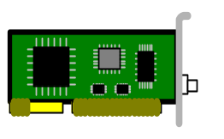
Software Architecture in Linux Systems: Router
User Space
Routed (RIP) / gated or zebra
(RIP, OSPF, BGP, etc.)
Inetd
(ftp, telnet, etc.)
update
Routing Table
Protocol Driver
Adapter
Driver
Adapter
Driver
Kernel Space
Control Plane
Control Plane
Data Plane
Data Plane
Chapter 1: Fundamentals

Slide 45
Software Architecture in Linux Systems: Host
User Space
Apache (HTTP) server / qmail
(SMTP, POP3) server, etc.
net-snmp
(SNMP) server
Protocol Driver
Adapter
Driver
Kernel Space
Control Plane
Data Plane
Chapter 1: Fundamentals

Slide 46
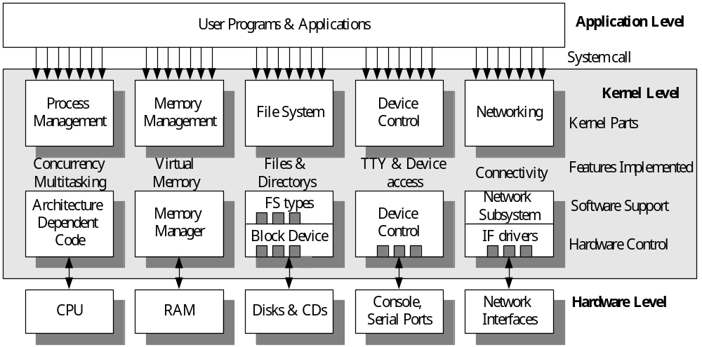
Kernel Components
Chapter 1: Fundamentals

Slide 47
Clients and Daemon Servers
Socket APIs: TCP, UDP, raw, link, routing
raw socket
DLPI socket
Client
Server
routing socket
TCP/UDP socket
TCP
TCP
IP
IP
MAC
MAC
PHY
PHY
Internet
Chapter 1: Fundamentals

Slide 48
Interface Drivers: In and Out
kernel
driver
TX
TX
RX
card
command
data
interrupt
registers
buffer
DMA
Chapter 1: Fundamentals

Slide 49
1.5 Book Roadmap: A Packet’s Life
sk_buff
The sk_buff structure
The sk_buff structure
next
prev
dev
sk
....
head
data
+mac_header
+network_header
+transport_header
+tail
+end
...
next
prev
dev
sk
....
head
data
+mac_header
+network_header
+transport_header
+tail
+end
...
next
prev
dev
sk
....
head
data
+mac_header
+network_header
+transport_header
+tail
+end
...
header
header
body
body
Fixed size of memory space for each packet
Chapter 1: Fundamentals

Slide 50
Book Roadmap
Packets’ Life in a Web Server
Web server
User Space
Web
Server
Request Handling Process
ch6
Apache
Build&Snd Responses
Rcv Requests
Socket
Write
Read
C
cp.
cp.
A
Snd DATA
Rcv ACK
Snd ACK
Rcv Data
Kernel Space
C
D
B
A
TCP
ch5
net/ipv4/*
Error Control
Congestion Control
C
B
D
A
IPv4
add IP header
hook on ip prerouting table
ch4
net/ipv4/*
Calc. chksum
version, len, and error chk
drop if fail
TX
Adapter Driver
Return space after trans.
sk_buff
pool
ch3
drivers/net/*
RX
free
hub
NIC
ch2/ch3
Get space for the receiving
A: incoming packet with the user req. B: TCP ACK for Packet A,
C: web resp. to the req. embedded in A D: TCP ACK returned from the user for Packet C
Chapter 1: Fundamentals

Slide 51
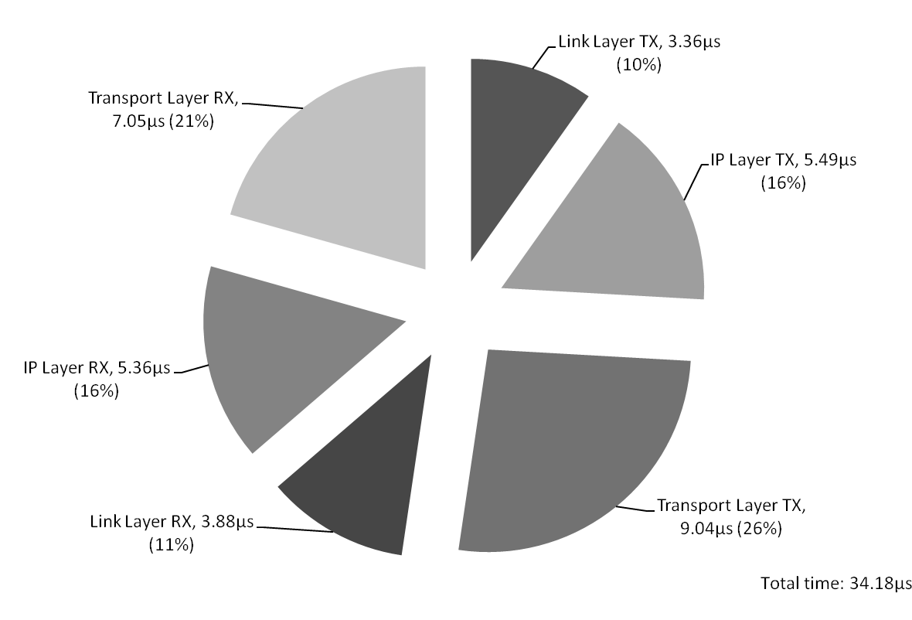
Performance Matters: From Socket to Driver within a Server
Chapter 1: Fundamentals

Slide 52
Book Roadmap
A Packet’s Life in a Router
User
Space
Log and detect Intrusion by Snort (ch8)
Routing by Zebra (ch4)
IPv4
to local process
check input chain
check ouput chain
make
routing
decision
Dest. IP is local
Kernel Space
ch4
Dest. IP isn’t local
check prerouting table for
(1) transparency proxy(ch6)
& (2) flow classification(ch7)
check forward chain
Src. IP is local
check post routing for ip masquerading
traffic control (ch7)
version, len, and error chk
host
TX
Adapter
Driver
Adapter
Driver
RX
ch3
router
NIC 2
ch2/ch3
RX
TX
NIC 1
ch2/ch3
gateway
hub
Chapter 1: Fundamentals

Slide 53
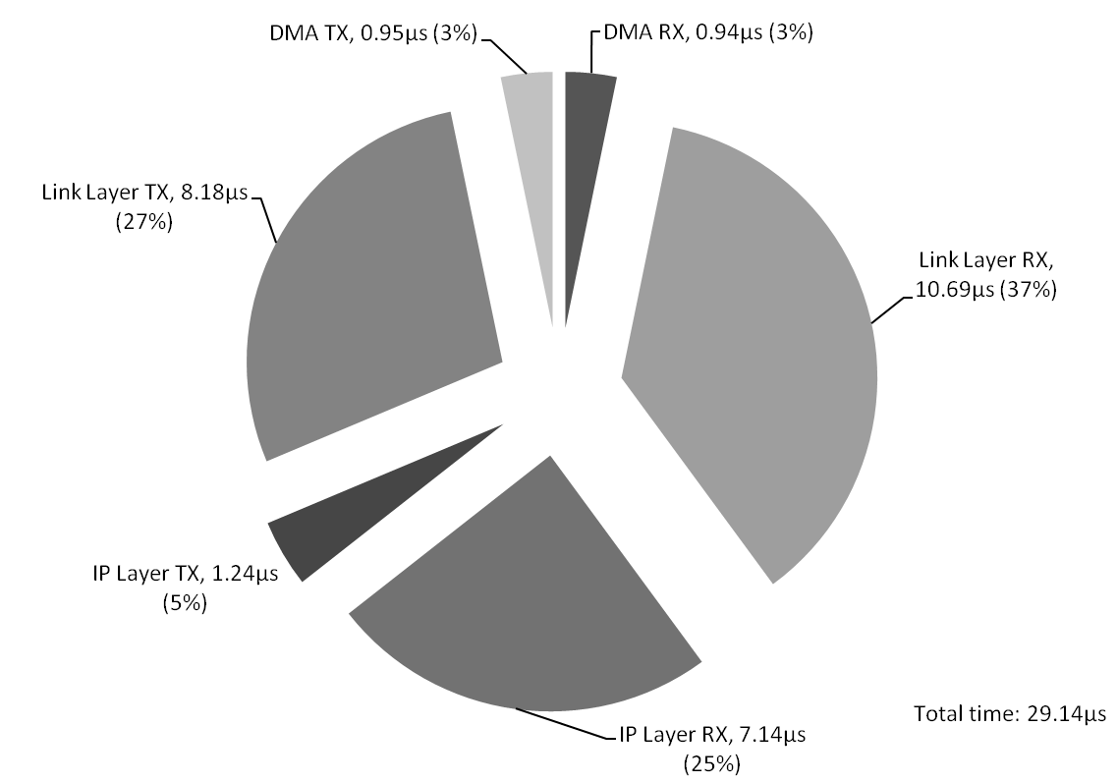
Performance Matters: From Input Port to Output Port within a Router
Chapter 1: Fundamentals

Slide 54
1.6 Summary
From requirements and principles to solutions and implementations
Key concepts: switching, routing, stateless, soft-state, best-effort, data plane, and control plane
Two biggest design decisions
  the end-to-end argument → stateless, best-effort IP, reliable/polite TCP
  three-level hierarchy → good scalability
The evolving hourglass
  Single IP technology + many links + huge applications
Chapter 1: Fundamentals

