Slide 1
Computer Networks
An Open Source Approach
Chapter 2: Physical Layer
Ying-Dar Lin, Ren-Hung Hwang, Fred Baker
Chapter 2: Physical Layer
Notes:
Chapter 2: Physical Layer

Slide 2
Content
2.1 General Issues
2.2 Medium
2.3 Information Coding and Baseband Transmission
2.4 Digital Modulation and Multiplexing
2.5 Advanced Topics
2.6 Summary
Chapter 2: Physical Layer
Notes:
Chapter 2: Physical Layer

Slide 3
2.1 General Issues
Data and Signal: Analog or Digital
Transmission and Reception Flow
Transmission: Line Coding and Digital Modulation
Transmission Impairments
Chapter 2: Physical Layer
Notes:
Chapter 2: Physical Layer

Slide 4
Data and Signal: Analog or Digital
Data
  Digital data – discrete value of data for storage or communication in computer networks
  Analog data – continuous value of data such as sound or image
Signal
  Digital signal – discrete-time signals containing digital information
  Analog signal – continuous-time signals containing analog information
Chapter 2: Physical Layer

Slide 5
Periodic and Aperiodic Signals (1/4)
Spectra of periodic analog signals: discrete
f1=100 kHz
f2=400 kHz
periodic analog signal
Amplitude
Time
Amplitude
100k
400k
Frequency
Chapter 2: Physical Layer

Slide 6
Periodic and Aperiodic Signals (2/4)
Spectra of aperiodic analog signals: continous
Amplitude
aperiodic analog signal
Time
Amplitude
f1
f2
Frequency
Chapter 2: Physical Layer

Slide 7
Periodic and Aperiodic Signals (3/4)
Spectra of periodic digital signals: discrete (frequency pulse train, infinite)
Amplitude
periodic digital signal
frequency = f kHz
...
Time
Amplitude
frequency pulse train
...
f
2f
3f
4f
5f
Frequency
Chapter 2: Physical Layer

Slide 8
Periodic and Aperiodic Signals (4/4)
Spectra of aperiodic digital signals: continuous (infinite)
Amplitude
aperiodic digital signal
Time
Amplitude
...
0
Frequency
Chapter 2: Physical Layer

Slide 9
Principle in Action: Nyquist Theorem vs. Shannon Theorem
Nyquist Theorem:
  Nyquist sampling theorem
    fs ≧ 2 x fmax
  Maximum data rate for noiseless channel
    2 B log2 L (B: bandwidth, L: # states to represent a symbol)
    2 x 3k x log2 2 = 6 kbps
Shannon Theorem:
  Maximum data rate for noisy channel
    B log2 (2(1+S/N)) (B: bandwidth, S: signal, N: noise)
    3k x log2 (2 x (1+1000)) = 32.9 kbps
Chapter 2: Physical Layer

Slide 10
Transmission and Reception Flows
A digital communications system
From Other Sources
Message
Channel
Channel
Baseband
Bandpass
Interference
Symbols
Symbols
Symbols
Waveform
Waveform
& Noise
Information
Source/Channel
Multiplexing
Line Coding
Modulation
Transmit
Source
Coding
Transmitted
Signal
Bit Stream
Digital Signal
Channel
Received
Information
Source/Channel
Signal
Sink
Decoding
Demultiplexing
Line Decoding
Demodulation
Receive
To Other Destinations
Chapter 2: Physical Layer

Slide 11
Baseband vs. Broadband
Baseband transmission:
  Digital waveforms traveling over a baseband channel without further conversion into analog waveform by modulation.
Broadband transmission:
  Digital waveforms traveling over a broadband channel with conversion into analog waveform by modulation.
Chapter 2: Physical Layer

Slide 12
Line Coding
Synchronization, Baseline Wandering, and DC Components
Synchronization
  Calibrate the receiver’s clock for synchronizing bit intervals to the transmitter’s
Baseline Wandering (or Drift)
  Make a received signal harder to decode
DC components (or DC bias)
  A non-zero component around 0 Hz
  Consume more power
Chapter 2: Physical Layer

Slide 13
Digital Modulation
Amplitude, Frequency, Phase, and Code
Use analog signals, characterized by amplitude, frequency, phase, or code, to represent a bit stream.
A bit stream is modulated by a carrier signal into a bandpass signal (with its bandwidth centered at the carrier frequency).
Chapter 2: Physical Layer

Slide 14
Transmission Impairments
Attenuation
  Gradual loss in intensity of flux such as radio waves
Fading: A time varying deviation of attenuation when a modulated waveform traveling over a certain medium
  Multipath fading: caused by multipath propagation
  Shadow fading: shadowed by obstacles
Distortion: commonly occurs to composite signals
  Different phase shifts may distort the shape of composite signals
Interference: usually adds unwanted signals to the desired signal, such as co-channel interference (CCI, or crosstalk), inter-symbol interference (ISI), inter-carrier interference (ICI)
Noise: a random fluctuation of an analog signal, such as electronic, thermal, induced, impulse, quantization noises.
Chapter 2: Physical Layer

Slide 15
Historical Evolution: Software Defined Radio
A functional model of a software radio communications system
Channel
Source
Set
Set
Network
Analog/Digital
IF
Baseband
Protected
Clear
Source
Waveform
Waveform
Bitsteam
Bitsteam
Bitsteam
RF/
Service
Channel
IF
Modem
Information
&
Source
Access
Processing
Security
Network
Coding
RF
Support
Waveform
Channel Coding/Decoding
Joint Control
(Radio Node)
Multiple Personalities
(Software Object)
Host Processors
Load/Execute
Chapter 2: Physical Layer

Slide 16
2.2 Medium
Wired Medium
Wireless Medium
Chapter 2: Physical Layer
Notes:
Chapter 2: Physical Layer

Slide 17
Wired Medium: Twisted Pair (1/2)
Two copper conductor twisted together to prevent electromagnetic interference.
  Shielded twisted pairs, STP
  Unshielded twisted pairs, UTP.
Metal shield
conductor
Plastic cover
Insulator
conductor
Plastic cover
Insulator
Chapter 2: Physical Layer

Slide 18
Wired Medium: Twisted Pair (2/2)
Specifications of common twisted pair cables.
Specifications | Description
Category 1/2 | For traditional phone lines. Not specified in TIA/EIA.
Category 3 | Transmission characteristics specified up to 16 MHz
Category 4 | Transmission characteristics specified up to 20 MHz
Category 5(e) | Transmission characteristics specified up to 100 MHz
Category 6(a) | Transmission characteristics specified up to 250 MHz (Cat-6) and 500 MHz (Cat-6a)
Category 7 | Transmission characteristics specified up to 600 MHz
Chapter 2: Physical Layer

Slide 19
Wired Medium: Coaxial Cable
Coaxial Cable
  An inner conductor surrounded by an insulating layer, a braided outer conductor, another insulating layer, and a plastic jacket.
Braided
Inner
outer conductor
conductor
Plastic jacket
Insulator
Insulator
Chapter 2: Physical Layer

Slide 20
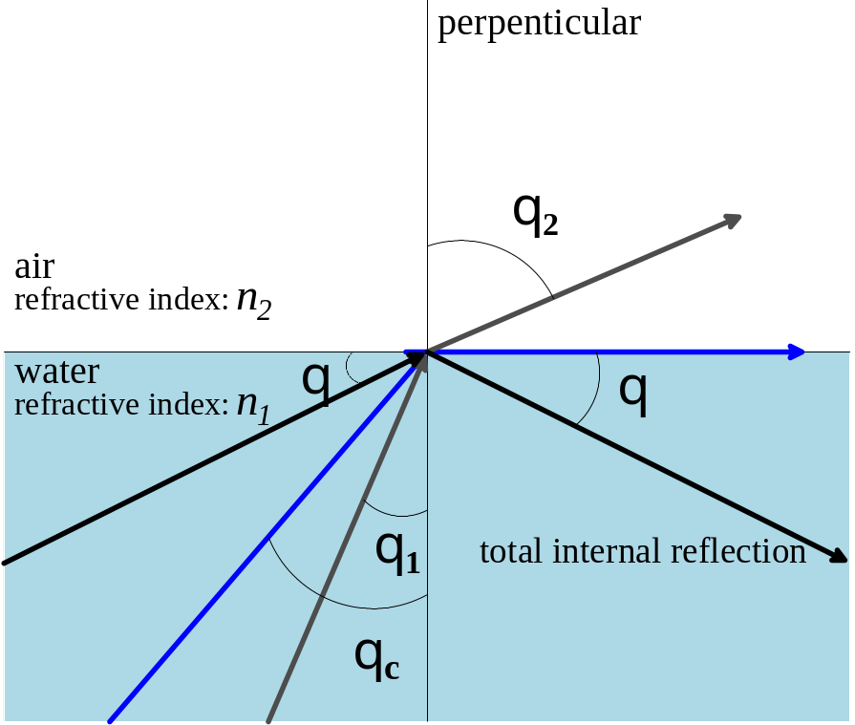
Wired Medium: Optical Fiber (1/3)
Optical Fiber
  Refraction of light and total internal reflection
Chapter 2: Physical Layer

Slide 21
Wired Medium: Optical Fiber (2/3)
Optical Fiber: a thin glass or plastic core is surrounded by a cladding glass with a different density.
Cladding
(Glass)
Jacket
Core
(Plastic cover)
(Glass or Plastic)
Chapter 2: Physical Layer

Slide 22
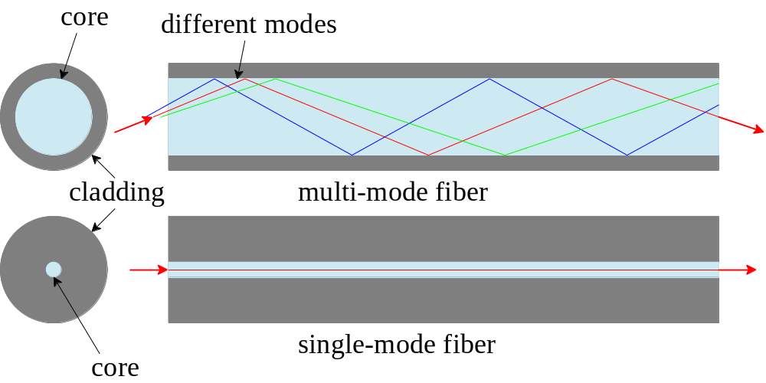
Wired Medium: Optical Fiber (3/3)
  Single-mode:
    A fiber with a very thin core allowing only one mode of light to be carried.
  Multi-mode:
    A fiber carries more than one mode of light
Chapter 2: Physical Layer

Slide 23
Wireless Medium
Propagation Methods
  Three types – ground, sky, and line-of-sight propagation
Transmission Waves:
  Radio, Microwave, Infrared waves
Mobility
  Mostly use microwave
Chapter 2: Physical Layer

Slide 24
2.3 Information Coding and Baseband Transmission
Source and Channel Coding
Line Coding
Chapter 2: Physical Layer
Notes:
Chapter 2: Physical Layer

Slide 25
Source Coding
To form efficient descriptions of information sources so the required storage or bandwidth resources can be reduced
Some applications:
  Image compression
  Audio compression
  Speech compression
Chapter 2: Physical Layer

Slide 26
Channel Coding
Used to protect digital data through a noisy transmission medium or stored in an imperfect storage medium.
The performance is limited by Shannon’s Theorem
Chapter 2: Physical Layer

Slide 27
Line Coding and Signal-to-Data Ratio (1/2)
Line Coding: applying a pulse modulation to a binary symbol and generating a pulse-code modulation (PCM) waveform
PCM waveforms are known as line codes.
Signal-to-Data Ratio (sdr):
  a ratio of the number of signal elements to the number of data elements
Chapter 2: Physical Layer

Slide 28
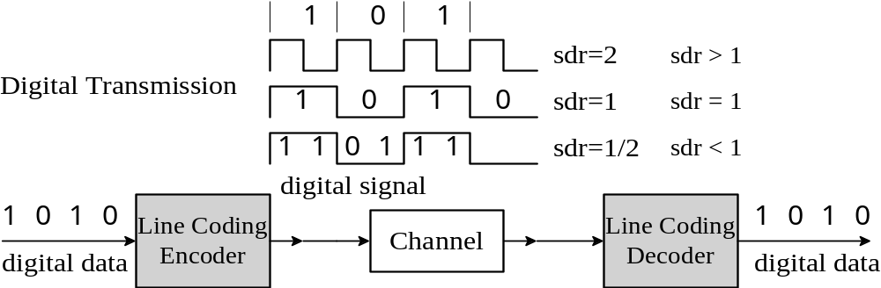
Line Coding and Signal-to-Data Ratio (2/2)
A simplified line coding process
Chapter 2: Physical Layer

Slide 29
Self-Synchronization
A line coding scheme embeds bit interval information in a digital signal
The received signal can help a receiver synchronize its clock with the corresponding transmitter clock.
The line decoder can exactly retrieve the digital data from the received signal.
Chapter 2: Physical Layer

Slide 30
Line Coding Schemes
Unipolar NRZ
Polar NRZ
Polar RZ
Polar Manchester and Differential Manchester
Bipolar AMI and Pseudoternary
Multilevel Coding
Multilevel Transmission 3 Levels
RLL
Chapter 2: Physical Layer

Slide 31
Categories of Line Coding
Category of Line Coding | Line Coding
Unipolar | NRZ
Polar | NRZ, RZ, Manchester, differential Manchester
Bipolar | AMI, Pseudoternery
Multilevel | 2B1Q, 8B6T
Multitransition | MLT3
Chapter 2: Physical Layer

Slide 32
The Waveforms of Line Coding Schemes
Clock
1
0
1
0
0
1
1
1
0
0
1
0
Data stream
Unipolar NRZ-L
Polar NRZ-L
Polar NRZ-I
Polar RZ
Manchester
Differential
Manchester
AMI
MLT-3
Chapter 2: Physical Layer

Slide 33
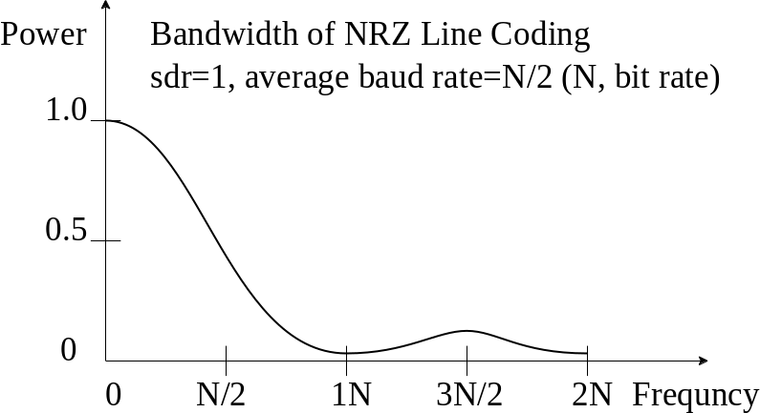
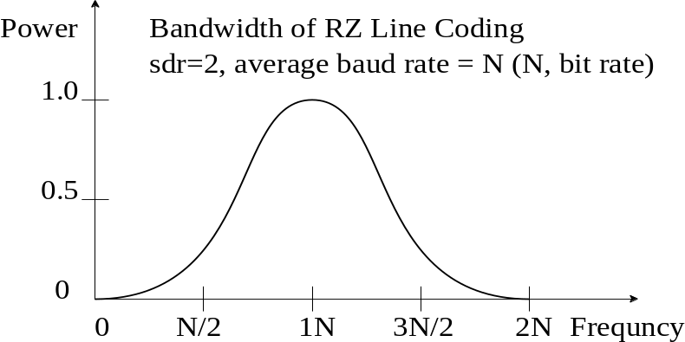
Bandwidths of Line Coding (1/3)
The bandwidth of polar NRZ-L and NRZ-I.
The bandwidth of bipolar RZ.
Chapter 2: Physical Layer

Slide 34
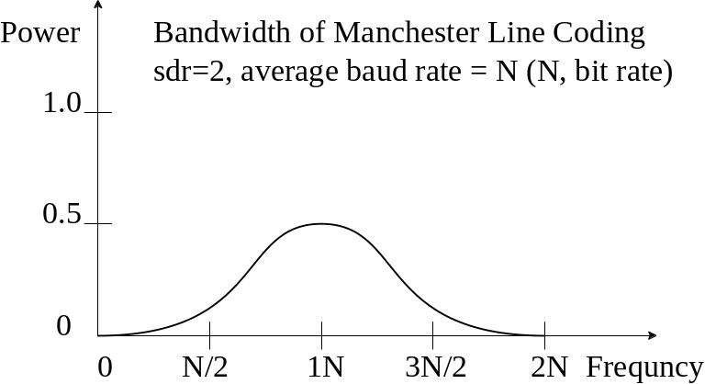
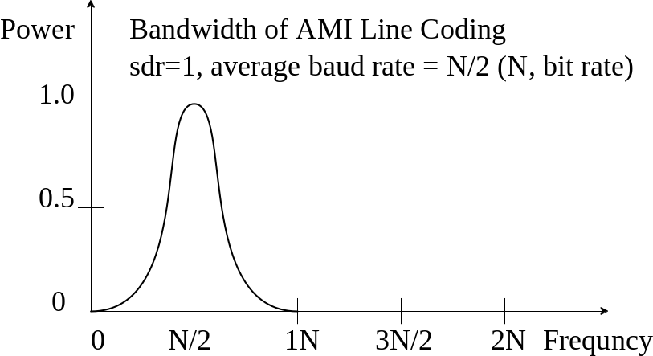
Bandwidths of Line Coding (2/3)
The bandwidth of Manchester.
The bandwidth of AMI.
Chapter 2: Physical Layer

Slide 35
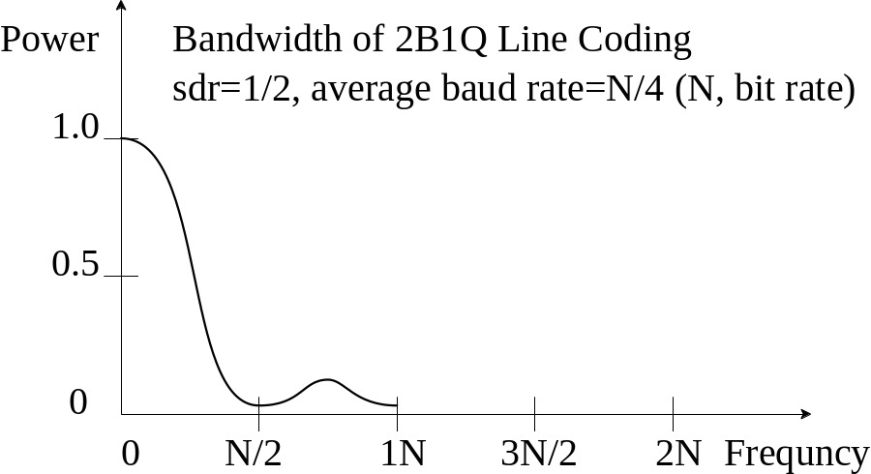
Bandwidths of Line Coding (3/3)
The bandwidth of 2B1Q
Chapter 2: Physical Layer

Slide 36
2B1Q Coding
One example of multilevel coding schemes
  reduce signal rate and channel bandwidth
The mapping table for 2B1Q coding.
Dibit (2 bits) | 00 | 01 | 10 | 11
If previous signal level, positive: next signal level = | +1 | +3 | -1 | -3
If previous signal level, negative: next signal level = | -1 | -3 | +1 | +3
Chapter 2: Physical Layer

Slide 37
Examples of RLL coding
limit the length of repeated bits
avoid a long consecutive bit stream without transitions
(a) (0,1) RLL (b) (2,7) RLL (c) (1,7) RLL
Data | (0,1) RLL |  | Data | (2, 7) RLL |  | Data | (1, 7) RLL
0 | 10 |  | 11 | 1000 |  | 00 00 | 101 000
1 | 11 |  | 10 | 0100 |  | 00 01 | 100 000
 |  |  | 000 | 000100 |  | 10 00 | 001 000
 |  |  | 010 | 100100 |  | 10 01 | 010 000
 |  |  | 011 | 001000 |  | 00 | 101
 |  |  | 0011 | 00001000 |  | 01 | 100
 |  |  | 0010 | 00100100 |  | 10 | 001
 |  |  |  |  |  | 11 | 010
Chapter 2: Physical Layer

Slide 38
4B/5B Encoding Table
Name | 4B | 5B | description
0 | 0000 | 11110 | hex data 0
1 | 0001 | 01001 | hex data 1
2 | 0010 | 10100 | hex data 2
3 | 0011 | 10101 | hex data 3
4 | 0100 | 01010 | hex data 4
5 | 0101 | 01011 | hex data 5
6 | 0110 | 01110 | hex data 6
7 | 0111 | 01111 | hex data 7
8 | 1000 | 10010 | hex data 8
9 | 1001 | 10011 | hex data 9
A | 1010 | 10110 | hex data A
B | 1011 | 10111 | hex data B
C | 1100 | 11010 | hex data C
D | 1101 | 11011 | hex data D
E | 1110 | 11100 | hex data E
F | 1111 | 11101 | hex data F
Q | n/a | 00000 | Quiet (signal lost)
I | n/a | 11111 | Idle
J | n/a | 11000 | Start #1
K | n/a | 10001 | Start #2
T | n/a | 01101 | End
R | n/a | 00111 | Reset
S | n/a | 11001 | Set
H | n/a | 00100 | Halt
Chapter 2: Physical Layer

Slide 39
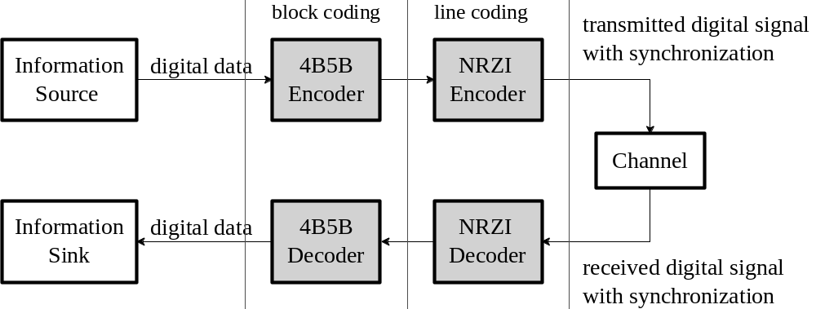
The Combination of 4B/5B Coding and NRZ-I Coding
the technique 4B/5B may eliminate the NRZ-I synchronization problem
Chapter 2: Physical Layer

Slide 40
Open Source Implementation 2.1: 8B/10B Encoder (1/2)
Widely adopted by a variety of high-speed data communication standards, such as
  PCI Express
  IEEE 1394b
  serial ATA
  Gigabit Ethernet
Provides
  DC – balance
  Clock synchronization
Chapter 2: Physical Layer

Slide 41
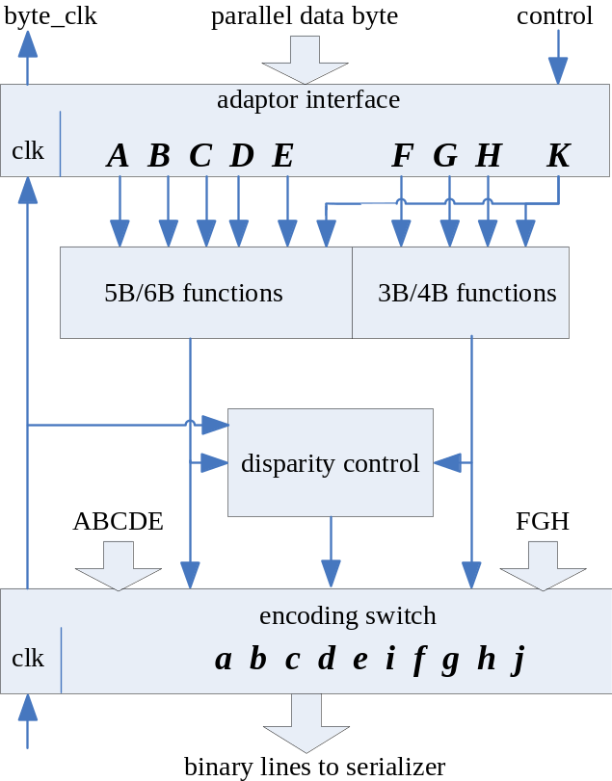
Open Source Implementation 2.1: 8B/10B Encoder (2/2)
Block diagram of 8B/10B Encoder
Chapter 2: Physical Layer

Slide 42
2.4 Digital Modulation and Multiplexing
Passband Modulation
Multiplexing
Chapter 2: Physical Layer
Notes:
Chapter 2: Physical Layer

Slide 43
Digital Modulation
A simplified passband modulation
  ASK, FSK, PSK
  QAM
BASK
Digital Modulation
BFSK
Information
10110110
Line
Modulator
BPSK
Source
Digital
Encoder
Baseband
Passband signal
bit stream
signal
with sinusoidal carrier
Channel
Information
10110110
Line
Demodulator
Sink
Decoder
BASK
BFSK
BPSK
Chapter 2: Physical Layer

Slide 44
Constellation Diagram (1/2)
A constellation diagram: constellation points with two bits: b0b1
Q
Quadrature Carrier
01
+1
11
Amplitue of Q component
Amplitue
-1
Phase
+1
I
In-phase Carrier
Amplitue of I component
00
-1
10
Chapter 2: Physical Layer

Slide 45
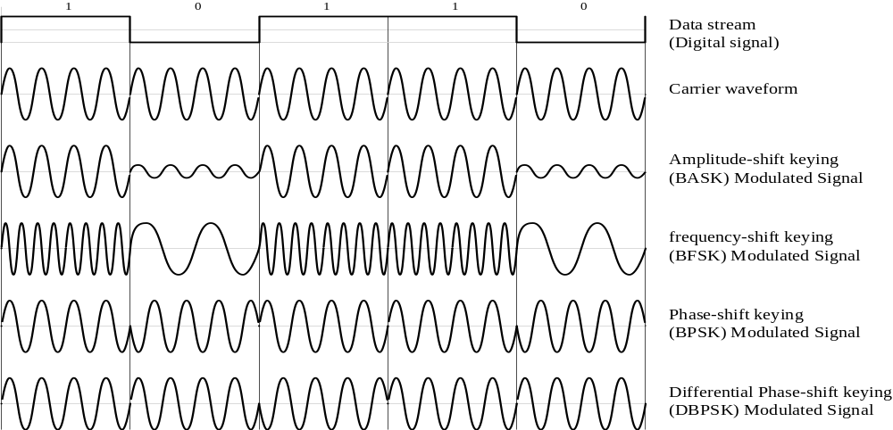
Constellation Diagram (2/2)
The waveforms of basic digital modulations
  BASK, BFSK, BPSK, DBPSK
Chapter 2: Physical Layer

Slide 46
Amplitude Shift Keying (ASK) and Phase Shift Keying (PSK)
The constellation diagrams of ASK and PSK.
Q
Q
Q
Q
010
Q
01
+1
11
011
110
0
1
0
1
001
111
0
+1
I
-1
+1
I
-1
+1
I
I
I
00
-1
10
000
101
100
(a) ASK (OOK): b0
(b) 2-PSK (BPSK): b0
(c) 4-PSK (QPSK): b0b1
(d) 8-PSK: b0b1b2
(e) 16-PSK: b0b1b2
Chapter 2: Physical Layer

Slide 47
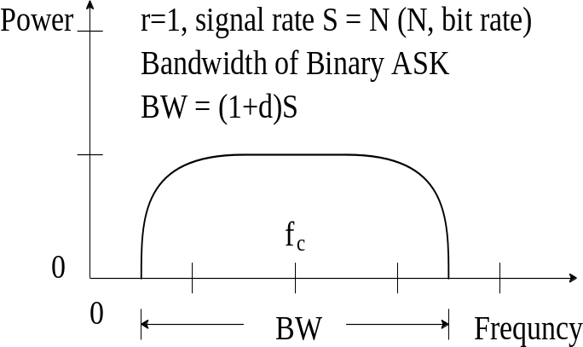
The Bandwidth and Implementation of BASK
(a) The bandwidth of BASK.
(b) The implementation of BASK.
1
0
1
1
0
1
1
0
Multiplier
v
Line
0
Encoder
Unipolar NRZ
Binary Amplitude
Shift Keying
(BASK)
Local
Oscillator
Carrier frequency: fc
Chapter 2: Physical Layer

Slide 48
The Bandwidth and Implementation of BFSK
(a) The bandwidth of BFSK.
(b) The implementation of BFSK.
Voltage-Controlled
Oscillator (VCO)
frequency: f1, f2
v
1
0
1
1
0
1
1
0
Line
0
Voltage-
Encoder
Controlled
Unipolar NRZ
Module
Binary Frequency
Shift Keying
(BFSK)
Local
Carrier frequency: fc
Oscillator
Chapter 2: Physical Layer

Slide 49
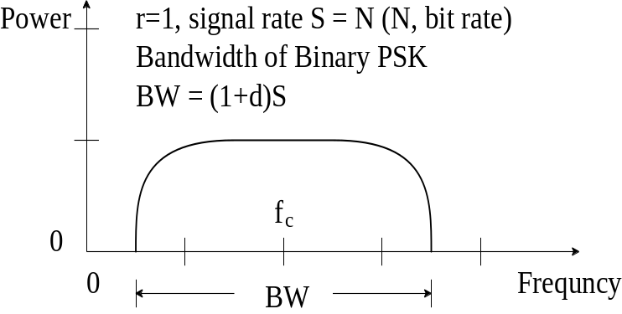
The Bandwidth and Implementation of BPSK
(a) The bandwidth of BPSK.
(b) The implementation of BPSK.
1
0
1
1
0
1
1
0
Multiplier
v
Line
-v
Encoder
Polar NRZ-L
Binary Phase Shift Keying
(BPSK)
Local
Oscillator
Carrier frequency: fc
Chapter 2: Physical Layer

Slide 50
The Simplified Implementation of QPSK
v
b1
...
b1
1 0 0 1
Polar NRZ-L
-v
Digital Data
Line Encoder
Digital Signal
Analog Signal: I
Local
cosine
in-pahse
Oscillator
QPSK
1 0 0 1
Signal
1 0 1 0
Demultiplexor
-90
Binary Bitstream
degree
quadrature
sine
(out-of-phase)
v
b0
...
b0
1 0 1 0
Polar NRZ-L
-v
Digital Data
Line Encoder
Digital Signal
Analog Signal: Q
Chapter 2: Physical Layer

Slide 51
The I, Q, and QPSK Waveforms
QPSK: A modulation using two carriers
  In-phase carrier and quadrature carrier
v
1
-1
-1
1
a split data (b1)
-v
cosine carrier
I-signal
v
1
-1
1
-1
-v
a split data (b0)
sine carrier
Q-signal
11
00
01
10
Binary bitstream(b1b0)
resulting signal:
QPSK signal
0
Ts
2Ts
3Ts
4Ts
Time
2Tb
4Tb
6Tb
8Tb
Chapter 2: Physical Layer

Slide 52
The Circular Constellation Diagrams
The constellation diagrams of ASK and PSK.
Q
Q
Q
+1+ 3
01
+1
11
+1
-1
+1
I
-1
+1
I
-1 - 3
+1+ 3
I
-1
-1
00
10
-1 - 3
(a) Circular 4-QAM: b0b1
(b) Circular 8-QAM: b0b1b2
(c) Circular 16-QAM: b0b1b2b3
Chapter 2: Physical Layer

Slide 53
The Rectangular Constellation Diagrams
0010
0110
Q
1110
1010
Q
+3
Q
Q
+1
+1
Q
0011
0111
+1
1111
1011
+1
+1
0
+1
I
-1
+1
I
-3
-1
+1
+3
I
-1
+1
I
-3
-1
+1
+3
I
-1
-1
0001
0101
-1
1101
1001
-1
0000
0100
-3
1100
1000
Alternative
Rectangular
4-QAM: b0b1
(b) Rectangular
4-QAM: b0b1
(c) Alternative
Rectangular
8-QAM: b0b1b2
(d) Rectangular
8-QAM: b0b1b2
(e) Rectangular
16-QAM: b0b1b2b3
Chapter 2: Physical Layer

Slide 54
The Constellation of Rectangular
64-QAM: b0b1b2b3b4b5
Q
000100
001100
011100
010100
+7
110100
111100
101100
100100
000101
001101
011101
010101
+5
110101
111101
101101
100101
000111
001111
011111
010111
+3
110111
111111
101111
100111
000110
001110
011110
010110
+1
110110
111110
101110
100110
-7
-5
-3
-1
+1
+3
+5
+7
I
000010
001010
011010
010010
-1
110010
111010
101010
100010
000011
001011
011011
010011
-3
110011
111011
101011
100011
000001
001001
011001
010001
-5
110001
111001
101001
100001
000000
001000
011000
010000
-7
110000
111000
101000
100000
Chapter 2: Physical Layer

Slide 55
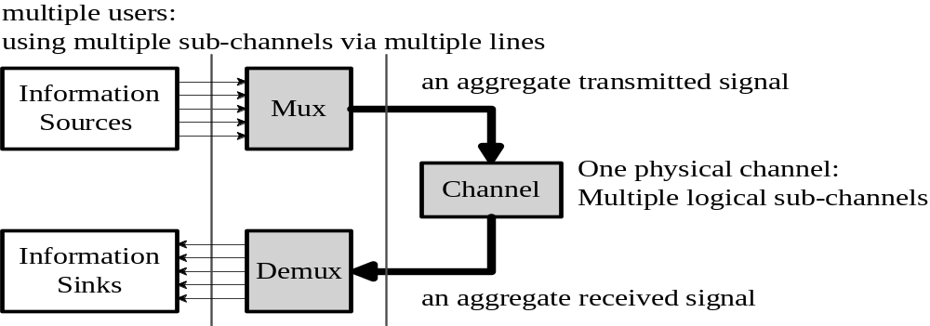
Multiplexing
A Physical Channel for Multiple Users Using Multiplexing Techniques via Multiple Sub-Channels
Chapter 2: Physical Layer

Slide 56
The Mapping of Channel Access Scheme and Multiplexing
Multiplexing | Channel Access Scheme | Applications
FDM (frequency division multiplexing) | FDMA (frequency division multiple access) | 1G cell phone
WDM (wavelength division multiplexing) | WDMA(wave-length division multiple access) | fiber-optical
TDM (time division multiplexing) | TDMA(time division multiple access) | GSM telephone
SS (spread spectrum) | CDMA(code division multiple access) | 3G cell phone
DSSS (direct sequence SS) | DS-CDMA(direct sequence CDMA) | 802.11b/g/n
FHSS (frequency hopping SS) | FH-CDMA(frequency hopping) CDMA) | Bluetooth
SM (spatial multiplexing) | SDMA(space division multiple access) | 802.11n, LTE, WiMAX
STC (space time coding) | STMA(space time multiple access) | 802.11n, LTE, WiMAX
Chapter 2: Physical Layer

Slide 57
Time Division Multiplexing (TDM)
Combining Multiple Digital Signals from Low-Rate Channels into a High-Rate Channel
Mux: with
Input data
interleaving
Demux
Output data
a2
a1
a1
TDM
b1
b1
c1
c1
Channel
One physical channel:
Multiple logical sub-channels
Chapter 2: Physical Layer

Slide 58
Frequency Division Multiplexing (FDM)
Dividing a frequency domain into several non-overlapping frequency ranges
Mux
Demux
bandpass
filters
Modulator: carrier f1
Demodulator: carrier f1
FDM
Modulator: carrier f2
sub-channel 1
Demodulator: carrier f2
sub-channel 2
sub-channel 3
Modulator: carrier f3
Demodulator: carrier f3
Channel
One physical channel:
Multiple logical sub-channels
Chapter 2: Physical Layer

Slide 59
2.5 Advanced Topics
Spread Spectrum (SS)
Single-Carrier vs. Multiple Carrier
Multiple Input Multiple Output (MIMO)
Chapter 2: Physical Layer
Notes:
Chapter 2: Physical Layer

Slide 60
The Modulation Techniques in WLAN Standards
The modulation schemes for IEEE 802.11 standards
  OFDM, DSSS, CCK, BPSK, QPSK, QAM
 | 802.11a | 802.11b | 802.11g | 802.11n
Bandwidth | 580 MHz | 83.5M0Hz | 83.5 MHz | 83.5MHz/580MHz
Operating Frequency | 5 GHz | 2.4 GHz | 2.4 GHz | 2.4 GHz/5 GHz
Number of Non-Overlapping Channels | 24 | 3 | 3 | 3/24
Number of Spatial Streams | 1 | 1 | 1 | 1,2,3, or 4
Date Rate per Channel | 6-54 Mbps | 1-11 Mbps | 1-54 Mbps | 1-600 Mbps
Modulation Scheme | OFDM | DSSS, CCK | DSSS, CCK, OFDM | DSSS, CCK, OFDM,
Subcarrier Modulation Scheme | BPSK, QPSK, 16 QAM, 64 QAM | n/a | BPSK, QPSK, 16 QAM, 64 QAM | BPSK, QPSK, 16QAM, 64 QAM
Chapter 2: Physical Layer

Slide 61
Pseudo Noise Code and a PN Sequence
Used in spread spectrum to spread a data stream
A pseudo random numerical sequence, not a real random sequence
data stream (data sequence): bit stream
v
spread sequence: chip stream
1
(polar NRZ-L)
-v
1 bit
0
input
0
0
0
1
1
1
0
1
1
0
1
1
1
1
0
0
0
1
0
0
1
0
output
XOR
1
1
1
0
0
0
1
0
0
1
0
1
1
1
0
0
0
1
0
0
1
0
PN sequence
11 chips
11 chips
PN Code: 11-bit Barker code (1 1 1 0 0 0 1 0 0 1 0)
Chapter 2: Physical Layer

Slide 62
Spread Spectrum and Narrowband Spectrum
The energy of the transmitted signal is spread over a broaden bandwidth.
Power
narrowband spectrum
Spread spectrum
BW 1
Frequency
BW 2
Chapter 2: Physical Layer

Slide 63
Barker codes and Willard codes.
11-bit Barker code is used in IEEE 802.11b
Barker codes have good correlation, but Willard codes provide better performance
Code Length (N) | Barker codes | Willard codes
2 | 10 or 11 | n/a
3 | 110 | 110
4 | 1101 or 1110 | 1100
5 | 11101 | 11010
7 | 1110010 | 1110100
11 | 11100010010 | 11101101000
13 | 1111100110101 | 1111100101000
Chapter 2: Physical Layer

Slide 64
A Spread Spectrum System Over a Noisy Channel
A noisy channel with different types of interference – such as narrowband, wideband, multipath interference.
Gaussian
narrowband
wideband
noise
interference
interference
Spreading
rx
Despreading
d
Input
transmitter
direct path
receiver
Output
data stream
data stream
Information
d
t
tx
b
Modulator
tx
Multipath
rx
Demodulator
rx
b
d
r
Information
Source
Channel
Destination
pn
t
rx
pn
r
r
PN Code
reflected path
PN Code
RF
RF
baseband
passband
baseband
Chapter 2: Physical Layer

Slide 65
Impact of Interference and Noise on DSSS
If interference i is narrowband interference
  After despreading, the interference i becomes a flattened spectrum with low power density
  can be filtered out by a low-pass filter.
If interference i is wideband interference
  After despreading, the interference i is flattened again and its power density is low.
  can be filtered out by a low-pass filter.
If interference i is noise
  After despreading, the noise i is still a noise-like spread sequence with low power density,
  can be filtered out by a low-pass filter.
Chapter 2: Physical Layer

Slide 66
A DSSS (Direct sequence spread spectrum) Transceiver
Two sublayers of the physical layer of DSSS WLAN: PLCP (physical layer convergence procedure) and PMD (physical medium dependent) layer.
Spreader for spreading spectrum belongs to PMD Layer
Transmitter
Receiver
Timing
DBPSK/
recovery
PLCP
Spreader
Transmit
DQPSK
Correlator
mask filter
modulator
DBPSK/
PLCP
DQPSK
Descrambler
modulator
Chip sequence
Chapter 2: Physical Layer

Slide 67
A Frequency Hopping Spread Spectrum System
A PN code generator
  for selecting carrier hopping frequencies
The bandwidth of the input signal is the same as that of the output signal
Input
signal
digital signal
M-FSK
FH
analog signal
Output
signal
Modulator
Modulator
carriers: f1, f2, ..., fn
Freqency
synthesizer
PN code
pn
t
Frequency
generator
word
Chapter 2: Physical Layer

Slide 68
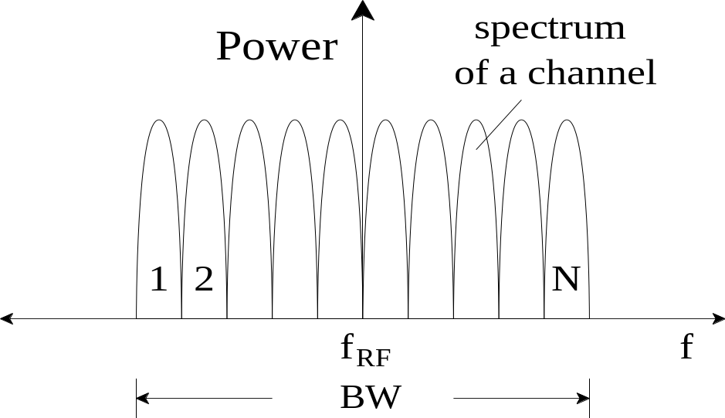
The Spectrum of an FHSS Channel
There are N carriers in this frequency pool
The required bandwidth is N times of that used by a single carriers.
Chapter 2: Physical Layer

Slide 69
Code Division Multiple Access (CDMA) (1/2)
A Spread Spectrum Multiple Access
Unlike TDMA, FDMA
  Do not divide a physical channel into multiple sub-channels.
Each user uses the entire bandwidth of a physical channel.
Different users use different orthogonal codes or PN codes
Chapter 2: Physical Layer

Slide 70
Code Division Multiple Access (CDMA) (2/2)
Synchronous CDMA
  Uses orthogonal codes
  Limited to a fixed number of simultaneous users.
Asynchronous CDMA
  Uses PN codes
  Using spectra more efficiently than TDMA and FDMA
  Can allocate PN-code to active users without a strict limit on the number of users.
Chapter 2: Physical Layer

Slide 71
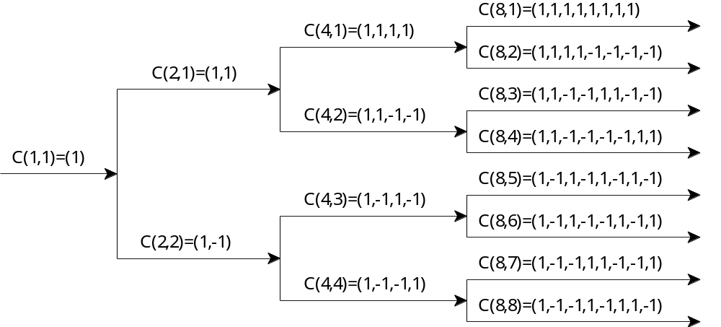
The OVSF Code Tree
Based on Hadamard matrix
Used in Synchronous CDMA
Chapter 2: Physical Layer

Slide 72
Spreading a Data Signal
One of Orthogonal Codes for one Subchannel
Data Signal
1
0
1
1
0
T
b
1
1
1
1
Orthogonal Code
-1
-1
-1
-1
T
c
1
1
1
1
Resulted Signal:
Data Signal XOR
-1
-1
-1
-1
Orthogonal Code
Chapter 2: Physical Layer

Slide 73
Advantages of CDMA
Reduce multipath fading and narrow interference
Reuse the same frequency
Enable the technique of soft handoff
Chapter 2: Physical Layer

Slide 74
Orthogonal Frequency Division Multiplexing (OFDM)
The orthogonality of sub-channels allows data to simultaneously travel over sub-channels
m
1
OFDM
Input
Serial-to-
m
2
Multicarrier
Add
Data
parallel
modulator
composite signal
Transmit
...
cyclic prefix
Stream
converter
m
k
(IFFT)
Channel
m
OFDM
Output
Serial-to-
1
Multicarrier
composite signal
m
2
Remove
Data
parallel
...
Decoder
...
demodulator
cyclic prefix
Receive
Stream
converter
m
k
(FFT)
Chapter 2: Physical Layer

Slide 75
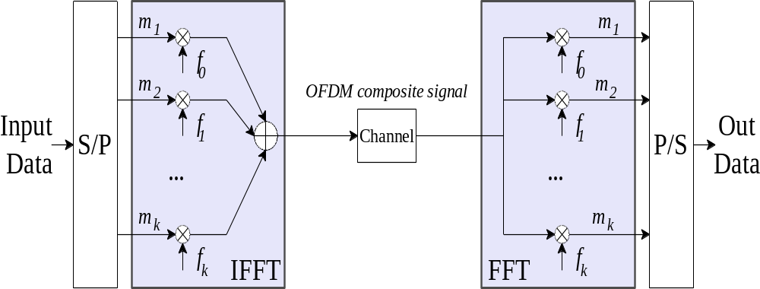
An OFDM System with IFFT and FFT
IFFT: inverse Fast Fourier Transform
FFT: Fast Fourier Transform
Chapter 2: Physical Layer

Slide 76
Orthogonality
Two signals that cross-over at the point of zero amplitude are orthogonal to each other
Amplitude
Frequency
Chapter 2: Physical Layer

Slide 77
Multipath Fading
A transmitted signal reaches the receiver antenna via different paths at different times
  Causing different level of constructive/destructive interference, phase shift, delay, and attenuation.
Chapter 2: Physical Layer

Slide 78
Applications of OFDM
ADSL, VDSL, power line communication
DVB-C2, wireless LANs in IEEE 802.11 a/g/n
WiMAX
Chapter 2: Physical Layer

Slide 79
Categories of MIMO Systems
SU-MIMO: single user MIMO
MU-MIMO: multiple user MIMO
Chapter 2: Physical Layer

Slide 80
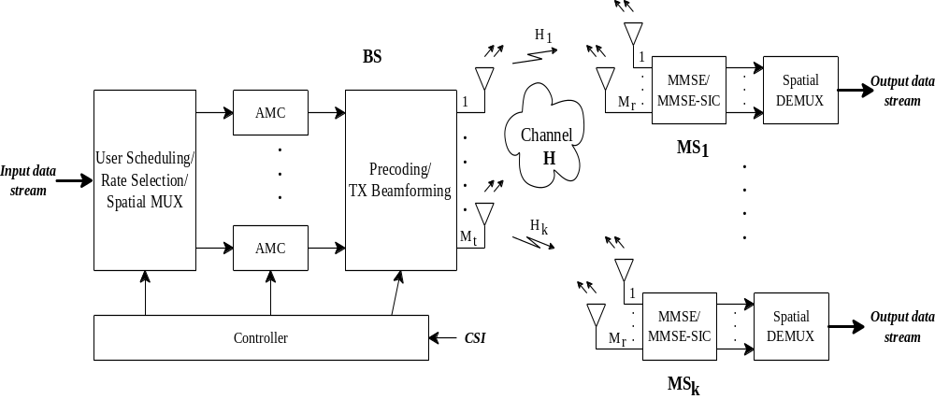
An MU-MIMO System
Antenna arrays
AMC: adaptive coding and modulation, or link adaptation
Chapter 2: Physical Layer

Slide 81
Applications of MIMO
EDGE: Enhanced Data rates for GSM Evolution
HSDPA: high speed downlink packet access
802.11N
Chapter 2: Physical Layer

Slide 82
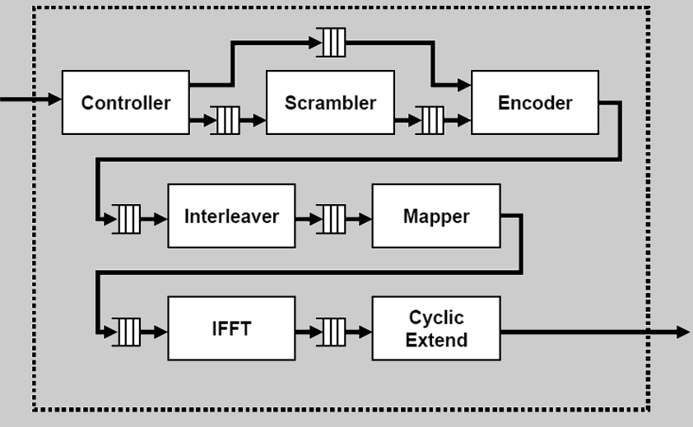
Open Source Implementation 2.2: 802.11a with OFDM (1/2)
Block Diagram: IEEE 802.11a Transmitter
  Controller: receives packets from MAC Layer
  Mapper: operates at the OFDM symbol level
  Cyclic Extender: extends the IFFT-ed symbol
Chapter 2: Physical Layer

Slide 83
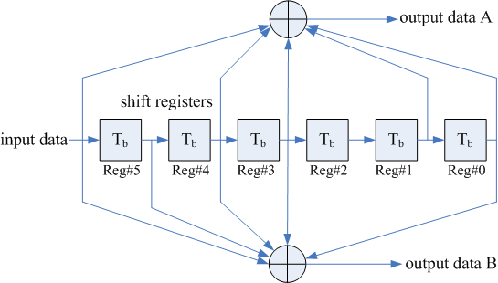
Open Source Implementation 2.2: 802.11a with OFDM (2/2)
The circuit of the convolutional encoder
  Defined in 802.11a
Chapter 2: Physical Layer

Slide 84
Historical Evolution: Cellular Standards
Cellular Standards | AMPS | GSM 850/900/ 1800/1900 | UMTS (WCDMA, 3GPP FDD/TDD) | LTE
Generation | 1G | 2G | 3G | Pre-4G
Radio signal | Analog | Digital | Digital | Digital
Modulation | FSK | GMSK/ 8PSK (EDGE only) | BPSK/QPSK/ 8PSK/16QAM | QPSK/16QAM/ 64QAM
Multiple Access | FDMA | TDMA/FDMA | CDMA/TDMA | DL:OFDMA UL:SC-FDMA
Duplex (Uplink/Downlink) | n/a | FDD | FDD/TDD | FDD+TDD (FDD focus)
Channel bandwidth | 30 kHz | 200kHz | 5MHz | 1.25/2.5/5/10/ 15/20MHz
Number of channels | 333/666/832 channels | 124/124/ 374/299 (8 users per channel) | Depends on services | >200 users per cell (for 5 MHz spectrum)
Peak Data Rate | Signaling rate = 10 kbps | 14.4 kbps 53.6 kbps(GPRS) 384 kbps(EDGE) | 144 kbps (mobile)/ 384 kbps (pedestrian)/ 2 Mbps (indoors)/ 10Mbps (HSDPA) | DL:100 Mbps UL:50 Mbps (for 20 MHz spectrum)
Chapter 2: Physical Layer

Slide 85
Historical Evolution: LTE-advanced vs. WiMAX-m
Feature | Mobile WiMAX(3G) (IEEE802.16e) | WiMAX-m(4G) (IEEE 802.16m) | 3GPP-LTE (pre-4G) (E-UTRAN) | LTE-advanced (4G)
Multiple Access | WirelessMAN-OFDMA | WirelessMAN-OFDMA | DL: OFDMA UL: SC-FDMA | DL: OFDMA UL: SC-FDMA
Peak Data Rate (TX × RX) | DL: 64 Mbps (2×2) UL: 28 Mbps (2×2 collaborative MIMO) (10 MHz) | DL: > 350 Mbps (4×4) UL: >200 Mbps (2×4) (20 MHz) | DL: 100Mbps UL: 50Mbps | DL: 1 Gbps UL: 500 Mbps
Channel Bandwidth | 1.25/5/10/20 MHz | 5/10/20 MHz and more (scalable bandwidths) | 1.25-20MHz | Band aggregation (chunks, each 20 MHz)
Coverage (cell radius, cell size) | 2-7 km | Up to 5 km (optimized) 5 -30 km (graceful degradation in spectral efficiency) 30 – 100 km (system should be functional) | 1-5 km (typical) Up to 100 km | 5km (optimal) 30 km (reasonable performance), up to 100 km (acceptable performance)
Mobility | Up to 60 ~ 120 km/h | 120-350 km/h, up to 500 km/h | Up to 250 km/h | 350 km/h , up to 500 km/h
Spectral Efficiency (bps/Hz) (TX × RX) | DL: 6.4 (peak) UL: 2.8 (peak) | DL: >17.5 (peak) UL: > 10 (peak) | 5 bps/Hz | DL: 30 (8×8) UL: 15 (4×4)
MIMO (TX×RX) (antenna techniques) | DL: 2×2 UL: 1×N (Collaborative SM) | DL: 2×2/2×4/4×2/4×4 UL: 1×2/1×4/2×2/2×4 | 2×2 | DL: 2×2/4×2/4×4/8×8 UL: 1×2/2×4
Legacy | IEEE802.16a ~d | IEEE802.16e | GSM/GPRS/EGPRS/ UMTS/HSPA | GSM/GPRS/EGPRS/ UMTS/HSPA/LTE
Chapter 2: Physical Layer

Slide 86
2.6 Summary
Popular line coding schemes, where self-synchronization dominates the game
Basic to advanced modulation schemes, delivering more bits under a given bandwidth and SNR
For wired links, QAM, WDM, and OFDM are considered advanced
For vulnerable wireless links, OFDM, MIMO, and smart antenna are now the preferred choices
Chapter 2: Physical Layer

