Slide 1
Computer Networks
An Open Source Approach
Chapter 3: Link Layer
Ying-Dar Lin, Ren-Hung Hwang, Fred Baker
Chapter 3: Link Layer

Slide 2
Content
3.1 General issues
3.2 Point-to-point protocol
3.3 Ethernet (IEEE 802.3)
3.4 Wireless links
3.5 Bridging
3.6 Device drivers of a network interface
3.7 Summary
Chapter 3: Link Layer

Slide 3
3.1 General Issues
Framing
Addressing
Error control
Flow control
Medium access control
Chapter 3: Link Layer

Slide 4
Data-link Layer Protocols
Provide direct communications over the physical channel and services to the network layer
Categories of major data-link protocols
 | PAN/LAN | MAN/WAN
Obsolete or Fading away | Token bus (802.4) Token ring (802.5) HIPPI Fiber Channel Isochronous (802.9) Demand Priority (802.12) ATM FDDI HIPERLAN | DQDB (802.6) B-ISDN HDLC X.25 Frame Relay SMDS ISDN
Mainstream or Still active | Ethernet (802.3) WLAN (802.11) Bluetooth (802.15) Fiber channel HomeRF HomePlug | Ethernet (802.3) Point-to-Point Protocol (PPP) DOCSIS xDSL SONET Cellular(3G, LTE, WiMAX(802.16)) Resilient Packet Ring (802.17) ATM
Chapter 3: Link Layer

Slide 5
Framing
Typical fields in the frame format
  address
  length
  type of upper layer protocol
  payload
  error detection code
Basic unit of a frame
  byte (e.g., Ethernet frame) → byte-oriented
  bit (e.g., HDLC frame) → bit-oriented
Chapter 3: Link Layer

Slide 6
Frame Delimit
Methods to delimit a frame
  Special sentinel characters
    e.g. STX (Start of text), ETX (End of text)
  Special bit pattern
    e.g. a bit pattern 01111110
  Special coding in physical layer
    e.g. /J/K/ and /T/R/ code group in 100BASE-X
Bit (or byte) stuffing to avoid ambiguity
Chapter 3: Link Layer

Slide 7
Bit-Stuffing and Byte-Stuffing
start of a frame
data-link-escape
end of a frame
end of a frame
STX
A
C
H
A
R
DLE
ETX
CRC
ETX
(a) byte-stuffing
start of a frame
stuffing bit
stuffing bit
0111111001011100011101111100000110111001101010101010101111101011 …
five consecutive 1’s
five consecutive 1’s
(b) bit-stuffing
Chapter 3: Link Layer

Slide 8
IEEE 802 MAC Address
MAC address
First byte Second byte Third byte Fourth byte Fifth byte Sixth byte
Organization-Unique Identifier(OUI)
Organization-Assigned Portion
0: unicast address
1: multicast address
First bit transmitted
Transmission order of bits in each byte
Little-Endian: e.g., Ethernet
Big-Endian: e.g., FDDI, Token Ring
Chapter 3: Link Layer

Slide 9
Error Detection Code
  Checksum
    Transmitter: add all words and transmit the sum
    Receiver: add all words and check the sum
  Cyclic Redundancy Check (CRC)
    Transmitter: Generate a bit sequence by modulo 2 division
    Receiver: Divide the incoming frame and check if no remainder
  CRC for link layer and checksum for IP/TCP/UDP
    CRC: easy implementation in hardware, but not in software; more robust to errors
    Checksum: just a double-check against nodal errors
Chapter 3: Link Layer

Slide 10
Cyclic Redundancy Check
frame content: 11010001110(11 bits)
pattern: 101011 (6 bits)
frame check sequence = (5 bits)
11100000111
11100000111
101011
1101000111000000
101011
1101000111010001
frame check sequence
101011
101011
111110
111110
101011
101011
101011
110000
101011
110110
101011
0
correct
111010
101011
10001
the remainder
Hardware implementation
C_{n-1}
C_{n-2}
C₁
C₀
frame bits
a_{n-1}
a₂
a₁
Chapter 3: Link Layer

Slide 11
Open Source Implementation 3.1 & 3.2: Checksum & Hardware CRC32
sum
checksum
1’s complement addition
folding
16-bit word
checksum = 0 (initially)
crc_next[31:0]
CRC
crc[31:0]
data[3:0]
crc= 32'hffffffff (initially)
Chapter 3: Link Layer

Slide 12
Error Control
Receiver response to incoming frame
Silently discard when the incoming frame is corrupt
Positive acknowledgement when the incoming frame is correct
Negative acknowledgement when the incoming frame is corrupt
Chapter 3: Link Layer

Slide 13
Flow Control
Keep fast transmitter from overwhelming slow receiver
Solutions:
  stop and wait
  sliding window protocol
  back pressure
  PAUSE frame
Chapter 3: Link Layer

Slide 14
Sliding Window over Transmitted Frames
window size (9 frames)
1
2
3
4
5
6
7
8
9
10
11
12
sent frames
frames to be sent
acknowledged frames
window size (9 frames)
1
2
3
4
5
6
7
8
9
10
11
12
sent frames
frames to be sent
Chapter 3: Link Layer

Slide 15
Why MAC?
Stands for “Medium Access Control”
An arbitration mechanism is needed for media shared by multiple stations
e.g., CSMA/CD, CSMA/CA, …
Services in MAC sublayer
  Data encapsulation
  Medium access management
Chapter 3: Link Layer

Slide 16
Bridging
Interconnecting LANs to extend coverage
Defined in IEEE 802.1D
Whether and where to forward an incoming frame?
  Plug-and-play: by self learning of MAC addresses
  Loop in topology: “confused” learning
  Logical spanning tree to eliminate loops
Chapter 3: Link Layer

Slide 17
Open Source Implementation 3.3: Link-Layer Packet Flows in Call Graphs
IP
Network layer
ip_rcv
ipv6_rcv
arp_rcv
ip_finish_output2
Device driver
netif_receive_skb
net_tx_action
qdisc_run
Link layer
poll(process_backlog)
dqueue_skb
net_rx_action
q→dequeue
Medium Access Control (MAC)
PHY
Physical link
Chapter 3: Link Layer

Slide 18
3.3 Point-to-Point Protocols
HDLC
PPP
LCP
IPCP
PPPoE
Chapter 3: Link Layer

Slide 19
PPP Categories
broad purposes; serve as the basis of many data link protocols
point-to-point or point-to-multipoint; primary – secondary model
Operations: NRM, ARM, ABM
HDLC
build a PPP link over Ethernet
for access control and billing
discovery stage → PPP session
carry multi-protocol datagrams over point-to-point link
point-to-point only; peer-peer model
LCP → NCP → carry datagrams
PPP
PPPoE
establish, configure, test PPP connection
followed by an NCP
LCP
NCP
establish and configure different layer protocols
followed by datagram transmission
A kind of NCP for IP
establish and configure IP protocol stacks on both peers
followed by IP datagrams transmission
is inherited from
is part of
is related to
IPCP
Chapter 3: Link Layer

Slide 20
High-level Data Link Control (HDLC)
A synchronous, reliable, full-duplex data delivery protocol
Bit-oriented frame format
bits 8 8 8 Any 16 8
Types of frames: information, supervisory, unnumbered
Used on peer-to-peer WAN link
Flag | Address | Control | Information | FCS | Flag
Chapter 3: Link Layer

Slide 21
Point-to-Point Protocol (PPP)
Carry multi-protocol datagrams over point-to-point link
Main components in PPP
  Encapsulation
    to encapsulate multi-protocol datagrams
  Link Control Protocol (LCP)
    to establish, configure, and test data-link connection
  A family of Network Control Protocols (NCP)
    to establish, configure network-layer protocols
Flag 01111110 | Address 11111111 | Control 00000011 | Protocol | Information | FCS | Flag 01111110
bits 8 8 8 8 or 16 Any 16 or 32 8
Chapter 3: Link Layer

Slide 22
PPP Operations
Link up by carrier detection or user configuration
Send LCP packets to configure and test data link
Peers can authenticate each other
Exchange NCP packets to configure one or more network-layer protocols
Link remains operational until explicit close by LCP, NCP or the administrator
1.
2.
3.
Up
Open
Authenticate
Success/None
Dead
Establish
Fail
Fail
Down
5.
4.
Close
Terminate
Network
Chapter 3: Link Layer

Slide 23
Link Control Protocol
Negotiate data link protocol options during the Establish phase.
Frame format : PPP frame with Protocol type 0xc021.
LCP operations
Class | Type | Function
Configuration | Configure-request | Open a connection by giving desired changes to options
 | Configure-ack | Acknowledge Configure-request
 | Configure-nak | Deny Configure-request because of unacceptable options
 | Configure-reject | Deny Configure-request because of unrecognizable options
Termination | Terminate-request | Request to close the connection
 | Terminate-ack | Acknowledge Terminate-request
Maintenance | Code-reject | Unknown requests from the peer
 | Protocol-reject | Unsupported protocol from the peer
 | Echo-request | Echo back the request (for debugging)
 | Echo-reply | The echo for Echo-request (for debugging)
 | Discard-request | Just discard the request (for debugging)
Configurable options: Maximum-Receive-Unit, Authentication-Protocol, Quality-Protocol, Magic-Number, Protocol-Field-Compression, Address-and-Control-Field-Compression
Chapter 3: Link Layer

Slide 24
Internet Protocol Control Protocol
An NCP to establish and configure IP protocol stacks over PPP
Frame format : PPP frame with Protocol type 0x8021.
IPCP operations
Class | Type | Function
Configuration | Configure-request | Open a connection by giving desired changes to options
 | Configure-ack | Acknowledge Configure-request
 | Configure-nak | Deny Configure-request because of unacceptable options
 | Configure-reject | Deny Configure-request because of unrecognizable options
Termination | Terminate-request | Request to close the connection
 | Terminate-ack | Acknowledge Terminate-request
Maintenance | Code-reject | Unknown requests from the peer
configurable options: IP-Compression-Protocol, IP-Address
Chapter 3: Link Layer

Slide 25
PPP over Ethernet (PPPoE)
Allows multiple stations in an Ethernet LAN to open PPP sessions to multiple destinations via bridging device.
Why PPPoE instead of IP over Ethernet?
  access control and billing in the same way as dial-up services using PPP.
Frame format : Ethernet frame with PPP frame in the payload
PPPoE operations
  Discovery stage
  PPP session stage
    Identify the Ethernet MAC address of the peer
    Establish a PPPoE Session-ID
    LCP
    IPCP
    IP over PPP data transmission
Chapter 3: Link Layer

Slide 26
Open Source Implementation 3.4: PPP Drivers
PPP Architecture
pppd
kernel
pppd | handles control-plane packets
kernel | handles data-plane packets
ppp generic layer | handles PPP network interface, /dev/ppp device, VJ compression, multilink
ppp channel driver | handles encapsulation and framing
ppp generic layer
ppp channel driver
tty device driver
serial line
Chapter 3: Link Layer

Slide 27
Outgoing Flow
ppp_start_xmit : put 2-byte ppp protocol
number on the front of skb
ppp_write : to take out the file->private_data
ppp_file_write : allocate skb , copy data
from user space , to ppp channel or ppp unit
ppp_xmit_process : to do any work queued
up on the transmit side that can be done now
ppp_channel_push : send data out on a channel
ppp_send_frame : VJ compression
ppp_push : handles multiple link
start_xmit : ppp_sync_send
ppp_sync_send : send a packet over an tty line
ppp_sync_tx_munge : framing
ppp_sync_push : push as mush as posibble
tty->driver.write : write data to device driver
/dev/ppp
ppp0
ppp_write
ppp_start_xmit
ppp_file_write
ppp_channel_push
ppp_xmit_process
ppp_send_frame
ppp_push
start_xmit
ppp_sync_send
ppp_sync_txmunge
ppp_sync_push
tty->driver.write
tty device driver
Chapter 3: Link Layer

Slide 28
Incoming Flow
ppp_sync_receive : take out the tty->disc_data
ppp_sync_input : stuff the chars in the skb
process_input_packet : strip address/control field
ppp_input : take out the packets that should be in
the channel queue
ppp_do_recv : check if the interface closed down
ppp_receive_frame : decide if the received frame is
a multilink frame
ppp_receive_nonmp_frame : VJ decompression if
proto == PPP_VJC_COMP , and decide it’s a control
plane frame or data plane frame
ppp_receive_mp_frame : reconstruction of multilink
frames
netif_rx : push packets into the queue for kernel
skb_queue_tail : push packets into the queue for
pppd
/dev/ppp
ppp0
skb_queue_tail
netif_rx
ppp_receive_nonmp_frame
ppp_receive_mp_frame
ppp_receive_frame
ppp_do_recv
ppp_input
ppp_input
process_input_packet
ppp_sync_input
ppp_sync_receive
tty device driver
Chapter 3: Link Layer

Slide 29
3.4 Ethernet (IEEE 802.3)
Ethernet evolution: A big picture
The Ethernet MAC
Selected topics in Ethernet
Chapter 3: Link Layer

Slide 30
Ethernet Evolution: A Big Picture
From low to high speed
From shared to dedicated media
From LAN to MAN and WAN
The medium is getting richer
Chapter 3: Link Layer

Slide 31
Milestones in Ethernet Standards
DIX Ethernet
Spec ver. 1
10 Mb/s Ethernet
DIX Ethernet
Spec ver. 2
IEEE 802.3
10BASE5
3 Mb/s experimental
Ethernet
DIX Consortium
formed
1973
1980
1981
1982
1983
Full-duplex
Ethernet
100BASE-T
10BASE-F
10BASE-T
10BASE2
1997
1995
1993
1990
1985
1000BASE-X
1000BASE-T
Link aggregation
10GBASE on fiber
Ethernet in the
First Mile
1998
1999
2000
2002
2003
40G and 100G
development
10GBASE-T
2008
2006
Chapter 3: Link Layer

Slide 32
IEEE 802.3 Physical Specifications
medium speed | Coaxial cable | Twisted pairs | Fiber
under 10 Mb/s |  | 1BASE5 (1987) 2BASE-TL (2003)
10 Mb/s | 10BASE5 (1983) 10BASE2 (1985) 10BROAD36 (1985) | 10BASE-T (1990) 10BASE-TS (2003) | 10BASE-FL (1993) 10BASE-FP (1993) 10BASE-FB (1993)
100 Mb/s |  | 100BASE-TX (1995) 100BASE-T4 (1995) 100BASE-T2 (1997) | 100BASE-FX (1995) 100BASE-LX/BX10 (2003)
1 Gb/s |  | 1000BASE-CX (1998) 1000BASE-T (1999) | 1000BASE-SX (1998) 1000BASE-LX (1998) 1000BASE-LX/BX10 (2003) 1000BASE-PX10/20 (2003)
10 Gb/s |  | 10GBASE-T (2006) | 10GBASE-R (2002) 10GBASE-W (2002) 10GBASE-X (2002)
Chapter 3: Link Layer

Slide 33
The IEEE 802.3/Ethernet MAC
Application
Presentation
Session
Transport
Network
Data-link
Physical
Purposes
Data encapsulation, transmit, receive
Medium access management
Higher layers
Logical Link Control (LLC)
Link Aggregation (optional)
LLC
MAC Control (optional)
MAC Control (optional)
MAC Control (optional)
MAC sublayer
MAC sublayer
MAC sublayer
MAC
Ethernet PHY
Ethernet PHY
Ethernet PHY
OSI model
Chapter 3: Link Layer

Slide 34
IEEE 802.3/Ethernet MAC Frame Format
Untagged frame
Preamble | SFD | DA | SA | T/L | Data | FCS
bytes 7 1 6 6 2 46 - 1500 4
Tagged frame
Preamble | SFD | DA | SA | VLAN protocol ID | Tag control | T/L | Data | FCS
bytes 7 1 6 6 2 2 2 42 - 1500 4
SFD: Start-of-Frame Delimit
DA: Destination Address
SA: Source Address
T/L: Type/Length (Ethernet/802.3)
FCS: Frame Check Sequence
Frame size:
Untagged frame : 64 – 1518 bytes
Tagged frame : 64 – 1522 bytes
Chapter 3: Link Layer

Slide 35
Frame Transmission and Reception
MAC client (IP, LLC, etc.)
data encapsulation data decapsulation
transmit medium management receive medium management
MAC sublayer
transmit data encoding receive data decoding
line signal
Physical layer
Chapter 3: Link Layer

Slide 36
An Example of Frame Transmission
Example: 100BASE-TX
Octet : b₇ b₆ b₅ b₄ b₃ b₂ b₁ b₀
Interframe gap
Preamble/SFD DA SA T/L Payload FCS
Interframe gap
62 bits
spaced in octet
32 bits
Transmission bits
10101010…..1010101011
Little Endian transmission order: low-order bit first, byte by byte
8 bits
0000 → 11110 0001 → 10010 0010 → 01010 0011 → 11010
0100 → 10100 0101 → 10110 0110 → 01110 0111 → 11100
1000 → 01001 1001 → 10011 1010 → 01011 1011 → 11011
1100 → 10101 1101 → 10111 1110 → 01111 1111 → 11101
4B/5B block coding
11000 10001 01101 10001 1111111111111…
/J/K/ code group
/T/R/ code group idle signal
Start of Stream Delimit (SSD)
End of Stream Delimit (ESD)
scrambler
Scramble bit by bit with shift register and XOR gate; to reduce EMI
NRZI
……..
1 1 1 0 0 1 1 0 1 0 1 1 0 0
……..
MLT-3
carried on CAT-5 UTP with fundamental frequency 31.25 MHz
Chapter 3: Link Layer

Slide 37
CSMA/CD
Carrier sense
  Listen before transmitting
Multiple access
  Multiple stations over common transmission channel
Collision detection
  More than one station transmitting over
  the channel. Stop and back off.
Chapter 3: Link Layer

Slide 38
CSMA/CD MAC Transmit/Receive Flow
Transmit Process
Receive process
Assemble frame
Start receiving
yes
no
Receiving done?
Half duplex and
channel busy?
yes
no
yes
Receiving frame
too small?
Wait interframe gap
no
Start transmission
no
Recognize address?
no
yes
Half duplex and
Collision detected?
yes
Frame too long?
yes
Send jam
Transmission done
no
no
Increment attempts
Valid FCS?
no
yes
no
yes
no
yes
Proper octet boundary?
Too many attempts?
Successful transmission
yes
Transmission fail
backoff
Successful reception
Receive error
Chapter 3: Link Layer

Slide 39
Maximum Frame Rate
A minimum frame occupies
7 bytes Preamble + 1 byte SFD
64 bytes minimum frame size
12 bytes Inter-frame gap (IFG)
In a 10 Mb/s system,
maximum frame rate = 10*10⁶ / ((7+1+64+12)*8)
= 14,880 frames / s
100 Mb/s system → 148,809 frames / s
1 Gb/s system → 1,488,095 frames / s
Chapter 3: Link Layer

Slide 40
Half-Duplex vs. Full-Duplex
Half-duplex
Only one station can transmit over common transmission channel (CSMA/CD needed)
Full-duplex (IEEE 802.3x, 1997)
Simultaneous transmission between a pair of stations with a point-to-point channel (no CS, MA, or CD)
Three necessary and sufficient conditions for full-duplex
Simultaneous transmission and reception without interference
Dedicated point-to-point link with exactly two stations
Both stations capable and configured in full-duplex mode
Chapter 3: Link Layer

Slide 41
Flow Control in Ethernet
Back pressure – for half-duplex Ethernet
  False carrier
  Force collision
PAUSE frame – for full-duplex Ethernet
  A PAUSE frame (IEEE 802.3x) sent from the receiver to the transmitter
Chapter 3: Link Layer

Slide 42
New Blood: Gigabit Ethernet
Specified by IEEE 802.3z(1998) and 802.3ab(1999)
Task Forces | Specification name | Description
IEEE 802.3z (1998) | 1000BASE-CX | 25 m 2-pair Shielded Twisted Pairs (STP) with 8B/10B encoding
 | 1000BASE-SX | Multi-mode fiber using short-wave laser with 8B/10B encoding up to 550 m
 | 1000BASE-LX | Multi- or single-mode fiber using long-wave laser with 8B/10B encoding up to 5000 m
IEEE 802.3ab (1999) | 1000BASE-T | 100 m 4-pair Category 5 (or better) Unshielded Twisted Pairs (UTP) with 8B1Q4 encoding
Chapter 3: Link Layer

Slide 43
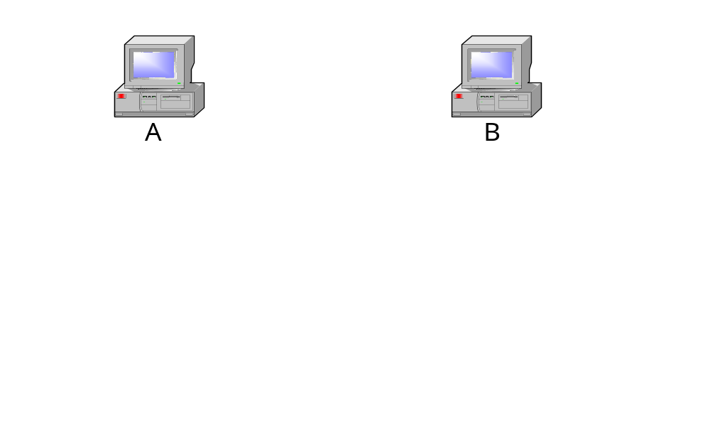
Challenge in Half-Duplex Gigabit Ethernet Design
Solution:
carrier extension, frame bursting
However, half-duplex Gigabit Ethernet is a failure
Only full-duplex Gigabit Ethernet exists in the market
1. Transmit a minimum frame
May transmit before t, but will have collision
Propagation time = t
3. A detects collision at 2t
frame from A
collision domain extent
frame from B
2. Transmit just before t
Principle: round-trip time 2t < time to transmit a minimum frame
Chapter 3: Link Layer

Slide 44
New Blood: 10 Gigabit Ethernet
Specified by IEEE 802.3ae (2002)
Design features
  Full-duplex only
  Compatible with existing Ethernet standards
  Move toward WAN market
  (Long distance, WAN interface with OC-192)
Code name | Wave length | Transmission distance (m)
10GBASE-LX4 | 1310 nm | 300
10GBASE-SR | 850 nm | 300
10GBASE-LR | 1310 nm | 10,000
10GBASE-ER | 1550 nm | 10,000
10GBASE-SW | 850 nm | 300
10GBASE-LW | 1310 nm | 10,000
10GBASE-EW | 1550 nm | 40,000
Chapter 3: Link Layer

Slide 45
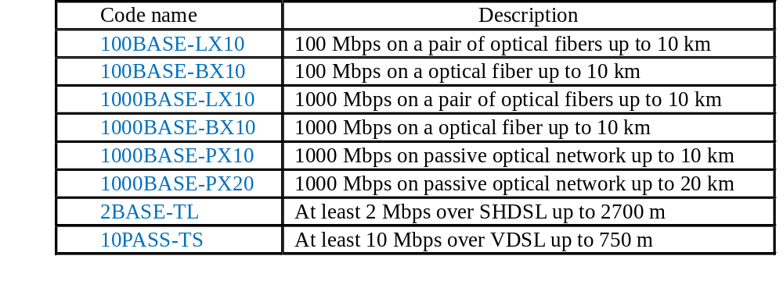
New Blood: Ethernet in the First Mile
IEEE 802.3ah finalized in 2003.
Target at subscriber access network
Development goals
  New Topologies: point-to-point fiber, point-to-multipoint fiber, point-to-point copper
  New PHYs: 1000BASE-X extension, Ethernet PON, voice-grade copper
  OAM: remote failure indication, remote loopback, link monitoring
Chapter 3: Link Layer

Slide 46
Open Source Implementation 3.5: CSMA/CD
Totally five modules :
- Host Interface Module
- TX Ethernet MAC ( transmit function )
- RX Ethernet MAC ( receive function )
- MAC Control Module
- MII Management Module
Transmit, Receive, and MAC control modules form the MAC module
For the complete Ethernet solution, an external PHY is needed
Chapter 3: Link Layer

Slide 47
Open Source Implementation 3.5 (cont)
Architecture
Wishbone bus
Ethernet
Core
Host Interface
(Registers, WISHBONE interface, DMA support)
Tx control
signals
Tx control
signals
Rx control
signals
MAC
control
signals
TX data
RX data
MII
Management
Module
RX Ethernet MAC
MAC Contrul Module
(Flow control)
TX Ethernet MAC
Management
data
Rx PHY
control signals
Tx PHY
control signals
RX data
TX data
Ethernet PHY
Ethernet
Chapter 3: Link Layer

Slide 48
Open Source Implementation 3.5 (cont) Functions (1/2)
Host Interface Module
- Configuration registers
- DMA operation
- Transmit and receive status
TX Ethernet MAC
- Generation of control and status signals
- Random time generation , used in the back-off process
- CRC generation
- Pad generation
- Data nibble generation
- Inter Packet Gap
- Monitoring CarrierSense and collision signals
RX Ethernet MAC
- Generation of control and status signals
- Preamble removal
- Data assembly
- CRC checking
Chapter 3: Link Layer

Slide 49
Open Source Implementation 3.5 (cont) Functions (2/2)
MAC Control Module
- Control frame detection and generation
- TX/RX MAC interface
- PAUSE timer
- Slot timer
MII Management Module
- Operation controller
- Shift registers
- Output control module
- Clock generator
Chapter 3: Link Layer

Slide 50
Open Source Implementation 3.5 (cont)
I/O Ports (1/2)
Host Interface ports ( Signal direction is in respect to the Ethernet IP Core )
Port | Width | Directioin | Description
DATA_I | 32 | I | Data input
DATA_O | 32 | O | Data output
REQ0 | 1 | O | DMA request to channel 0
REQ1 | 1 | O | DMA request to channel 1
ACK0 | 1 | I | DMA ack channel 0
ACK1 | 1 | I | DMA ack channel 1
INTA_O | 1 | O | Interrupt output A
Chapter 3: Link Layer

Slide 51
Open Source Implementation 3.5 (cont)
I/O Ports (2/2)
PHY Interface ports
Port | Width | Directioin | Description
MTxClK | 1 | I | Transmit nibble clock
MTxD[3:0] | 4 | O | Transmit data nibble
MTxEn | 1 | O | Transmit enable
MRxClK | 1 | I | Receive nibble clock
MRxDV | 1 | I | Receive data valid
MRxD[3:0] | 4 | I | Receive data nibble
MColl | 1 | I | Collision detected
MCrS | 1 | I | Carrier sense
Chapter 3: Link Layer

Slide 52
Open Source Implementation 3.5 (cont) Registers
Name | Address | Width | Access | Description
MODER | 0x00 | 32 | RW | Mode register
INT_SOURCE | 0x01 | 32 | RW | Interrupt source register
IPGT | 0x03 | 32 | RW | Inter packet gap register
PACKETLEN | 0x06 | 32 | RW | Packet length register
COLLCONF | 0x07 | 32 | RW | Collision and retry configuration
MAC_ADDR0 | 0x11 | 32 | RW | MAC address ( LSB 4 bytes )
MAC_ADDR1 | 0x12 | 32 | RW | MAC address ( MSB 2 bytes )
Chapter 3: Link Layer

Slide 53
Open Source Implementation 3.5 (cont)
TX State Machine
Data[0]
Backoff
Jam
Data[1]
Defer
IFG
Preamble
PAD
TxDone
Idle
FCS
Chapter 3: Link Layer

Slide 54
Open Source Implementation 3.5 (cont)
CSMA/CD
CarrierSense and Collision signals are provided from PHY
assign StartDefer = StateIFG & ~Rule1 & CarrierSense & NibCnt[6:0] <= IPGR1 & NibCnt[6:0] != IPGR2
| StateIdle & CarrierSense
| StateJam & NibCntEq7 & (NoBckof | RandomEq0 | ~ColWindow | RetryMax)
| StateBackOff & (TxUnderRun | RandomEqByteCnt)
| StartTxDone | TooBig;
assign StartData[1] = ~Collision & StateData[0] & ~TxUnderRun &
~MaxFrame;
assign StartJam = (Collision | UnderRun) & ((StatePreamble & NibCntEq15)
|(|StateData[1:0]) | StatePAD | StateFCS);
assign StartBackoff = StateJam & ~RandomEq0 & ColWindow & ~RetryMax
& NibCntEq7 & ~NoBckof;
Chapter 3: Link Layer

Slide 55
Open Source Implementation 3.5 (cont)
Transmit Nibble
always @ (StatePreamble or StateData or StateData or StateFCS or StateJam or
StateSFD or TxData or Crc or NibCnt or NibCntEq15)
begin
if(StateData[0]) MTxD_d[3:0] = TxData[3:0]; // Lower nibble
else
if(StateData[1]) MTxD_d[3:0] = TxData[7:4]; // Higher nibble
else
if(StateFCS) MTxD_d[3:0] = {~Crc[28], ~Crc[29], ~Crc[30], ~Crc[31]}; // Crc
else
if(StateJam) MTxD_d[3:0] = 4'h9; // Jam pattern
else
if(StatePreamble)
if(NibCntEq15) MTxD_d[3:0] = 4'hd; // SFD
else MTxD_d[3:0] = 4'h5; // Preamble
else MTxD_d[3:0] = 4'h0;
end
Chapter 3: Link Layer

Slide 56
Open Source Implementation 3.5 (cont)
RX State Machine
Preamble
SFD
Drop
Idle
Data0
Data1
Chapter 3: Link Layer

Slide 57
3.5 Wireless Links
WLAN: Wi-Fi (IEEE 802.11)
WPAN: Bluetooth (IEEE 802.15)
WMAN: WiMAX (IEEE 802.16)
Chapter 3: Link Layer

Slide 58
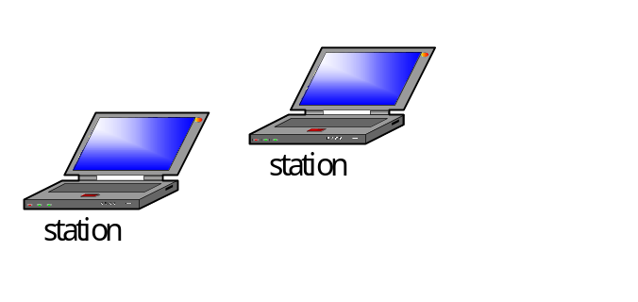
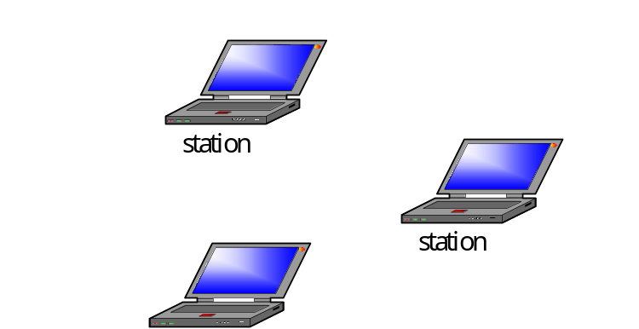
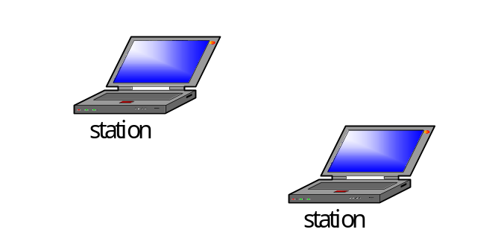
IEEE 802.11 (Wireless LAN) Topology
Basic Service Set
(BSS)
AP
Basic Service Set
(BSS)
Distribution system
(can be any type of LAN)
Access Point (AP)
Independent Basic Service Set
(IBSS)
Also ad hoc network
Infrastructure
Ad hoc network
Chapter 3: Link Layer

Slide 59
IEEE 802.11 Layering
802.2 LLC |  |  |  | Data-link layer
802.11 MAC
FHSS | DSSS | IR | OFDM | Physical layer
FHSS: Frequency Hopping Spread Spectrum
DSSS: Direct Sequence Spread Spectrum
OFDM: Orthogonal Frequency Division Multiplexing
IR: Infra Red
Operate at ISM band
Operates at U-NII band
Chapter 3: Link Layer

Slide 60
WLAN Evolution: Speed and Functionality
Speed
  1 and 2 Mbps (IR, DSSS, FHSS)
    5.5 and 11 Mbps (11b by DSSS at 2.4 GHz)
    54Mbps (11a, 5 GHz, and 11g, 2.4 GHz, by OFDM)
    300 Mbps (11n by MIMO-OFDM at 5 GHz)
Functionality
  11e: QoS, 11i: enhanced security, 11s: mesh, 11k and 11r: roaming (measures and hand-off)
Chapter 3: Link Layer

Slide 61
DCF vs. PCF
DCF (Distributed Coordination Function)
  CSMA/CA approach
  Physical and virtual carrier sense
PCF (Point Coordination Function)
  Point Coordinator (PC) arbitration (in AP)
  Contention-Free Period (CFP) is reserved
  Station transmits when polled by PC
Chapter 3: Link Layer

Slide 62
CSMA/CA
Carrier sense
  Deferral before transmitting
Collision avoidance
  Random backoff when a busy channel becomes free
MAC-level acknowledgement
  Retransmit if no ACK
Why not collision detection? (or why not CSMA/CD in WLAN?)
  Full-duplex RF → expensive
  Hidden terminal → collision not propagated over all stations
Chapter 3: Link Layer

Slide 63
Distributed Coordinate Function
yes
Receive process
Transmit Process
ACK received?
no
no
Channel active?
Assemble frame
Increment attempts
Successful
transmission
yes
yes
no
Too many attempts?
yes
yes
Start receiving
Channel busy?
no
Transmission
fail
Channel still active?
Wait interframe space
no
Receiving frame
too small?
yes
yes
Backoff timer > 0?
no
no
Generate a new
backoff time
Recognize address?
no
Wait backoff time
Valid FCS?
Start transmit
yes
* Send ACK only if the DA is unicast
Receive error
*Send ACK
Successful reception
Chapter 3: Link Layer

Slide 64
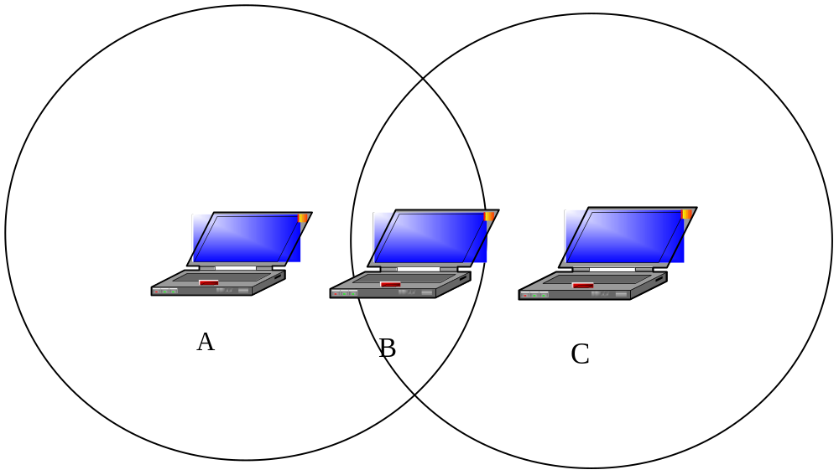
The Hidden Terminal Problem
Chapter 3: Link Layer

Slide 65
Virtual Carrier Sense (RTS/CTS)
C
A
B
D
C
RTS
C
A
CTS
B
D
E
E
A’s transmission range
B’s transmission range
A’s transmission range
B’s transmission range
Principle:
Collision-free period reserved by the duration field in RTS/CTS or data frame
Chapter 3: Link Layer

Slide 66
DCF/PCF Coexistence
CFP repetition period
Delay
CFP repetition period
Contention-Free Period (CFP)
Contention Period
Beacon
PCF
DCF
Busy
Beacon
PCF
DCF
time line
PC sends a beacon frame to reserve CFP (length controlled by PC)
Stations set their Network Allocation Vector (NAV) to reserve PCF
PCF followed by DCF
CFP repetition period may be delayed by busy channel
Chapter 3: Link Layer

Slide 67
IEEE 802.11 MAC Frame Format
General frame format
Frame control | Duration/ID | Address 1 | Address 2 | Address 3 | Sequence control | Address 4 | Frame body | FCS
bytes 2 2 6 6 6 2 6 0-2312 4
Frame types in IEEE 802.11: exact format depends on frame type
  Control frames (RTS, CTS, ACK…)
  Data frames
  Management frames
Frame control: frame type and other info
Duration/ID: expected busy period and BSS id
4 addresses: source/dest, transmitter/receiver (optional for bridging with an AP)
Sequence control: sequence number
Chapter 3: Link Layer

Slide 68
Open Source Implementation 3.6:
IEEE 802.11 MAC Simulation with NS-2
Link Layer Object
ARP
Layer 2
Interface Queue
MAC Object
Antenna Propagation Energy
Layer 1
802.11 PHY
Layer 0
CHANNEL
Layer 2
  Link Layer Object: LLC, works together with ARP
  Interface Queue: priority queuing to control messages
  MAC Object: CSMA/CA, unicast for RTS/CTS/DATA/ACK and broadcast for DATA
Layer 1: PHY (DSSS with 3 parameters to set)
Layer 0: delivers to neighbors within a range, passes frames to Layer 1
Chapter 3: Link Layer

Slide 69
NS-2 Source Code of 802.11 MAC
send_timer()
tx_resume()
retransmitRTS()
tx_resume()
start backoff timer
check_pktRTS()
transmit()
start send timer
deferHandler()
check_pktCTRL()
transmit()
start receive timer
check_pktTx()
transmit()
recvACK()
tx_resume()
callback_
rx_resume()
recv_timer()
recvRTS()
sendCTS()
tx_resume()
recvCTS()
tx_resume()
start defer
timer
rx_resume()
recvDATA()
sendCTS()
uptarget_
recv()
start defer
timer
rx_resume()
backoffHandler()
check_pktRTS()
transmit()
recv()
start receive timer
send()
sendDATA() and sendRTS()
start defer timer
5 entry functions triggered by events
send_timer(): called as transmit timer expires, retransmits RTS or DATA
recv_timer(): called as receive timer expires, i.e. a frame received, calls
corresponding functions to process ACK, RTS, CTS, or DATA
deferHandler(): called as defer time and back-off time expire, calls check_ to transmit
backoffHandler(): called as back-off timer expires, transmits RTS or DATA
recv(): called when ready to receive, starts receive timer; calls send (), which runs CSMA/CA, to transmit RTS or DATA
Chapter 3: Link Layer

Slide 70
An NS-2 Example of Two Mobile Nodes with TCP and FTP
FTP TCP agent
TCP sink
802.11 ad-hoc network
node 0
node 1
Chapter 3: Link Layer

Slide 71
Bluetooth Technology
Purpose: short-range radio links to replace cables connecting electronic devices
Operating in the 2.4 GHz ISM band with FHSS
Topology in Bluetooth
Two or more devices sharing the same channel form a piconet.
Two or more piconets form a scatternet.
Master (control channel access)
Slave
Master
Slave
Slave
Slave
Slave
Slave
Slave
piconet
scatternet
Chapter 3: Link Layer

Slide 72
Connection Setup in Bluetooth
Inquiry and Paging
2. Reply (after random backoff)
1. inquiry (broadcast)
Slave
3. paging
Master
Slave
Inquiry: device discovery
Paging: connection establishment
Slave
Chapter 3: Link Layer

Slide 73
Piconet Channel
1600 frequency hops per second with 1 MHz RF channel
A frame of 366 bits occupies a slot (payload: 366-72-54=240 bits = 30 bytes)
Slots can be reserved for voice in a synchronous link
Frames can occupy up to 5 slots to improve channel efficiency
Interleaved reserved/allocated slots
  Reserved: Synchronous for time-bounded info, e.g. voice (1 byte/0.125 ms → 30 bytes/3.75ms → 3.75ms/625μs = 1 out of 6 slots
  Allocated: Asynchronous and on-demand
Collision-free polling, reservation, and allocation
frame (366 bits)
Slot
Slot
Slot
625 us
1 second ( 1600 hops)
Chapter 3: Link Layer

Slide 74
Time Slots in the SCO Link and the ACL Link
SCO: Synchronous Connection-Oriented
ACL: Asynchronous Connectionless
SCO
ACL
SCO
SCO
ACL
ACL
SCO
SCO
Master
Slave 1
Slave 2
Chapter 3: Link Layer

Slide 75
Protocol Stack in Bluetooth
Application
software modules
L2CAP: channel establishment for higher layer protocols
HCI control: Interface to control Bluetooth chip
SDP: Service discovery and query for peer device
RFCOMM: RS-232 cable connection emulation
Service
discovery
protocol
PPP
HCI control
RFCOMM
Data
Audio
L2 CAP
Link Manager Protocol
Bluetooth chip
Baseband
RF: radio characteristics
Baseband: device discovery, link establishment
LMP: baseband link configuration and management
RF
Chapter 3: Link Layer

Slide 76
Historical Evolution: IEEE 802.11 vs. Bluetooth
 | IEEE 802.11 | Bluetooth
Frequency | 2.4 GHz (802.11, 802.11b) 5 GHz (802.11a) | 2.4GHz
Data rate | 1, 2 Mb/s (802.11) 5.5, 11 Mb/s (802.11b) 54 Mb/s (802.11a) | 1 – 3 Mb/s (53-480 Mb/s in proposal)
Range | round 100 m | within 1 - 100 m, depending on the class of power
Power consumption | higher (with 1W, usually 30 – 100 mW) | lower (1 mW – 100 mW, usually about 1mW)
PHY specification | Infrared OFDM FHSS DSSS | (adaptive) FHSS
MAC | DCF PCF | Slot allocation
Price | Higher | Lower
Major application | Wireless LAN | Short-range connection
Chapter 3: Link Layer

Slide 77
WiMAX Technology
IEEE 802.16-2003: fixed
IEEE 802.16e-2005: mobile
Differences with WLAN
  MAN vs. LAN
  2-11 GHz & 10-66 GHz vs. ISM band
  DOCSIS-like uplink/downlink allocation/scheudling vs. CSMA/CA
  OFDM PHY and OFDMA (symbols & sub-carriers) MAC vs. IR/FH/DS/OFDM and CSMA/CA
Chapter 3: Link Layer

Slide 78
WiMAX PHY and MAC
3 modes in PHY: all works with OFDMA
  Time Division Duplex (TDD)
  Frequency Division Duplex (FDD)
  Half-Duplex FDD
TDD subframe
  UL-MAP and DL-MAP for control messages
  Uplink/downlink data bursts as scheduled in MAP
  OFDMA slots: 3 symbols in uplink and 2 symbols in downlink
Uplink scheduling classes ~ DOCSIS
  UGS, rtPS, nrtPS, BE, ertPS
Chapter 3: Link Layer

Slide 79
TDD Sub-Frame Structure
DL_MAP_{n-1}
DL_MAP_{n}
DL_MAP_{n+1}
UL_MAP_{n-1}
UL_MAP_{n}
UL_MAP_{n+1}
Frame
control
Downlink
sub-frame
Uplink
sub-frame
Frame_{n-1}
Frame_{n}
Frame_{n+1}
Chapter 3: Link Layer

Slide 80
WiMAX Service Classes and the Corresponding QoS Parameters
Feature |  | UGS | ertPS | rtPS | nrtPS | BE
Request Size |  | Fixed | Fixed but changeable | Variable | Variable | Variable
Unicast Polling |  | N | N | Y | Y | N
Contention |  | N | Y | N | Y | Y
QoS Parameters | Min. rate | N | Y | Y | Y | N
 | Max. rate | Y | Y | Y | Y | Y
 | Latency | Y | Y | Y | N | N
 | Priority | N | Y | Y | Y | Y
Application |  | VoIP without silence suppression, T1/E1 | Video, VoIP with silence suppression | Video, VoIP with silence suppression | FTP, Web browsing | E-mail, message-based services
Chapter 3: Link Layer

Slide 81
3.6 Bridging
Self learning
Spanning tree protocol
VLAN
Chapter 3: Link Layer

Slide 82
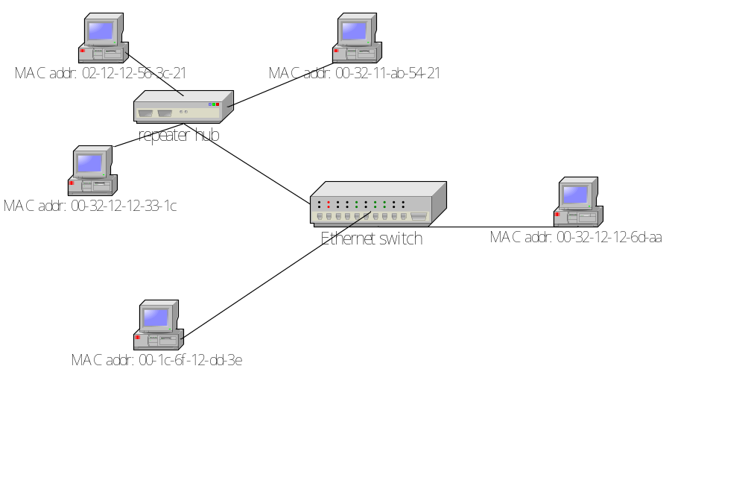
Ethernet Switch
Features of Ethernet switch
Transparent to stations
Self-learning
Separation of collision-domains
Forward to port 2
Dest MAC addr: 00-1c-6f-12-dd-3e
frame
Port 1
Port 3
Port 2
Address table
MAC address | port
00-32-12-12-6d-aa 00-1c-6f-12-dd-3e 00-32-11-ab-54-21 02-12-12-56-3c-21 00-32-12-12-33-1c | 3 2 1 1 1
Chapter 3: Link Layer

Slide 83
Historical Evolution: Store-and-forward vs. Cut-through
Store-and-forward | Cut-through
Transmit a frame after receiving completely | May transmit a frame before receiving completely
Slightly larger latency | May have slightly smaller latency
No problem for broadcast or multicast frames | Generally not possible for broadcast or multicast frames
Can check FCS in time | May be too late to check FCS
Mostly found in the market | Less popular in the market
Chapter 3: Link Layer

Slide 84
Open Source Implementation 3.7: Self-Learning Bridging
The Self-Leaning Process of a Forwarding Database
A | n
hash[br_mac_hash(A)]
src MAC =A
forwarding database
Chapter 3: Link Layer

Slide 85
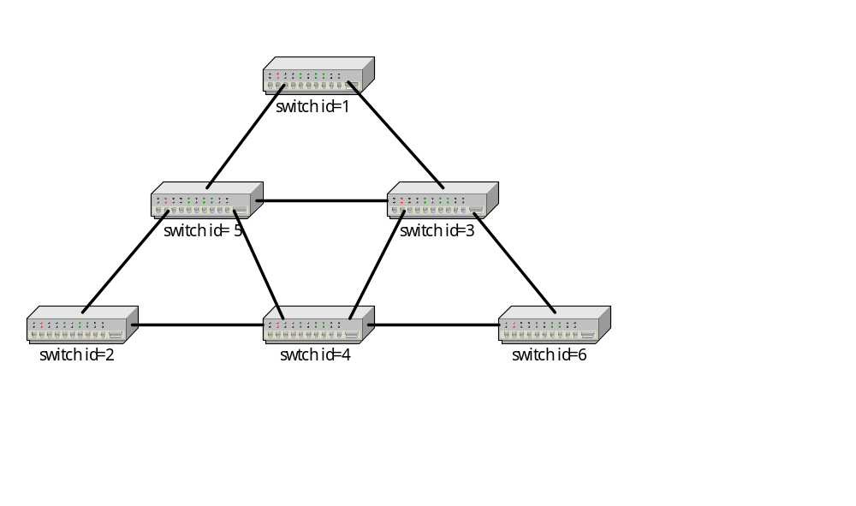
Spanning Tree Protocol
Purpose: Resolve loops in the bridged network
The switch with smallest id as the root
Propagate Configuration Info, including path cost, in BPDU to designated bridge
For each LAN (switch), the DP (RP) is selected as the port with the lowest path cost
If ties occur, select the switch (port) with the lowest id as the Designated switch, DP, or RP
All ports other than DP or RP are blocked
root
DP
DP
RP
RP
DP
DP
DP
DP
DP
RP
RP
RP
Smaller port id
DP
DP
RP: Root port
DP: Designated port
BPDU: Bridge Protocol Data Unit
Chapter 3: Link Layer

Slide 86
Open Source Implementation 3.8: Spanning Tree
Call flows of handling BPDU frames
br_stp_rcv
br_received_config_bpdu
br_record_config_information
br_configuration_update
br_port_state_selection
br_root_selection
br_designated_port_selection
Chapter 3: Link Layer

Slide 87
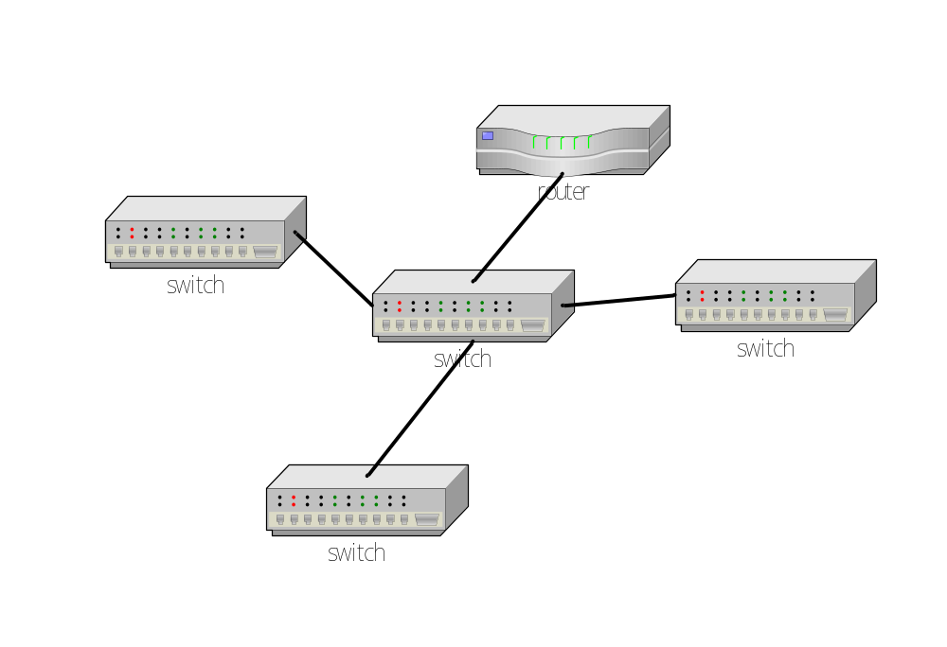
VLAN Deployment
specified in IEEE 802.1Q
logical connectivity vs. physical connectivity
tagged frame vs. untagged frame
tag-aware vs. tag-unaware
VLAN can be
Port-based
MAC address-based
Protocol-based
IP subnet-based
Application-based
VLAN 2
VLAN 1
VLAN 3
e.g. One-armed router configuration
Chapter 3: Link Layer

Slide 88



Two-Switch Deployment without VLAN.
subnet 140.113.241.0
subnet 140.113.88.0
Chapter 3: Link Layer

Slide 89
One-Switch Deployment with VLAN and One-Armed Router.
subnet 140.113.241.0
subnet 140.113.88.0
Chapter 3: Link Layer

Slide 90
Priority Tag
Priority field embedded in VLAN tag
Preamble | SFD | DA | SA | VLAN protocol ID | Tag control | T/L | Data | FCS
0x8100
priority | CFI | VLAN identifier
Figure 2.13
bits 3 1 12
Priority | Traffic type
1 | Background
2 | Spare
0(default) | Best effort
3 | Excellent effort
4 | Controlled load
5 | < 100 ms latency and jitter
6 | < 10 ms latency and jitter
7 | Network control
000000000000
low
802.1p QoS
Class of Service (CoS) vs.
Quality of Service (QoS)
high
Chapter 3: Link Layer

Slide 91
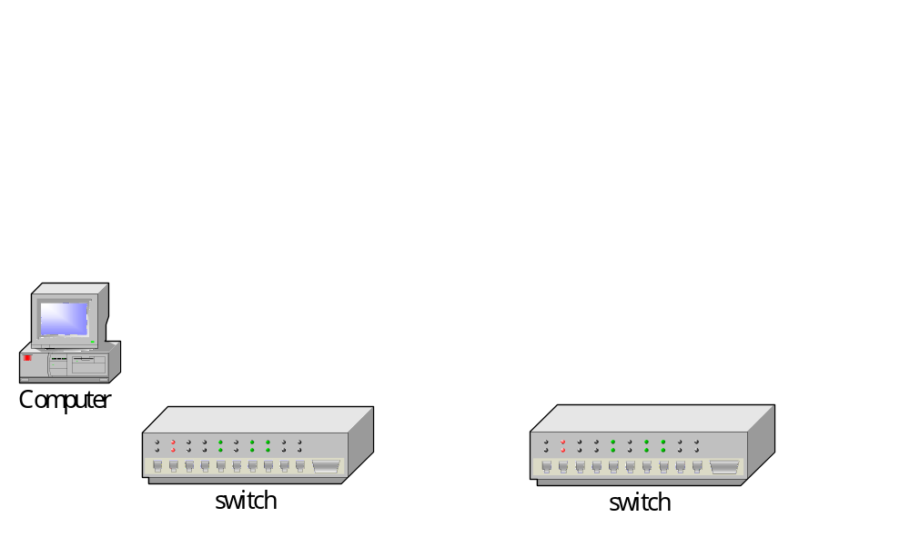
Link Aggregation
Defined in IEEE 802.3ad (2000)
Increased availability
Load balancing among multiple links
Transparent to upper layers
2 x 100 Mb/s = 200 Mb/s
4 x 100 Mb/s = 400 Mb/s
Chapter 3: Link Layer

Slide 92
3.7 Device Drivers of a Network Interface
An introduction to device drivers
Communicating with hardware in a Linux device driver
The network device drivers in Linux
Chapter 3: Link Layer

Slide 93
An Introduction to Device Drivers
I/O request
I/O reply
I/O functions
User processes
I/O calls, spooling
Device-independent OS software
Device driver
Naming, protection, allocation
Interrupt handlers
Device
Setup device registers, check status
Chapter 3: Link Layer

Slide 94
Communicating with Hardware in a Linux Device Driver
Probing I/O probing
  Mapping registers to a region of addresses for R/W
  Can be probed by R/W the I/O ports
Interrupt handling
  Asynchronous event to get CPU’s attention
  A handler is invoked upon the interrupt generation
Direct memory access (DMA)
  Efficiently transfer a large batch of data to and from main memory without the CPU’s involvement
Chapter 3: Link Layer

Slide 95
Read Data From ioports
Communicate with controller’s registers
~ unsigned inb ( unsigned port );
~ unsigned inb_p ( unsigned port );
DMA
~ void insw(unsigned port,void *addr,unsigned long count);
~ void insl(unsigned port,void *addr,unsigned long count);
Chapter 3: Link Layer

Slide 96
Write Data to ioports
Communicate with controller’s registers
~ void outbp (unsigned char byte , unsigned port);
~ void outb_p (unsigned char byte , unsigned port);
DMA
~ void outsw(unsigned port,void *addr,unsigned long count);
~ void outsl(unsigned port,void *addr,unsigned long count);
Chapter 3: Link Layer

Slide 97
Skeleton of Handling an Interrupt
Hardware stacks program counter, etc.
Hardware loads new program counter from interrupt vector
Assembly language procedure saves registers
Assembly language procedure sets up new stack
C procedure does the real work of processing the interrupt ,then awaken the sleeping process
Assembly language procedure starts up current process
ISR : 3 ~ 6, drivers implement 5.
Chapter 3: Link Layer

Slide 98
Fast and Slow Handlers
Fast handler
- disable interrupt reporting in the processor
- disable interrupt being serviced in the
interrupt controller
Slow handler
- enable interrupt reporting in the processor
- disable interrupt being serviced in the
interrupt controller
Chapter 3: Link Layer

Slide 99
Implementing a Handler (1/2)
What to do
- recognize what kind of interrupt it is
e.g., packet arrival, transmission complete
- awaken processes sleeping on the device
- reduce the execution time , otherwise
use bottom halves
- register a handler to kernel
Chapter 3: Link Layer

Slide 100
Implementing a Handler (2/2)
Using arguments – irq, dev_id, regs
irq : used to solve the problem of
handler sharing
dev_id : the device identifier, used to solve
the problem of interrupt sharing
regs : the processor’s context, used to
debug
Chapter 3: Link Layer

Slide 101
Bottom Halves
Why Bottom halves are used ?
- to perform long tasks within a handler
- it is scheduled by the “top half “
How to use Bottom halves ?
- void init_bh
( int nr , void (*routine)(void) )
- void mark_bh ( int nr )
- DECLARE_TASKLET(name, function, data);
- tasklet_schedule(struct tasklet_struct *t);
Chapter 3: Link Layer

Slide 102
Register a Handler to Kernel
Kernel must map IRQ to Interrupt handler
Drivers must register Interrupt handler to the kernel by
int request_irq( irq , handler , flags , device , dev_id )
Chapter 3: Link Layer

Slide 103
Open Source Implementation 3.9: Probing I/O Ports, Interrupt Handling, and DMA
 | Probing ioports | Probing IRQs | DMA
Mechanism | Scan any possible ioports | Drivers give order to device to produce an interrupt , then check the information | transfer a large batch of data to and from main memory without the CPU’s involvement
Useful functions | check_region (port,range); request_region(port,range, dev); release_region(port,range); | unsigned long probe_irq_on (void); int probe_irq_off (unsigned long); | dma_map_single(struct device *dev, void *buffer, size_t size, enum dma_data_direction direction);
Chapter 3: Link Layer

Slide 104
Network Device Driver in Linux
kernel
driver
device
skbuff
Skb
Skb
frame
kernel
driver
device
net_device
dev
dev
local
Chapter 3: Link Layer

Slide 105
sk_buff Structure
Defined in <linux/skbuff.h>
A representation of packet in Linux
Important fields
head : head of buffer
data : data head pointer
tail : tail pointer
end : end pointer
pointers
head
end
dev : device packets arrived on or
leaving from
len : length of actual data
ip_summed : how checksum is to be
computed on the packet
pkt_type : packet class
data
tail
other
fields
sk_buff
Chapter 3: Link Layer

Slide 106
net_device Structure
Defined in <linux/netdevice.h>
A representation of a network interface
Important fields
name : the name of the device
base_addr : device I/O address
irq : device IRQ number
init : the device initialization function
hard_header_len : hardware hdr length
dev_addr : hardware address
mtu : interface MTU value
Chapter 3: Link Layer

Slide 107
Open Source Implementation 3.10:
The Network Device Driver in Linux
Example: ne2k-pci.c
Initialization
- probing hardware to get ioports and irq
- setup the interrupt handler
request_irq
Probe hardware
Kernel
Driver
Device
Chapter 3: Link Layer

Slide 108
Open Source Implementation 3.10 (cont)
Outgoing Flow
2
ne2k_pci_block_output
1
dev->hard_start_xmit
(TX)
ei_start_xmit
3
NS8390_trigger_send
(IH)
ei_interrupt
Kernel
5
Device
(RX)
ei_receive
6
8
ei_tx_intr
netif_wake_queue
NS8390_trigger_send
7
4
Interrupt occurs
Chapter 3: Link Layer

Slide 109
Open Source Implementation 3.10 (cont) Incoming Flow
interrupt occurs
1
(TX)
ei_start_xmit
Kernel
Device
(IH)
ei_interrupt
3
(RX)
ei_receive
2
ei_tx_intr
ne2k_pci_block_input
5
4
netif_rx
Chapter 3: Link Layer

Slide 110
Performance Matters: Interrupt and DMA within a Driver
 | Interrupt handler |  | DMA
Payload size of ICMP packet | TX | RX | TX | RX
1 | 2.43 | 2.43 | 7.92 | 9.27
10 | 2.24 | 2.71 | 9.44 | 12.49
1000 | 2.27 | 2.51 | 18.58 | 83.95
Chapter 3: Link Layer

Slide 111
3.7 Summary
Key concepts: framing, addressing, error control, flow control, and medium access control
Ethernet vs. WLAN: reliability vs. mobility
Bridging: forwarding, spanning tree, VLAN
Device driver implementation: I/O probing, interrupt, and DMA
40Gbps/100Gbps Ethernet and 600Mbps 11n WLAN
Chapter 3: Link Layer

