Slide 1
Computer Networks
An Open Source Approach
Chapter 4: Internet Protocol Layer
Ying-Dar Lin, Ren-Hung Hwang, Fred Baker
Chapter 4: Internet Protocol Layer

Slide 2
Content
4.1 General Issues
4.2 Data-Plane Protocols: IPv4
4.3 Data-Plane Protocols: IPv6
4.4 Control-Plane Protocols: Address Management
4.5 Control-Plane Protocols: Error Reporting
4.6 Control-Plane Protocols: Routing
4.7 Control-Plane Protocols: Multicast Routing
4.8 Summary
Chapter 4: Internet Protocol Layer

Slide 3
Protocols Discussed in this Chapter
DHCP server
host
NAT Server
Router
TCP/UDP
Routing
Protocols
IP address
Subnet
Default
router
ICMP
Routing
Table
IP
ARP
IP
NAT
IP
Data Link
Data Link
Data Link
Chapter 4: Internet Protocol Layer

Slide 4
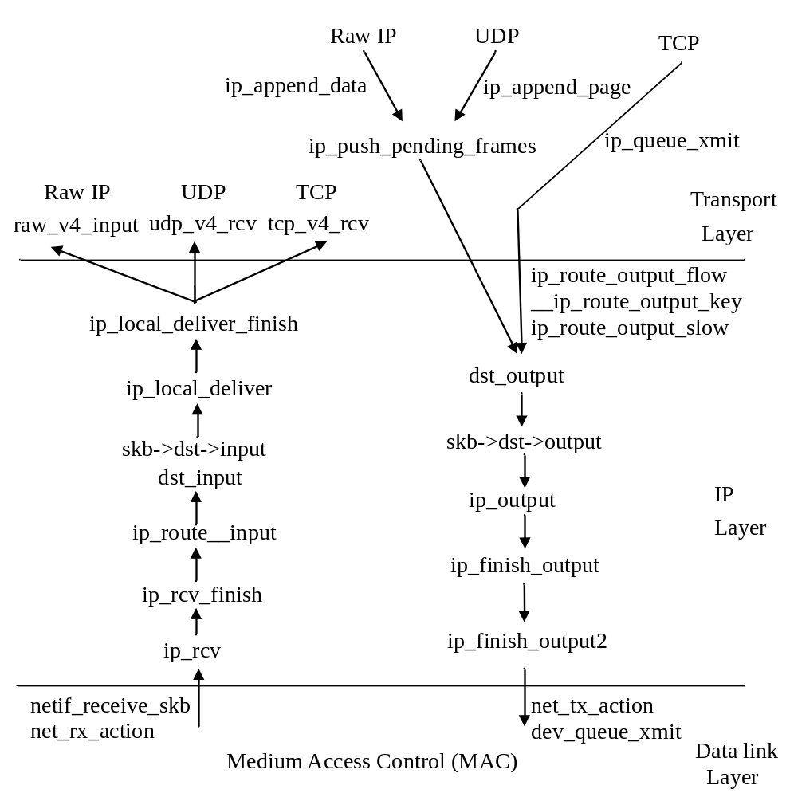
Open Source Implementation 4.1: IP-Layer Packet Flows in Call Graphs
Chapter 4: Internet Protocol Layer

Slide 5
4.1 General Issues
Service
Addressing
Forwarding
Routing
Security
Chapter 4: Internet Protocol Layer

Slide 6
Service
Provides a host-to-host transmission service
Connects several LANs into an internetwork
  a network of networks
“Internet”
  the global internetwork to which most of networks are connected
Chapter 4: Internet Protocol Layer

Slide 7
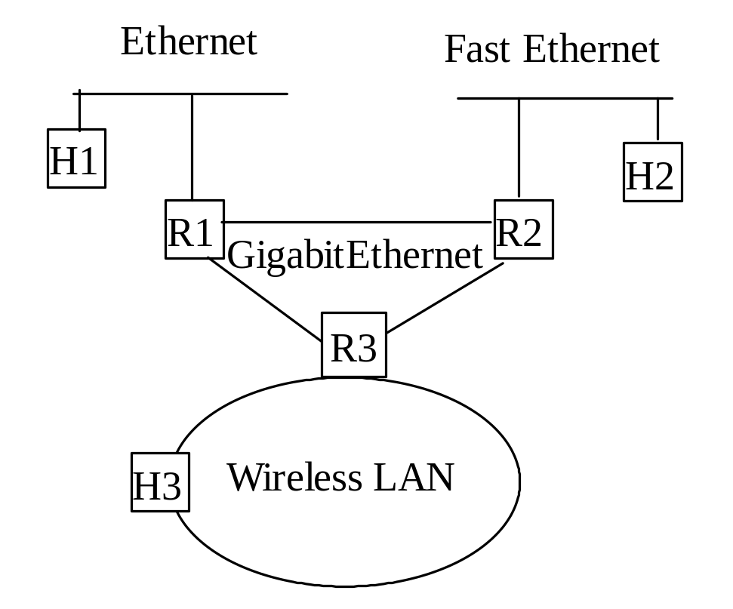
Internetwork
An example of an internetwork
Chapter 4: Internet Protocol Layer

Slide 8
Internet Service Model
Connectionless
Best effort delivery
  packets may be lost
  packets are delivered out of order
  duplicate copies of a packet are delivered
  packets can be delayed for a long time
Next-hop forwarding based on destination address
Chapter 4: Internet Protocol Layer

Slide 9
Address
A globally unique address for host identification
Data link layer: a flat address
Network layer: a hierarchical address
Chapter 4: Internet Protocol Layer

Slide 10
Deliver a packet
How to deliver a packet?
  Routing
    Find a path from source to destination
    Done by routing protocols
  Forwarding
    Forward packets at a router
    Look up the next-hop from the routing table and then forward
Chapter 4: Internet Protocol Layer

Slide 11
Forwarding at Data Plane
Steps
  Extract destination address
  Look up destination address in routing table
    Obtain the output interface from routing table
  Forward the packet
Chapter 4: Internet Protocol Layer

Slide 12
Look Up the Routing Table
Issues
  Speed and memory requirement
  Good data structure
    fast look up and table update
    low memory requirement
  Classical approaches
    Trie
    Hash
    Fast lookup table
    Hardware implementation
Chapter 4: Internet Protocol Layer

Slide 13
Routing at Control Plane
Task of routing
  Select a path from the source to the destination
Goal of routing
  Efficient (low delay, high throughput, …)
  Scalable
  Stable
  Robust
  Fair
Chapter 4: Internet Protocol Layer

Slide 14
IP Routing
Hop-by-hop routing
  Option: source routing
Shortest path routing
Available information
  Global information vs. local information
Information exchange
  Flooding (broadcast) vs. neighbors only
Chapter 4: Internet Protocol Layer

Slide 15
Multicast
Definition of a multicast
  Communication between a group of hosts
  Packets are sent to all group members
Issues
  Group membership
    receivers of a multicast session
  Multicast tree construction
    Multiple point-to-point connections or a multicast tree
    A multicast tree connects the source node to all destination nodes
Chapter 4: Internet Protocol Layer

Slide 16
Security of IP
Aspects on the network security
  Access Control
    Control who has the rights to access
  Data Security
    Encrypt messages transmitted
  Intrusion Detection
    Detect illegal break in
Chapter 4: Internet Protocol Layer

Slide 17
Data-Plane Protocols and Mechanisms
3.2 Internet Protocol
3.3 Internet Protocol Version 6
Chapter 4: Internet Protocol Layer

Slide 18
4.2 Internet Protocol
Addressing
Subnetting
Forwarding
Packet format
Fragmentation and re-assembly
Chapter 4: Internet Protocol Layer

Slide 19
IP Address
A globally unique 32-bit address to identify a network interface
A hierarchical address
  consists of network id and host id
A router usually has more than one interface and one address
A host may have more than one address
Chapter 4: Internet Protocol Layer

Slide 20
IP Address Notation
140.123.1.1 = 10001100 01111011 00000001 00000001
140
123
1
1
IP address notation
Chapter 4: Internet Protocol Layer

Slide 21
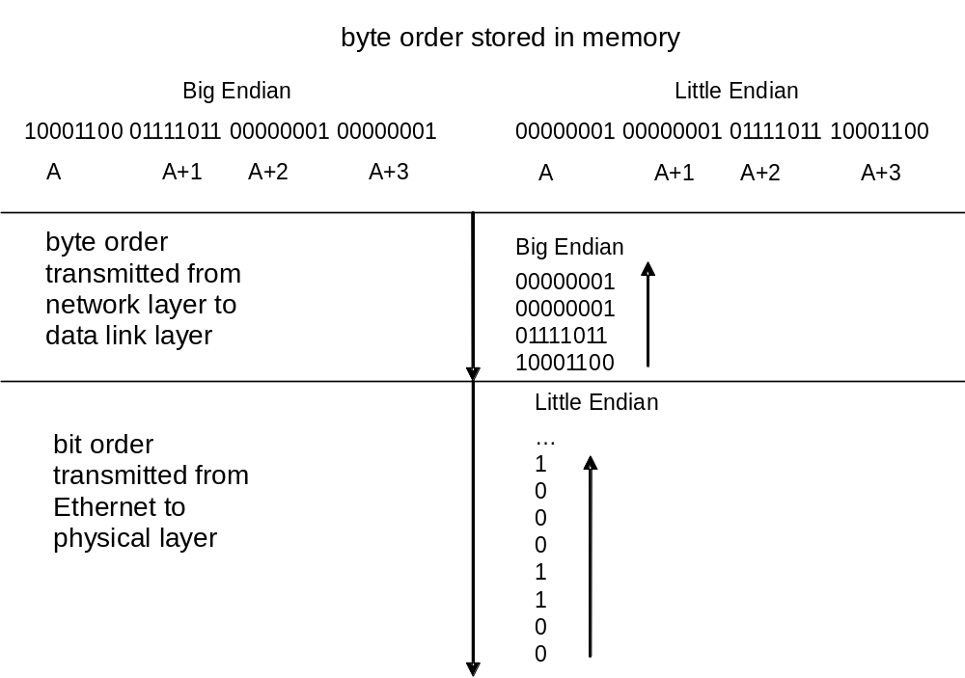
Transmission Order
Chapter 4: Internet Protocol Layer

Slide 22
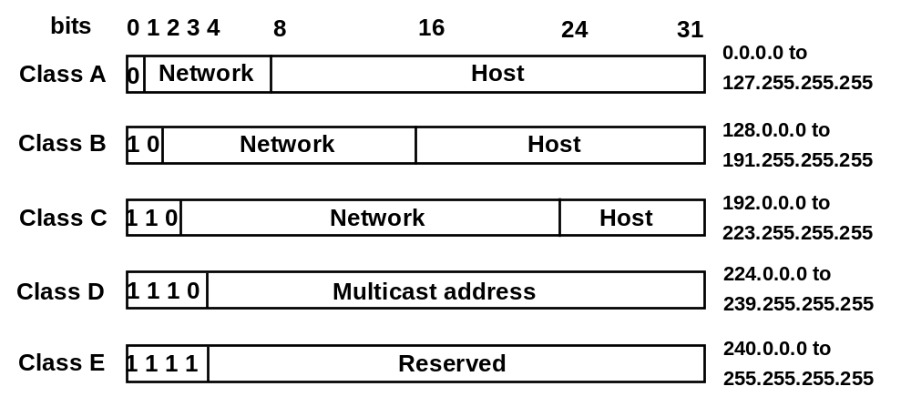
Class-ful IP Address
Chapter 4: Internet Protocol Layer

Slide 23
Reserved IP Addresses
Host id = 0
  denotes the network itself
Host id = F…F
  broadcast address of the network
Chapter 4: Internet Protocol Layer

Slide 24
IP Subnet
Network address uniquely identifies a physical network
A physical network consists of several LANs
  Subnet mask is used to identify a subnet
  Hosts in the same IP subnet talk directly without intervening router
For example
  cs.ccu.edu.tw: 140.123.101.0
  subnet mask: 255.255.255.0 or 140.123.101.0/24
Chapter 4: Internet Protocol Layer

Slide 25
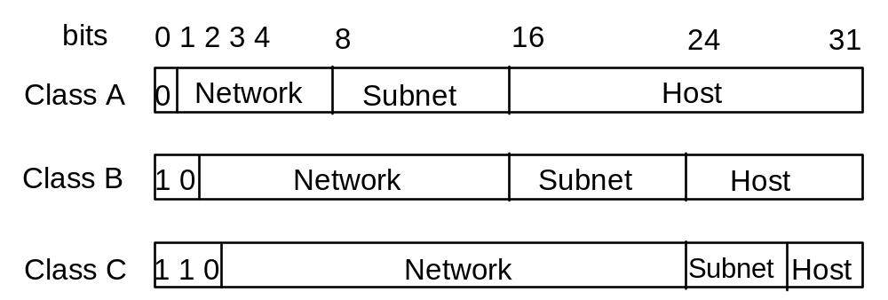
IP Subnet Addressing
Copyright reserved 2001 (Lin & Hwang)
Chapter 4: Internet Protocol Layer

Slide 26
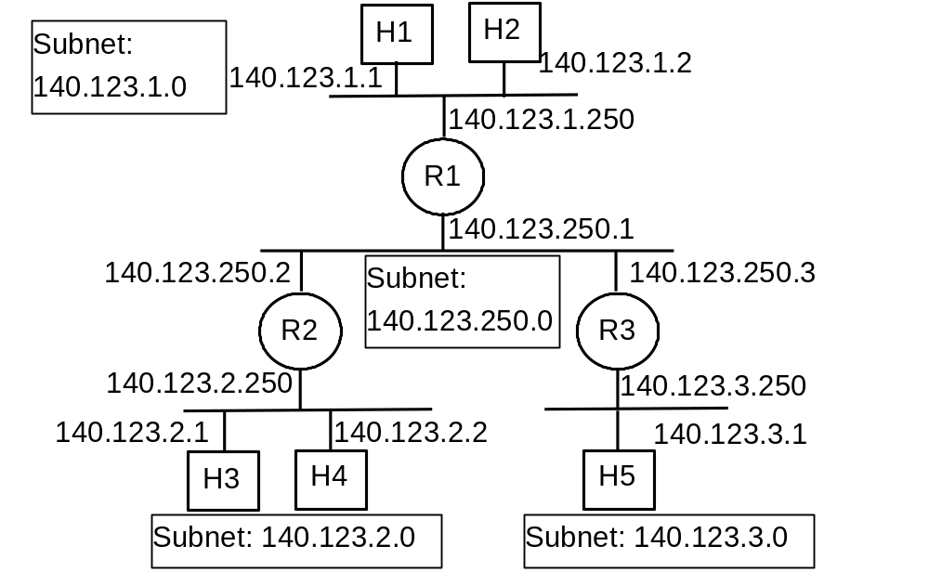
IP Subnet
Chapter 4: Internet Protocol Layer

Slide 27
Classless IP Address
Classful addressing:
  Inefficient use of address space
    A class B address is too large
    A class C address is too small
  Scalability: too many class C routing entries
CIDR: Classless InterDomain Routing
  network portion of address of arbitrary length
  address format: a.b.c.d/x
Chapter 4: Internet Protocol Layer

Slide 28
Authority
ICANN: Internet Corporation for Assigned
Names and Numbers
  allocates addresses
  manages DNS
  assigns domain names, resolves disputes
Chapter 4: Internet Protocol Layer

Slide 29
IP Forwarding
Aspects of forwarding
  Packets from upper layer protocols
  Packets from a network interface
Routing table
  Forwarding is based on routing table
  Routing entry: (Destination/SubnetMask, NextHop)
  Default router: (0.0.0.0/0, default router)
Chapter 4: Internet Protocol Layer

Slide 30
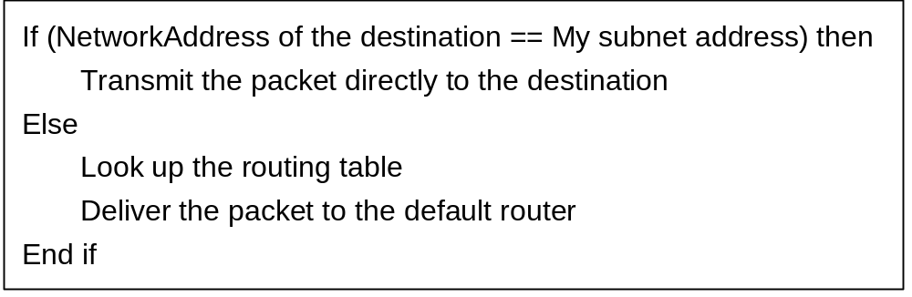
Packet Forwarding (at Host)
Check if destination is in my sbunet:
If ((HostIP ^ DestinationIP) & SubnetMask)==0)
Chapter 4: Internet Protocol Layer

Slide 31
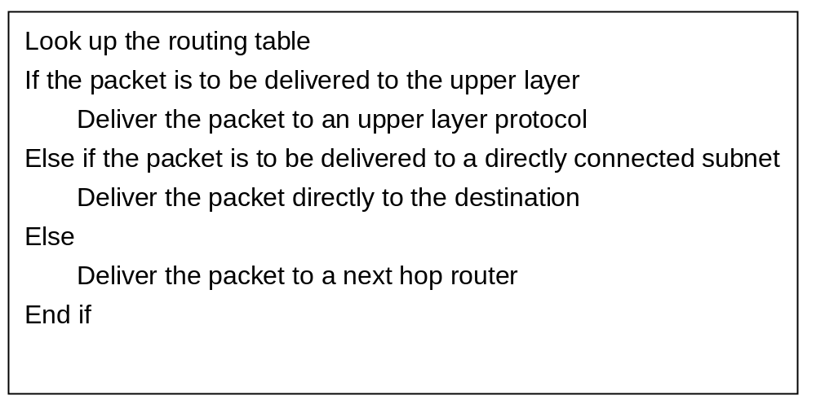
Packet Forwarding (at Router)
Chapter 4: Internet Protocol Layer

Slide 32
Table Look Up
Longest prefix match
  Organization A: 194.24.0.0/21
  Organization B: 194.24.7.0/24
  194.24.7.10 matches 194.24.0.0/21 (21 bits) as well as 194.24.7.0/24 (24bits)
  Longest prefix: 194.24.7.0/24 is the right routing entry
Chapter 4: Internet Protocol Layer

Slide 33
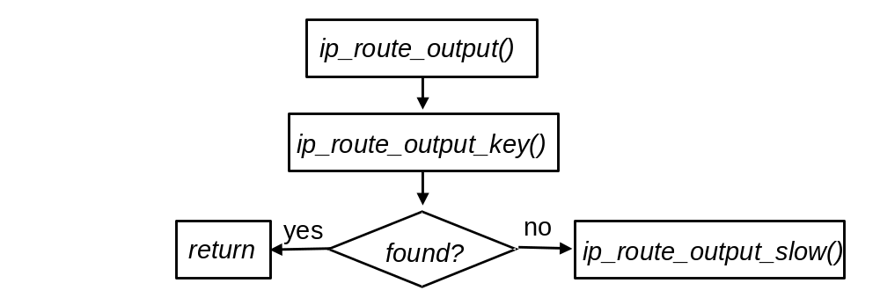
Open Source Implementation 4.2: IPv4 Packet Forwarding
Search cache first; if not found, search the routing table (FIB).
Chapter 4: Internet Protocol Layer

Slide 34
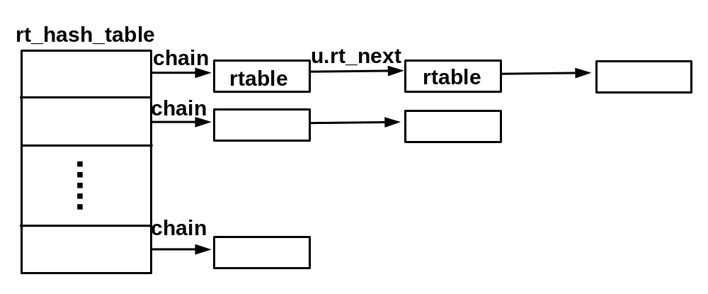
Open Source Implementation 4.2 (cont)
Routing Cache
Chapter 4: Internet Protocol Layer

Slide 35
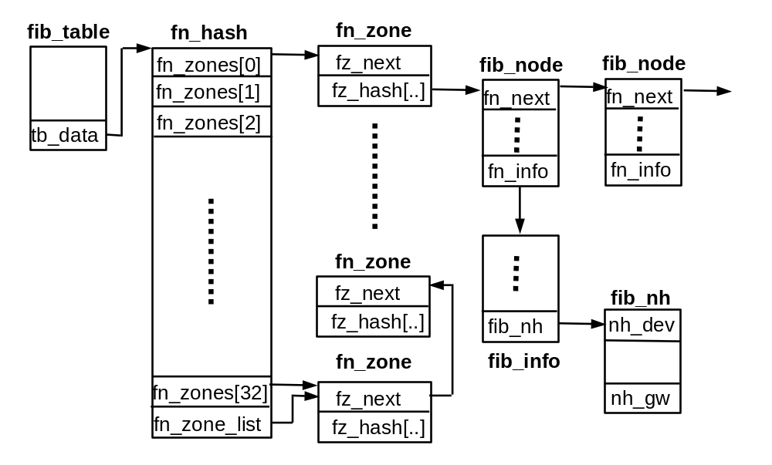
Open Source Implementation 4.2 (cont)
Routing Table (FIB)
Chapter 4: Internet Protocol Layer

Slide 36
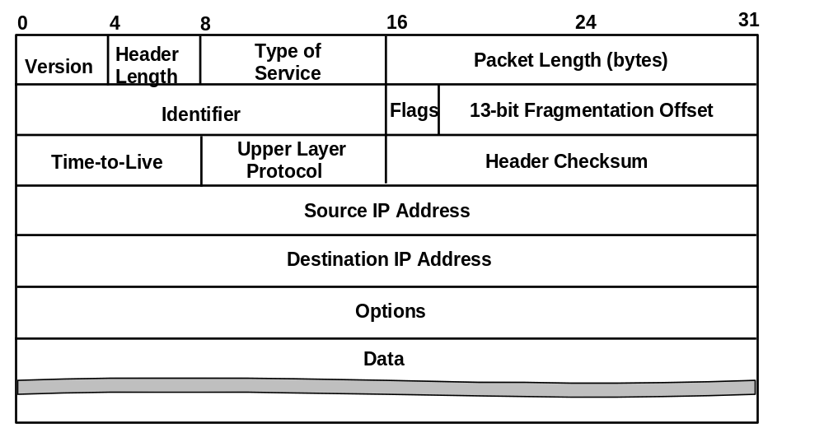
IP Packet Format (1/5)
Chapter 4: Internet Protocol Layer

Slide 37
IP Packet Format (2/5)
Version Number
  Current version 4
  Version for next generation IP is 6
Header Length
  In units of 4-byte words
Type of Service (TOS)
  Desired service of the packet
Chapter 4: Internet Protocol Layer

Slide 38
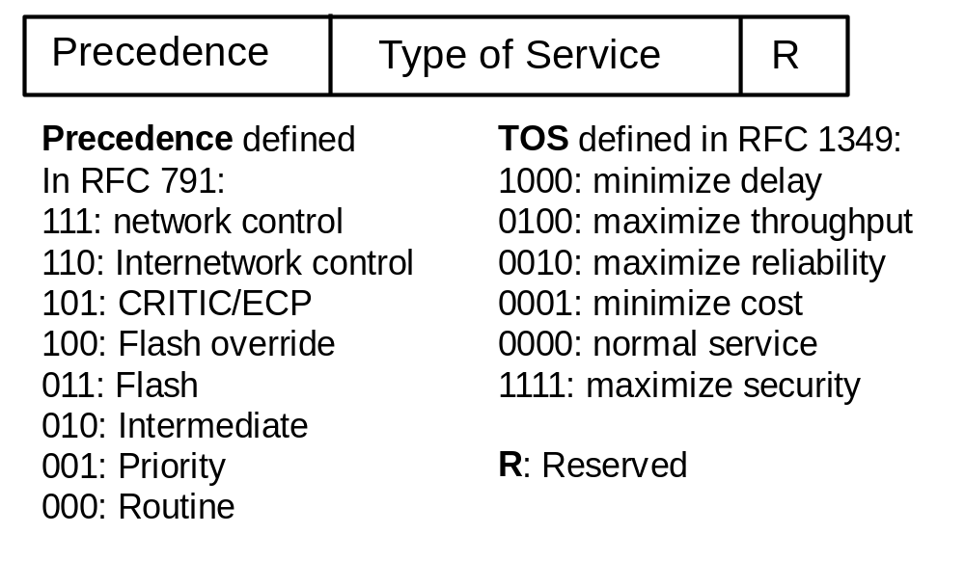
IP TOS
New:
Used as DS codepoint.
Not implemented!!
Partially implemented!!
Chapter 4: Internet Protocol Layer

Slide 39
IP Packet Format (3/5)
Packet Length
  Total number of bytes (header + data)
  Maximum is 65,535 bytes
Identifier
  Uniquely identify an IP packet
Flags
  Low-order two bits: for fragmentation control
    First bit: do not fragment
    Last bit: more
Chapter 4: Internet Protocol Layer

Slide 40
IP Packet Format (4/5)
Fragmentation Offset
  Position of the fragment, measured in unit of 8 bytes.
Time-to-live (TTL)
  Used as hop limit
  Each router decrease TTL by one
  If TTL reaches zero, sent an ICMP message
Upper Layer Protocol
  IP:0, ICMP:1, TCP:6, UDP:17
Chapter 4: Internet Protocol Layer

Slide 41
IP Packet Format (5/5)
Header Checksum
  16-bit 1’s complement checksum of the IP header and IP options
Source Address (32 bits)
Destination Address (32 bits)
Options
  loose source routing, strict source routing, record route, record timestamp
Data
  Payload from upper layers
Chapter 4: Internet Protocol Layer

Slide 42
Open Source Implementation 4.3:
IPv4 Checksum in Assembly
ip_fast_csum() function (src/include/asm_i386/checksum.h).
  optimized by writing this function in assembly languages.
  For 80x86 machines,
    do the summation in 32-bit words first
    The result is then copied to another register
    Shifting registers to have 16 bits in their low-order bits
    add up registers
    Taking the complement of the result gives the checksum
Chapter 4: Internet Protocol Layer

Slide 43
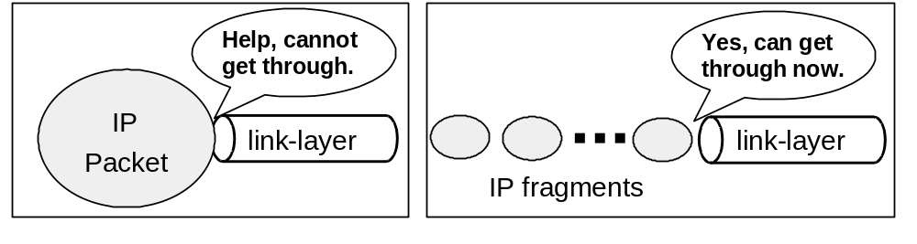
IP Fragmentation & Reassembly
Limitation from data link layers
  MTU(different link-layers, different MTUs)
An IP packet larger than MTU of its data link layer needs to be “fragmented”
  one packet becomes several small packets
  Re-assembled only at the destination
Chapter 4: Internet Protocol Layer

Slide 44
Fragment Control
Identify fragments of a packet
  All fragments have the same identifier
Know the position of a fragment
  Recorded in fragmentation offset (13 bits)
Know the end of a packet
  more fragment bit of the last fragment is 0
Chapter 4: Internet Protocol Layer

Slide 45
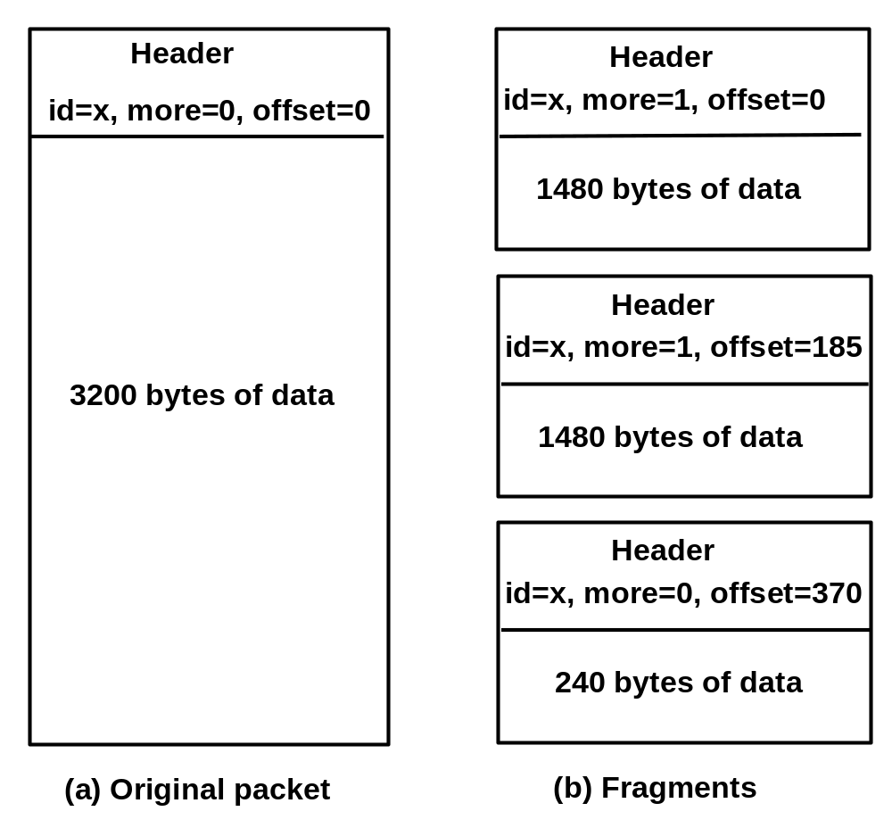
IP Fragmentation Example
Chapter 4: Internet Protocol Layer

Slide 46
Open Source Implementation 4.4:
IPv4 Fragmentation
Upper layer protocol calls ip_queue_xmit()
After routing is determined, call ip_queue_xmit2()
ip_queue_xmit2() calls ip_fragment() if the packet length is larger than the MTU of the device
ip_fragment()
  A while loop is used to fragment the original packet into fragments
  Size (in bytes) of a fragment, except the last one, is set to the largest multiplicative number of 8 that is less than the MTU
Chapter 4: Internet Protocol Layer

Slide 47
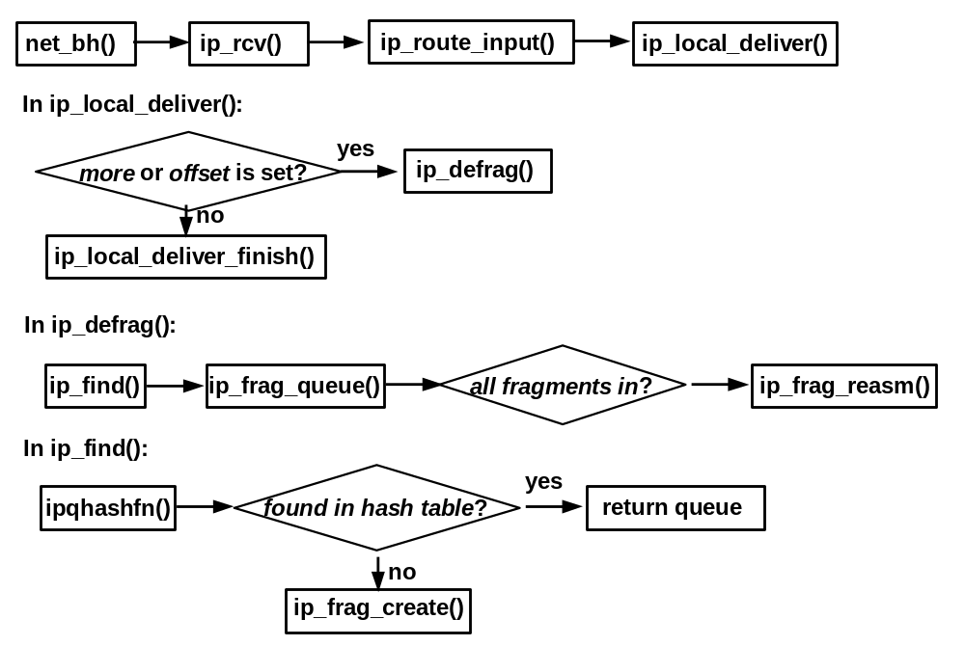
Open Source Implementation 4.4 (cont)
Re-Assembly
Chapter 4: Internet Protocol Layer

Slide 48
Network Address Translation
Network Address Translation Protocol
Chapter 4: Internet Protocol Layer

Slide 49
Network Address Translation
Why NAT?
  Solution to IP address depletion
  Private IP address (RFC 1918)
    10.0.0.0-10.255.255.255
    172.16.0.0-172.31.255.255
    192.168.0.0-192.168.255.255
  Network address translation (RFC 3022)
    Allow hosts with private IP address to have Internet access
    Short-term solution for IP address depletion
    Also provides security for Intranet service
Chapter 4: Internet Protocol Layer

Slide 50
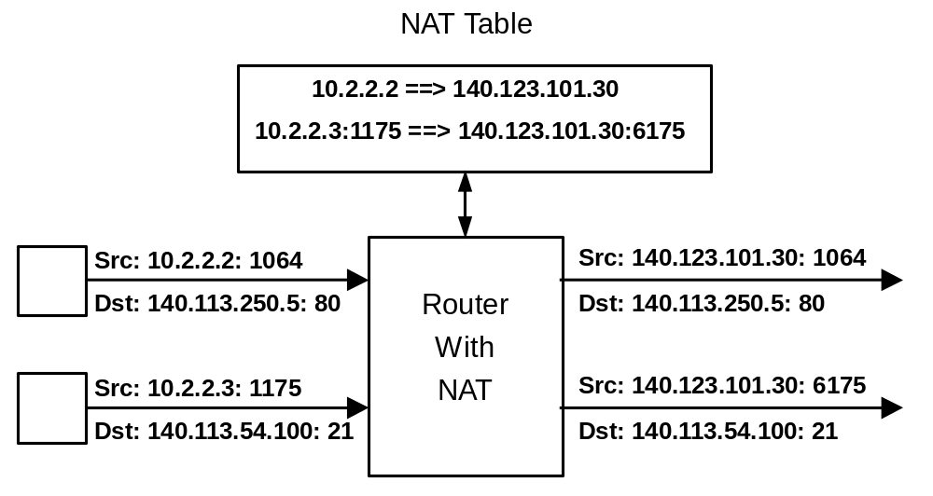
NAT Example
Chapter 4: Internet Protocol Layer

Slide 51
Types of NAT (1/2)
NAT with a pool of global IP addresses
  10.2.2.2 ==> 140.123.101.30
  10.2.2.3 ==> 140.123.101.31
  dynamic: translate IP address on demand
  static: translate IP address with pre-configuration
NAT with Port Address Translation (NAPT) of one global IP address
  10.2.2.2:1064 ==> 140.123.101.30:5064
  10.2.2.3:1175 ==> 140.123.101.30:6175
Chapter 4: Internet Protocol Layer

Slide 52
Types of NAT (2/2)
Port redirection
  Redirect all WWW service to a specific IP and private port number
    DNS: www.cs.ccu.edu.tw ==> 140.123.101.38
    NAT: 140.123.101.38:80 ==> 10.2.2.2:8080
Transparent proxy
  Enforce all www traffic to a proxy with cache
    140.123.101.38:80 ==> internal www proxy (10.1.1.1)
    All HTTP requests go to the internal proxy
Chapter 4: Internet Protocol Layer

Slide 53
Problems with NAT (1/2)
Modify source IP and/or port number
Modify IP header checksum
Modify TCP checksum
Application dependent modification
  ICMP:
    Basic NAT: ICMP checksum, query id (echo)
    NAPT: ICMP packets that may contain IP address
      destination unreachable (3), source quench (4), redirect (5), time exceeded (11), IP header error (12)
Chapter 4: Internet Protocol Layer

Slide 54
Problems with NAT (2/2)
Application Specific Gateways (ALGs)
  FTP
    PORT/PASV command has IP address:port in ASCII
    Translate IP address may result in a change of packet size
      If new size is shorter, pad with zeroes
      If new size is longer, need to change TCP sequence number
      Affects acknowledge, congestion control, …
      A special table is used to correct the TCP sequence and acknowledge numbers
  Others: SMTP, SNMP, …….
Chapter 4: Internet Protocol Layer

Slide 55
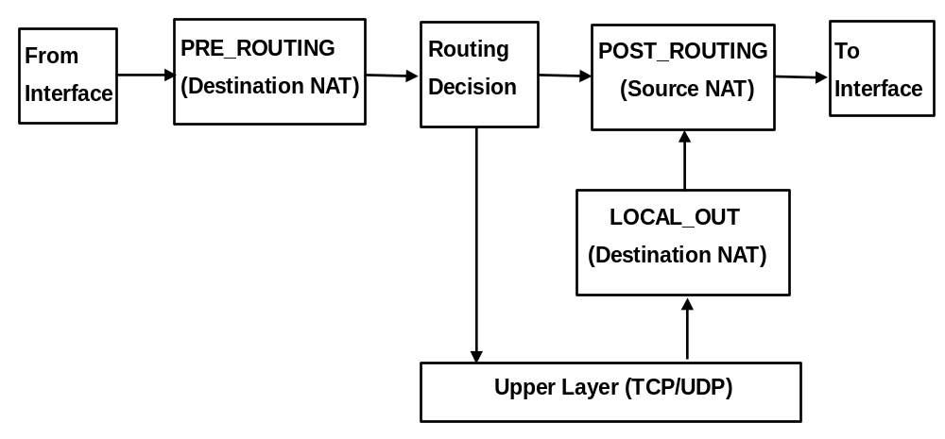
Open Source Implementation 4.5: NAT
Source and destination NAT implementation in Linux iptables
Chapter 4: Internet Protocol Layer

Slide 56
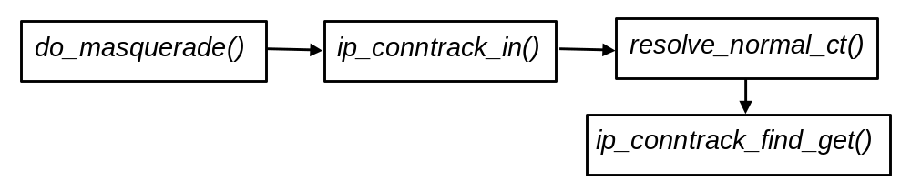
Open Source Implementation 4.5 (cont)
Data structure
  Hash table: ip_conntrack_hash[]
  Hash function: hash_conntrack()
  Linear search with a hashed list
Chapter 4: Internet Protocol Layer

Slide 57
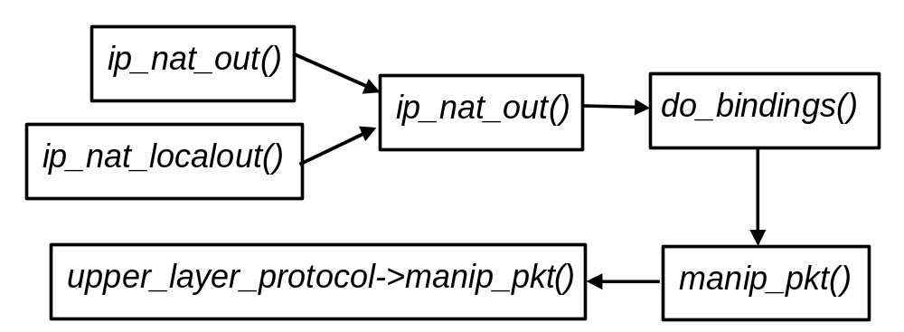
Open Source Implementation 4.5 (cont)
NAT function flows
Chapter 4: Internet Protocol Layer

Slide 58
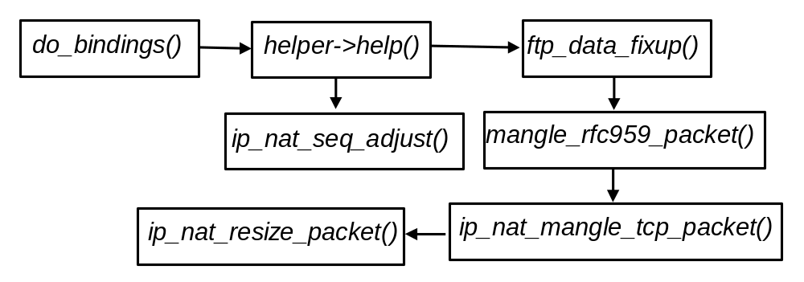
Open Source Implementation 4.5 (cont)
FTP ALG function flows
Chapter 4: Internet Protocol Layer

Slide 59
4.3 Internet Protocol Version 6
Changes from IPv4
IPv6 Header
IPv6 Extension Header
IPv6 Fragmentation and Reassembly
IPv6 Address Space
Chapter 4: Internet Protocol Layer

Slide 60
IPv6
Problems with IPv4
  Shortage of address space
  Lack of Quality of Service guarantee
New features of IPv6
  Enlarge address space
  Fixed header format helps speed processing/forwarding
  Better support for Quality of Service
  Auto-configuration
  new “anycast” address: route to “best” of several replicated servers
Chapter 4: Internet Protocol Layer

Slide 61
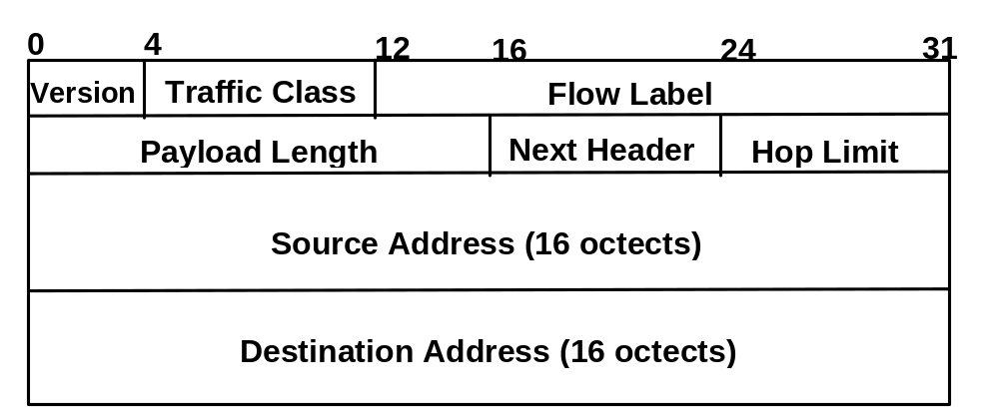
IPv6 Header (1/2)
Chapter 4: Internet Protocol Layer

Slide 62
IPv6 Header (2/2)
Version: 6
Traffic class:
  identify class of service
  e.g., DiffServ (DS codepoint)
Flow Label:
  identify datagrams in same “flow”
Next header:
  identify upper layer protocol for data
Hop Limit:
  Like TTL in IPv4
Chapter 4: Internet Protocol Layer

Slide 63
IPv4 and IPv6 Header Comparison
IPv4 Header
IPv6 Header
Version | IHL | Type of Service | Total Length
Identification |  |  | Flags | Fragment Offset
Time to Live |  | Protocol | Header Checksum
Source Address
Destination Address
Options |  |  |  |  | Padding
Version | Traffic Class | Flow Label
Payload Length |  |  | Next Header | Hop Limit
Source Address
Destination Address
Field’s name kept from IPv4 to IPv6
Fields not kept in IPv6
Name and position changed in IPv6
New field in IPv6
Legend

Slide 64
Changes from IPv4 (1/2)
Expanded Addressing Capabilities
  From 32 bits to 128 bits (more level and nodes)
  Improve multicast routing (“scope” field)
  “anycast address”: send a packet to any one of a group of nodes
Header Format Simplification
  Reduce bandwidth cost
Extensions
  More flexibility
Chapter 4: Internet Protocol Layer

Slide 65
Changes from IPv4 (2/2)
Options
  Allowed, but outside of header, indicated by “Next Header” field
Checksum
  Removed to reduce processing at routers
Fragmentation
  Not allowed at intermediate routers
Chapter 4: Internet Protocol Layer

Slide 66
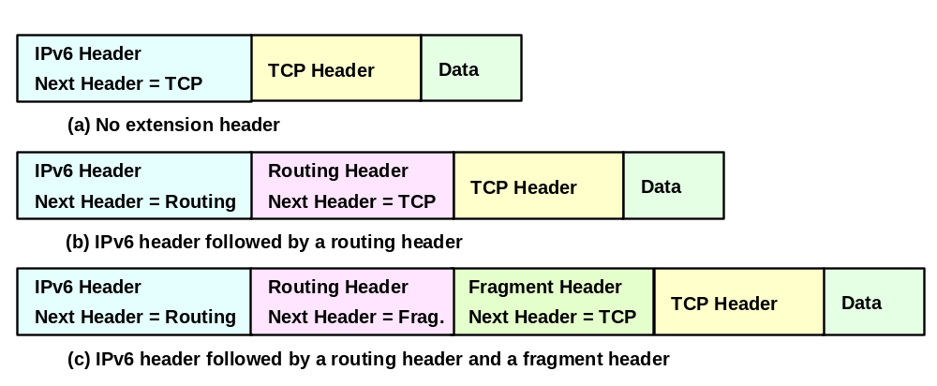
IPv6 Extension Header Examples
Chapter 4: Internet Protocol Layer

Slide 67
IPv6 Extension Header (1/2)
Order of extension headers
  IPv6 (41)
  Hop-By-Hop Options header (0)
  Destination Options header (60)
  Routing header (43)
  Fragment header (44)
  Authentication header (51)
  Encapsulating Security Payload header (50)
  Destination Options header (60)
  Upper-layer header
    ICMPv6(58)
    TCP(6), UDP(17), RSVP(46), SCTP(132)
Chapter 4: Internet Protocol Layer

Slide 68
IPv6 Extension Header (2/2)
Not processed by intermediate routers
  except hop-by-hop option header
Processed strictly in order
Each extension header occurs at most once
  except Destination Options header, which occurs at most twice
Chapter 4: Internet Protocol Layer

Slide 69
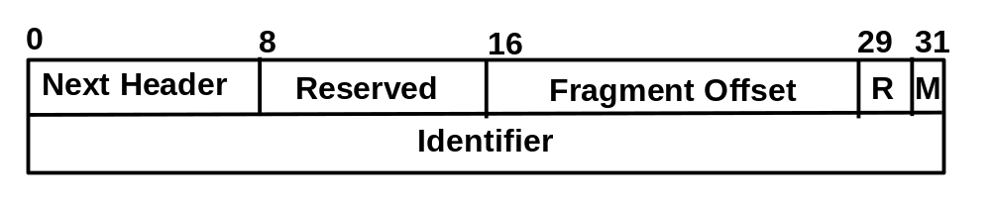
Fragment Header
Fragmentation is only performed by source
Fragment header format
Chapter 4: Internet Protocol Layer

Slide 70
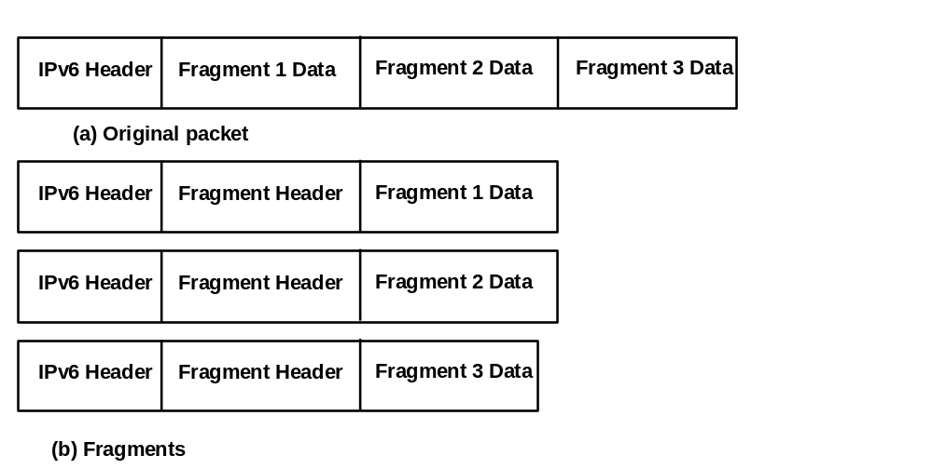
Fragmentation Example
Chapter 4: Internet Protocol Layer

Slide 71
Packet Size Issue
MTU of every link must >= 1280 bytes
  Use Path MTU Discovery to discover MTU greater than 1280 bytes
  A node need to accept a fragmented packet that is as large as 1500 octets
Chapter 4: Internet Protocol Layer

Slide 72
IPv6 Addressing
Three categories
  Unicast
  Multicast
  Anycast
Notation
  16-bit Hex’s separated by colons
  3FFD:3600:0000:0000:0302:B3FF:FE3C: C0DB
  Consecutive null 16-bit numbers replaced by ::
  3FFD:3600:0:0:0:0:1:A =>3FFD:3600::1:A
Chapter 4: Internet Protocol Layer

Slide 73
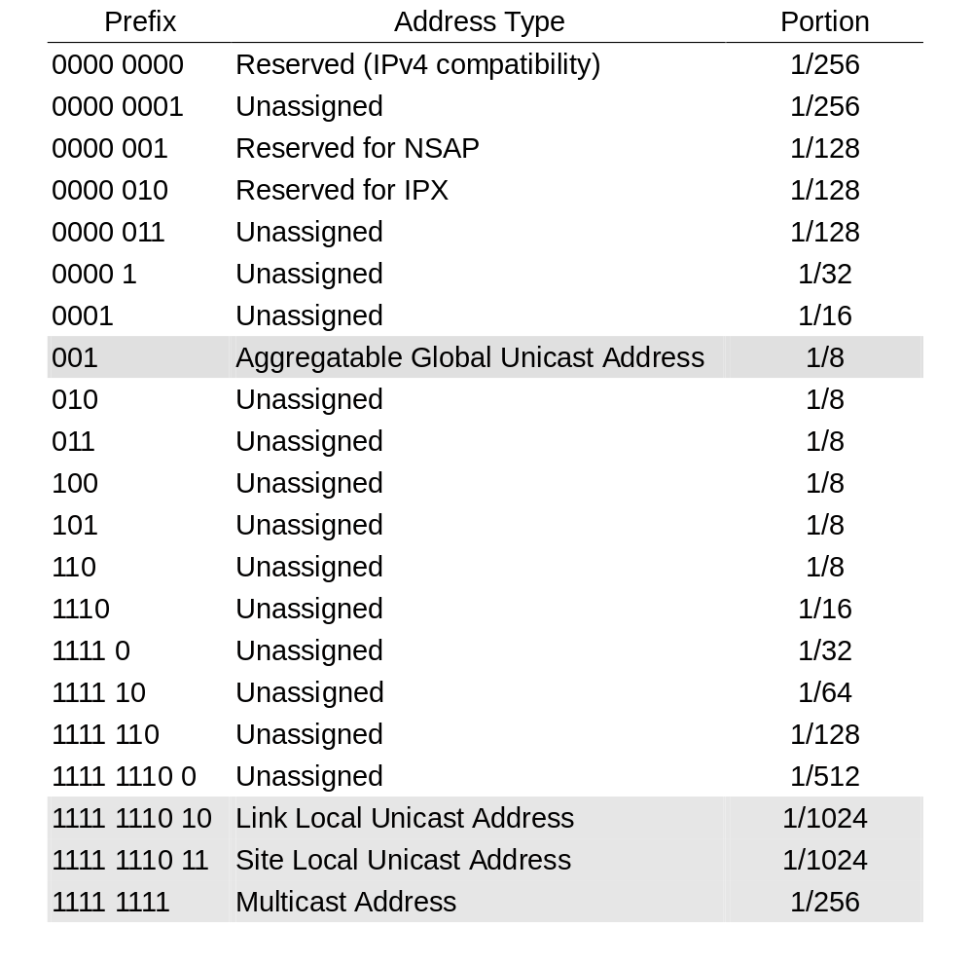
IPv6 Address Assignment
Chapter 4: Internet Protocol Layer

Slide 74
IPv6 Unicast Address (1/2)
Unicast Address without Internal Structure:
Node Address
Unicast Address with Subnet:
Subnet Prefix
Interface ID
Unicast Unspecified Address:
0000
0000
0000
Unicast Loopback Address:
0000
0000
0001
Chapter 4: Internet Protocol Layer

Slide 75
IPv6 Unicast Address (2/2)
IPv4-compatible IPv6 Address:
::8C7B:65A0
32
32 bits
0000
0000
0000
IPv4 Address
IPv4-Mapped IPv6 Address:
32
::FFFF:8C7B:65A0
32 bits
0000
0000
FFFF
IPv4 Address
NSAP Addresses:
00000001
defined according to usage requirements
IPX Addresses:
00000010
to be defined
Chapter 4: Internet Protocol Layer

Slide 76
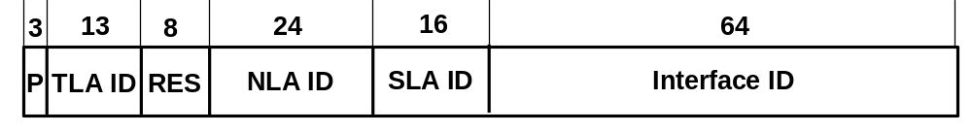
Aggregatable Global Unicast Address
RFC 2374
P : Fromat Prefix (001)
TLA : Top-Level Aggregation Identifier (8192)
RES : Reserved
NLA : Next-Level Aggregation Identifier
SLA : Site-Level Aggregation Identifier
Interface ID : Interface Identifier
Current APNIC IPv6 address allocation policy (as of August, 2011):
RIR /12, ISP /32, Site /48 (normal max.)
Chapter 4: Internet Protocol Layer

Slide 77
Interface ID: EUI-64 (RFC 2464)
Prefix range from 001 to 111 should use EUI-64 format for interface ID.
For 48-bit MAC address
  0xff-fe is inserted between the 3rd and 4th bytes
  The universal/local bit (the second low-order bit of the first byte) is complemented.
  Example
    MAC: 00-02-b3-1e-83-29
    EUI-64 ID: 02-02-b3-ff-fe-1e-83-29
    Link local: FE80::202:b3ff:fe1e:8329
Some problem with privacy: a host can be traced from IPv6 address
Chapter 4: Internet Protocol Layer

Slide 78
Current Address Allocations
APNIC
  2001:0200::/23, 2001:0C00::/23, …, 2400:0000::/12
  http://www.apnic.net/faq/IPv6-FAQ.html
ARIN
  2001:0400::/23, …, 2600:0000::/12
  http://www.arin.net/library/guidelines/ipv6_initial.html
RIPE NCC
  2001:0600::/23, 2001:0800::/23, 2A00:0000::/12
  http://www.ripe.net/ripencc/mem-services/registeration/ipv6.html
LACNIC
  2001:1200::/23, …, 2800:0000::/12
6to4 tunnels
  2002::/16
http://www.iana.org/assignments/ipv6-unicast-address-assignments/ipv6-unicast-address-assignments.xml
Chapter 4: Internet Protocol Layer

Slide 79
IPv6 Multicast Address (1/2)
Format:
8
4
4
8
8
64
32 bits
11111111
flag
scope
Res
Plen
Prefix
Group ID
flag : 00PT
  T = 0 : well-known multicast address
  T = 1 : transient multicast address
scope : scope of multicast group
  0000 : reserved
  0001 : node-local scope
  0010 : link-local scope
  0101 : site-local scope
  1000 : organization-local scope
  1110 : global scope
P=0 address not assigned on prefix
P=1 assigned based on prefix
Plen: length of network prefix
Prefix: up to 64 bits
Chapter 4: Internet Protocol Layer

Slide 80
IPv6 Multicast Address (2/2)
Node-Local Scope
  FF01:0:0:0:0:0:0:1 All Nodes Address
  FF01:0:0:0:0:0:0:2 All Routers Address
Link-Local Scope
  FF02:0:0:0:0:0:0:1 All Nodes Address
  FF02:0:0:0:0:0:0:2 All Routers Address
  FF02:0:0:0:0:1:FFxx:xxxx Solicited Node Address
  (Unicast : 4037::01:800:200E:8C6C is FF02::1:FF0E:8C6C)
Site-Local Scope
  FF05:0:0:0:0:0:0:2 All Routers Address
  FF05:0:0:0:0:0:0:3 All DHCP Servers
Chapter 4: Internet Protocol Layer

Slide 81
Transition From IPv4 To IPv6
Not all routers can be upgraded simultaneous
  How will the network operate with mixed IPv4 and IPv6 routers?
Transition assumptions
  No “Flag Day”
    Last Internet transition was 1983 (NCP → TCP)
  Transition will be incremental
    Possibly over several years
  Transparent to end users
    Seamless transition from IPv4 to IPv6
  IPv6 is designed with transition in mind
    Assumption of IPv4/IPv6 coexistence
Chapter 4: Internet Protocol Layer

Slide 82
Transition Approaches
Dual Stacks
  Allow IPv4/IPv6 to co-exist on one device
Tunnels
  For tunneling IPv6 across IPv4 clouds
    Encapsulate IPv6 packets in IPv4 packets (PID=41)
  Manually configured tunnel
  Automatic tunnel
    Relies on some special IPv6 addresses
Translators
  IPv6 only device communicates with IPv4 only device
Chapter 4: Internet Protocol Layer

Slide 83
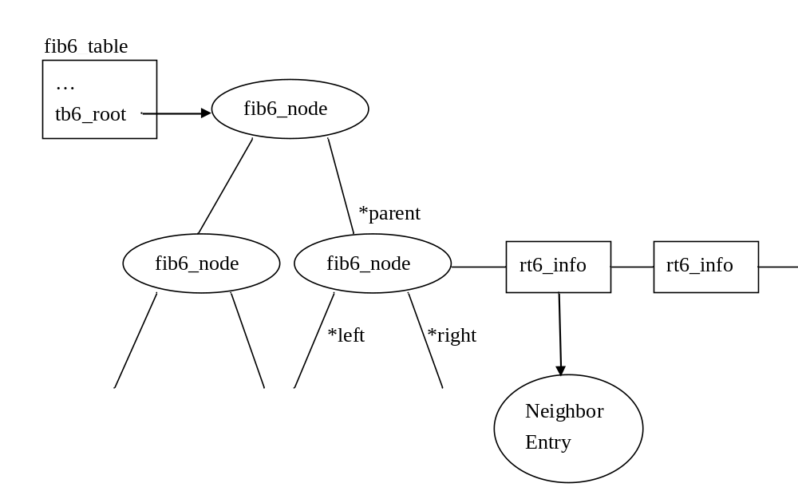
Conceptual View of IPv6 Routing Table
Copyright reserved 2001 (Lin & Hwang)
Chapter 4: Internet Protocol Layer

Slide 84
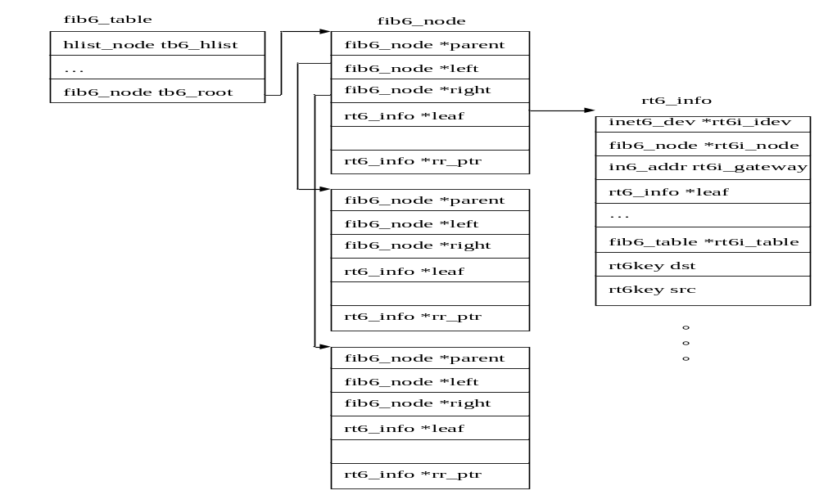
FIB6 Data Structure
Copyright reserved 2001 (Lin & Hwang)
Chapter 4: Internet Protocol Layer

Slide 85
Chapter 4
Internet Protocol Layer
Part II
Chapter 4: Internet Protocol Layer

Slide 86
Control Plane Mechanisms
Address Management
  Address resolution
  Address configuration
Error reporting
  Internet Control Message Protocol
Routing
  Intra-domain routing
  Inter-domain routing
Multicast
Chapter 4: Internet Protocol Layer

Slide 87
4.4 Address Management
Address resolution
Address configuration
Chapter 4: Internet Protocol Layer

Slide 88
Address Resolution
Address Resolution Protocol (ARP)
Chapter 4: Internet Protocol Layer

Slide 89
Address Resolution
What is address resolution
  Translate address at different layers
  For example
    host name to IP address
    IP address to Ethernet address
Why address resolution
  MAC address vs. IP address
Chapter 4: Internet Protocol Layer

Slide 90
Address Resolution Protocol
Protocol operation
  Source node broadcasts an ARP request packet on the IP subnet
  All nodes on the subnet will receive the ARP request, but only the target node (or some designate server) will reply an ARP reply packet via unicast
  Source node receives the reply and gets the MAC address of the target node
  Cache is used to speed up (w/ timer)
Chapter 4: Internet Protocol Layer

Slide 91
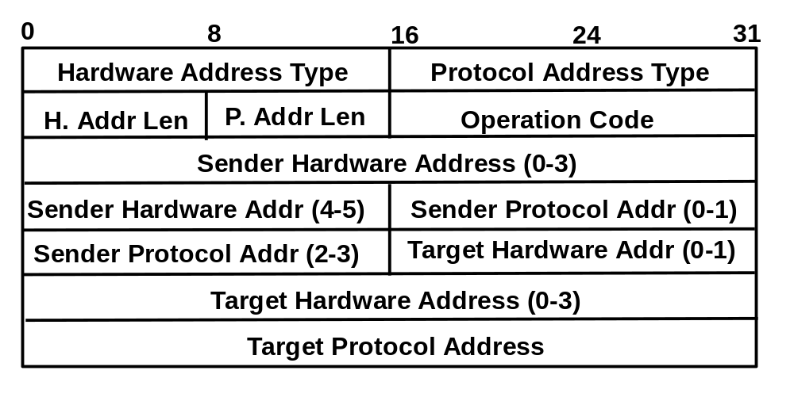
ARP Packet Format (1/3)
Chapter 4: Internet Protocol Layer

Slide 92
ARP Packet Format (2/3)
HARDWARE ADDRESS TYPE
  Link types: Ethernet=0x0001
PROTOCOL ADDRESS TYPE
  Upper layer protocol identifier: IP=0x0800
HADDR LEN
  Length of the address of the link layer: Ethernet=6
PADDR LEN
  Length of the address of the network layer: IP=4
Chapter 4: Internet Protocol Layer

Slide 93
ARP Packet Format (3/3)
OPERATION
  Operation code: ARP request=1, ARP reply=2 RARP request=3, RARP reply=4
SENDER HADDR
  Sender link layer address
SENDER PADDR
  Sender network layer address
TARGET HADDR
  Target link layer address, fill zero if unknown
TARGET PADDR
  Target network layer address
Chapter 4: Internet Protocol Layer

Slide 94
Encapsulate ARP Packet into MAC Frame
Protocol id: 0x0806
Destination address of an ARP request packet: 0xFFFFFFFFFFFF
Chapter 4: Internet Protocol Layer

Slide 95
Reverse ARP (RARP)
Allow a diskless workstation to discover its IP address
Need a RARP server on each network
Bootp:
  Use UDP messages which are forwarded over routers to find the file server that holds the mapping
Chapter 4: Internet Protocol Layer

Slide 96
Open Source Implementation 4.6:
ARP
Data structure
  Hash table: arp_table
  Hash parameters: a primary key and device interface index
Functions
  Arp_send(): set up ARP header and then xmit
  Arp_rcv(): Only deal with reply or request operation.
    Request: calls ip_input_route(), if routes to local, calls arp_send() to send out ARP reply. Otherwise, if the host is an arp proxy, also sends ARP reply.
    Reply: update ARP table.
  __neigh_lookup(): calls neigh_lookup() to search the arp hash table, if not found, create one
  Eth_rebuild_header (old) or arp_solicit() calls arp_send()
Chapter 4: Internet Protocol Layer

Slide 97
Address Configuration
Dynamic Host Configuration Protocol (DHCP)
Chapter 4: Internet Protocol Layer

Slide 98
Address Configuration
What is address configuration
  Automatically and dynamically assign an IP address to a host
Why address configuration
  Setting IP address is error prone.
  Insufficient IP addresses: share IP addresses among hosts
  Better network management
Chapter 4: Internet Protocol Layer

Slide 99
DHCP Protocol
Dynamic Host Configuration Protocol
DHCP is derived from BOOTP
  Some fields are not for host configuration
Operations
  A host broadcasts a DHCPDISCOVER message
  A DHCP server receives and replies it
  Or a DHCP relay server receives it and forwards to the DHCP server, gets the configuration and relays to the host
  DHCP message are sent over UDP (port 67 (to sever) & 68 (to client))
Chapter 4: Internet Protocol Layer

Slide 100
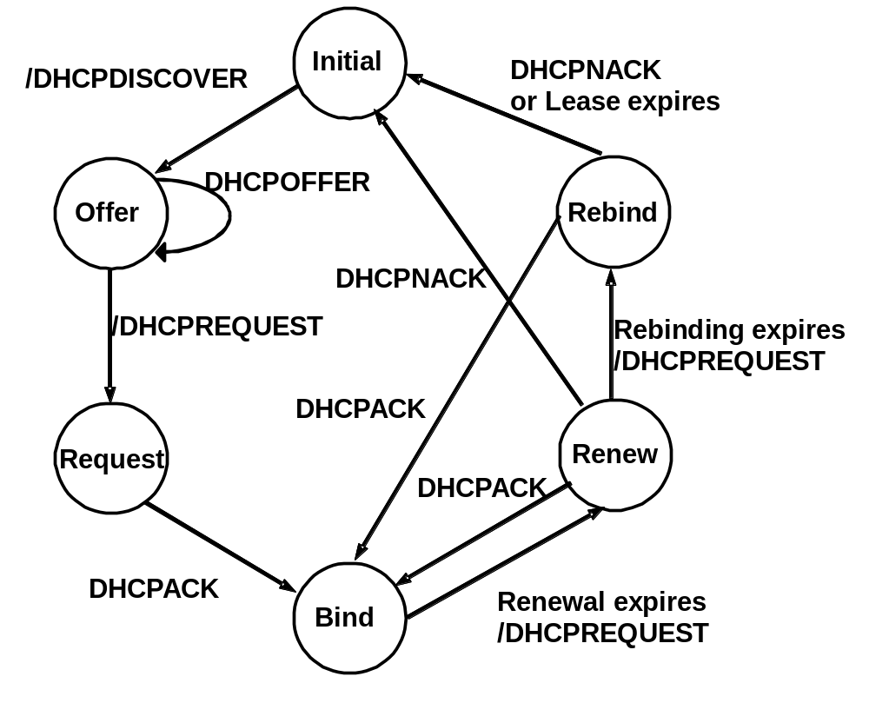
State Diagram for DHCP Client
Chapter 4: Internet Protocol Layer

Slide 101
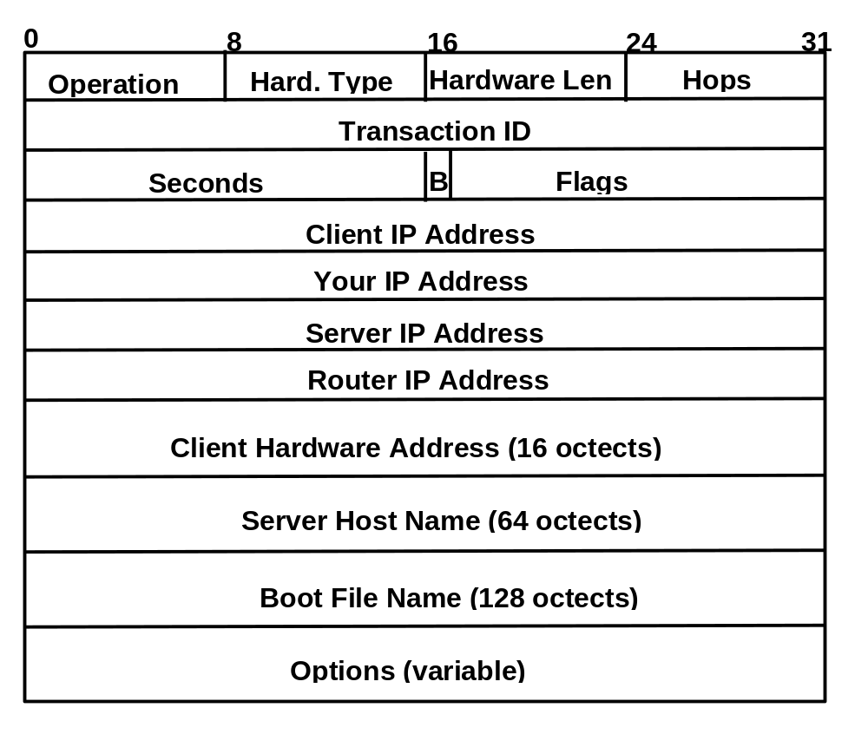
DHCP Packet Format
Chapter 4: Internet Protocol Layer

Slide 102
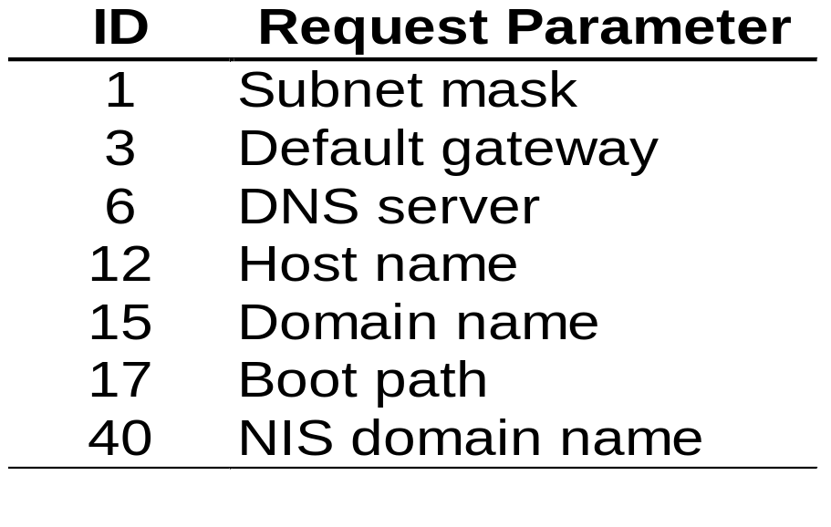
DHCP Packet Format
More information for host configuration
  such as default router, subnet mask
  encoded in the option field (code=55, length, parameter)
Chapter 4: Internet Protocol Layer

Slide 103
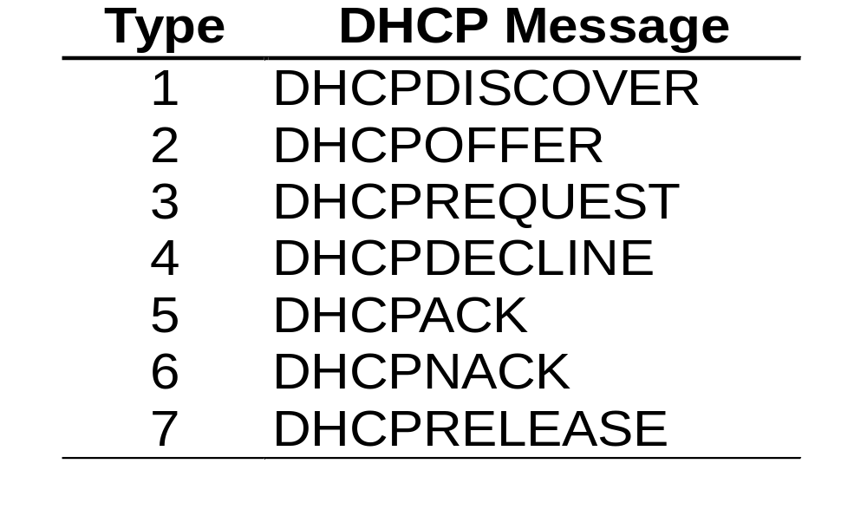
DHCP Packet Format
Options
  Option field starts with three fields: code (53), length(1), type(1-7)
Chapter 4: Internet Protocol Layer

Slide 104
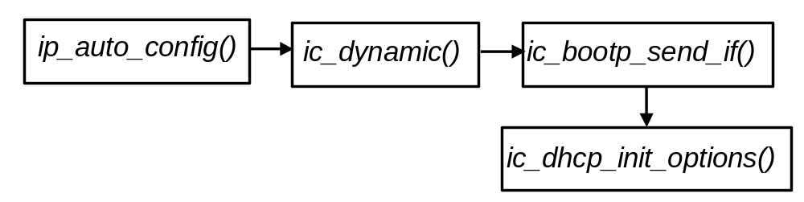
Open Source Implementation 4.7:
DHCP
struct bootp_pkt { /* BOOTP packet format */
struct iphdr iph; /* IP header */
struct udphdr udph; /* UDP header */
u8 op; /* 1=request, 2=reply */
u8 htype; /* HW address type */
u8 hlen; /* HW address length */
u8 hops; /* Used only by gateways */
u32 xid; /* Transaction ID */
u16 secs; /* Seconds since we started */
u16 flags; /* Just what it says */
u32 client_ip; /* Client's IP address if known */
u32 your_ip; /* Assigned IP address */
u32 server_ip; /* (Next, e.g. NFS) Server's IP address */
u32 relay_ip; /* IP address of BOOTP relay */
u8 hw_addr[16]; /* Client's HW address */
u8 serv_name[64]; /* Server host name */
u8 boot_file[128]; /* Name of boot file */
u8 exten[312]; /* DHCP options / BOOTP vendor extensions */
};
Chapter 4: Internet Protocol Layer

Slide 105
4.5 Error Reporting
Internet Control Message Protocol (ICMP)
Chapter 4: Internet Protocol Layer

Slide 106
Error Control Protocol
What is error control protocol
  A protocol for reporting error or status of TCP/IP at remote site (router or host)
Why error control protocol
  For monitoring the status of TCP/IP at each host/router
  For reporting error between hosts or routers
Chapter 4: Internet Protocol Layer

Slide 107
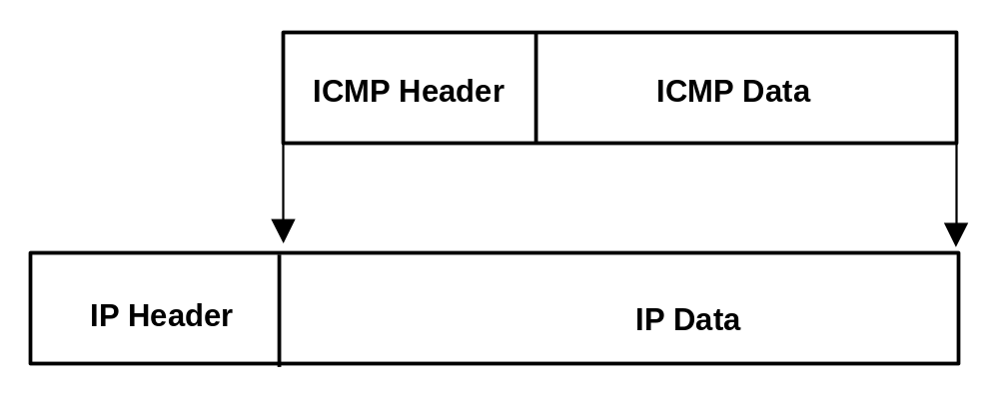
Internet Control Message Protocol (ICMP)
ICMP runs over IP
Chapter 4: Internet Protocol Layer

Slide 108
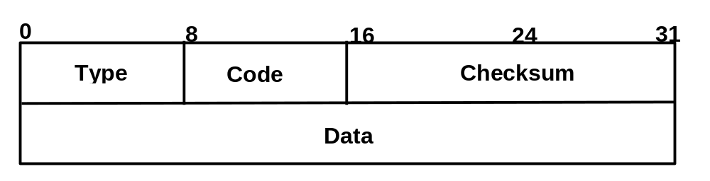
ICMPv4 Packet Format
Type and Code are used to identify an error event
The data filed contains
  STD 5, RFC 792, “Internet Control Message Protocol”
    IP header plus the first 64 bits of the packet that elicited the ICMP message
  STD 3, RFC 1122, “Requirements for Internet Hosts – Communication Layers”
    IP header and at least the first 8 data octets of the datagram that triggered the error (more than 8 octets MAY be sent)
  RFC 1812, "Requirements for IP Version 4 Routers“
    SHOULD contain as much of the original datagram as possible without the length of the ICMP datagram exceeding 576 bytes
Chapter 4: Internet Protocol Layer

Slide 109
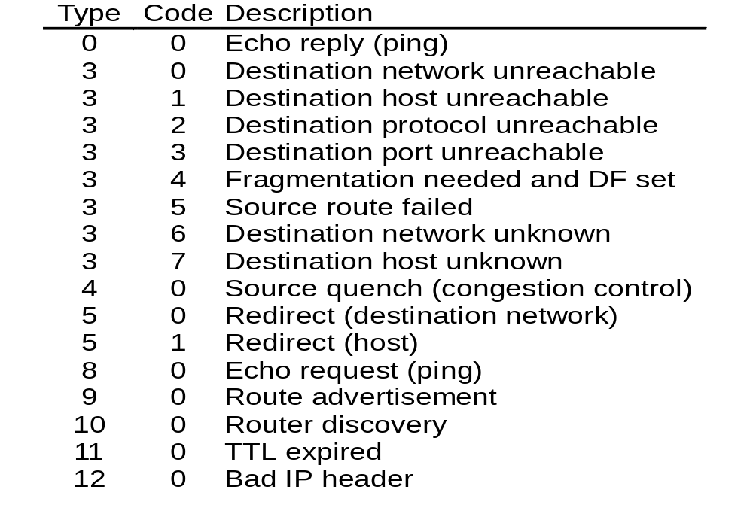
Type and Code
Chapter 4: Internet Protocol Layer

Slide 110
ICMPv4 Examples (1/6)
Echo Request/Reply
  Source sends an echo request (type=8) to a destination, destination responses with an echo reply (type=0)
    The data received by the Echo Request must be entirely included in the Echo Reply.
    The Identifier and Sequence Number is used by the client to match the reply with the request that caused the reply.
  ping uses echo request and reply
0
8
16
24
31
Type
Code
Checksum
Identifier
Sequence Number
Data
Chapter 4: Internet Protocol Layer

Slide 111
ICMPv4 Examples (2/6)
Destination Unreachable (type=3)
  destination unreachable is used to report various unreachable reasons, such as network, host, or port unreachable.
  However, code 4 of type 3 message is used to report the error that fragmentation is needed at an intermediate router (due to MTU) but the do not fragment bit in the IP header is set.
0
8
16
24
31
Type=3
Code
Checksum
Empty
Next-hop MTU
IP header + first 8 bytes of original packet’s data
Chapter 4: Internet Protocol Layer

Slide 112
ICMPv4 Examples (3/6)
  Source Quench
    when buffer overflows, router sends a source quench (type=4) to source
  Routing redirect
    If a host forwards a packet to a wrong router, router sends a redirect (type=5, code=0 or 1, (network/ host)) ICMP message to source
0
8
16
24
31
Type
Code
Checksum
Unused
Data
0
8
16
24
31
Type
Code
Checksum
Gateway (router) IP address
Data
Chapter 4: Internet Protocol Layer

Slide 113
ICMPv4 Examples (4/6)
  Time Exceeded
    If TTL is less or equal to zero (after decrement), router sends a Time Exceeded (type=11) ICMP message to source
    traceroute implementation
      traceroute sends an ICMP echo request with TTL=1 to the target machine
      When the first router receives the message, it responds with a time exceeded message
      traceroute then sends another echo request with TTL=2
      The message passes the first router, but discarded by the second router with a returned time exceeded message
      Traceroute repeats sending echo requests until it receives an echo reply from the target machine
Chapter 4: Internet Protocol Layer

Slide 114
ICMPv4 Examples (5/6)
  IP header error
    Wrong IP header, such as wrong option field. (type=12)
    Code=0: IP header is invalid
    Code=1: a required option is missing
Chapter 4: Internet Protocol Layer

Slide 115
ICMPv4 Examples (6/6)
Time Stamp Request/Reply
  Type=13/14, code=0
Information Request/Reply
  Type=15/16, code=0
Address Mask Request/Reply
  Type=17/18, code=0
Chapter 4: Internet Protocol Layer

Slide 116
ICMPv6
New type and code
  Type 0..127: error report
    1: Destination unreachable
    2: Packet too big
    3: Time Exceeded
    4: Parameter problem
  Type 128..255: informational
    128, 129: Echo request & reply (RFC 2463)
    130, 131, 132: Multicast group membership management (RFC 2710)
    133,134: Router solicitation and advertisement (RFC 2461)
    135, 136: Neighbor solicitation and advertisement (RFC2461)
    137: Redirect (RFC 2461)
    138: Router renumbering (RFC 2894)
    139, 140: node information query/response (draft, name-lookups)
    141, 142: Inverse ND solicitation/ Adv message (RFC 3122)
    150, 151: Home agent address discovery request/reply (draft)
    152, 153: Mobile prefix solicitation/advertisement
Chapter 4: Internet Protocol Layer

Slide 117
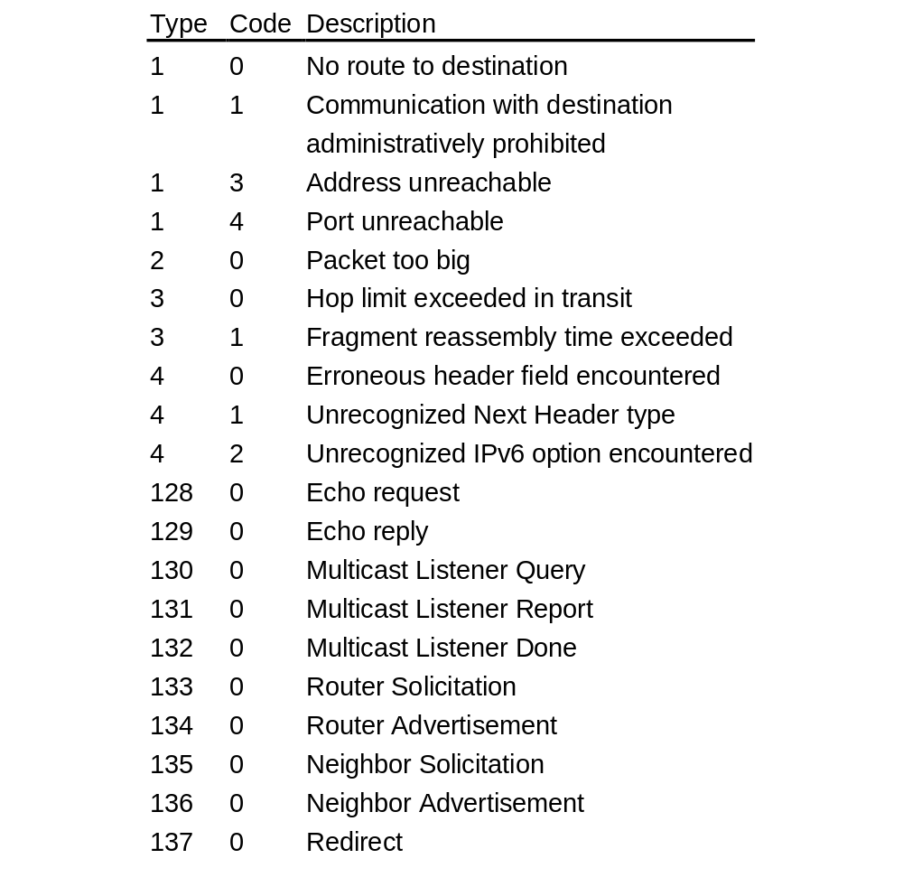
ICMPv6
Chapter 4: Internet Protocol Layer

Slide 118
Open Source Implementation 4.8:
ICMP
Data structure
  ICMP header: struct icmphdr
Error when forwarding IP packets
  ip_forward() → icmp_send()
    TTL<=1
    Strict source routing Fail
    Route redirect
Error when receiving IP packets
  ip_route_input_slow() →ip_error() → icmp_send()
    destination unreachable
Chapter 4: Internet Protocol Layer

Slide 119
Open Source Implementation 4.8 (cont)
Receiving ICMP packets
  Control handlers: icmp_pointers[]
    icmp_unreach() for type 3, 4, 11, and 12
    icmp_redirect() for type 5
    icmp_echo() for type 8
    icmp_timestamp() for type 13
    icmp_address() for type 17
    icmp_address_reply() for type 18
    icmp_discard() for other types
  icmp_rcv() → icmp_pointers
  ICMPv6
    icmpv6_send()
    icmpv6_rcv() →icmpv6_echo_reply(), icmpv6_notify()
Chapter 4: Internet Protocol Layer

Slide 120
4.6 Routing
Principle
Intra-domain routing
Inter-domain routing
Chapter 4: Internet Protocol Layer

Slide 121
Routing Principle
Link State Routing
Distance Vector Routing
Chapter 4: Internet Protocol Layer

Slide 122
Routing
Task of routing
  Select a path to the destination
Goal of routing
  Efficient (low delay, high throughput, …)
  Scalable
  Stable
  Robust
  Fair
Chapter 4: Internet Protocol Layer

Slide 123
Optimality of IP Routing
IP uses hop-by-hop routing(forwarding)
  Each router determines its own routing table
  Why packets will be delivered to their destinations along the optimal path?
    If k is an intermediate node on the optimal path from source node s to destination d
    The path from s to k is also the optimal path from s to k
    A shortest path tree can be constructed from a source to the rest of the graph.
Chapter 4: Internet Protocol Layer

Slide 124
Routing Algorithm Classification
Global or decentralized information?
  Link State routing: use Dijkstra algorithm
  Distance Vector routing: use distributed
  Bellman-Ford algorithm
Static
  Fixed routing table, set up manually
Dynamic (adaptive)
  Routing table adapts to network status
Chapter 4: Internet Protocol Layer

Slide 125
The Shortest Path Algorithm
View a network as a graph
  Nodes are routers
  Edges are physical links
    Associated with a link cost: delay, congestion level, …
Find the least cost path
  Depends on information available
Chapter 4: Internet Protocol Layer

Slide 126
Link-State Routing
Routing information
  Global information is available by reliable broadcasting
  Dynamic: information exchanged when topology changes or periodically
Path calculation
  Dijkstra algorithm
Chapter 4: Internet Protocol Layer

Slide 127
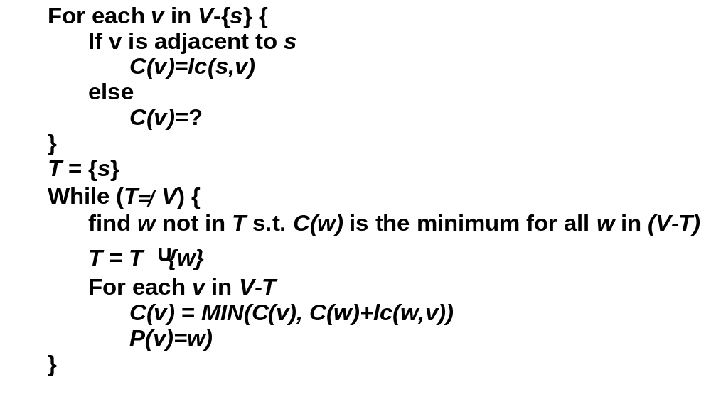
Dijkstra Algorithm
Chapter 4: Internet Protocol Layer

Slide 128
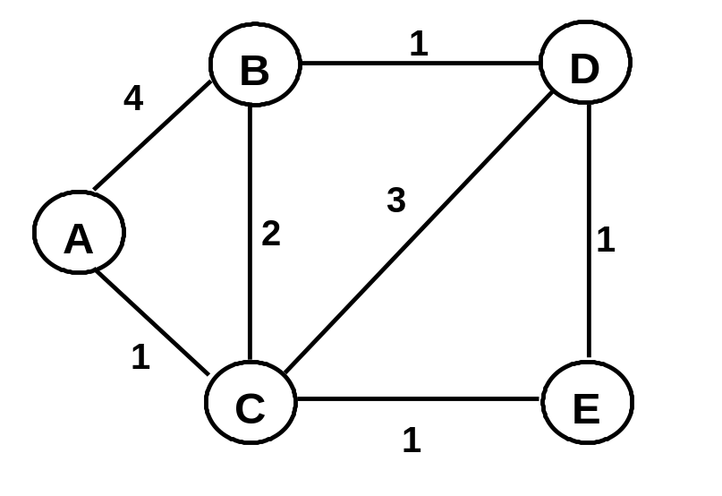
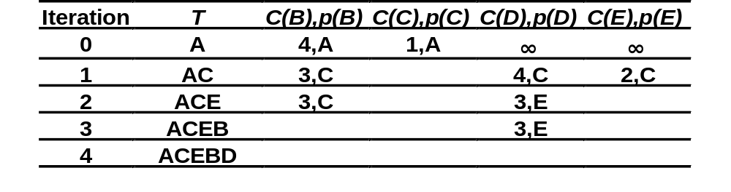
Dijkstra Algorithm Example
Chapter 4: Internet Protocol Layer

Slide 129
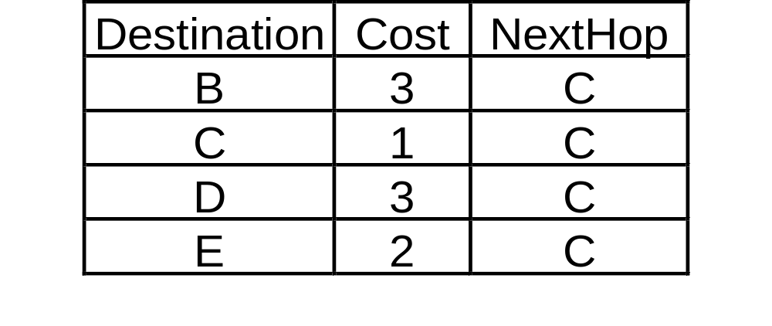
Routing Table at Node A
Chapter 4: Internet Protocol Layer

Slide 130
Distance Vector Algorithm
Routing information
  Only local information is known
    Knows status of adjacent links and routing information of adjacent nodes
  Dynamic: information exchanged when link cost or shortest path changed
Path calculation
  Bellman-Ford
Chapter 4: Internet Protocol Layer

Slide 131
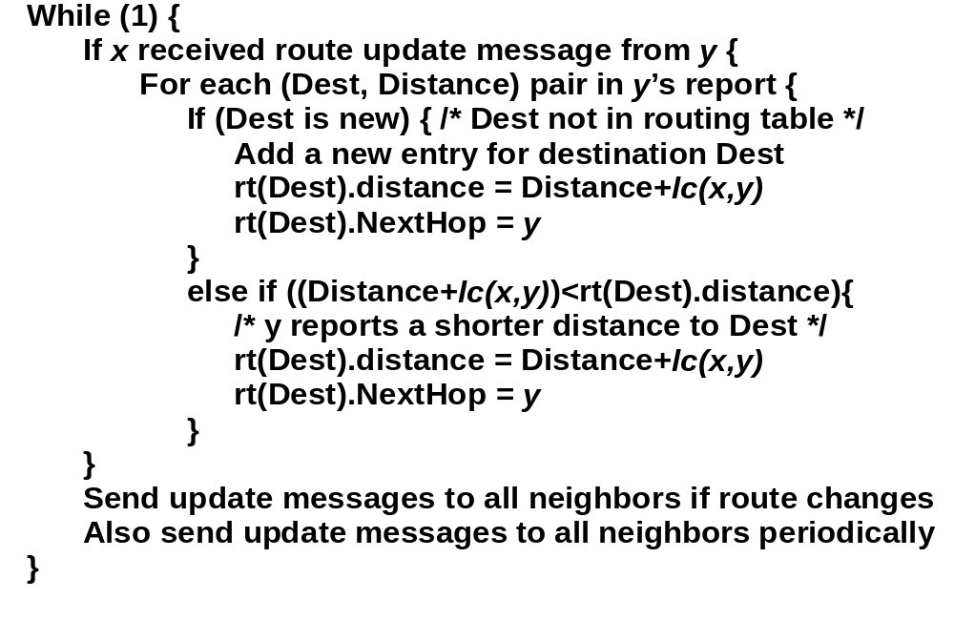
Bellman-Ford Algorithm
Chapter 4: Internet Protocol Layer

Slide 132
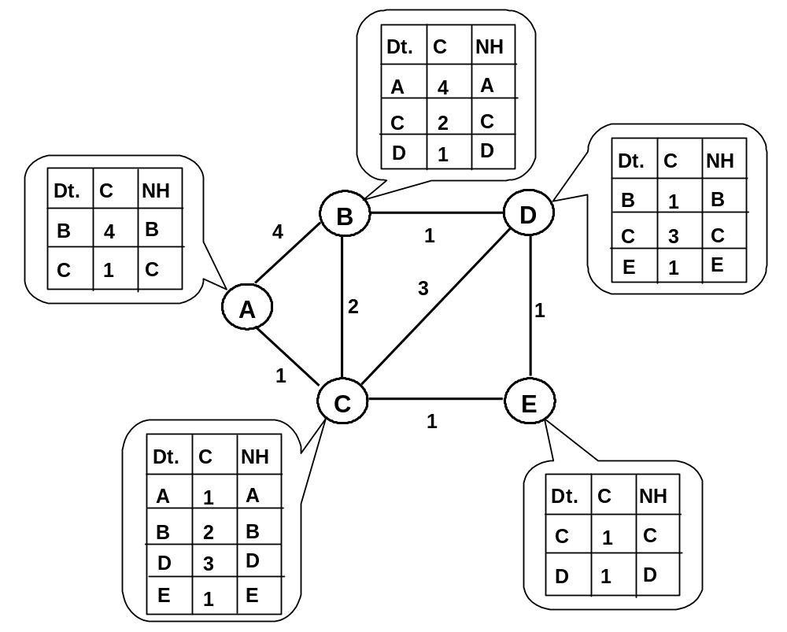
Bellman-Ford Algorithm Example:
Step 1
Chapter 4: Internet Protocol Layer

Slide 133
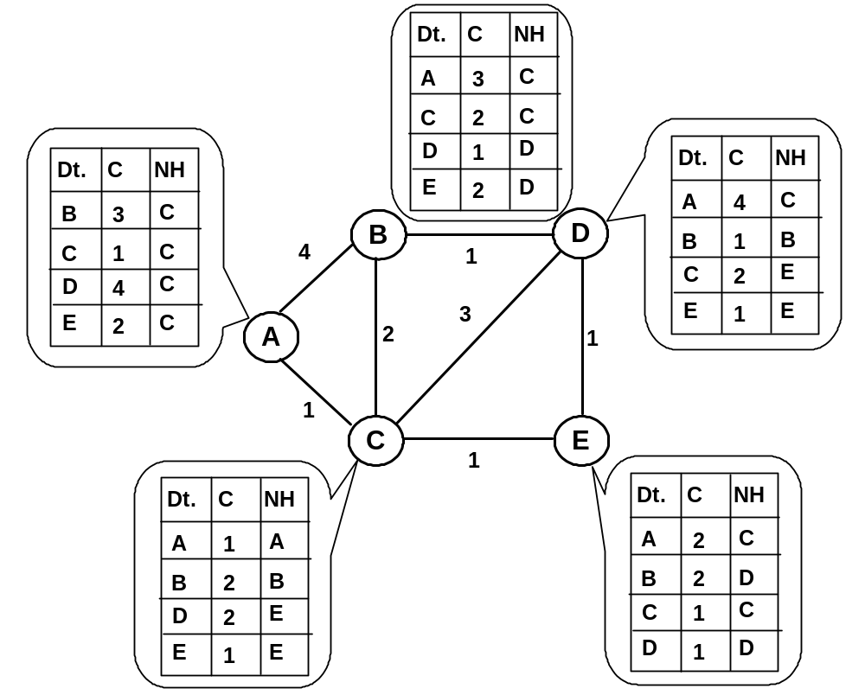
Bellman-Ford Algorithm Example:
Step 2
Chapter 4: Internet Protocol Layer

Slide 134
Bellman-Ford Algorithm Example:
Step 3
Dt.
C
NH
A
3
C
C
2
C
D
1
D
Dt.
C
NH
Dt.
C
NH
E
D
2
A
3
E
B
3
C
D
B
B
1
B
C
1
C
4
1
D
3
C
C
2
E
E
2
C
3
E
1
E
A
2
1
1
C
E
1
Dt.
C
NH
Dt.
C
NH
A
1
A
A
2
C
B
2
B
B
2
D
D
2
E
C
1
C
E
1
E
D
1
D
Chapter 4: Internet Protocol Layer

Slide 135
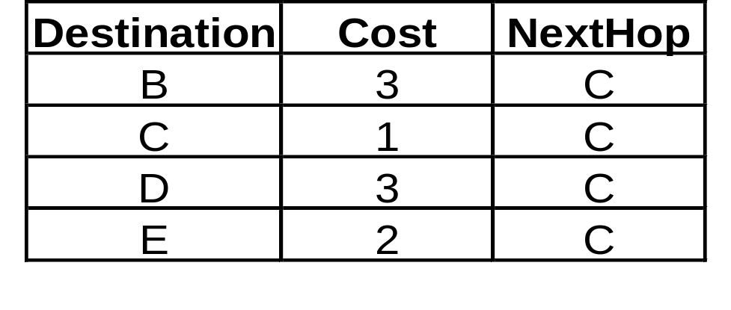
Bellman-Ford Algorithm Example
Routing table of node A after convergence
Chapter 4: Internet Protocol Layer

Slide 136
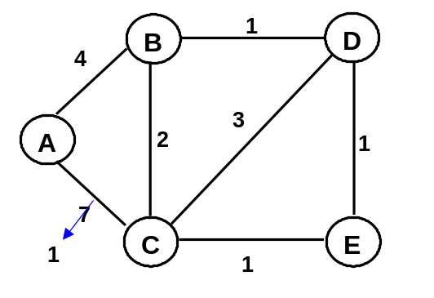

Problem with DV Routing (1/2)
Phenomenon
  good news travels fast
  bad news travels slowly
Route updated in two iterations.
Route updated in more than 25 iterations.
Chapter 4: Internet Protocol Layer

Slide 137
Problem with DV Routing (2/2)
Routing loop
  Due to the above phenomenon
  Loop formed before routing converged
Partial solutions
  Split horizon
    Routing updates sent to a neighbor should not contain route learned from that neighbor.
  Poisoned reverse
    If A learns a route to D from B, then A tells B that he cannot reach D so to poison the route.
  Hold down timer
    When a router receives an update from a neighbor indicating a network is inaccessible, the router marks the route as inaccessible and starts a holddown timer
    Holddown timers help prevent counting to infinity but also increase convergence time
Chapter 4: Internet Protocol Layer

Slide 138
Hierarchical Routing
Not a flat network: too many routing entries
Define an AS
  Routers within an AS are under the same administrative control
Routing within an AS and between AS’s
  Intra-domain routing
  Inter-domain routing
Chapter 4: Internet Protocol Layer

Slide 139
AS
The Internet consists of Autonomous Systems (AS) interconnected with each other:
  Stub AS: small corporation
  Multihomed AS: large corporation (no transit)
  Transit AS: provider
Two-level routing:
  Intra-AS: routing within an AS
  Inter-AS: routing between AS’s
Chapter 4: Internet Protocol Layer

Slide 140
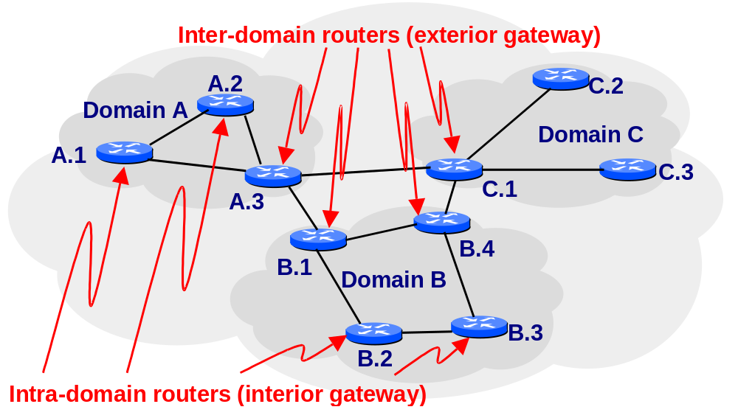
An example of Hierarchical Routing
Chapter 4: Internet Protocol Layer

Slide 141
Example of Internet Routing Protocols
Intradomain routing
  RIP
  OSPF
Interdomain routing
  BGP-4
Chapter 4: Internet Protocol Layer

Slide 142
Intra-domain Routing
Routing Information Protocol (RIP)
Open Shortest Path First (OSPF)
Chapter 4: Internet Protocol Layer

Slide 143
Intra-domain Routing
What is intra-domain routing
  Routing within a domain (AS)
  Administrator decides the routing protocol
  Administrator has total control on all routers
Why intra-domain routing
  Maintain connectivity within a domain
Chapter 4: Internet Protocol Layer

Slide 144
Intra-domain Routing
Runs Interior Gateway Protocols (IGP)
Most Common IGP’s
  RIP: Routing Information Protocol
  OSPF: Open Shortest Path First
Chapter 4: Internet Protocol Layer

Slide 145
RIP
Originally designed for Xerox PARC Universal Protocol (used in XNS)
Adopted by UNIX and TCP/IP in 1982
  routed of BSD
RIP: RFC 1058 [1988]
RIPv2: RFC 1388 [1993]
RIPng: RFC 2080 [1997]
Chapter 4: Internet Protocol Layer

Slide 146
RIP
Distance Vector routing
  Use hop count as cost metric (up to 15)
  Restrict size of the network to 15
  Exchange routing message (advertisement)
    every 30 seconds
  Each advertisement consists of up to 25 routes (destination nets)
Chapter 4: Internet Protocol Layer

Slide 147
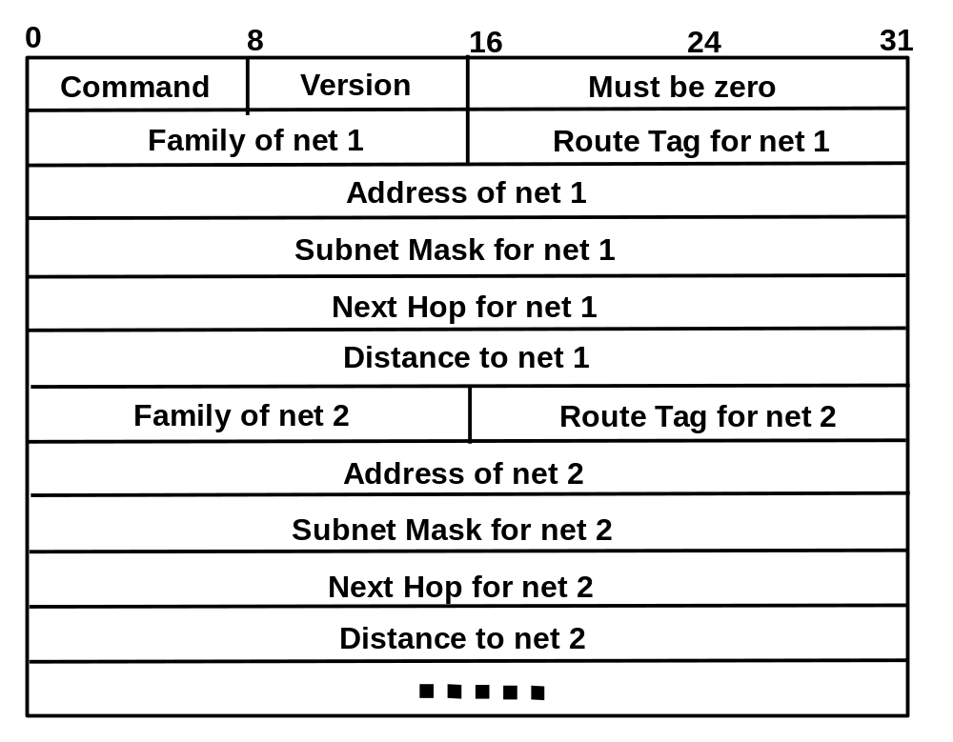
RIPv2 Packet Format
Chapter 4: Internet Protocol Layer

Slide 148
RIP Packet Format and Stability
RIP packet format
  commands: request or reply, version number
  up to 25 destination addresses
Stability
  hop count limit: 15 means infinity
  Stabilization Timer:
    allows RIP to learn all routes from its neighbors before sending full updates
  Split horizons
    no update on backward route (omits routes learned from that neighbor)
  Poison Reverse Update
    sends updates to a neighbor includes routes learned from that neighbor but sets the route metric to infinity
Chapter 4: Internet Protocol Layer

Slide 149

Routing Table of RIP
Taken from a cisco router at cs.ccu.edu.tw
Chapter 4: Internet Protocol Layer

Slide 150
Open Source Implementation 4.9: RIP
GNU Zebra Project
  Supports many routing protocols
    RIP, OSPF, BGP
  Runs routing daemon as user process
    Communicates with kernel via netlink
Chapter 4: Internet Protocol Layer

Slide 151
Open Source Implementation 4.9 (cont)
Routing Daemon and Kernel
Routing manager
(Zebra, routed, gated, …)
Handling protocol specific packets
User space
Control
packets
Kernel space
Kernel
Routing Table
Data packets
Packets from NICs
Chapter 4: Internet Protocol Layer

Slide 152
Open Source Implementation 4.9 (cont)
Overview of Zebra Routing Protocols
RIPd
OSPFd
BGPd
RIPngd
Routing Information
(via socket interface)
Zebra Daemon
ioctl
sysctl
netlink
proc fs
rtnetlink
Kernel
Routing Table
Chapter 4: Internet Protocol Layer

Slide 153
Open Source Implementation 4.9 (cont)
RIP Daemon (ripd)
Initialization
Scheduling
RIP core
rip_version
rip_default_metric
rip_timers
rip_route
rip_distance
Interface
rip_network
rip_neighbor
rip_passive_interface
ip_rip_version
ip_rip_authentication
rip_split_horizon
Zebra
client
RIP Peer
rip_peer_timeout
rip_peer_update
rip_peer_display
Zebra Daemon
routemap
offset
Chapter 4: Internet Protocol Layer

Slide 154
OSPF Features (1/3)
OSPF v2: RFC 2328 [1998]
OSPF v3: RFC 2740 [1999]
Run internal to a single Autonomous System
Link-state routing protocol
Shortest-path tree be constructed for routing table
  Dijkstra algorithm
Support for equal-cost multipath routing
Support for TOS-based routing
Support variable subnet length
  each route distributed has a destination and mask
Chapter 4: Internet Protocol Layer

Slide 155
OSPF Features (2/3)
Integrated uni- and multicast support:
  Multicast OSPF (MOSPF) uses same topology database as OSPF
Two levels of hierarchy : areas within an AS
  Area: a group of contiguous networks and hosts
    Topology of an area is invisible form outside
  Routing in the AS takes place on two level
    intra-area routing, inter-area routing
Chapter 4: Internet Protocol Layer

Slide 156
OSPF : Two Levels of Hierarchy
AS boundary router
backbone
Area border
router
Area border
router
Backbone
router
internal
internal
internal
router
router
router
Area A
Area B
Area C
Chapter 4: Internet Protocol Layer

Slide 157
OSPF Hierarchy
Area border routers
  “summarize” distances to networks of its area
  advertise to other Area Border routers
Area internal routers
  Only participate intra-area routing
  Receive external routes broadcasted by area border router
Backbone routers
  run OSPF routing limited to backbone
AS Boundary routers
  connect to other AS’s
Chapter 4: Internet Protocol Layer

Slide 158
OSPF Features (3/3)
External routing data is advertised through AS
  Flood without modification
  Two types of cost
    type 1: compatible with costs within area, cost to an external network is the sum of internal cost and external cost
    type 2: order of magnitude larger, cost to an external network is solely determined by external cost
Chapter 4: Internet Protocol Layer

Slide 159
OSPF
Features
  Supports stub to reduce broadcasting
    An area can be figured as stub when there is a single exit point from the area.
    AS boundary routers cannot be placed internal to stub areas.
    No AS external advertisements are flood into /through stub areas.
Chapter 4: Internet Protocol Layer

Slide 160
RT1
3
RT5
8
N12
1
RT4
8
1
8
8
N13
N1
N3
8
1
1
7
N14
3
6
8
Internal
router
RT2
6
N2
2
RT3
6
RT6
Area border
router
N4
Area 1
7
Ia
AS boundary
router
Area 2
N11
N12
6
RT7
2
Ib
9
Stub
RT9
5
RT10
N15
1
3
1
1
RT11
1
2
N9
N6
N8
H1
1
RT12
1
10
RT8
2
N10
Chapter 4: Internet Protocol Layer
4
N7
Area 3

Slide 161

OSPF Example: Intra-area
Summarized area information advertised by RT3 and RT4 to backbone.
RT1
3
1
RT4
N1
1
N3
1
1
3
RT2
N2
2
RT3
N4
Area 1
Chapter 4: Internet Protocol Layer

Slide 162

OSPF Example: Inter-area
Backbone information advertised into area 1 by RT3 and RT4.
RT5
8
N12
RT4
8
8
8
N13
8
7
N14
6
8
RT3
6
6
RT6
7
Ia
Ib
5
RT10
6
2
N12
RT7
1
9
Chapter 4: Internet Protocol Layer
1
N6
N15

Slide 163

OSPF Example: Final Routing Table
RT4’s routing table
Chapter 4: Internet Protocol Layer

Slide 164
Open Source Implementation 4.10: OSPF
Initialization
Scheduling
OSPF core
ip_ospf_interface
ip_ospf_neighbor
ospf_router_id
network_area
show_ip_ospf_cmd
Interface
LSA
Link State
Advertisement
zclient
Route
Network
Zebra
daemon
Route Map
route_map_update
route_map_event
OSPF Flooding
OSPF SPF
calcuation
ASE
AS external
route calculation
LSDB
Chapter 4: Internet Protocol Layer

Slide 165
Inter-domain Routing
Border Gateway Protocol (BGP)
Chapter 4: Internet Protocol Layer

Slide 166
Inter-domain Routing
Called Exterior Gateway Protocols (EGP)
Most common EGP
  BGP: Border Gateway Protocol
Chapter 4: Internet Protocol Layer

Slide 167
BGP Features (1/3)
RFC 1771 (BGP-4)
“Path vector” routing
  loop free inter-domain routing between ASs
Runs over TCP with port 179
Routing table keeps all feasible paths
  Only advertises optimal path to neighbors
Chapter 4: Internet Protocol Layer

Slide 168
BGP Features (2/3)
Can be used within and between ASs
  multiple border routers (BGP speaker) within an AS
  IBGP: Interior BGP
    runs between routers in the same AS
    All BGP speakers within the AS must be fully meshed (through IGP protocol)
  EBGP: Exterior BGP
    runs between routers belonging to two different ASs
Chapter 4: Internet Protocol Layer

Slide 169
BGP Features (3/3)
Support information aggregation
  CIDR
  Confederation
    could also be used to allow multiple ASs within an AS
Policy routing at AS
  access-list permit or deny (route or path filtering)
Link cost metric
  combination of different metric with the degree of preference (weight, loc pref, med, …)
Chapter 4: Internet Protocol Layer

Slide 170
BGP Messages
Open
  First message sent after connection
Keepalive
  Send often enough to keep from timer expiration
Update
  No periodic refresh of the entire table
  Advertise a single feasible route to a peer
  Withdraw multiple routes previously advertised
  Message contains path attributes and Network Layer Reachability Information (NLRI)
Notification
  send when an error is detected
Chapter 4: Internet Protocol Layer

Slide 171
BGP Routing Algorithm
Path vector routing
  Different ASs may have different link cost metrics
  Loop free is very important
  Policy routing is preferred (different priorities, prohibit lists, …)
  AS_PATH of the path attribute
    A list of ASs to the destination
    Loop is found if current AS already in the AS_PATH
  Next_Hop of the path attribute indicates the next router to the destination
  NLRI
    A list of subnets that can be reached by the AS_PATH
Chapter 4: Internet Protocol Layer

Slide 172
BGP Path Selection
Path selection
  (1) If Next_Hop is inaccessible, drop the update
  (2) Prefer largest LOCAL_PREF
  (3) Prefer shorter AS_PATH
  (4) Prefer lower origin code (igp<egp<incomplete)
  (5) Prefer lower MED (MULTI_EXIT_DISC)
  (6) Prefer external path over internal path
  (7) Prefer closer IGP neighbor
  (8) Prefer BGP router with lower ip address
Advertise the highest degree of preference for each destination to neighbor BGP speakers
Chapter 4: Internet Protocol Layer

Slide 173
BGP PATH Attributes (1/2)
Origin
  Defines the origin of the path information
    IGP, BGP, Incomplete (unknown, e.g., static route)
AS_PATH
  Ordered list or a set
Next_Hop
  IP of the next hop to the destination
  For multiaccess network, nexthop could be a router other than the BGP speaker
Chapter 4: Internet Protocol Layer

Slide 174
BGP PATH Attributes (2/2)
LOCAL_PREF
  Indicate preferred exit router within an AS
Multi_Exit_Disc(MED)
  When a router has multiple external links to the same AS, the link to the router with lower MED is preferred.
Chapter 4: Internet Protocol Layer

Slide 175

BGP Example
Chapter 4: Internet Protocol Layer

Slide 176
4.7 Multicast
Internet Group Management Protocol (IGMP)
Distance Vector Multicast Routing Protocol (DVMRP)
Protocol-Independent Multicast (PIM)
New Developments: SSM, MSDP, Anycast RP
Multicast Backbone (MBONE)
Chapter 4: Internet Protocol Layer

Slide 177
Multicast
Communication among more than two parties
  Multi-party video conferencing
  Distance learning
Issues
  Maintain group member information
  Construct a multicast tree for packet transmission
  Many to many communication
Chapter 4: Internet Protocol Layer

Slide 178
Membership Management
IGMP
Chapter 4: Internet Protocol Layer

Slide 179
Internet Group Management Protocol ( IGMPv2)
RFC 2236
Used by IP hosts to report multicast group memberships to routers
Enhances IGMPv1
  Querier election mechanism
  IGMPv2 Leave Group message
  Group-Specific Query message
Chapter 4: Internet Protocol Layer

Slide 180
Protocol Overview (1/4)
Multicast router plays one of the two roles: Querier or Non-Querier
  Querier is responsible for maintain membership information
  Router with the smallest IP address becomes the Querier
    Routers hear the Query messages and make the judge
  Querier periodically sends General Query to solicit membership information
  A General Query is sent to 224.0.0.1 (ALL-SYSTEMS multicast group)
Chapter 4: Internet Protocol Layer

Slide 181
Protocol Overview (2/4)
When a host receives a General Query
  Delays a random time from the range of [0..Max Response Time](starts a timer)
    Max Resp. Time is given in the Query message
  Sends a report with TTL=1 when timer expires
  Report suppression
    If another host’s report received, stop the timer and does not send the report
Similar for a host receives a Group-Specific Query
Chapter 4: Internet Protocol Layer

Slide 182
Protocol Overview (3/4)
When a router receives a report
  adds the group being reported to the list of multicast groups
  Sets timer for the membership to [Group Membership Interval].
    Deletes it if no reports received before timer expired
    Query is sent periodically
When a host joins a multicast group
  Sends an unsolicited report immediately
Chapter 4: Internet Protocol Layer

Slide 183
Protocol Overview (4/4)
When a host leaves a multicast group
  If it was the last host to reply to a Query, it should send a Leave Group message to all-routers multicast address (224.0.0.2)
When a router receives a Leave Group message
  Sends Group-specific Queries every [Last Member Query Interval] to the group being left for [Last Member Query Count] times.
  If no reports received before [Last Member Query Interval], assumes no local members.
Chapter 4: Internet Protocol Layer

Slide 184

IGMPv2 Message Format (1/2)
message format
type
0x11=Membership Query
- General query
- Group-Specific Query
0x16=Version 2 Membership Report
0x17=Leave Group
Chapter 4: Internet Protocol Layer

Slide 185
IGMPv2 Message Format (2/2)
Max Response Time
- only in membership query message
- set to be zero in other messages
Checksum
- 16-bit one’s complement
Group address
- zero when sending a General Query
- group address when sending a Group-Specific
query
Chapter 4: Internet Protocol Layer

Slide 186
IGMPv3
IETF RFC 3376
Adds support for “source filtering”
  A receiver may request to receive packets only from specific source addresses
  Select source addresses by INCLUDE or EXCLUDE
    IPMulticastListen(socket, interface, multicast-address, filter-mode, source-list)
    filter-mode: INCLUDE or EXCLUDE
Chapter 4: Internet Protocol Layer

Slide 187
Multicast Routing Protocols
DVMRP
PIM-SM
SSM
MSDP
Anycast RP
Chapter 4: Internet Protocol Layer

Slide 188
Multicast Routing Protocols
Two types of multicast tree
  source-based tree
  core-based tree (shared tree)
Multicast protocols
  DVMRP
  PIM
    Sparse mode
    Dense mode
  SSM
  MSDP
  Anycast RP
  MBGP
What’s the difference:
per (S,G) tree or
per (*,G) tree
Chapter 4: Internet Protocol Layer

Slide 189

Example where Steiner tree is different from least-cost-path tree
Copyright reserved 2001 (Lin & Hwang)
Chapter 4: Internet Protocol Layer

Slide 190
Distance Vector Multicast Routing Protocol (DVMRP)
RFC-1054
Derived from RIP
  Relies on RIP for unicast routing
Widely used on the Mbone
  Enable incremental deployment of IP multicast since it supports tunnel
Construct a source-based tree per source
  Provide a shortest path between source and receivers using Reverse Path Forwarding (RPF) algorithm
Chapter 4: Internet Protocol Layer

Slide 191
RPF Algorithm
Three steps
  Reverse Path Broadcast (RPB)
  Prune to a Reverse Path Multicast (RPM) tree
  Forwarding data uni-directionally
Chapter 4: Internet Protocol Layer

Slide 192
Reverse Path Broadcast (RPB)
Broadcast on the Reserve Path
  When a multicast packet is received
    Forward the packet on all of its outgoing links only if
      Packet arrives on the interface that is also the interface of the shortest path back to the sender
      Packet is not duplicated
    Otherwise, discard the packet
Chapter 4: Internet Protocol Layer

Slide 193

RPB Example
RA
RD
RB
RC
RF
RE
RG
Chapter 4: Internet Protocol Layer

Slide 194
Prune RPB Tree
Prune to RPM tree
  Routers that do not lead to any members send prune messages to upstream routers
  Routers know membership information via IGMP
Chapter 4: Internet Protocol Layer

Slide 195

Prune RPB Tree Example
RA
RD
RB
RC
RF
RE
RG
Chapter 4: Internet Protocol Layer

Slide 196

Example of a RPM tree
Chapter 4: Internet Protocol Layer

Slide 197
DVMRP Drawbacks and Benefits
Drawbacks
  First packet has to be flooded
  Periodic prune state refresh
  Routing state per (source , group) pair
Benefits
  guarantee efficient delivery
  easy to implement
Chapter 4: Internet Protocol Layer

Slide 198
Problems of DVMRP
Work well only for densely represented
groups
  periodic broadcast will cause performance problems
Large amount of state information stored
  Information for forwarding
  Prune-state information
Not scaleable
Chapter 4: Internet Protocol Layer

Slide 199
PIM-SM
Protocol Overview
Special Features
Packet Formats
Chapter 4: Internet Protocol Layer

Slide 200
Protocol Overview
Documents
  RFC 2362, 4601(August, 2006)
Terminologies
  DR: Designated Router
  RP: Rendezvous Point
  RPT: RP-based Tree
PIM-SM route packets in three phases
  Phase one: RP tree
  Phase two: Register Stop
  Phase three: Shortest-Path Tree (Optional)
Chapter 4: Internet Protocol Layer

Slide 201
Phase One: RP Tree
Receiver
  Sends join message to DR using IGMP
  DR sends (*,G) PIM Join message to RP
    Reaches RP or converge on a router on the RPT
    Join message is sent periodically (o.w., it will time out)
Sender
  Sender sends a packet with multicast address as its destination to DR
  DR unicasts encapsulated packet to RP
    PIM Register packets
  RP decapsulates it and forwards it onto RPT
Chapter 4: Internet Protocol Layer

Slide 202

Phase One: RP Tree (Fig)
RTA
Chapter 4: Internet Protocol Layer

Slide 203
Phase Two: Register Stop
Motivation
  Encapsulation and decapsulation are too expensive
Steps
  RP initiates an (S,G) source-specific Join to S
  All the routers on the path records the (S,G) multicast state
  Packets start to flow following the (S,G) tree to RP
  RP may now receive duplicate packets: native and encapsulated. RP discards the encapsulated packet
  RP sends a Register-Stop message to DR of Source
  RP forwards native packets to the RPT
  If the packet reaches a router with (*,G), do a short-cut to receivers.
Chapter 4: Internet Protocol Layer

Slide 204
Phase Two: Register Stop (Fig)
member
Source specific join
RP
DR
RP
(S,G)
source
Chapter 4: Internet Protocol Layer

Slide 205
Phase Three: Shortest-Path Tree
Motivation
  From source to RP, then to receivers is too long.
Steps
  A receiver’s DR may optionally initiate to transfer from the RPT to a source-specific tree (SPT)
  It issues an (S,G) join to S. The join message may reach the source or converged at some router.
  It starts to receive two copies of packets. Drop the one from RPT.
  It then sends an (S,G) prune message to RP
    (S, G, rpt) prune
    Prune message reaches RP or converged at some router on RPT
Chapter 4: Internet Protocol Layer

Slide 206
Phase Three: Shortest-Path Tree (Fig)
member
Source specific join (IGMPv3)
RP
Source specific prune
DR
RP
(S,G)
(S,G,rpt)
source
Chapter 4: Internet Protocol Layer

Slide 207
Source-specific Joins and Prunes
If a receiver sends a source-specific join using IGMPv3
  If no other receiver on that group, DR may omit performing a (*,G) join.
  Instead, DR issues a source-specific (S,G) join.
Multicast addresses for source-specific multicast
  232.0.0.0 to 232.255.255.255
  Only source-specific join will be accepted for group in this range.
A receiver may also sends a source-specific join with exclusive source list
  DR will perform a (*,G) join as normal, but may combine this with an (S,G,rpt) prune for each source in the list.
Chapter 4: Internet Protocol Layer

Slide 208
Inter-domain Multicast: MSDP
RP in each domain establishes an MSDP peering relation with RPs in other domains
When the RP learns a new multicast source within its own domain, it informs its MSDP peers
  The RP encapsulates the first data packet in a Source Active (SA) message and sends the SA to all peers.
  The SA is forwarded by each receiving peer using a modified RPF check
  If the receiving MSDP peer is an RP, and the RP has a (*,G) entry for the group in the SA, the RP sends a (S,G) join. The RP also decapsulates the data and forwards down to its shared tree
  The receiver that interests in this (S,G) could sends a (S,G) join to have the shortest path to the source
Each RP periodically sends SAs, which include all sources within its domain.
Chapter 4: Internet Protocol Layer

Slide 209
Inter-domain Multicast: Multi-Protocol BGP (MBGP)
Defined in RFC 2283 (extensions to BGP)
MBGP is extended to carry different information to support
  IPv4 Unicast
  IPv6 Unicast
  IPv4 Multicast
  IPv6 Multicast
  ….
Routing information may be carried in same BGP session
Chapter 4: Internet Protocol Layer

Slide 210

Open Source Implementation 4.12: Mrouted
Data structures of Mrouted
Copyright reserved 2001 (Lin & Hwang)
Chapter 4: Internet Protocol Layer

Slide 211
Summary on Multicast
Source-based tree
  Advantage
    Optimal path between sources and receivers
  Disadvantage
    Routing information for each (S,G) pair
Shared tree
  Advantage
    Less state in each router
  Disadvantage
    Non-optimal path between sources and receivers
Chapter 4: Internet Protocol Layer

Slide 212
4.8 Summary
Forwarding: longest prefix matching
Routing: two-level, intra-domain and inter-domain
Distance vector routing vs. link state routing: distributed vs. centralized
Other mechanisms: IPv6, NAT, ARP, DHCP, ICMP
Broadcast in subnet: used by ARP and DHCP
Chapter 4: Internet Protocol Layer

