Slide 1
Computer Networks
An Open Source Approach
Chapter 5: Transport Layer
Ying-Dar Lin, Ren-Hung Hwang, Fred Baker
Chapter 5: Transport Layer

Slide 2
Content
5.1 General Issues
    Port-Multiplexing, Reliability, Flow/Congestion Control
5.2 UDP - Unreliable Connectionless Transfer
    Port-Multiplexing
5.3 TCP - Reliable Connection-Oriented Transfer
    Connection Management
    Reliability
    Flow Control
    Performance Enhancements
5.4 Socket Programming Interface
5.5 Real-time Transport (RTP & RTCP)
5.6 Summary
Chapter 5: Transport Layer

Slide 3
5.1 General Issues
End-to-End Communication Channel
Data Integrity
Flow Control
Socket Programming Interface
Chapter 5: Transport Layer

Slide 4
5.1 General Issues
End-to-End Communication Channel: Port-Multiplexing
  Port: communication end point
IP
IP
AP1
AP2
AP1
AP2
MAC
Multi-Access
Channel
MAC
TCP/UDP
IP Network
TCP/UDP
LAN host 1
LAN host 2
IP host 1
IP host 2
Condense delay distribution
Loose delay distribution
Node-to-Node Channel
End-to-End Channel
Chapter 5: Transport Layer

Slide 5
General Issues: Direct-Linked vs. End-to-End
 |  | Direct-Linked Protocol Layer | End-to-End Protocol Layer
base on what services? |  | physical layer | internetworking layer
services | addressing | node-to-node channel within a link. (MAC address) | process-to-process channel between hosts (port number)
 | error checking | per-frame | per-segment
 | data reliability | per-link | per-flow
 | flow control | per-link | per-flow
channel delay |  | condensed distribution | loose distribution
  Note: per-frame integrity such as Ethernet
    Collision: can be detected and be retransmitted
    CRC/alignment error: can only rely on upper-layer protocols
Chapter 5: Transport Layer

Slide 6
Open Source Implementation 5.1:
an incoming packet in the transport layer
Application layer
recvfrom
read
sys_socketcall
sys_read
sys_recvfrom
vfs_read
sock_recvmsg
do_sync_read
__sock_recvmsg
sock_aio_read
sock_common_recvmsg
do_sock_read
raw_recvmsg (sk, buf)
udp_recvmsg (sk,buf)
sock_recvmsg
skb_recvdatagram
tcp_recvmsg(sk,buf)
skb=skb_dequeue
skb_copy_datagram_iovec
sk_receive_queue
sk->sk_data_ready
__skb_queue_tail(sk->sk_receive_queue, skb)
socket_queue_rcv_skb(sk,skb)
tcp_data_queue(sk,skb)
raw_rcv_skb(sk,skb)
tcp_rcv_established
raw_rcv(sk,skb)
udp_queue_rcv_skb(sk,skb)
tcp_v4_do_rcv(sk,skb)
sk=__raw_v4_lookup(skb)
sk=udp_v4_lookup(skb)
sk=inet_lookup(skb)
raw_v4_input(skb)
udp_rcv(skb)
tcp_v4_rcv(skb)
Transport layer
RAW
UDP
TCP
io_local_deliver_finish
Network layer
Copyright Reserved 2009
Chapter 5: Transport Layer

Slide 7
Open Source Implementation 5.1:
an outgoing packet in the transport layer
Application
layer
sendto
write
sys_socketcall
sys_write
sys_sendto
vfs_write
sock_sendmsg
do_sync_write
inet_sendmsg
sock_aio_write
raw_sendmsg(sk,buf)
udp_sendmsg(sk,buf)
do_sock_write
ip_append_data(sk, buf)
sock_sendmsg
skb=sock_wmalloc(sk)
skb=sock_alloc_send_skb(sk)
inet_sendmsg
ip_generic_getfrag
tcp_sendmsg(sk,buf)
skb_queue_tail(&sk->sk_write_queue,skb)
sk_write_queue
udp_push_pending_frames
tcp_push
ip_push_pending_frames
__tcp_push_pending_frames
tcp_write_xmit
tcp_transmit_skb
dst_output
ip_queue_xmit
Transport
layer
skb->dst->output
ip_output
Network
layer
Copyright Reserved 2009
Chapter 5: Transport Layer

Slide 8
5.2 UDP – Unreliable Connectionless Transfers
Objectives
Header Format
Unicast Real-time Applications Using UDP
Copyright Reserved 2009
Chapter 5: Transport Layer

Slide 9
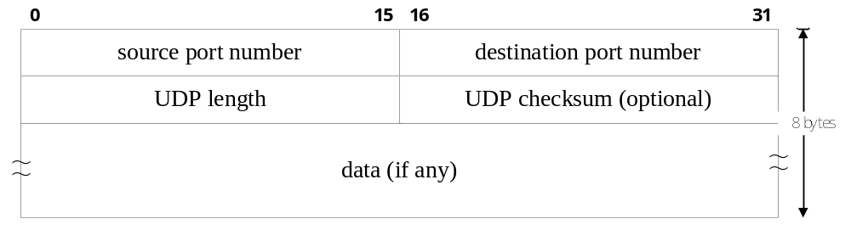
5.2 UDP – For Unreliable Connectionless Transfers
Objectives
  Port-Multiplexing
  Per-Segment Error Checking: Checksum
Header Format
Carrying Unicast/Multicast Real-Time Traffic
  Retransmission is Meaningless: No Per-Flow Integrity Needed
  Bit-rate is Determined by Codec Used: No Flow Control Needed
AP1
AP2
AP1
AP2
TCP
IP Networks
TCP
IP host 1
IP host 2
Copyright Reserved 2009
Chapter 5: Transport Layer

Slide 10
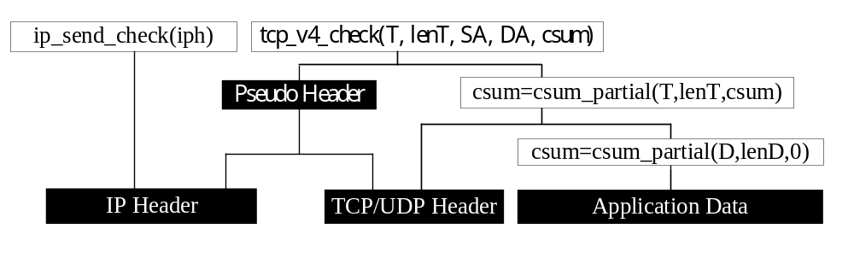
Open Source Implementation 5.2: UDP and TCP Checksum
th->check = tcp_v4_check(len, inet->saddr,
inet->daddr,
csum_partial((char *)th,
th->doff << 2,
skb->csum));
Checksum in TCP/IP
  In Linux 2.6:
Copyright Reserved 2009
Chapter 5: Transport Layer

Slide 11
5.3 TCP – Reliable Connection-Oriented Transfers
Objectives
Connection Management
Per-Flow Data Integrity
Per-Flow Flow/Congestion Control
Performance Problems and Enhancements
Copyright Reserved 2009
Chapter 5: Transport Layer

Slide 12
5.3 TCP – For Reliable Connection-Oriented Transfers
Objectives
  Port-Multiplexing: Same as UDP
  Per-Flow Reliability
  Per-Flow Flow Control
Connection Management
  Connection Establishment/Disconnection & State Transitions
Per-Flow Data Integrity
  Per-Frame Checksum & Per-Flow ACKs
Per-Flow Flow/Congestion Control
Performance
  Interactive vs. Bulk-Data Transfers
Stateful (Ch1) !! Requires connection management
Copyright Reserved 2009
Chapter 5: Transport Layer

Slide 13
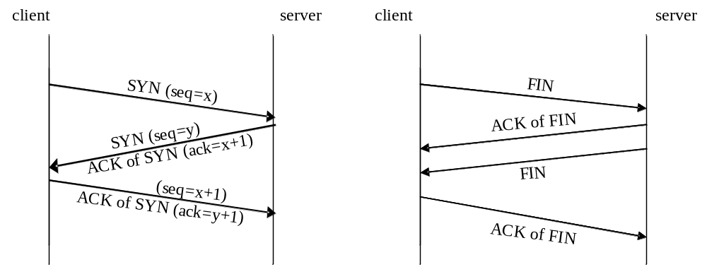
TCP Connection Management
Establishment/Termination – 3-Way Handshake Protocol
Establishment
Termination
Copyright Reserved 2009
Chapter 5: Transport Layer

Slide 14
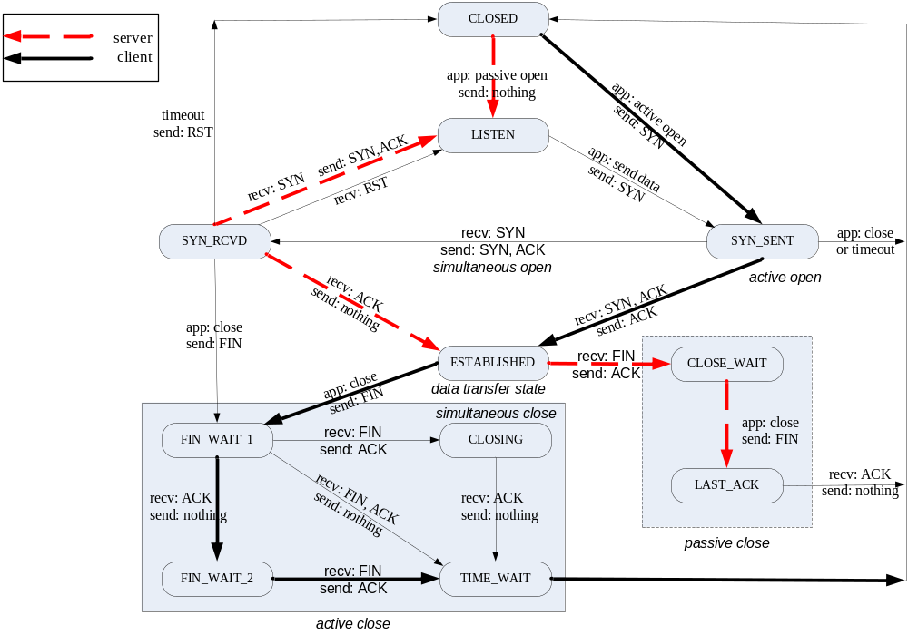
TCP State Transition Diagram
Copyright Reserved 2009
Chapter 5: Transport Layer

Slide 15
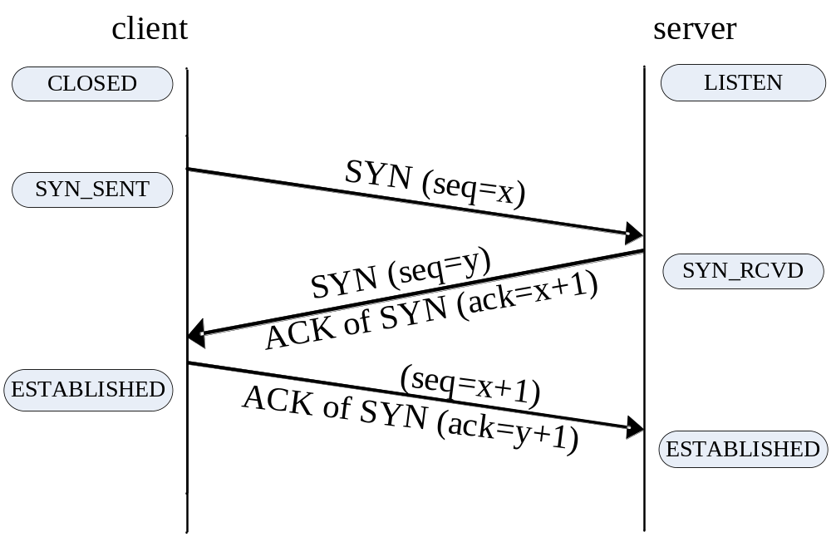
State Transitions: Establishment
Chapter 5: Transport Layer

Slide 16
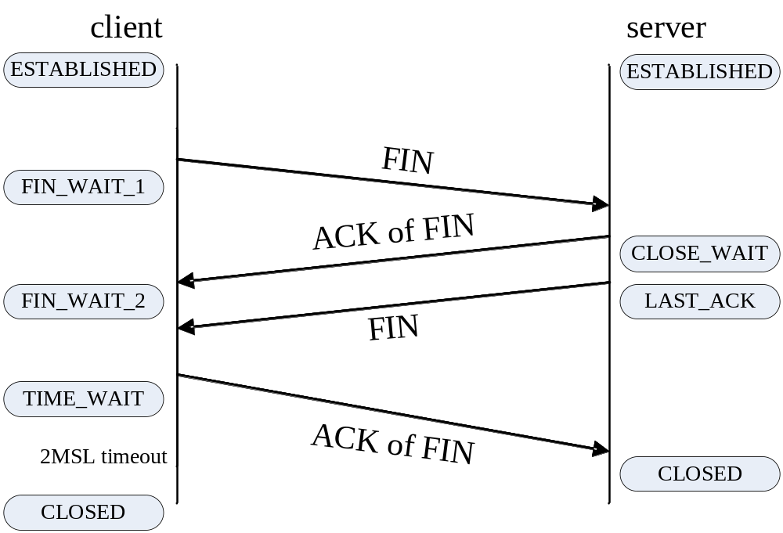
State Transitions: Termination
Chapter 5: Transport Layer

Slide 17
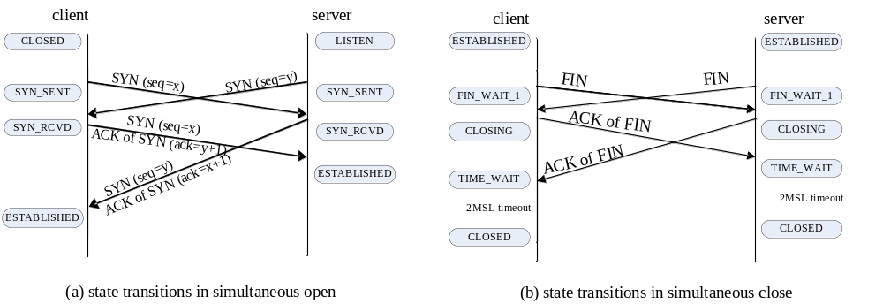
State Transitions: Simultaneous Open/Close
Chapter 5: Transport Layer

Slide 18
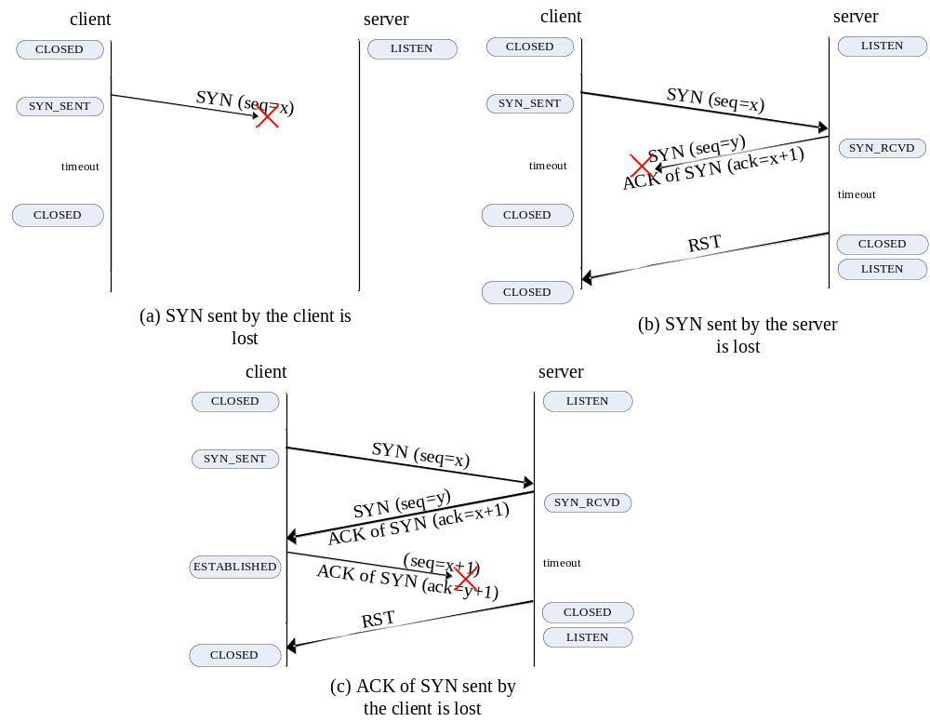
State Transitions : Loss in Establishment
Chapter 5: Transport Layer

Slide 19

TCP State Transition Implementation
In “sock” structure
State names
Copyright Reserved 2009
Chapter 5: Transport Layer

Slide 20
Reliability of Data Transfers
Definition: Data Reliability vs. Data Integrity
  Data Integrity:
    Successfully received packets are exactly the same as they are transmitted.
  Data Reliability:
    Every transmitted packet is successfully received and is exactly the same as the original transmitted one.
TCP
  Per-Segment Integrity: Checksum
  Per-Flow Reliability: Sequence Number & ACK
Copyright Reserved 2009
Chapter 5: Transport Layer

Slide 21
Per-Flow Data Reliability: Sequence Number & Acknowledgement
Per-Flow Data Reliability: Sequence Number & ACK
  ACK every successfully received data segment
  Segment sent but not ACK?
    Dropped by some intermediate router
      Insufficient buffer
      Forced drop
    Dropped by the receiver
      Wrong checksum
Retransmitting Lost Packets
  When to Retransmit Which?
Copyright Reserved 2009
Chapter 5: Transport Layer

Slide 22
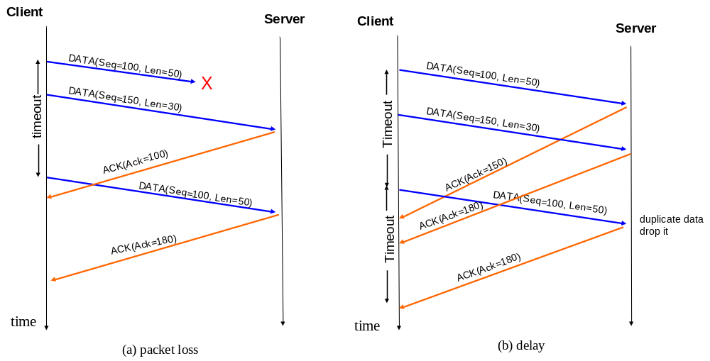
Data Reliability: Cumulative ACK (1/2)
Chapter 5: Transport Layer

Slide 23
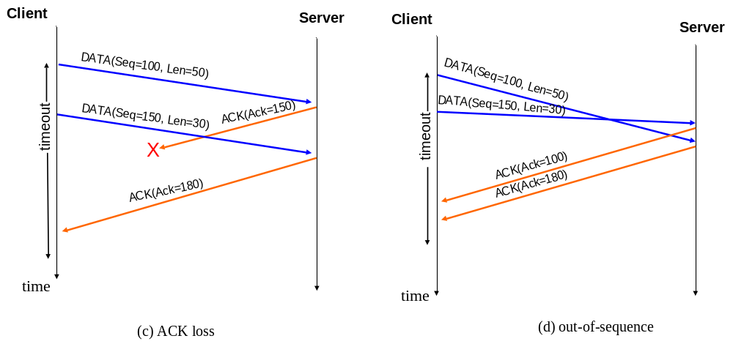
Data Reliability: Cumulative ACK (2/2)
Chapter 5: Transport Layer

Slide 24
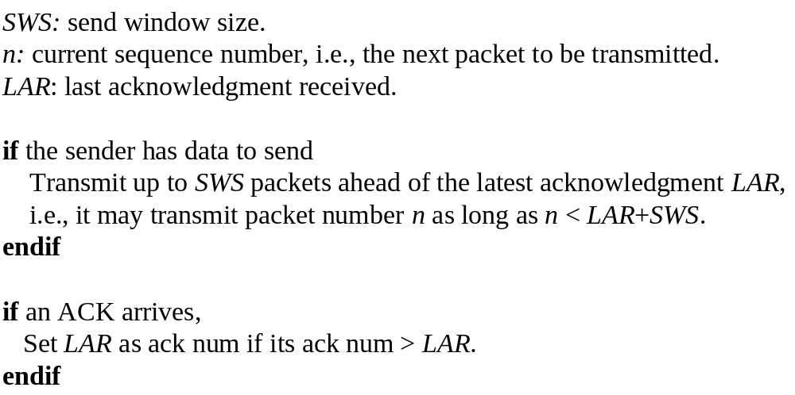
Pseudo Code of Sliding Window in the Sender
Chapter 5: Transport Layer

Slide 25
Per-Flow Flow/Congestion Control
Sliding Window
Should maintain a out-of-order queue to re-sequence before returning to application
Receiving byte stream
Receiver
2
3
4
5
DATA 6
ACK
Ack=6
DATA 7
SND_NXT
SND_UNA
Network Pipe
(size=Data 4~8)
ACK
Ack=5
sliding
DATA 8
Sending Stream
2
3
9
10
Sender
Sent & ACKed
TCP Window Size( = min(RWND, CWND) )
To be sent
When window moves
Should maintain a retransmission queue in case of packet loss
Copyright Reserved 2009
Chapter 5: Transport Layer

Slide 26
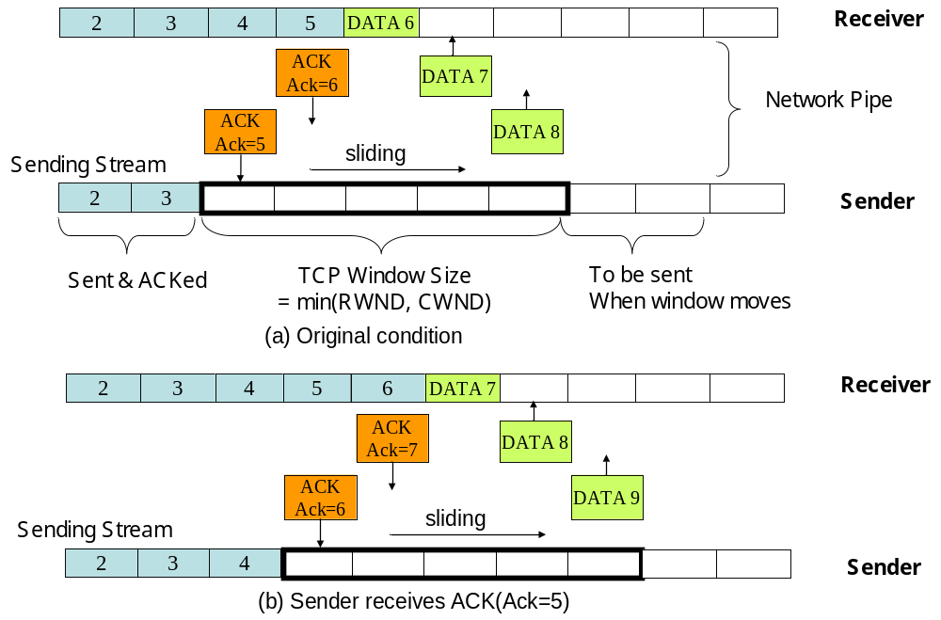
Sliding Window : Normal Case (1/2)
Chapter 5: Transport Layer

Slide 27
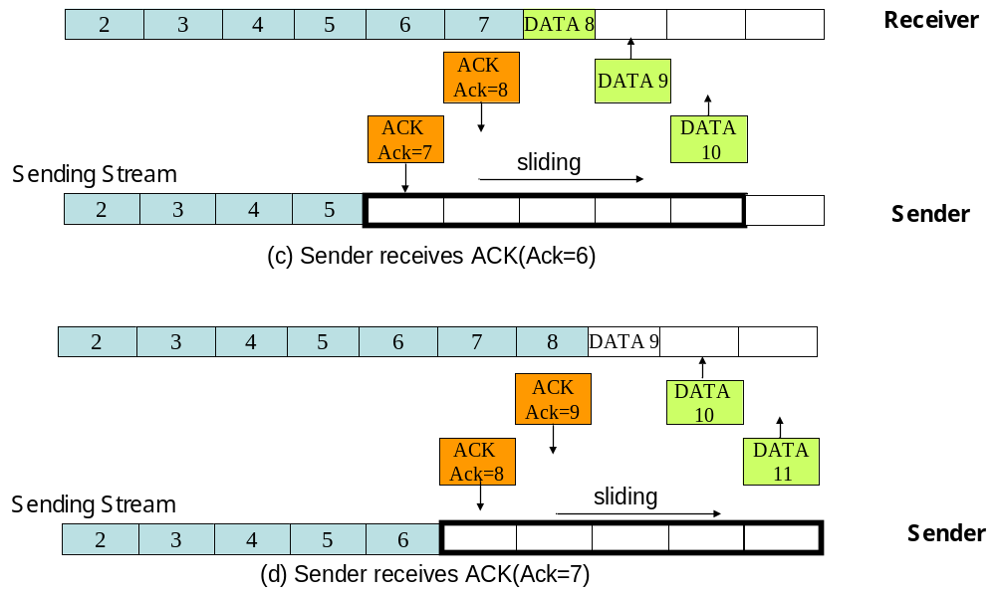
Sliding Window : Normal Case (2/2)
Chapter 5: Transport Layer

Slide 28
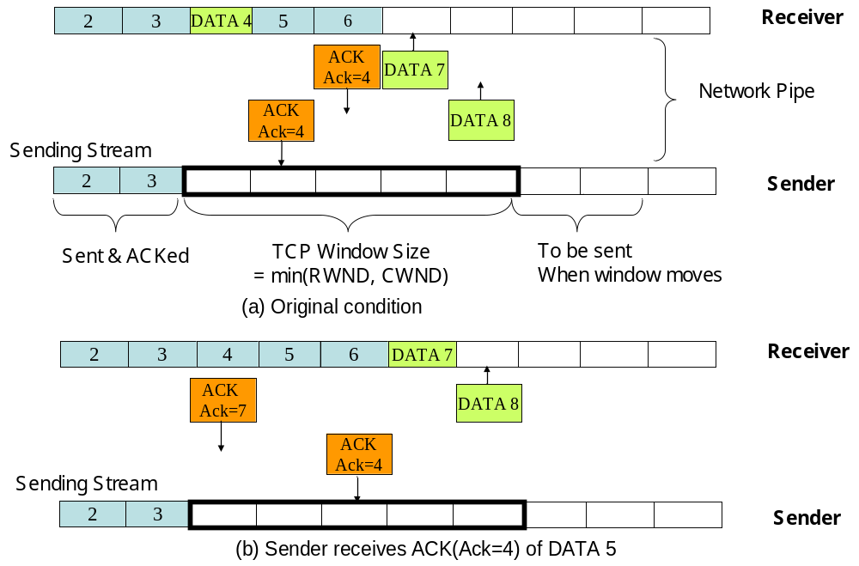
Sliding Window : Out-of-Sequence(1/2)
Chapter 5: Transport Layer

Slide 29
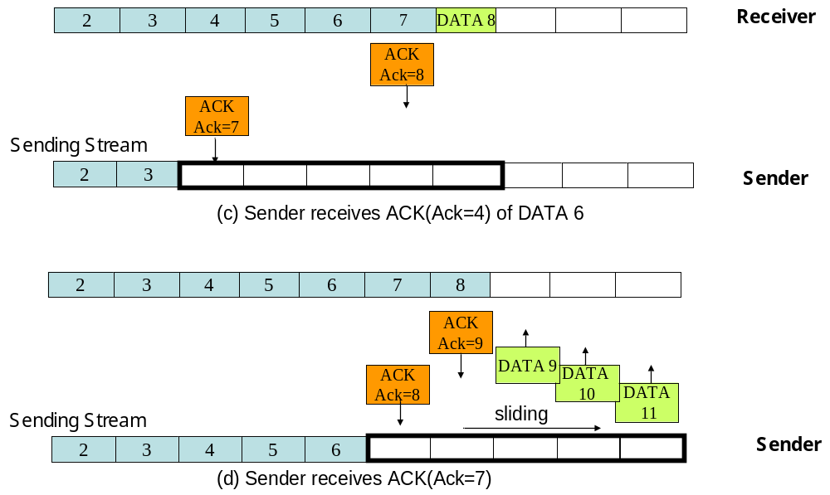
Sliding Window : Out-of-Sequence(2/2)
Chapter 5: Transport Layer

Slide 30
Per-Flow Flow/Congestion Control
Opening & Shrinking of Window Size
Close
Shrink
Open
2
3
9
10
TCP Window Size( = min(RWND, CWND) )
Copyright Reserved 2009
Chapter 5: Transport Layer

Slide 31
Retransmitting Lost Packets
Retransmit Which Packet?
  Fast Retransmit
  Towards Better Accuracy: TCP SACK Option
    Further Refinement: FACK (based on SACK)
When to Retransmit?
  Fast Retransmit: same as above
  Retransmission Timeout (RTO)
    Round-Trip Time (RTT) Measurement
      Tradeoff: RTT vs. RTO
    Karn’s Algorithm
  Towards Better RTO: TCP Timestamp Option
Copyright Reserved 2009
Chapter 5: Transport Layer

Slide 32
Retransmit Which Packet?
3
4
4
4
4
ACK
Fast Retransmit
  Duplicate ACKs
    Packet Reordering
      Packet Loss
      Internet Route Change
    TCP Receiver ACK the First “Hole”
  Triple Duplicate ACKs (TDA)
    4 Same ACKs (ACK field=X)
    TCP Sender Infer TDA as Congestion
    Retransmit the Packet with SeqNum=X
    Halve Its Sending Rate
Time at Receiver
2
3
6
7
8
DATA
2
3
6
7
8
Copyright Reserved 2009
Chapter 5: Transport Layer

Slide 33
When to Retransmit?
Retransmission TimeOut (RTO)
  Round-Trip Time (RTT) Measurement vs. RTO
    RTT: Varying Dramatically
      Smoothed RTT (SRTT) : Exponential Weighted Moving Average
      Mdev: Mean Deviation of RTT
    RTO=SRTT+4*Mdev
  Karn’s Algorithm
    Don’t Update RTO When Retransmission is Also Lost
Copyright Reserved 2009
Chapter 5: Transport Layer

Slide 34
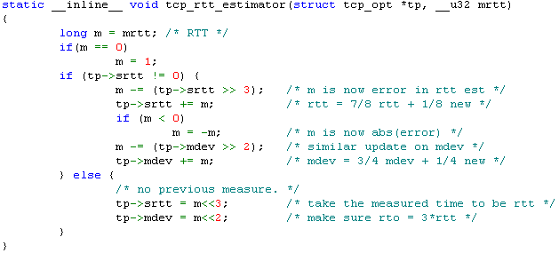
TCP RTT Estimator
Fast estimator by Van Jacobson ’88 & ‘90
  srtt (smoothed rtt) is kept in 8 times RTT
  mdev is kept in 4 times the real mean deviation
  In tcp_input.c from Linux 2.6:
exponential weighted moving average
Copyright Reserved 2009
Chapter 5: Transport Layer

Slide 35
Per-Flow Flow/Congestion Control
How Fast to Send?
  Fast Sender vs. Slow Receiver
    How to Know?
      Feedback RWND (Receiver Advertised Window) in ACK by Receiver
  Fast Sender vs. Congested Network
    How to Know?
      Feedback Loss Events by Network
      Re-adjust (Congestion Window) CWND
  How Fast?
    Satisfy Both: min (RWND, CWND)
Copyright Reserved 2009
Chapter 5: Transport Layer

Slide 36
TCP Tahoe Congestion Control
Fast
retransmit
≧3 duplicate ACK
≧3 duplicate ACK
send missing packet
ssth=cwnd/2
cwnd=1
send data packet
cwnd=cwnd+1
cwnd=cwnd+ 1/ cwnd
ACK
send packet
cwnd
≧
ssth
ACK
Slow start
Congestion
start
avoidance
timeout
timeout
all ACKed
Retransmission
timeout
cwnd=1
Chapter 5: Transport Layer

Slide 37
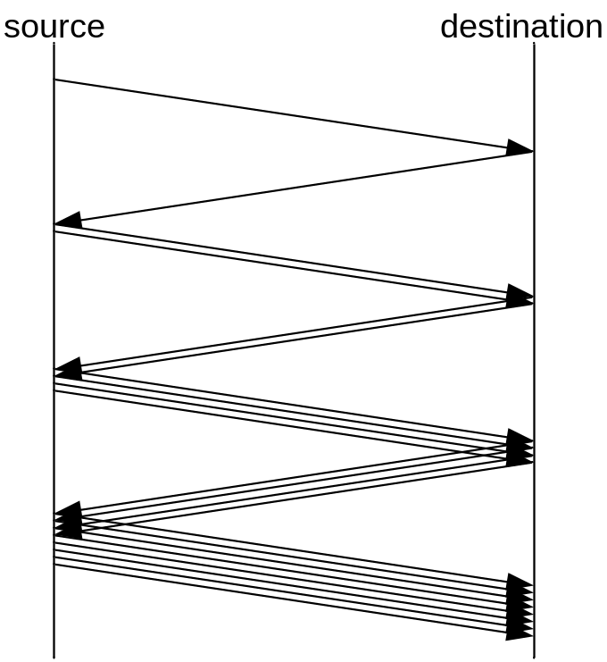
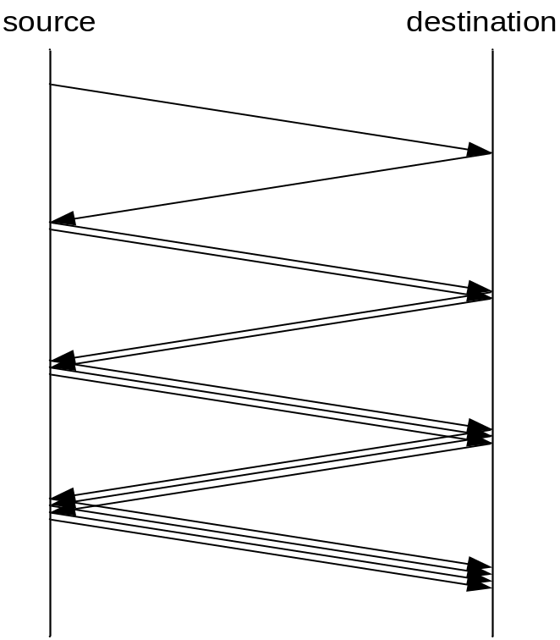
Slow Start & Congestion Avoidance
Slow Start
Congestion Aviodance
Copyright Reserved 2009
Chapter 5: Transport Layer

Slide 38
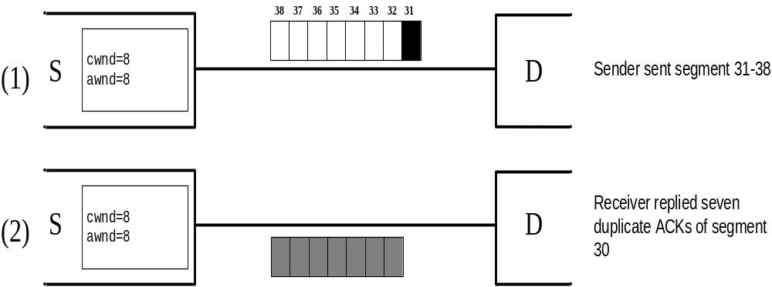
An example: TCP Tahoe (1/2)
Chapter 5: Transport Layer

Slide 39
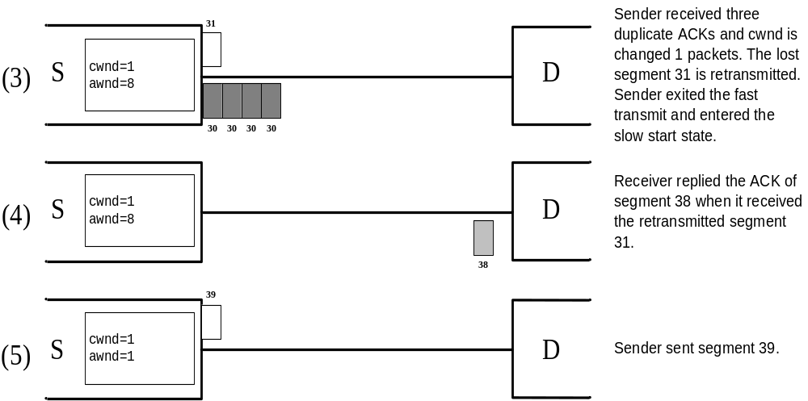
An example: TCP Tahoe (2/2)
Chapter 5: Transport Layer

Slide 40
TCP Reno Congestion Control
(RFC 2581)
Fast
retransmit
ssth=cwnd/2
cwnd=ssth
send missing packet
≧ 3 duplicate ACK
>= 3 duplicate ACK = x
send data packet
cwnd=cwnd+1
cwnd=cwnd+ 1/ cwnd
ACK
send packet
ACK
Slow start
cwnd
≧
ssth
Congestion
cwnd=ssth
Fast
recovery
start
avoidance
non-duplicate
ACK > x
duplicate ACK
timeout
send data
packet
cwnd=cwnd+1
timeout
timeout
all ACKed
Retransmission
timeout
cwnd=1
Copyright Reserved 2009
Chapter 5: Transport Layer

Slide 41
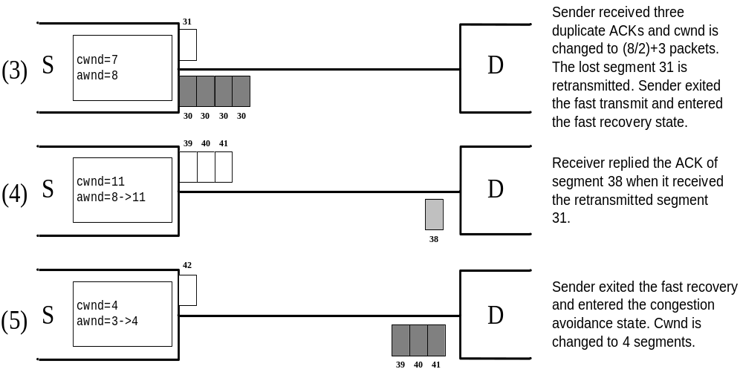
An example: TCP Reno
Chapter 5: Transport Layer

Slide 42
Open Source Implementation 5.4: TCP Slow Start and Congestion Avoidance
if (tp->snd_cwnd <= tp->snd_ssthresh) { /* Slow start*/
if (tp->snd_cwnd < tp->snd_cwnd_clamp)
tp->snd_cwnd++;
} else {
if (tp->snd_cwnd_cnt >= tp->snd_cwnd) {
/* Congestion Avoidance*/
if (tp->snd_cwnd < tp->snd_cwnd_clamp)
tp->snd_cwnd++;
tp->snd_cwnd_cnt=0;
} else
tp->snd_cwnd_cnt++;
}
}
Copyright Reserved 2009
Chapter 5: Transport Layer

Slide 43
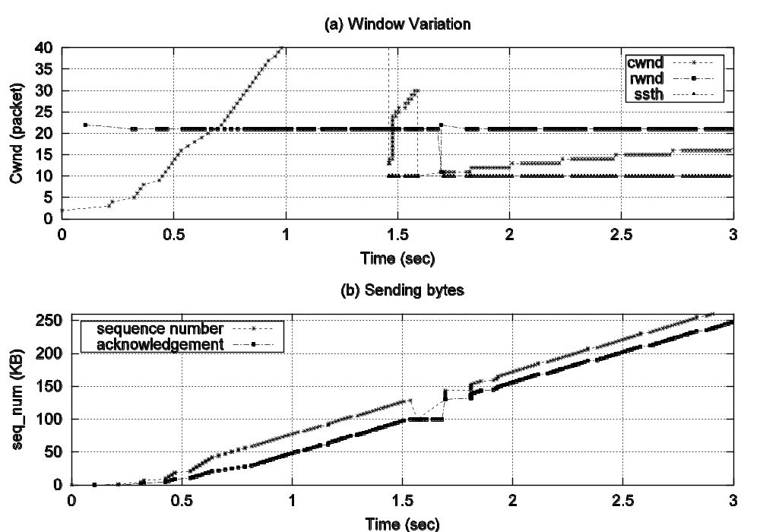
Principle in Action: TCP Congestion Control Behaviors
slow-start
fast recovery
pipe limit
ssth reset
congestion avoidance
fast retransmit
triple-duplicate ACKs
Copyright Reserved 2009
Chapter 5: Transport Layer

Slide 44
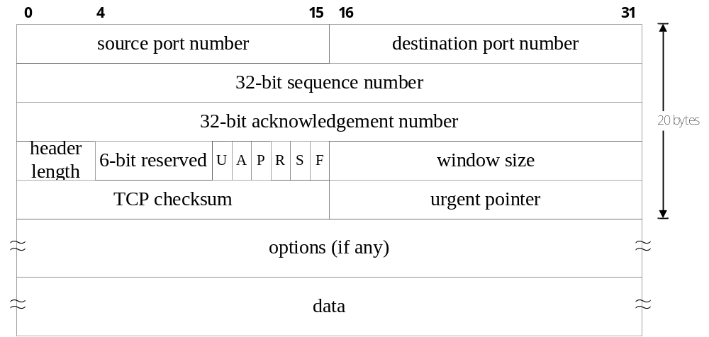
TCP Header Format
Chapter 5: Transport Layer

Slide 45
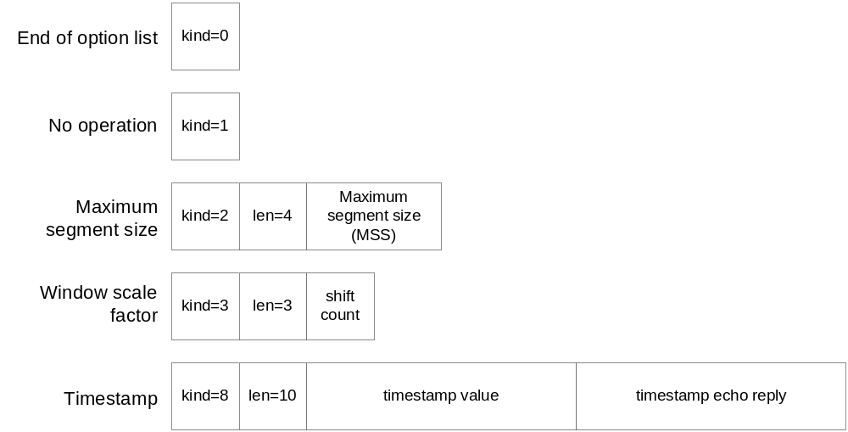
TCP Options
Chapter 5: Transport Layer

Slide 46
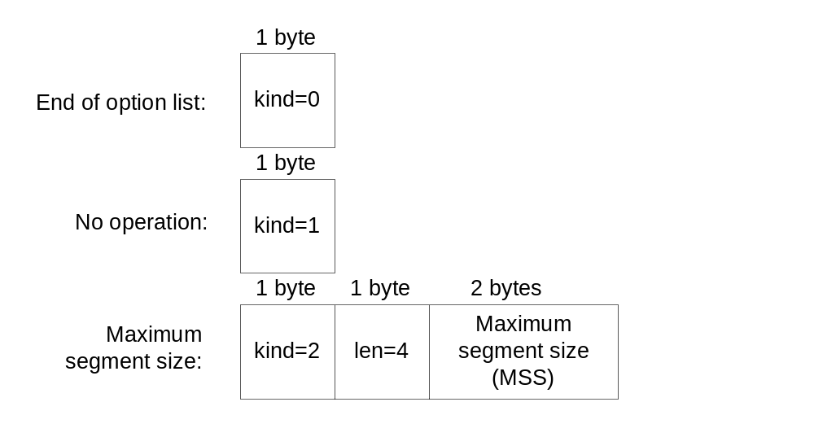
TCP Options
End of Option List
  As name suggests
No Operation
  Padding fields to a multiple of 4 bytes
Maximum Segment Size
  Negotiating the max transfer unit at 3-way handshake
Chapter 5: Transport Layer

Slide 47
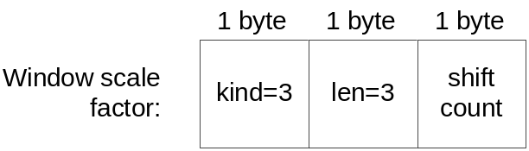

TCP Options (Window Scale Factor, RFC 1323)
Issue: window too small when in Gigabit networks, causing limited throughput
  Solution: negotiate a shifting factor for window
    Negotiate during 3-way handshaking
      SYN with timestamp, then SYN+ACK with timestamp
    Shift up to 14 bits (from 2¹⁶ to 2¹⁶x2¹⁴)
    When this option is not used:
      Linux do not advertise window over 2¹⁵ to avoid other stack that uses signed bit (include/net/tcp.h)
Chapter 5: Transport Layer

Slide 48
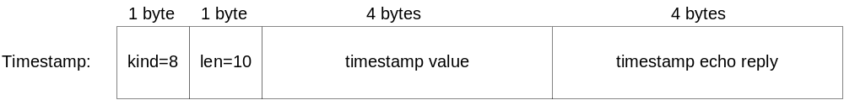
TCP Options – Timestamp
Mission 1 – Improving RTT measurement
  Receiver: copies & replies the timestamp
    Delayed ACK
  Sender: always update RTT when seeing timestamp
Mission 2 – Protecting Wrapped SeqNum
  Avoid receiving old segments in high speed network
How to enable timestamp option?
  3-way handshake
    Timestamp in SYN, timestamp in its ACK
Chapter 5: Transport Layer

Slide 49
TCP Timer Management in Linux
Retransmit Timer
  To start retransmitting
Persist Timer
  To prevent deadlocks
Keepalive Timer (non-standard)
  To clean up redundant TCP states
Chapter 5: Transport Layer

Slide 50
Functions of All TCP Timers
Name | Function
connection timer | To establish a new TCP connection, a SYN segment is sent. If no response of the SYN segment is received within connection timeout, the connection is aborted.
retransmission timer | TCP retransmits the data if data is not acknowledged and this timer expires.
delayed ACK timer | The receiver must wait till delayed ACK timeout to send the ACK. If during this period there is data to send, it sends the ACK with piggybacking.
persist timer | A deadlock problem is solved by the sender sending periodic probes after the persist timer expires.
keepalive timer | If the connection is idle for a few hours, the keepalive timeout expires and TCP sends probes. If no response is received, TCP thinks that the other end is crashed.
FIN_WAIT_2 timer | This timer avoids leaving a connection in the FIN_WAIT_2 state forever, if the other end is crashed.
TIME_WAIT timer | The timer is used in the TIME_WAIT state to enter the CLOSED state.
Chapter 5: Transport Layer

Slide 51
Open Source Implementation 5.5: TCP Retransmit Timer
Approximating RTT
  Linux provides good retx timer granularity
    Just like other timers
  BSD-derived UNIXs have bad granularity
    For minimizing timer overhead
      check wether ACKed every 500 ms
        RTT is over-estimated
        RTO is then over-estimated
        Slow packet retx when lost recovered not by Fast Retx
Chapter 5: Transport Layer

Slide 52
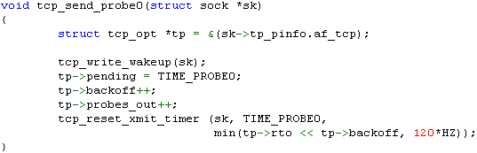
Open Source Implementation 5.6: TCP Persistent (or Probe) Timer
When RWND=0 && Next RWND>0 lost
  Deadlock occurs
    Sender waits for RWND>0 (window update)
    Receiver waits for new data
  Solution
    Sender emits one byte of data to probe
      Persist timer
tcp_output.c (Linux 2.6)
Use RTO with binary exponential backoff until 120 seconds
Chapter 5: Transport Layer

Slide 53
Open Source Implementation 5.6 (cont): TCP Keepalive Timer (Non-standard)
When no data exchange for a long time
  Connection Timeout?
    Belongs to application’s preference
  The other end is dead?
    Linux 2.6 Implementation (tcp_timer.c)
      Call tcp_keepalive_timer() every 75 seconds
        Initialized by af_inet init routine
        searches every established TCP connection
      If dead & not reboot => state cleared after 5 probes
      If dead & reboot => state cleared after getting RST
Chapter 5: Transport Layer

Slide 54
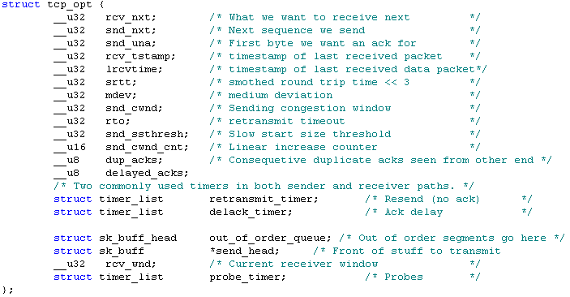
Data Structures of TCP Connections in Linux
Important variables:
include/net/sock.h
Chapter 5: Transport Layer

Slide 55
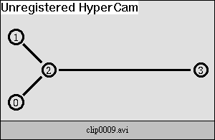
Summary: Properties of TCP
Per-Flow Reliability Through ACKs
Window-based Flow Control
Self-clocking using ACKs
Chapter 5: Transport Layer

Slide 56
TCP Performance
Interactive Connections
  Silly Window Syndrome
Bulk-Data Transfers
  ACK Compression Phenomenon
  Reno’s Multiple Packet Loss Problem
Chapter 5: Transport Layer

Slide 57
TCP Performance Problems & Enhancement
Interactive Connections
  Silly Window Syndrome (SWS)
    Solution: Clark & Nagle
Bulk Data Transfers
  ACK Compression Phenomenon
    Possible solution: Paced TCP Sender
  Reno’s Multiple Packet Loss Problem
    Solution: NewReno, SACK, FACK
Chapter 5: Transport Layer

Slide 58
Performance of Interactive Connections – Problems & Solutions
Problem: Silly Window Syndrome (SWS)
  Sender transmits small packets
  Receiver advertises small window
Solution
  Sender sends whenever either of the following holds:
    Data Accumulated to Full-sized Segment
    Data Accumulated to ½ RWND
    Nagle’s Algorithm Disabled/Not Applied
  Receiver advertises window whenever either of the following holds:
    Buffer available to full-sized Segment
    Buffer available to ½ of its buffer space
Chapter 5: Transport Layer

Slide 59
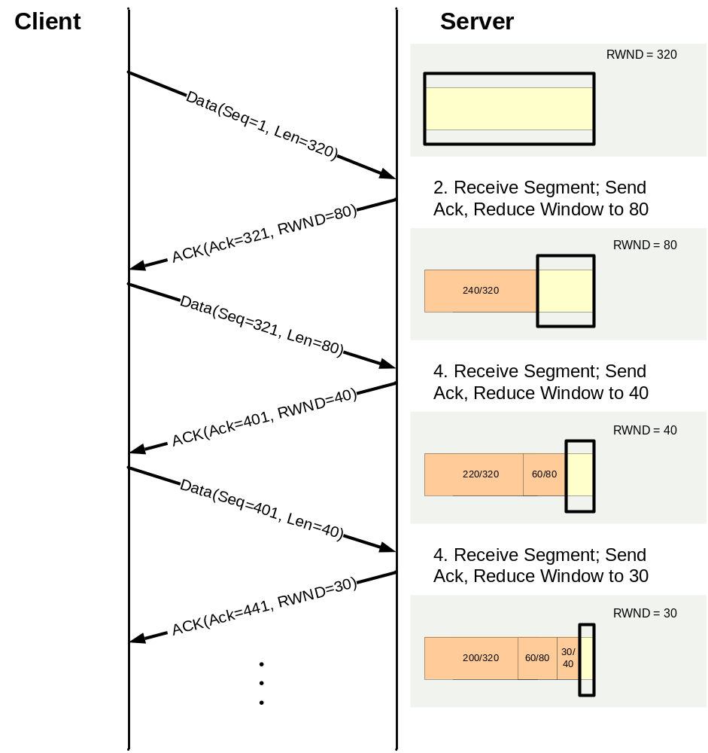
SWS : Receiver Advertises Small Window
Chapter 5: Transport Layer

Slide 60
Performance Enhancement of Interactive Connections – Nagle’s Algorithm
To efficiently utilize the bandwidth resource
  TELNET: Typing speed vs. available bandwidth
    When RTT is short (bandwidth may be sufficient)
      Inter-character spacing > RTT
        Only one outstanding packet per RTT => efficient!!!
    When RTT is large (bandwidth may be insufficient)
      Inter-character spacing < RTT
        Multiple single-character packets per RTT => inefficient!!
  Nagle: don’t send small packet until pipe is clean (keep only one packet in pipe) => efficient!!!
    When RTT is short
      Nagle’s Algorithm is rarely used
    When RTT is large
      Nagle’s Algorithm is often used
The beauty of Nagle
Chapter 5: Transport Layer

Slide 61
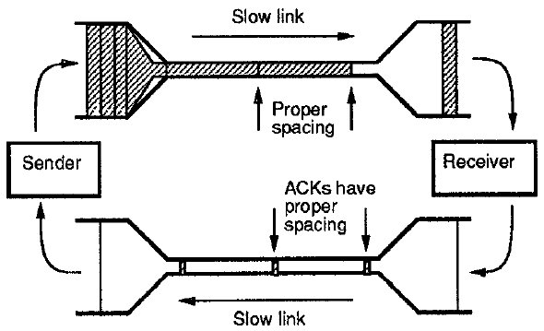
Performance of Bulk Data Transfers
Computing the Performance through Bandwidth Delay Product (BDP)
  Horizontal Dimension: Delay
  Vertical Dimension: Bandwidth
  Shaded Area: Packet Size
  BDP=pipe size=Bandwidth x RTT
Chapter 5: Transport Layer

Slide 62
Performance of Bulk Data Transfers
Filling the network pipe
Highest Performance: Pipe is full
Pipe for sending data packets
TCP Sender
TCP Receiver
Pipe for replying ACKs
WAN Pipe
TCP Sender
TCP Receiver
Chapter 5: Transport Layer

Slide 63
Performance of Bulk Data Transfers
Steps of filling the pipe using Congestion Avoidance
cwnd=1
(1)
(2)
(3)
(4)
(5)
(6)
cwnd=2
(7)
(8)
(9)
(10)
(11)
(12)
cwnd=3
(13)
(14)
(15)
(16)
(17)
(18)
cwnd=4
(19)
(20)
(21)
(22)
(23)
(24)
cwnd=5
(25)
(26)
(27)
(28)
(29)
(30)
cwnd=6
(31)
(32)
(33)
(34)
(35)
(36)
Chapter 5: Transport Layer

Slide 64
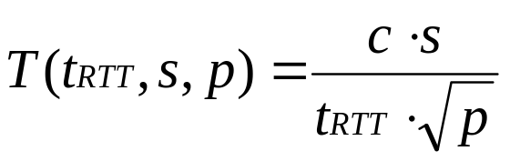
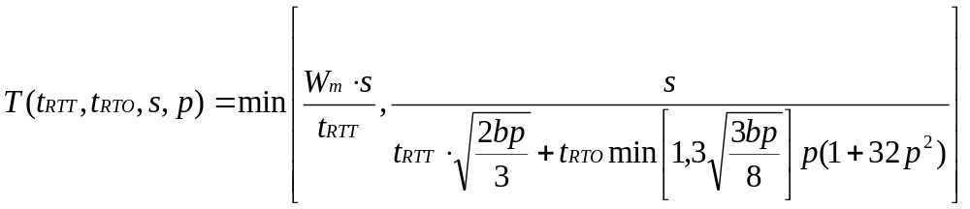
Performance of Bulk Data Transfers
Modeling TCP Throughput
  Given RTT, segment size s, loss rate p:
  where c is a constant value
  Given additional information: Max Window Size Wm, # delayed ACK b, RTO
Chapter 5: Transport Layer

Slide 65
Problem of TCP Bulk Data Transfers:
ACK-Compression Phenomenon
Bursty traffic when
  Simultaneous 2-Way Traffic
  Asymmetric Path
No general solution
  Distribute a window of packets across an RTT may alleviate the phenomenon
Slow link
Proper
spacing
Sender
ACKs have proper spacing
Receiver
Slow link
Chapter 5: Transport Layer

Slide 66
Historical Evolution: Multiple-Packet-Loss Recovery in NewReno, SACK, FACK and Vegas
Solution (I) to TCP Reno’s Problem: TCP NewReno
Solution (II) to TCP Reno’s Problem: TCP SACK
Solution (III) to TCP Reno’s Problem: TCP FACK
Solution (IV) to TCP Reno’s Problem: TCP Vegas
Copyright Reserved 2009
Chapter 5: Transport Layer

Slide 67
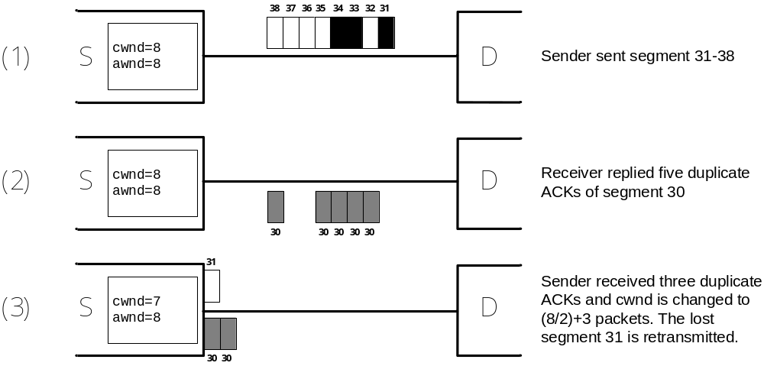
Problem of TCP Bulk Data Transfers:
Reno’s Multiple Packet Lost Problem(1/2)
Chapter 5: Transport Layer

Slide 68
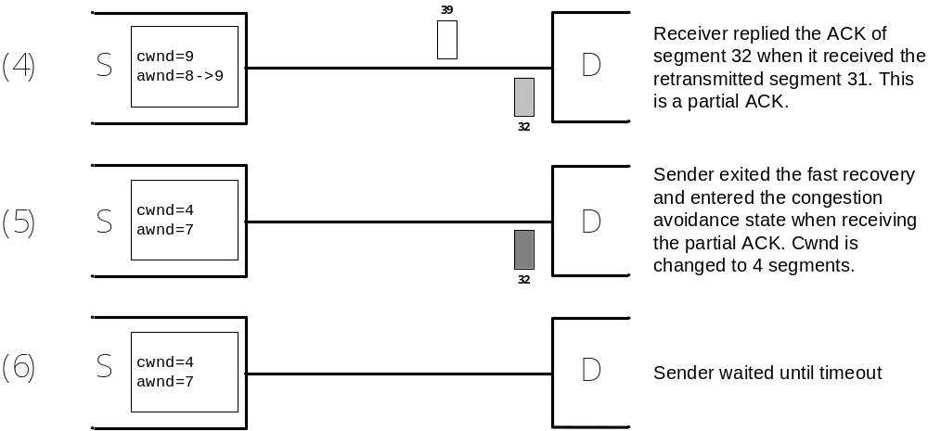
Problem of TCP Bulk Data Transfers:
Reno’s Multiple Packet Lost Problem(2/2)
Chapter 5: Transport Layer

Slide 69
Eliminating MPL Problem (I):
TCP NewReno (1/3)
RFC 2582: Extending Fast-Recovery Phase
  Remain in Fast-Recovery until
    All data in pipe before detecting 3-Dup ACK are ACKed
Chapter 5: Transport Layer
Copyright Reserved 2009

Slide 70
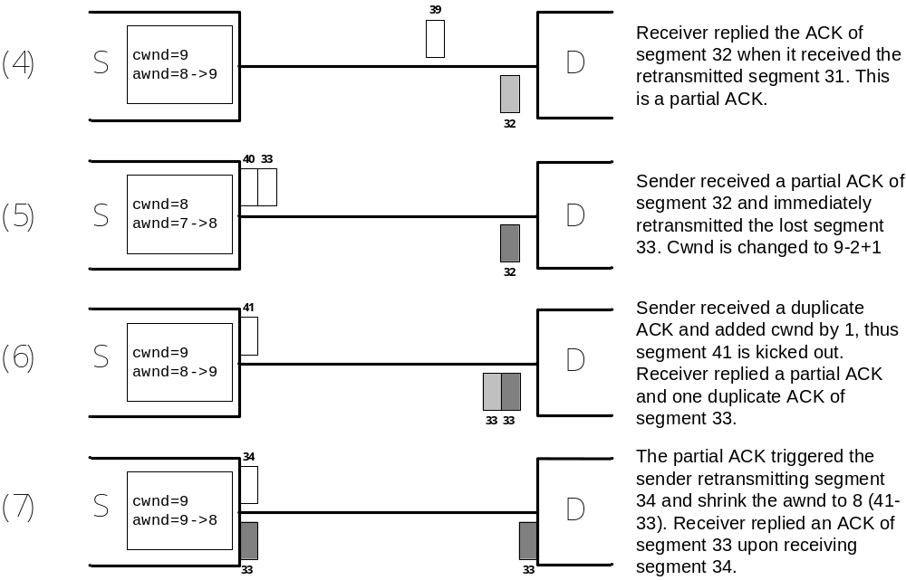
Eliminating MPL Problem (I):
TCP NewReno (2/3)
Chapter 5: Transport Layer

Slide 71
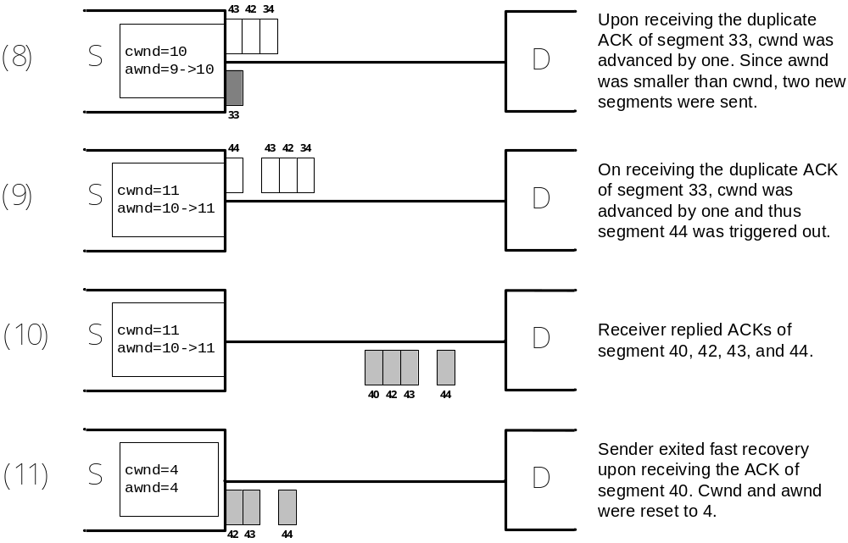
Eliminating MPL Problem (I):
TCP NewReno (3/3)
Chapter 5: Transport Layer

Slide 72
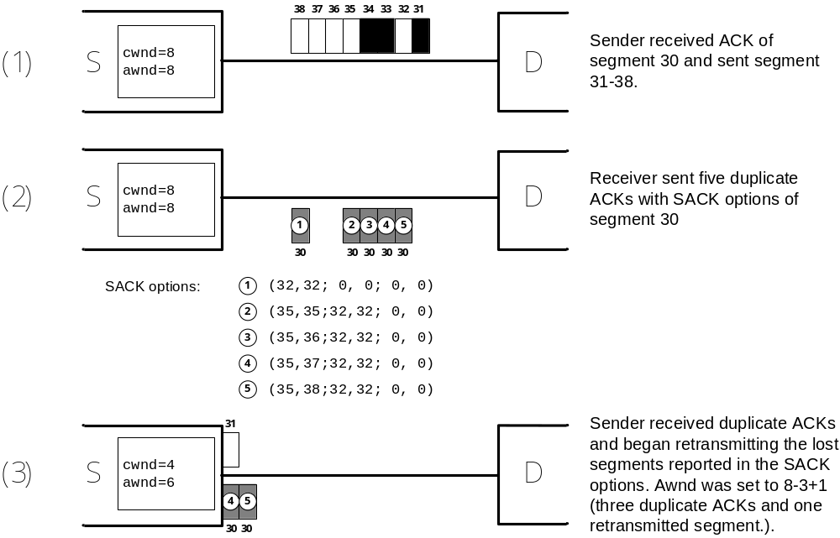
Eliminating MPL Problem (II):
TCP SACK (1/2)
Reporting non-contiguous block of data
Chapter 5: Transport Layer

Slide 73
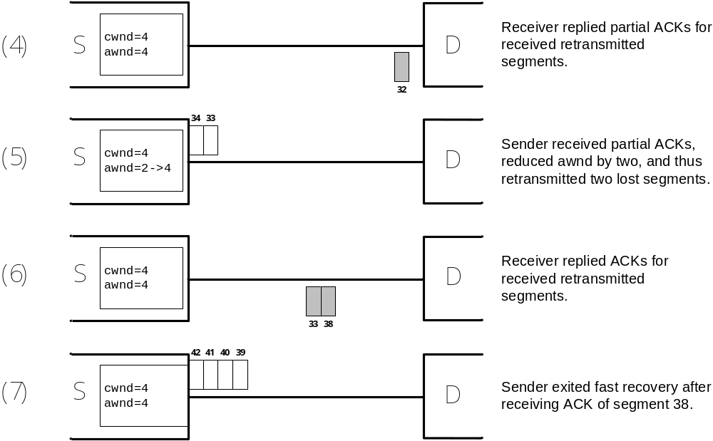
Eliminating MPL Problem (II):
TCP SACK (2/2)
Chapter 5: Transport Layer

Slide 74
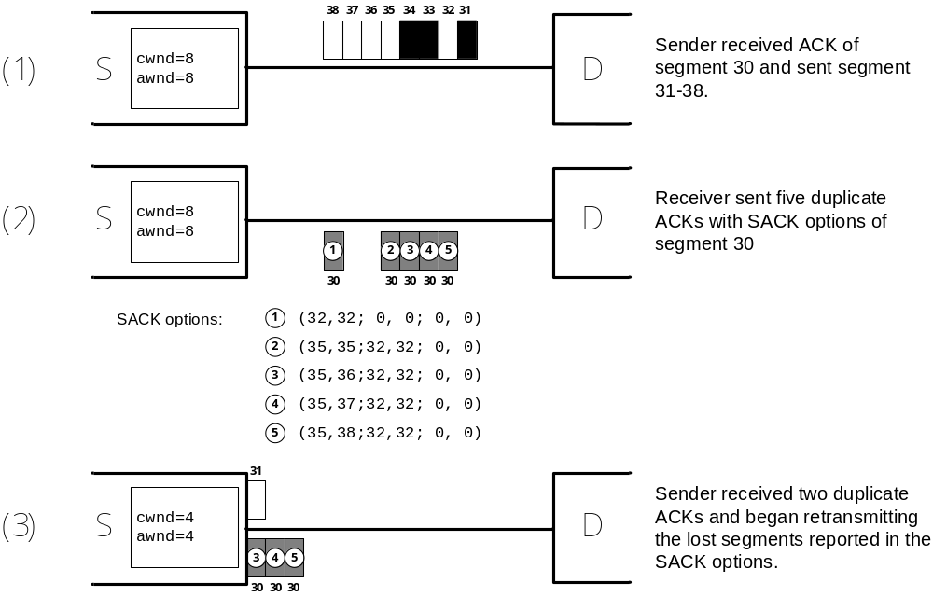
Eliminating MPL Problem (III):
TCP FACK (1/2)
Extension of SACK, better estimation of awnd
Chapter 5: Transport Layer

Slide 75
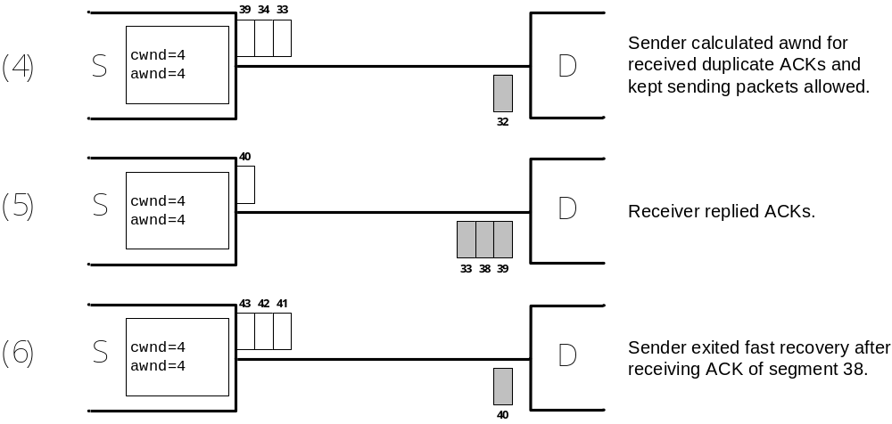
Eliminating MPL Problem (III):
TCP FACK (2/2)
Chapter 5: Transport Layer

Slide 76
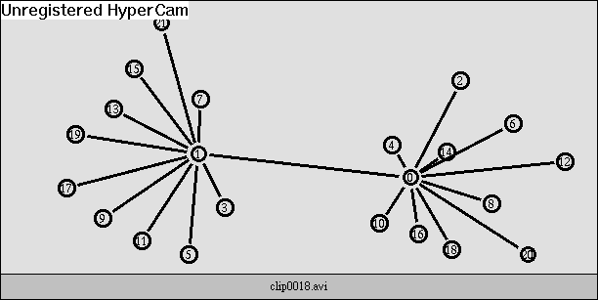
Performance of Bulk Data Transfers
When RTTs are heterogeneous……
What have you observed?
Chapter 5: Transport Layer

Slide 77
5.4 Socket Programming Interface
Programming Interface to Protocol Layers in Linux
  Accessing End-to-End Protocol Layer
  Accessing Internetworking Protocol Layer
  Accessing Direct-Linked Protocol Layer
Packet Capturing & Filtering
Chapter 5: Transport Layer

Slide 78
5.4 Socket Programming Interface
Issue: programming interface to protocol layers
  Socket interface in Linux 2.2.17 kernel
Application
Socket interface
Socket Library
User-space
net/socket.c
BSD Socket
Kernel-space
net/ipv4/af_inet.c
INET Socket
net/ipv4/{tcp*,udp*}
TCP/UDP
ICMP
net/ipv4/{ip*,icmp*}
IP
…
ARP
net/ethernet/eth.c
ethernet-header builder
drivers/net/*.{c,h}
ethernet NIC Driver
Chapter 5: Transport Layer

Slide 79
Bridging Applications & End-to-End Protocols
socket(domain, type, protocol)
  INET domain: AF_INET
  type
    UDP: SOCK_DGRAM
    TCP: SOCK_STREAM
  Protocol: NULL
Typical Applications:
  telnet
  ftp
  HTTP
Chapter 5: Transport Layer

Slide 80
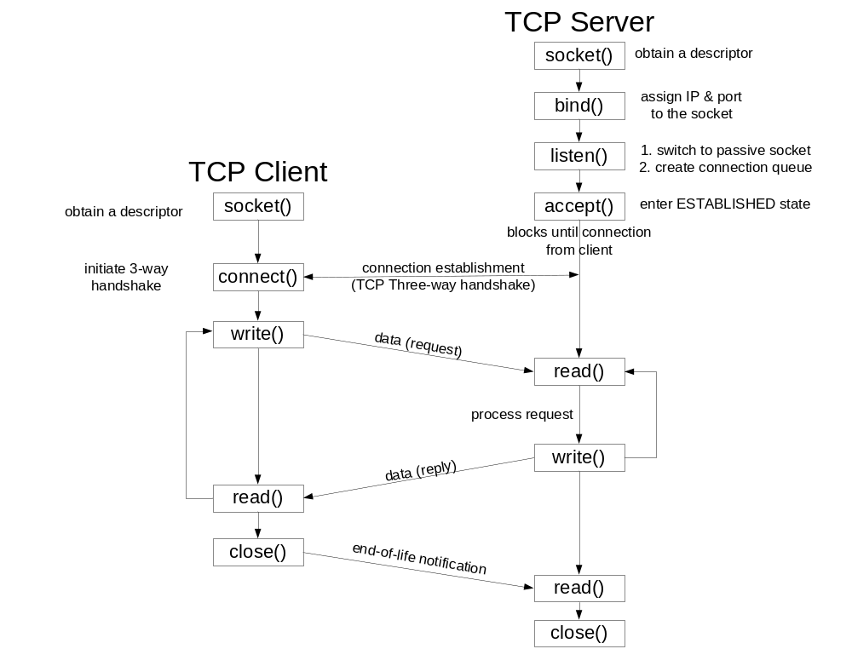
Elementary Socket: TCP Client/Server
Chapter 5: Transport Layer

Slide 81
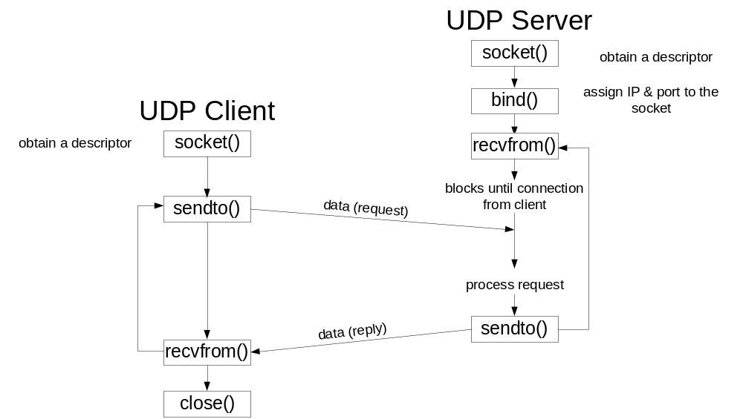


Elementary Socket: UDP Client/Server
bind() is optional
Chapter 5: Transport Layer

Slide 82
Open Source Implementation 5.7: Socket Read/Write Inside out
User Space
Server
Client
Server socket creation
send data
Client socket creation
send data
socket()
bind()
listen()
accept()
write()
socket()
connect()
read()
sys_socketcall
sys_write
do_sock_write
sock_
sendmsg
inet_
sendmsg
tcp_
sendmsg
tcp_
write_xmit
sys_socketcall
sys_read
do_sock_read
sock_
recvmsg
sock_common_
recvmsg
tcp_
recvmsg
memcpy_
toiovec
sys_socket
sock_create
inet_create
sys_bind
inet_bind
sys_listen
inet_listen
sys_accept
inet_accept
tcp_accept
wait_for_
connection
sys_socket
sock_create
inet_create
sys_connect
inet_stream
_connect
tcp_v4_
getport
tcp_v4_
connect
inet_wait
_connect
Kernel Space
Internet
Chapter 5: Transport Layer

Slide 83
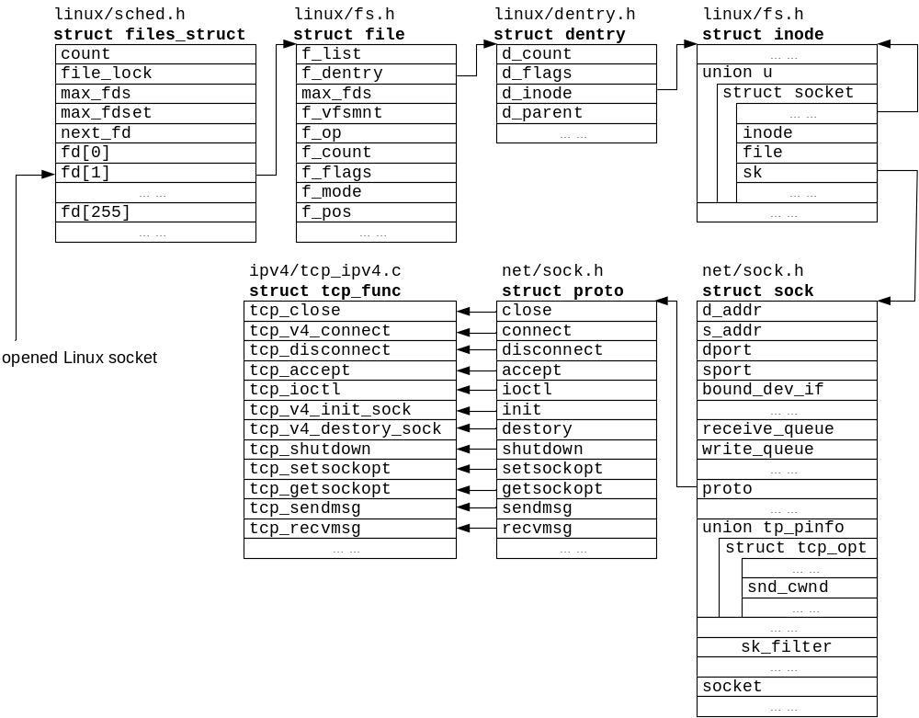
Open Source Implementation 5.7: Socket Read/Write Inside out
Chapter 5: Transport Layer

Slide 84
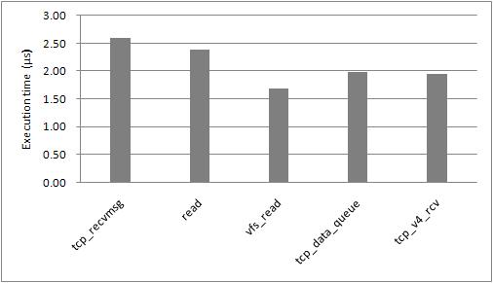
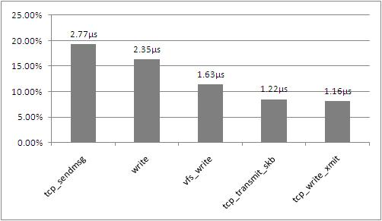
Performance Matters: Interrupt and Memory Copy at Socket
Latency in receiving TCP segments in the TCP layer
Latency in transmitting TCP segments in the TCP layer
Chapter 5: Transport Layer

Slide 85
Bridging Applications to Internetworking Protocols in Linux 2.6
socket(domain, type, protocol)
  Parameters:
    PACKET domain: PF_PACKET
    type: SOCK_DGRAM
    Protocol: NULL
  Kernel functions
    net/packet/af_packet.c
Typical Applications:
  ping
  traceroute
Chapter 5: Transport Layer

Slide 86
Bridging Applications to Node-to-Node Protocols in Linux 2.6
socket(domain, type, protocol)
  Parameters:
    PACKET domain: PF_PACKET
    type: SOCK_RAW
    Ethernet Encapsulated IP packet: ETH_P_IP
      Or others in “/usr/include/linux/if_ether.h”
  Complete access to Ethernet header
  Kernel functions
    net/packet/af_packet.c
Typical Applications:
  Packet sniffers => performance problem!!!
  Hacking tools
Chapter 5: Transport Layer

Slide 87
Open Source Implementation 5.8: Bypassing the End-to-End Layer
int main()
{
int n;
int fd;
char buf[2048];
if((fd = socket(PF_PACKET, SOCK_RAW, htons(ETH_P_ALL))) == -1)
{
printf("fail to open socket\n");
return(1);
}
while(1)
{
n = recvfrom(fd, buf, sizeof(buf),0,0,0);
if(n>0)
printf("recv %d bytes\n", n);
}
return 0;
}
Copyright Reserved 2009
Chapter 5: Transport Layer

Slide 88
Open Source Implementation 5.9: Making Myself Promiscuous
strncpy(ethreq.ifr_name,"eth0",IFNAMSIZ);
ioctl(sock, SIOCGIFFLAGS, &ethreq);
ethreq.ifr_flags |= IFF_PROMISC;
ioctl(sock, SIOCSIFFLAGS, &ethreq);
Copyright Reserved 2009
Chapter 5: Transport Layer

Slide 89
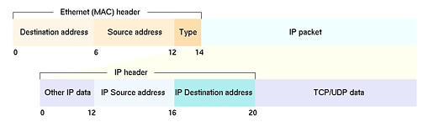
Packet Sniffers: Packet Capturing & Filtering
Capture until what header?
Towards Efficient Packet Filtering: Layered Model
  User-Space Tool: tcpdump
  User-Space Packet Filter: libpcap (portable)
  Kernel-Space Packet Filter: Linux Socket Filter
Chapter 5: Transport Layer

Slide 90

Open Source Implementation 5.10: Linux Socket Filter
Linux Socket Filter (net/core/filter.c)
  Similar to BPF (Berkley Packet FIilter)
network
monitor
network
monitor
rarpd
user
buffer
buffer
buffer
protocol
stack
kernel
filter
filter
filter
link-level
driver
link-level
driver
link-level
driver
kernel
network
Copyright Reserved 2009
Chapter 5: Transport Layer

Slide 91
5.5 Transport Protocols for Streaming
Issues
Real-Time Transport Protocol (RTP)
RTP Control Protocol (RTCP)
Example: VoIP Gateway Using RTP/RTCP
Chapter 5: Transport Layer

Slide 92
Issue 1: Multi-homing & Multi-streaming
Stream Control Transmission Protocol
Multi-homing
  a session of the SCTP can be concurrently constructed by multiple connections through different network adapters
  a heartbeat for each connection
Multi-streaming
  Support ordered reception for each streaming
  Avoid the HOL blocking of TCP.
  a 4-way handshake mechanism for security
Copyright Reserved 2009
Chapter 5: Transport Layer

Slide 93
Issue 2: Smooth Rate Control and TCP-friendliness
AIMD is not suitable for streaming
TCP-friendliness: A flow should ….
  respond to the congestion at the transit state
  use no more bandwidth than a TCP flow at the steady state
  when both received the same network conditions, such as packet loss ratio and RTT.
Datagram Congestion Control Protocol (DCCP) :
  free selection of a congestion control scheme
Copyright Reserved 2009
Chapter 5: Transport Layer

Slide 94
Principle in Action: Streaming: TCP or UDP?
Why not TCP
  loss retransmission mechanism
  continuous rate fluctuation
Why not UDP
  too simple,
  dropped by network devices for security
Both are the only two mature protocols, so..
UDP is used to carry pure audio streaming,
  like audio and VoIP.
TCP is used for streaming : large buffer ->delay
  OK one-way application, e.g. watching clips from YouTube
  Not OK for the interactive application, like video conference,
Copyright Reserved 2009
Chapter 5: Transport Layer

Slide 95
Issues 3: Playback Reconstruction and Path Quality Report
Issues: Codec Encapsulation & Path Quality Report
  Data-Plane: Video/Voice Codecs
    Video: H.264…
    Voice: G.729…
  Control-Plane: Delay/Jitter/Loss Report
RFC Standards: RTP & RTCP
  RTP: Data-Plane, Encapsulating the Chosen Codec
  RTCP: Control-Plane, Reporting Delay/Jitter/Loss to Senders
Chapter 5: Transport Layer

Slide 96
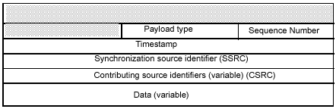
RTP (Real-time Transfer Protocol)
Objectives
  Eliminating Packet Reorder & Loss Detection: Sequence #
  Timestamp
  Synchronization Source Identifier
  Contributing Source Identifier
Header Format
Chapter 5: Transport Layer

Slide 97
RTCP (Real-time Transfer Control Protocol)
Objectives
  Reporting End-to-End Delay
  Reporting Delay Jitter
  Reporting Loss Rate
Report to sender for what?
  Switch to lower-bitrate codec
    User may get smoother real-time
Chapter 5: Transport Layer

Slide 98

VoIP using RTP: Multiplexing using SSRC
One RTP session between VoIP gateways
  Many phone call between branch offices
    Multiplexing using different SSRC ID within the RTP session
Gatekeeper
Public Telephone
Network
Public Telephone
Network
IP Cloud
Phone
VoIP
Gateway
VoIP
Gateway
Phone
Internet or private IP network
Chapter 5: Transport Layer

Slide 99
VoIP using RTP: Codec Encapsulation
Compress/Decompress
  Analog to Digital
  Compander
Inside a VoIP Gateway Codec
VoIP Gateway
Digital
output
signal
Analog to
Digital
Converter
128 kbps
16 bits, 8khz
Compander
A-Law
u-Law
64 kbps
8 bits, 8khz
64
kbps
Analog
signal source
The converter assigns
16 bits evenly distributed
across x,y coordinates of the sine
The compander
compresses the data
Chapter 5: Transport Layer

Slide 100
Historical Evolution: RTP Implementation Resources
Sample Implementation in RFC 1889
  http://rfc.net/rfc1889.txt
Vat
  http://www-nrg.ee.lbl.gov/vat/
Rtptools
  ftp://ftp.cs.columbia.edu/pub/schulzrinne/rtptools/
NeVoT
  http://www.cs.columbia.edu/~hgs/rtp/nevot.html
RTP Library
  http://www.iasi.rm.cnr.it/iasi/netlab/gettingSoftware.html
  by E.A.Mastromartino offers convenient ways to incorporate RTP functionality into C++ Internet applications.
Chapter 5: Transport Layer

Slide 101
5.6 Summary (1/2)
Three key features in process-to-process channels
  (1) port-level addressing, (2) reliable packet delivery, (3) flow rate control
  UDP: (1) only; TCP: all of them
TCP techniques
  three-way handshake
  ack/retx,
  sliding-window flow control
  various versions of congestion control
    to retx potentially lost packets
Chapter 5: Transport Layer

Slide 102
5.6 Summary (2/2)
Real-time transport by RTP/RTCP
  multi-streaming, multi-homing, smooth rate control, TCP-friendliness, playback reconstruction, and path quality reporting
Socket interfaces to different layers
Chapter 5: Transport Layer

