Slide 1
Computer Network
An Open Source Approach
Chapter 7: Internet QoS
Ying-Dar Lin, Ren-Hung Hwang, Fred Baker
Chapter 7: Internet QoS

Slide 2
Content
7.1 General Issues
  Signal Protocol
  QoS Routing
  Admission Control
  Packet Classification
  Policing
  Scheduling
7.2 QoS Architectures
  Integrated Service (IntServ)
  Differential Service (DiffServ)
  Comparison
7.3 Algorithms for QoS Components
  Admission Control
  Flow Identification
  Token Bucket
  Packet Scheduling
  Packet Discarding
7.4 Summary
Chapter 7: Internet QoS

Slide 3
Problem Statement
There is no QoS in Internet currently
  (Only Best Effort is supported)
However, the Internet architecture (Ethernet/IP) is popular
And QoS is required for many applications
  (Bounded delay and fixed sending rate requirement)
So.. What is the QoS Internet Architecture?
The first kind of model is Integrated Services.
  (It is intuition, but is difficult to implement and scale)
The Second kind of model is Differentiated Services.
  (A simple solution for implementation and deployment)
Chapter 7: Internet QoS

Slide 4
7.1 General Issues
  Signal Protocol
  QoS Routing
  Admission Control
  Packet Classification
  Policing
  Scheduling
Chapter 7: Internet QoS

Slide 5
Requirements for the QoS Network
Requirements for the QoS Network
Control Plane
Signaling Protocol
QoS Routing
Admission Control
Admission
Control
Data
Plane
Classification
Marking
Policing
Shaping
Scheduling
Taipei: 90 mins ->
<- HsinChu: 30 mins
QoS
Routing
packet
Chapter 7: Internet QoS

Slide 6
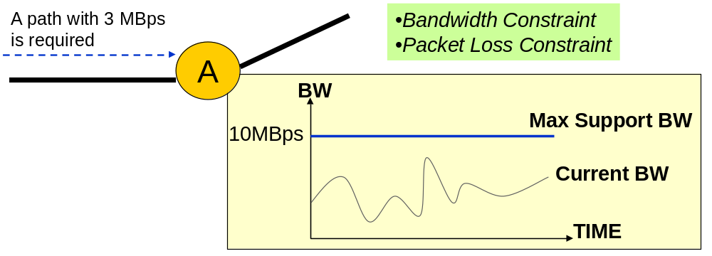
An Operating Example of
Admission Control
Chapter 7: Internet QoS

Slide 7
The General Model of a Queuing Discipline
Queuing Discipline
Black Pipe
arrival packets
Enqueue
Dequeue
departure packets
FIFO Queue
Single FIFO Queue
C
FIFO Queue
S
FIFO Queue
Chapter 7: Internet QoS

Slide 8
Open Source Implementation 7.1: Traffic Control Elements in Linux
Upper Layers Process
Without QoS
Output Queuing
Output Device
Input Device
IP Forwarding
Traffic Control
Output Device
Filter
Class
Policing
Queuing Discipline
Filter
Class
Queuing Discipline
Queuing Discipline
Chapter 7: Internet QoS

Slide 9
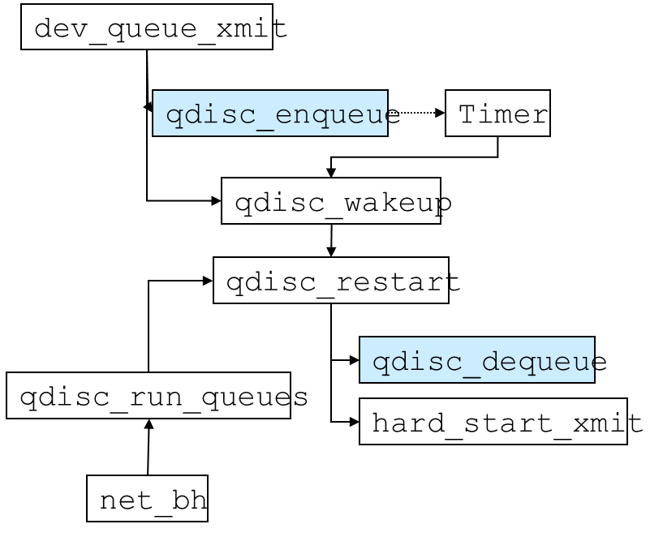
Open Source Implementation 7.1: Traffic Control Elements in Linux
Functions invoked when enqueue and dequeue
Chapter 7: Internet QoS

Slide 10
7.2 QoS Architectures
  Integrated Service (IntServ)
    Service Type: Guaranteed, Control load, Best effort
    The Trip of a Resource Reservation Request
    Request Handling by IntServ Routers
    Request Enforcement in IntServ Routers
  Differential Service (DiffServ)
    DS field, per hop forward behavior,
    Ingress, interior, exgress router
  Comparison
Chapter 7: Internet QoS

Slide 11
Concept of IntServ Network
A “ flow “ is the basic management unit
Supporting accurate quality control.
Resource reservation is dynamic.
All traffic control functions are embedded in one router.
All routers in the network must be IntServ aware.
Chapter 7: Internet QoS

Slide 12
Service Types Provided by IntServ
Service Types | Guaranteed | Control Load | Best Effort
Provide QoS | Guaranteed BW E2E* Delay Bound | Emulate a lightly loaded network for AP | None
RFC | RFC 2212 | RFC 2211 | None
Common Traffic Description Parameters:
  Peak rate p
  Average rate r
  Burst size b
*) “E2E” implies End-to-End
Chapter 7: Internet QoS

Slide 13
The RSVP Process from the Viewpoint of an Application
IntServ Domain
B
Server
Application
A
C
Reservation
request
Accept?
Y-> Forward the request
QoS-Aware Router
N-> Reject the request
Chapter 7: Internet QoS

Slide 14
The Data Plane in an IntServ Router.
Src IP
Dest. IP
Protocol ID
Src Port
Dest Port
Flow Queue
Policer
Data Plane of
IntServ Router
Fq₁
Flow
Identifier
Fq₂
scheduler
Fq_{n}
Best Effort Q
Chapter 7: Internet QoS

Slide 15
Basic Elements Tree of DiffServ
Differentiated Services
Service Level
Agreement (SLA)
Traffic Control
Service
Link-Layers
Signaling
Traffic Engineering
Policy
Traffic Conditioning Agreement (TCA)
service provisioning
Expedited Forwarding
Pt-to-Pt
RSVP
service configuration
Assured Forwarding
MPLS
LDAP
classification
Best-effort
ATM
COPS
policer
marker
scheduler
Chapter 7: Internet QoS

Slide 16

Concept of DiffServ Network
Objective: Define a simple and coarse methods of providing differentiated classes of service for Internet traffic.
If you want to get QoS, you should sign the contracts with SP first
Support the aggregated traffic resource allocation only
Provide a better behavior and provision (no accurate bandwidth reservation )
Core Routers
Ingress Router
Forward Packet
Egress Router
Police, Mark, Shape, Drop Packets
Core Router
Edge Router
DiffServ Domain
Chapter 7: Internet QoS

Slide 17
Differentiated Services (DS) Field
Redefine the existing IP TOS field to DS field
Some level of backward compatibility to IP TOS
No use
IP TOS
Precedence
D
T
R
0
0
1
2
3
4
5
6
7
8
DS
DSCP
0
0
12 AF PHBs
1 EF PHB
1 Best Effort PHB
8 Class Selector PHBs
2⁶ = 64 behaviors
Chapter 7: Internet QoS

Slide 18
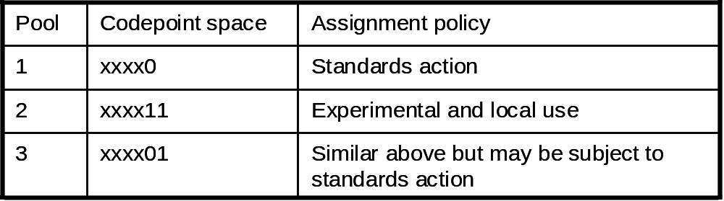
Allocated Space of Code Points
Chapter 7: Internet QoS

Slide 19
Per-Hop Behavior Group
PHB Group | AF (Assured Forwarding) |  |  |  |  | EF (Expedited Forwarding) | Best-Effort
Features | Olymic service (an example) 4 delay priority classes, each with 3 drop precedence subclasses (quantitative service) |  |  |  |  | Premium/Virtual Leased Line Service (quantitative service) | none
Recommended DSCP in DS-field |  | AF1 | AF2 | AF3 | AF4 | 101110 | 000000
 | Low | 010000 | 011000 | 100000 | 101000
 | Middle | 010010 | 011010 | 100010 | 101010
 | High | 010100 | 011100 | 100100 | 101100
Traffic Control | Static SLA Policing, classification, marking, RIO/WRED scheduling |  |  |  |  | Dynamic SLA Policing, classification, marking, Priority/WFQ scheduling | FIFO scheduling
Non-conforming Traffic | Re-mark as Best-Effort |  |  |  |  | Drop | Forward
Chapter 7: Internet QoS

Slide 20
The Ingress stage of a packet in the Edge Router
DS Domain
Meter
DSCP
Classifier
Packet Classifier
DSCP Marker
Shaper
Class
Scheduler
Dropper
Traffic Conditioning
Traffic Forwarding
Chapter 7: Internet QoS

Slide 21
The Interior Stage of a Packet in the Core Router
DS Domain
Routing
Database
Control Plane
Data Plane
DSCP
Classifier
Class
Scheduler
Traffic Forwarding
Chapter 7: Internet QoS

Slide 22
Differences between
DiffServ and IntServ
Compared Items | DiffServ | IntServ
Manageable Unit | Class | Flow
Router’s Capability | Edge and Core | All in One
Defined in the Standard | Forwarding behavior | Service Type
Guarantee Required | Provisioning | Reservation
Work Region | Domain | End-to-end
Chapter 7: Internet QoS

Slide 23
7.3 Algorithms for QoS Components
  Admission Control
  Flow Identification
  Token Bucket
  Packet Scheduling
  Packet Discarding
Chapter 7: Internet QoS

Slide 24
Objectives and Issues of Admission Control
Objectives
  Provide a mechanism to admit users’ resource reserved request according to
  Current Resource Usage
  The User’s Requirement
Major Issues
  How to get the information about link resource usage efficiently ?
  How to know the residual resource is enough to satisfy a user’s request under OVERBOOKING?
Chapter 7: Internet QoS

Slide 25
Basic Approaches of Admission Control
Statistical-Based
Apply to the Specific traffic Model
Detail Version:
- Average/Peak Rate Combinatory
- Additive Effective Bandwidths
- Engineering the loss Curve
- Maximum-Variance-Based Approaches
Drawbacks
Sometimes, it is difficult to give a accurate and tight traffic model. It may cause low utilization of network in order to meet the worst-case requirements.
Chapter 7: Internet QoS

Slide 26
Basic Approaches of Admission Control
Measurement-Based
Apply to the non-specific traffic Model
- Exponential averaging over consecutive measurement estimation
  new =(1-w) X estimation_{old}+ w X measurement_{new}
- Time Window
  Estimated rate=max[C1,C2,C3….Cn]
Drawbacks
It can not be used to provide tight guarantee constraints Measurement is expensive.
Chapter 7: Internet QoS

Slide 27
Objectives and Issues of Flow Identification
Objectives
  Identify a packet to decide whether it belongs to one reserved flow or nothing.
Major Issues
  Search Speed
  Low Storage requirement
  Fast Update
  Scalability
    Number Fields
    Flow Numbers
Identified Fields in a IP pkt
Source IP, Port
Dest IP, Port
Protocol ID
104 bits
SPACE VS. SPEED
Binary Search Tree
Direct Memory Lookup
Chapter 7: Internet QoS

Slide 28
Open Source Implementation 7.3: Flow Identification rsvp_classify of CLS_RSVP.h
rsvp_session
dstaddr
protocol id
tunnelid
rsvp_filter
src
tcf_result
skb
rsvp_filter
rsvp_filter
tcp_police
h1
h1=hash_dst()
rsvp_session
X
RF
RF
return value
rsvp_session
h2=hash_src()
RF
srcaddr
tcf_result
tcf_police info.
h2
RF
RF
RF
Chapter 7: Internet QoS

Slide 29
Open Source Implementation 7.3: Flow Identification
The Double-level Hash Structure in CLS_RSVP.C
rsvp_session: Second
-
Level
Hash
rsvp_filter list
rsvp_head: First
-
Level
Hash
rsvp_filter list
rsvp_session list
src_dst
()
A
pkt
. arrives
rsvp_session list
rsvp_filter list
hash_dst
()
16 (src,src port) list + 1 wildcard src lists
rsvp_session list
hash bucket
total 256 (dst,protocol id, tunnelid) lists
hash function
Chapter 7: Internet QoS

Slide 30
Open Source Implementation 7.3: Flow Identification rsvp_classify & rsvp_change of CLS_RSVP.h
hash_dst()
Has rsvp_filter
assigned ?
modify
sequential search in
the rsvp_session list
N
adjust classid
create
Has rsvp_session
existed ?
Y
hash_src()
sequential search in
the rsvp_filter list
N
N
insert a rsvp_session
Y
match
nomatch
insert a rsvp_filter
The flowchart of function rsvp_classify
The flowchart of function rsvp_change
Chapter 7: Internet QoS

Slide 31
Traffic Description Model
Traffic Regulator & Traffic Policing
Objective:
  Conforming the incoming traffic for each flow to it’s traffic specification described as resource reserved.
Token Stream with average rate r
Bucket depth b
Token Bucket
Peak Rate p
Flow Queue
drop?
Incoming Packets
Rate Permitted Packets
Chapter 7: Internet QoS

Slide 32
Example for Token Bucket
(a) t=10s
r=1
(b) t=15s
r=1
h=10
h=5
Flow Queue
p=2
Flow Queue
p=2
5
9
10
5
9
10
(c) t=19s
r=1
(d) t=24s
r=1
h=0
h=0
Flow Queue
p=2
Flow Queue
p=2
5
9
10
5
9
10
Chapter 7: Internet QoS

Slide 33
Open Source Implementation 7.4: Token Bucket
The enqueue function of TBF
get a packet from sk_buff
skb->len >
q->max_size
N
Y
full
qdisc_enqueue(skb, q->qdisc)
drop
Chapter 7: Internet QoS

Slide 34
Open Source Implementation 7.4: Token Bucket
The dequeue function of TBF
Get one packet
from skb queue
Estimate the admitted tx time given the pkt is sent out
toks = tokens + toks – (len(pkt)/R)
Calculate the accumulated tokens toks after the last query
toks=min(t_c-now,buffer)
both ptoks and toks >=0
N
Reinsert the pkt into the head of the skb queue
Y
is the peak rate set?
N
Admitted the packet to be txed and update the value of tbf_sched
Y
Estimate the admitted tx time ptoks given the pkt is sent out
ptoks = ptokens + toks – (len(pkt)/P)
Chapter 7: Internet QoS

Slide 35
Objectives and Issues of Packet Scheduling
Objective
  Provide a mechanism to divide the bandwidth and guarantee that each flow can get the allocated resource
Issues
  Isolation of Flows
  Low End-to-End Delays
  Utilization
  Fairness
  Simplicity of Implementation
  Scalability
  Work-conserving or Non Work-conserving
Chapter 7: Internet QoS

Slide 36
Basic Type of Scheduling:
Round Robin (Frame Based)
Flow Queue 1
credit
200
200
200
200
100
300
200
200
200
S
200
200
400
200
300
200
200
400
Flow Queue N
Deficit Round Robin: A Practical Scheduler
It is simple , but not very fair within a small time interval
Chapter 7: Internet QoS

Slide 37
An operating case of DRR:
Round 1 and 2
Flow Queue 1
credit
200
200
200
200
100
F4
F4
F3
F2
300
200
0
S
200
200
200
200
200
200
400
100
0
Flow Queue N
Flow Queue 1
credit
200
200
200
0
F3
F2
F1
300
0
S
400
200
200
200
200
0
0
Flow Queue N
Chapter 7: Internet QoS

Slide 38
An operating case of DRR:
Round 3 and 4
Flow Queue 1
credit
200
200
200
100
200
F3
300
S
200
200
100
0
Flow Queue N
Flow Queue 1
credit
200
200
0
F3
F2
F1
0
S
200
300
200
0
0
Flow Queue N
Chapter 7: Internet QoS

Slide 39
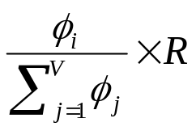
Advanced Concept of Scheduling:
Smallest Selection (Sorted-Based)
Generalized Processor Sharing (GPS)
  An ideal fair queuing based on the fluid model.
  It provides perfect fairness in bandwidth allocation
  For a traffic source LB(b,r) , it can guarantee
    - a delay bound of b/r
    - the received BW >=
  However, it’s impossible to be implemented!!
Flow A
A1
A2
A3
Fluid Model
Flow B
B1
B2
Flow C
C1
C2
C3
C1
A1
B1
A2
C2
A3
B2
C3
Packetized Model
Chapter 7: Internet QoS

Slide 40
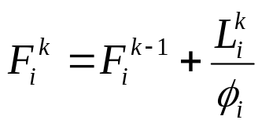
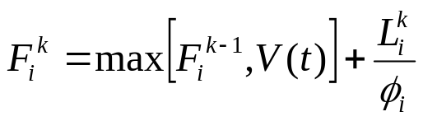
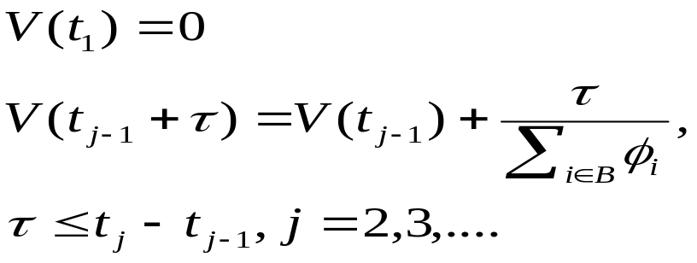
Packet-by-Packet GPS (PGPS)
Try to emulate a GPS by calculating the departure time of a packet (finish time) and give a virtual timestamp for each packets.
Finish time is a number representing the order of sending out the packets. ( not is a real departure time )
If there are packets in the flow queue i, the finish time of k-th packet is
If the flow queue i is empty, the finish time of k-th packet is
Virtual Time Implementation
t_{j} is the time where
the j^{th} event occurs.
Chapter 7: Internet QoS

Slide 41
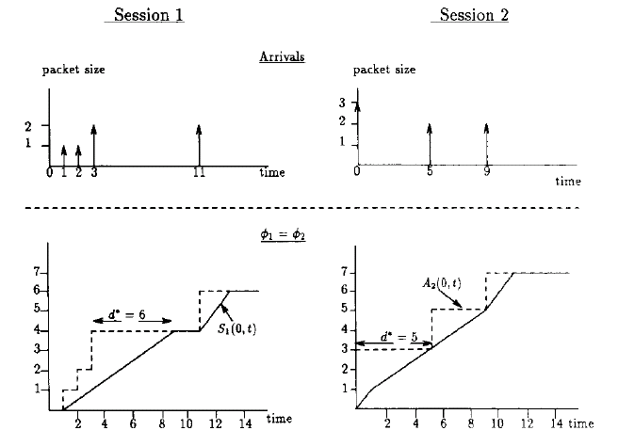
Arrival-Departure Curve
Chapter 7: Internet QoS

Slide 42
An operating case of WFQ
id
packet length
Flow Queue 1 (φ₁=0.1)
4, 200
3, 200
2, 200
1, 200
Flow Queue 2 (φ₁=0.2)
7, 300
6, 200
5, 200
S
Flow Queue 3 (φ₁=0.3)
11, 200
10, 200
9, 400
8, 200
Flow Queue 4 (φ₁=0.4)
13, 200
12, 200
VFT
Flow Queue 1 (φ₁=0.1)
8000
6000
4000
2000
Flow Queue 2 (φ₁=0.2)
3500
2000
1000
S
Flow Queue 3 (φ₁=0.3)
3332
2666
2000
666
Flow Queue 4 (φ₁=0.4)
1000
500
F1
F1
F1
F2
F3
F3
F2
F1
F4
F2
F3
F4
4, 200
3, 200
2, 200
7, 300
11,200
10, 200
9, 400
6, 200
1, 200
13,200
5, 200
8, 200
12, 200
Output queue
id
packet length
Chapter 7: Internet QoS

Slide 43
Round Robin and Sorted-Based will be similar as….
Assume the credits got by all flows in one round is decrease to infinitesimal with a fixed ratio.
Assume it spends no time to decide whether there are packets allowed to be send out in one flow.
Then, the order of packet transmitting will be similar.
In fact, Sorted-Based may be regarded as a ingenious implementation of Round Robin
Chapter 7: Internet QoS

Slide 44
Open Source Implementation 7.5: Packet Scheduling
The enqueue function of sch_csz.c
csz_classify():get the flow id
drop the pkt
full
check the len.
of flow queue
csz_update(): update VST
calculated new VFT
based on the VST
N
Is the flow active?
Y
csz_insert_finish() :
Wake up the flow
calculated new VFT
based on the last VST
csz_insert_start() :
Wake up the flow
skb_queue_tail()
Chapter 7: Internet QoS

Slide 45
Open Source Implementation 7.5: Packet Scheduling
The VFT calculation function of sch_csz.c
get the csz_flow where
the headed packet
with the smallest VFT
skb_dequeue(): get the
headed packet of the flow
if the flow is non empty
Y
recalculate the min
VFT in the flow
N
Return the packet
for sending out
csz_insert_start()
Chapter 7: Internet QoS

Slide 46
Open Source Implementation 7.5: Packet Scheduling
The dequeue function of sch_csz.c
Set delay to the time escaped from last arrival packet
Assume all flows are active and calculate the current VST
VST<F
N
If any active flow exists
Y
The first flow in the list f
is inactive
Get the minimum VFT, F, from the headed flow
of the list f
Calculate VST at the time that the flow became inactive and adjust delay.
All residual flows are active and we get the correct F.
Chapter 7: Internet QoS

Slide 47
Packet Discard(Buffer Management)
(a) Tail Drop (The Natural Method ) : Drop packet as queue is full
Drop
queue
(b) Early Drop : To early drop packets before queue is full
Queue
Drop
with P
queue
Drop
Chapter 7: Internet QoS

Slide 48
Longest Tail Drop
Rerspective Space
A
A
A
A
B
B
B
B
C
C
C
C
C
Logic Memory Pool
A
A
A
A
B
B
B
B
C
C
C
C
C
queue but has a P to be dropped
Chapter 7: Internet QoS

Slide 49
Random Early Detection (RED)
To Maintain a variable Qlength_{avg} computed by Qlength
Qlength_{avg}= (1-W)Qlength_{avg} + W * Qlength
Rules
1. To Drop or Mark all packets as Qlength_{avg}>max_threshold
2. To Queue all packets as Qlength_{avg}<min_threshold
3. To Drop packets with p as min_threshold < Qlength_{avg}<max_threshold
where p = max_{p} * ( Qlength_{avg} – min_threshold)
/ (max_threshold-min_threshold)
Chapter 7: Internet QoS

Slide 50
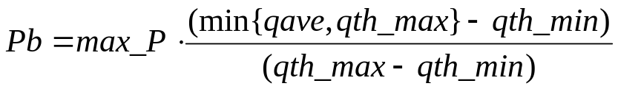
An operating case of RED
(a) qave = 0 and then Pb=0
Queue
5
4
3
2
1
Drop
with P
qth_max=4
qth_min=1
Drop
(b) qave = 2; then Pb=0.1*(2-1)/(4-1)=0.033
Queue
7
6
5
4
Drop
with P
2
1
Drop
qth_max=4
qth_min=1
3
(c) qave = 6; then Pb=0.1*(4-1)/(4-1)=0.1
Queue
13
12
11
Drop
with P
9
7
6
5
4
2
Drop
qth_max=4
qth_min=1
Let qth_min=1, qth_max=4, max_P=0.1 and w=1. Such a w implies that qave is always equal to the present queue length.
8
10
Chapter 7: Internet QoS

Slide 51
7.4 Summary
6 key QoS components
  Control-plane: signaling protocol, QoS routing, admission control
  Data-plane: classifier, policer, scheduler
Per-flow IntServ vs. per-class DiffServ
QoS architectures: failed to be deployed
QoS components: in our daily usage
Chapter 7: Internet QoS

