Slide 1
Computer Networks
An Open Source Approach
Chapter 8: Network Security
Ying-Dar Lin, Ren-Hung Hwang, Fred Baker
Chapter 8: Network Security

Slide 2
Content
8.1 General Issues
8.2 Data Security
8.3 Access Security
8.4 System Security
8.5 Summary
Chapter 8: Network Security

Slide 3
8.1 General Issues
Data security: protecting private data on the public Internet
  Encryption & authentication → Virtual Private Network (VPN)
Access security: deciding who can access what
  TCP/IP firewall or application firewall
System security: protecting system resources from hackers
  Intrusion detection and prevention
Chapter 8: Network Security

Slide 4
8.2 Data Security
Cryptography
Digital Signature and Message Authentication
Link Layer Tunneling
IP Security (IPSec)
Transport Layer Security
Comparison of VPNs
Chapter 8: Network Security

Slide 5
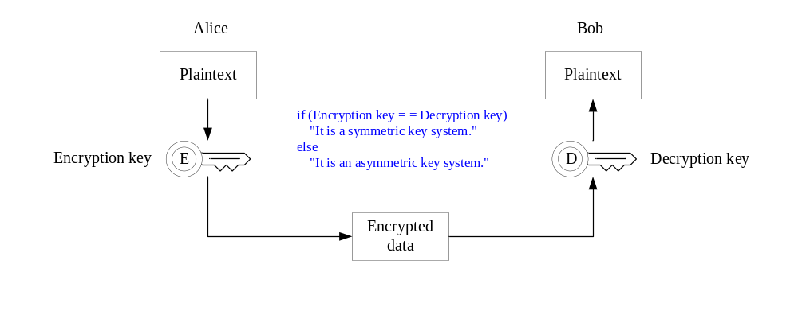
Cryptography
Symmetric Key Algorithm
Asymmetric Key Algorithm
Chapter 8: Network Security

Slide 6
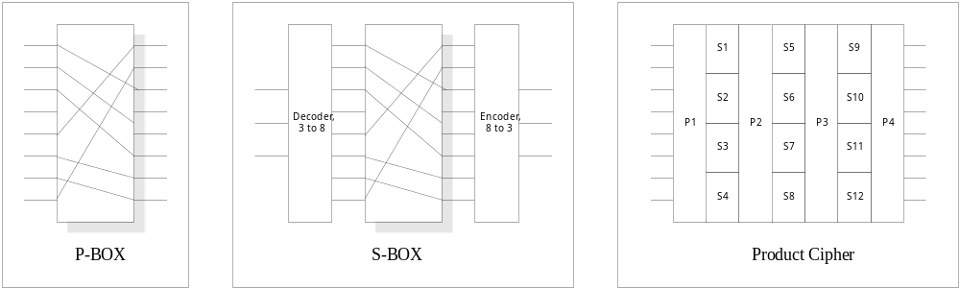
Symmetric Key Algorithm
Symmetric key
  Encryption (public) key = Decryption (private) key
Basic elements
  P-BOX: Transition cipher
  S-BOX: Substitution cipher
Product cipher
Chapter 8: Network Security

Slide 7
Data Encryption Standard (DES)
Originally developed by IBM
Adopted by the US government in Jan. 1977
Encrypted in blocks of 64 bits with 56-bits key
A monoalphabetic substitution cipher using a 64-bit character.
  Same input produces same output
Algorithm
  Transposition
  16 iterations (with 56-bit key)
  32-bit swap
  Inverse transposition
Chapter 8: Network Security

Slide 8
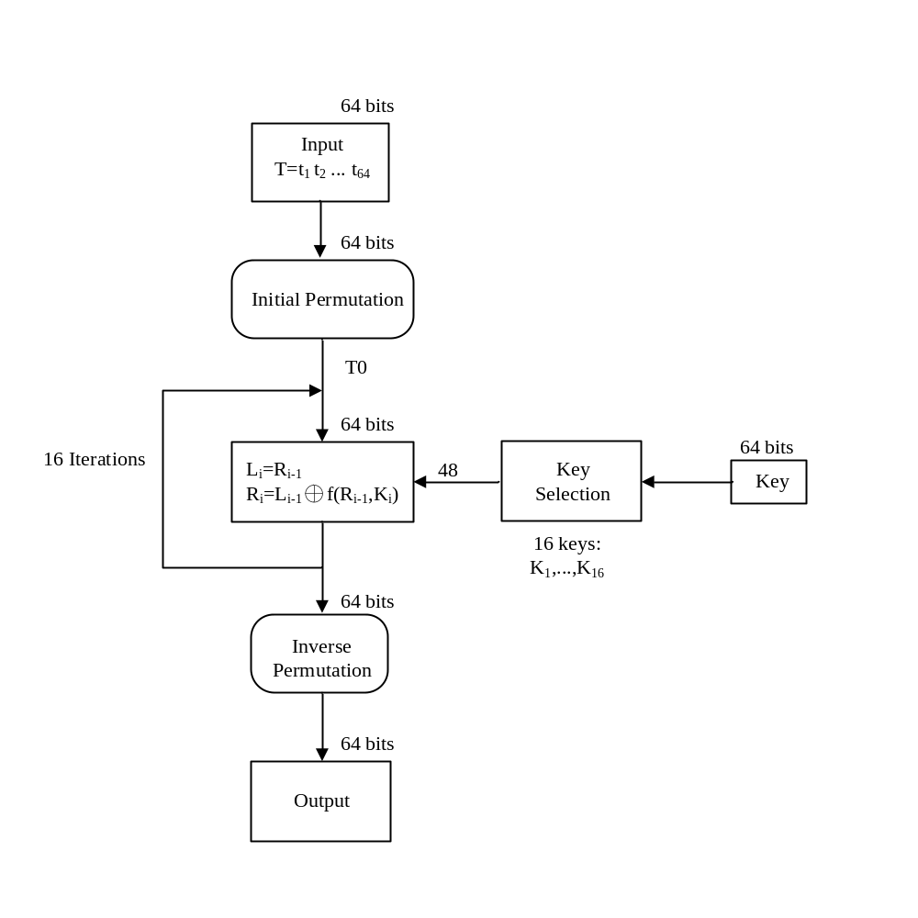
Encryption Procedure of DES
Chapter 8: Network Security

Slide 9
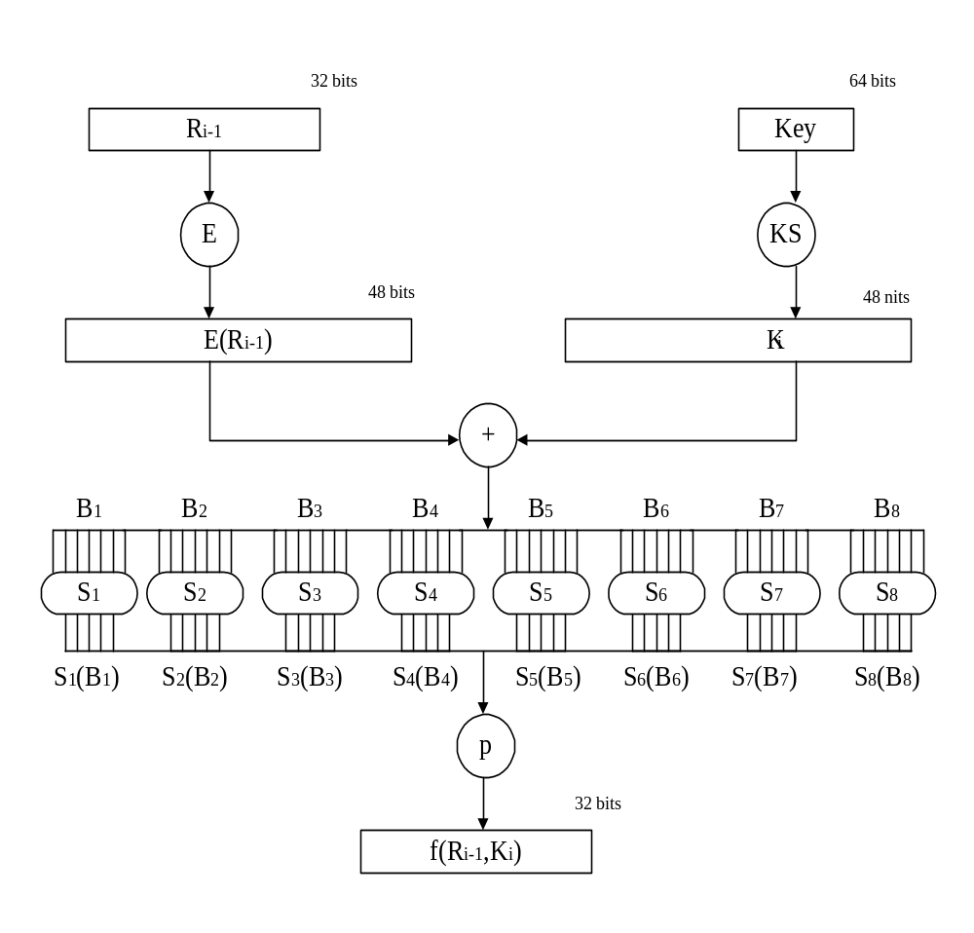
Computation Process of f(R_{i-1},K_{i})
Chapter 8: Network Security

Slide 10
Breaking DES
56-bit key for international use but 128-bit key within USA
56-bit key can be broken
  Within 4 hours by super computers (1994)
  About 22 hours by a network of volunteers and a special purpose computer that was built for less that $250,000 (1999)
Solution
  Run DES couple times, using different keys?
  Triple DES algorithm
    E_{K3}(D_{K2}(E_{K1}(P))) = C
    D_{K1}(E_{K2}(D_{K3}(C))) = P
Chapter 8: Network Security

Slide 11
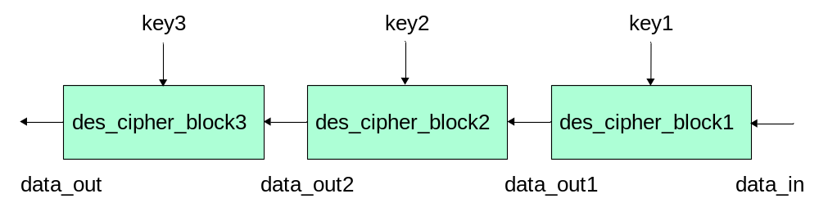
Open Source Implementation 8.1: Hardware 3DES
Signal | Direction | Description
KEY1_IN[0:63] | IN | the first 64-bit key
KEY2_IN[0:63] | IN | the second 64-bit key
KEY3_IN[0:63] | IN | the third 64-bit key
FUNCTION_SELECT | IN | encryption or decryption
LDKEY | IN | indicates the keys are ready
LDDATA | IN | indicates the data are ready
RESET | IN | reset to the initial state
CLOCK | IN | synchronous clock input
DATA_OUT[0:63] | OUT | 64-bit encrypted/decrypted data
OUT_READY | OUT | output data is ready
Chapter 8: Network Security

Slide 12
Asymmetric Key Algorithm
First proposed by W.Diffie and M.E. Hellman
Asymmetric keys
  Encryption (public) key ≠ Decryption (private) key
The encryption algorithm E and the decryption algorithm D should meet the following requirements
  D(E(P)) = P
  Difficult to deduce D from E
  E cannot be broken by a chosen plaintext attack
Chapter 8: Network Security

Slide 13


RSA Algorithm
Proposed by Rivest, Shamir, and Adleman at MIT in 1978
RSA
  Choose two very large primes, p and q (> 10¹⁰⁰)
  Compute n=p*q and z=(p-1)*(q-1)
  Choose a number relatively prime to z and call it d
  Find e such that e*d=1 mod z
Plaintext P, 0 ≤ P ≤ n (664-bit block is n ~ 10²⁰⁰)
encryption key = (n,e) decryption key = (n,d)
Based on the difficulty of factoring large numbers.
Chapter 8: Network Security

Slide 14
An example of RSA
Plaintext | m | m^{e} | c = m^{e} mod n
‘c’ | 3 | 94143178827 | 181
‘l’ | 12 | 6.6247E+24 | 177
‘a’ | 1 | 1 | 1
‘p’ | 16 | 4.9517E+27 | 169
Procedure of Alice encrypting plaintext “clap” by using public key (n=187, e=23).
Encrypted text, c | c^{d} | m = c^{d} mod n | Plaintext
181 | 6.3642E+15 | 3 | ‘c’
177 | 5.4426E+15 | 12 | ‘l’
1 | 1 | 1 | ‘a’
169 | 3.9373E+15 | 16 | ‘p’
Procedure of Bob decrypting by using secret key (n=187, d=7).
Chapter 8: Network Security

Slide 15
Authentication
Message Authentication
Digital Signature
Message Digest
Chapter 8: Network Security

Slide 16
Digital Signature
3 Requirements
  Authentication
    The receiver can verify the claimed identity of the sender.
  Non repudiation
    The sender cannot later repudiate the contents of the message.
  Integrity
    The receiver cannot possibly have concocted the message itself.
Chapter 8: Network Security

Slide 17
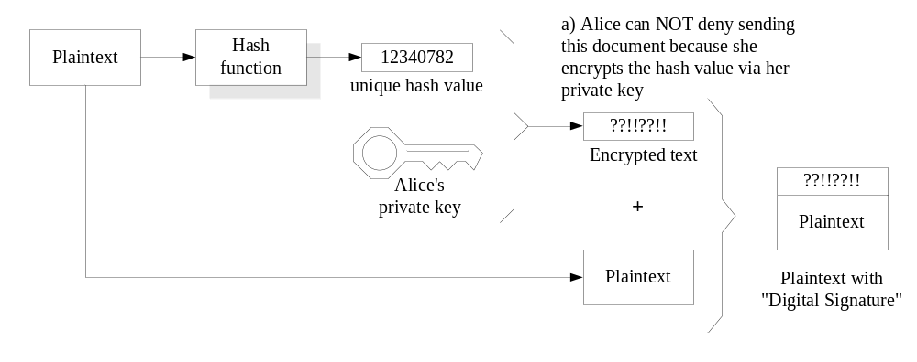
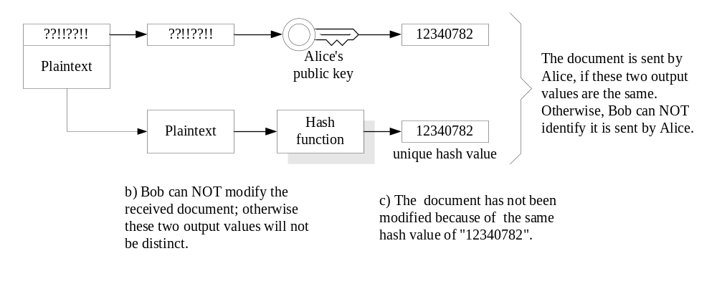
An Example of Digital Signature
Alice sends the document with “Digital Signature”.
Bob identifies whether the received document with “Digital Signature” is
from Alice or not.
Chapter 8: Network Security

Slide 18
Authentication without Encryption
Authentication only, but without message encryption
  e.g., Message broadcast from authorized source
Solution
  Message Digest (MD)
    Use a secure (one-way) hash function H to compute a fixed-size tag H(M||SAB), called a message digest for a given message M concatenated with a shared secret value SAB
    For secret-key digital signature
Chapter 8: Network Security

Slide 19
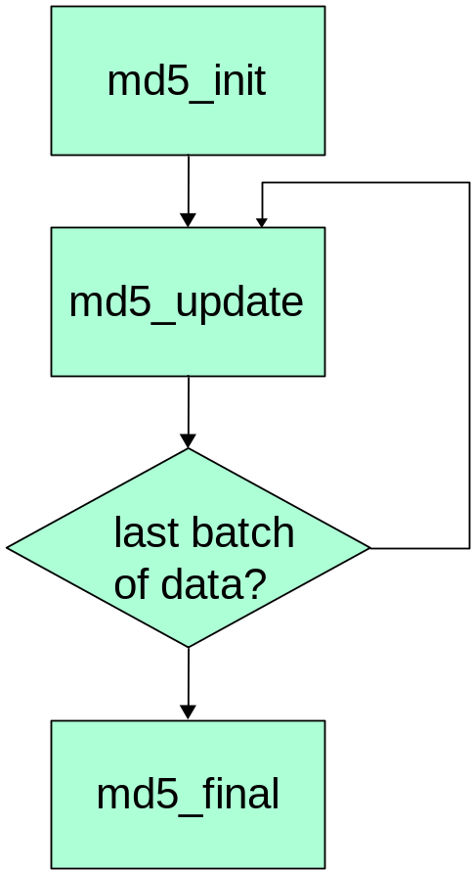
Open Source Implementation 8.2: MD5
Main code of md5_update
const u32 avail = sizeof(mctx->block) - (mctx->byte_count & 0x3f);
mctx->byte_count += len;
if (avail > len) {
memcpy((char *)mctx->block + (sizeof(mctx->block) - avail), data, len);
return 0;
}
memcpy((char *)mctx->block + (sizeof(mctx->block) - avail),data, avail);
md5_transform_helper(mctx);
data += avail;
len -= avail;
while (len >= sizeof(mctx->block)) {
memcpy(mctx->block, data, sizeof(mctx->block));
md5_transform_helper(mctx);
data += sizeof(mctx->block);
len -= sizeof(mctx->block);
}
memcpy(mctx->block, data, len);
return 0;
Chapter 8: Network Security

Slide 20
Link Layer Tunneling and IP Security
Link Layer Tunneling
  Point-to-Point Tunneling Protocol (PPTP)
  Layer-2 Tunneling Protocol (L2TP)
IP Security (IPSec)
  Authentication Header (AH)
  Encapsulation Security Payload (ESP)
Chapter 8: Network Security

Slide 21
IPSec
Why IPSec?
  Provide interoperable,high quality, cryptographically-based security for IPv4 and IPv6 communication
Security services
  Access control
  Integrity
  Authentication
  Confidentiality
Chapter 8: Network Security

Slide 22
Components for IPSec
Traffic security
  Authentication Header (AH)
    Integrity
    Authentication
  Encapsulation Security Payload (ESP)
    Confidentiality
Key management and distribution
  Simple Key-management for IP (SKIP)
  Internet Key Exchange (IKE)
Chapter 8: Network Security

Slide 23
Key Concept: Security Association
One-way relationship between a sender and a receiver
  For two-way secure exchange, two security associations are required.
Uniquely identified by an IP and SPI
  SPI: security parameter index
Parameters
  Authentication algorithm, mode, key(s)
  Encryption algorithm, mode, transform, key(s)
  Lifetime of the keys, security association
  Security level, source IP, ...
Chapter 8: Network Security

Slide 24
Authentication
RFC 1828 specifies the use of MD5 for authentication.
The MD5 algorithm is performed over the IP packet plus a secret key and then inserted into the IP packet.
At the destination, the same calculation is performed on the IP packet plus the secret key and compared to the received value.
Provides both authentication and data integrity.
Chapter 8: Network Security

Slide 25
Authentication (cont.)
Two ways in which IP authentication service can be used
  End-to-end
  End-to-intermediate
End-to-intermediate
Router/
Firewall
Intranet
Internet
End-to-end authentication
Chapter 8: Network Security

Slide 26
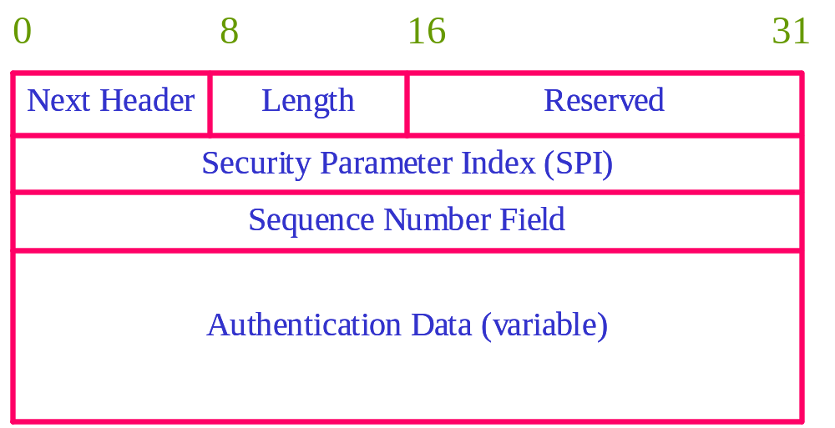
Authentication (cont.)
Length : Length of Authentication Data field in 32-bits words.
Security Parameters index: Identifies a security association.
Chapter 8: Network Security

Slide 27
Encapsulating Security Payload
Provide support for privacy and data integrity for IP packets.
Two modes
  Transport-mode ESP mechanism encrypts a transport-layer segment
  Tunnel-mode ESP mechanism encrypts an entire IP packet
ESP Header
  SPI
  Parameters dependent on the encryption algorithm
Chapter 8: Network Security

Slide 28
Transport-Mode ESP
Encrypt the data carried by IP
  ESP header is inserted into the IP packet immediately prior to the transport-layer header (or Destination Option header is present)
Suspectable to traffic analysis on the transmitted packets
  End-to-end transport
IP Header
Ext. Header
ESP Header
Transport layer segment
Unencrypted
Encrypted
Chapter 8: Network Security

Slide 29
Tunnel-Mode ESP
Encrypt an entire IP packet
  Counter traffic analysis problem
  Source sends encrypted IP packet to firewall
  Firewall sends to destination firewall
  Destination firewall forwards to destination
IP Header
Ext. Header
ESP Header
IP header + Transport layer segment
Unencrypted
Encrypted
Chapter 8: Network Security

Slide 30
Authentication Plus Privacy
Encryption before authentication
  Transport-mode ESP
    Authentication applies to the entire IP packet delivered to the ultimate destination
  Tunnel-Mode ESP
    Authentication applies to the entire IP packet delivered to the firewall
IP Header
Auth. Header
ESP Header
Transport layer segment
E-T
Scope of authentication
E-T : Encapsulating Security Payload trailing fields
Chapter 8: Network Security

Slide 31
Authentication Plus Privacy (cont.)
Authentication before encryption
  Only appropriate for tunnel mode ESP
  Authentication before encryption is better
    AH is protected by ESP
    More convenient to perform authentication on unencrypted data, then protected by encryption
IP-H
ESP-H
IP-H
A-H
Transport layer segment
E-T
Scope of authentication
Chapter 8: Network Security

Slide 32
Key Management
SKIP
  Proposed by Sun Microsystem
  Apply Diffie-Hellman key exchange algorithm to share private key
  For security, public key is authenticated by Certificate Authority (CA)
    Need Public Key Infrastructure(PKI) support
Chapter 8: Network Security

Slide 33
Key Management (cont.)
ISAKMP/Oakley(IKE)
  Oakley defines key identification
  ISAKMP defines key distribution
    Two phases
    Phase 1: ISAKMP SA establishment
      The two ISAKMP peer establish a secure, authenticated channel with which to communicate
      Unlike IPSec SA, ISAKMP SA is bi-directional
    Phase 2: use ISAKMP SA to construct AH or ESP SA
Chapter 8: Network Security

Slide 34
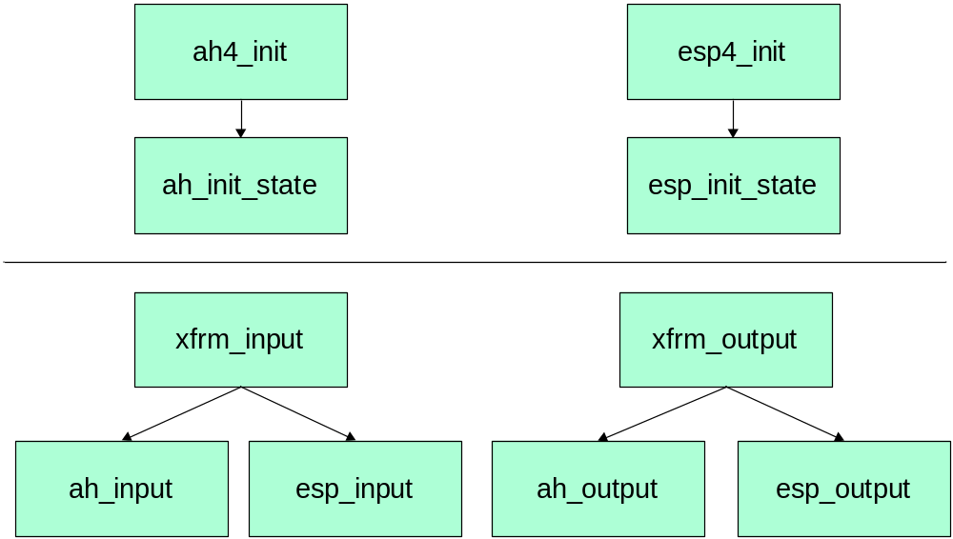
Open Source Implementation 8.3: AH and ESP
net/ipv4/ah4.c
net/ipv4/esp4.c
Chapter 8: Network Security

Slide 35
Transport Layer Security
Secure Socket Layer (SSL)
Security Electronic Transaction (SET)
Chapter 8: Network Security

Slide 36
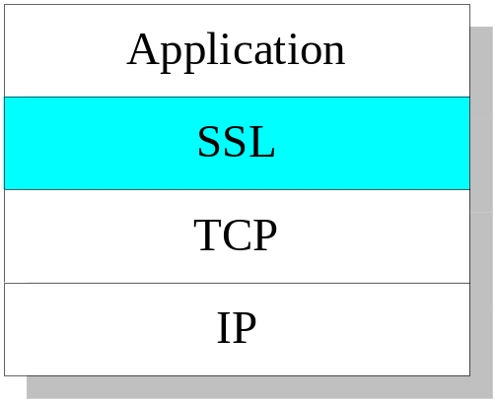
Secure Socket Layer (SSL)
What’s SSL?
  Provide encryption layer between Application and TCP layers
  RFC 2246 :Transport Layer Security (TLS) protocol.
  Original development by Netscape in 1994
  Encrypt data with various algorithm
    DES, Triple DES, RSA, Digital Signature
  SSL Contents
    SSL server authentication
    SSL client authentication
    Encrypted SSL session
Chapter 8: Network Security

Slide 37
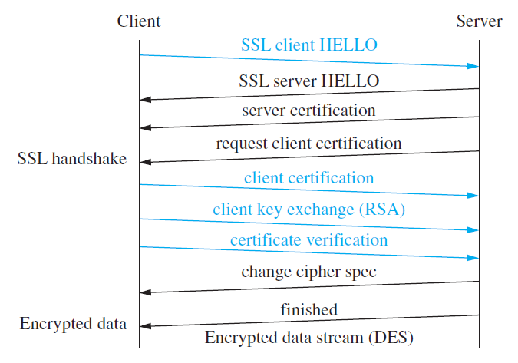
SSL Transaction Flow
Chapter 8: Network Security

Slide 38
Security Electronic Transaction (SET)
Why SET?
  SSL is only for securing the communication data between client and server
  Problems with SSL
    Client ← SSL→ Server
    Server : illegal using the client’s credit card
    Client : send un-authorization credit card
  SET is a security mechanism for E-transaction via networks
    The same procedure as traditional transaction, but with networking
Chapter 8: Network Security

Slide 39
Security Electronic Transaction (SET) (cont.)
What’s SET?
  Development by VISA, MasterCard, IBM, Microsoft, and HP in 1996.
  Members
    Cardholder
    Merchant
    Issuer (Credit card bank)
    Acquirer (Bank)
    Certificate Authority , (CA)
  Two types of payment
    E-wallet
    Credit card
Chapter 8: Network Security

Slide 40
SET Mechanisms
Confidentiality
  Data with DES and RSA
Authentication
  Digital Signature with RSA
  Cardholder, Merchant, and Bank
Integrity
  Digital Envelope to exchange DES key
  Receiver’s RSA public key(DES key)
Non repudiation
  Digital Signature with RSA
Chapter 8: Network Security

Slide 41





SET Operation
1
2,3
Merchant
E-wallet
Internet
5
Cardholder
12
Merchant Server
4
CA
6,7
11
Internet
Credit Card
9
Payment Gateway
10
Issuer/Credit Card Bank
Acquirer (Bank)
Chapter 8: Network Security
8

Slide 42
Virtual Private Network (VPN)
Why VPN?
  Private data network for enterprises
  Lease line
    X.25, Frame Relay , and ATM
    Custom-made service
  Disadvantages of lease line
    Complexity configuration
    High cost of network access equipments
    Hard to scale
Chapter 8: Network Security

Slide 43
VPN
What is VPN?
  Build private network communication on public network
How to implement VPN
  Tunneling
  MPLS
  Encryption & decryption
  Key management
  Authentication
Chapter 8: Network Security

Slide 44
Comparison of VPNs
Layer 2 tunneling
  Extend the PPP model by allowing the L2 and PPP endpoints to reside on different devices
    Save the long-term toll charge
    Use Internet to transmit PPP frames
  Support multi-protocol
    IP, IPX, NetBEUI, AppleTalk
    Take advantage of PPP
  PPTP/L2TP
Layer 3 tunneling
  IPSec
Application layer
  SSL VPN
Chapter 8: Network Security

Slide 45
8.3 Access Security
Introduction
Network/Transport Layer Firewall
  Netfilter and iptables
Application Layer Firewall
  FireWall ToolKit (FWTK)
Chapter 8: Network Security

Slide 46
Introduction to Firewalls
A system or group of systems that enforces an access control policy between two networks
  Redirects request to actual server
  Hide intranet servers from internet
  Access logs, invasion detection and alarms
Categories of firewalls
  Network layer firewall
  Application layer firewall
Chapter 8: Network Security

Slide 47
What can a firewall protect against?
Protect against unauthenticated interactive logins from the “outside” world
Record and monitor status of the protected network
  suspicious data access
Monitor abnormal instruction of the protected network
  Intrusion detection
  Against network-borne attack
Chapter 8: Network Security

Slide 48
Network Layer Firewall
Works on the network layer of OSI model
  Packet filter
Based on the header of the IP packet and rules defined by administrator
Fields checked
  Protocol ID
  Source IP address
  Destination IP address
  Source TCP/UDP port
  Destination TCP/UDP port
Chapter 8: Network Security

Slide 49
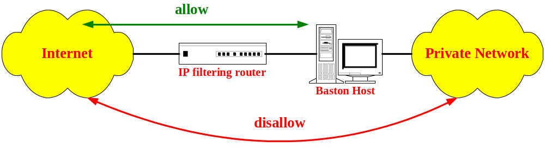
Screened Host Firewall
Chapter 8: Network Security

Slide 50
Screened Host Firewall (cont.)
Bastion host
  A exposed gateway machine
    highly-defended and secured strong point that can resist attack
Router operation
  Traffic from Internet to bastion host is permitted
  All traffic from inside to Internet are rejected unless it comes from bastion host
Advantage
  Simple router filtering rules
Disadvantage
  Packet can go inside directly
Chapter 8: Network Security

Slide 51
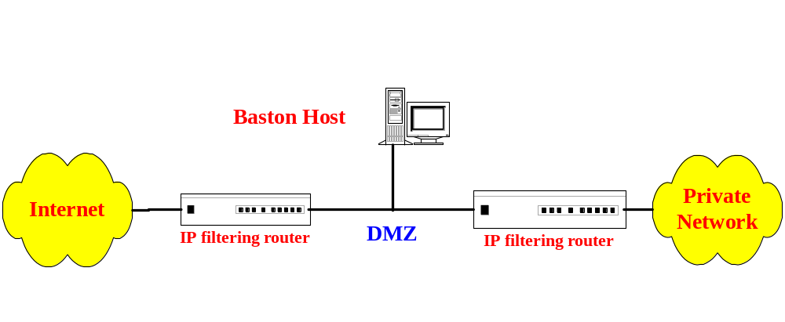
Screened Subnet Firewall
Bastion Host
Chapter 8: Network Security

Slide 52
Screened Subnet Firewall (cont.)
DMZ (demilitarized zone)
  An area between inside firewall and outside firewall
    Inside firewall refers to router located in private network
    Outside firewall refers to Internet access router
  Hosts in private network are protected by two or more firewalls
Create private network and DMZ by two routers
Advantage
  No site in private network is exposed to Internet
  Router closed to private network has better routing performance than bastion host
Chapter 8: Network Security

Slide 53
Open Source Implementation 8.4: Netfilter and iptables
What is netfilter?
  A set of checkpoints in the packet’s traversal of the protocol stack
    The checkpoints are called hooks
Actions taken on hooks
  NF_ACCEPT
  NF_DROP
  NF_STOLEN
  NF_QUEUE
  NF_REPEAT
Packet selection is done by IP Tables
Chapter 8: Network Security

Slide 54
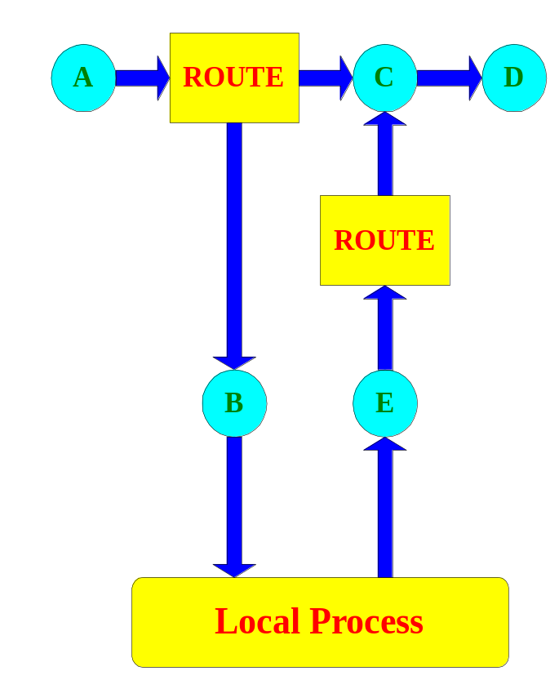
Open Source Implementation- Netfilter
Hooks in packet traversal
  NF_IP_PRE_ROUTING
  NF_IP_LOCAL_IN
  NF_IP_FORWARD
  NF_IP_POST_ROUTING
  NF_IP_LOCAL_OUT
Chapter 8: Network Security

Slide 55
Open Source Implementation - iptables
Rule structure
  Struct ipt_entry
    struct ipt_ip
    nf-cache
    target_offset
    next_offset
    comefrom
    struct ipt_counters
  Strcut ipt_entry_match
  Struct ipt_entry_target
Chapter 8: Network Security
Notes:
Struct ipt_ip:general IP header stuff
nf-cache: match specific stuff(bitfield)
Target_offset:where the ipt_entry_target begins
Next_offset

Slide 56
Application Layer Firewall
Works on the application layer of OSI model
  Filtering rules based on application content
  May support HTTP, SMTP, POP3, FTP, etc.
  Proxy server
Chapter 8: Network Security

Slide 57
Open Source Implementation 8.5: FireWall ToolKit (FWTK)
Set of programs to facilitate the network firewall
Netperm-table (An example from squid-gw)
  loaded for the settings and rules of application filtering
squid-gw: deny-destinations http *://*.*.*.*
squid-gw: destinations http://www.*.edu
Chapter 8: Network Security

Slide 58
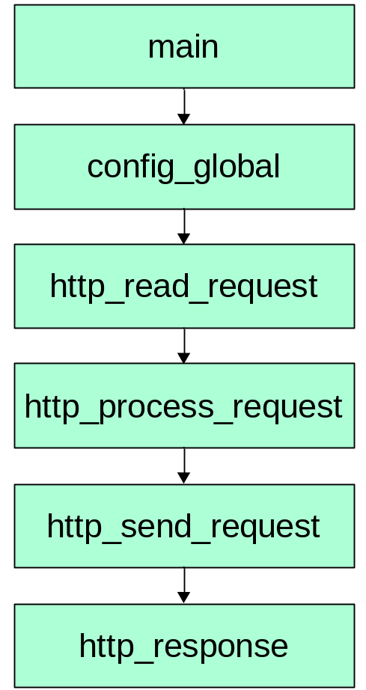
Block Diagram squid-gw in FWTK
while (i < cf->argc && cf->argv[i][0] != '-')
{
if (strcmp (cf->argv[i], "*") == 0)
cmp = 0;
else
{
if (url_parse (&pattern, (octet*) cf->argv[i], strlen (cf->argv[i]), UPF_WILDCARD | UPF_NODEFPORT) != 0)
url_error ("destinations", cf->ln);
cmp = url_compare ((octet*) cf->argv[i], &pattern, (octet*) s, u, UCF_IGNORE_CASE | UCF_WILDCARD);
}
if (cmp == 0)
// A URL match is found. Details skipped here.
}
Chapter 8: Network Security

Slide 59
8.4 System Security
Information Gathering
Vulnerability Exploiting
Malicious Code
Intrusion
Protection
Open Source Implementation- Snort
Chapter 8: Network Security

Slide 60
Information Gathering
Remote scanning
Local scanning
Sniffing
Snooping
Social engineering
Chapter 8: Network Security

Slide 61
Scanning
What’s scanning?
  Dawn of attacking
  Scanning services and security holes of the target only, but not real attacking
  Scanning types
    Local scanning
      COPS
      TIGER
    Remote scanning
      SATAN (Security Administrator’s Tool for Analyzing Networks)
      SAINT (Security Administrator’s Integrated Network Tool)
      Fluxay
Chapter 8: Network Security

Slide 62
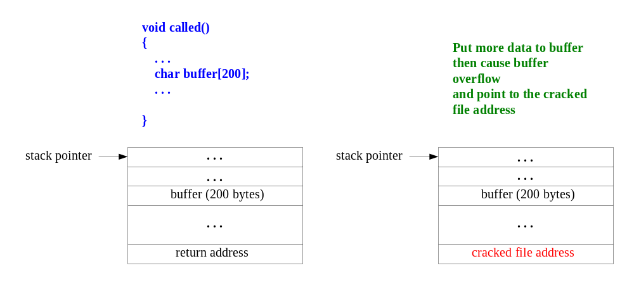
Vulnerability Exploiting
Buffer overflow attack
  Put more data to the specified buffer to cause buffer overflow
  Return address pointing to the cracked file to execute
Chapter 8: Network Security

Slide 63
Vulnerability Exploiting (cont.)
Remote/Local vulnerabilities
Vulnerabilities | Application | Version | Reason
phf Remote Command Execution Vulnerability | Apache Group Apache | 1.0.3 | Input Validation Error
Multiple Vendor BIND (NXT Oveflow) Vulnerabilities | ISC BIND | 8.2.1 | Buffer Overflow
MS IIS FrontPage 98 Extensions Buffer Overflow Vulnerability | Microsoft IIS | 4.0 | Buffer Overflow
Univ. Of imapd Buffer Overflow Vulnerability | imapd | 12.264 | Buffer Overflow
ProFTPD Remote Buffer Overflow | Professional FTP proftpd | 1.2pre5 | Buffer Overflow
Sendmail Daemon Mode Vulnerability | Eric Allman Sendmail | 8.8.2 | Input Validation Error
RedHat Piranha Virtual Server Package Default Account and Password Vulnerability | RedHat Linux | 6.2 | Configuration Error
Wu-Ftpd Remote Format String Stack Overwrite Vulnerability | wu-ftpd | 2.6 | Input Validation Error
Chapter 8: Network Security

Slide 64
Password Cracking
How to crack passwords
  Guess
  Brute force with a dictionary file
    Unix, /etc/passwd and /etc/shadow files
    Windows 2000, SAM file
  Plain text transmission without encryption
Chapter 8: Network Security

Slide 65
Denial of Service
What’s DoS?
  Not a intrusion attack, but deny services of target system
  Exhaust target resources
  Stop providing services
How does DoS do?
  TCP SYN flood with IP spoofing attack
  ICMP reply flood attack
  Ping of Death
  Teardrop attack
  UDP flood attack
  DDoS – Distributed DoS
Chapter 8: Network Security

Slide 66
Distributed DoS (DDoS)
Launch coordinated UDP flood DoS attacks from many sources
Hierarchy of attacker, master, client, and target
  Attacker, the Intruder
  A small number of servers, or masters
  A large number of clients, or daemons
  Target, the victim
Two of the tools have seen are known as
  Trinoo (or trin00)
  Tribe Flood Network (or TFN), and TFN2K
Chapter 8: Network Security

Slide 67
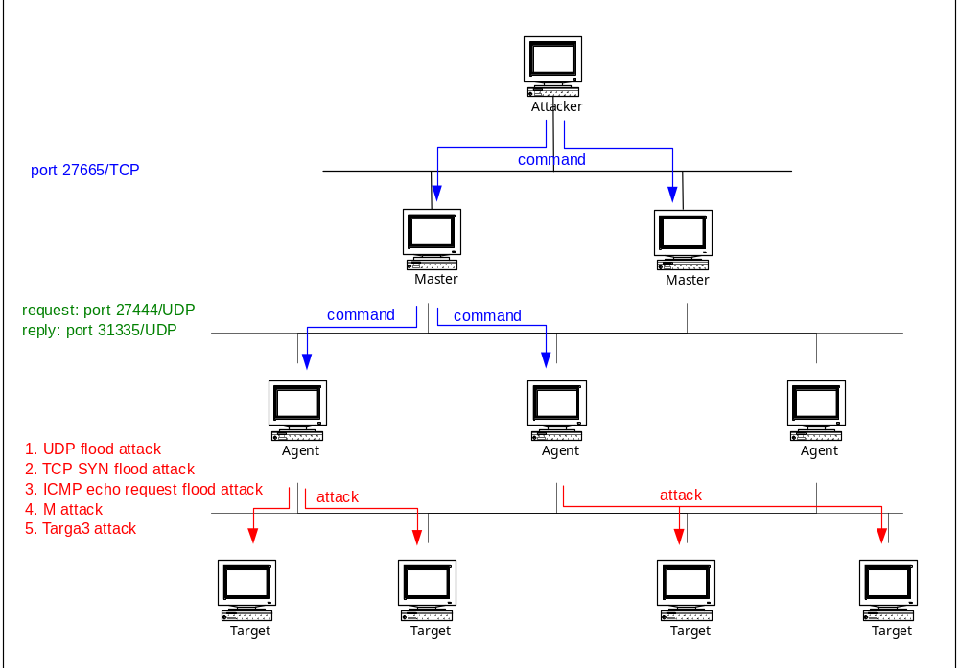
DDoS (cont.)
Chapter 8: Network Security

Slide 68
Malicious Code
What’s Malicious Code?
  Computer programs are written specifically to cause mischief or, worse, cause damage to infected computers
  Types of Malicious Code
    Virus
    Worm
    Trojan
    Backdoor
    Bot
Chapter 8: Network Security

Slide 69
Open Source Implementation 8.6: ClamAV
Introduction
  open-source package for virus scanning
  have detected over 570,000 malicious codes (viruses, worms and trojans, etc.) with the release of 0.95.2 version
  Types of signatures
    MD5 for a certain PE section (part of an executable file)
    basic signatures of fixed strings (to be scanned in the entire file)
    extended signatures (in a simplified form of regular expressions containing multiple parts
    logical signatures (multiple signatures combined with logical operators)
    logical signatures (multiple signatures combined with logical operators)
Chapter 8: Network Security

Slide 70
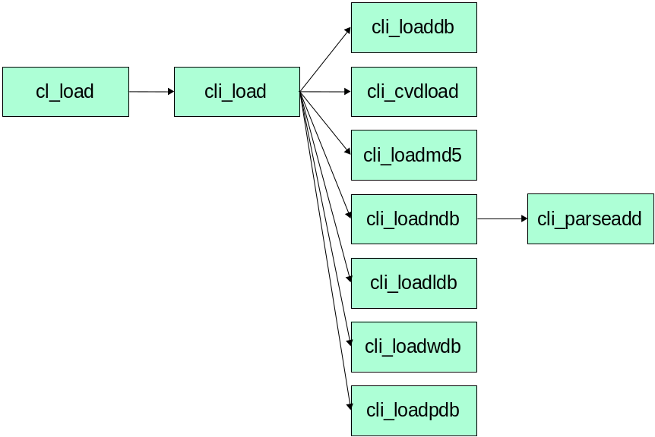
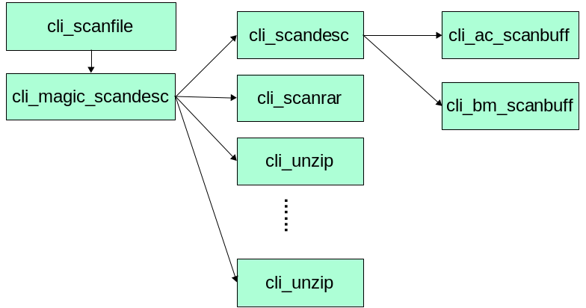
Block Diagrams of ClamAV
for signature loading
for signature matching
Chapter 8: Network Security

Slide 71
Types of Defense
Auditing
  record security-related events in log files
Monitoring
  monitor the system for any abnormal activities
Intrusion Detection and Prevention
  detect intrusions based on known signatures or anomalous traffic
  actively block the traffic if an intrusion is found
Chapter 8: Network Security

Slide 72
Packages for Protection
Types of Defense | Software | URL
Data Encryption | PGP | http://web.mit.edu/network/pgp.html
 | SSH | http://www.ssh.org
Access Control | Firewall-1 | http://www.checkpoint.com
 | Ipchains | http://netfilter.filewatcher.org/ipchains
 | TCP Wrappers | ftp://ftp.porcupine.org/pub/security/index.html
 | Portmap | ftp://ftp.porcupine.org/pub/security/index.html
 | Xinetd | http://synack.net/xinetd
Monitoring | Tripwire | http://www.tripwiresecurity.com
 | RealSecure | http://www.iss.net
Scanning | Pc-cillin | http://www.trend.com.tw
Chapter 8: Network Security

Slide 73

Open Source Implementation 8.7: Snort
Three modes
  Sniffer
    Read and decode network packets
  Packet logger
    Log packets to disk
  Intrusion detection system
    Analyze traffic based on pre-defined rules
    Perform actions based upon what it sees
Chapter 8: Network Security

Slide 74
Snort Rules
A powerful description language
  Snort takes action based upon rule type
  Divide into two sections :
    Rule header
      action, protocol
      source and destination IP address, port information
    Rule option
      Alert message
      Which part of packet should be inspected
Chapter 8: Network Security

Slide 75
Writing Snort Rules
Rule header
alert tcp any any - > 10.1.1.0/24 80
Rule option
(content: “/cgi-bin/phf”; msg: “PHF probe!”;)
action
protocol
Source address and port number
destination address and port number
inspective part
alert message
Chapter 8: Network Security

Slide 76
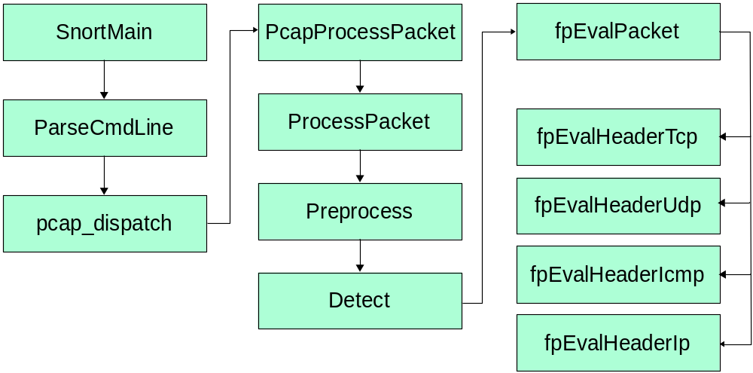
Block Diagram of Snort
Chapter 8: Network Security

Slide 77
Open Source Implementation 8.8: SpamAssassin
open source package that can identify and filter spam, i.e., unsolicited e-mails.
filtering mechanisms
  analysis on mail header and text
  Bayesian filtering
  DNS blocklists
  implemented as plug-ins for flexibility
Chapter 8: Network Security

Slide 78
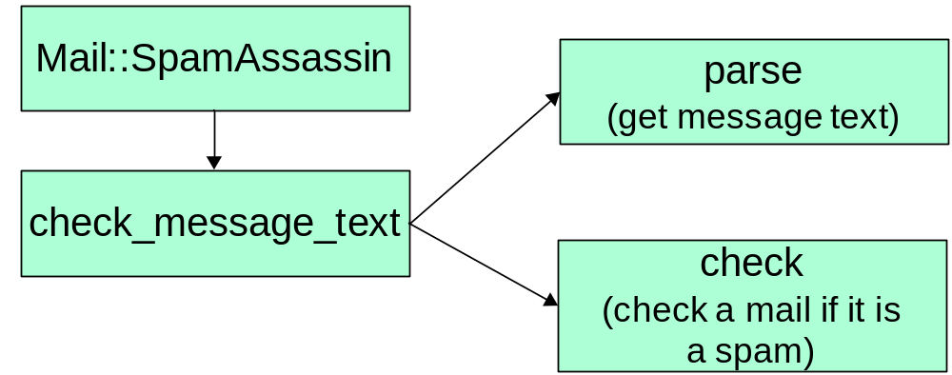
Implementation of SpamAssassin
Block diagram
header FROM_BLANK_NAME From =~ /(?:\s|^)”” <\S+>/i
describe FROM_BLANK_NAME From: contains empty name
Sample rules
Chapter 8: Network Security

Slide 79
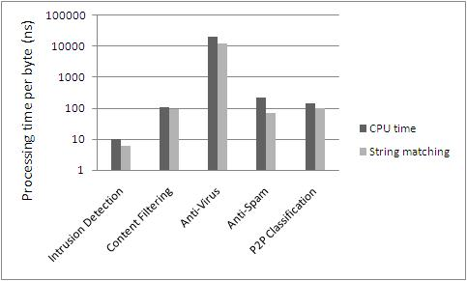
Performance Matters: Comparing Intrusion Detection, Antivirus, Anti-Spam, Content Filtering, and P2P Classification
 | Snort | DansGuardian | ClamAV | SpamAssassin | L7-filter
Percentage of string matching | 62% | 86% | 57% | 31% | 70%
Inspection depth | Byte jump | Http request / response | All attachment content | Mail header/ body | First 10 packets
Chapter 8: Network Security

Slide 80
8.5 Summary
General issues
  Data Security
  Access Security
  System Security
Data Security
  Cryptography, Digital Signature, Message Authentication
Access Security
  Firewalls at Network/Transport/Application layers
System Security
  Intrusion, Defense
Struggles between attackers and defenders
Chapter 8: Network Security

