Slide 1
Modern Computer Networks
An Open Source Approach
Appendices
Ying-Dar Lin, Ren-Hung Hwang, Fred Baker
Appendices

Slide 2
Content
Appendix A Who’s Who
A.1 IETF: Defining RFCs
A.2 Open Source Communities
A.3 Research and Other Standard Communities
A.4 History
Further Readings
Appendices

Slide 3
Content (cont)
Appendix B Linux Kernel Overview
B.1 Kernel Source Tree
B.2 Source Code of Networking
B.3 Tools for Source Code Tracing
Further Readings
Appendices

Slide 4
Content (cont)
Appendix C Development Tools
C.1 Programming
C.2 Debugging
C.3 Maintaining
C.4 Profiling
C.5 Embedding
Further Readings
Appendices

Slide 5
Content (cont)
Appendix D Network Utilities
D.1 Name-Addressing
D.2 Perimeter-Probing
D.3 Traffic-Monitoring
D.4 Benchmarking
D.5 Simulation and Emulation
D.6 Hacking
Further Readings
Appendices

Slide 6
Appendix A Who’s Who
IETF: defining RFCs
  History, process, statistics
Open source communities
  Free Software Foundation
  Linux, BSD
  Open Cores
History
  Good but dead
  Bad and gone
Appendices

Slide 7
Spirit of IETF
Implement as you go
  vs. specify first and implement later
“We reject kings, presidents, and voting. We believe in rough consensus and running code.” (David Clark)
Appendices

Slide 8
IETF: Defining RFCs
IETF (Internet Engineering Task Force)
    From ARPA WG since 1969
    ISOC: IAB, IRTF, IETF
    8 areas and many WGs
    IESG (Internet Engineering Steering Committee): area directors
The RFC (Request For Comments) process
    IETF draft reviewed by IESG, edited by RFC-Editor
The RFC statistics
    Over 5600 RFCs
    RFC status: FYI, informational/experimental, BCP (best current practice), standard track
    Telnet: defined by 70 RFCs (with updates, options)
Appendices

Slide 9
Historical Evolution:
Who’s who in IETF
Name | # of RFCs | Key Contributions
Jonathan B. Postel | 202 | IP, TCP, UDP, ICMP, FTP
Keith McCloghrie | 94 | SNMP, MIB, COPS
Marshall T. Rose | 67 | POP3, DNS security
Yakov Rekhter | 62 | BGP4, MPLS
Henning Schulzrinne | 62 | SIP, RTP
Bob Braden | 59 | FTP, RSVP
Jonathan Rosenberg | 52 | SIP, STUN
Bernard Aboba | 48 | RADIUS, EAP
Appendices

Slide 10
The RFC Process
Individual
Internet Draft
(2 weeks)
(2 weeks)
Informational,
Experimental
BCP
Proposed-Standard
(6 months)
Draft-Standard
(4 months)
Standard
Historic
Reviewed and approved by IESG
Reviewed and recommended by IESG, and approved by the RFC Editor
Appendices

Slide 11
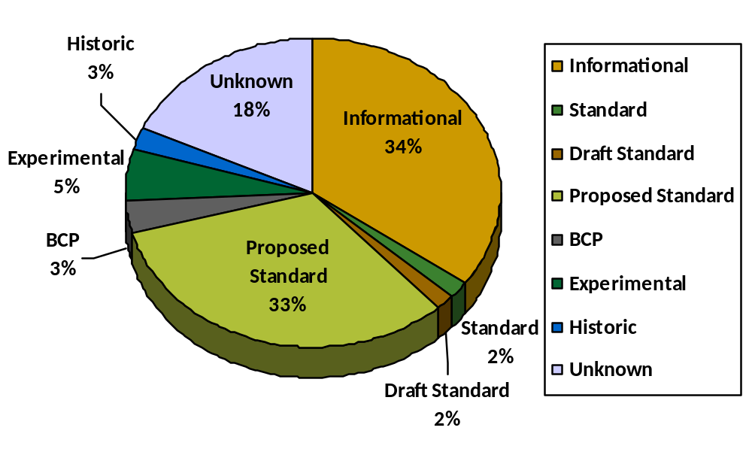
The RFC Statistics
Statistics for RFC Status
Appendices

Slide 12
The RFC Statistics
Well-known Protocols in 5600 RFCs
Layer | Protocol | Count | Layer | Protocol | Count
Data Link | ATM | 46 | Transport | TCP | 111
 | PPP | 87 |  | UDP | 21
Network | ARP/RARP | 24 | Application | DNS | 105
 | BOOTP/DHCP | 69 |  | FTP/TFTP | 51
 |  |  |  | HTTP/HTML | 37
 | ICMP/ICMPv6 | 16
 |  |  |  | MIME | 99
 | IP/IPv6 | 259
 |  |  |  | SMTP | 41
 | Multicast | 95 |  | SNMP/MIB | 238
 | RIP/BGP/OSPF | 154 |  | TELNET | 108
Appendices

Slide 13
Open Source Communities
Free Software Foundation
    www.fsf.org supports www.gnu.org
Linux: www.linux.org
BSD: www.bsd.org
Open Cores
    Open source IP (Intellectual Properties), in Verilog codes, for ASIC design
    www.opencores.org
Appendices

Slide 14
Taxonomy of Open Source Packages
68
Console/ GNOME/KDE/X11
[247] Administration
[019] AfterStep applets
[019] Anti-Spam
[119] Applications
[048] Backup
[008] Browser Addons
[023] CAE
[034] CD Writing Software
[196] Communication
[030] Compression
[009] Core
[130] Database
[063] Desktop
[027] Development
[006] Dialup Networking
[055] Documentation
[108] Drivers
[088] Editors
[062] Education
[165] eMail
[008] Embedded
[088] Emulators
[068] Encryption
[028] Enlightenment Applets
[023] FTP Clients
[044] File Managers
[052] Filesystems
[051] Financial
[179] Firewall and Security
[026] Fonts and Utilities
[593] Games
[277] Graphics
[008] Home Automation
[103] IRC
[053] Java
[074] Log Analyzers
[208] MP3
[010] Mail Clients
[051] Mini Distributions
[021] Mirroring
[351] Misc
[028] Modelling
[007] Modem gettys
[184] Monitoring
[003] Motif
[032] Multimedia
[480] Networking
[048] News
[053] OS
[048] Office Applications
[042] Packaging
[053] Printing
[189] Scientific Applications
[007] Screensavers
[031] Shells
[265] Sound
[136] System
[041] TV and Video
[011] Terminals
[190] Text Utilities
[665] Utilities
[004] VRML
[033] Video
[038] Viewers
[684] Web Applications
[038] Web Browsers
[121] Window Maker Applets
[039] Window Managers
Appendices

Slide 15
Taxonomy of Open Source Packages (cont)
24
Daemons
23
Development
[007] Anti-Virus
[005] Batch Processing
[030] BBS
[010] Chat
[032] Database
[026] DNS
[015] Filesharing
[009] Finger
[022] FTP
[006] Hardware
[097] HTTP
[013] Ident
[013] IMAP
[050] IRC
[015] Mailinglist Managers
[231] Misc
[027] MUD
[009] Network Directory Service
[013] NNTP
[023] POP3
[071] Proxy
[031] SMTP
[005] SNMP
[002] Time
[010] Bug Tracking
[068] Compilers
[014] CORBA
[073] Database
[038] Debugging
[084] Environments
[028] Game SDK
[048] Interfaces
[173] Java Packages
[028] Kernel
[001] Kernel Patches
[121] Languages
[485] Libraries
[100] Perl Modules
[008] PHP Classes
[001] Pike Modules
[057] Python Modules
[031] Revision Control
[019] Tcl extensions
[017] Test Suites
[558] Tools
[178] Web
[055] Widget Sets
Appendices

Slide 16
Events and People
1969 | Internet started as ARPAnet. Unix.
1979 | Berkeley Software Distribution (BSD).
1983 | Sendmail by Eric Allman.
1984 | Richard Stallman started GNU project.
1986 | Berkeley Internet Name Domain (BIND).
1987 | Perl by Elaine Ashton.
1991 | Linus Thorvald wrote Linux.
1994 | Allan Cox carried on the Linux kernel maintenance. PHP by Rasmus Lerdorf.
2/1995 | Apache HTTP Server Project with 8 team members.
3/1998 | Navigator went Open Source.
8/1998 | “Sure, we're worried.”-- Microsoft president Steve Ballmer.
3/1999 | Macintosh released Darwin (kernel of MacOSX) under APS license.
7/2000 | No. of Apache Web servers exceeded 11 millions (62.8% of the whole market).
10/2000 | Sun Microsystems made the StarOffice code available.
10/2003 | UK government announced a deal with IBM on open source software.
10/2004 | IBM offered 500 patents for open-source developers.
1/2005 | Sun Microsystems opened the Solaris operation system.
5/2007 | Microsoft claimed Linux infringed its patents.
11/2007 | Google announced an open mobile device platform named Android.
9/2008 | Microsoft CEO confessed that 40% of Web servers run Windows but 60% run Linux.
7/2009 | Google introduced its open-source OS, Google Chrome OS.
Appendices

Slide 17
Sidebar – Historical Evolution: Who’s Who in Open Source
Must-Know
Linus Torvalds | Wrote Linux and currently at Transmeta
Richard Stallman | Founded GNU and FSF, currently loafing around for free software
Eric Raymond | Open Source Initiative
Brian Behlendorf | Founded Apache, currently CEO of ASF and CFO of Collab.Net
Should-Know
Allan Cox | Linus handed on to Allan kernel maintenance
Donald Becker | Wrote Linux Ethernet driver
Bob Young | Founded Red Hat
Bruce Perens | Debian Project, Open Source Initiative, LSB, TECHNOCRAT.NET
Tom Paquin and Jim Hamerly | Founded mozilla.org, Netscape
Appendices

Slide 18
People: Layered must-know
Layer | Name | Achievement
Physical/Data link layer | Robert M. Metcalfe, David R. Boggs | Inventors of Ethernet
Network/ Transport-layer | Bob Kahn and Vint Cerf | Inventors of Internet
 | Jon Postel | Inventors of TCP/IP, DNS, SMTP, FTP
 | David D. Clark | Chief protocol architect in the development of the Internet, and chair of the Internet Activities Board.
 | W. Richard Stevens | TCP Slow Start, Congestion Avoidance, Fast Retransmit, and Fast, Recovery Algorithms
 | Van Jacobson | Congestion Avoidance and Control
 | Sally Floyd | RED, CBQ, and Improvement of TCP,
Application layer | B. Lee and R. Cailliau | Inventors of WWW
Appendices

Slide 19
History
Architecture standard: OSI (Open System Interconnection)
Integrated services: ISDN, B-ISDN
Switching technology: ATM (Asynchronous Transfer Mode)
WAN services: X.25, Frame Relay, SMDS
LAN technologies: IEEE 802.x (x= 4, 5, 6, 9, 12, 14), FDDI, ATM
Appendices

Slide 20
Timeline with all short-lived and failed technologies
X.25, 80s
Frame Relay, 90s, (Replaced by IP over DSL)
Token Ring/Bus, 80s
FDDI and DQDB, 90s (Failed to replace Ethernet)
ISDN, B-ISDN, 80s
ATM, 90s (Failed to replace TCP/IP and Ethernet)
OSI, 79 ~ 85 (Failed to replace TCP/IP)
Year
1980
1985
1990
1995
2000
2005
Appendices

Slide 21
Appendix B Linux Kernel Overview
Summary of Linux kernel source
Category | Directories | Description
Creation | usr/, scripts/ | Help the making of kernel.
Architecture-specific | arch/, virt/ | Architecture-specific source and header files
Kernel core | init/, kernel/, include/, lib/, block/, ipc/, mm/, security/, crypto/ | Core functions and frameworks used in kernel
File system | fs/ | File system related source codes
Networking | net/ | Networking related source codes
Drivers | drivers/, sound/, firmware/ | Device drivers
Helper | Documentation/, samples/ | Document and sample codes that help you get involved into the kernel development.
Appendices

Slide 22

Kernel Source Tree
Helper
Creation
build
Documentation/
usr/
initrd
HOWTO, …
samples/
script/
Networking
TCP/IP
WiMAX
…
Kconfig, …
net/
Kernel core
lib/
init/
PCI
SCSI
…
strcmp, …
crypto/
kernel/
Kernel
Source
Drivers
aes, sha1, …
ipc/
mm/
drivers/
sound/
ALSA
…
shm_init, …
security/
block/
firmware/
SELinux, …
include/
Filesystem
Architecture-specific
fs/
arch/
virt/
function
declarations
ext3, nfs, …
x86, …
Intel VT-x
Appendices

Slide 23
Summary of directories and files related to networking
Layer | Topics | Directory | Files | Functions | Descriptions
Data Link | Receiving Frames | net/core/ | dev.c | net_rx_action()-> netif_receive_skb() | Upon NET_RX_SOFTIRQ interrupt, kernel calls net_rx_action() which in turn calls netif_receive_skb() to process the frame.
Data Link | Sending Frames | net/core/ | dev.c | net_tx_action()-> dev_queue_xmit() | Upon NET_TX_SOFTIRQ interrupt, kernel calls net_tx_action() which in turn calls dev_queue_xmit() to send the frame.
Data Link | Netcard drivers | drivers/net/ | 3c501.c, etc. | el_interrupt(), el_open(), el_close(), etc. | network interface drivers, include interrupt handlers
Data Link | PPP outgoing flow | drivers/net/ | ppp_generic.c | ppp_start_xmit(), ppp_send_frame(), start_xmit() | PPP deamon calls ppp_write while kernel calls ppp_start_xmit()
Data Link | PPP outgoing flow | drivers/net/ | ppp_generic.c | ppp_start_xmit(), ppp_input(), ppp_receive_frame(), netif_rx() | ppp_sync_receive() takes out the tty->disc_data, frame received trhough netif_rx() or skb_queue_tail()
Appendices

Slide 24
Summary of directories and files related to networking (cont)
Data Link | Bridging | net/bridge/ | br_fdb.c | __br_fdb_get(), fdb_insert() | Self-Learning Bridging, MAC table look up
Data Link | Bridging | net/bridge/ | br_stp_bpdu.c | br_stp_rcv(), br_received_config_bpdu() br_record_config_information(), br_configuration_update() | Spanning Tree protocol
Network | Packet forwarding | net/ipv4/ | route.c | ip_queue_xmit(), __ip_route_output_key(), ip_route_output_slow() fib_lookup() ip_rcv_finish(), ip_route_input(), ip_route_input_slow() | Forward packets based on routing cache; if cache miss, forward based on routing table
Network | IPv4 checksum | include/ asm_i386/ | checksum.h | ip_fast_csum() | Speed up checksum computation with codes in machine-dependent assembly language
Network | IPv4 Fragment- ation | net/ipv4/ | ip_output.c ip_input.c ip_fragment.c | ip_fragment(), ip_local_deliver(), ip_defrag(), ip_find(), ipqhashfn(), inet_frag_find(), ipq_frag_create() | IP packet fragmentation and re-assembly procedure; hash is used to indentify fragments of a packet.
Appendices

Slide 25
Summary of directories and files related to networking (cont)
Network | NAT | net/ipv4/ netfilter/ | nf_conntrack_core.c nf_nat_standalone.c nf_nat_ftp.c nf_nat_proto_icmp.c ip_nat_helper.c | nf_conntrack_in(), resolve_normal_ct(), nf_conntrack_find_get(), nf_nat_in(), nf_nat_out(), nf_nat_local_fn(), nf_nat_fn(), nf_nat_ftp(), nf_nat_mangle_tcp_packet(), mangle_contents(), adjust_tcp_sequence() icmp_manip_pkt() | Perform source NAT after packet filtering and before sending to the output interface; perform destination NAT before packet filtering for packets from network interface card or upper layer protocols. NAT ALG (helper function) for FTP and ICMP;
Network | IPv6 | net/ipv6/ | ip6_fib.c | fib6_lookup(), fib6_lookup_1(), ipv6_prefix_equal() | Lookup the IPv6 routing table (FIB) which is stored in a binary radix tree.
Network | ARP | net/ipv4/ | arp.c | arp_send(), arp_rcv(), arp_process() | Implementation of the ARP protocol, include send, receive, and process ARP packets.
Network | DHCP | net/ipv4/ | ipconfig.c | ic_bootp_send_if(), ic_dhcp_init_options(), ic_bootp_recv(), ic_do_bootp_ext() | Implementation of the DHCP/ BOOTP/RARP protocol; we trace the send and receive procedure of a DHCP message.
Appendices

Slide 26
Summary of directories and files related to networking (cont)
Network | ICMP | net/ipv4/ | icmp.c | icmp_send(), icmp_unreach(), icmp_redirect(), icmp_echo(), icmp_timestamp, icmp_address(), icmp_address_reply(), icmp_discard(), icmp_rcv() | Implementation of ICMPv4, different types of ICMP messages are processed by corresponding functions.
Network | ICMPv6 | net/ipv6/ | icmp.c ndisc.c | icmpv6_send(), icmpv6_rcv(), icmpv6_echo_reply(), icmpv6_notify(), ndisc_rcv(), ndisc_router_discovery() | Implementation of ICMPv6, include five new types of ICMPv6 messages, i.e., router solicitation, router advertisement, neighbor solicitation, neighbor advertisement, and route redirect messages.
Transport | UDP and TCP Checksum | net/ipv4/ | tcp_ipv4.c | tcp_v4_send_check(), csum_partial(), csum_tcpudp_magic() | Computation of the checksum of a TCP/UDP segment, include pseudo header.
Transport | TCP Sliding Window Flow Control | net/ipv4/ | tcp_output.c | tcp_snd_test(), tcp_packets_in_flight(), tcp_nagle_check() | Check follow three conditions before sending out a TCP segment: (1) outstanding segments is less than cwnd (2) number of sent segments plus the one to be sent is less than rwnd (3) do Nagle’s test
Appendices

Slide 27
Summary of directories and files related to networking (cont)
Transport | TCP Slow Start and Congestion Avoidance | net/ipv4/ | tcp_cong.c | tcp_slow_start(), tcp_reno_cong_avoid(), tcp_cong_avoid_ai() | TCP slow start and congestion avoidance.
Transport | TCP Retransmit Timer | net/ipv4/ | tcp_input.c | tcp_ack_update_rtt(), tcp_rtt_estimator(), tcp_set_rto() | Measure RTT, calculate the smoothed RTT, and update the Retransmission TimeOut (RTO).
Transport | TCP Persistence Timer and Keepalive Timer | net/ipv4/ | tcp_timer.c | tcp_probe_timer(), tcp_send_probe0(), tcp_keepalive(), tcp_keepopen_proc() | Codes for managing the persistent timer (probe timer) and keepalive timer.
Transport | TCP FACK Implementation | net/ipv4/ | tcp_output.c | tcp_adjust_fackets_out(), tcp_adjust_pcount(), tcp_xmit_retransmit_queue() | Compute packets in flight using FACK information.
Transport | Socket Read/Write Inside out | net/ | socket.c | sys_socketcall(), sys_socket(), sock_create(), inet_create(), sock_read(), sock_write() | Explain how the user space’s socket interfaces are implemented in the kernel space.
Transport | Socket Filter | net/ | socket.c | SYSCALL_DEFINE5(setsockopt,…) sock_setsockopt() | Implementation of the Berkeley Packet Filter (BPF).
Appendices

Slide 28
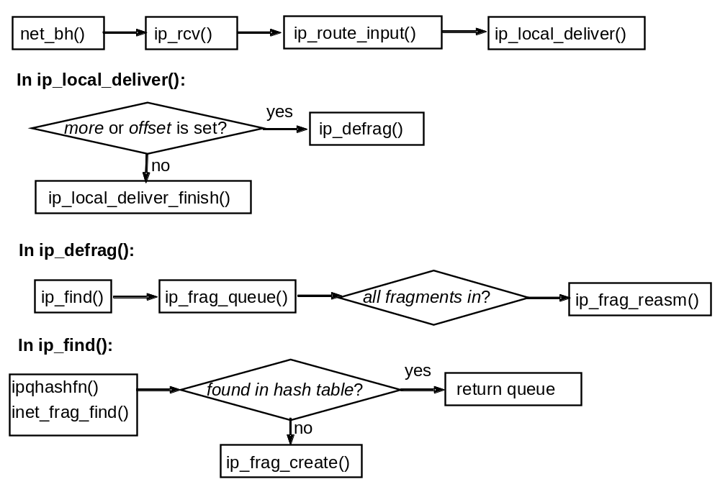
Call graph of re-assembly procedure
Appendices

Slide 29

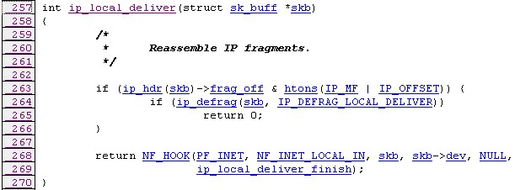
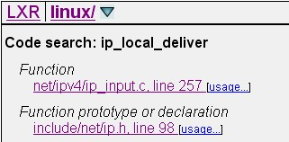
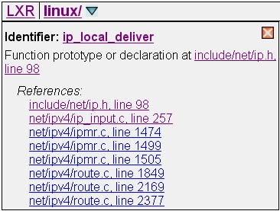
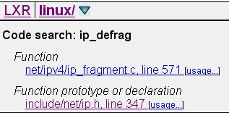
LXR search bar
LXR search bar
Search results from LXR
Source of ip_local_deliver()
Search results of ip_defrag
Appendices
Usage of ip_local_deliver()

Slide 30
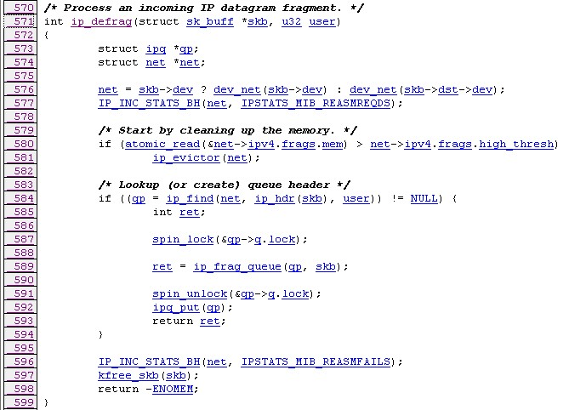
Source of ip_defrag()
Source of ip_defrag()
Appendices

Slide 31

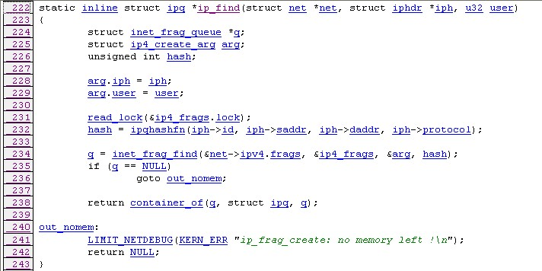
Search result of ip_find()
Search result of ip_find()
Source of ip_find()
Appendices

Slide 32
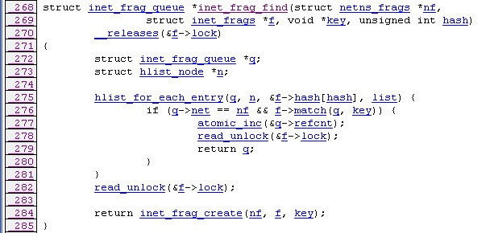
Source of ip_frag_find()
Source of ip_frag_find()
Appendices

Slide 33
Appendix C Development Tools
Operating modes of the vim text editor
Start vi
motion commands
search
Command mode
Yanking/deleting commands
forw.
/
back.
?
Enter
:
i
I
Insert (before cursor/line)
Other commands
Colon commands
a
A
Append (after cursor/line)
w
o
O
Open new line(after/before)
save
ESC
r
R
Replace (one char/many chars)
q
quit
Insert mode
!
forcely
Enter
Z
Z
Quick quit
End vi
Appendices

Slide 34
Important commands for cursor movement and text editing
Command mode |  | Effects
Motion | h , j , k , l | left, down, up, right
 | w , W | forward next word, blank delimited word
 | e , E | forward end of word, of blank delimited word
 | b , B | backward beginning of word, of blank delimited word
 | ( , ) | sentence back, forward
 | { , } | paragraph back, forward
 | 0 , $ | beginning, end of line
 | 1G , G | beginning, end of file
 | nG or :n | line n
 | fc , Fc | forward, back to char c
 | H , M , L | top, middle, bottom of screen
Yanking | yy | Copy current line
 | :y | Copy current line
 | Y | Copy until end of line
Deleting | dd | Delete current line
 | :d | Delete current line
 | D | Delete until end of line
Appendices

Slide 35
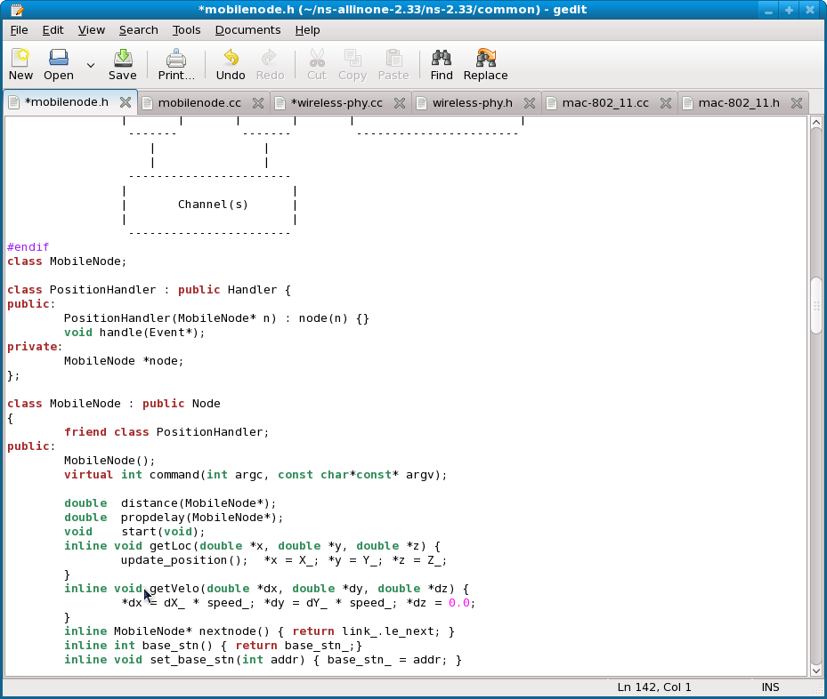
Screenshot: the main window of gedit
Modified file
Tool Bar
Tab Bar
Edit area
Scroll Bar
Status line
Appendices

Slide 36
The work flow of gcc
.o
.a
.s
.c
.C
.cc
Preprocessor
(cpp, the C
preprocessor)
Compiler
(gcc, the GNU
C compiler)
Assembler
(gas, the portable
GNU assembler)
Linker
(ld, the GNU linker)
a.out
Appendices

Slide 37
An example of make
$ cat Makefile
# Any line beginning with a `#' sign is a comment and will be
# ignored by the "make" command. To generate the executable
# programs, simply type "make".
prog: main.o sub.o
gcc -o prog main.o sub.o
main.o: incl.h main.c
gcc -c main.c
sub.o: incl.h sub.c
gcc -c sub.c
$ ls
incl.h main.c Makefile prog sub.c
$ make
gcc -c main.c
gcc -c sub.c
gcc -o prog main.o sub.o
$ ls
incl.h main.c main.o Makefile prog sub.c sub.o
Content of
the Makefile
Before making
Execution
After making
Appendices

Slide 38
An example of debugging with gdb
$ gdb prog
GNU gdb (GDB) Fedora (7.0.1-35.fc12)
Copyright (C) 2009 Free Software Foundation, Inc.
License GPLv3+: GNU GPL version 3 or later <http://gnu.org/licenses/gpl.html>
This is free software: you are free to change and redistribute it.
There is NO WARRANTY, to the extent permitted by law. Type "show copying"
and "show warranty" for details.
This GDB was configured as "i686-redhat-linux-gnu".
For bug reporting instructions, please see:
<http://www.gnu.org/software/gdb/bugs/>...
Reading symbols from /home/book/C.2.1/prog...done.
(gdb) run
Starting program: /home/book/C.2.1/prog
Program received signal SIGSEGV, Segmentation fault.
0x0029b546 in memcpy () from /lib/libc.so.6
Missing separate debuginfos, use: debuginfo-install glibc-2.11.1-1.i686
(gdb) backtrace
#0 0x0029b546 in memcpy () from /lib/libc.so.6
#1 0x00000000 in ?? ()
(gdb) break Hello
Breakpoint 1 at 0x804841e: file sub.c, line 8.
(gdb) run
The program being debugged has been started already.
Start it from the beginning? (y or n) y
Starting program: /home/book/C.2.1/prog
Breakpoint 1, Hello () at sub.c:8
8 char *str = NULL;
(gdb) list
3
4 #include "incl.h"
5
6 void Hello()
7 {
8 char *str = NULL;
9 strcpy(str, "hello world\n");
10 printf(str);
11 }
(gdb) next
9 strcpy(str, "hello world\n");
(gdb) print str
$1 = 0x0
(gdb) quit
A debugging session is active.
Inferior 2 [process 24886] will be killed.
Quit anyway? (y or n) y
Segment fault
Examine current
stack frames
Set a breakpoint
Browse current
source code
Step program
Examine a variable
Appendices

Slide 39
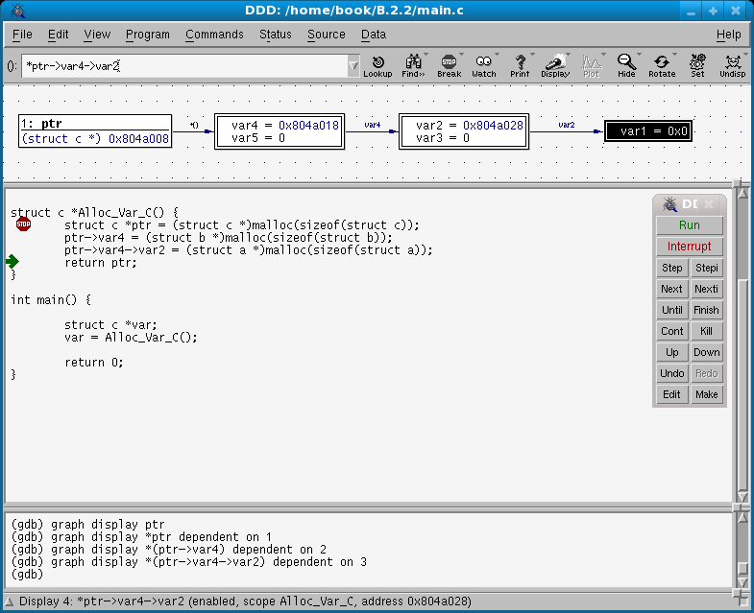
Screenshot: the main window of ddd
Tool Bar
Data Window
Breakpoint
Command Tools
Scroll Bar
Source Window
Debug Console
Status Line
Appendices

Slide 40
An example run of cscope
C symbol: Alloc_Var_C
File Function Line
0 incl.h <global> 18 extern struct c *Alloc_Var_C();
1 main.c main 7 var = Alloc_Var_C();
2 sub.c Alloc_Var_C 13 struct c *Alloc_Var_C() {
Find this C symbol:
Find this global definition:
Find functions called by this function:
Find functions calling this function:
Find this text string:
Change this text string:
Find this egrep pattern:
Find this file:
Find files #including this file:
Find all function definitions:
Find all symbol assignments:
Result area
Command area
Appendices

Slide 41
Important git_controlled_url available in Git
Format | Description | Example of svn checkout
local_path | The Git repository is on the local_path. | git clone /home/Bob/project
http://host/path | The Git repository is controlled by a Git-aware web server. | git clone http://1.2.3.4/project.git
https://host/path | Same as above, but with SSL encryption. | git clone https://1.2.3.4/project.git
ssh://user@host/remote_path | The Git repository stored on host/remote_path, and it can be accessed through a secure tunnel using the SSH protocol. | git clone ssh://Bob@1.2.3.4/home/Bob/project
git://host/remote_path | The Git repository is stored on the remote host via the git protocol. | git clone git://1.2.3.4/project.git
Appendices

Slide 42
An example of Git conflict and manually merge
$ git branch
bonjour_version
* goodday_version
master
$ git merge bonjour_version
Auto-merging sub.c
CONFLICT (content): Merge conflict in sub.c
Automatic merge failed; fix conflicts and then commit the result.
$ head -13 sub.c
#include <stdio.h>
#Include <string.h>
#include <stdlib.h>
#include "incl.h"
void printHello()
{
<<<<<<< HEAD
char *str = "Good day!\n";
=======
char *str = "Bonjour!\n";
>>>>>>> bonjour_version
$ vi sub.c
$ git add . ; git commit -m "a merged version"
[goodday_version 626937e] a merged version
Current branch is “goodday_version”
Failed to merge two branches
at the first time
Here is the conflict
Resolve the conflict manually
Successfully merge
Appendices

Slide 43
Screenshot of gprof
$ gprof -b prog
Flat profile:
Each sample counts as 0.01 seconds.
% cumulative self self total
time seconds seconds calls s/call s/call name
91.11 3.38 3.38 1 3.38 3.38 funcA
8.89 3.71 0.33 101 0.00 0.00 funcB
0.00 3.71 0.00 1 0.00 0.33 funcC
Call graph
granularity: each sample hit covers 4 byte(s) for 0.27% of 3.71 seconds
index % time self children called name
<spontaneous>
[1] 100.0 0.00 3.71 main [1]
3.38 0.00 1/1 funcA [2]
0.00 0.33 1/1 funcC [4]
0.00 0.00 1/101 funcB [3]
-----------------------------------------------
3.38 0.00 1/1 main [1]
[2] 91.1 3.38 0.00 1 funcA [2]
-----------------------------------------------
0.00 0.00 1/101 main [1]
0.33 0.00 100/101 funcC [4]
[3] 8.9 0.33 0.00 101 funcB [3]
-----------------------------------------------
0.00 0.33 1/1 main [1]
[4] 8.8 0.00 0.33 1 funcC [4]
0.33 0.00 100/101 funcB [3]
-----------------------------------------------
Index by function name
[2] funcA [3] funcB [4] funcC
Flat profile
Callee function
Current function
Called
functions
Call graph
index
Appendices

Slide 44
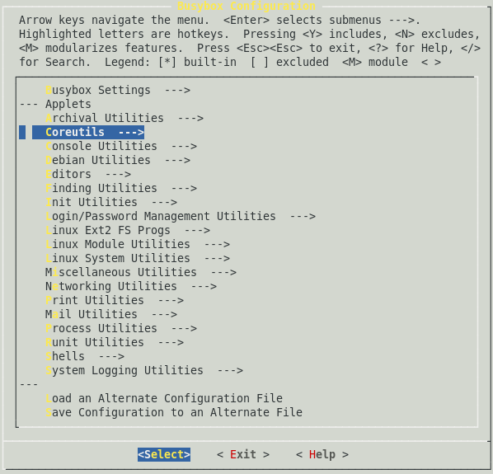
Configuring the busybox
Available utilties
grouped by functions
Appendices

Slide 45
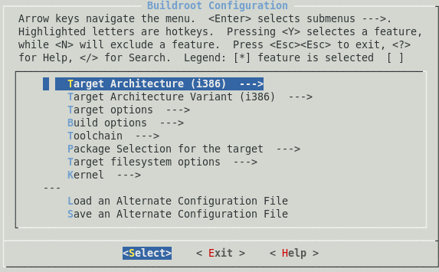
Configuring the buildroot
Configurable settings
Appendices

Slide 46
Appendix D Network Utilities
An example of using host
$ host www.google.com
www.google.com is an alias for www.l.google.com.
www.l.google.com has address 74.125.153.103
www.l.google.com has address 74.125.153.104
www.l.google.com has address 74.125.153.105
www.l.google.com has address 74.125.153.106
www.l.google.com has address 74.125.153.147
www.l.google.com has address 74.125.153.99
Appendices

Slide 47
An example of using arp
$ arp
Address HWtype HWaddress Flags Mask Iface
88-router.cs.nctu.edu.t ether 00:19:06:e8:0e:4b C eth0
140.113.88.140 ether 00:16:35:ae:f5:6c C eth0
Appendices

Slide 48
An example of using ifconfig
$ ifconfig
eth0 Link encap:Ethernet HWaddr 00:1D:92:F1:8A:E9
inet addr:192.168.1.1 Bcast:192.168.88.255 Mask:255.255.255.0
inet6 addr: fe80::21d:92ff:fef1:8ae9/64 Scope:Link
UP BROADCAST RUNNING MULTICAST MTU:1500 Metric:1
RX packets:1147154 errors:0 dropped:0 overruns:0 frame:0
TX packets:296781 errors:0 dropped:0 overruns:0 carrier:0
collisions:0 txqueuelen:100
RX bytes:312608565 (298.1 MiB) TX bytes:110166934 (105.0 MiB)
Memory:fe940000-fe960000
Appendices

Slide 49
An example of using ping
$ ping 192.168.1.2
PING 192.168.1.2 (192.168.1.2) 56(84) bytes of data.
64 bytes from 192.168.1.2: icmp_seq=1 ttl=128 time=2.01 ms
64 bytes from 192.168.1.2: icmp_seq=2 ttl=128 time=1.90 ms
64 bytes from 192.168.1.2: icmp_seq=3 ttl=128 time=1.96 ms
^C
--- 192.168.1.2 ping statistics ---
3 packets transmitted, 3 received, 0% packet loss, time 2990ms
rtt min/avg/max/mdev = 1.909/1.962/2.017/0.044 ms
Report for
each iteration
Summarized
report
Appendices

Slide 50
An example of using tracepath
$ tracepath -l 2000 www.google.com/33434
1: Stanley.cs.nctu.edu.tw (140.113.88.181) 0.048ms pmtu 1500
1: 88-router.cs.nctu.edu.tw (140.113.88.254) 1.904ms
1: 88-router.cs.nctu.edu.tw (140.113.88.254) 2.589ms
2: 140.113.0.198 (140.113.0.198) 0.824ms
3: 140.113.0.166 (140.113.0.166) 0.753ms asymm 4
4: 140.113.0.74 (140.113.0.74) 0.543ms asymm 5
5: 140.113.0.105 (140.113.0.105) 1.096ms
6: Nctu-NonLegal-address (203.72.36.2) 5.227ms
7: TCNOC-R76-VLAN480-HSINCHU.IX.kbtelecom.net (203.187.9.233) 5.090ms
8: TPNOC3-C65-G2-1-TCNOC.IX.kbtelecom.net (203.187.3.77) 23.713ms
9: TPNOC3-P76-10G2-1-C65.IX.kbtelecom.net (203.187.23.98) 10.498ms
10: 72.14.219.65 (72.14.219.65) 44.223ms asymm 11
11: 209.85.243.30 (209.85.243.30) 6.663ms asymm 12
12: 209.85.243.23 (209.85.243.23) 6.603ms asymm 13
13: 72.14.233.130 (72.14.233.130) 14.260ms
14: ty-in-f99.1e100.net (74.125.153.99) 6.802ms reached
Resume: pmtu 1500 hops 14 back 51
Appendices

Slide 51
An example of using tcpdump
$ tcpdump -i eth0 -c 4 host www.google.com -X -s 0 -n
tcpdump: verbose output suppressed, use -v or -vv for full protocol decode
listening on eth0, link-type EN10MB (Ethernet), capture size 65535 bytes
13:38:38.386024 IP 192.168.1.1 > 74.125.153.106: ICMP echo request, id 28763, seq 41, length 64
0x0000: 4500 0054 0000 4000 4001 719b 8c71 58b5 E..T..@.@.q..qX.
0x0010: 4a7d 996a 0800 aaba 705b 0029 5e8e b14b J}.j....p[.)^..K
0x0020: dce3 0500 0809 0a0b 0c0d 0e0f 1011 1213 ................
0x0030: 1415 1617 1819 1a1b 1c1d 1e1f 2021 2223 .............!"#
0x0040: 2425 2627 2829 2a2b 2c2d 2e2f 3031 3233 $%&'()*+,-./0123
0x0050: 3435 3637 4567
13:38:38.392037 IP 74.125.153.106 > 192.168.1.1: ICMP echo reply, id 28763, seq 41, length 64
0x0000: 4500 0054 4c6d 0000 3301 722e 4a7d 996a E..TLm..3.r.J}.j
0x0010: 8c71 58b5 0000 b2ba 705b 0029 5e8e b14b .qX.....p[.)^..K
0x0020: dce3 0500 0809 0a0b 0c0d 0e0f 1011 1213 ................
0x0030: 1415 1617 1819 1a1b 1c1d 1e1f 2021 2223 .............!"#
0x0040: 2425 2627 2829 2a2b 2c2d 2e2f 3031 3233 $%&'()*+,-./0123
0x0050: 3435 3637 4567
Ping’s request
Ping’s response
Captured packet
Appendices

Slide 52
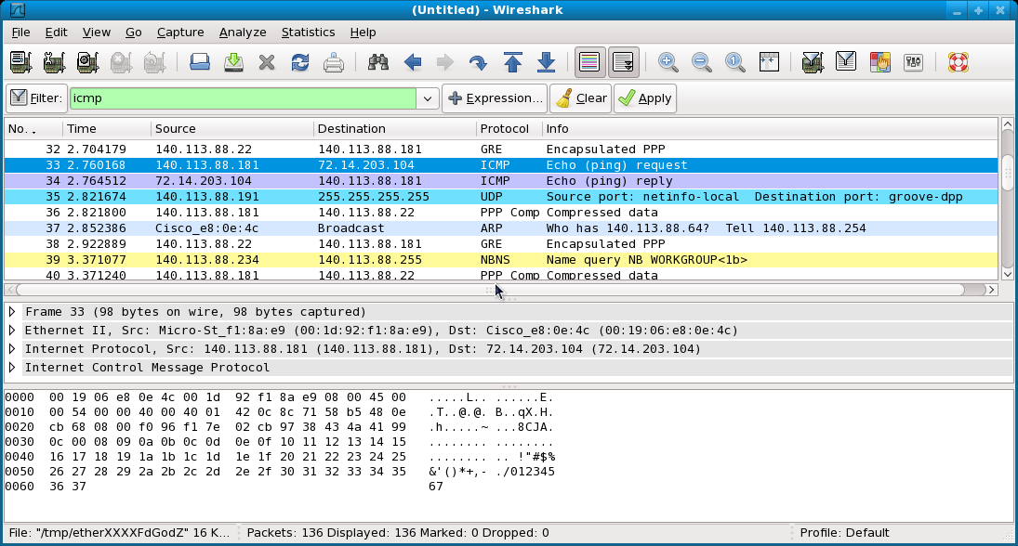
Screenshot of Wireshark
Filter bar
Captured packets
Brief of a packet
Detail packet
content
Appendices

Slide 53
Results of netstat
$ netstat -an
Active Internet connections (servers and established)
Proto Recv-Q Send-Q Local Address Foreign Address State
tcp 0 0 0.0.0.0:22 0.0.0.0:* LISTEN
tcp 0 0 0.0.0.0:80 0.0.0.0:* LISTEN
tcp 0 0 192.168.1.1:22 192.168.1.2:50910 ESTABLISHED
Appendices

Slide 54


An example of using ttcp
Receiver
192.168.1.1
$ ttcp -r > /dev/null
ttcp-r: buflen=8192, nbuf=2048, align=16384/0, port=5001 tcp
ttcp-r: socket
ttcp-r: accept from 192.168.1.2
ttcp-r: 102400000 bytes in 0.14 real seconds = 723557.59 KB/sec +++
ttcp-r: 12501 I/O calls, msec/call = 0.01, calls/sec = 90451.93
ttcp-r: 0.0user 0.0sys 0:00real 57% 0i+0d 268maxrss 0+2pf 4705+15csw
/dev/null
$ ttcp -t 192.168.1.1 < test_file
ttcp-t: buflen=8192, nbuf=2048, align=16384/0, port=5001 tcp -> 192.168.1.1
ttcp-t: socket
ttcp-t: connect
ttcp-t: 102400000 bytes in 0.14 real seconds = 724170.64 KB/sec +++
ttcp-t: 12500 I/O calls, msec/call = 0.01, calls/sec = 90521.33
ttcp-t: 0.0user 0.1sys 0:00real 92% 0i+0d 260maxrss 0+2pf 0+16csw
test_file
Sender
192.168.1.2
Appendices

Slide 55
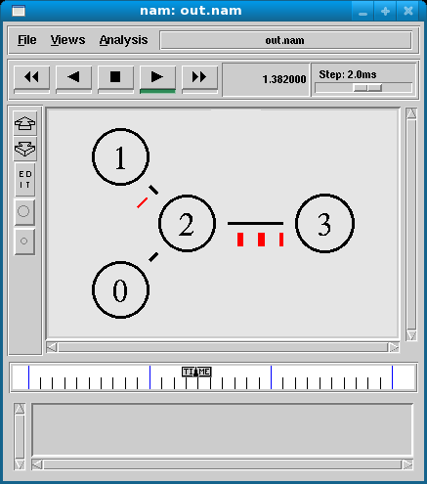
Screenshot of nam (an ns utility)
Action buttons
Step interval
control bar
Topology
Timeline in
progress
Appendices

Slide 56
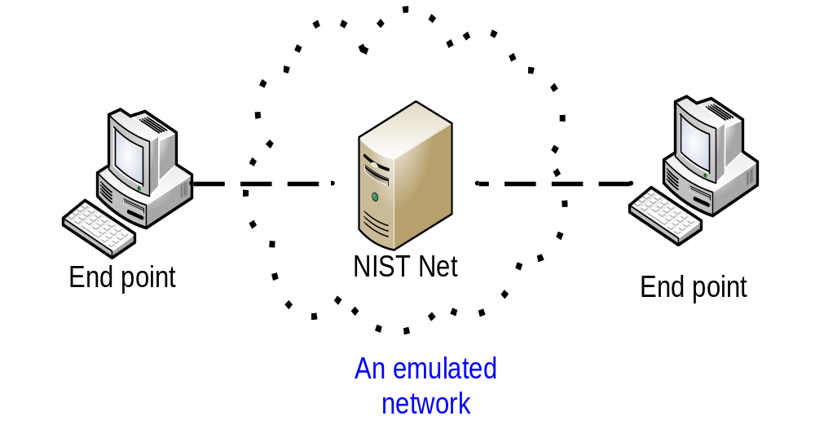
The network architecture of NIST Net
Appendices

Slide 57
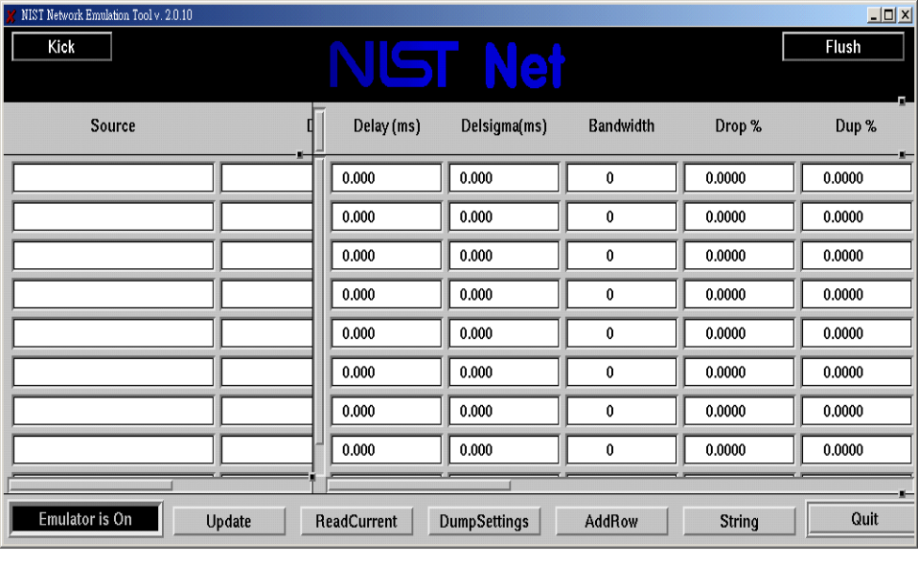
Screenshot of NIST Net
A source/destination pair
Emulated properties
for the pair
Function buttons
Appendices

Slide 58

The network architecture of nessus
client
nessusd
Testbed network
Appendices

Slide 59
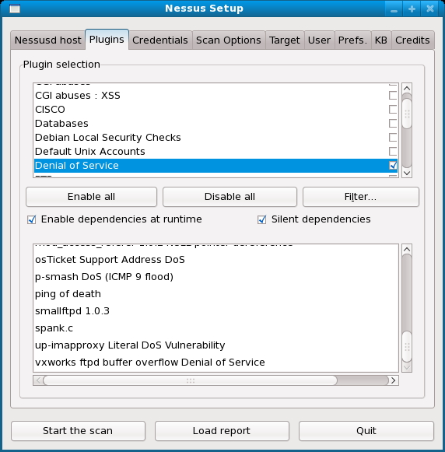
Screenshot of Nessus 2
Tab bar showing
more functions
Supported hacking
methods
Detail hacking
methods
Action buttons
Appendices

